Slide 1
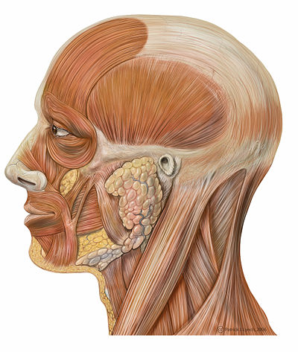
Topic 5: Anatomy of the
Muscular System
Part 1
Chapter 10
http://en.wikibooks.org/wiki/Human_Physiology/The_Muscular_System

Slide 2
5.1 GROSS ANATOMY OF A SKELETAL MUSCLE
• recall that muscle fiber is the name of a single muscle tissue cell
• several different levels of CT wrapping
1) endomysium: fine layer of CT that surrounds each muscle fiber (cell)
perimysium: sheath around a fascicle
3) epimysium: dense, fibrous CT that surrounds & holds together a group of fascicles = outside layer of a single muscle
5) deep fascia: still coarser layer of dense CT that binds muscles into functional groups »» eg: hamstrings vs quadriceps

Slide 3
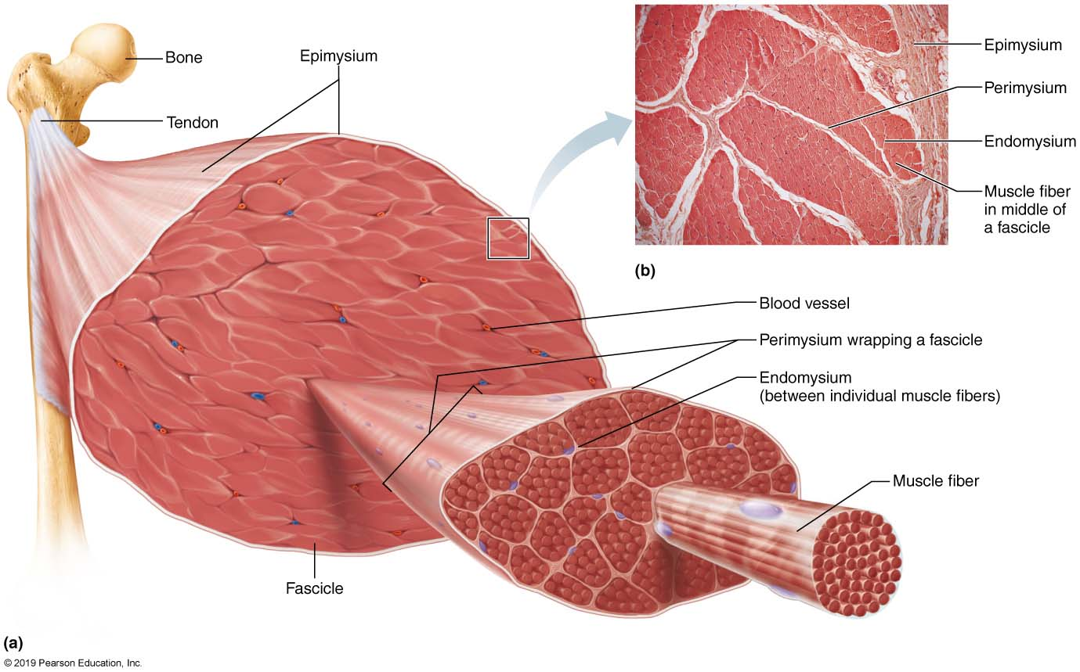
Fig. 9.1a
MUSCLE ATTACHMENTS
• most muscles span joints
• most muscles are attached to bones in at least 2 places
origin: ……………………..
insertion: ……………………..
Most attachments are indirect attachments involving either a tendon or an aponeurosis

Slide 4
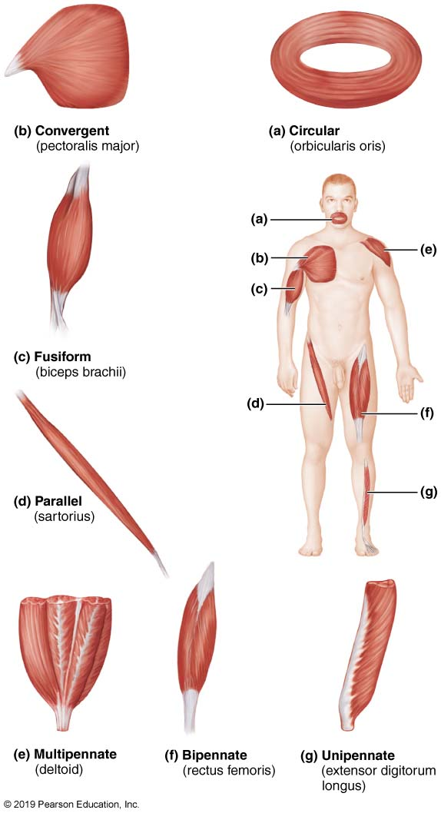
ARRANGEMENT OF FASCICLES
• all skeletal muscles have fascicles
• 4 basic patterns:
Parallel:
• can be straplike (sartorius) or fusiform (biceps brachii)
Pennate: unipennate (eg: extensor digitorum longus)
bipennate (eg: rectus femoris)
multipennate (eg: deltoid)
Convergent: muscle is triangular or fan-shaped (eg: pectoralis major)
Circular: concentric rings surround ext openings & contract to close opening (eg: obicularis oris)
Fig. 10.1

Slide 5
5.2 INTERACTIONS OF SKELETAL MUSCLES
• muscles can work together or in opposition
• 3 functional groups: prime movers, antagonists & synergists
1) Prime Mover:
• ……………………………………………………………………………………..
• eg: biceps brachii & elbow flexion
2) Antagonist:
• ……………………………………………………………………………………..
• can provide resistance to prevent overshoot or control rate of movement
• a single muscle can be a prime mover for one action & an antagonist for another action - eg: biceps brachii & triceps brachii
3) Synergists:
• muscles that help the prime mover by:
a) promoting the same movement
b) reducing undesirable movements (eg: finger flexor muscles cross both wrist & phalangeal joints)
c) some are fixators- eg: muscles involved in posture

Slide 6
Naming Skeletal Muscles
Location of muscle: bone or body region – eg: temporalis, intercostal
Shape of muscle: eg: deltoid (triangular), right & left trapezius muscles form a trapezoid
Relative size of muscle: maximus, minimus, longus, brevis – eg: gluteus maximus & gluteus minimus
Direction of muscle fibers: eg: rectus = straight, parallel to midline (rectus femoris); also transversus abdominis, oblique
Number of origins: biceps, triceps, quadriceps – eg: biceps brachii
Location of muscle’s origin and/or insertion: if both indicated, origin always indicated first – eg: sternocleidomastoid (neck region – dual origin on sternum and clavicle & insertion on mastoid process of temporal bone)
Action of the muscle: flexor, extensor, adductor – eg: adductor longus for thigh adduction & suppinator muscle in forearm
What can we say about the extensor carpi radialis longus???

Slide 7
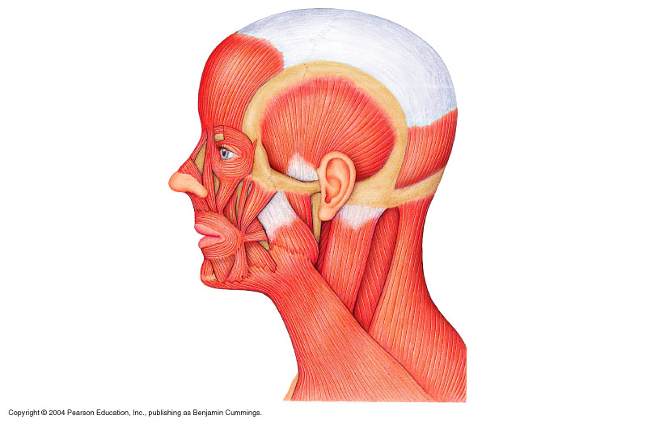
5.3 Muscles of the Head – Facial Expression
• insert into skin or other muscles, not bones; innervated by the facial nerve
epicranius = main muscle of scalp – consists of:
(i) frontal belly: raises eyebrows, wrinkles forehead
(ii) occipital belly: fixes aponeurosis and pulls scalp posteriorly
orbicularis oculi: surrounds rim of orbit; protects eyes from light by producing blinking, squinting, also draws eyebrows down
zygomaticus (cheek to corner of mouth):
smiling muscle
orbicularis oris:
lips; multi-layered; closes, purses, protrudes lips
mentalis (mandible to chin):
V-shaped pair – protrudes lower lip (pout); wrinkles chin
ʘ buccinator (mandible/maxilla to orb.oris): deep to masseter – whistling, sucking; hold food in place when chewing; especially in nursing infants
platysma (fascia of chest to mandible):
helps depress mandible; tenses skin of neck
epicranial
aponeurosis
Fig. 10.6

Slide 8
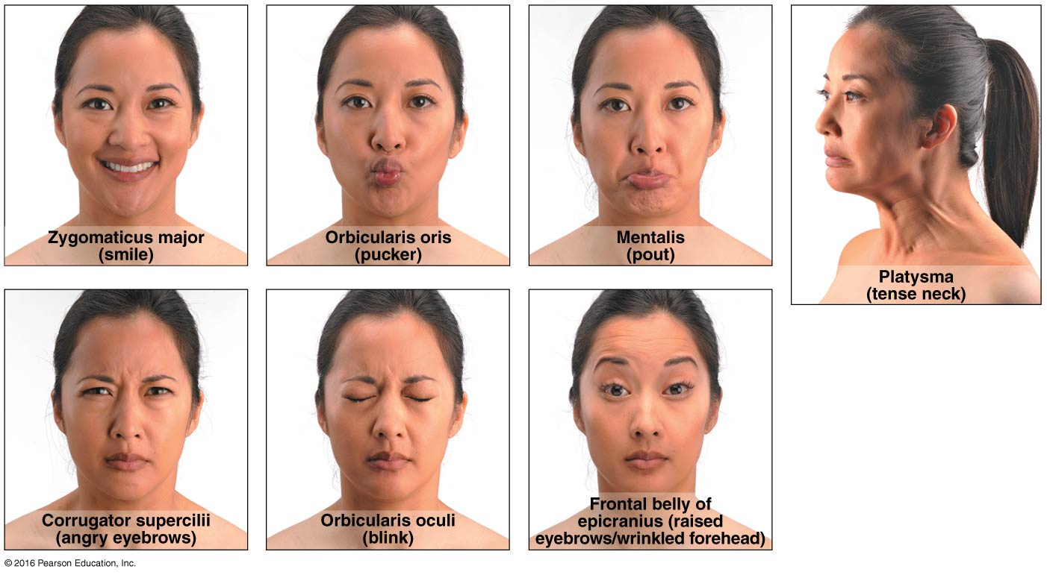
Fig. 10.7

Slide 9
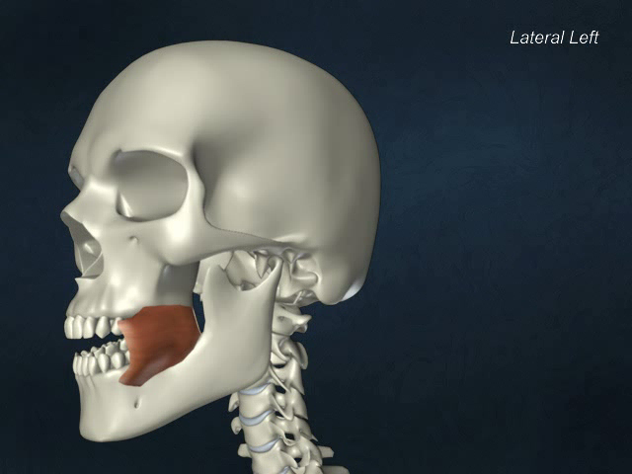
Buccinator

Slide 10
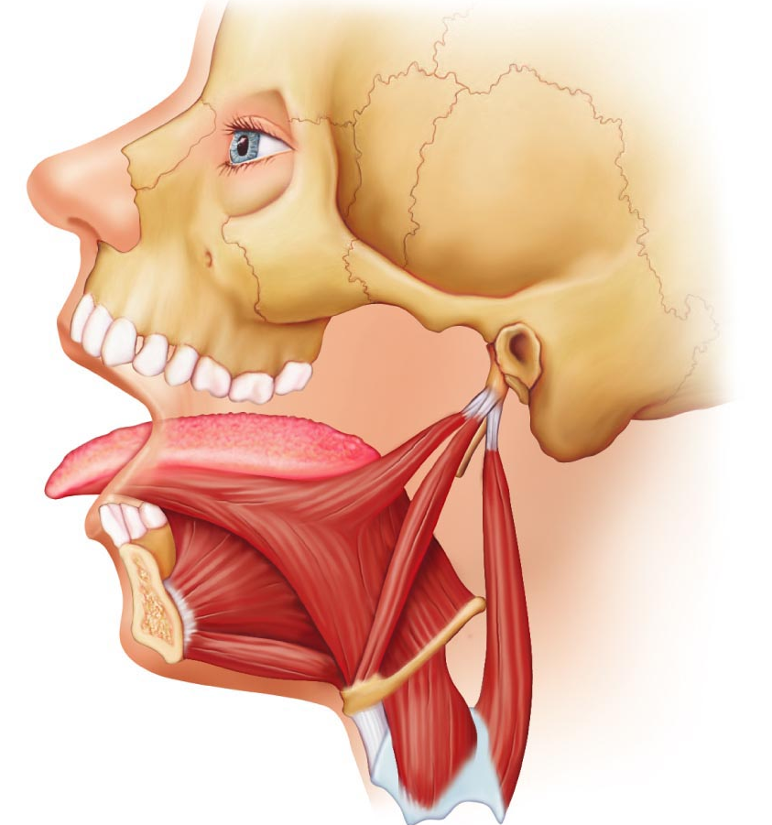
5.4 Muscles that move the tongue
genioglossus (mandible to inferior tongue & hyoid bone): prime mover of tongue protrusion; anchors tongue to prevent obstruction of respiration
hyoglossus (hyoid bone to inferolateral tongue): depresses tongue, especially lateral margins
styloglossus (styloid process of temporal bone to inferolateral tongue): retracts & elevates tongue
Fig. 10.8c

Slide 11
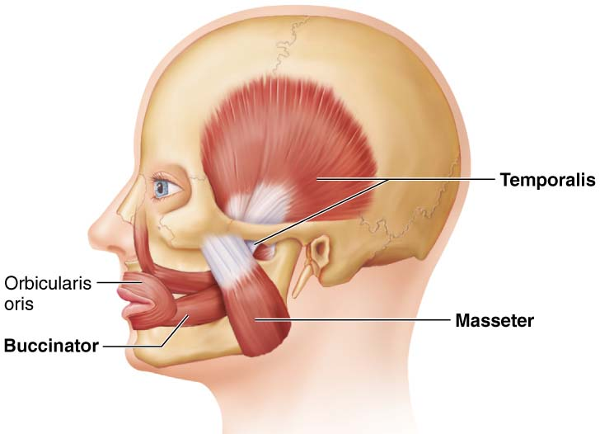
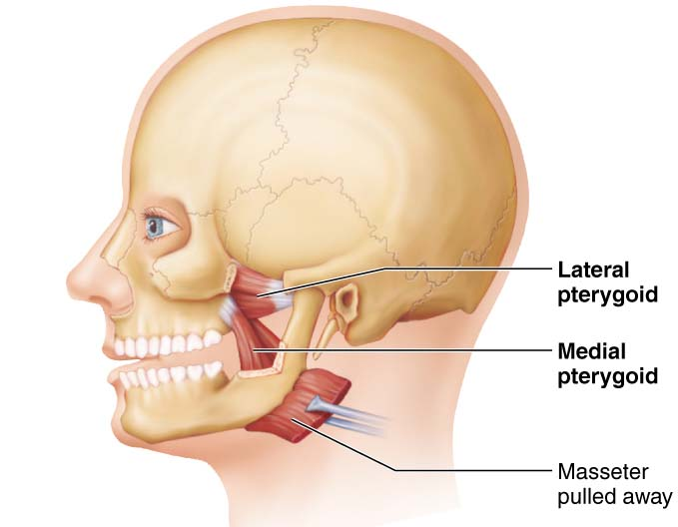
Muscles of the Head: Mastication, etc
• 4 pairs involved in chewing; all innervated by mandibular division of cranial nerve V
ʘ masseter (zygomatic to mandible): prime mover of jaw closure (powerfully)
ʘ temporalis (temporal to mandible): elevates and retracts mandible (closes jaw); maintains closed jaw at rest
medial and lateral pterygoid (sphenoid to mandible): both two-headed; additional jaw movements (eg: side-to-side grinding movments)
buccinator (mandible/maxilla to orbicularis oris): helps keep food between grinding surfaces of teeth during chewing
Fig. 10.8

Slide 12
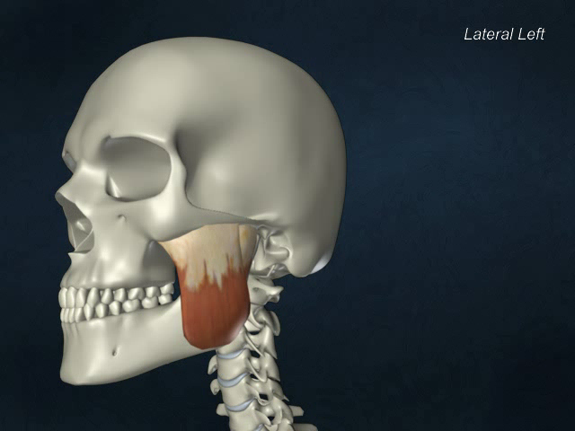
Masseter

Slide 13
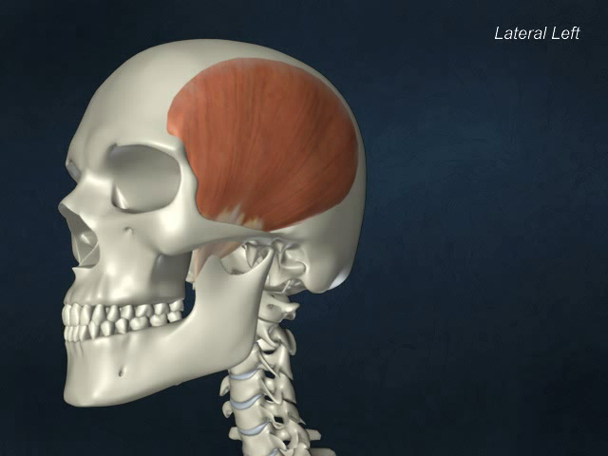
Temporalis

Slide 14
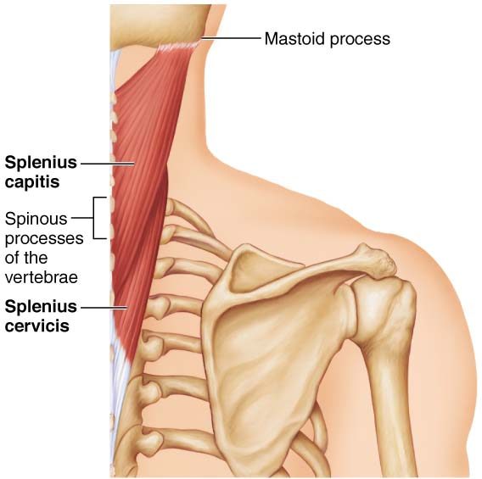
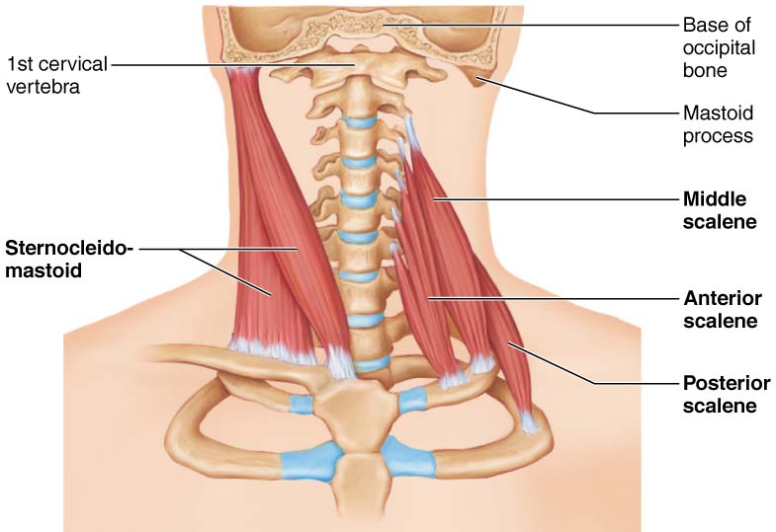
5.5 Muscles of the Neck & Vertebral Column: Head & Trunk Movements
• head moved by muscles originating from axial skeleton
sternocleidomastoid (manubrium/clavicle to mastoid process of temporal): 2-headed; deep to platysma; prime mover (both sides) of head flexion; muscle action on one side for head rotation to opposite side, head tilts to same side
scalenes (cervical vertebrae to 1st 2 ribs): more laterally and deep to platysma & sternocleidomastoid – elevate first 2 ribs, role in coughing, flex & rotate neck
ʘ splenius (vertebrae to mastoid process of temporal): superficial; “bandage muscle”; head extension (both sides) or if one side, rotation, tilts to same side
Fig. 10.10a,b

Slide 15
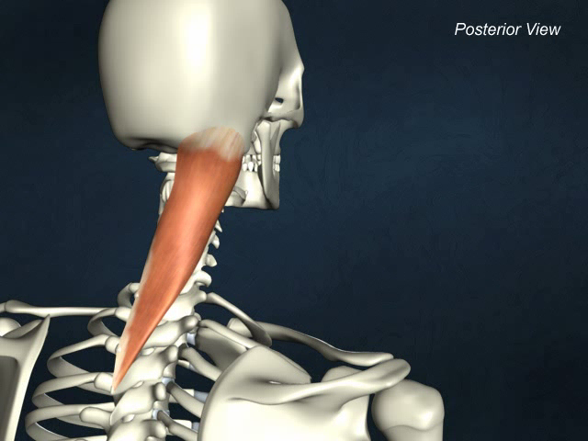
Splenius capitis

Slide 16
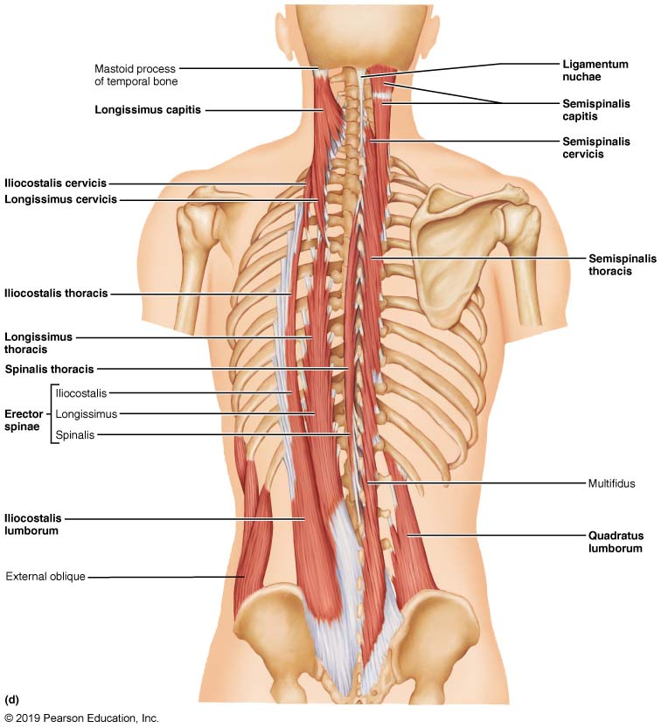
5.6 Muscles of the Neck & Vertebral Column: Head & Trunk Movements
erector spinae: prime mover of back extension; consists of 3 columns of muscles (iliocostalis, longissimus, spinalis); resistance to bending forward & extensors for return to erect position
ʘ semispinalis: deeper, composite muscle from thoracic region to head; extends vertebral column & head, rotation of head, synergistic with sternocleidomastoid muscles
quadratus lumborum (iliac crest to lumbar vertebrae): individual muscles flex vertebral column laterally; jointly to extend lumbar spine & fix 12th rib; maintain upright posture
Fig. 10.10d

Slide 17
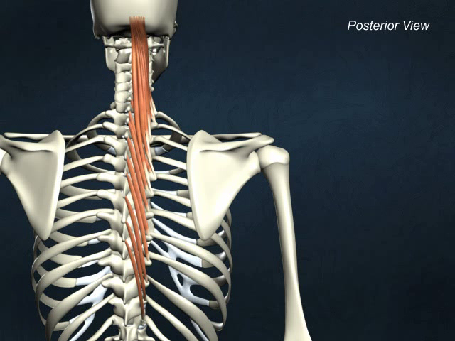
Semispinalis capitis

Slide 18
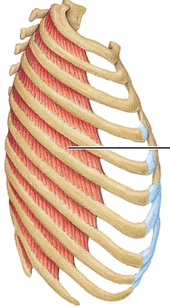
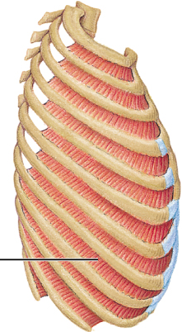
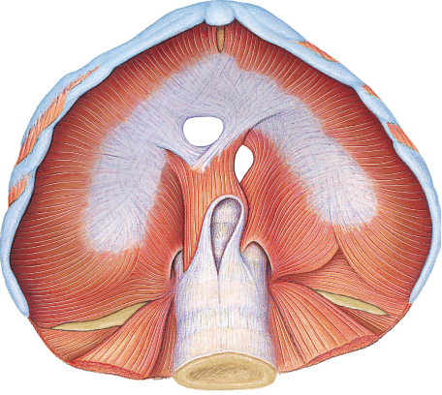
Fig. 10.11
External
Internal
5.7a Muscles of Respiration
ʘ external intercostals: 11 pairs, between ribs; oblique; pull ribs together to elevate rib cage (inspiration;1st ribs fixed by scalene muscles)
internal intercostals: 11 pairs, between ribs; ⊥ external intercostals; draw ribs together to depress rib cage (expiration; 12th ribs fixed by quadratus lumborum)
diaphragm: dome-shaped when relaxed; prime mover of inspiration

Slide 19
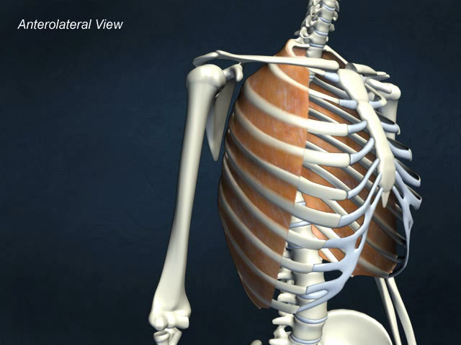
External intercostals

Slide 20
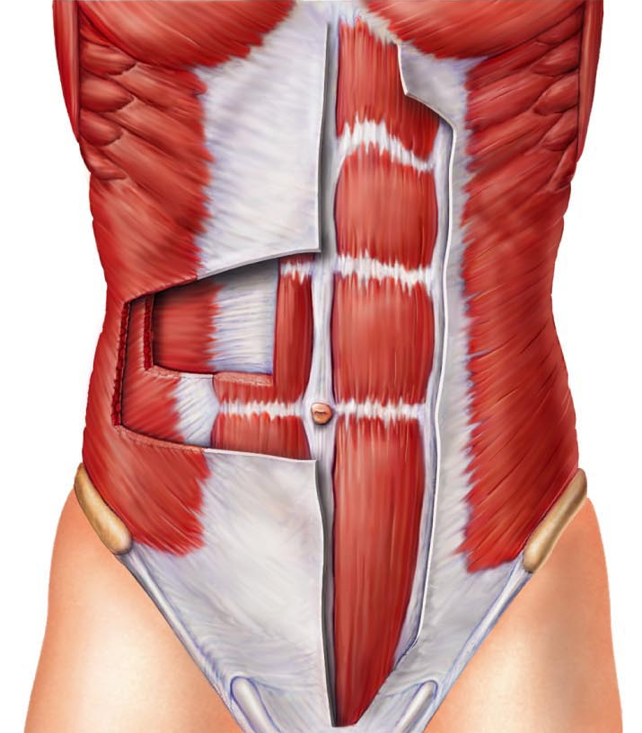
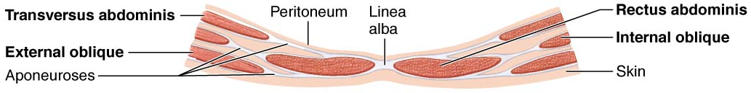
5.7b Muscles of Abdominal Wall
ʘ rectus abdominis – medial superficial; pubis to rib cage; lumbar rotation, fix & depress ribs, stabilize pelvis during walking
external oblique – largest & most superficial lateral muscle; together ➢ increase ab pressure, flex vertebral column; individual ➢ rotation
internal oblique – deeper, but same actions as ext obliques
ʘ transversus abdominis – deepest; compresses abdominal contents
Fig. 10.12

Slide 21
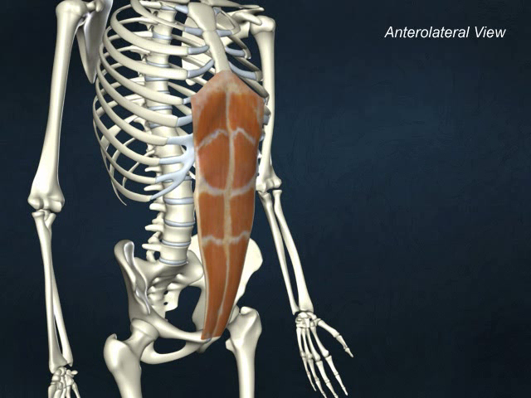
Rectus abdominis

Slide 22
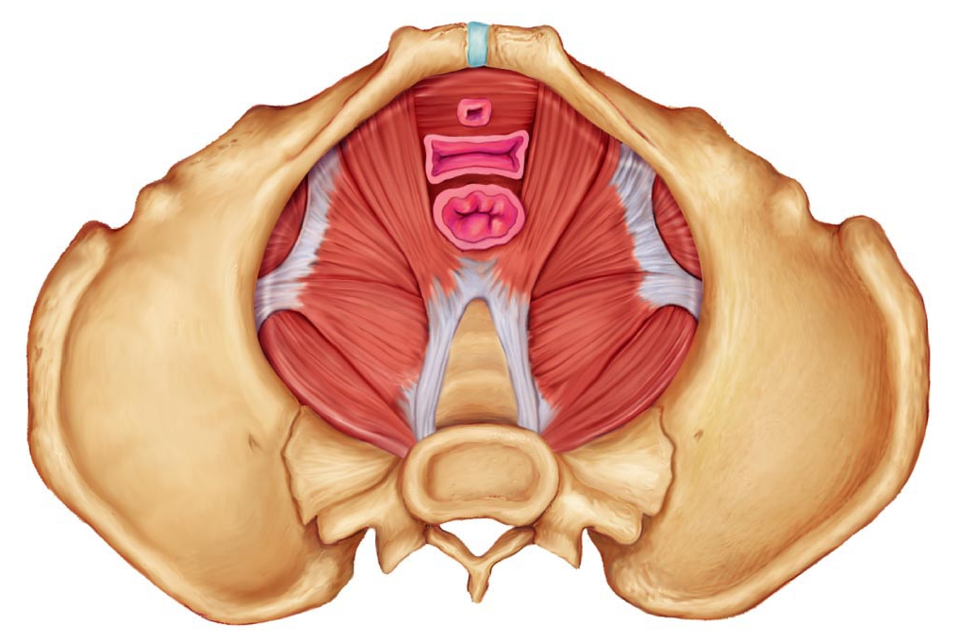
5.8 Muscles of the pelvic floor and perineum
levator ani (pubis to inner coccyx): supports visceral organs of pelvis & forms supportive sling at anorectal junction & vagina; resists downward increases in intra-abdominal pressure (e.g. during coughing, vomiting)
coccygeus (spine of ischium to sacrum & coccyx): supports pelvic viscera & coccyx (e.g. pulls it forward after childbirth)
urogenital diaphragm: supports pelvic organs and constricts urethra
levator ani & coccygeus = pelvic diaphragm

Slide 23
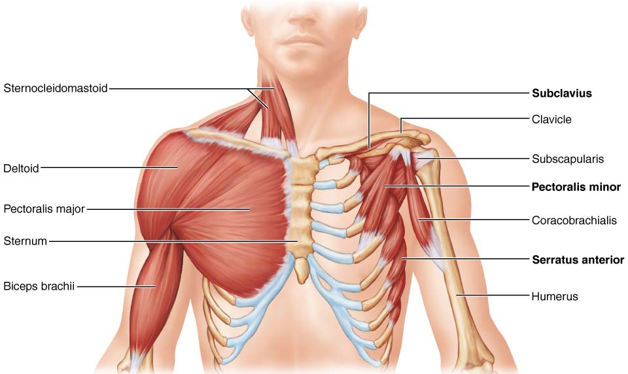
5.10 Superficial Muscles of Thorax:arm movements
pectoralis major (sternum/rib cartilages to humerus): prime mover of arm flexion; rotates arm medially; adducts arm; climbing, throwing, pushing
ʘ latissimus dorsi (vertebrae to humerus): broad, flat back muscle; prime mover of arm extension, arm adductor, rotates arm at shoulder, rowing, swimming
ʘ deltoid (clavicle/scapula to humerus): thick, rounded, site of IM injection, prime mover of arm abduction (all fibers); also lateral & medial rotations, flexion or extensions if only some fibers used; swinging arm when walking
Fig. 10.14

Slide 24
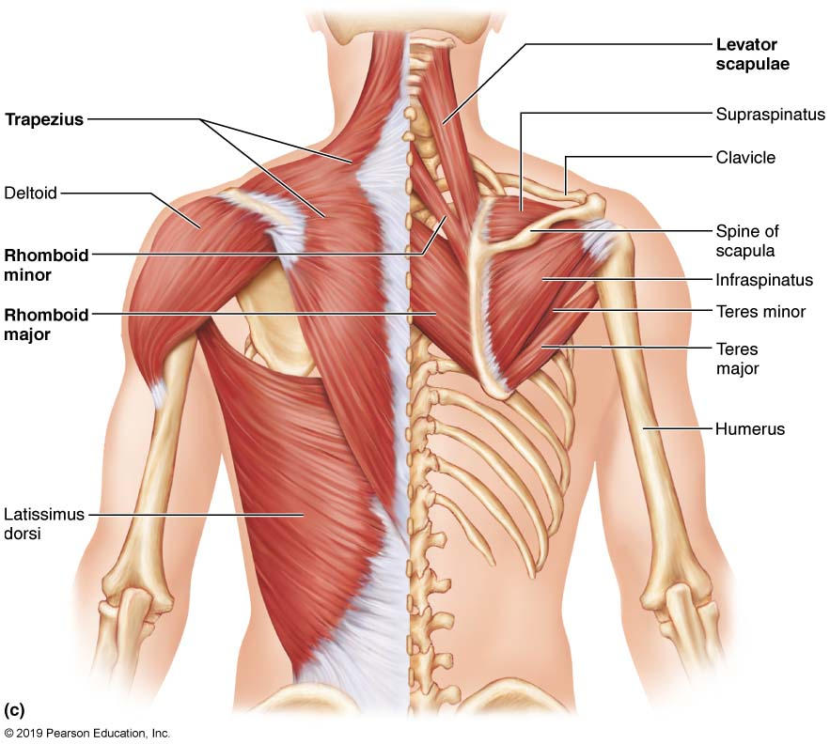
trapezius (occipital & vertebrae to scapula): superficial, stabilizes, raises, retracts, rotates scapula
rhomboids (vertebrae to scapula): deep to trapezius; aid in scapula movements (eg: squaring shoulders, rotation when lowering arm)
+ subscapularis = rotator cuff muscles
Fig. 10.14c

Slide 25
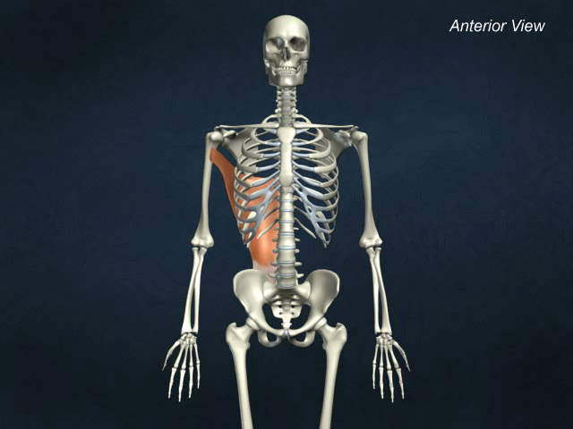
Latissimus dorsi

Slide 26
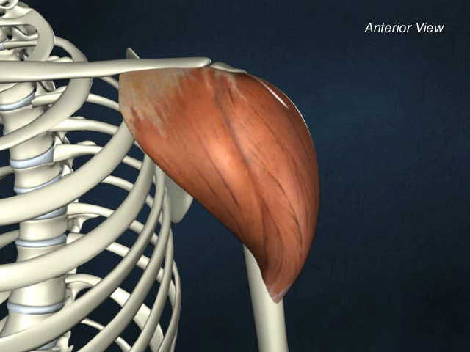
Deltoid

