Slide 1
Engineering Economics
ECO 1192
Topic 2: Time-value mechanics
Claude Théoret
University of Ottawa

Slide 2
References
Fraser et al.** chapters 2 and 3
  Newnan et al. chapters 3 and 4
  Park chapters 2 and 3
Background Papers (See Brightspace)
  1. Discount and Compound Interest Factor Applications
  2. Decision Criteria Interest Factor Derivation
  3. Application of Decision Criteria Interest Factors
  Excel Functions For Engineering Economics

Slide 3
Lecture objectives
Define and calculate
  Simple and compound interest rates
    nominal, effective and actual
  Discrete and continuous cash flows
Develop different cash flow patterns
Understand interest rate factors
Combine interest rates and cash flows
Apply summary measures (e.g., Present Worth)

Slide 4
Time value mechanics: capturing the importance of time in decision-making
Time is a critical factor in engineering economic studies.
  Reflects the preference for consuming goods and services sooner than later.
  the stronger the preference for consuming now over later, the more important is time in investment decisions
The amount and timing of a project’s cash flows (operating expenses; revenues/sales) are crucial to the value of a project’s worth.

Slide 5

Time value mechanics: Rate of interest
The importance of time in engineering economic studies is captured by a rate of interest
  a cost to the borrower
  a source of income to the lender.
The market rate of interest has three components: real; inflation; risk of default.
This course focuses on applications of rates of interest in an inflation-free and risk-free environment.

Slide 6
Defining a project: Key parameters
First or initial cost (P); $
Salvage value (SV); $
Operating revenue (OR or AOR); $
Operating cost (OC or AOC); $
Rate of interest or MARR (i%)
The rate of interest will be known as the MARR -- an acronym which stands for Minimum Acceptable Rate of Return

Slide 7
Example: Importance of Time
Project Parameters |  | Project A | Project B
First cost or initial cost (P) |  | $10,000 | 10,000
Salvage value (SV; $) |  | $0 | 0
Life (N; years) |  | 5 years | 5 years
Net end-of-year (EOY) cash flows = AOR-AOC
Year 1 ($) | Revenues – operating costs = 3,000 |  | 5,000
Year 2 ($) | 3,000 |  | 4,000
Year 3 ($) | 3,000 |  | 3,000
Year 4 ($) | 3,000 |  | 2,000
Year 5 ($) | 3,000 |  | 1,000

Slide 8
Example: The importance of time in decision-making
Elements common to projects A & B
  first or initial costs (i.e., $10,000)
  duration or life of projects (5 years)
  cumulative cash flows over 5 years (i.e., $15,000).
If i = 0%, projects A & B are equivalent
  indifferent between projects A or B
If i > 0%, project A is superior to project B (see next slide).
Negative interest rates (i% < 0%) have no economic meaning or significance.

Slide 9
Example 2: Importance of Time
Goal: $1 million retirement fund after working 40 years
  8% rate of interest compounded annually (interest paid on interest income)
  contributions to the retirement fund at the end of each year
  the first contributions to the fund occur at the end of the first year of work.
Option | Contributions at end of years 1 to 9 inclusively | Contributions at end of years 10 to 40 inclusively
Option 1 (Good Times Now) | $0 | $8,107
Option 2 (Good Times Later) | $7,368 | $0
Contributions in option 1 total about $228,000 (=31*$8,107) compared to $73,000 (9*$7,368) for option 2.
Interest income generated by early contributions accounts for the difference in required contributions.

Slide 10
Which projects are valid (acceptable)?
Which project (if any) is best?
?
?
?
?
?
?
Project parameters | Project A | Project B | Project C
First cost ($) | 3,000 | 5,000 | 8,000
Annual cost ($) | 600 | 900 | 1300
Annual revenues ($) | 1500 | 1750 | 4000
Salvage value ($) | 0 | -200 | 1000
Duration (years) | 5 | 10 | 20
Interest rate (MARR) (10%) | 10 | 10 | 10

Slide 11
Cash Flows for Project A
End-of-Year (EOY) | Revenues | Costs | Net Cash Flows
0 | --- | 3,000 | -3,000
1 | 1,500 | 600 | 900
2 | 1,500 | 600 | 900
3 | 1,500 | 600 | 900
4 | 1,500 | 600 | 900
5 | 1,500+SV(=0) | 600 | 900
SV = salvage or end-of-life value

Slide 12
What is a valid or acceptable project?
A project for which cash inflows (revenues if a private project and benefits if a public project) exceed cash outflows (costs) after adjusting for the time at which cash inflows and outflows occur during the life of the project.
  Based on the assumption that a dollar today is worth more than a dollar tomorrow.

Slide 13
Frequently used symbols
r ≡ nominal or market interest rate
i ≡ effective interest rate
n ≡ number of years
m ≡ number of within-year interest periods
  if r is 12% compounded monthly, m = 12
P or PW ≡ Present worth; NPW ≡ Net Present Worth
AEC = Annual Equivalent Cost
AER = Annual Equivalent Revenue
AEW ≡ Annual Equivalent Worth = AER-AEC
F or FW ≡ Future worth; NFW ≡ Net Future Worth

Slide 14
Working assumptions
Discrete (not continuous) cash flows and discrete compounding
      Examples: Annual or monthly cash flows
Ownership capital only (no debt capital)
No price changes (neither inflation nor deflation during a project’s life)
Unlimited funds (no capital budgeting): can select all acceptable independent projects
Neither risk nor uncertainty.
No government (neither taxes nor subsidies)
No imponderables (all project benefits and costs have been converted to their equivalent monetary value)
  Value of time and lives saved ……………

Slide 15
Cash flow diagrams
Arrows
  interpretation depends on one's perspective
      positive for cash inflows (e.g., revenues)
      negative for cash outflows (e.g., expenses)
      length represents the magnitude ($) of the cash flow
Important to show when cash flows occur during a project’s life
  EOY1 (End-of-year 1); EOY5 …
The rate of interest and its within-year frequency of calculation must be known.

Slide 16
Discrete Cash Flow Diagram
Cash Inflows
2
4
0
1
3
5
Cash Outflows

Slide 17
Simple interest
(Interest generated by the principal ONLY)
Interest income is based on
  the number of finite interest periods per year
  the amount of money initially borrowed or loaned
Interest income earned in previous periods has no bearing on the interest income earned this period.
      F_{n} = P + Pin = P(1+ in)
  where P = amount invested (borrowed)
  F = future amount = interest income + P
  i = the rate of interest earned per period on the amount invested
  n = the number of interest periods
    e.g., the number of years or months

Slide 18
Compound Interest Rates:
Discrete or Continuous
Discrete Compounding
  Compound interest rate
    Finite number (m) of within-year compounding periods
    12% compounded monthly (m = 12)
    12% compounded quarterly (m = 4)
Continuous Compounding
  Infinite number of within-year compounding periods
    m ➔ ∞
    e.g., 12% compounded continuously

Slide 19
Discrete Interest: compounded
Interest income is based on
  number of interest periods
  interest earned or owed in each interest period
  the amount of money borrowed or loaned
F = P(F/P, i%, N) i.e., future worth
I = [P(1+i)^{N} – P] ➔ interest income
    F₁= P+Pi = P(1+i) [end of year 1]
    F₂= P(1+i)^{i} + P(1+i) = P(1+i)² [end of year 2]
    F₃= P(1+i)²i + P(1+i)² = P(1+i)³ [end of year 3]
General Formula: F_{n} = P(1+i)^{n}

Slide 20
Examples: Discrete Interest Rate Calculations
  $1,000 borrowed for 3 years
  Annual interest rate = 10%.
  Find the amount owed after three (3) years if money is borrowed at
    simple interest (10% annually)? [Example 1]
    compounded (10%) annually? [Example 2]

Slide 21
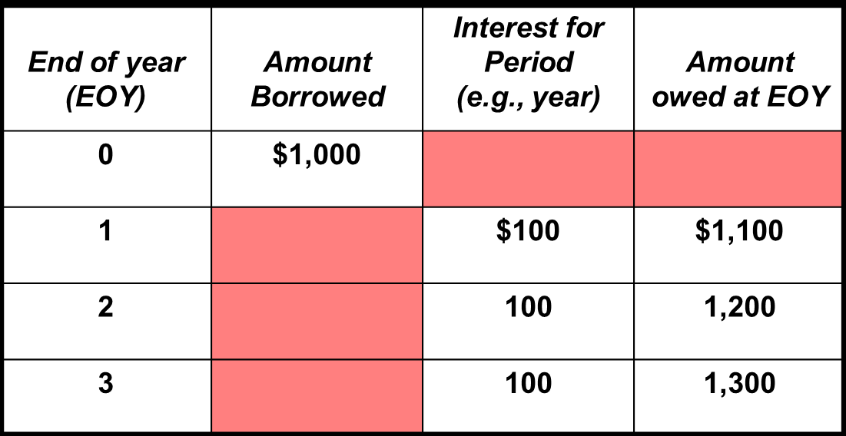
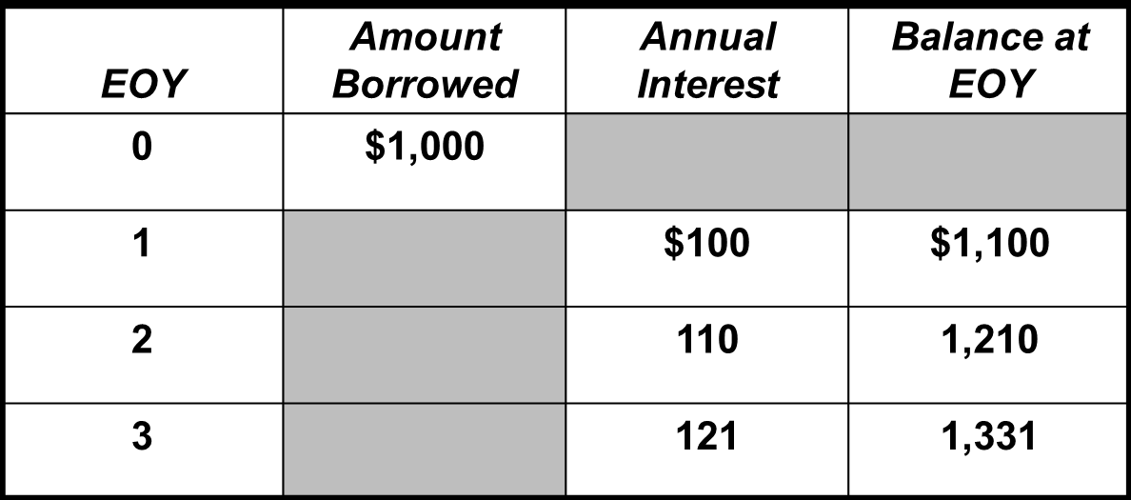
Simple vs Compound Interest
Example 1: Simple Interest
Example 2: Compound Interest

Slide 22
Interest Rate Compounding
What is the frequency of within-year compounding?
  How many times is interest income (or expense) calculated each year?
Discrete compounding
  Nominal
  Effective
  Actual (periodic or per period ) interest rate
Continuous compounding
  Nominal
  Effective
  Actual interest rate ≈ 0 since m ➔ ∞

Slide 23
Nominal Interest Rates
The complete description of an interest rate has a quantitative and a qualitative component.
  Quantitative component = interest rate percentage only (e.g., 15%)
  Qualitative = the within-year frequency of compounding (i.e., once, twice … per year)
The nominal rate captures the quantitative dimension of an interest rate ONLY.
  no reference to the within-year frequency of compounding
  If the interest rate is defined as
    15% compounded annually ➔ 15% nominal rate.
    12% compounded semi-annually ➔ 12% nominal rate.
    10% compounded monthly ➔10% nominal rate.
    15% compounded daily ➔ 15% nominal rate.
The nominal rate is usually stated on an annual basis.

Slide 24
Discrete Effective and Actual Interest Rates
Effective Interest Rate (i)
Combines the quantitative and qualitative components of an interest rate (e.g., 15% compounded semi-annually)
Converts an interest rate with one or more within-year compounding periods to an equivalent interest rate compounded annually
  = (F- P)/P = {P(1+r/m)^{m} - P}/P [applies to one year only]
  = (1+r/m)^{m} - 1
Usually stated on an annual basis
Actual (Periodic) Interest Rate (= r/m)
the nominal rate (r) per within-year compounding period (m)
  12% compounded semi-annually ➔ 6%
  12% compounded monthly ➔ 1%

Slide 25
Example: Discrete Interest Rate
Given an interest rate of 12% compounded quarterly
  Nominal rate = 12%
  Effective rate = [1+(0.12/4)]⁴ – 1 = 0.1255
  = 12.55%
  Actual rate = 12%/4 = 3% per quarter
    Investing $1 at 3% per quarter is equivalent to investing $1 at 12.55% annually
    If you invest one dollar, your account balance after 1 year would be $1.13 in both cases.

Slide 26
Excel Function: EFFECT (r,m)
Calculates the effective interest rate that corresponds to a nominal rate (r) with “m” within-year compounding periods.
Example
Given a nominal rate of 10%
compounded semi-annually
=EFFECT(10%,2) = 0.1025 or 10.25%
compounded quarterly
=EFFECT(10%,4) = 0.103813 or 10.38%
compounded monthly
=EFFECT(10%,12) = 0.104713 or 10.47%

Slide 27
Financial Table
Discrete Cash Flows and Discrete Compounding
DISCRETE CASH FLOW and DISCRETE COMPOUNDING (10%)
n | (F/P,i%,n) | (P/F,i%,n) | (A/P,i%,n) | (P/A,i%,n) | (A/F,i%,n) | (F/A,i%,n) | (A/G,i%,n)
1 | 1.1000 | 0.9091 | 1.1000 | 0.9091 | 1.0000 | 1.0000 | 0.0000
2 | 1.2100 | 0.8264 | 0.5762 | 1.7355 | 0.4762 | 2.1000 | 0.4762
3 | 1.3310 | 0.7513 | 0.4021 | 2.4869 | 0.3021 | 3.3100 | 0.9366
4 | 1.4641 | 0.6830 | 0.3155 | 3.1699 | 0.2155 | 4.6410 | 1.3812
5 | 1.6105 | 0.6209 | 0.2638 | 3.7908 | 0.1638 | 6.1051 | 1.8101

Slide 28
Continuous Nominal Interest Rates (r)
The complete description of an interest rate has a quantitative and a qualitative component.
  Quantitative compounded = interest rate percentage (i.e., 15%)
  Qualitative = the within-year frequency of compounding (i.e., once, twice … per year)
Captures the quantitative dimension ONLY of an interest rate
  no reference to the within-year frequency of compounding
  If the interest rate is defined as
    15% compounded continuously ➔ nominal rate = 15%
    10% compounded continuously ➔ nominal rate = 10%

Slide 29
Continuous Effective and Actual Interest Rates
Effective Interest Rate (i)
Combines the quantitative and qualitative components of an interest rate (e.g., 15% compounded continuously)
Converts an interest rate with an infinite number of within-year compounding periods to an equivalent interest rate compounded annually
  Example: 10% compounded continuously
Modify the discrete effective rate = (1+r/m)^{m} - 1 as follows:
{[1+1/(m/r)]^{m/r}}^{r} – 1
As "m" ➔ ∞, the effective annual interest rate tends to
(e^{r} - 1)
Usually stated on an annual basis
Actual Interest Rate (r/m) ➔ 0%
actual interest rate (r/m where m ➔∞) ≈ 0%

Slide 30
Example: Continuous Interest Rate
Given: 15% interest rate compounded continuously
Nominal rate = 15%
Effective rate: (e^{0.15 - 1}) = 0.1618 or 16.18% compounded annually
Actual rate = “m” ➔ ∞ = (0.15/∞) ➔ 0%

Slide 31
Nominal Interest Rate = 10%
The effective rate increases as the within-year frequency of compounding (m) increases.
For example, the effective rate for monthly compounding is larger than for quarterly compounding.
The maximum rate occurs when within-year compounding is infinite.

Slide 32
Interest Rate and Cash Flow Scenarios
Note: For all decision criteria calculations, the frequency of within-year compounding MUST match the frequency of the cash flows (e.g., monthly cash flows AND monthly interest rate compounding).
Cash Flows ↓ | Compound Interest Rate
 | 1. DISCRETE RATE | 2. CONTINUOUS RATE
DISCRETE | A** (discrete & discrete) | B
2. CONTINUOUS | C | D
** Major focus of problems in this course

Slide 33
Scenario A
Discrete Compounding and Discrete Cash Flows
Cash flows and compounding of interest MUST have matching frequencies.
Example: Annual cash flows and quarterly compounding of interest.
Three possible situations: the frequency of within-year compounding
  = frequency of the cash flows (annual interest compounding and annual cash flows)
  > frequency of the cash flows
  3. < frequency of the cash flows
CASH FLOWS ↓ | INTEREST RATE COMPOUNDING SITUATIONS
 | 1. DISCRETE RATE | 2. CONTINUOUS RATE
1.DISCRETE | A | B
2.CONTINUOUS | C | D
The frequency of compounding (m) must always match the frequency of cash flows

Slide 34
Typical cash flow patterns
1. Single sums (PW & FW)
2. Uniform series (annuities)
3. Linear gradient (arithmetic) series
4. Geometric gradient series
5. Irregular series
Note:
Shortcuts for calculations of summary measures (e.g., NPW) are only possible for categories 1 to 4.
This section is irrelevant if NPW and other calculations are performed with a computer or financial calculator.

Slide 35
Cash flow patterns
A single disbursement (money spent) or receipt (money received)
A set of equal disbursements or receipts over a sequence of periods, referred to as an annuity
A set of disbursements or receipts that change by a constant amount from one period to the next in a sequence of periods, referred to as an arithmetic gradient series
A set of disbursements or receipts that change by a constant proportion from one period to the next in a sequence of periods, referred to as a geometric gradient series.

Slide 36
Cash flow diagram
Present Worth (PW)
$1,000
PW = ??
≡
0
1
2
3
4
5
0
5
What is the value TODAY or NOW (time = 0) of $1,000 in five
years for a given interest rate (e.g., 10%) compounded annually?

Slide 37
Cash flow diagram
Future Worth (FW)
FW = ??
$1,000
≡
0
1
2
3
4
5
0
5
How much will $1,000 TODAY or NOW be worth in five years (t=5)
for a given interest rate (e.g., 10% compounded annually)?

Slide 38
Cash Flow Diagram:
Present Worth of an annuity
PW = ??
PATTERN
➔ Shortcut
$1,000
$1,000
$1,000
$1,000
$1,000
≡
0
1
2
3
4
5
0
5
What is the value today (t=0) of five yearend deposits of $1,000 for a given rate of interest (e.g., 10% compounded annually)?

Slide 39
Cash Flow Diagram:
Future Worth (FW)
FW = ??
$1,000
$1,000
$1,000
$1,000
$1,000
≡
0
1
2
3
4
5
0
5
What will be the value in five years of five yearend deposits of $1,000 for a given compound interest rate (e.g., 10% compounded annually)?

Slide 40
Cash Flow Diagram:
Converting a present value to an annuity
Present Worth = $4,000
A = Annuity
A
A
A
A
A
≡
0
(years)
5
0
1
2
3
4
5
What annual cash flow over five years can be generated by $4,000 today at a given interest rate?

Slide 41
Cash Flow Diagram: Linear Gradient Series
(Arithmetic Series)
Constant $ gradient = +$250
$1000
$750
$500
$250
0
1
2
3
4
An arithmetic (or gradient) series can be increasing (as shown) or decreasing.
The dollar difference between any two adjacent members must be the same.

Slide 42
Cash Flow Diagram: Geometric Series
10% rate of growth (increase).
$110 = 100(1+k)¹
$121 = 110(1+k)¹ = 100(1+k)²
k ≡ rate of growth (or decay) of series
$146.41
PATTERN
➔ Shortcut
$133.10
$121
$110
$100
0
1
2
3
4
5
A series that increases (shown) or decreases at a given rate (e.g., 5% or -20%).

Slide 43
Cash Flow Diagram: Geometric Series
10% rate of decline
Decaying geometric series
$146.41
$200
PATTERN
➔ Shortcut
$180
$162
$145.80
0
1
2
3
4
5
A series that increases (shown) or decreases at a given rate (e.g., 5% or -20%).

Slide 44
Cash Flow Diagram:
Irregular Series (No pattern)
300
No Pattern → No Shortcut
200
100
1
2
3
4
5
-200
-300

Slide 45
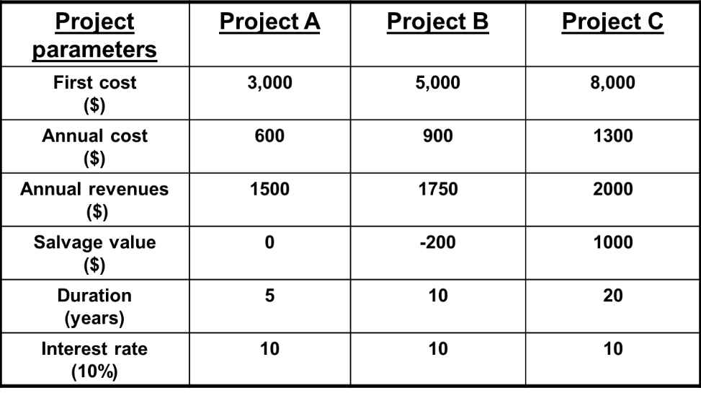
Which project(s) is(are) valid?
Which project (if any) is best?
Difficult task because the projects have different parameters (identifiers)
  Except for the interest rate
A project conversion process is required (i.e., to summary measures) to reduce the projects to a common denominator such as a single sum (present or future worth).

Slide 46
Interest Rate and Cash Flow Mismatch
Formula for converting the frequency of interest compounding to the frequency of the cash flows.
The interest rate per cash flow period is
(1+r/m)^{(m/k)} - 1
where
  “m” is the number of within-year interest periods
    if quarterly compounding, m=4
  “r” is the nominal rate of interest per year
  “k” is the frequency of cash flow per year
If quarterly cash flows are $1,000 each and the interest rate is
10% compounded semi-annually, the effective quarterly interest rate is (1+0.10/2)^{(2/4)} – 1 = 0.0247 or 2.47%

Slide 47
Example
Frequency Mismatch
Quarterly deposits of $1,000
12% interest compounded monthly
The first $1,000 deposit is made in 3 months from now.
Find the dollar value of the deposits after 5 years?
Using the frequency conversion formula with m = 12 and k = 4,
the effective quarterly interest rate becomes
(1+[0.12/12])^{(12/4)} -1 = 0.0303 or 3.03% per quarter
Future Value (F) = A(F/A,i%,N)
F = 1,000[F/A,3.03%,5(4)]
F = 1,000(F/A,3.03%,20) = 1,000(26.9525)
F = $26,952.50
The “F = A(F/A,i%,N)” formula applies only to discrete interest and discrete cash flow situations.

Slide 48
Scenario B
Continuous Compounding: Discrete Cash Flows
Interest credited (or calculated) on an on-going basis [e.g., 5% compounded continuously]
Deposits (or payments) are made at fixed times (e.g., $200 at the end of each 5-year period)
Example: How much money would you have in an account fifteen (15) years from now if you made fifteen (15) end-of-year deposits of $1,000 each?
  The first $1,000 deposit occurs one year from now and the account pays interest at a 10% rate compounded continuously.
CASH FLOWS ↓ | INTEREST RATE COMPOUNDING SITUATIONS
 | 1. DISCRETE RATE | 2. CONTINUOUS RATE
1.DISCRETE | A | B
2.CONTINUOUS | C | D

Slide 49
Scenario B
Continuous Compounding & Discrete Cash Flows
There are two possible solutions to the previous example
  Use the appropriate interest rate factor for calculating the Future Worth of discrete cash flows and continuous interest compounding situations
    discussed later
  Convert the 10% continuous interest rate to an equivalent annual compounding interest rate and use the appropriate discrete cash flow and discrete compounding interest factor = (e^{r}-1)=(e^{0.10}-1)=0.11
CASH FLOWS ↓ | INTEREST RATE COMPOUNDING SITUATIONS
 | 1. DISCRETE RATE | 2. CONTINUOUS RATE
1.DISCRETE | A | B
2.CONTINUOUS | C | D

Slide 50
Continuous Cash Flows
uniform (step)
  Continuous, constant cash flow throughout a period of time (e.g., one year) which is equivalent to an aggregate amount
gradient (ramp)
decay
exponential
growth
** Please note that continuous cash flow patterns 2, 3, 4 and 5 are not required for this course.

Slide 51
SCENARIO C
Discrete Compounding & Continuous Cash Flows
The cash flow frequency has no effect on the interest owed or owing during specific periods of the year.
Example
Busy toll booth on a major New England highway collects about $1 million in fees evenly distributed throughout the year (day and night).
Interest rate is 12% compounded quarterly
Actual interest rate = 3% per quarter
Effective cash flow = $1M/4 or $250K per quarter.
CASH FLOWS ↓ | INTEREST RATE COMPOUNDING SITUATIONS
 | 1. DISCRETE RATE | 2. CONTINUOUS RATE
1.DISCRETE | A | B
2.CONTINUOUS | C | D

Slide 52
SCENARIO C
Discrete Compounding &
Continuous Cash Flows
No requirement for a “special” interest factor since the continuous cash flow can be partitioned (divided) to match the frequency of interest rate compounding.
In the previous example, the $1,000 (over one year) continuous cash flow is partitioned into quarterly cash flows of $250 to match the 3% interest rate per quarter.
CASH FLOWS ↓ | INTEREST RATE COMPOUNDING SITUATIONS
 | 1. DISCRETE RATE | 2. CONTINUOUS RATE
1.DISCRETE | A | B
2.CONTINUOUS | C | D

Slide 53
SCENARIO D
Continuous Compounding & Cash Flow
Example
Constant cash flows equivalent to $500 annually are
deposited in a bank account that pays 5% interest
compounded continuously.
Special interest factors are needed in continuous cash flow and compounding situations
CASH FLOWS ↓ | INTEREST RATE COMPOUNDING SITUATIONS
 | 1. DISCRETE RATE | 2. CONTINUOUS RATE
1.DISCRETE | A | B
2.CONTINUOUS | C | D

Slide 54
Interest Rate Factors
Algebraic short forms (or shortcuts) for dealing with frequently encountered cash flow and compounding situations
Example: (F/P,i%,N)
  Find the future worth (F) of a present amount (P) given an interest rate of “i%” and the number of interest periods “N” (if annual compounding).
Interest factors are used for the following types of situations:
  single sums (mostly present and future values)
  uniform or constant series
  gradient (arithmetic and geometric) series
Please refer to Document #2, Derivation of Decision
Criteria Interest Factors, ECO 1192 Background Papers, Brightspace.

Slide 55
Discrete Compounding and Cash Flows: Interest Rate Factors (Short Cuts)
Single sum
  P = F(P/F,i%,N) ➔ Find P given F, i% and N
  F = P(F/P,i%,N) ➔ Find F given P, i% and N
Uniform (Constant) series
  P = A(P/A,i%,N) ➔ Find P given A, i% and N
  F = A(F/A,i%,N) ➔ Find F given A, i% and N
  A = P(A/P,i%,N) ➔ Find A given P, i% and N
  A = F(A/F,i%,N) ➔ Find A given F, i% and N
Arithmetic )Gradient) series
  P = P(P/A,i%,N)+/-G(P/G,i%,N) ➔ Find P given G, i% and N
  F = F(F/A,i%,N) +/- A(F/G,i*,N) ➔ Find P given G, i% and N

Slide 56
Discrete Compounding and Cash Flows: Interest Rate Factors (Short Cuts)
Geometric series
  P= C(P/C,i%,k%,N)
  F= C(F/C,i%,k%,N)
    where
      C = first term of the series (must be non zero)
      i% = interest rate
      K% = rate of growth or decay of series

Slide 57
Formulas Provided at All Examinations

Slide 58
Formulas Provided at All Examinations

Slide 59
Discrete Single Sums:
Present (PW) and Future Worth (FW)
INTEREST FACTOR | NOTATIONAL FORM | ALGEBRAIC EQUIVALENT
1. Compound amount factor | (F/P,i%,n) [Find F given P, i% and n] | F = P(1+i)^{n}
2. Discount amount factor | (P/F,i%,n) [Find P given F, i% and n] | P = F(1+i)^{-n}

Slide 60
Discrete Cash Flow Diagram: Single Sum (PW)
PW = 1,000(P/F,10%,5)
F=$1,000
PW = ??
≡
0
1
2
3
4
5
0
5
What is the value TODAY (t=0) of $1,000 in five years
if the rate of interest is 10% compounded annually?

Slide 61
Financial Table
DISCRETE CASH FLOW AND COMPOUNDING (10%)
n | (F/P,i%,n) | (P/F,i%,n) | (A/P,i%,n) | (P/A,i%,n) | (A/F,i%,n) | (F/A,i%,n) | (A/G,i%,n)
1 | 1.1000 | 0.9091 | 1.1000 | 0.9091 | 1.0000 | 1.0000 | 0.0000
2 | 1.2100 | 0.8264 | 0.5762 | 1.7355 | 0.4762 | 2.1000 | 0.4762
3 | 1.3310 | 0.7513 | 0.4021 | 2.4869 | 0.3021 | 3.3100 | 0.9366
4 | 1.4641 | 0.6830 | 0.3155 | 3.1699 | 0.2155 | 4.6410 | 1.3812
5 | 1.6105 | 0.6209 | 0.2638 | 3.7908 | 0.1638 | 6.1051 | 1.8101
PW = F(P/F,i%,N) = 1,000(P/F,10%,5) = 1,000(0.6209) = $620.09

Slide 62
Cash Flow Diagram:
Single Sum (FW)
FW = 1,000(F/P,10%,5)
FW = ??
$1,000
≡
0
1
2
3
4
5
0
5
How much is $1,000 TODAY worth in five years if the rate of interest is 10% compounded annually?

Slide 63
Financial Table
DISCRETE CASH FLOW AND COMPOUNDING (10%)
n | (F/P,i%,n) | (P/F,i%,n) | (A/P,i%,n) | (P/A,i%,n) | (A/F,i%,n) | (F/A,i%,n) | (A/G,i%,n)
1 | 1.1000 | 0.9091 | 1.1000 | 0.9091 | 1.0000 | 1.0000 | 0.0000
2 | 1.2100 | 0.8264 | 0.5762 | 1.7355 | 0.4762 | 2.1000 | 0.4762
3 | 1.3310 | 0.7513 | 0.4021 | 2.4869 | 0.3021 | 3.3100 | 0.9366
4 | 1.4641 | 0.6830 | 0.3155 | 3.1699 | 0.2155 | 4.6410 | 1.3812
5 | 1.6105 | 0.6209 | 0.2638 | 3.7908 | 0.1638 | 6.1051 | 1.8101
FW = P(F/P,i%,N) = 1,000(F/P,10%,5) = 1,000(1.6105) = $1,610.05

Slide 64
Examples: Single Sums
Example 1
What is the value 5 years from now (future value) of $100 invested at 10% per year?
FW = P(1+i)^{N} = 100(1+0.10)⁵ = $161.05
Example 2
What is the present value of $1,000 in 20 years if the interest rate is 6% compounded annually?
PW = F(1+i)^{-N} = F(1+0.06)⁻²⁰ = $311.80
You would be indifferent between $311.80 now and $1,000 in20 years (no risk). The difference between $1,000 and $311.80 is interest income earned during the 20 years.

Slide 65
Annuities
Series of equal-valued and equidistant (no gaps) cash flows
FW = ??
$1,000
$1,000
$1000
$1,000
$1,000
IS EQUIVALENT TO
≡
0
1
2
3
4
5
0
5
Find the value in five years of annual deposits of $1,000 over five years beginning in one year from today?

Slide 66
Financial Table
DISCRETE CASH FLOW AND COMPOUNDING (10%)
n | (F/P,i%,n) | (P/F,i%,n) | (A/P,i%,n) | (P/A,i%,n) | (A/F,i%,n) | (F/A,i%,n) | (A/G,i%,n)
1 | 1.1000 | 0.9091 | 1.1000 | 0.9091 | 1.0000 | 1.0000 | 0.0000
2 | 1.2100 | 0.8264 | 0.5762 | 1.7355 | 0.4762 | 2.1000 | 0.4762
3 | 1.3310 | 0.7513 | 0.4021 | 2.4869 | 0.3021 | 3.3100 | 0.9366
4 | 1.4641 | 0.6830 | 0.3155 | 3.1699 | 0.2155 | 4.6410 | 1.3812
5 | 1.6105 | 0.6209 | 0.2638 | 3.7908 | 0.1638 | 6.1051 | 1.8101
F = P(F/A,i%,N) = 1,000(F/A,10%,5) = 1,000(6.1051) = $6,105.10

Slide 67
Annuities
PW = ??
$1000
$1000
$1000
$1000
$1000
≡
0
1
2
3
4
5
0
Find the Present Worth (value today) of five annual deposits of $1,000 beginning in one year from now?

Slide 68
Financial Table
DISCRETE CASH FLOW AND COMPOUNDING (10%)
n | (F/P,i%,n) | (P/F,i%,n) | (A/P,i%,n) | (P/A,i%,n) | (A/F,i%,n) | (F/A,i%,n) | (A/G,i%,n)
1 | 1.1000 | 0.9091 | 1.1000 | 0.9091 | 1.0000 | 1.0000 | 0.0000
2 | 1.2100 | 0.8264 | 0.5762 | 1.7355 | 0.4762 | 2.1000 | 0.4762
3 | 1.3310 | 0.7513 | 0.4021 | 2.4869 | 0.3021 | 3.3100 | 0.9366
4 | 1.4641 | 0.6830 | 0.3155 | 3.1699 | 0.2155 | 4.6410 | 1.3812
5 | 1.6105 | 0.6209 | 0.2638 | 3.7908 | 0.1638 | 6.1051 | 1.8101
P = A(P/A,i%,N) = 1,000(P/A,10%,5) = 1,000(3.7908) = $3,790.80

Slide 69
Uniform (Constant or regular) ) Series
INTEREST FACTOR | NOTATIONAL FORM | ALGEBRAIC EQUIVALENT
Uniform series compound factor | (F/A,i%,n) | {(1+i)^{n} - 1}/i
Uniform series discount factor | (P/A,i%,n) | {(1+i)^{n} - 1}/{i(1+i)^{n}}
Sinking fund factor | (A/F,i%,n) | i/{(1+i)^{n} - 1}
Capital recovery factor | (A/P,i%,n) | {i(1+i)^{n}}/{(1+i)^{n} -1}
Please refer to PowerPoint document #4 Key Excel Functions in Engineering Economics
in the course website folder “ECO 1192 Documents on Virtual Campus”.

Slide 70
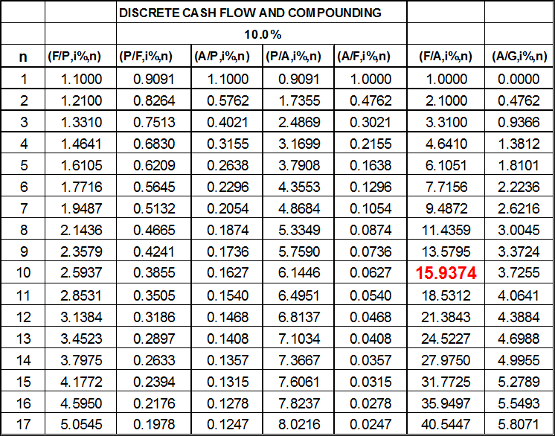
Example of a uniform or constant series
$800 is deposited annually
in a fund for 10 years. If
the fund earns interest at
the rate of 10% per year,
what will be the value of
the fund at the end of the
tenth year?
FW = A(F/A,i%,N)
= 800(F/A,10%,10)
= 800(15.9374)
= $12,750

Slide 71
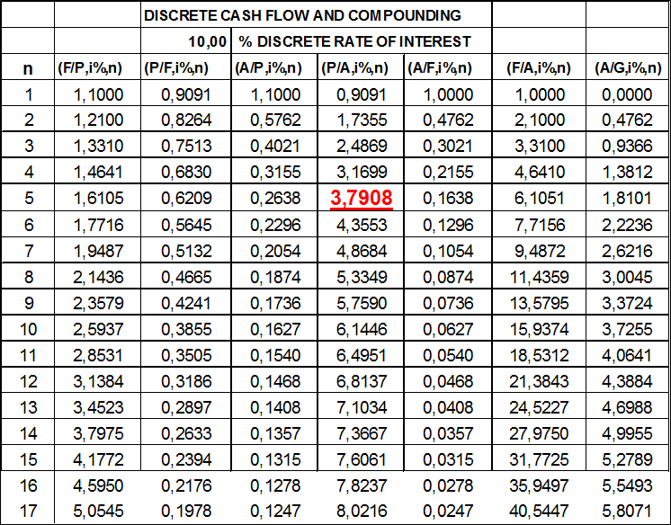
Example of a uniform or constant series
How much should you spend
(i.e., the purchase price) for an
energy-saving device with a
five-year life (and no salvage
value) if the device is to provide
annual savings of $200?
Assume end-of-year savings
and an interest rate of 10%.
P = A(P/A,i%,N) = 200(P/A,10%,5)
= 200(3.7908) = $758.16

Slide 72
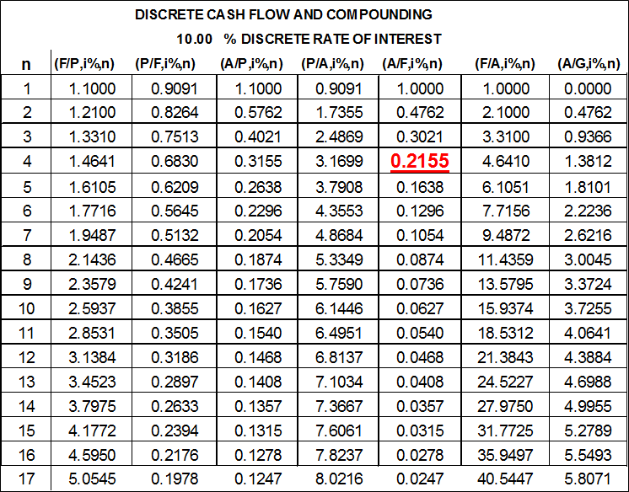
Example of a uniform or constant series
Your plans are to purchase a $30,000 sports car when you graduate in four years. How much should you deposit in your bank account at the end of each of the 4 years in order to pay cash for the car?
Assume that your deposits earn 10% compounded annually.
A = F(A/F,i%,N)
= 30,000(A/F,10%,4)
= 30,000(0.2155) = $6,465

Slide 73
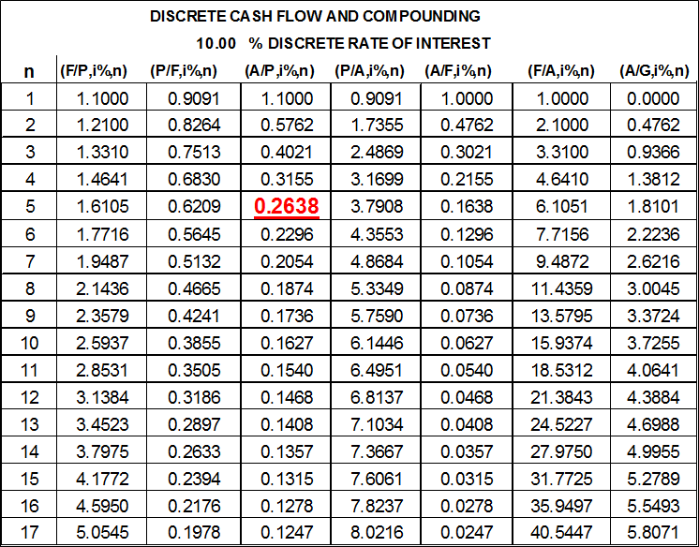
Example of a uniform or constant series
A young couple paid $40,000 for expensive household
furniture. After a rocky five-year relationship, the couple
decided to split.
the furniture was practically worthless after 5 years
the interest rate was 10% compounded annually
What was the annual equivalent value of its furniture?
A = P(A/P,i%,N)
= 40,000(A/P,10%,5)
= 40,000(0.2638) = $10,552

Slide 74
Linear Gradient Series
(Arithmetic Series)
A series that grows or declines by a constant dollar value (not by a rate) from, for example, year to another.
$1000
PW
$1000
PW
$750
$750
$500
$500
$250
$250
0
1
2
3
4
0
1
2
3
4
Increasing or growing series
Decreasing or decaying series
Please refer to document #2 Decision Criteria Interest Factor Derivation
in the course website folder “ECO 1192 Documents on Virtual Campus”.

Slide 75
Conversion of linear gradient series to an annuity (uniform series)
Original Series
Step 1: Create a new series (annuity in this case) by repeating the first element of the arithmetic series.
$1000
$750
$500
$250
$250
$250
$250
$250
0
1
2
3
4
0
1
2
3
4
Increasing or growing series

Slide 76
Conversion of linear gradient series to an annuity (uniform series)
$750
$500
$250
Original Series
$0
$1000
0
1
2
3
4
$750
$500
$250
0
1
2
3
4
0
1
2
3
4
Increasing or growing series
Step 2: Subtract the first element from all
elements of the series including the
first element and convert to an annuity.

Slide 77
Conversion of linear gradient series to an annuity (uniform series)
Original Series
$1000
$750
$500
$250
0
1
2
3
4
0
1
2
3
4
Increasing or growing series
Step 3: Add annuities from steps 1 and 2.

Slide 78
Arithmetic Gradient Series
Composite series (two series in one): Increasing or
growing series
P = 0 + G/(1+i)² + G/(1+i)³ + G/(1+i)⁴ … + G/(1+i)^{N}
OR P = sum G(n -1)(1+i)^{N-1}, n = 1 to N
Annual Equivalent = A1 + G(A/G,i%,n)
where G = gradient
  A1 = first element of series
(A/G,i,N) = (1/i) -[N/[(1+i)N + 1]]
Present Worth = A1(P/A1,i%,n) + G(P/G,i%,n)
(P/G,i,N) = {[(1+i)^{N} - iN -1]/ [i²(1+i)^{N}]}
Future Worth = A1(F/A1,i%,n) + G(F/G,i%,n)
(F/G,i,N) = {[(1+i)^{N} – 1]/i} - N

Slide 79
Arithmetic Gradient Series
Composite series (two series in one): Decreasing or
decaying series
P = 0 + G/(1+i)² + G/(1+i)³ + G/(1+i)⁴ + … G/(1+i)^{N}
OR P = sum G(n-1)(1+i)^{N-1}, n =1 to N
Annual Equivalent = A1 - G(A/G,i%,n)
where G = gradient
  A1 = first element of series
(A/G,i,N) = (1/i) -[N/[(1+i)N - 1]]
Present Worth = A1(P/A1,i%,n) - G(P/G,i%,n)
(P/G,i,N) = {[(1+i)^{N} - iN -1]/ [i²(1+i)^{N}]}
Future Worth = A1(F/A1,i%,n) - G(F/G,i%,n)
(F/G,i,N) = {[(1+i)^{N} – 1]/i} - N

Slide 80
Arithmetic Gradient Series
Title (name) | Formula (Need not be memorized)
Arithmetic gradient present worth factor: (P/G,i,N) | [(1+i)^{n}-in-1]/ [i²(1+i)^{n}]
Arithmetic gradient uniform series factor: (A/G,i,N) | [(1+i)^{n}-in-1]/[i(1+i)^{n} -1]
Arithmetic gradient future worth factor: (F/G,i,N) | {[(1+i)^{n} - 1]/i} – N

Slide 81
Example: Increasing Arithmetic Gradient Series
Assume that your car is projected to have the following maintenance record during your 4-year studies at U of O. The rate of interest will be 10% compounded annually.
Find the equivalent annual value of the maintenance charges which are:
  $300 (EOY1): $350(EOY 2);$400 (EOY 3) and $450(EOY 4)
A = A1 + G(A/G,i%,N) = 300 + 50(A/G,10%,4)
= 300 + 50(1.381) = $369.05
Note: EOY ≡ End of year

Slide 82
Annuity
Actual Series
Equivalent to:
$300
$300
$300
$300
$450
$400
0
1
2
3
4
$350
+
$300
3G=$150
2G=$100
1
2
3
4
1G =$50
0
0G=0$
0
1
2
3
4

Slide 84
Decreasing Arithmetic Gradient Series
Annual Equivalent = A1 - G(A/G,i%,n)
where G = gradient
A1 = first term of the series
Present Worth (PW) = A1(P/A1,i%,n) - G(P/G,i%,n)
Future Worth (FW) = A1(F/A1,i%,n) - G(F/G,i%,n)

Slide 85
Example: Decreasing Arithmetic Gradient Series
Your investment income is expected to be $2000 on December 31
of this year and to decrease by $100 on December 31 of the next 5 years.
Find the Present Worth of your investment income if the annual
  interest rate is 10% compounded annually.
PW = A(P/A,i%,N)-G(P/G,i%,N)
PW = 2000(P/A,10%,5)-100(P/G,i%,N)
where (P/G,i%,N) = (P/A,i%,N)(A/G,i%,N)
= 2000(3.7908)-100(A/G,10%,5)(P/A,10%,5)
= 7581.60-100(1.8101)(3.7908) = $6895.43

Slide 86
Geometric Series
 | Series 1 | Series 2 | Series 3
 | i(=10%) > k(=5%) | I(=10%) < k(=15%) | i(=10%) = k(=10%)
EOY
0 | -10,000 | -10,000 | -10,000
1 | 2,000(1.05)¹ | 2,000(1.15)¹ | 2,000(1.10)¹
2 | 2,000(1.05)² | 2,000(1.15)² | 2,000(1.10)¹
3 | 2,000(1.05)³ | 2,000(1.15)³ | 2,000(1.10)¹
4 | 2,000(1.05)⁴ | 2,000(1.15)⁴ | 2,000(1.10)¹
5 | 2,000(1.05)⁴ | 2,000(1.15)⁵ | 2,000(1.10)¹
i = MARR = discount factor; k= series growth or decay factor

Slide 87
Finding The Present Worth of a Geometric Series
Three (3) methods (same answer)
  Summing individually discounted cash flows.
  Geometric Series Present Worth Formula
    See course lecture notes (Not in the course textbook)
    Two cases: i) i% ≠ k% and ii) i% = k%
  Conversion to an Equivalent Uniform Series using a modified discount factor
    See course textbook (Not in the course lecture notes)
    Three cases: i) i% > k%; ii) i% < k%; and iii) i% = k%
i% = Discount Rate and k% = Series Rate of Growth or Decay

Slide 88
Geometric Series Conversion
Method 1: Sum of Discounted Cash Flows
Series 1: i(=10%) > k(=5%)
Summing discounted cash flows
= -10000 + 4000(1.05)¹ ÷ (1.1)¹
+ 4000(1.05)² ÷ (1.1)² + 4000(1.05)³ ÷ (1.1)³
+ 4000(1.05)⁴ ÷ (1.1)⁴ + 4000(1.05)⁵ ÷ (1.1)⁵ = $2289
Series 2: i(=10%) < k(=15%)
= -10000 + 4000(1.15)¹ ÷ (1.1)¹
+ 4000(1.15)² ÷ (1.1)² + 4000(1.15)³ ÷ (1.1)³
+ 4000(1.15)⁴ ÷ (1.1)⁴ + 4000(1.15)⁵ ÷ (1.1)⁵ = $3460
Series 3: i=k=10%
= -10000 + 4000(1.1)¹ ÷ (1.1)¹
+ 4000(1.1)² ÷ (1.1)² + 4000(1.1)³ ÷ (1.1)³
+ 4000(1.1)⁴ ÷ (1.1)⁴ + 4000(1.1)⁵ ÷ (1.1)⁵ = $2874

Slide 89
Geometric Series Conversion
Method 2: Present Worth Conversion
Series 1: i(=10%) > k(=5%)
NPW = {-P + {C÷(i-k)}{1-[(1+k)÷(1+i)]^{N}}
= -10000 + {4000÷(0.1-0.05)}{1-[(1+0.5)÷(1+0.1)]⁵} = $2289
Series 2: i(=10%) < k(=15%)
NPW = {-P + {C÷(i-k)}{1-[(1+k)÷(1+i)]^{N}}
= -10000 + {4000÷(0.1-0.15)}{1-[(1+0.15)÷(1+0.1)]⁵} = $3460
Series 3: i=k=10% ➔ Different Formula From Series 1 & 2
NPW = -P + nC÷(1+i) = -P + nC÷(1+k) = -10000 + 5(4000)÷(1+0.1)
= $2874

Slide 90
Geometric Series Conversion
Method 3: Growth-adjusted interest rate (i*)
  Series 1: i(=10%) > k(=5%); i* = {(1+i)÷(1+k)}-1={1.1÷1.05}-1= 4.7619%
  Note that i%>k%>0 ➔ growth is positive.
  NPW = -P + 4000{(1+i*)^{N}-1}÷{i*(1+i*)^{N}}{1÷(1+k)}
  NPW = -10000+4000{(1+0.04762)^{N}-1}÷{0.4762(1+0.04762)⁵}{1÷(1+0.05)}
  NPW = $2289
  Series 2: i(=10%) < k(=15%); i* = {(1+i)÷(1+k)}-1={1.1÷1.15}-1= -4.348%
  Note that i%<k%>0 ➔ growth is negative.
  NPW = -P + {(1+i*)^{N}-1}÷{i*(1+i*)^{N}}{1÷(1+g)}
  NPW = -10000+4000{(1-0.04348)^{N}-1}÷{-0.04348(1-0.04348)⁵}{1÷(1+0.15)}
  NPW=$3460
  Series 3: i=k=10%
  Note that i%=k% ➔ growth is positive.
  PW = -P + nC÷(1+i) = -P + nC÷(1+k)
  PW = -10000 + {5(4000)÷(1+0.1)} = $2874

Slide 91
Geometric Series Conversion
NPW of a Decaying Geometric Series i=10%; k=-2%
  Method 1: Summing discounted cash flows
  NPW= -10000 + 4000(1-0.02)¹ ÷ (1.1)¹
  +4000(1-0.02)² ÷ (1.1)² +4000(1-0.02)³ ÷ (1.1)³
  + 4000(1-0.02)⁴ ÷ (1.1)⁴ +4000(1-0.02)⁵ ÷ (1.1)⁵
  NPW = $1470
  Method 2: Present Worth Conversion
  NPW = [-P + {C÷(i-k)}]{1-[(1+k)÷(1+i)]^{N}}
  = -10000 + {4000÷(0.1-(-0.02)}{1-[(1-0.02)÷(1+0.1)]⁵} =
  NPW = $1470
  Method 3: Growth-adjusted interest rate (i*)
  i(=10%) > k(=-2%); i* = {(1+i)÷(1+k)}-1={1.1÷1-0.02}-1= 12.245%
  Note that i%>k%>0 ➔ growth is positive.
  NPW = -P + {(1+i*)^{N}-1}÷{i*(1+i*)^{N}}{1÷(1+k)}
  NPW = -10000+4000{(1+0.12245)⁵-1}÷{0.12245(1+0.12245)⁵}{1÷(1-0.02)}
  NPW = $1470

Slide 92
Geometric Series
Title (name) | Formulas
Geometric Series Present Worth Factor: (P/C,i,k,N) (where “C” is the first element of the series) 1. If k% ≠ i% 2. If k% = i% | 1. {1÷(i-k)}{1-[(1+k) ÷(1+i)]^{N}} 2. N÷(1+i) OR N÷(1+k)
Geometric Series Future Worth Factor: (F/C,i,k,N) 1. If k% ≠ i% 2. If k% = i% | 1. (1+i)^{N} (P/C,i,k,N) 2. N(1+i)^{N-1} OR N(1+k)^{N-1}

Slide 93
Limiting Factors
INTEREST FACTOR | ALGEBRAIC EQUIVALENT | N  ∞ | i%=0
(F/P,i%,n) | (1+i)^{n} | Infinity | 1
(P/F,i%,n) | (1+i)^{-n} | 0 | 1
(F/A,i%,n) | {(1+i)^{n} - 1}/i | Infinity | N
(P/A,i%,n) | {(1+i)^{n} -1}/{i(1+i)^{n}} | 1/i | N
(A/P,i%,n) | {i*(1+i)^{n}}/{(1+i)^{n} -1} | I | 1/n
(A/F,i%,n) | i/{(1+i)^{n} – 1} | 0 | 1/n
Special cases: n ➔ ∞ or i% = 0

Slide 94
Example: Frequency Mismatch
(Cash Flow and Interest Compounding)
10 end-of-year $1,000 deposits to an account that pays 18% compounded quarterly.
What is the account balance after the 10th deposit?
Method 1 : Find the effective interest rate
From the effective rate formula:
(1+r/m)^{m} - 1 = (1+0.18/4)⁴ - 1 = 0.1925
Therefore: F₁₀ = 1,000(F/A, 19.25%,10) = $25,015.36
Method 2 : Find the effective quarterly deposit
A = 1000(A/F,18%/4,4) = $233.74
F₄₀ = 233.74(F/A, 4.5%, 40) = $25,017.27

Slide 95
Example: Frequency Mismatch
(Cash Flow and Interest Compounding)
Essex Bank of Canada pays 4% compounded semi-annually on its deposits.
Your plan is to deposit $100 monthly in your Essex Bank account.
What would be your account balance after 5 years?
  Use the future worth of a uniform series formula to calculate your future balance: F=A(F/A,i%,N) where i%= (1+r/m)^{(m/k)}-1
= (1+[0.04/2])^{(2/12)} -1=0.003306 OR 0.33.06% and N = NxM = 5 x 12 = 60
F = 100(F/A,0.3306%,60)

Slide 96
Next Topic (#3)
Single Sums and Annuities

Slide 97
Engineering Economics
ECO 1192
Topic 2: Time-value mechanics
Claude Théoret
University of Ottawa

