Slide 1
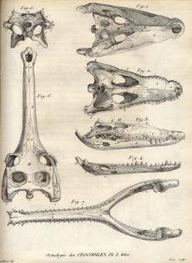
Chapter 2
Evolutionary Thinking Before Darwin
2.1 Transformism in Antiquity
  2.1.1 Anaximander (610-546)
  2.1.2 Empedocles(483-423)
  2.1.3 Democritus(460-360)
2.2 Classical thinkers
  2.2.1 Socrates (469-399) and Plato (427-347)
  2.2.2 Aristotle (384-322)
2.3 The impact of Christianity
2.4 From fixity of species to transformism
  2.4.1 Linnaeus (1707-1778)
  2.4.2 Buffon (1707-1788)
  2.4.3 Lamarck (1774-1829)
  2.4.4 Cuvier (1769-1832)
  2.4.5 Hutton (1728-1799) et Lyell (1797-1875)
Complementary Notes :
Chapter 2-complementary notes.pdf
Campbell biology: Chapter 22 :492-495
Notes:
Association with names and ideas

Slide 2
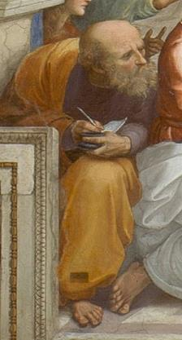
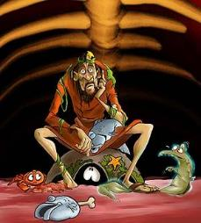
2.1 Transformism in Antiquity
2.1.1 Anaximander (610-546 BCE )
First philosopher to write his thoughts.
“Animals are born from the sea, by solar heat on water. They were first wrapped in spiny bark...as they aged, they migrated on the mainland. When the bark burst, they survived briefly in their new lifestyle.”
Thus, humans originated from fishes that attempted to invade the mainland.
Water is the central element of the universe.
Notes:
Greek philosopher
All life came from water
Babies grew within fish
tried to analyze nature using a materialistic approach

Slide 3
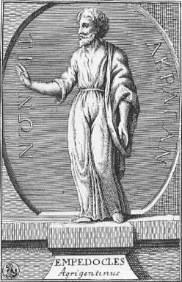
2.1 Transformism in Antiquity
2.1.2 Empedocles (483-423)
All structures of the world (matter) are made of four elements: _earth, water, air, fire.
These elements are simple, eternal and unalterable
Two major forces interact constantly on these elements; love (attraction or harmony) and strife or hate (repulsion or discord).

Slide 4
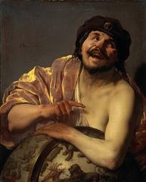
2.1 Transformism in Antiquity
2.1.3 Democritus (460-360)
The most “scientific” of the Greek philosophers.
Two realities: atoms and emptiness.
Matter: group of atoms in movement. An atom cannot be created of destroyed (atomic theory).
There is an intrinsic property, a force of atoms that creates shapes.
Humans and animals are born directly from dirt (spontaneous generation).
Notes:
Atoms- Not created, cant be split, smallest particle possible
Had properties that allowed them to be glued together to form living things

Slide 5
2.1 Transformism in Antiquity
Conclusion
Acts of creation are not due to gods, but rather due to the innovative power of matter.
2. The origin of all things is not teleological (namely, with an ultimate goal), but is the result of chance.

Slide 6
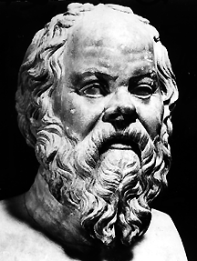
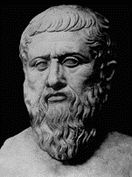
2.2 Classical Thinkers
2.2.1 Socrates (469-399 A.D.) – Plato (427-347 A.D.)
With the classical tradition, the materialistic approach of past philosophers gives way to more abstract questions and to the contemplation of the soul.
The important questions are not materialistic, but rather linked to a search and an understanding of the concepts of beauty, kindness, justice and sanity.
Arguments about logical, ethical and political questions are more interesting than the search for truth.
The answers are not found in nature, but within the self.

Slide 7
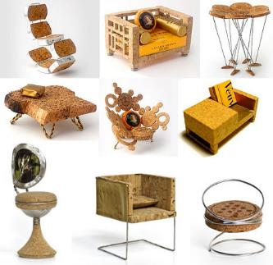
2.2 Classical Thinkers
2.2.1 Socrates (469-399) – Plato (427-347)
Theories of Ideal Forms (essentialism): the visible, imperfect and changing realm which surrounds us is a poor imitation of an Ideal World (permanent and perfect that we possess at birth: the world of Ideal Forms).
The variation of forms is not important. Only the quest to define and understand the Ideal Form is important.
This philosophy will have a lasting impact on our perception of nature.
Gods are the creative forces.
Notes:
Born with some kind of ideal form of world, some notion of beauty, ideal chair spend our life trying to posses them
Nature was full of imperfection
Variation was not important you wanted to find the essence of things (ideal form)

Slide 8
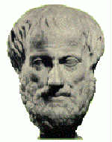
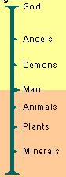
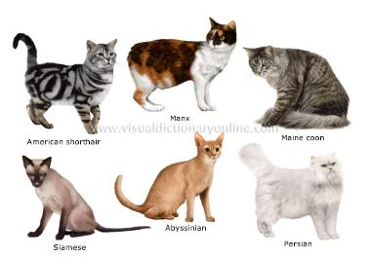
2.2 Classical Thinkers
2.2.2 Aristotle (384-322)
Does not believe in the innate aspect of the world of Ideal Forms.
It is important to describe the essence of living beings and this essence is observed in nature.
Believes that species are static (unchangeable). Thus, morphological variability is illusion and imperfection.
He is a vitalist and perceives multiple levels of souls with cumulative effects: vegetal (plants), animate (animals) and rational (humanity).
Created the scala naturae) or great chaing of beings in which species are organised in a static and unchangeable hierarchy.
Notes:
Quest was to find essence of things by observing nature
rational (humans only)
Animal soul (move)
Vegetal soul (property of growing and reproduction)

Slide 9
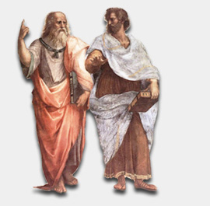
There is a world of Ideas or Forms that is totally separate from the material world. Every things or living beings that we observe with our senses is just a poor imitation of its perfect representation in the world of Forms. this world forms is innate.
There is no need to postulate the hypothetical existence of an innate world of Ideas or Forms. We determine the essence of things by _carefully examining the world around us
Painting from Raphaël: public domain
2.2 Classical Thinkers
Plato
427-347 BCE
Aristotle
384-322 BCE
2.2 Classical Thinkers
Notes:
Aristotle is a student of plato

Slide 10
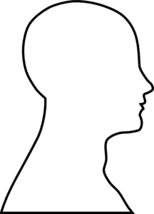
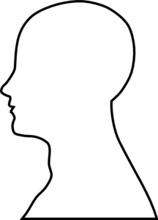


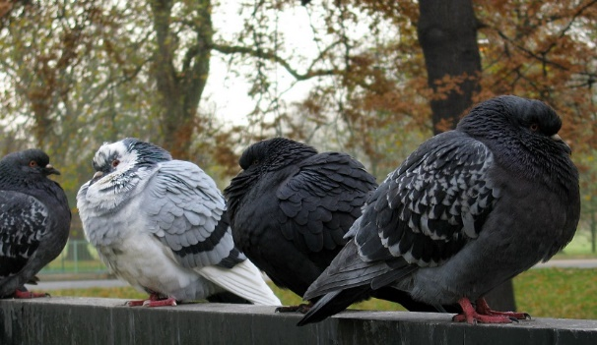
2.2 Classical Thinkers
Two visions of the Theory of Forms (Essentialism)
Plato
Aristotle
Notes:
Plato, knowledge comes from reasoning rather than the use of the senses and the observation of nature.
For Aristotle, the use of the senses is necessary to acquire knowledge.
It is by observing the pigeons that we can define the essence of a pigeon. Contrary to Plato's abstract approach, Aristotle would have based his description of the pigeon on characteristics common to the individuals of the species. Probably he would have dwelt on the shape of the body, the beak and the wings. Another important point is that for Plato and Aristotle, the variability between pigeons, for example in the color of plumage is not particularly important or interesting because it does not allow to recognize the ideal form or the essence of case. It is interesting to note that 2000 years later, Charles Darwin will be the first scientist to understand the importance of this morphological variability. In fact, it will make it the material that will be used by its evolutionary process, natural selection, to explain the adaptations and diversity of life.
Aristotle- By looking at the nature we get the image
Wikimedia commons

Slide 11
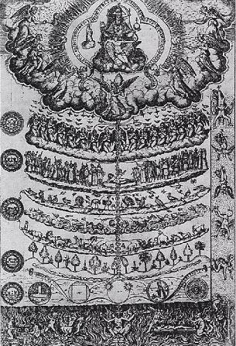
2.3 The Impact of Christianism
With the decline of the Roman empire, christianity becomes the main ideology in the western world.
This will be the dark age for tranformism (evolutionary thought)
God becomes the measure of all things, and the Christian bible, the word of the day.
The concept of scala naturae becomes purely metaphysical, proclaiming the perfection of the Creator.
God
Angels
Humanity
Animals
Vegetation
minerals
Drawing of scala naturæ by Didadus Valades, Rhetorica Christiana (1579)
Notes:
Strength of religious thought- no questions by humans

Slide 12
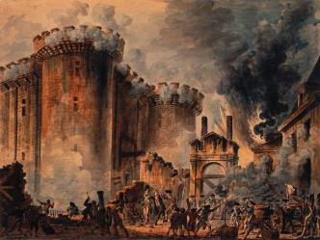
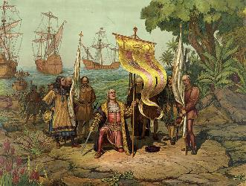
2.4 From Fixity of Species to Transformism
Renaissance in Europe (14th to 17th century):
  Back to nature (great expeditions + discoveries)
  Power of religion is progressively challenged
French Revolution (end of the 18th century)
  Challenge of ordered systems (monarchy) for an active pursuit of progress.
  More open-mindedness towards science.
Capture of the Bastille; 14 July 1789
Arrival of Christopher Columbus in America 1492
Notes:
Traveling- discovering new worlds
Rejection of the power of religion, challenges, changes in Christianity
Science can improve the quality of life- evolutionary change of views
Instead of aiming for order they aimed for progress

Slide 13
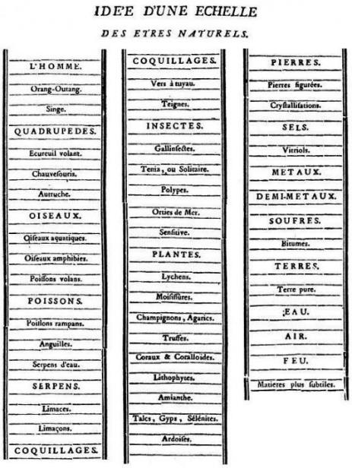
2.4 From Fixity of Species to Transformism
During and immediately after the Renaissance, there’s a return towards experimentation and the observation of nature.
Attempts to classify living organisms were done within the framework of the _Great Chain of Beings.
Bonnet (1745)
Notes:
Wednesdays from 7-830 marion 133
- Bonnet wanted to show order of creation in a the form of a ladder
Showed complexity in material that is on the planet
An attempt to show some kind of order and organization of nature and the world
In line with Aristotle

Slide 14
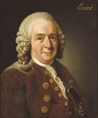
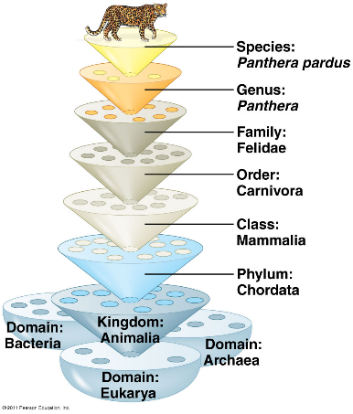
2.4 From Fixity of Species to Tranformism
2.4.1 Linnaeus (1707-1778)
Linnaeus, influential Swedish scientist, father of modern taxonomy (Systema Naturae, 1758)
  Hierarchical classification
  Binomial system of nomenclature (e.g. Homo sapiens).
Discovering each piece of the ultimate puzzle, the Plan of Creation.
Linnaeus’s concepts remain valid today
It is a excellent application of the essentialism of Aristotle.
Notes:
Linnaeus wrote a book trying to organize life
Not as much based on creation but evolution
Species name and genus name
Based off of essentialism of Aristotle and trying to find the essence of things
Creationist- thought of the idea that species had similar ancestors

Slide 15
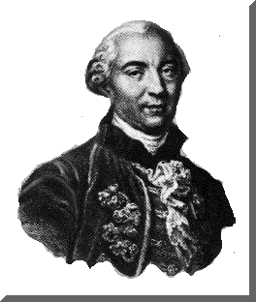
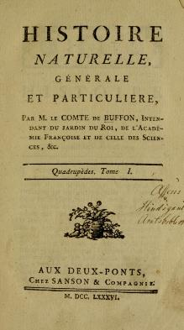
2.4 From Fixity of Species to Transfromism
2.4.2 Buffon (1707-1788)
Objective: describe nature (44 volumes)
He wrote (around 1740):
  “every family, from animals to plants, has a common origin, all animals derive from one animal, which through time produced all animal species in existence today”.
  His theory established the age of Earth to be around 75 000 years. According to Buffon, the initial temperature of the Earth was very high. Since then the climate has mellowed out.
The faculty of Theology of the Sorbonne censored, in 1751, many of Buffon’s theories because of conflicts with religious views.
He then decided to abandon his evolutionary ideas and to focus on observing nature.
Notes:
observed nature- tropical plants (didn’t make sense)
Thought planet was a ball of fire- the earth is cooling down ever since
Society was not ready for his thinking (due to his conflicts with religion)

Slide 16
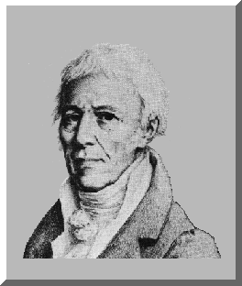
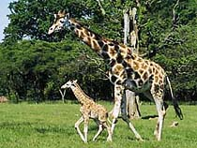
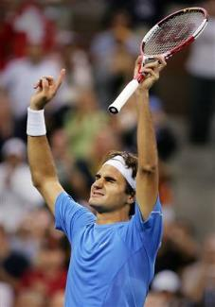
2.4 From Fixity of Species to Transfromism
2.4.3 Lamarck (1774-1829)
First evolutionist (species modify their morphology through time).
Uses the environment as a factor of change (environmental determinism).
2 principles (affects individuals):
  Principle of usage and non-usage.
  Principle of inheritance of acquired characteristics.
Gradual mechanism, adaptive and involves an innate ability (internal force) of an organisms to become more complex (i.e., the static “ladder” or “chain” becomes an escalator)
_Spontaneous generation explains the presence of simple organisms.
Theory not well received by his peers because it contradicted the religious view of the creation of life.
Notes:
More openness to new things
Morphology is dictated by environment
If you use an organ = larger, don’t use it = smaller
Giraffe- longer and longer neck cause it eats high trees (neck is stretching)
Tennis – right arm larger than left
Animals adapt to environment- general idea SPECIES CHANGE
Invertebrates

Slide 17

Bonsai tree
Problem with Lamarck’s theory : _Acquired trains cannot be inherited
Notes:
Trimming doesn’t change its genetic makeup
We don’t modify our genes- we don’t evolve POPULATIONS EVOLVE

Slide 18
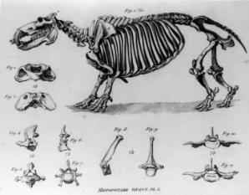
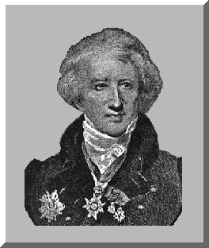
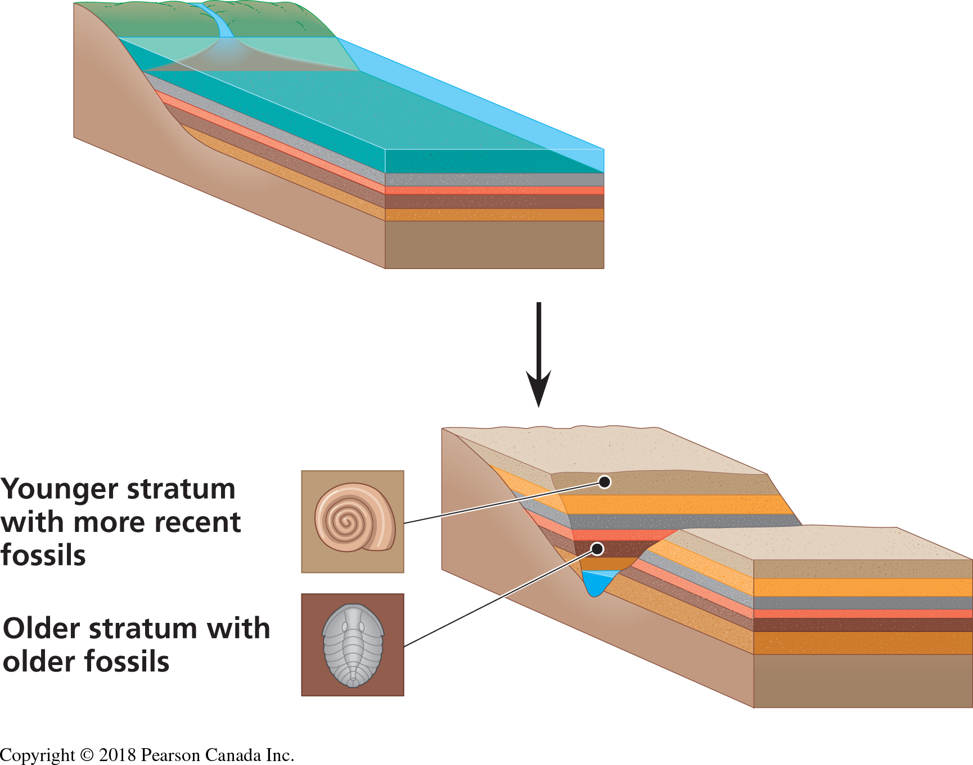
2.4 From Fixity of Species to Transfromism
2.4.4 Cuvier (1769-1832)
French scientist interested in mammal fossils
Established the science of _paleontology.
  The older the stratum, the more dissimilar its fossils are to current species
  From one layer to the next, species appear and disappear.
Theory of correlation of parts (organs).
Notes:
Working with mammals
Correlation of parts- able to reconstruct the entire fossil due to his knowledge
Scissoring movement = jaw or carnivore (jaw is same level of teeth) , very tight joint like a hinge
Herbivore- jaw higher than teeth (grinding motion)

Slide 19
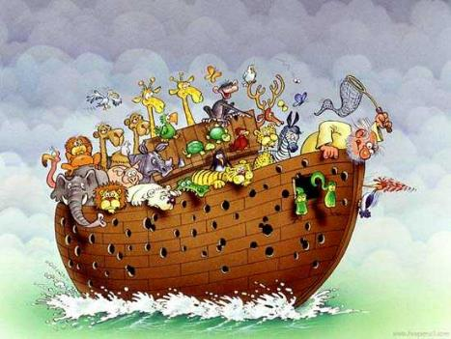
2.4 From Fixity of Species to Transfromism
2.4.4 Cuvier (1769-1832)
Cuvier believed in the fixity of species, extinction and catastrophism
_Progressive creationism
Notes:
All species became extinct and new species were created
More religious: Every time there was a catastrophe god created new species, stopped at humans

Slide 20
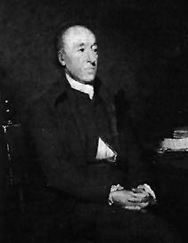
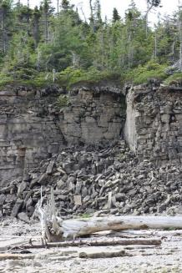
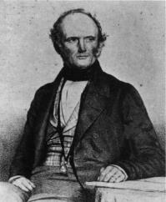
2.4 From Fixity of Species to Transfromism
2.4.5 Hutton (1728-1797) and Lyell (1797-1875)
Hutton
Hutton and Lyell (geologists)
  Geological changes are the result of a slow, gradual and continuous process.
  Principle of _uniformity (uniformatarianism):The laws of nature are not affected by the passage of time.
  So,“the present is the key to the past”
  Vision of the world: “with respect to human observation, this world has neither a beginning nor an end”.
  Lyell is the first to establish geology as a scientific discipline.
Lyell
Notes:
Hutton
You could see a lot of things in the life time
Did not believe he needed idea of creation
It is the culminative element explains changes in planet
By studying present you can learn the past
Where do environment come from? Continents?
Everything is gradual and things develop over time

Slide 21
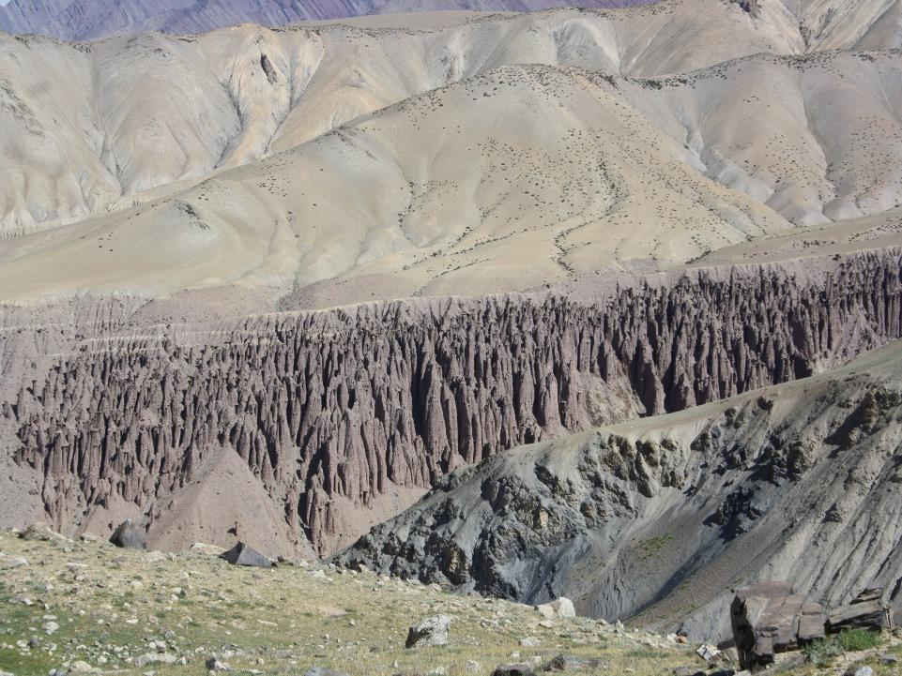
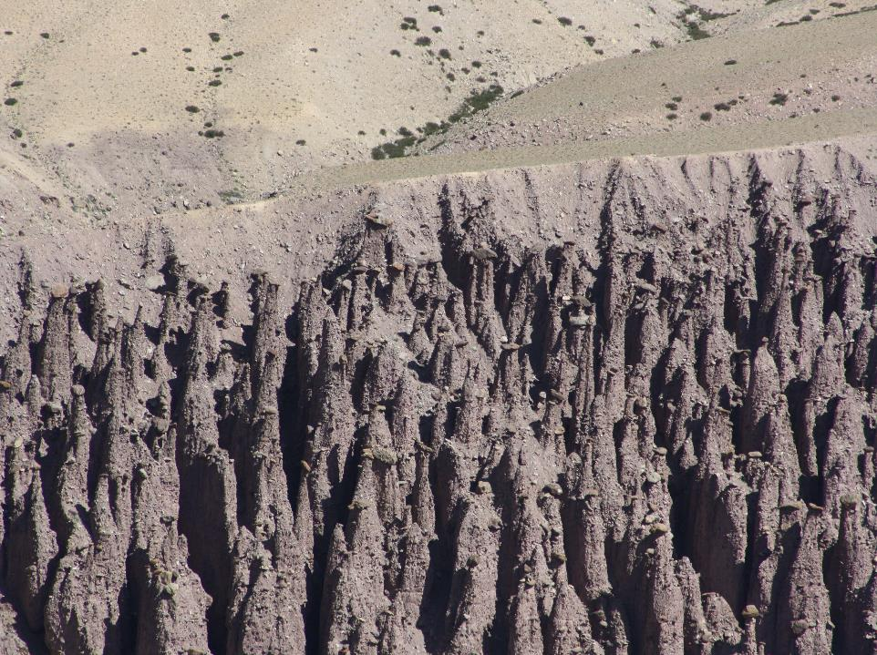
Hoodoo (tent rock)
Himalaya (Ladahk , India) : 5,000 m
Notes:
Column of sand with rock on top
Vertical type of erosion- orientation of the valley

Slide 22
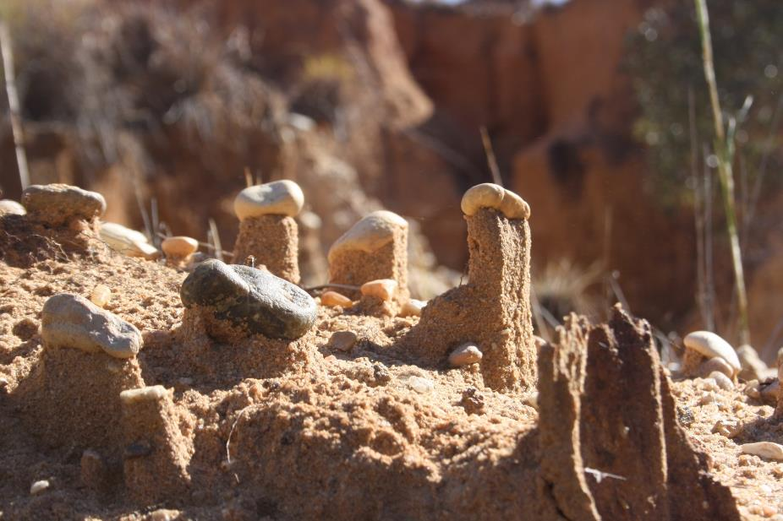
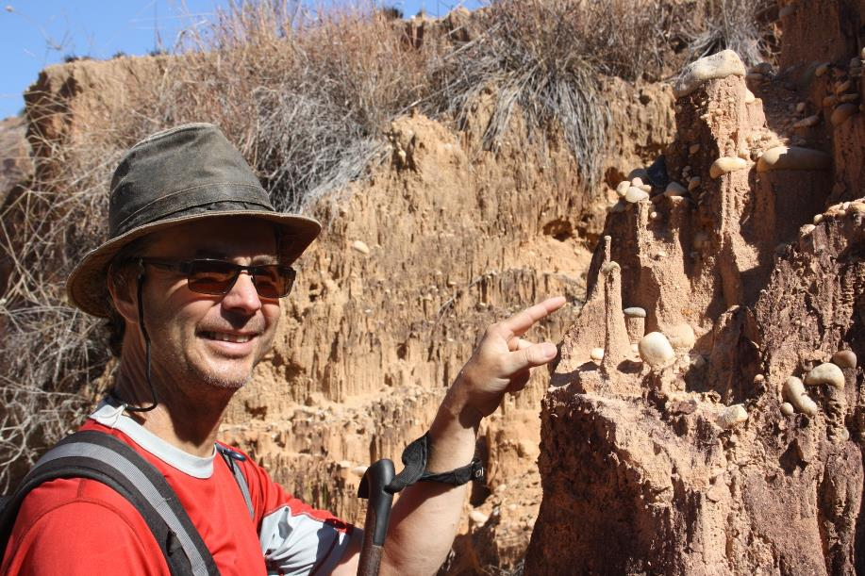
Madagascar
hoodoo
Notes:
Understand process now then you are able to extrapolate the facts

