Slide 1
Stress and Diabetes
Dr. Syd Miller
Joy Lim, Janita Jeganathan, Brittany Spencer

Slide 2
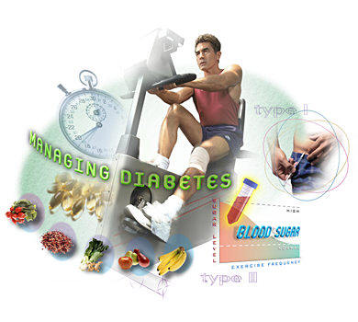
Outline
Diabetes Type I and II
Biological factors in stress and diabetes
Environmental factors in stress and diabetes
Psychological factors in stress and diabetes
Conclusion

Slide 3
https://www.youtube.com/watch?v=X9ivR4y03DE&feature=iv&src_vid=jHRfDTqPzj4&annotation_id=annotation_3720898155

Slide 4
Definition of Diabetes
Diabetes mellitus (DM): a metabolic disorder caused by defect in insulin secretion or action resulting in chronic hyperglycaemia
Dysfunction of the pancreas which typically produces beta cells to release insulin. This disturbs glucose metabolism
Diabetes complications: nervous system disorders, blindness, kidney diseases, amputation, sexual malfunction

Slide 5
Classification of Diabetes
Diabetes Mellitus Type I (DMI): Insulin-dependent diabetes or Juvenile diabetes
An autoimmune reaction involving the destruction of beta cells in the pancreas, therefore hindering the production insulin
Rapidly develops in childhood or adolescence or progressively develops into latent autoimmune diabetes in adulthood
Insulin injection is needed for survival

Slide 6
Classification of Diabetes
Diabetes Mellitus Type 2 (DM2): Non-insulin-dependent or adult-onset diabetes
Development of insulin resistance in that insulin is not properly utilized
Pancreas fails to produce sufficient levels of insulin for exceeding demand of insulin production due to high blood glucose level
Life style management is needed with insulin support
Progress in DM2 can lead to becoming insulin-dependent

Slide 7
SNS Response and Diabetes
Sympathetic
nervous system
Adrenal medulla
Epinephrine and norepinephrine
Fight or flight responses:
Decrease secretion in insulin production in pancreas
Liver releases glucose into blood stream

Slide 8

HPA and Diabetes
HPA axis
Pituitary gland
ACTH
Cortisol (glucocorticoids)
Adrenal cortex

Slide 9
Cortisol and Diabetes
Increase blood glucose levels causing hyperglycemia (high blood sugar)
Despite normal or even elevated insulin levels, blood glucose cannot be taken up by the cells due to the blocking effect of cortisol increase
Higher HPA axis activation is significantly associated with chronic diabetes complications such as neuropathy, retinopathy, and macroangiopathy (Chiodini, Iacopo et al., 2007)
Depressed immune system =autoimmune diseases (prone to develop DM1)

Slide 10
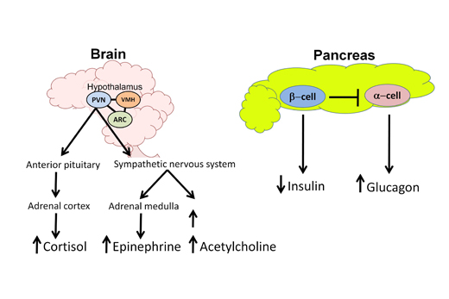
Stress effect on Diabetes

Slide 11
Family History and Diabetes
Twins studies show that only 50% concordance for Type I Diabetes
Twin studies show almost 100% concordance for Type II Diabetes
Monozygotic twins living in a different environment for decades are concordant for Type II Diabetes
Monozygotic twins of even different weights are still concordant for Type II Diabetes
genetic factors affect incidence and severity of diabetes
Pyke, D. A. (1979)

Slide 12
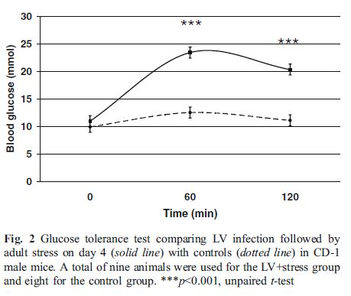
Stress Effects on Rats WiTh Type II Diabetes
Niklasson, B. et al (2006)
utero exposure to Ljungan virus to both male and female mice
LV infection of mice during pregnancy can induce glucose intolerance in stressed adult male mice and develop DM2

Slide 13
Environmental Stressors and Type II Diabetes
Different types of stress impairs glycemic control
in diabetic patients.
Environmental stress indirectly affects metabolic control by interfering with dietary and treatment compliance in diabetics
Etiology: 1) Genetic factors
2) Environmental factors
Affecting 34% of American adults aged 20 or over.
In the US 57 million individuals are at serious risk.

Slide 14
Dietary factors and Type II Diabetes
Stoeckli & Keller (2004)
Type 2 diabetes and obesity are twin epidemics.
Linear correlation between eating patterns and the development of Type II diabetes.
Western-diet:
1) red meat
2) refined carbohydrates
3) sweets
4) full-fat dairy products
Notes:
.

Slide 15
Dietary factors and Type II Diabetes
The type of fat:
Saturated fat (opposed to monounsaturated and polyunsaturated fats) is more harmful with respect to fat-induced insulin insensitivity.
Dietary prevention programs:
The Diabetes Prevention Program reduced diabetes by 58%
The Da Qing Study after a 6 year lifestyle intervention demonstrated a diabetes risk reduction from 43-67%.

Slide 16
Burnout and Risk for Type II Diabetes
Melamed et al. (2006)
An association of burnout with Type II diabetes in
healthy workers (1.84-fold increase).
The incidence of type 2 diabetes were much higher in the high
burnout workers than the low burnout workers.
Control Variables:
▪ age and family history
▪ alcohol and drug intake
▪ reduced physical activity
▪ hypertension

Slide 17
Women in Poverty and Type II Diabetes
De Groot et al. (2003)
African American women living in poverty at greater risk for developing Type II Diabetes than women with higher economic resources.
1) healthier food is more expensive
2) stress due to lack of resources
The Conservation of Resources Theory (COR)
    Individuals with less resources may experience more stress in the face of loss because they have less resources to fall back on.
    - Coping resources decrease with each succeeding loss → this predicts that individuals will be at greater risk of future loss.

Slide 18
Women in Poverty and Type II Diabetes

Slide 19
Social Stigma
Study about obese individuals with Type II Diabetes.
Obesity → viewed as being under the persons control
Leads to increase daily stress and feelings of blame, guilt, and helplessness.
▪ Impacts diabetes management.
▪ Leads to a circular cycle of depression
and bad life-style choices.

Slide 20
Psychological Stress & Type II Diabetes
Study:
- Pima Indians who have a strong genetic predisposition to Type II Diabetes
- A 10-minute mental arithmetic test induced an increase in blood glucose levels in Pima Indians but did not do so in a control group of white subjects
- Both groups showed similar cardiovascular and neuroendocrine responses to the stress

Slide 21
Depression and Type II Diabetes
Clinically significant depression is associated with a 60-65%
increased risk of diabetes mellitus (Mezuk et al)
Depression is a common co-morbid condition among adults with
diabetes
Psychotropic medications lead to weight gain in predisposed
individuals leading to the development of Type II Diabetes
Depression also causes abnormal HPA axis functioning leading to glucose dysregulation
Depression has been associated with worse diabetes-related
outcomes including poorer glycemic control and cardiovascular
disease

Slide 22
Depression and Diabetes
-Psychotropic medications
-glucose dysfunction
Depression
Increase diabetes severity and complication
Diabetes
Poor glycaemic control
Depression

Slide 23
Stress Management and Type II Diabetes
(Surwit et. al., 2002)
Patients with type 2 diabetes were randomized to undergo a five-session group diabetes education program with or without stress management training.
Stress management training was associated with a small (0.5%) reduction in Glycated hemoglobin test (HbA1c), measuring glucose levels in blood.
This is a significant reduction in risk of microvascular complications
These results were significant at one year follow-up.

Slide 24
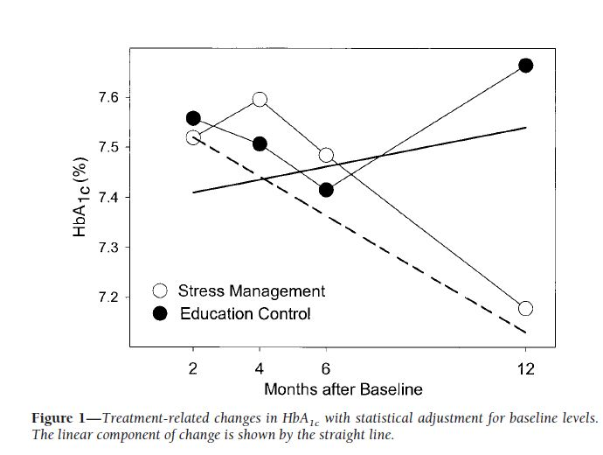
Stress Management and Type II Diabetes
(Surwit, R.S., et al 2002)

Slide 25
References
Alberti, K.G.M.M., & Zimmet, P.Z. (1998). Definition, diagnosis and classification of diabetes mellitus and its complications. Diabetic Medicine, 15, 539-553.
Retrieved from http://dx.doi.org/10.1002/(SICI)1096-9136(199807)15:7<539::AID- IA668>3.0.CO;2-S
Boyer, B. A., & Paharia M. I. (2008). Comprehensive handbook of clinical health psychology. New Jersey: John Wiley and Sons
Kai, K. K., Morimoto, I. I., Morita, E. E., Okada, Y. Y., Yamamoto, S. S., Kanda, K. K., & ... Eto, S. S. (2000). Environmental stress modifies glycemic control and diabetes onset in type 2 diabetes prone Otsuka Long Evans Tokushima Fatty (OLETF) rats. Physiology & Behavior, 68(4), 445-452. doi:10.1016/S0031-9384(99)00187-0
Kruger, D.F., McMurry, J.F., & Peyrot, M. (1999). A Biopsychosocial Model of Glycemic Control in Diabetes: Stress, Coping and RegimenAdherence. American Sociological Association.
Teixeira, M., & Budd, G. M. (2010). Obesity stigma: A newly recognized barrier to comprehensive and effective type 2 diabetes management. Journal of the American Academy of Nurse Practitioners, 22(10), 527-533. doi:10.1111/j.1745-7599.2010.00551.x
Wales, J.K. (1995). Does Psychological Stress Cause Diabetes? Diabetic Medicine.

