Slide 1
Business Analytics
ADM2302 B
Week 1b
Introduction to Linear Programming

Slide 2
Learning Objectives
Explain what linear programming is
Recognize problems that can be solved using linear programming models
Set up and formulate a linear programming model in mathematical terms

Slide 3
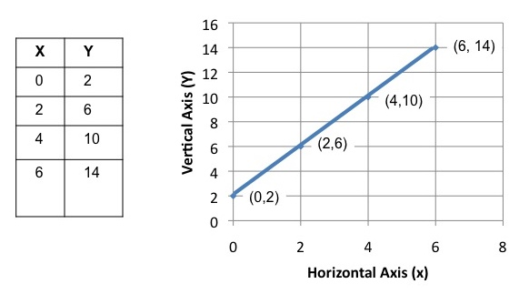
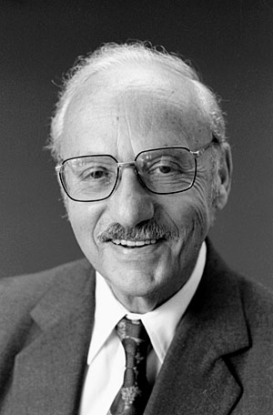
Linear Programming
Linear programming (LP; also called linear optimization) is a method to achieve the best outcome (such as maximum profit or lowest cost) in a mathematical model whose requirements are represented by linear relationships.
George Dantzig
  (1914-2005)

Slide 4
Linear Programming Problem Classification
Resource Allocation Problems
  Constrained by resources for an activity
  Amount used ≤ Amount available
Cost-Benefit-Trade-Off Problems
  Set required “benefits”
  Must minimize cost while achieving these benefits
Mixed Problems
  Combination of constraint types
Fixed Constraint Problems
  Assignment Problems
  Transportation Problems
Not limited to what is written and discussed here

Slide 5


Examples
(X) Should Apple sell ipad or ipad-mini ?
(O) How many should apple produce for each ?
(X) Should Toyota invest in Corolla or Camry?
(O) How much should Blackberry invest in each?
(X) Should the Body Shop advertise by TV or by internet?
(O) How much time should Body Shop advertise on each?

Slide 6
Assumptions of an LP Model
Proportionality - the effect of a decision variable in any one equation is proportional to a constant quantity
Additivity - the combined effect of the decision variables in any one equation is the algebraic sum of their individual weighted effects
Divisibility - the decision variables can take on fractional (non-integer) values
Certainty - all model parameters are known constants

Slide 7



Example – Computer Production
A firm that assembles computers and computer equipment is about to start production of two new products for 2019: desktop and laptop computers. Each type will require assembly time, inspection time, and storage space. The amounts of each of these resources that can be devoted to the production of the computer is limited. The manager of the firm would like to determine the quantity of each type to produce to maximize the profit generated by the sales of these computers.

Slide 8
Example – Computer Production
To develop a suitable model of the problem, the manager has met with design and manufacturing personnel. As a result of those meetings, the manager has obtained the following information
 | Desktop | Laptop
Profit per unit | $60 | $50
Assembly time per unit | 4 hr. | 10 hr.
Inspection time per unit | 2 hr. | 1 hr.
Storage space per unit | 3 cubic feet | 3 cubic feet

Slide 9
Example – Computer Production
The manager also has acquired information on the availability of company resources. These daily amounts are:
The manager also met with the firm’s marketing manager and learned that demand for the computers was such that whatever combination of these two types is produced, all of the output can be sold.
Resources | Amount Available
Assembly Time | 100 hr.
Inspection Time | 22 hr.
Storage Space | 39 cubic feet

Slide 10
Example – Computer Production
Can the problem be solved using linear programming?
What are the assumptions of a linear programming model?
  Proportionality (linearity)
  Additivity
  Divisibility
  Certainty
What are the steps to model formulation?
Notes:
Discussed why in this case we can make half a unit as opposed to a production plant where we can’t make half a unit

Slide 11
Step 1 – Define the Decision Variables
Based on the statement “The manager of the firm would like to determine the quantity of each type to produce to maximize the profit generated by the sales of these computers.”
We can write
Let X₁ represent the quantity of desktop computers to produce.
Let X₂ represent the quantity of laptop computers to produce.

Slide 12
Step 2 – Determine the Objective Function
Ask ourselves what is the objective?
  Maximize/Minimize
  Profit/Cost/Revenue/etc.
The profit per unit of the desktop is listed as $60 and the profit per unit of the laptop is $50.
We can write
Maximize Z = 60X₁ + 50X₂
Where Z is the profit and is the value of the objective function

Slide 13
Step 3 – Identify the Constraints
There are 3 resources with limited availability
  Assembly Time
  Inspection Time
  Storage Space
The computer requires 4 hr of assembly time per unit and the laptop requires 10 hr per unit. We have a total of 100 hr and so we can write:
4X₁ + 10X₂ ≤ 100
*note: units for the constraints’ RHS should equal LHS

Slide 14
Step 3 – Identify the Constraints (cont.)
We can set up the constraints for inspection time and storage space constraints in a similar manner (≤,≥,=)
The availability is limited; therefore the constraints are ≤ constraints
Inspection Time
2X₁ + X₂ ≤ 22
Storage Space
3X₁ + 3X₂ ≤ 39

Slide 15
Step 4 – Non-Negatives
Check to see if the system of equations requires a non-negative constraint.
Is it possible to produce a negative number of desktop computers or laptops?
X₁ ≥ 0
X₂ ≥ 0
*note: must include the non-negative constraints in formulation for full marks

Slide 16
Linear Programming Model
Let X₁ represent the quantity of desktop computers to produce.
Let X₂ represent the quantity of laptop computers to produce.
Maximize Z = 60X₁ + 50X₂
Subject to: 4X₁ + 10X₂ ≤ 100
2X₁ + X₂ ≤ 22
3X₁ + 3X₂ ≤ 39
X₁, X₂ ≥ 0
Any combination (x₁, x₂) that satisfies all the constraints is called a feasible solution, and a feasible solution that has the largest value (if maximization problem) of the objective function is called optimal solution.
Notes:
Objective Function
Parameters/Coefficients
Decision Variables
Constraints
RHS vs LHS

Slide 17
Linear Programming Model
Let X₁ represent the quantity of desktop computers to produce.
Let X₂ represent the quantity of laptop computers to produce.
Maximize Z = 60X₁ + 50X₂
Subject to: 4X₁ + 10X₂ ≤ 100
2X₁ + X₂ ≤ 22
3X₁ + 3X₂ ≤ 39
X₁, X₂ ≥ 0
Objective Function
Decision Variables
Coefficients
Constraints
Decision Variables
Coefficients
RHS
Notes:
Objective Function
Parameters/Coefficients
Decision Variables
Constraints
RHS vs LHS

Slide 18
Assumptions of an LP Model
Proportionality - the effect of a decision variable in any one equation is proportional to a constant quantity
Additivity - the combined effect of the decision variables in any one equation is the algebraic sum of their individual weighted effects
Divisibility - the decision variables can take on fractional (non-integer) values
Certainty - all model parameters are known constants

Slide 19
What are some feasible solutions?
X1 | X2 | Z | Feasible?
0 | 3
12 | 2
6 | 15
5.6 | 7.3
? | ?

Slide 20
Questions to think about…
Is it possible that for a linear programming problem
  there is no feasible solution?
  there are many optimal solutions?
  the optimal solution is not integer for the above problem?

Slide 21
Terms to be Familiar With
Constraint
Decision Variable
Feasible Solution
Infeasible Solution
Linear Programming Model
Non-negativity Constraint
Objective Function
Optimal Solution
Parameter / Coefficient
LHS / RHS

Slide 22
Example – Confectionary Company
A confectionary company produces two sizes of its popular chocolate bars: a 3.5-ounce size and a 6-ounce size. The 3.5-ounce bar costs $0.22 to make and sells for $0.35. Whereas the 6-ounce bars costs $0.40 to make and sells for $0.55.
The company has 15000 ounces of chocolate in stock and the manager wants to use it all in the next production run. In addition, the manager has specified that a minimum of 800 of the 3.5-ounce bars and 600 of the 6-ounce bars should be made.
Formulate the LP model that will enable the manager to determine how many of each size bar to produce to satisfy the conditions specified with maximum profit.
Notes:
Let X1 be the quantity of 3.5 ounce chocolate bars
Let X2 be the quantity of 6 ounce chocolate bars
Maximize: Z = $0.13 X1 + $0.15 X2
Subject to:
3.5 X1 + 6 X2 = 15000
X1 >= 800
X2 >= 600
X1 >= 0
X2 >= 0

Slide 23
Example – Diet Problem
A dietician has been asked by the athletic director of a university to develop a snack that athletes can use in their training programs. The dietician intends to mix two separate products together to make the snack. The following information has been obtained by the dietician:
Product A costs $0.20 per ounce and Product B costs $0.10 per ounce.
Nutrient | Minimum Amount Required | Contribution per ounce
 |  | Product A | Product B
Carbohydrates | 20 g | 2 g | 5 g
Protein | 12 g | 6 g | 1 g
Calories | 450 cal | 90 cal | 50 cal
Notes:
Let x₁ be the weight of product A in ounces
Let x₂ be the weight of product B in ounces
Min z = .2x₁ + .1x₂
Subject to: 2x₁ + 5x₂ ≥ 20 (carbohydrates)
6x₁ + x₂ ≥ 12 (protein)
90x₁ + 50x₂ ≥ 450 (calories)
x₁, x₂ ≥ 0

Slide 24
Example – Rocket Dog
Rocket Dogs is a food processing plant that manufactures hot dogs and hot dog buns. They grind their own flour for the hot dog buns at a maximum rate of 200 pounds per week. Each hot dog bun requires 0.1 pound of flour. They currently have a contract with Pigland Inc. which specifies that a delivery of 800 pounds of pork product is delivered every Monday. Each hot dog requires a quarter pound of pork product. All the other ingredients in the hot dog and hot dog buns are in plentiful supply. Finally the labour force of Rocket Dogs consists of 5 employees working full time (40hr/week each). Each hot dog requires 3 min of labour, each hot dog bun requires 2 min of labour. Each hot dog yields a profit of $0.20 and each bun yields a profit of $0.10.
Rocket Dogs would like to know how many hot dogs and how many hot dog buns they should produce each week to achieve the highest possible profit.

Slide 25
Learning Objectives
Explain what linear programming is
Recognize problems that can be solved using linear programming models
Set up and formulate a linear programming model in mathematical terms

