Slide 1
Chapter 6
PERCEPTION

Slide 2
Chapter Overview
Basic Concepts of Sensation and Perception
Define sensation and perception, and explain the difference between bottom-up and top-down processing.
Identify the three steps that are basic to all our sensory systems.
Distinguish between absolute thresholds and difference thresholds, and discuss what effect, if any stimuli below the absolute threshold have on us.
Discuss whether subliminal stimulation enables subliminal persuasion.
Explain the function of sensory adaptation.
Explain how our expectations, contexts, motivation, and emotions influence our perceptions.

Slide 3
Chapter Overview
Vision: Sensory and Perceptual Processing
Describe the characteristics of the energy that we see as visible light, and identify the structures in the eye that help focus that energy.
Describe how the rods and cones process information, as well as the path information travels from the eye to the brain.
Describe how we perceive color in the world around us.
Describe the location and function of the feature detectors.

Slide 4
Chapter Overview
Vision: Sensory and Perceptual Processing
Explain how the brain uses parallel processing to construct visual perceptions.
Describe how Gestalt psychologists understood perceptual organization, and explain how figure-ground and grouping principles contribute to our perceptions.
Explain how we use binocular and monocular cues to perceive the world in three dimensions and perceive motion.
Explain how perceptual constancies help us construct meaningful perceptions.
Describe what research on restored vision, sensory restriction, and perceptual adaptation reveals about the effects of experience on perception.

Slide 5
Chapter Overview
The Nonvisual Senses
Describe the characteristics of air pressure waves that we hear as sound.
Explain how the ear transforms sound energy into neural messages.
Explain how we detect loudness, discriminate pitch, and locate sounds.
Describe how we sense touch.
Describe the biological, psychological, and social-cultural influences that affect our experience of pain, and discuss how placebos, distraction, and hypnosis help control pain.

Slide 6
Chapter Overview
The Nonvisual Senses
how placebos, distraction, and hypnosis help control pain.
Explain how our sense of taste and smell are similar, and how they differ.
Explain how we sense our body’s position and movement.
Describe how sensory interaction influences our perceptions, and define embodied cognition.
List the claims of ESP, and discuss the conclusions of most research psychologists after putting these claims to the test.

Slide 7





Overview
Sensation is the process by which our sensory receptors and nervous system receive and represent stimulus energies from our environment. Bottom-up processing is analysis that begins with the sensory receptors and works up to the brain’s integration of sensory information.
Perception is the process of organizing and interpreting sensory information, enabling us to recognize meaningful objects and events. Top-down processing is information processing guided by our experience and expectations

Slide 8


Overview
All our senses perform three basic steps: They receive sensory stimulation, transform that stimulation into neural impulses, and deliver the neural information to our brain. The process of converting one form of energy into another that our brain can use is called transduction.
Psychophysics is the study of how what we detect affects our psychological experiences.

Slide 9

Basic Concepts of Sensation and Perception
Sensation and perception are actually parts of one continuous process.
Sensation
  Bottom-up process by which the physical sensory system receives and represents stimuli at the very basic level of sensory receptors and works up
Perception
  Top-down mental process of organizing and interpreting sensory input from experience and expectations

Slide 10
Basic Concepts of Sensation and Perception
Bottom-up processing is sensory analysis that begins at the entry level, with information flowing from the sensory receptors to the brain.
Top-down processing is information processing guided by high-level mental processes, as when we construct perceptions by filtering information through our experience and expectations.

Slide 11
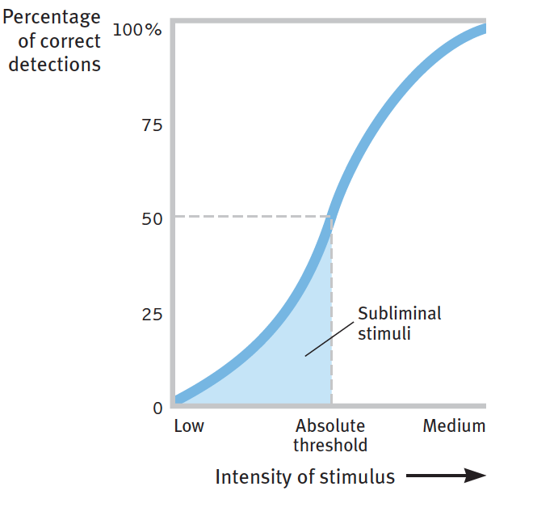






Basic Concepts of Sensation and Perception
Absolute threshold
  Minimum stimulation needed to detect a particular stimulus 50% of the time
Signal detection theory
  Predicts how and when we will detect a faint stimulus amid background noise.

Slide 12



Basic Concepts of Sensation and Perception
Individual absolute thresholds vary
  Depending on the strength of the signal and also on our experience, expectations, motivation, and alertness

Slide 13








How much stimuli does it take to have a sensation?
Subliminal
  Input, below the absolute threshold for conscious awareness
Priming
  Activating, often unconsciously, associations in our mind, thus setting us up to perceive, remember, or respond to objects or events in certain ways

Slide 14
The priming effect, as shown in experiments, reveals that we can process some information from stimuli too weak to recognize (subliminal stimuli—below our absolute threshold), indicating that much of our information processing occurs automatically, unconsciously. In a typical experiment, an image or word is quickly flashed, then replaced by a masking stimulus that interrupts the brain’s processing before conscious perception.

Slide 15


How much stimuli does it take to have a sensation?
Difference threshold (just noticeable difference)
  Minimum difference a person can detect between any two stimuli half the time; increases with stimulus size
Weber’s law
  For an average person to perceive a difference, two stimuli must differ by a constant minimum percentage (not a constant amount); exact proportion varies, depending on the stimulus.

Slide 16


A difference threshold is the minimum difference between two stimuli that a person can detect 50 percent of the time. In humans, difference thresholds (experienced as a just noticeable difference [jnd]) increase in proportion to the size of the stimulus—a principle known as Weber’s law.

Slide 17

Subliminal Persuasion
Subliminal stimuli are those that are too weak to detect 50 percent of the time.
Subliminal sensation is a fact. Remember that an “absolute” threshold is merely the point at which we can detect a stimulus half the time. At or slightly below this threshold, we will still detect the stimulus some of the time.
Subliminal persuasion may produce a fleeting, subtle, but not powerful, enduring effect on behavior (Greenwald, 1992).
  Experiments discount attempts at subliminal advertising and self-improvement.

Slide 18



Subliminal Persuasion
The effect of subliminal stimuli is too fleeting to enable advertisers to exploit us with subliminal messages and produce subliminal persuasion. Sixteen double-blind experiments evaluating subliminal self-help recordings uniformly found that no recording helped more than a placebo, which works only because of our belief in it.

Slide 19
Basic Concepts of Sensation and Perception
  Entering your neighbors’ living room, you smell a musty odor. You wonder how they endure it, but within minutes you no longer notice it. Sensory adaptation has come to your rescue.
  When we are constantly exposed to an unchanging stimulus, we become less aware of it because our nerve cells fire less frequently. (To experience sensory adaptation, move your watch up your wrist an inch: You will feel it—but only for a few moments.)

Slide 20

Basic Concepts of Sensation and Perception
Sensory adaptation
  Is diminished sensitivity as a consequence of constant stimulation
  Aids focus by reducing background chatter
  Influences how the world is perceived in a personally useful way
  Influences emotions
  Perceptions are influenced, top-down, not only by our expectations and by the context, but also by our emotions and motivation.

Slide 21
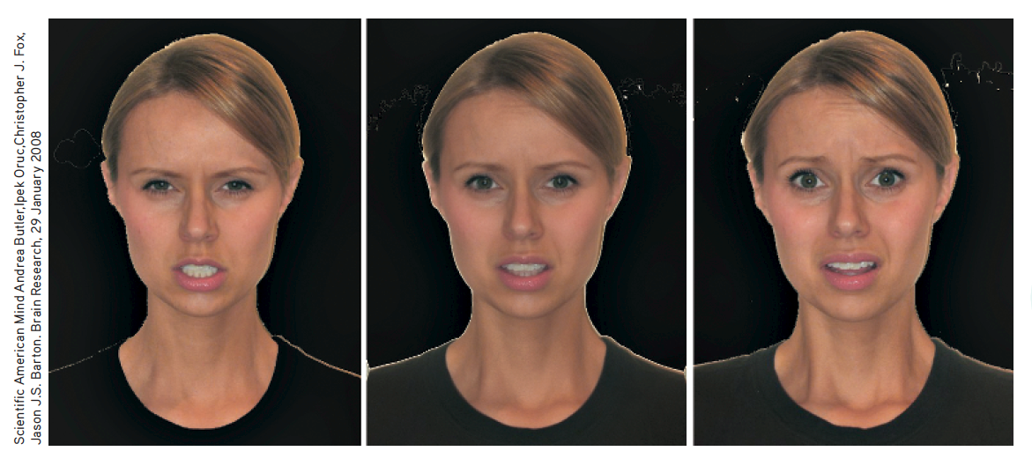
Emotion adaptation
Gaze at the angry face on the left for 20 to 30 seconds, then look at the center face (looks scared, yes?). Then gaze at the scared face on the right for 20 to 30 seconds, before returning to the center face (now looks angry, yes?). (From Butler et al., 2008.)

Slide 22
Perceptual Set
Perceptual set
  Mental tendencies and assumptions that affect (top-down) what we hear, taste, feel, and see
What determines our perceptual set?
  Schemas organize and interpret unfamiliar information through experience
  Preexisting schemas influence top-down processing of ambiguous sensation interpretation, including gender stereotypes

Slide 23

Perceptual Set: Motivation and Emotion
Context effects
  A given stimulus may trigger different perceptions because of the immediate context.
CULTURE AND CONTEXT EFFECTS
What is above the woman’s head?
In one study, nearly all the East Africans who were questioned said the woman was balancing a metal box or can on her head and that the family was sitting under a tree.
What do you think Westerners said?
Notes:
Context effects
A given stimulus may trigger different perceptions, partly because of differing perceptual set, but also because of the immediate context.
Westerners, for whom corners and boxlike architecture were more common, were more likely to perceive the family as being indoors, with the woman sitting under a window. (Adapted from Gregory & Gombrich, 1973.)

Slide 24

Terms to Learn
Wavelength
  Distance from the peak of one light or sound wave to the peak of the next. Electromagnetic wavelengths vary from the short blips of cosmic rays to the long pulses of radio transmission.
Hue
  Dimension of color that is determined by the wavelength of light; what we know as the color names blue, green, and so forth.
Intensity
  Amount of energy in a light wave or sound wave, which influences what we perceive as brightness or loudness. Intensity is determined by the wave’s amplitude (height).

Slide 25
Sensory and Perceptual Processing in Vision
What is seen as light is only a thin slice of the broad spectrum of electromagnetic energy.
  The portion visible to humans extends from the blue-violet to the red light wavelengths.
  After entering the eye and being focused by a lens, light energy particles strike the eye’s inner surface, the retina.
  The perceived hue in a light depends on its wavelength, and its brightness depends on its intensity.

Slide 26
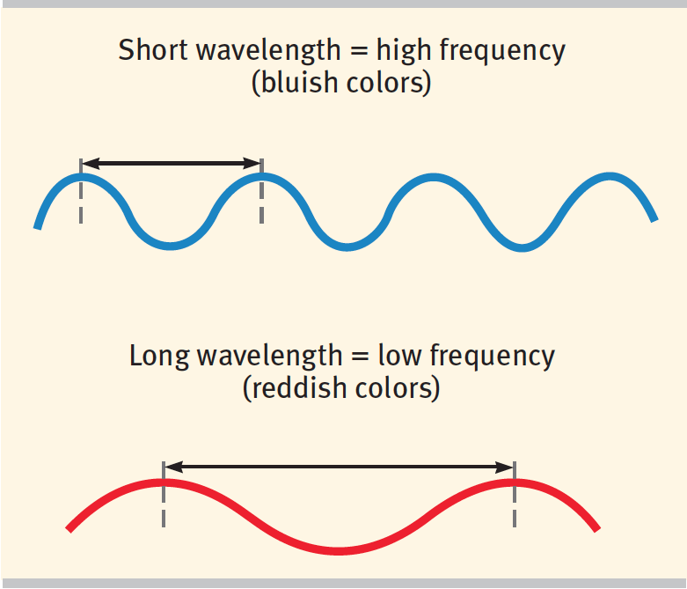
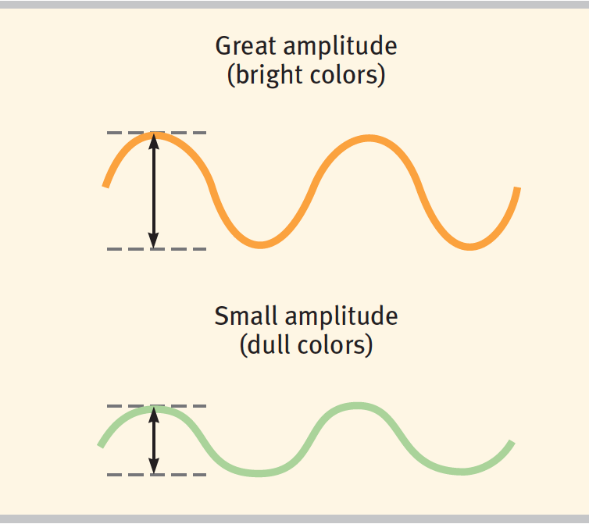


Waves vary in wavelength, the distance between successive peaks.
Frequency, the number of complete wavelengths that can pass a point in a given time, depends on the length of the wave.
Waves also vary in amplitude, the height from peak to trough (top to bottom). Wave amplitude determines the brightness of colors (and also the loudness of sounds).
The shorter the wavelength, the higher the frequency. Wavelength determines the color of light (and also the pitch of sound).
Physical energy seen as light

Slide 27
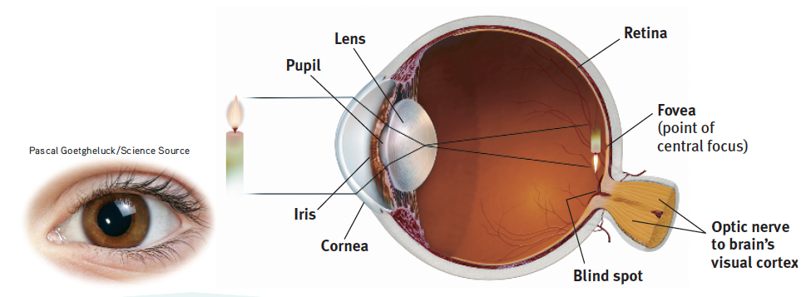
Vision: The Eye
Light rays reflected from a candle pass through the cornea, pupil, and lens.
The curve and thickness of the lens change to bring nearby or distant objects into focus on the retina.

Slide 28
Vision: The Eye
Rays from the top of the candle strike the bottom of the retina. Those from the left side of the candle strike the right side of the retina.
The candle's image appears on the retina upside down and reversed.

Slide 29
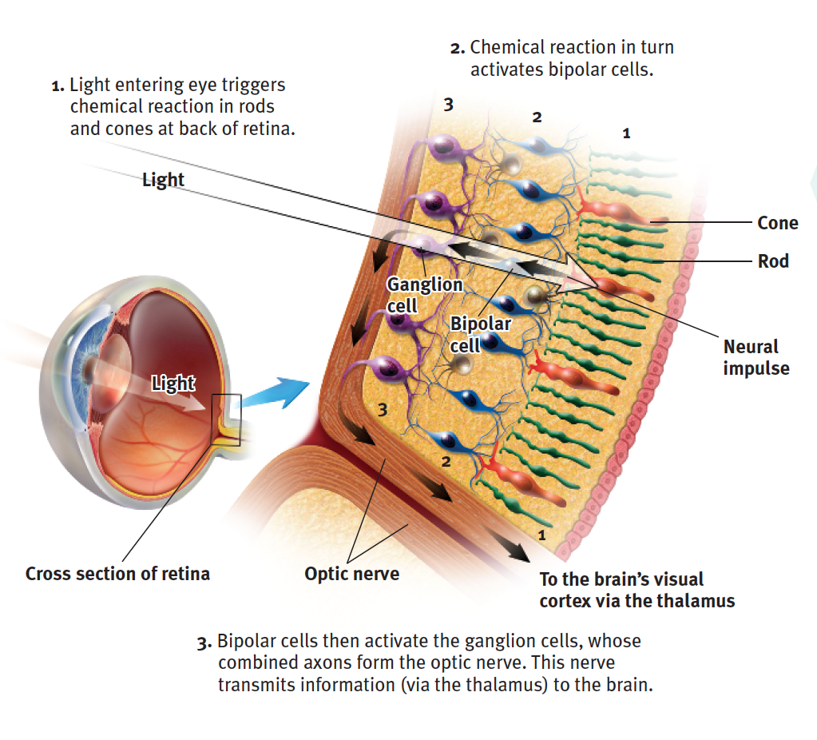
The Retina’s Reaction to Light

Slide 30
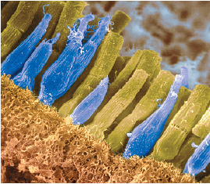
Rods detect blacks, whites, and grays, and are necessary for peripheral and twilight vision.
Cones are clustered near the center of the retina, they detect fine detail and allow color vision.
Omikron/Science Source

Slide 31
Light energy triggers chemical changes in the rods and cones, which activate the bipolar cells.
These cells then activate the ganglion cells of the optic nerve, which transmits the neural impulses from the eye to the brain.
Omikron/Science Source

Slide 32
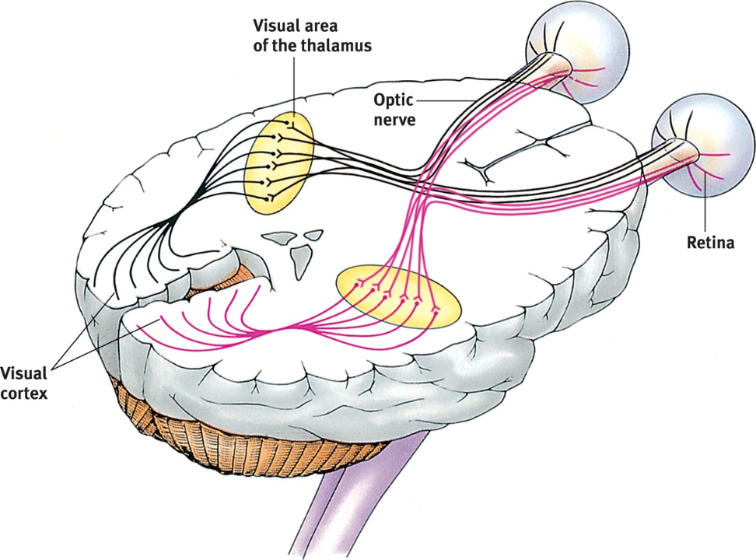
Vision: Visual Information Processing
How does the brain turn light stimuli into useful information about the world?
  Collection and analysis of sensory information
  Linkage of optic nerve with neurons in thalamus
Pathway from the eyes to the visual cortex Ganglion axons forming the optic nerve run to the thalamus, where they synapse with neurons that run to the visual cortex.

Slide 33
Information Processing in the Eye and Brain
Color processing occurs in two stages
  Retina’s red, green, and blue cones respond in varying degrees to different color stimuli, as the Young-Helmholtz trichromatic theory suggested.
  Cones’ responses are then processed by opponent-process cells, as Hering’s theory proposed.
Feature detection
  Involves nerve cells in the brain that respond to specific feature of the stimulus, such as shape, angle, or movement

Slide 34
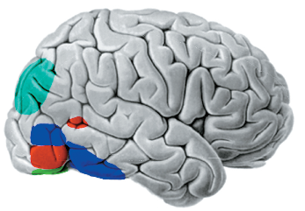
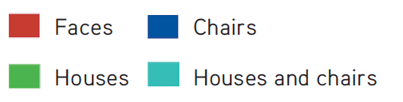
Information Processing in the Eye and Brain
Hubel and Wiesel
  Showed brain’s computing system deconstructs and then reassembles visual images
  Found specialized occipital lobe neuron cells receive information from ganglion cells and pass to supercell clusters
THE TELLTALE BRAIN
Looking at faces, houses, and chairs activates different brain areas in this right-facing brain.

Slide 35
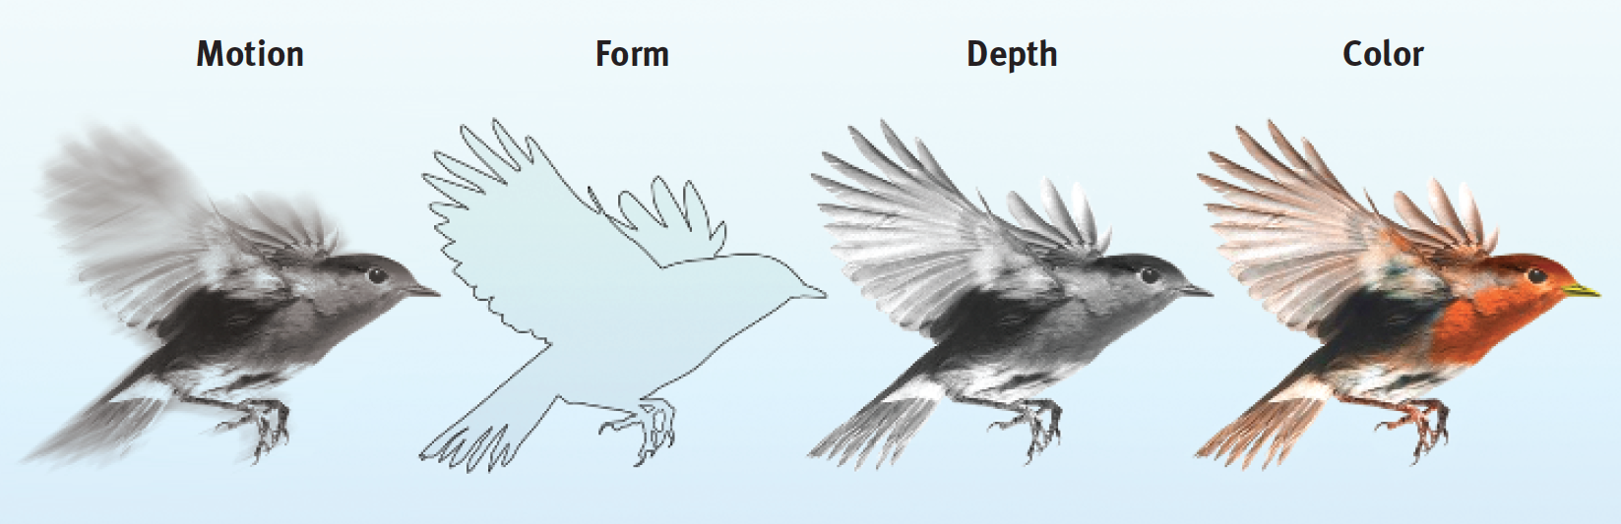
PARALLEL PROCESSING
Studies of patients with brain damage suggest that the brain delegates the work of processing motion, form, depth, and color to different areas. After taking a scene apart, the brain integrates these subdimensions into the perceived image.
  Brain divides it into subdimensions—motion, form, depth, color—and works on each aspect simultaneously
  How does the brain do this? The answer to this question is the Holy Grail of vision research.

