Slide 1
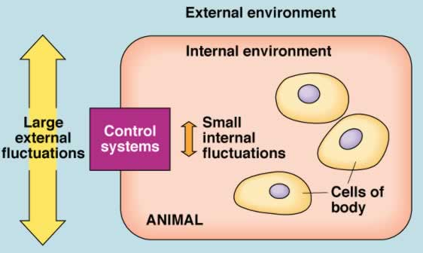

3. HOMEOSTASIS: CONTROL MECHANISMS
3.1 Define & identify the principal characteristics of homeostasis (pp.9-12)
3.2 Introduction to the Nervous System (pp. 531-535, 543-547)
3.3 Introduction to the Endocrine System (pp. 602-617)
J. Carnegie, UofO

Slide 2
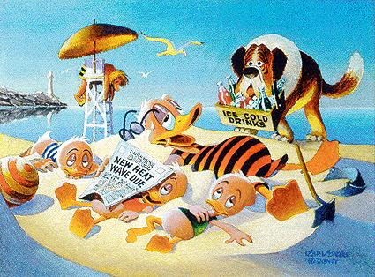
3.1.1 define homeostasis, giving at least 2 physiological examples
Walter Cannon: ability of the body: “to maintain relatively stable internal conditions even though there is continuous change in the outside world”
• not unchanging - rather a dynamic state of equilibrium involving many systems:
(i) adequate blood levels of vital nutrients
(ii) heart activity/blood pressure monitored & adjusted as needed
(iii) wastes must not accumulate
(iv) core body temperature must remain within range
http://del.icio.us/jleather/Temperature
Notes:
(ii) So blood is propelled to all body tissues

Slide 3
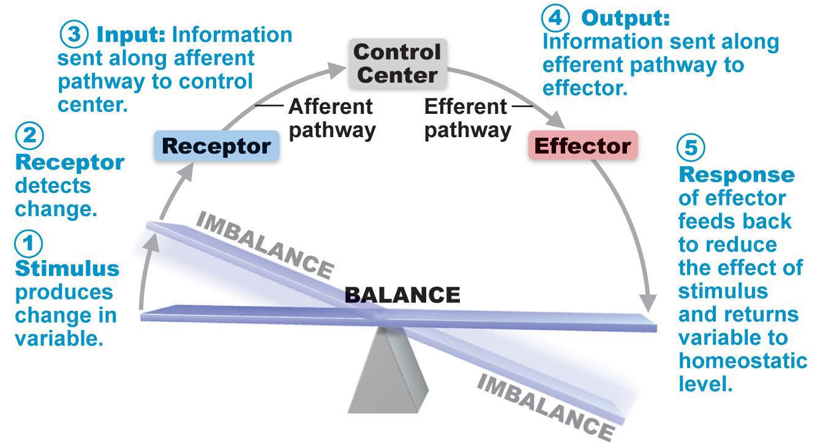
3.1.2 list the 3 essential components of a homeostatic control mechanism, defining the roles of each
• 3 essential characteristics:
receptor: senses change (stimulus) & sends info (afferent pathway) to:
control centre: determines set point for variable maintenance; analyzes info & determines correct response
effector: provides means for response (output along efferent pathway)
feedback (negative/positive) allows for regulation within a range/enhanced response
Fig. 1.5
Notes:
Communication accomplished by nervous (neural electrical impulses) & endocrine systems (bloodborne hormones)
Receptor cell or nerve ending of sensory neuron
Monitors environment
Responds to stimuli (changes) by sending info. (input) along afferent pathway to control centre
Effector muscle or gland or other organ capable of being activated by nerve endings
Carries out control centre’s response to stimulus
Info. (output) flows from control centre along efferent pathway to effector
Need to sense if there’s a change, evaluate the change, initiate certain response, effector to carry out response

Slide 4
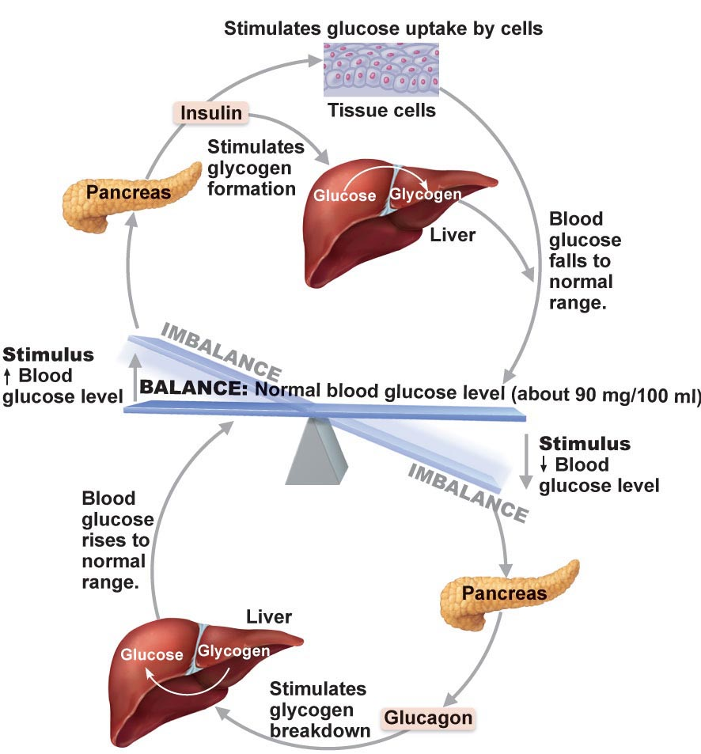
3.1.3 differentiate between positive and negative feedback; define disease and aging in terms of homeostasis
Negative Feedback Mechanisms
• output reduces or shuts off stimulus – 2 options:
1 hormone or neural pathway regulating a process: negative feedback ↓ secretion
process regulated in opposite directions by 2 different hormones or neural pathways – eg: blood glucose
goal of negative feedback: prevent sudden, severe changes
J. Carnegie, UofO
Fig. 16.17
Notes:
Fig. 16.17
As blood sugar rises, receptors in body sense change, & pancreas (control centre) secretes insulin into the blood. This prompts body cells to absorb more glucose, removing it from bloodstream. As blood sugar falls, stimulus for insulin release ends.
Regulation of blood glucose levels. Need to maintain 90mg/100mL

Slide 5
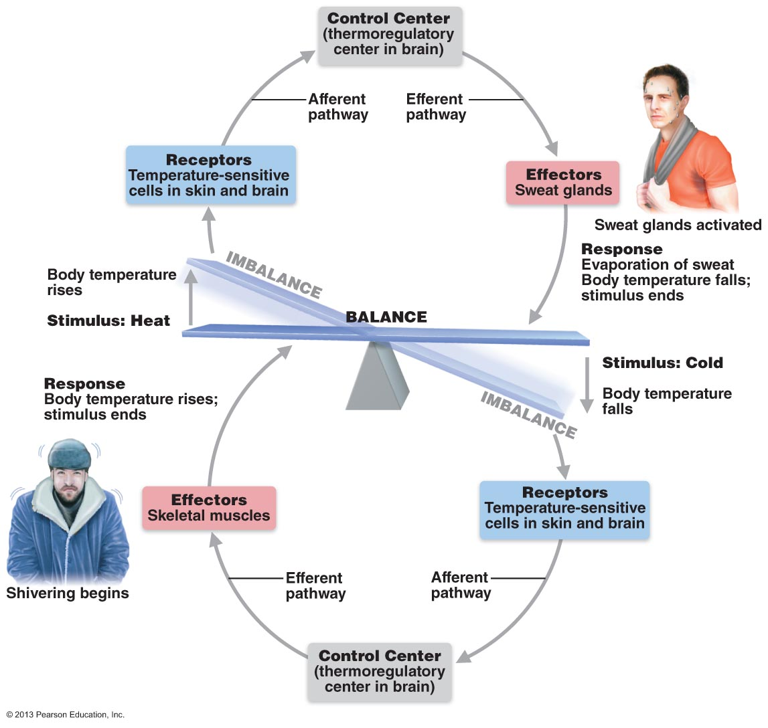
Fig. 1.6: Regulation of Body Temperature by Negative Feedback
Notes:
If too cold, shiver because muscle action (contracting, relaxing, contracting, relaxing, etc.) generates heat as by-product

Slide 6
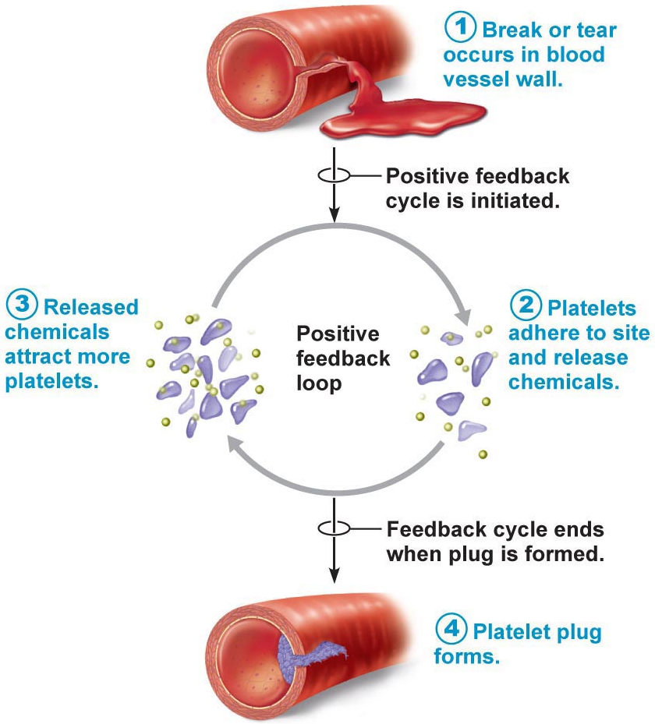
Positive Feedback
Mechanism
• response of mechanism enhances original stimulus ➢ output is further stimulated
• change occurs in same direction as original response
• there is a goal to be attained
• eg: blood clotting - how is this still, overall, maintaining homeostasis??
Homeostatic Imbalance
most disease seen as a disturbance of homeostasis = a homeostatic imbalance
aging is associated with progressive decrease in our ability to maintain homeostasis ➢ greater risk for illness
Fig. 1.6
Notes:
Usually control infrequent events that do not require continuous adjustments
(ex. Enhancement of labor contractions during birth & blood blotting)
Blood clotting - how is this still overall, maintaining homeostasis?? Once vessel has been broken, platelets immediately begin to cling to injured site & release chemicals that attract more platelets. Rapidly growing pileup of platelets forms a clot. (BP, adequate flow to tissues)
Accelerated in injured vessels, but does not normally spread to entire circulation
Few mechanisms in body that use (+) feedback
As we age, body’s control systems become less efficient, & our internal environment becomes less & less stable. These events increase our risk for illness & produce the changes we associate with aging.

Slide 7
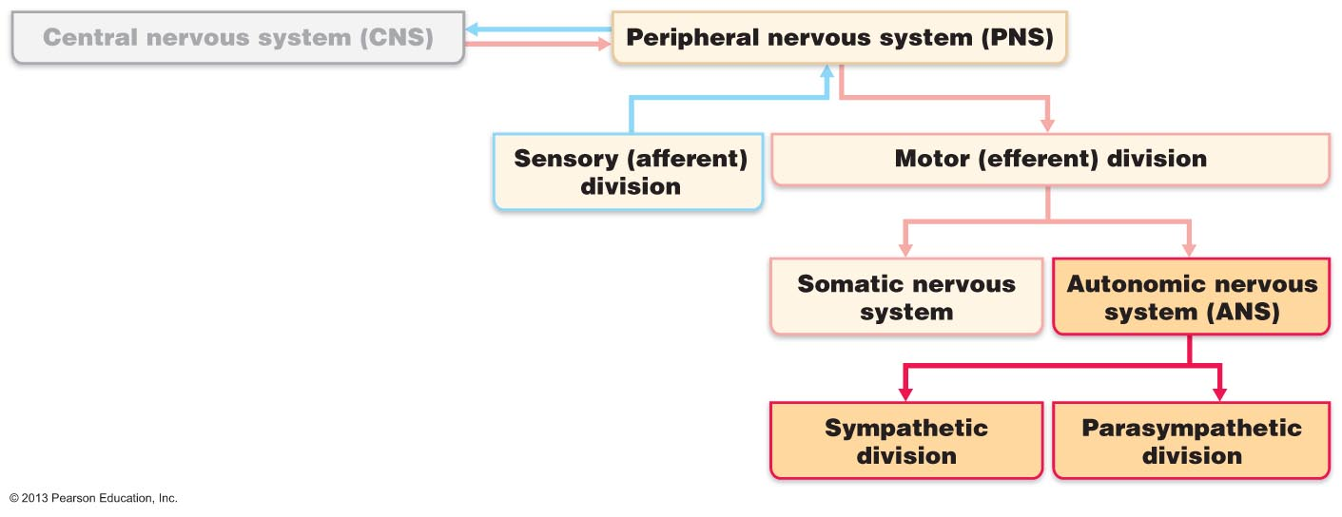
3.2.1.1 Using a flow chart, indicate the positions of the autonomic and somatic nervous systems in the structural organization of the nervous system as a whole
• auto = self; nom = govern
• ANS = system of motor neurons to smooth & cardiac muscle & glands to allow responses usually without our awareness
(i) shunt blood to more needy areas
(ii) speed/slow heart & respiratory rates
(iii) adjust blood pressure, body temperature
(iv) increase/decrease gastric secretions
Fig. 14.1
Notes:
ANS controls functions, both we’re aware of & those we’re not

Slide 8
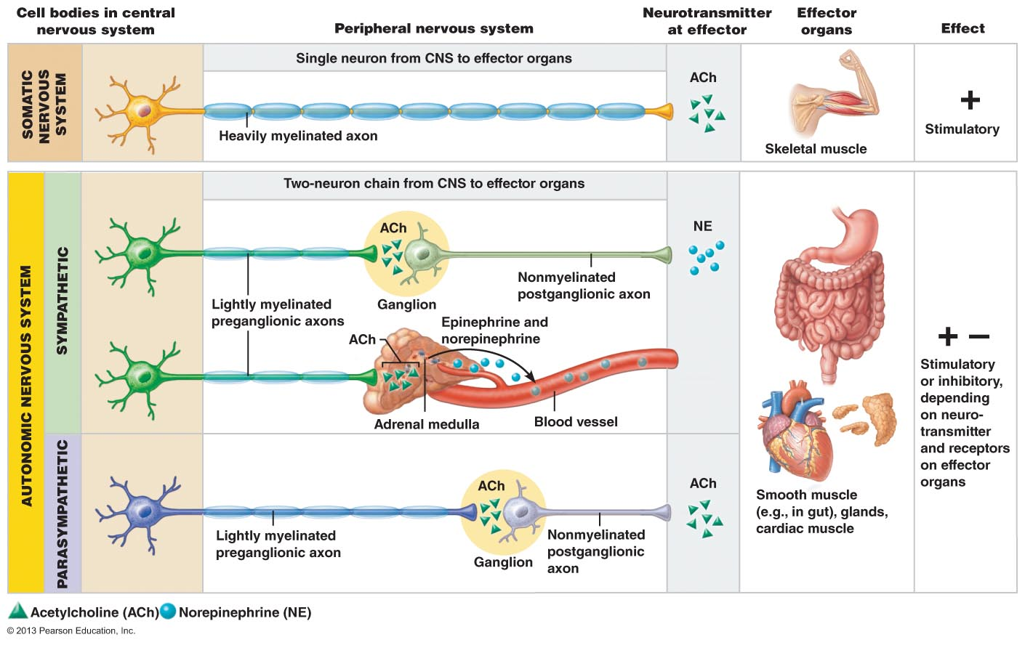
3.2.1.2 compare the autonomic and somatic nervous systems in terms of effectors, pathways, use of ganglia, transmitter effects
Fig. 14.2
Effectors:
• somatic: skeletal muscle; ANS: smooth muscle, cardiac muscle & glands
Notes:
Similarities between somatic & nervous systems:
Their effectors
Their efferent pathways & ganglia
Target organ responses to their NTs
Differences in the physiology of the effector organs account for most of the differences between somatic & autonomic effects on their target organs
Comparing organization of neural pathways
Cell bodies, what axons look like, & what NTs are being used, targets & effects

Slide 9
Pathways & Ganglia:
• somatic: thick, myelinated axon from spinal cord to skeletal muscle; rapid conduction of impulses (no ganglia)
• ANS: two-neuron chain: preganglionic neuron: originates in brain or spinal cord; preganglionic axon synapses with 2nd motor neuron (postganglionic) in ganglion outside CNS ➢ postganglionic axon to effector organ
• conduction is slow; preganglionic axons are thin & lightly myelinated; postganglionic axons are thinner & unmyelinated
Notes:
Somatic
Motor neuron cell bodies in CNS
ANS
Two-neuron chain to reach its effectors:
Cell body of first neuron, the preganglionic neuron, resides in the brain stem or spinal cord. Its axon, the preganglionic axon, synapses with the second motor neuron.
Preganglionic neuron automatic motor neuron that has its cell body in the CNS & projects it axon to an automatic ganglion
Postganglionic neuron is the second motor neuron. Its cell body is in an autonomic ganglion outside the CNS. Its axon, the postganglionic axon, extends to the effector organ.
Postganglionic neuron automatic motor neuron that has its cell body in automatic ganglion & projects its axon to an effector.
Automatic ganglion collection of sympathetic or parasympathetic postganglionic neuronal cell bodies.
Conduction through automatic efferent chain is slower than conduction in somatic motor system.

Slide 10

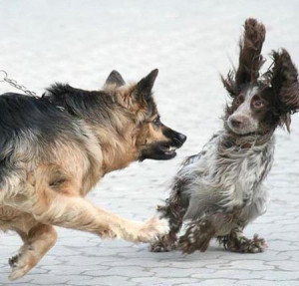
3.2.2.1 Distinguish between the PNS and SNS in terms of the types of processes regulated
Parasympathetic Division:
• active in non-stressful situations - « resting & digesting system »
• keeps body’s energy use low while regulating « housekeeping » activities (digestion, elimination of feces & urine)
what are the predominate effects of the parasympathetic ns when reading a newspaper after a meal??
• “D” system: digestion, defecation, diuresis
B2. Sympathetic Division:
• “ fight or flight” system; also important during exercise: increased heart rate, rapid, deep breathing, cold sweaty skin(why?), dilated eye pupils
• “E” system: exercise, excitement, emergency, embarrassment
Notes:
Parasympathetic Division:
Promotes maintenance functions & conserves body energy
What are the predominate effects of the parasympathetic NS when reading a newspaper after a meal?? BP & HR are regulated at low normal levels & the GI tract is actively digesting food. In the eyes, the pupils are constricted & the lenses are accommodated for close vision to improve the clarity of the close-up image.
Sympathetic Division:
Mobilizes the body during activity
Why? enables the body to cope with potential threats to homeostasis. It provides the optimal conditions for an appropriate response, whether that response is to run, see distant objects better, or think more clearly.

Slide 11
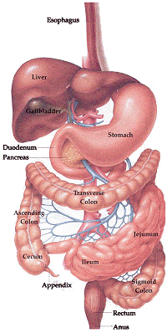
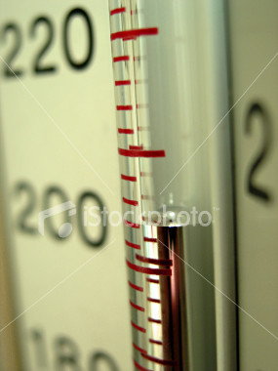
3.2.2.2 Define: sympathetic tone, parasympathetic tone
SNS and vascular tone: ➢ blood vessels kept in a state of partial vasoconstriction; blood shunting possible via variations in sympathetic output to specific vessels
PNS & tone: tonic slowing effect on heart, regulation of contractile activity of smooth muscle of GI & urinary tracts- can be overridden by SNS
Notes:
SNS and vascular tone:
Sympathetic division is major actor in controlling BP even at rest.
Sympathetic (vasomotor tone) state of partial vasoconstriction of blood vessels maintained by sympathetic fibres
PNS & tone:
Parasympathetic effects normally dominate heart & smooth muscle of digestive & urinary tracts or organs
Parasympathetic tone normal level of parasympathetic output; sustains normal GI & urinary tract activity, lowers HR.
Sympathetic division can override these parasympathetic effect during times of stress.

Slide 12
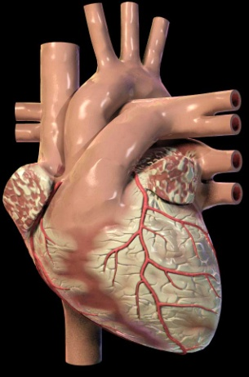
3.2.2.3 identify: (i) systems regulated in opposite directions by the SNS and PNS, (ii) cooperative effects of the SNS & PNS, (iii) unique regulatory roles of the SNS
Interactions of the Autonomic Divisions
• most visceral organs receive dual innervation
Antagonistic Interactions:
• eg: activity of heart, GI system, respiratory system
 | PNS | SNS
Heart | (-) | (+)
GI System | (+) | (-)
Resp. System | (-) | (+)
Cooperative Effects:
• eg: regulation of external genitalia during intercourse:
a) PNS: dilation of blood vessels in penis
b) SNS: ejaculation, reflex peristalsis of female’s vagina
Notes:
Interactions of the Automatic Divisions
Both divisions generally serve the same visceral organs but cause opposite effects: While one stimulates certain smooth muscles to contract or a gland to secrete, the other inhibits that action.
Antagonistic Interactions:
In a fight-or-flight situation, the sympathetic division increases HR, dilates airways, & inhibits digestion & elimination. When emergency is over, the parasympathetic division restores HR & airway diameter to resting levels & then attends to processes that refuel body cells & discard wastes.

Slide 13
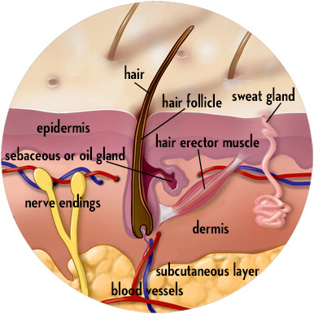
Unique Roles of Sympathetic NS:
SNS regulation only: adrenal medulla, sweat glands, arrector pili muscles of skin, kidneys, most blood vessels
also:
> thermoregulatory responses to heat
> renin release from kidneys - result will be increased blood pressure
metabolic effects:
(i) increases metabolic rate of body cells
(ii) raises blood glucose levels
(iii) stimulates mobilization of fats
(iv) increases mental alertness
(v) increases speed/strength of muscle contraction
J. Carnegie, UofO
Notes:
Responses to heat only in SNS, dilate blood at surface of skin if hot, constrict if cold
Renin – regulate what’s going on in blood vessels
Link to stress – emotional, physical
Response to blood vessel diameter
Sympathetic neurons travel to adrenal medulla
Arrector pili – allows you to create goosebumps while under stress
Kidneys – when regulating rate of filtration, we’re really regulating blood vessel diameter
Hot – vasodilate, cold – vasoconstrict
Metabolic rxn’s that would provide energy as fast as possible

Slide 14
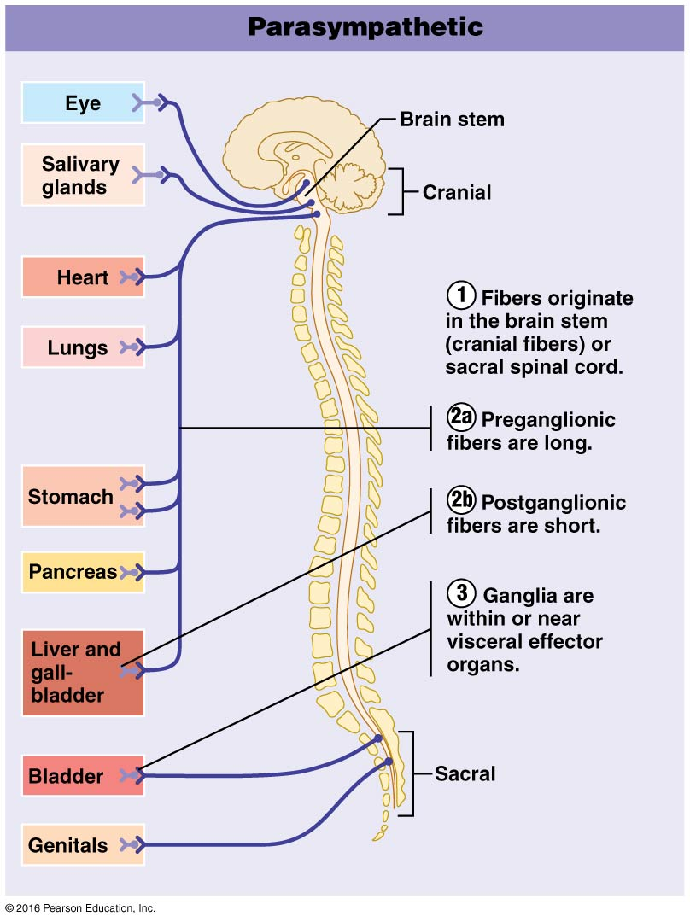
The PNS and SNS differ as to:
Sites where nerves originate
Relative lengths of pre- and post-ganglionic fibers
Locations of ganglia
Fig. 14.3 A
Notes:
Motor output to targets
Pre-ganglionic – darker blue, post-ganglionic short arrows
Ganglia – where you have a concentration of neurons
If post-ganglionic short, ganglia has to be located near neurons

Slide 15
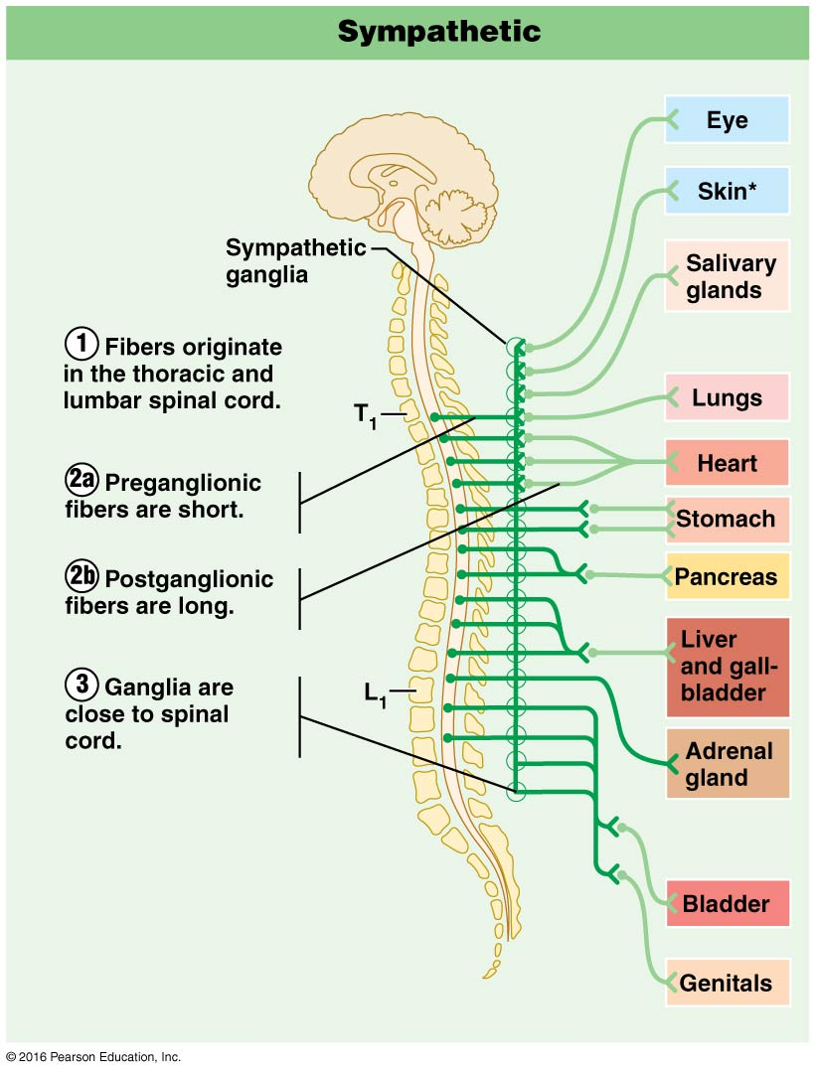
Fig. 14.3 B
Notes:
Ganglia fibres located closer to spinal cord then target organs

Slide 16
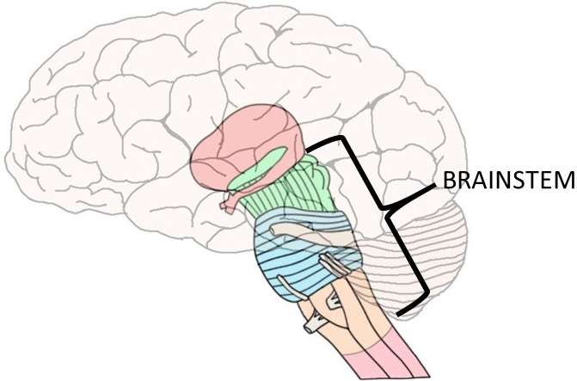
3.2.2.4 List the 3 levels of regulation of autonomic function, giving examples
1. Brain Stem & Spinal Cord Controls
significant direct effects on ANS-regulated activities
motor centres in ventro-lateral medulla (eg: cardiovascular centre ➢ heart rate, blood vessels; also GI, respiratory centres
2. Hypothalamic Controls:
hypothalamus = integration centre of ANS
> anterior regions ➢ parasympathetic
> posterior areas ➢ sympathetic
• hypothalamus contains centres to coordinate heart activity, blood pressure, body temp, water balance, endocrine activity; also centres that help mediate emotions & biological drives
Notes:
Although the ANS is not usually considered to be under voluntary control, its activity is regulated by CNS controls in the spinal cord, brain stem, hypothalamus & cerebral cortex
In general, the hypothalamus is the integrative center at the top of ANS control hierarchy. From there, orders flow to lower & lower CNS centers for execution
Lower to higher areas of CNS
1. Brain Stem & Spinal Cord Controls:
Brain stem leads directly to spinal cord
Brain stem -> medulla oblongata
If damaged, no stimulation to breath in
Motor output going to heart, diaphragm
2. Hypothalamic Controls:
“Boss”
Hypothalamic centers exert their effects both directly & via relays through reticular formation, which in turn influences the preganglionic motor neurons in the brain stem & spinal cord
Communicates with centres in medulla. (e.g. increase HR, decrease HR)

Slide 17
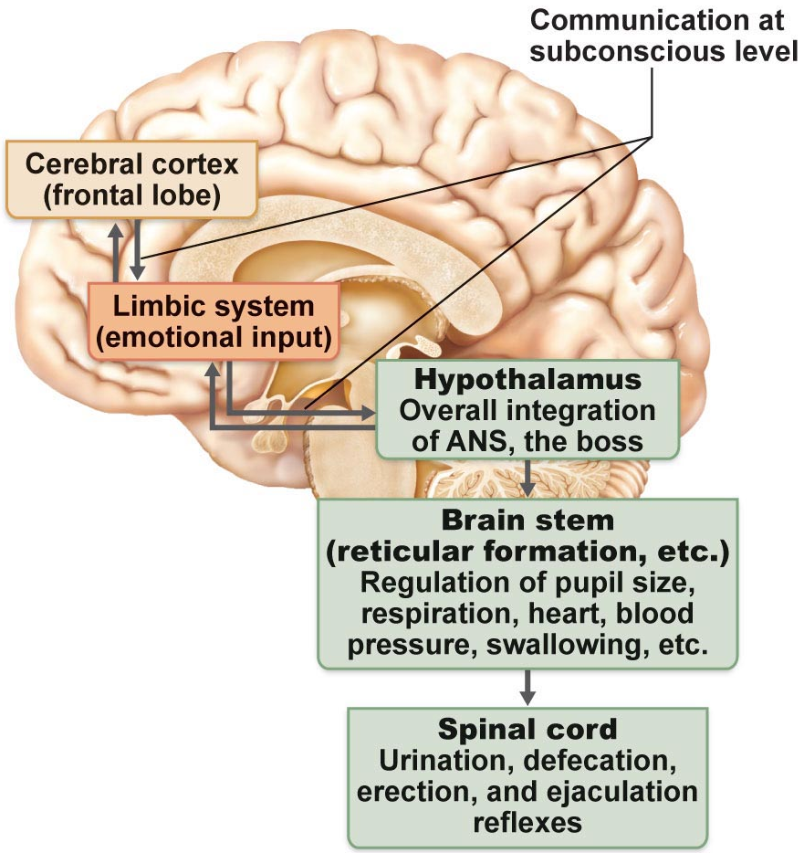
3. Cortical Controls:
• e g: meditation & biofeedback allow some conscious control over visceral activities
> e g: during meditation, can lower heart & breathing rates, oxygen use, metabolic rate
> biofeedback to improve management of migraine headaches, stress & cardiac function
Homeostatic Imbalances of ANS
• e g: hypertension:
Fig. 14.9
J. Carnegie, UofO
Notes:
3. Cortical Controls:
Things having to do with regulation of HR, breathing, metabolism – we have a rate of conscious control (i.e. meditation)
Homeostatic Imbalances of ANS
Most autonomic disorders reflect exaggerated or deficient controls of smooth muscle activity. The most devastating involve blood vessels & include conditions such as hypertension, Raynaud’s disease, & autonomic dysreflexia.
Hypertension (high BP)
May result from an overactive sympathetic vasoconstrictor response promoted by continuous high levels of stress
Forces heart to work harder & increases wear & tear on artery walls
Sometimes treated with adrenergic receptor–blocking drugs that counteract the effects of the SNS on the cardiovascular system

Slide 18
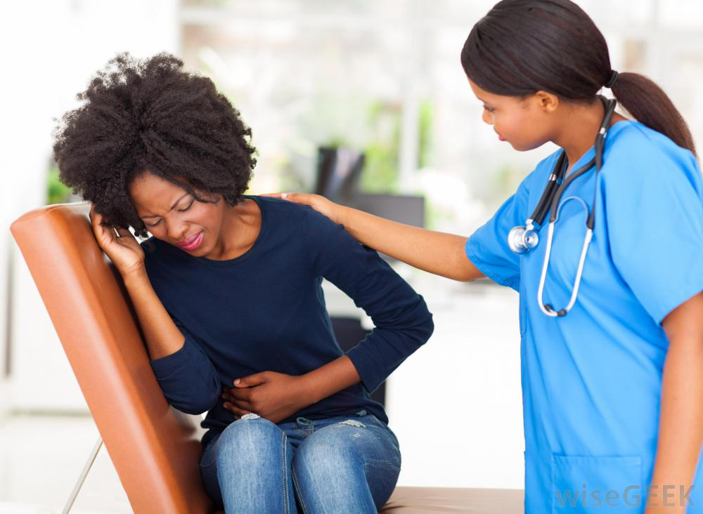
1. After surgery, patients are often unable to urinate and bowel sounds are absent. What division of the ANS is affected by anaesthetic?
2. A risk factor for ulcers can be stress and the associated excess activity of the sympathetic nervous system. For example, one contributing factor to ulcers is a severe reduction in blood flow to the stomach wall. How is this related to sympathetic function?
Notes:
Parasympathetic
Stressed -> increase activity of NS. Send blood to some areas, losing blood in other areas

Slide 19
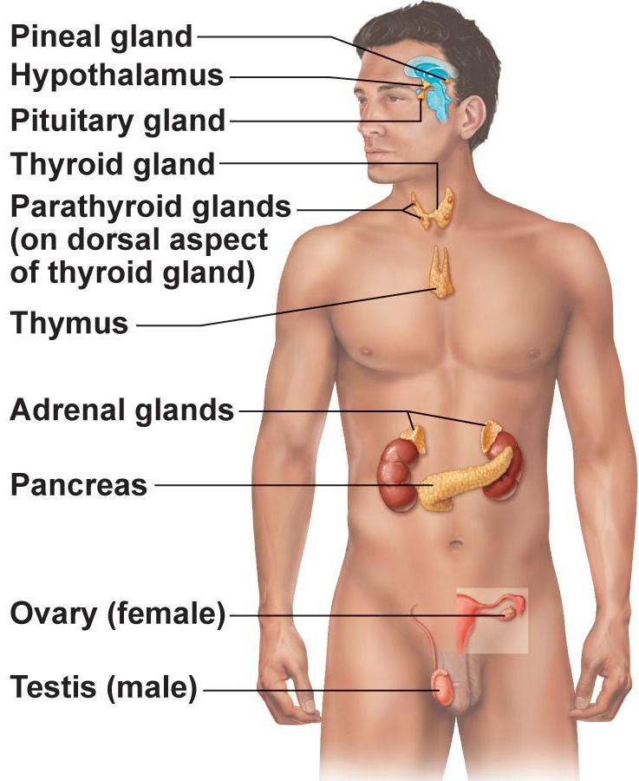
THE ENDOCRINE SYSTEM 
3.3.1.1 Hormones: define receptor, specificity, affinity
3.3.1.2 List the 3 structural groups of hormones & differentiate between steroid hormones and protein/peptide hormones in terms of their mechanisms of action
What is a hormone?
Chemical substance released into the ECF that regulates the metabolic function of other cells in the body
Remember:
• hormones must bind to specific receptors to influence target cell function
• hormones are specific; level of target cell activation depends on:
(i) hormone concentration
(ii) target cell receptor content
(iii) affinity of hormone for receptor
Fig. 16.1
J. Carnegie, UofO
Notes:
Endocrine system influences metabolic activity by means of hormones
Hormones travel through blood & regulate metabolic function of other cells in the body. Binding of a hormone to cellular receptors initiates responses that typically occur after a lag period of seconds or even days. But, once initiated, those responses tend to last much longer than those induced by the nervous system. Hormones start by going to the ECF, & many use bloodstream to get from point A to point B
If a hormone is going to a target, target has to be displaying a receptor. Helps them to be specific.
(i) Hormone concentration How much hormone is in vicinity or cell or target tissue
(ii) Affinity of hormone for receptor. How strongly it’s attracted to the receptor. If low affinity, need a lot of hormone to lead to response.

Slide 20
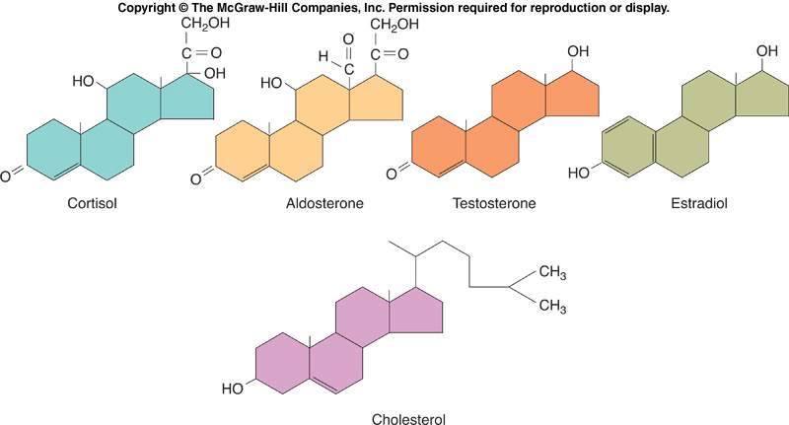
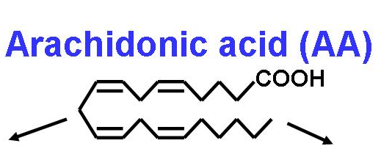
Mechanism of Hormone Action:
• hormones alter levels of cell activity:
» membrane permeability/potential (channels)
» synthesis of enzymes within cells
» enzyme activation/deactivation
» induction of secretory activity
» stimulation of mitosis
3 structural groups of hormones:
(i) amino acids, peptides, proteins
(ii) steroid hormones (derivatives of cholesterol)
(iii) eicosanoids (from arachidonic acid)
http://www.gremi.asso.fr/mediator_inflammation-uk.html
Notes:
Mechanism of Hormone Action:
Hormones regulate rate & intensity of cellular activity
Stimulating release of product that was already present in cell
3 structural groups of hormones:
Hormone’s chemical structure determines its solubility in water
Its water solubility in turn affects how that hormone is transported in the blood (which is mostly water), how long it lasts before it is degraded, & what receptors it can act upon.
Amino acid based:
Molecular size varies widely
Usually water soluble & cannot cross PM
Act on receptors in the PM (receptors for water-soluble hormones must be in the PM since these hormones cannot diffuse across the PM)
Steroids:
Synthesized from cholesterol
All lipid soluble & can cross PM
Act on receptors inside the cell, which directly activate genes. (inside the cell because these hormones can diffuse across the PM into the cell)
Eicosanoids:
Typically highly localized, affecting only nearby cells
Carbons at each bends of the structure

Slide 21
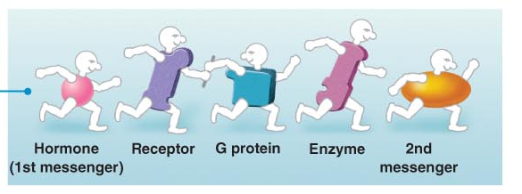
2 main mechanisms of action:
Peptide/protein hormones: bind to cell surface receptor » activation of membrane-bound G protein » production of 2nd messenger (eg: cyclic AMP (cAMP), calcium) ➢ activation of protein kinases to regulate activity of key enzymes
Notes:
Second messengers intracellular molecule generated by the binding of a chemical (e.g. hormone or NT) to receptor protein; mediates intracellular response to the chemical messenger.
Act on their target cell by binding to cell receptors

Slide 22
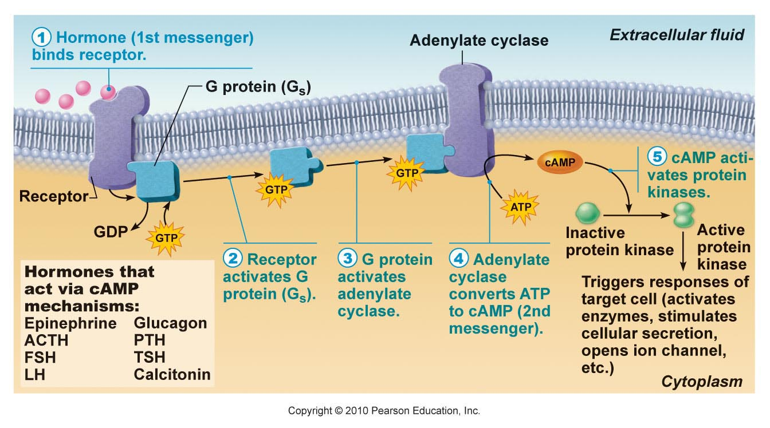
Fig. 16.2 Cyclic AMP Second Messenger Mechanism of Water-Soluble Hormones (proteins, peptides)
Notes:
Mechanism involves the interaction of 3 plasma membrane components—a hormone receptor, a G protein, & an effector enzyme (adenylate cyclase)—to determine intracellular levels of cyclic AMP
1. Hormone (1st messenger) binds receptor
Hormone, acting as 1st messenger, binds to receptor in PM
2. Receptor activates G protein (G_{s}).
Hormone binding causes receptor to change shape, allowing it to bind to a nearby inactive G protein. Allows G protein to be activated as GDP bound to it is displaced by the high-energy compound GTP.
G-protein (GTP binding protein)
3. G protein activates adenylate cyclase.
Activated G protein (moving along membrane) binds to its effector enzyme adenylate cyclase.
Some G proteins (G_{s}) stimulate adenylate cyclase, but others (G_{i}) inhibit adenylate cyclase.
Eventually, the GTP bound to the G protein is hydrolyzed to GDP and the G protein becomes inactive once again
4. Adenylate cyclase converts ATP to cAMP (2nd messenger)
For as long as activated G_{s} is bound to it, adenylate cyclase generates the second messenger cAMP from ATP.
Cyclic AMP (2nd messenger) binds to a 1:1 ratio.
5. cAMP activates protein kinases.
cAMP, which is free to diffuse throughout the cell, triggers a cascade of chemical reactions by activating protein kinases.
Protein kinases are enzymes that phosphorylate (add a phosphate group to) various proteins, many of which are other enzymes. Because phosphorylation activates some of these proteins & inhibits others, it may affect a variety of processes in the same target cell at the same time.
Hormone stays on outside, but binding to receptor it causes a chain of rxns that leads to a cellular response
Each activated adenylate cyclase generates large numbers of cAMP molecules, and a single kinase enzyme can catalyze hundreds of reactions
Action of cAMP persists only briefly because the molecule is rapidly degraded by the intracellular enzyme phosphodiesterase. While at first glance this may appear to be a problem, it is quite the opposite. Because of the amplification effect, most hormones need to be present only briefly to cause results, & the quick work of phosphodiesterase means that no extracellular controls are necessary to stop the activity.

Slide 23
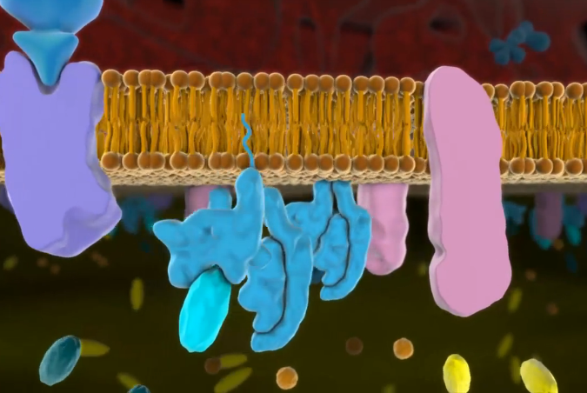
A & P Flix (Chapter 16): Mechanism of Hormone Action: Second Messenger cAMP

Slide 24
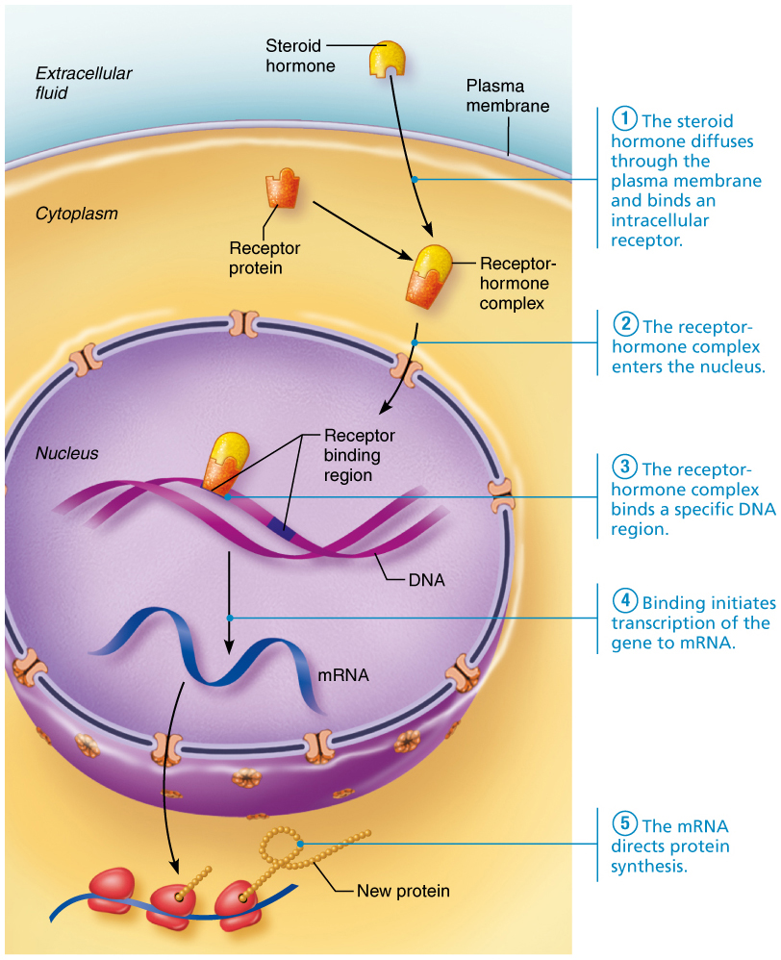
Steroid hormones:
entry into nucleus and activation of gene transcription
Fig. 16.3:
Notes:
Lipid-soluble steroid hormones (derivatives of cholesterol, hard for them to be in aqueous, & must be attached to binding protein) are able to diffuse through PM into target cells.
Bind to & activate intracellular receptors
Activated receptor-hormone complex then makes its way to the nuclear chromatin & binds to a specific region of DNA.
When the receptor-hormone complex binds to DNA, it “turns on” a gene; that is, it prompts transcription of DNA to produce a messenger RNA (mRNA)
mRNA is then translated on the cytoplasmic ribosomes, producing specific proteins. These proteins include enzymes that promote the metabolic activities induced by that particular hormone &, in some cases, promote synthesis of either structural proteins or proteins to be exported from the target cell.
Tend to get all the way into nucleus, where there very specific receptor is located (either in cytoplasm or nucleus).
Mechanism used by steroid hormones involves activation of gene
Takes more time than protein-elicited hormones (open/close channel)

Slide 25
3.3.1.3 differentiate between positive and negative feedback as well as between humoral vs neural vs hormonal regulation of hormone release
Half-life, Onset & Duration of Hormone Activity
• hormones are potent
• blood level of hormone depends on:
» rate of synthesis
» rate of degradation/clearance from blood
• half-life: persistence of a hormone in the blood; usually < 1 min to a week
• time to onset of hormone action variable: enzyme activation - rapid (minutes); enzyme synthesis - hours to days
• some hormones secreted as prohormones; activated once reach target cell
• duration of hormone action also variable (hours to days)
J. Carnegie, UofO
Notes:
Potent exert profound effects on their target organs even at very low concentrations
Synthesis – how quickly it’s being made & therefore released
Degradation – how quickly it’s cleared, determined by half-life of hormone. Depends on what hormone.
The length of time for a hormone’s blood level to decrease by half, referred to as its half-life, varies from a fraction of a minute to a week
When activating transcription, amplification occurs
If hormone is acting to just change the activity of something present in the cell, occurs quickly
Many hormones are released in their active state, others secreted as prohormones (e.g., insulin, testosterone – often gets converted into estrogen or more active Duration – how quickly it’s going to be cleared out of body

Slide 26
Control of Hormone Release
• usually negative feedback (setpoint); sometimes positive feedback (goal)
• 3 types of stimuli: humoral, neural & hormonal
a) Humoral stimuli: hormone secretion in direct response to change in blood level of a nutrient, ion [eg: parathyroid hormone (PTH) & blood calcium; insulin & blood glucose]
b) Neural stimuli: not as common, eg: sympathetic ns & epinephrine release by adrenal medulla, hypothalamic neurons & oxytocin release
c) Hormonal stimuli: 3-tiered system involving hypothalamus, pituitary & target endocrine gland - concept of hypothalamic-pituitary axis
Notes:
Control of Hormone Release
Synthesis & release of most hormones regulated by some type of negative feedback mechanism
Negative feedback mechanism net effect is that the output of the system shuts off original stimulus or reduces its intensity.
Humoral stimuli: whole body
Cells of the parathyroid glands monitor the body’s crucial blood Ca²⁺ levels & release parathyroid hormone as needed
Other hormones released in response to humoral stimuli: Insulin in response to increased blood glucose
Neural stimuli:
Nerve fibers stimulate hormone release
The classic example of neural stimuli is the response to stress, in which the SNS stimulates the adrenal medulla to release norepinephrine & epinephrine
Oxytocin that travels through bloodstream to stimulate uterine contractions
Hormonal stimuli:
Many endocrine glands release their hormones in response to hormones produced by other endocrine organs
For example, releasing & inhibiting hormones produced by the hypothalamus regulate the secretion of most anterior pituitary hormones, & many anterior pituitary hormones in turn stimulate other endocrine organs to release their hormones
As blood levels of the hormones produced by the final target glands increase, they inhibit the release of anterior pituitary hormones and thus their own release.

Slide 27
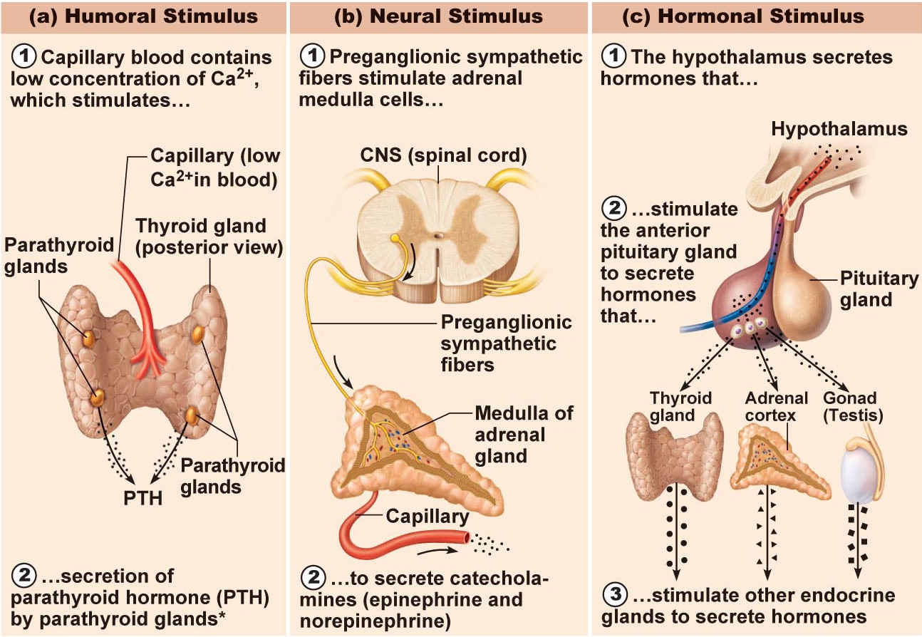
Fig. 16.4: Endocrine stimulation – 3 mechanisms
Notes:
Hormonal
Hypothalamus produces # of diff. hormones
Aren’t travelling by synapses, travelling by bloodstream

Slide 28
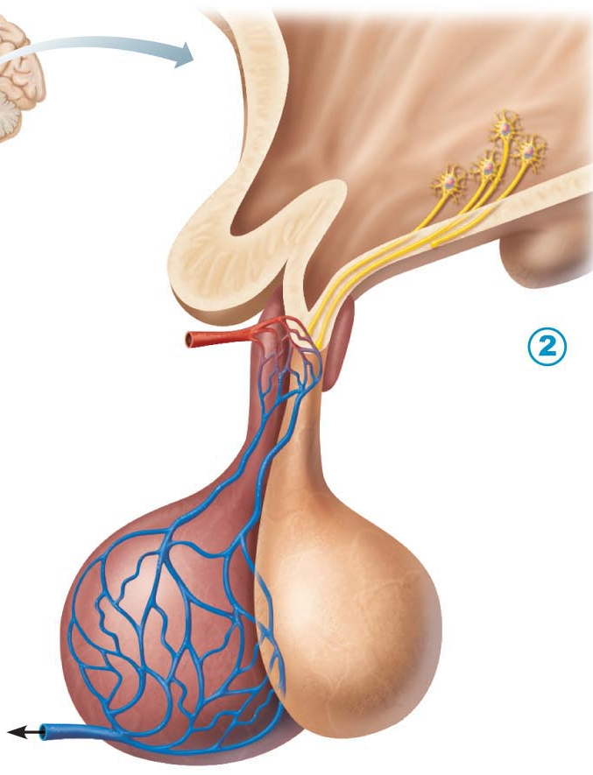
Hormonal Stimulus (cont.)
Thyroid-releasing hormone (TRH)
(hypothalamus)
Hypothalamus
Thyroid-stimulating hormone (TSH)
(anterior pituitary)
Thyroid hormones (T₃ & T₄)
(thyroid gland)
Hypothalamus is neural; produces a number of releasing factors (hormones) which travel to anterior pituitary via hypophyseal portal system
(what is a portal system?)
Fig. 16.5b: Hypothalamus-Anterior Pituitary
Notes:
Thyroid stimulating hormone (TSH) anterior pituitary hormone that regulates secretion of thyroid hormones. Its release follows the hypothalamic–pituitary–target endocrine organ feedback loop
The hypothalamic peptide thyrotropin-releasing hormone (TRH) triggers the release of TSH from thyrotropic cells of the anterior pituitary. Rising blood levels of thyroid hormones act on both the pituitary and the hypothalamus to inhibit TSH secretion.
TRH – neural hormone that travels by bloodstream to stimulate cells to produce TSH
TSH – travel by systemic to stimulate T3 & T4
Hypophyseal portal system the primary & secondary capillary plexuses and the intervening hypophyseal portal veins
What is a portal system? 2 capillary beds joined by small veins
An unusual arrangement of blood vessels in which a capillary bed feeds into veins, which in turn feed into a second capillary bed.
Structurally hypothalamus – all neural tissue

Slide 29
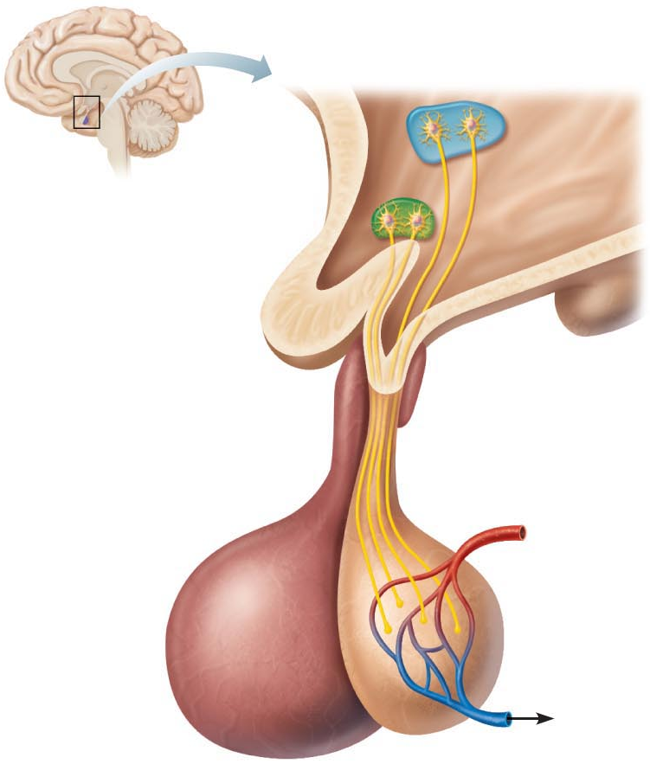
Pituitary Gland:
• size & shape of a pea
• infundibulum connects pituitary to hypothalamus
posterior lobe:
• axon terminals
• hormone storage area
• antidiuretic hormone (SON)
oxytocin (PVN)
Structurally similar (both are nonapeptides); but very different functions!!
antidiuretic hormone: …………………….
oxytocin: …………...…………………………
paraventricular
supraoptic
Fig. 16.5a: Hypothalamus & posterior pituitary
Notes:
Pituitary Gland:
Infundibulum stalk of tissue
Posterior lobe:
Composed largely of neural tissue & nerve fibers
Not a true endocrine gland that manufactures hormones
Oxytocin & ADH, each composed of 9 amino acids. They differ in only 2 amino acids, & yet they have dramatically different physiological effects
Antidiuretic hormone (SON) hormone produced by the hypothalamus & released by the posterior pituitary; stimulates the kidneys to reabsorb more water, reducing urine volume.
Vasopressin under certain conditions, such as severe blood loss, exceptionally large amounts of ADH are released, causing vasoconstriction & raising BP. This response targets different ADH receptors found on vascular smooth muscle.
Oxytocin (PVN) hormone synthesized in the hypothalamus & secreted by the posterior pituitary; stimulates contraction of smooth muscles of the uterus during childbirth & ejection of milk during nursing.

Slide 30

Notes:
Anterior Pituitary Hormone
Thyroid stimulating hormone (TSH) stimulated by TRH. Hormone that regulates secretion of thyroid hormones.
Adrenocorticotropic hormone (ACTH) stimulated by CRH; stimuli that increase CRH release include fever & other stressors. Hormone that influences the activity of the adrenal cortex.
Growth Hormone stimulated by GHRH release which is triggered by levels of GH as well as by a # of secondary triggers including deep sleep, increases in blood levels of AAs, low levels of FAs, exercise, etc. Hormone that stimulates growth in general.
Follicle-stimulating hormone (FSH) stimulated by GnRH. Hormone that stimulates ovarian follicle production in females & sperm in men.
Luteinizing hormone (LH) stimulated by GnRH. Hormone that aids in the maturation of cells in the ovary & triggers ovulation in females. In males, causes the interstitial endocrine cells of the testis to produce testosterone.
Prolactin stimulated by decreases PIH; release enhanced by estrogens, birth control pills, breast-feeding, & dopamine-blocking drugs (PIH). Hormone that stimulates the breast to produce milk.

Slide 31
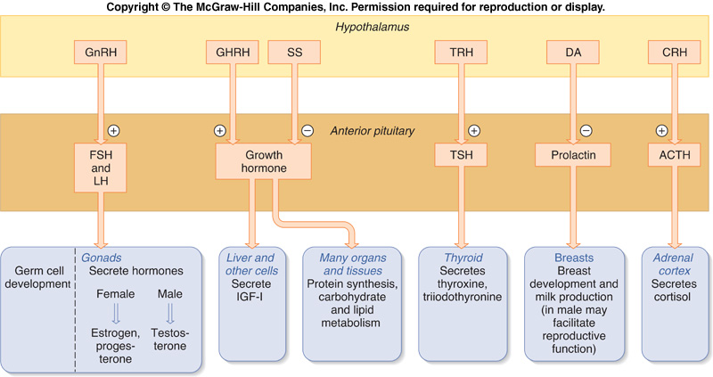
Fig. 11-18 (Vanders): The Complete Hypothalamic-Pituitary-Target Organ System

Slide 32
To Summarize:
2 key homeostatic regulatory systems:
Autonomic nervous system
  sympathetic versus parasympathetic
  sensory and motor neural pathways
  fast response
Endocrine system
  hormones released into extracellular fluid and often travel to target organs via bloodstream
  slower response time but response can be long-lived
  different chemical classes of hormones with associated mechanisms of action

