Slide 1
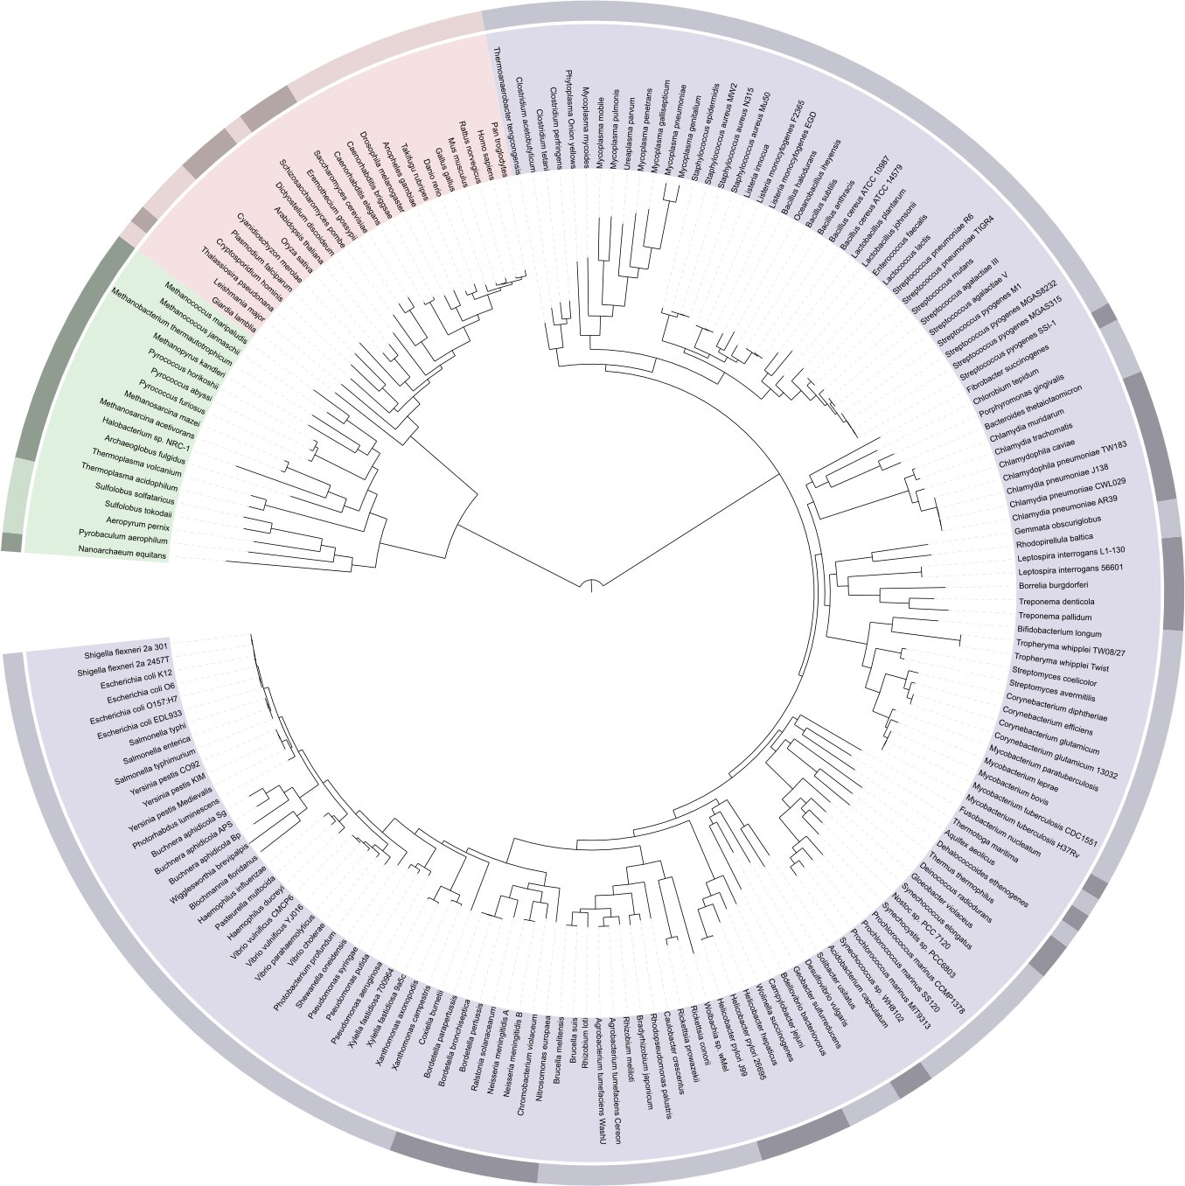
Lab3 – Vertebrate Phylogeny
vertebrates
LIFE

Slide 2
Objectives
Understand terminology associated with cladistic analysis
Make detailed observations concerning 12 morphological characters in nine different species of chordates
Express phylogenetic information regarding the evolution of the vertebrates in a cladogram
Recognize homoplasies and postulate whether they are the result of convergence or reversals
Postulate a hypothesis regarding the evolution of endothermy in vertebrates

Slide 3
Cladogram
Cladogram: Branching diagram that presents the relationship between different groups based on the distribution and transmission of derived characters.
OG
A
B
C
D
E
F
descendents
present time
4(1)*
4(1)*
5(1)
7(1)
2(1)
branching points
(speciation event)
common ancestor to B-F
3(1)
1(1)
6(1)
common ancestor to all species on cladogram
Past

Slide 4
Monophyletic group
(mono→one ; phyletic /phylum →group)
A B C D
Time
Group that includes a unique ancestor AND all its descendants
Each of the group on this slide are monophyletic
Notes:
Exemple de cladogramme…..
Suite de groupes monophyletiques imbriques les uns dans les autres, sans chevauchement

Slide 5
non-monophyletic group
A B C D
Time
Group that includes an ancestor AND SOME but not ALL of its descendants
Notes:
Exemple de cladogramme…..
Suite de groupes monophyletiques imbriques les uns dans les autres, sans chevauchement

Slide 6
Terminology (cont’d)
Character: any morphological, biochemical or behavioural feature that can be observed.
Homologous characters: 2 characters are homologous if they derive from a structure present in a distant, common ancestor. Only these characters are informative to define monophyletic groups.
Character states (or evolutionary stages of a character):
  Derived or apomorphic
  Ancestral or plesiomorphic
transformation
Notes:
Cladogram: Branching diagram (tree) that presents the distribution of derived characteristics (apomorphies) within a group of species / taxa. An apomorphy shared by many species is called synapomorphy. Synapomorphy defines monophyletic groups = groups that contains all the species which present a derived stage and its direct ancester

Slide 7
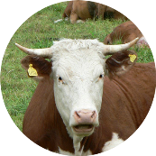
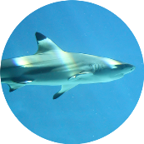
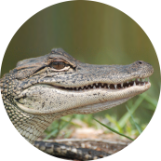
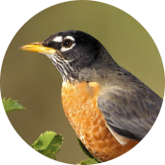
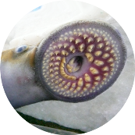
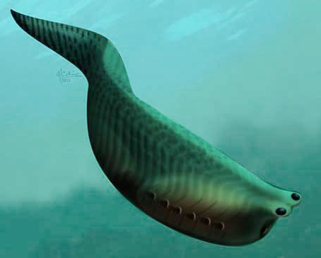
Evolution: Characters Exist in Different States
Some species possess the ancestral state (e.g. lamproie), other possess the derived state (e.g. crocodile, cow, birds, etc….)
Evolutionary event:
Character transformation from:
Initial state (ancestral) = Cartilaginous
New state (derived) = Bony
Time
The ancestor of all modern vertebrates possessed a cartilaginous skeleton
Notes:
Maintenant, regardons comment la clasdistique permet de se pencher sur les l’evolution des especes.
Les caracteres etudies ont une particularite, qui est qu’ils existent sous differentes formes……
Pour construire un cladogramme on va en fait representer de facon graphique la distribution des caracteres derives.

Slide 8
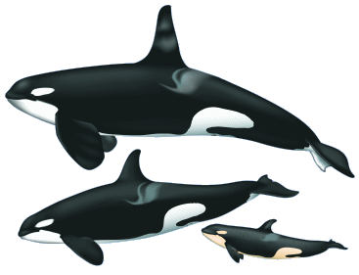
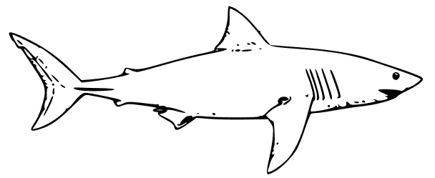
Cladistics: a method that relies on the observation of specific traits (=characters) rather that the general shape of organisms
General shape: similar (from a distance)
Particular traits of shark:
Particular traits of Orca:
Cartilaginous skeleton
No lungs
No amnion
Cartilaginous fin rays
Bony skeleton
lungs
Amnion
Tarsi et carpi (digit bones) in limbs
Notes:
Si on regarde maintenant la methode permettant de construire un cladogramme, appelee la cladistique

Slide 9
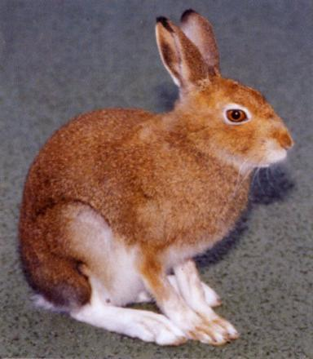





Cladistics: a method that relies on the observation of specific traits (=characters) rather that the general shape of organisms
General shape:
…..
Particular traits of rabbit:
Bony skeleton
lungs
Amnion
Tarsi et carpi (digit bones) in limbs
-Lactation
Particular traits of Orca
Bony skeleton
lungs
Amnion
Tarsi et carpi (digit bones) in limbs
-Lactation
$$√$$
$$√$$
$$√$$
$$√$$
$$√$$
Notes:
La vache presente les memes caracteristiques que l’orque et le lapin
Maintenant, regardons comment la clasdistique permet de se pencher sur les l’evolution des especes.
Les caracteres etudies ont une particularite, qui est qu’ils existent sous differentes formes……

Slide 10
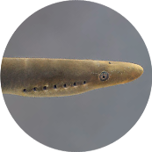
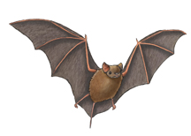
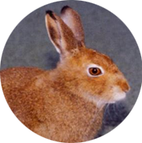
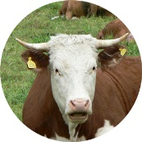
Non homologous characters
The monophyletic group that includes birds and bats is called Tetrapoda
These species do NOT form a group that is specific to them (= non monophyletic

Slide 11
Terminology (end)
Homoplasy: phenotypic similarity among different species that is not inherited from a common ancestor (non-homologous similarity).
There are 2 types:
Convergence: similar feature appearing in several species that do not share a common ancestor (ex. wings in insects and birds).
Reversal: when a derived character reverts to a more ancestral state within a group of species (ex: Loss of limbs in snakes, loss of teeth in turtles and birds).
Notes:
parsimony: it is not because simplicity is most likely to be real. Nature is not simple and simplicity does not exist. It’s a question of probability: it is more probable that an initial event occurred in a common ancestor then was transmitted to descendants, than the other possibilty which involves several identical events occurring independently in several species.

Slide 12

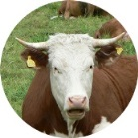
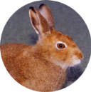


Principle of parsimony
1
2
1
Evolutionary novelty specific to Mammals
3
VERSUS
SCENARIO#1: 3 transformations
SCENARIO#2: 1 transformation
Principle of parsimony: the scenario that includes the fewer evolutionary events represents the most likely solution. Therefore it is chosen over other possible scenarios.
Notes:
Pour construire un cladogramme on va en fait representer de facon graphique la distribution des caracteres derives.

Slide 13
Procedure
Three phases:
1- Conduct a series of morphological observations (12 characters) on 9 animals
2- Record observations in table format (matrix) using the lamprey as a sister group or outgroup
3- Carry out a phylogenetic analysis of your data and construct a cladogram

Slide 14
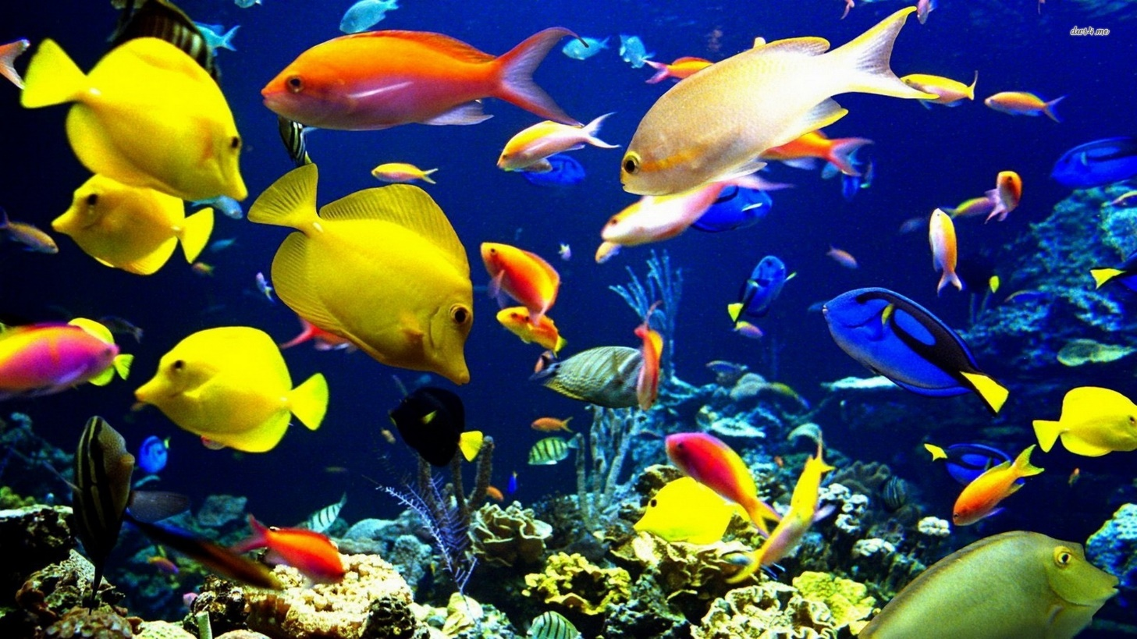
An example of phylogenetic analysis
Observations regarding 9 characters were made on 8 species of fish (one of these was chosen as the outgroup OG)

Slide 15
Observations Matrix
Group or species
characters

Slide 16
Polarization using the outgroup comparison
The character state found in the outgroup is coded as “0” by definition (ancestral)
If the ancestral state of a character is also found in species within the ingroup, enter a “0” for these species.
If the character state is different from the sister group, it is apomorphic and is coded as “1”
If two apomorphic states are present, they are coded by 1 and 2 (irrespectively of which one is 1 or 2).

Slide 17
Recoding the character matrix = polarisation of characters

Slide 18
Color-coding your matrix makes it easier to read

Slide 19
Building the cladogram
3 basic rules:
  The cladogram presents the distribution of derived characters (and nothing else)
  Species that possess the same derived character(s) must be regrouped (monophyletic groups)
  When several solutions are possible, you must choose the one that requires the lowest number of transformations (parsimony)

Slide 20
Step 1: no resolution cladogram
OG
A
B
C
D
E
F
G
F G D A B C E
← Order of species that are connected at the level of a common ancestor can be altered
Cladogram 1
Initial cladogram. No resolution

Slide 21
Step2: Adding the first character on your cladogram
Refine cladogram progressively by adding transformations of characters.
Begin with binary characters that define large monophyletic groups (= lots of “1”, no “2”)

Slide 22
Step2: Adding the first character on your cladogram
OG
A
B
C
D
E
F
G
level of
transformation
character
state
1(1)
Cladogram 2
Character #
Syntax: X(Y) X=character number - Y=character state

Slide 23
Step 3
Use the same reasoning to add characters 3, 5 and 2 on the cladogram

Slide 24
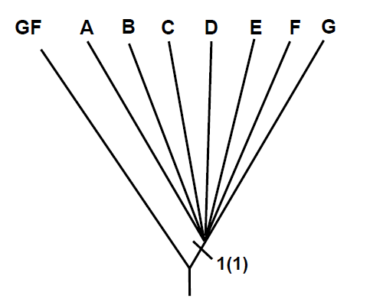
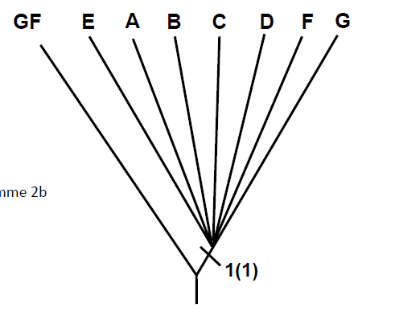
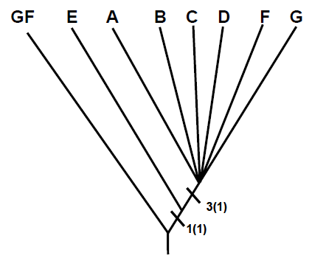
Previous step cladogram must be rearranged in order to add character #3
OG
Characters-> Species | (2) | (3) | (5)
OG | 0 | 0 | 0
A | 1 | 1 | 1
B | 1 | 1 | 1
C | 0 | 1 | 0
D | 0 | 1 | 0
E | 0 | 0 | 0
F | 0 | 1 | 0
G | 1 | 1 | 1
Cladogram 2
Rearrangement
(move E beside SG)
OG
SG
Addition of char #3
Cladogram 2b
Cladogram 3

Slide 25
OG E C D F A B G
OG E A B C D F G
5(1)
2(1)
3(1)
3(1)
1(1)
Rearrangement of C and D
and addition of #2 and #5
1(1)
Cladogram 3
Cladogram 4

Slide 26
Contradictory characters
7 and 8: regroup D and C
4: groups C and G
One of these is not a homologous character

Slide 27
Observing the cladogram from the previous step allows to add 7 and 8 with no ambiguity
Characters→ Species ↓ | (4) | (7) | (8)
OG | 0 | 0 | 0
A | 0 | 0 | 0
B | 0 | 0 | 0
C | 1 | 1 | 1
D | 0 | 1 | 1
E | 0 | 0 | 0
F | 0 | 0 | 0
G | 1 | 0 | 0
OG E F C D A B G
SG E F C D A B G
SG E F C D A B G
7(1)
8(1)
5(1)
5(1)
5(1)
2(1)
2(1)
2(1)
7(1)
8(1)
3(1)
3(1)
3(1)
1(1)
1(1)
1(1)
WRONG
Cladogram 4
Cladogram 5

Slide 28
Character 4 does not define a monophyletic group: it’s a homoplasy
Is it the result of reversal or convergence event?
Characters Species | (4)
OG | 0
A | 0
B | 0
C | 1
D | 0
E | 0
F | 0
G | 1
OG E F C D A B G
7(1)
8(1)
5(1)
2(1)
3(1)
1(1)
Cladogram 5

Slide 29
Scenario I: Reversal
C and G inherited 4(1) from their common ancestor: reversal on D, A and B
OG E F C D A B G
4(0)*
4(0)*
7(1)
8(1)
Syntax for reversals:
4(0)*
5(1)
4(1)
2(1)
3(1)
1(1)
→ Implies 2 reversals: on D and ancestor of A and B

Slide 30
Scenario II: Convergence
4(1) appeared independently on C and G
OG E F C D A B G
4(1)*
4(1)*
7(1)
8(1)
5(1)
2(1)
3(1)
1(1)
Implies: 1 convergence event

Slide 31
Convergence is more parsimonious
The convergence hypothesis is more parsimonious. This results in the following cladogram:
OG
E
F
C
D
A
B
G
4(1)*
4(1)*
7(1)
8(1)
5(1)
2(1)
3(1)
1(1)
Cladogram 6

Slide 32
Characters with 2 derived states
Let’s now consider a character with more than two states, such as character 6.

Slide 33
Characters with 2 derived states
Three sets of transformations for this trait are possible:
  Dorsal mouth (0) →ventral mouth (1) →terminal mouth (2)
  Dorsal mouth (0)→terminal (2)→ventral (1)
  Terminal mouth (2) ventral (1)
  Dorsal (0)

Slide 34
We use the information already available on the cladogram to determine the sequence of transformation of character 6.
Species that possess state 6(1) can be grouped in a monophyletic group [CDABG]
6(1)
OG
E
F
C
D
A
B
G
4(1)*
4(1)*
7(1)
8(1)
5(1)
2(1)
3(1)
1(1)

Slide 35
Species that possess 6(2) do not form a monophyletic group (E-F), but the transformation to 6(2) is easy to place using the parsimony principle.
6(2)
6(1)
OG
E
F
C
D
A
B
G
4(1)*
4(1)*
7(1)
8(1)
5(1)
2(1)
3(1)
1(1)

Slide 36
we resolved the sequence of transformation: dorsal mouth → ventral → terminal
6(0) → 6(2) → 6(1)
OG
E
F
C
D
A
B
G
4(1)*
4(1)*
7(1)
9(2)
8(1)
5(1)
2(1)
6(1)
9(1)
3(1)
1(1)
6(2)
Cladogram 7 (final)

Slide 37
This final cladogram results:
OG
E
F
C
D
A
B
G
4(1)*
4(1)*
7(1)
9(2)
8(1)
5(1)
2(1)
6(1)
9(1)
3(1)
1(1)
6(2)
Final Cladogram

Slide 38
How to be prepared
Before the lab
Carefully read the manual & Prelab presentation
Know the characters
The day of the lab
Arrive at 2:20
Bring your lab coat
Attendance is mandatory

Slide 39
Lab3 Activities
1-Record your observation in the excel matrix
2-Submit you coded matrix to your TA (use your Uottawa email address)
3-You corrected matrix will be sent back to you by your TA the day after your lab.
Contact your TA immediately if you do not receive your corrected matrix. It is your responsibility.
PRINT YOUR CORRECTED MATRIX AND ATTACH IT TO YOUR REPORT
4-Hand in your report one week after your lab

Slide 40
Content of lab report
Title page
Assignment matrix (species and characters)
Printout of the corrected matrix sent back by your TA
Cladogram (based on the corrected matrix):
  Initial cladogram with no resolution
  One cladogram per stage (all characters added successively to the previous step)
  Comment for each step including full name of added character and reasoning if a homoplasy has been added
  Final cladogram: big, clean and annotated (species full names).
Conclusion: answer the following questions:
  What species on your cladogram are endothermic?
  Considering their location on your cladogram, what type of character does endothermy represent (homologous, homoplasy: convergence or reversal)?

Slide 41
Visit the lab website for more information
Don’t forget your labcoat. No labcoat = -10%
Do not wait the last minute to start your cladogram… It may be too late to contact a TA for additional help.

