Slide 1
CVG 2132
Fundamentals of Environmental Engineering
REACTION KINETICS
Professor Chris Kinsley
Office: A-1514
Email: ckinsley@uottawa.ca

Slide 2
REACTION KINETICS
INTRODUCTION
(Mines: Chapter 6)
Slide 2
Notes:
What dies “material balance mean” and “where did material balance”.

Slide 3
KINETICS
Slide 3
Time Dependant Reaction Rates:
A → B
Examples of a single reactant to single product irreversible reaction.
r = rate of reaction with respect to species A = - dA/dt = change in species A concentration with respect to time =
  dA/dt = rate in terms of instantaneous time step
  ΔA/ Δt = [A]_{t} – [A]₀ / Δt = rate in terms of time step Δt
  dA/dt is a negative value because A is a reactant and is used up in the production of species B. Therefore the concentration of A is decreasing with time.
Notes:
What dies “material balance mean” and “where did material balance”.

Slide 4
KINETICS
Slide 4
  dB/dt ≈ [B]_{t} – [B]₀ / Δt = +ve
Stoichiometric Effects on Reaction Rates:
2A→ 3B
  When the stoichiometric coefficient is not unity, multiply each rate by the reciprocal of the stoichiometric coefficient to equate the rates of reactant consumption and product production.
  - (1/2) dA/dt = (1/3) dB/dt
Notes:
What dies “material balance mean” and “where did material balance”.

Slide 5
KINETICS
Slide 5
Non Conservative Substances in Mass Balance Equations:
Non conservative substances are involved in physiochemical, chemical or biological reactions that or the substance of interest.
Non conservative substances have kinetics rates of consumption or generation.
dCV = (QC)_{in} – (QC)_{out} + Gen
dt
dCV = (QC)_{in} – (QC)_{out} + rV
dt
ΔCV = (QC)_{in} – (QC)_{out} + rV
Δt
=
-
+
Accumulation
Inflow
Outflow
Notes:
What dies “material balance mean” and “where did material balance”.

Slide 6
KINETICS
Slide 6
Non Conservative Substances that are Involved in Multiple Reactions:
A → B → C
    B is being formed from A
    B is being consumed to form C
Thus the rate of generation/consumption of B:
rB=rBgen+rBcons
The in mass balance of the above reaction would be:
dCV = (QC)_{in} – (QC)_{out} + Gen
dt
dCV = (QC)_{in} – (QC)_{out} + r_{Bgen}V+ r_{Bcons}V
dt
Notes:
What dies “material balance mean” and “where did material balance”.

Slide 7
ORDER OF A REACTION
Slide 7
Notes:
What dies “material balance mean” and “where did material balance”.

Slide 8
ORDER OF REACTIONS
Slide 8
Orders of Reactions:
A→ B
Single reactant to single product irreversible reaction rate equation:
r_{A} = - = kC^{n}
  r_{A} = rate of reaction of consumption of species A [mass/volume x time]
  C = concentration of species A [mass / volume]
  t = time [time]
  k = reaction rate constant (varies with order of reaction)
  n = order of the rxn (dimensionless)
Kinetic equations (and their respective orders) are derived from curve fitting to experimental data.
Notes:
What dies “material balance mean” and “where did material balance”.

Slide 9
ZERO ORDER REACTIONS
Slide 9
Zero Order Reactions:
A→ B
A reaction that proceeds at a rate that is independent of the concentration of the reactant.
Single reactant to single product irreversible reaction rate equation:
r_{A} = - = kC⁰ = k
Notes:
What dies “material balance mean” and “where did material balance”.

Slide 10

ZERO ORDER REACTIONS
Slide 10
Zero Order Reactions:
k (zero order reactions) has units of [mass/volume x time]
= -k
C – C₀ = - kt
  C=C0-kt
    C₀ = initial concentration of species A (corresponding to t = 0)
    C = concentration of species A at time = t
Notes:
What dies “material balance mean” and “where did material balance”.

Slide 11
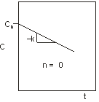
ZERO ORDER REACTIONS
Slide 11
Zero Order Reactions:
Plots as a straight line with a slope of k on a C vs. t graph.
Notes:
What dies “material balance mean” and “where did material balance”.

Slide 12
FIRST ORDER REACTIONS
Slide 12
First Order Reactions:
A→ B
A reaction that proceeds at a rate that is directly proportional to the concentration of the reactant.
Single reactant to single product irreversible reaction rate equation:
r_{A} = - = kC¹ = kC
Notes:
What dies “material balance mean” and “where did material balance”.

Slide 13
FIRST ORDER REACTIONS
Slide 13
First Order Reactions:
k (first order reactions) has units of [1/time]
= -kC
Notes:
What dies “material balance mean” and “where did material balance”.

Slide 14
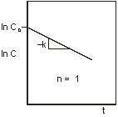
FIRST ORDER REACTIONS
Slide 14
First Order Reactions:
Plots as a straight line with a slope of k on a ln C vs. t graph.
Notes:
What dies “material balance mean” and “where did material balance”.

Slide 15
n-ORDER REACTIONS
Slide 15
n-Order Reactions:
A→ B
A reaction that proceeds at a rate that is proportional to the n^{th} power of the concentration of the reactant.
Single reactant to single product irreversible reaction rate equation:
r_{A} = - = kC^{n}
Notes:
What dies “material balance mean” and “where did material balance”.

Slide 16
n-ORDER REACTIONS
Slide 16
n-Order Reactions:
k (n-order reactions) has variable units depending on “n”.
= -kC^{n}
Notes:
What dies “material balance mean” and “where did material balance”.

Slide 17
n-ORDER REACTIONS
Slide 17
2nd Order Reaction Example:
Notes:
What dies “material balance mean” and “where did material balance”.

Slide 18
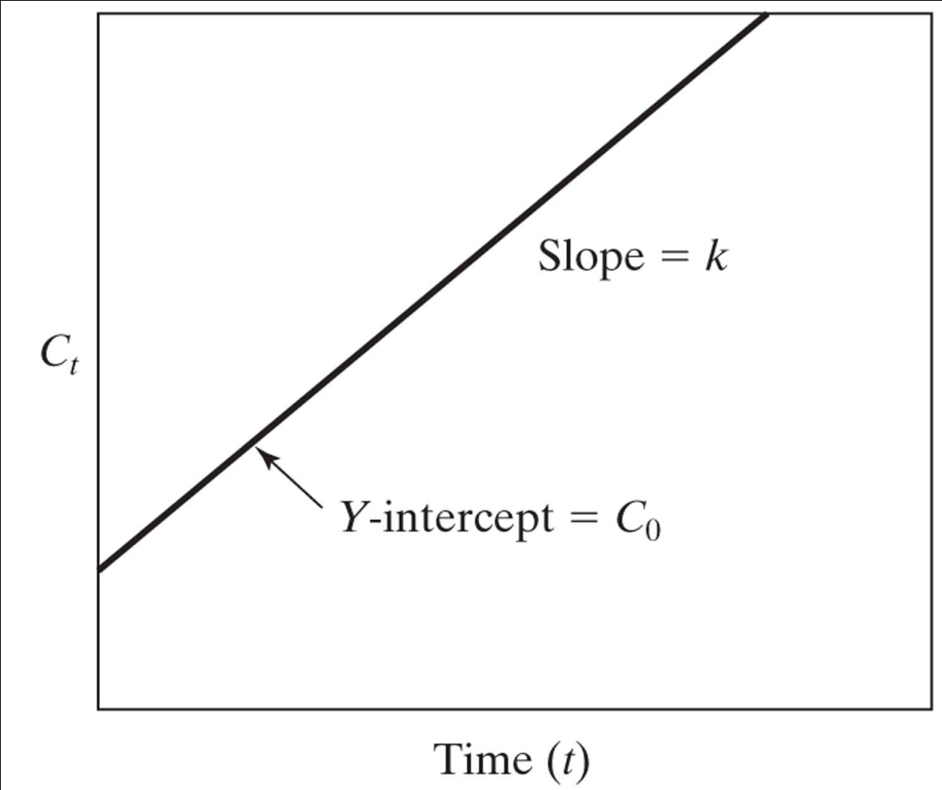
n-ORDER REACTIONS
Slide 18
2nd Order Reactions:
Plots as a straight line with a slope of k on a 1/C vs. t graph.
n = 2
1
C
1
C₀
Notes:
What dies “material balance mean” and “where did material balance”.

Slide 19
n-ORDER REACTIONS
Slide 19
0.5th Order Reaction Example:
Notes:
What dies “material balance mean” and “where did material balance”.

Slide 20
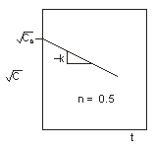
n-ORDER REACTIONS
Slide 20
0.5th Order Reactions:
Plots as a straight line with a slope of k on a √C vs. t graph.
Notes:
What dies “material balance mean” and “where did material balance”.

Slide 21
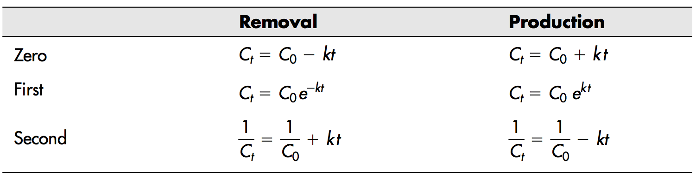
n-ORDER REACTIONS
Slide 21
Summary of Common n-Order Reaction Equations:
Notes:
What dies “material balance mean” and “where did material balance”.

Slide 22
n-ORDER REACTIONS
Slide 22
Example:
The data below was collected from the irreversible conversion of pollutant A to substance P: A → P
  Evaluate the following data to determine whether the reactions is best described by a zero order, first order or second order reaction, or whether none of these reaction orders describes the data well.
  Determine the rate constant k for the reaction.
Time (minutes) | Concentration A (g/L)
0 | 1.00
11 | 0.50
20 | 0.25
48 | 0.10
105 | 0.05
Notes:
What dies “material balance mean” and “where did material balance”.

Slide 23
n-ORDER REACTIONS
Slide 23
Example:
Plot Concentration of A vs. Time:
Non linear- therefore zero order rxn is a poor description
Notes:
What dies “material balance mean” and “where did material balance”.

Slide 24
n-ORDER REACTIONS
Slide 24
Example:
Calculate ln (A):
Time (minutes) | Concentration A (g/L) | ln A
0 | 1.00 | 0.00
11 | 0.50 | -0.69
20 | 0.25 | -1.39
48 | 0.10 | -2.30
105 | 0.05 | -3.00
Notes:
What dies “material balance mean” and “where did material balance”.

Slide 25
n-ORDER REACTIONS
Slide 25
Example:
Plot ln (A) vs. Time:
Non linear – therefore first-order is a poor description
Notes:
What dies “material balance mean” and “where did material balance”.

Slide 26
n-ORDER REACTIONS
Slide 26
Example:
Calculate 1/A:
Time (minutes) | Concentration A (g/L) | ln A | 1/A (L/g)
0 | 1.00 | 0.00 | 1.00
11 | 0.50 | -0.69 | 2.00
20 | 0.25 | -1.39 | 4.00
48 | 0.10 | -2.30 | 10.00
105 | 0.05 | -3.00 | 20.00
Notes:
What dies “material balance mean” and “where did material balance”.

Slide 27
n-ORDER REACTIONS
Slide 27
Example:
Plot 1/A vs. Time:
Linear- therefore second order rxn is a goog description
k=0.1865 L/g/min
Notes:
What dies “material balance mean” and “where did material balance”.

Slide 28
n-ORDER REACTIONS
Slide 28
Example:
The quality of Lake Silbersee in Germany has been diminishing for many years. A rotten egg smell is often emitted from the lake. The smell is from the release of leachate from a nearby landfill into the lake and the subsequent anaerobic production of hydrogen sulphide (H₂S).
  To remediate the problem, the government has decided to aerate the lake in an attempt to oxidize the odorous H2S gas to non-odorous sulphate ion (SO₄²⁻).
        H₂S + 2O₂ → SO₄²⁻ + 2H⁺
  The kinetics of the reaction follows first order rates with respect to BOTH oxygen and hydrogen sulphide.
  d[H₂S]/dt = -k[H₂S][O₂]
Notes:
What dies “material balance mean” and “where did material balance”.

Slide 29
n-ORDER REACTIONS
Slide 29
Example:
With aeration the O₂ level in the lake can be maintained at 2 mg/L and k was determined experimentally to be 1000 L/mol/d. How long will it take to reduce the H₂S concentration from 500 μM to 1 μM if the aeration is assumed to completely inhibit anaerobic digestion?
Convert reaction into a pseudo first order reaction:
d[H2S]/dt=-k[H2S][O2]
Let k[O2]=k’
Therefore: d[H2S]/dt=-k’[H2S]
Now we have a first order rxn
Notes:
What dies “material balance mean” and “where did material balance”.

Slide 30
n-ORDER REACTIONS
Slide 30
Solve for k’:
K’=k[O2]
K’=1000(L/mol/d)x2(mg/L)x1mol O2/ 32g O2 x 1g / 1000mg
K’=0.0625 (1/d)
Solve for time:
d[H2S]/dt=-k’[H2S]
[H2S]=[H2S]0e^(-k’t)
Soln to first order
1uM = 500uM e^-0.0625t
t=100 days
Notes:
What dies “material balance mean” and “where did material balance”.

Slide 31
EXPONENTIAL GROWTH AND DECAY
Slide 31
Notes:
What dies “material balance mean” and “where did material balance”.

Slide 32
EXPONENTIAL GROWTH
Slide 32
Special case of a first-order reaction:
Occurs when the increase is proportional to the amount currently present.
Will occur in unlimited conditions.
Exponential growth is a particular case of first-order rate reactions.
Discrete compounding exponential growth (compounded at discrete time intervals):
N_{t+1} = N_{t} + kN_{t} = N_{t}·(1 + k)
N₁ = N₀ + kN₀ = N₀·(1 + k); N₂ = N₁·(1 + k) = N₀·(1 + k)²
Where: N₀ = initial quantity, N_{t} = quantity at time = t, k = growth rate constant
Therefore: N_{t} = N₀(1 + k)^{t}
Notes:
What dies “material balance mean” and “where did material balance”.

Slide 33
EXPONENTIAL GROWTH
Slide 33
Special case of a first-order reaction:
Many environmental processes of interest follow smooth, continuous growth curves.
Continuous compounding exponential growth:
= kN
Same equation as a single reactant to single product irreversible reaction rate equation.
The solution is:
N=N0e^(kt)
Notes:
What dies “material balance mean” and “where did material balance”.

Slide 34
DOUBLING TIME
Slide 34
A quantity that increases (grows) exponentially requires a fixed amount of time to double in quantity.
  It takes the same amount of time to increase from N₀ to 2N₀ as it does from 2N₀ to 4N₀.
The doubling time (t_{d}) of a quantity can be calculated by letting N = 2N₀ at t = t_{d}.
2N₀ = N₀e^{ktd}
ln2 = kt_{d}
td=ln2/k
Notes:
What dies “material balance mean” and “where did material balance”.

Slide 35
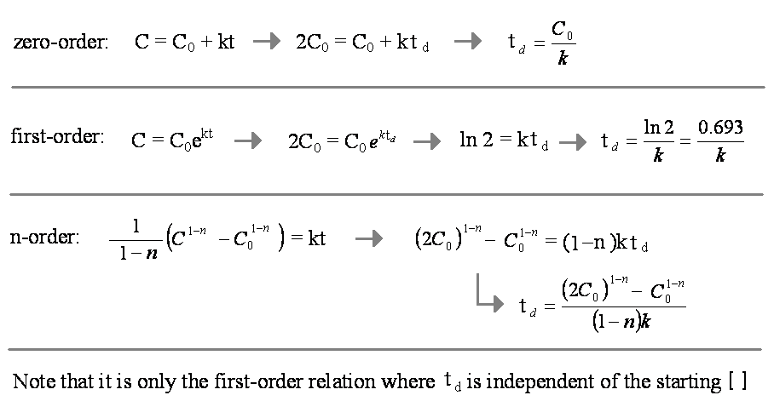
DOUBLING TIME
Slide 35
A quantity that increases (grows) according to a known rate requires a fixed amount of time to double in quantity.
Notes:
What dies “material balance mean” and “where did material balance”.

Slide 36
HALF LIFE
Slide 36
A quantity that decreases (decays) exponentially requires a fixed amount of time to halve in quantity.
  It takes the same amount of time to decrease from N₀ to 1/2N₀ as it does from 1/2N₀ to 1/4N₀.
The half-life (t_{1/2}) of a quantity can be calculated by letting N = N₀/2at t = t_{1/2}.
N₀/2= N₀e^{-kt1/2}
ln(1/2) = -kt_{1/2}
t1/2=ln2/k
Notes:
What dies “material balance mean” and “where did material balance”.

Slide 37
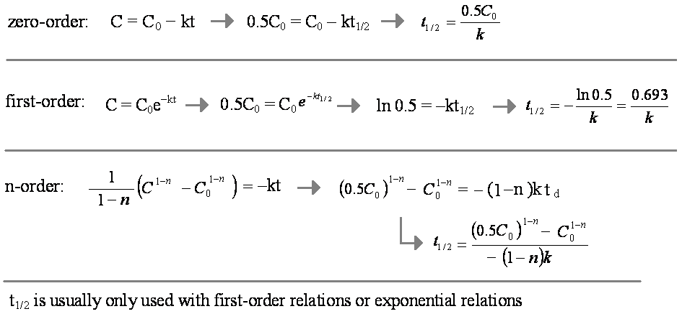
HALF LIFE
Slide 37
A quantity that decreases (decays) according to a known rate requires a fixed amount of time to halve in quantity.
Notes:
What dies “material balance mean” and “where did material balance”.

Slide 38
HALF LIFE
Slide 38
Example:
Half lives for benzene, TCE and toluene were experimentally determined to be 69, 231 and 12 days, respectively. What are the rate constants for each pollutant? The experiments also revealed that benzene and TCE degrade according to a first order reaction but toluene degrades as a zero order reaction and is a concern at initial concentrations of 50 ppm in groundwater aquifers.
Notes:
What dies “material balance mean” and “where did material balance”.

