Slide 1
Organizational Design (Part I)
Class #3

Slide 2
Questions and Upcoming Events
Questions?
Upcoming Events
  Reaction Memos #1… don’t forget to check which week you have
  Bring laptop/smartphone/tablet to next class… we are Kahooting!

Slide 3
So how about the Daily?
What is managerialism?
Who are we (as a representative of an organization) supposed to pay attention to then?

Slide 4
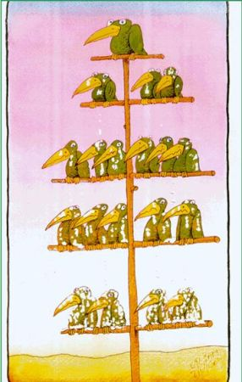
Today’s Roadmap
Basic concepts of organizational structure
Recap Dimensions of Organizational Designs
What are structural design options? What are pros and cons of each option?

Slide 5
Why is organizational structure important?
  It’s a core question that managers face:
    How to organize all the people at work, each day?
      Jobs: what responsibilities does each person have?
      Departments: how are the jobs grouped?
      Coordination: how do people work together?
      Hierarchy: who has what authority - who reports to whom - who’s in charge?
  Structural choices are enormously consequential
      Structure determines which customers, products, and regions an organization can address & how well they do so
      An individual’s location in the structure can fundamentally shape their goals, perceptions, attributions, interests, identities
  Organizational Structure is one of the “big levers”

Slide 6
Organizational structure: Fundamental concepts
  Organization Structure defines how job tasks are formally divided, grouped, and coordinated
  Two basic components in organizational structure design:
    Specialization: how work is divided up
    Coordination: keeping everyone ‘in sync’
  Purposes of organizational structure:
    Designates formal relationships
    Division of labor: create groups, specify who does what
    Integration: coordinate across individuals and groups
    Define boundaries: what we “make” vs. what we “buy”

Slide 7
Organization Chart
  A formal organization chart can be useful in understanding how an organization works….

Slide 8
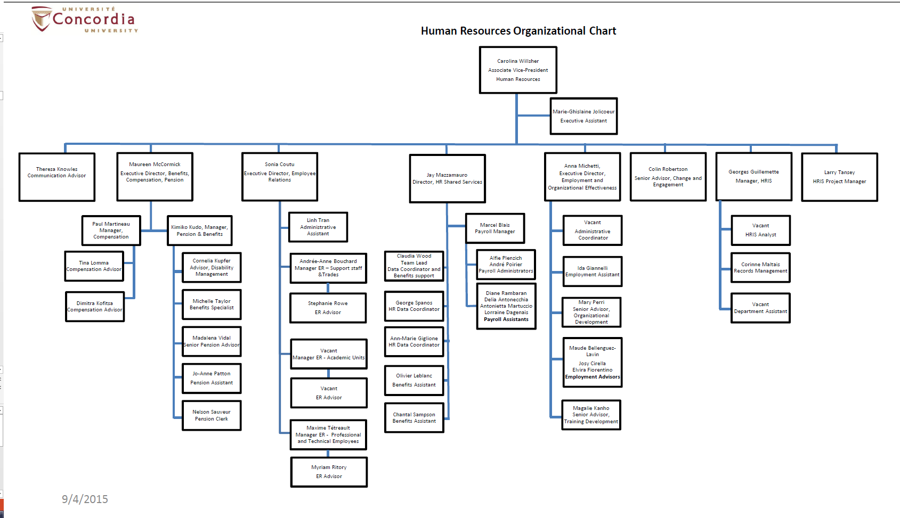

Slide 9
Organization Chart (cont’d)
  Why is a formal organization chart useful?
  Because it shows:
    the various sub-units of an organization and what positions exist;
    the hierarchy of authority and who reports to whom;
    how different jobs are grouped and how they are related;
    how each position and department fits into the whole;
    some indirect clues about the organization’s size.

Slide 10
Organization Chart (cont’d)
  What are the implications of “where you are on the organization chart”?
    Location on the chart, particularly departmental affiliation, can shape goals, perceptions, interests, politics
      Goals: can be shaped by departmental affiliation
      Perceptions: Problems, opportunities, failures, and successes are interpreted from the department’s perspective
      Coordination: Communication is easier within the department; goals are coordinated within the department
      Interests & Politics: Individuals gain as their department does. Credit for success, blame for failure is (generally) fought out between departments
  “Where you stand depends on where you sit.”

Slide 11
Basic Problems of Organizational Design
  Main problem of design is to ensure information flows throughout organization:
    Vertical information flow is mostly about organizational control
        Necessary for efficiency and consistency
          e.g.: hierarchical referral (the chain of command), rules and plans
    Horizontal information flow is mostly about coordination
        Necessary for adaptation, learning, & innovation
          e.g.: task-forces or cross-functional teams
  There is an inherent tension between vertical and horizontal mechanisms in an organization
    Solving one problem tends to make the other one worse

Slide 12
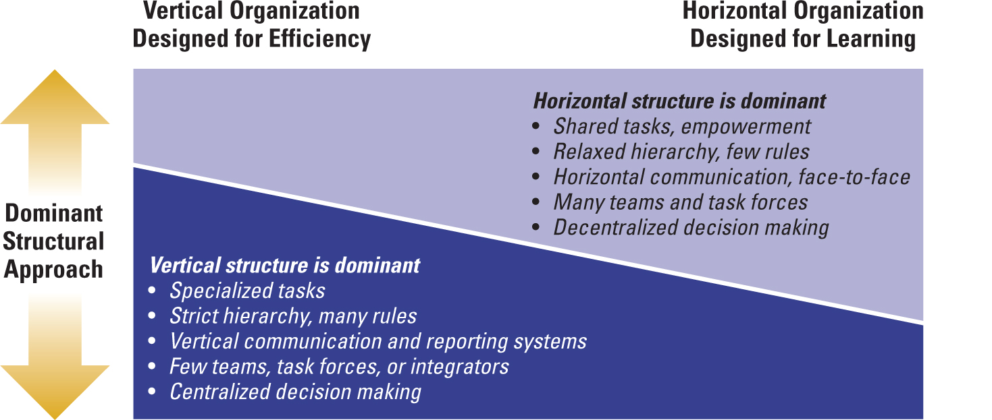
Organizational Design: Efficiency vs Learning

Slide 13
Vertical Linkage Mechanisms
  Hierarchical Referral: chain of command
  Formalization: rules or procedures so that employees know how to respond without having to talk to a manager
  Vertical Information Systems
      Periodic reports
      Written information
      Computer-based communications distributed to managers

Slide 14
Horizontal Integrating Mechanisms
  Computerized Information Systems
  Direct Contact: between managers or employees
      Liaison Role – communicating with another department
  Task Forces: temporary and involves a linkage to more than one department; corporate concern usually
  Full-Time Integrator: coordinates several departments, that are typically located outside the department
  Project Teams: similar to task force, but they are usually focused on a particular product/service that needs to be addressed
  Virtual Cross Functional Teams: made up of organizationally/ geographically dispersed members who are linked by tech.
Notes:
http://www.cui.edu/en-us/aboutcui/diversity/race-and-ethnicity
http://concordiafoodgroups.ca/
https://blog.kainexus.com/employee-engagement/cross-functional-collaboration/top-5-challenges-faced-by-cross-functional-teams

Slide 15
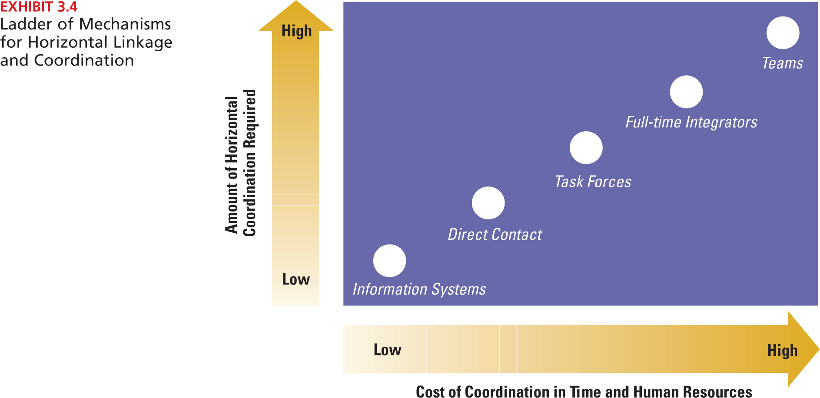
Horizontal Linkage Mechanisms

Slide 16
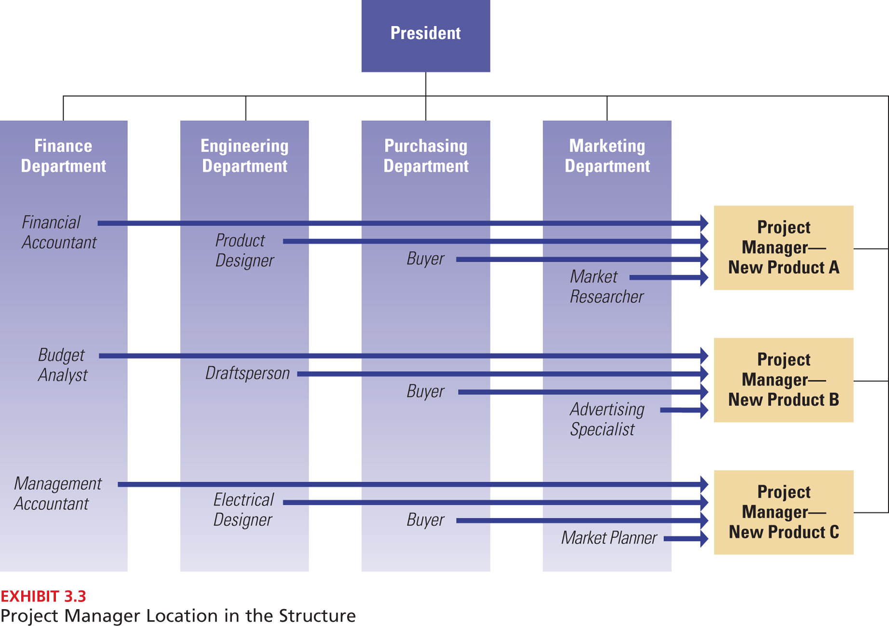
Information Processing to Full-Time Integrator

Slide 17
Simplified way of thinking about structure
  Tasks broken down into specialized, separate parts
  Strict hierarchy of authority and control, and many rules
  Knowledge and control of tasks are centralized at the top of the organization
  Communication is vertical
  Efficiency, stability, & reliability as key system outcomes
Mechanistic
  Tasks are adjusted and redefined through teamwork
  Less hierarchy of authority and control, and few rules
  Knowledge and control of tasks are located anywhere in the organization (decentralized)
  Communication is horizontal
  Flexibility, adaptation, learning, & innovation as key system outcomes
Organic

Slide 18
Today’s Roadmap
Basic concepts of organizational structure
Recap Dimensions of Organizational Designs
What are structural design options? What are pros and cons of each option?

Slide 19
Contingency Theory
Structure
Formalization
Specialization
Hierarchy of authority
Centralization
Professionalism
Personnel ratios
Context
Goals and Strategy
Organizational Size
Environment
Culture and Values
Technology
FIT
Performance

Slide 20
Elements of Structure (1)
  Formalization: The degree to which jobs are guided by standardized rules and procedures.
    Higher formalization means:
      more explicit job descriptions
      more clearly defined procedures
      less discretion for workers
      lower flexibility
    High formalization is appropriate when:
      jobs are simple and routine
      consistency is important (safety, legal, equity)
  Specialization: (sub)division of labor or of tasks
    Degree to which org tasks are subdivided into separate jobs
    Extensive specialization: employees perform a narrow range of tasks

Slide 21
Elements of Structure (2)
  Hierarchy of authority: An organization’s chain of command that defines the relative authority each manager has.
    Span of control for each manager
    Narrow (Tall) or Wide (Shorter)
  Centralization: who makes decisions; the degree to which decisions are made at higher organizational levels
  Professionalism: the level of formal education and training of employees
  Personnel ratios: e.g.: administrative ratio, professional staff ratio, ratio of part-time to full-time employees, etc.

Slide 22
It’s not easy being lean: Nucor (Glader, 2006)
  What does it mean to be ‘lean’ from a macro perspective? (Also known as ‘Just In Time’ (JIT))
    creating value for customers with fewer resources
    ‘perfection’/zero waste
    involvement of labor (personal responsibility, engagement, ‘ownership’)
    continuous improvement
  Name some companies that are ‘lean’:
    Toyota
    NASA
    Hospitals
  What does Nucor teach us about pros and cons of a lean organization?

Slide 23
Span of control: Tall vs. Flat Structure
  Span of control: The number of direct subordinates a manager has
# of people at this level
1
1
1
2
4
8
Organizational Level
3
16
64
4
64
“Narrow” Span of 4
Individual Workers = 64
Managers (levels 1-3) = 21
# of levels: 4 (“tall”)
“Wide” Span of 8
Individual Workers = 64
Managers (levels 1-2) = 9
Total # of levels: 3 (“flat or short”)

Slide 24
It’s not easy being lean….
  Communication quality and speed
  Slow decision making
  Decrease in motivation of employees
  Increased bureaucratic costs
  Parkinson’s Law – managers seek to increase the number of subordinates below them
  Coordination problems
  Narrow span of control
Tall Structure
  Wide span of control
    Within dept.: Less control and coordination by manager (more empowerment)
    Across organization: Quicker communication, decision-making, and implementation
  Few managers → Lower overhead costs
Flat Structure
  The trend is heading to flatter organizations

Slide 25
Six Rules to Boost Co-operation- Schachter (2014)
Name some concepts from the book chapters that you saw addressed in this article?
    Hint: Think back to our first class, as a point of departure
Can you think of an example or two of when their Six Simple Rules will not work?
Lets talk about power: can anyone ‘have’ power? Or, is it just the CEO/Managers in Org Chart that ‘have’ power?
Did you agree with what the consultants recommended? Why or why not?

Slide 26
Today’s Roadmap
Basic concepts of organizational structure
Recap Dimensions of Organizational Designs
What are structural design options? What are pros and cons of each option?

Slide 27
Basic Design Choices
Functional Structure
Activity Grouping: Functions
Divisional Structure
Product / Geography
Output grouping: Product, Service, Project, Business
CEO
Engineering
Marketing
Manufacturing
CEO
Product
Line #1
Product
Line #2
Product
Line #3
Matrix
Multi-focused: a combination
Geography / Customer grouping: Geography, customer, market segment
CEO
Marketing
Manufacturing
CEO
Product 1
…..
Eastern
U.S.
Western
U.S.
Asia
Product 2

Slide 28
Functional Structure
CEO
R & D
Manufacturing
Accounting
Marketing
  Functional Structure: activities are grouped together by common function
    Functions: marketing, sales, finance, manufacturing, etc.
    Probably (still) the “standard” concept of an organization

Slide 29
Example of Functional Structure (TV monitor producer)
CEO
COO
CFO
CSO
HR
Strategy & BI
COO Controller
Operations 1
(Asia)
Operations 2
(Europe)
Operations 3
(America)
Corp Control
Asia Pacific
Sales
Corp Quality
Plant A
Plant A
Mgm Support
Treasury
Europe Sales
COO Planning
Internal Audit
Plant B
Production
planning
Taxation
Purchasing
Plant B
America Sales
Legal
Plant C
Tech Support
IT
Business
Excellence
Plant C
Plant D
Plant A
M&A /
Restructuring
Operations
Support
Plant D
Plant E
Plant B
Corp
Communication
Plant F
Plant C
Components
Europe
Components
America

Slide 30
Linking Functional Structure to You
  Think about your work experience so far:
    Have you worked in a functional structure?
    Name some examples

Slide 31
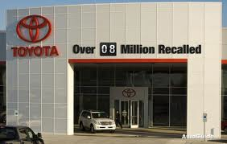
Case: Toyota – Growth at Risk (Discuss in Groups)
  Toyota enjoyed a long run of market share growth in the US. But recent quality missteps and defections by top executives created new challenges.
    According to the article, what was the root cause of the company’s problems?
    Why was it hard to fix this structural issue at Toyota?

Slide 32
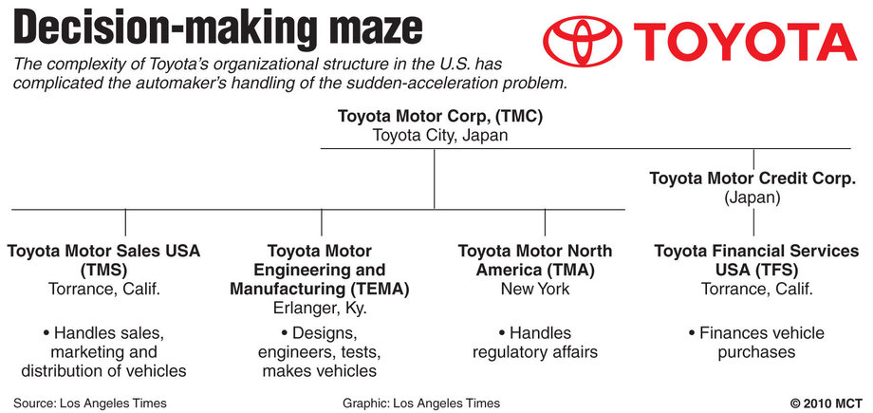
Case: Toyota – Growth at Risk
Notes:
Restructuring of Toyota http://articles.latimes.com/2013/mar/06/autos/la-fi-hy-toyota-management-overhaul-20130306
Has Toyota Learned its lesson? http://fortune.com/2016/06/28/toyota-recall-airbag-prius-lexus/

Slide 33
Advantages and Disadvantages of Functional Structure
  Allows efficiency and economies of scale within functional departments
  Enables in-depth knowledge, technical expertise, and skill development
  Little duplication of resources
  Enables organization to achieve functional goals
Is best with only one or a few products
Advantages
Disadvantages
  Internally focused (e.g., Marketing vs. Engineering)
  People don’t see “big picture” of organization goals
  Poor horizontal communication & coordination among departments
  A slow response to environmental changes
  Results in less innovations
  May cause decisions to pile up, hierarchy overload

Slide 34
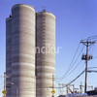
Key problem with functional structures in large organizations: “Silos”
“SILOS”
(Functions)
  As functional organizations grow, the # of layers increases
  You get the “Silo” effect:
    Slow communication & decisions
    Action is up and down the hierarchy, not across it
    Preoccupation with departmental rather than organizational goals
  “Throwing it over the wall”:
    Doing your job without really involving the next group/function

Slide 35
Key problem with functional structures

Slide 36
Appropriate contexts for functional structures
  Goals: efficiency, consistency, and/or technical quality
  Size: small/medium. Not too many products or markets
  Environment: simple and stable
  Technology: routine, low interdependence between functions

Slide 37
When to rethink using a functional structure
  When functional structures lose effectiveness:
    What if your organization has many different types of products?
    What if your organization operates in many (different) countries?
    What if your organization has customers of many different types?
  In these situations, functional structures perform poorly
    Because loyalties (and focus and expertise) are ultimately based on function rather than one specific product, country, or customer

Slide 38
For the next class:
  Agenda: Organizational Design (Part II)
  Assignment:
    Textbook: Chapter 3
    Additional readings
        Guth, Robert. "Microsoft Sets Big Restructuring: Shift to Three Major Units Aims to Improve Flexibility against the Likes of Google." The Wall Street Journal. (Sept. 21, 2005)
        Sandberg, Jared. "Office Democracies: How Many Bosses Can One Person Have?" The Wall Street Journal. (Nov. 22, 2005)
        Vantrappen, H., & Wirtz, F. (2016). Making matrix organizations actually work. Harvard Business Review Digital Articles, 2-5.
      This material is reproduced for course instruction purposes only. It is available for use by students enrolled in this course only (MANA 341- Concordia University) through “Moodle”.
      You are not allowed to reproduce or distribute this document.

