Slide 1
Managerial Accounting
Tools for Business Decision-Making
Chapter 6
Decision-Making:
Cost-Volume-Profit
Fifth Canadian Edition
Weygandt Kimmel Kieso Aly
Prepared by Angela Davis, CPA, CA, CFE, MSc

Slide 2
Learning Objectives (1 of 2)
Prepare a cost-volume-profit income statement to determine contribution margin.
Calculate the break-even point using three approaches.
Determine the sales required to earn the target operating income and define the margin of safety.

Slide 3
Learning Objectives (2 of 2)
Understand how to apply basic cost-volume-profit concepts in a changing business environment.
Explain the term sales mix and its effect on break-even sales.
Understand how cost structure and operating leverage affect profitability (Appendix 6A).

Slide 4
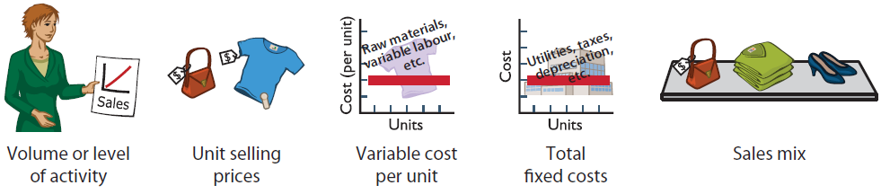
Cost-Volume-Profit Analysis
Study of the effects of changes of costs and volume on a company’s profits
A critical factor in management decisions
Important in profit planning
Considers the interrelationships among the five components of CVP analysis:
Components of CVP analysis

Slide 5
Assumptions Underlying CVP Analysis (1 of 2)
Behaviour of both costs and revenues is linear throughout the relevant range of the activity index
All costs can be classified as either variable or fixed with reasonable accuracy
Changes in activity are the only factors that affect costs

Slide 6
Assumptions Underlying CVP Analysis (2 of 2)
Inventory levels remain constant - all units produced are sold
When more than one type of product is sold, the sales mix will remain constant

Slide 7
CVP Income Statement
A statement for internal use
Classifies costs and expenses as fixed or variable
Reports contribution margin in the body of the statement.
  Contribution margin – amount of revenue remaining after deducting variable costs
Reports the same income as a traditional income statement

Slide 8
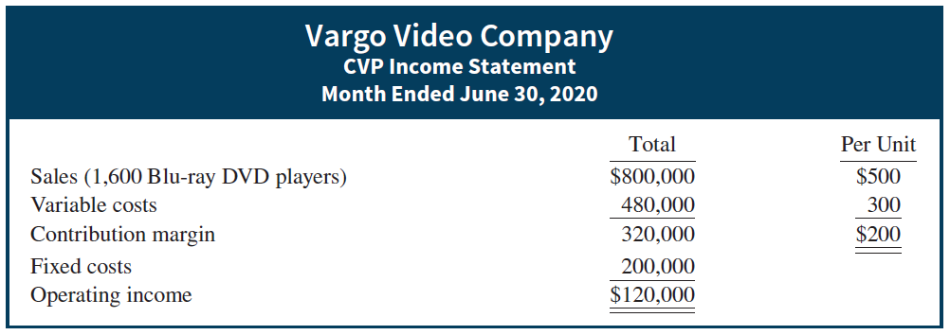
CVP Income Statement: Example
Vargo Video Company produces DVD players.
Relevant data for June:
    Unit selling price of DVD player $500
    Unit variable costs $300
    Total monthly fixed costs $200,000
    Units sold 1,600
CVP income statement, with operating income

Slide 9
Let’s Review 1
A company can achieve an increase in contribution margin (given no other changes) if
  fixed costs decrease
  selling price decreases
  fixed costs increase
  variable costs decrease

Slide 10
Let’s Review 1: Solution
A company can achieve an increase in contribution margin (given no other changes) if
  fixed costs decrease
  selling price decreases
  fixed costs increase
  variable costs decrease

Slide 11
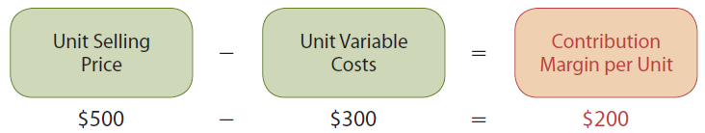
CVP Income Statement
Contribution Margin: Example (1 of 3)
Contribution margin is available to cover fixed costs and to contribute to income
Formula for contribution margin per unit:
Example: Calculation for Vargo Video
Formula for contribution margin per unit

Slide 12
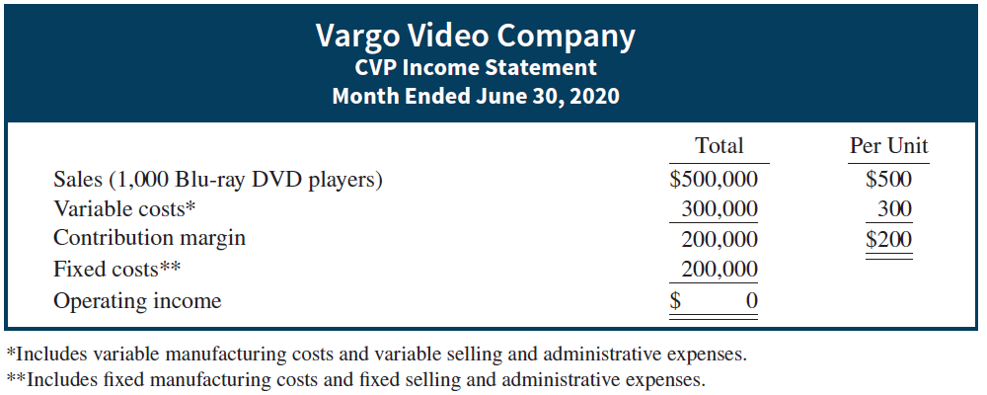
CVP Income Statement
Contribution Margin: Example (2 of 3)
To cover fixed costs of $200,000, Vargo Video must sell 1,000 DVD players ($200,000 ÷ $200) before it earns any net income.
CVP income statement, with zero operating income

Slide 13
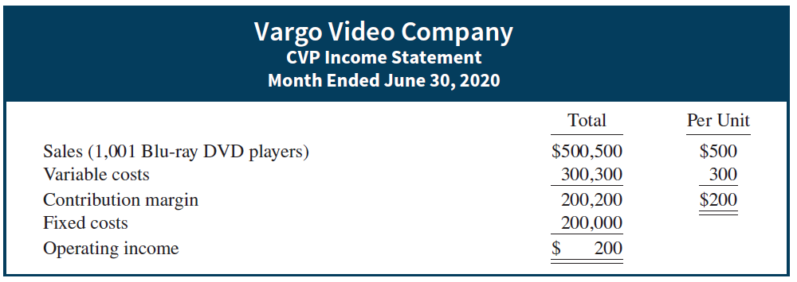
CVP Income Statement
Contribution Margin: Example (3 of 3)
Every DVD sold above 1,000 will generate a contribution margin of $200
CVP income statement, with operating income

Slide 14
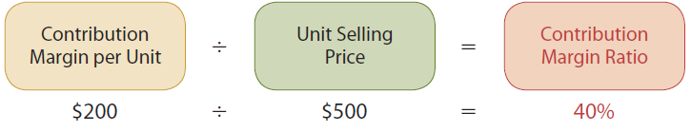
CVP Income Statement
Contribution Margin Ratio
CM Ratio shows the percentage of each sales dollar available to apply toward fixed costs and profits
Example: Calculation for Vargo Video
Formula for contribution margin ratio

Slide 15
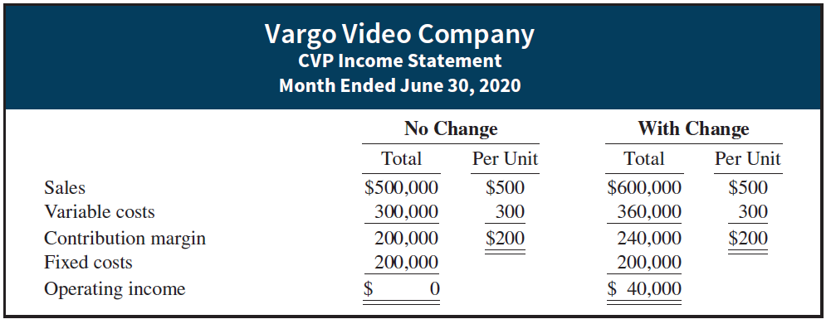
CVP Income Statement
Contribution Margin Ratio
If Vargo Video’s sales increases by $100,000, net income increases by $40,000.
CM ratio (40%) x increase in sales ($100,000)
Comparative CVP income statement

Slide 16
Let’s Review 2
Contribution margin is
  sales revenue less variable expenses.
  sales revenue less fixed and variable expenses.
  fixed expenses less variable expenses.
  sales revenue less cost of goods sold.

Slide 17
Let’s Review 2: Solution
Contribution margin is
  sales revenue less variable expenses.
  sales revenue less fixed and variable expenses.
  fixed expenses less variable expenses.
  sales revenue less cost of goods sold.

Slide 18
Break-Even Analysis
Break-Even Analysis is the process of finding the break-even point
Break-even point
  Level of activity at which total revenues equal total costs (both fixed and variable)
  Can be calculated or derived
    from a mathematical equation
    by using contribution margin
    from a cost-volume-profit (CVP) graph
  Expressed either in sales units or in sales dollars

Slide 19
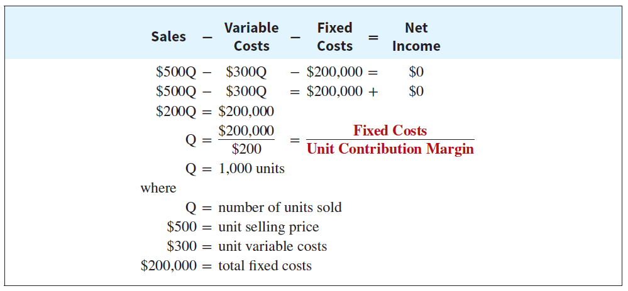
Break-Even Analysis
Mathematical Equation - Example
Using the Vargo Video data:
Where: Q = sales volume; $500 = selling price;
$300 = variable cost per unit; $200,000 total fixed costs
To find sales dollars required to break-even:
1,000 units X $500 = $500,000 (break-even sales dollars)

Slide 20
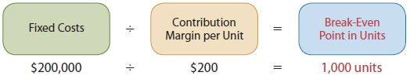
Break-Even Analysis
Contribution Margin Technique (1 of 2)
At the break-even point, contribution margin must equal total fixed costs (CM = total revenues – variable costs)
The break-even point can be calculated using either contribution margin per unit or contribution margin ratio
  When the break even point in units is desired, contribution margin per unit is used in the following formula:
Formula for break-even point in units using contribution margin

Slide 21
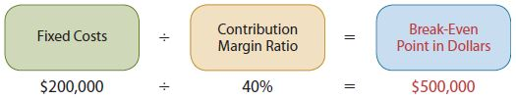
Break-Even Analysis
Contribution Margin Technique (2 of 2)
At the break-even point, contribution margin must equal total fixed costs (CM = total revenues – variable costs)
The break-even point can be calculated using either contribution margin per unit or contribution margin ratio
  When the break even point in dollars is desired, contribution margin ratio is used in the following formula:
Formula for break-even point in sales dollars using contribution margin ratio

Slide 22
Break-Even Analysis
Contribution Margin Technique - Example
Using Vargo Video data:
Formula for break-even point in units using contribution margin
Formula for break-even point in sales dollars using contribution margin ratio

Slide 23
Break-Even Analysis
Graphic Presentation
A cost-volume-profit (CVP) graph shows costs, volume, and profits
It is used to visually find the break-even point
To construct a CVP graph,
  Plot the total sales/revenue line starting at the zero activity level
  Plot the total fixed cost by a horizontal line
  Plot the total cost line (starts at the fixed cost line at zero activity)
  Determine the break-even point from the intersection of the total cost line and the total revenue line

Slide 24
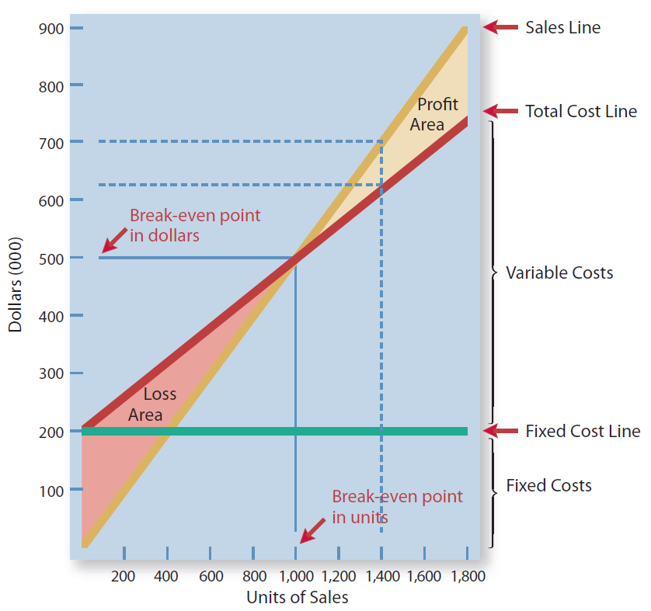
Break-Even Analysis
CVP Graph for Vargo Video
CVP graph

Slide 25
Let’s Review 3
How is the breakeven point in units calculated?
  Fixed costs divided by contribution margin ratio
  Net operating income divided by contribution margin per unit
  Fixed costs divided by contribution margin per unit
  Net operating income divided by contribution margin ratio

Slide 26
Let’s Review 3: Solution
How is the breakeven point in units calculated?
  Fixed costs divided by contribution margin ratio
  Net operating income divided by contribution margin per unit
  Fixed costs divided by contribution margin per unit
  Net operating income divided by contribution margin ratio

Slide 27
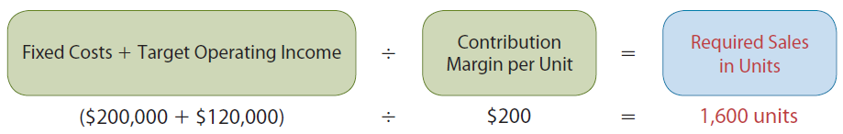
Break-Even Analysis
Target Operating Income Before Tax (1 of 2)
Using the Contribution Margin Approach and the Vargo Video Data:
Formula for required sales in units:
Formula for required sales in units using contribution margin per unit

Slide 28
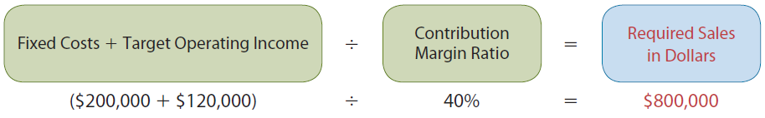
Break-Even Analysis
Target Operating Income Before Tax (2 of 2)
Using the Contribution Margin Approach and the Vargo Video Data:
Formula for required sales in dollars:
Formula for required sales in dollars using contribution margin ratio

Slide 29
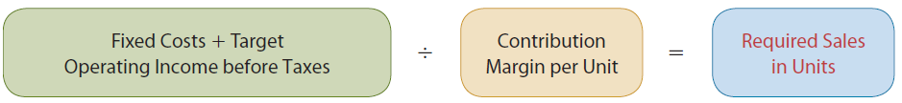
Break-Even Analysis
Target Operating Income After Tax (1 of 2)
Operating Income after taxes is calculated as:
Formula for required sales in units using contribution margin per unit
Calculation for required sales in units using contribution margin per unit

Slide 30
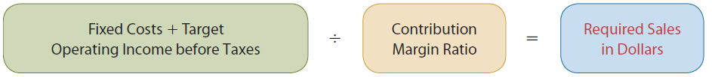
Break-Even Analysis
Target Operating Income After Tax (2 of 2)
Operating Income after taxes is calculated as:
Formula for required sales in dollars:
Formula for required sales in dollars using contribution margin ratio
Calculation for required sales in dollars using contribution margin ratio

Slide 31
Let’s Review 4
The Norman Company recorded net operating income of $51,000 on sales of $280,000. If the company’s variable costs were 60% of sales, fixed costs must have been
  $117,000.
  $112,000.
  $61,000.
  $137,400.

Slide 32
Let’s Review 4: Solution
The Norman Company recorded net operating income of $51,000 on sales of $280,000. If the company’s variable costs were 60% of sales, fixed costs must have been
  $117,000.
  $112,000.
  $61,000.
  $137,400.

Slide 33
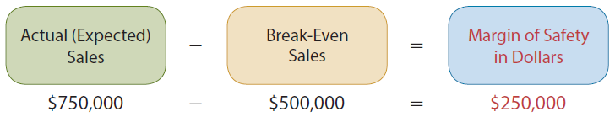
Break-Even Analysis
Margin of Safety
Difference between actual or expected sales and sales at the break-even point
May be expressed in dollars or as a ratio
Example:
To determine the margin of safety in dollars for Vargo Video, assuming that actual (expected) sales are $750,000:
Formula for margin of safety in dollars

Slide 34
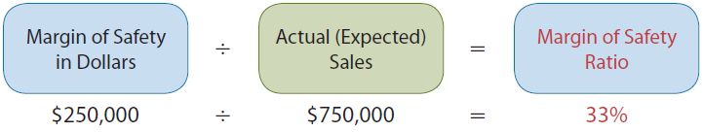
Break-Even Analysis
Margin of Safety Ratio
Calculated by dividing the margin of safety in dollars by the actual or expected sales (using Vargo Video data)
Formula for margin of safety ratio
Results indicate that Vargo Video’s sales could fall by 33 percent before it would be operating at a loss
The higher the dollars or the percentage, the greater the margin of safety

Slide 35
Let’s Review 5
The Margin of Safety refers to
  the amount by which profits exceeds breakeven sales.
  the amount by which sales exceeds breakeven sales.
  the amount by which sales exceeds expenses.
  the breakeven point.

Slide 36
Let’s Review 5: Solution
The Margin of Safety refers to
  the amount by which profits exceeds breakeven sales.
  the amount by which sales exceeds breakeven sales.
  the amount by which sales exceeds expenses.
  the breakeven point.

Slide 37
Sales Mix
Companies often sell more than one product
Critical decision: what mix of products to sell
Relative percentage in which each product is sold when more than one product is sold
Important because different products have substantially different contribution margins

Slide 38
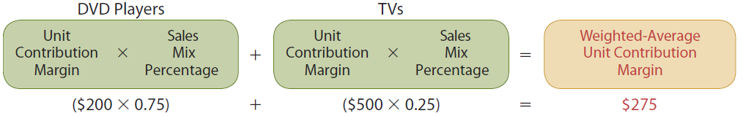
Sales Mix
Break-Even Sales In Units (1 of 2)
Steps for a mix of two or more products:
Step 1: Calculate the weighted-average unit contribution margin of all the products:
Weighted-average unit contribution margin

Slide 39
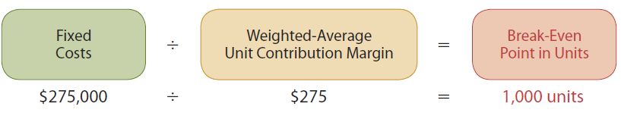
Sales Mix
Break-Even Sales In Units (2 of 2)
Steps for a mix of two or more products:
  Step 2: Calculate the break-even point in units:
Break-even points in units

Slide 40
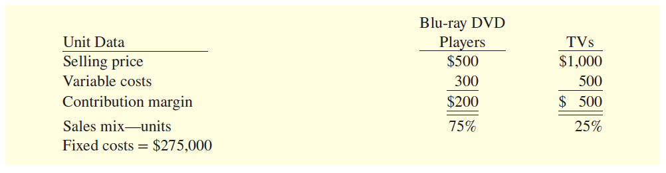
Sales Mix
Break-Even Sales In Units – Example (1 of 4)
Vargo Video Basic Data
  Sells both Blu-ray DVD players and TVs
  Fixed costs of $275,000
Per-unit data—sales mix

Slide 41
Sales Mix
Break-Even Sales In Units – Example (2 of 4)
Step 1: Determine weighted-average unit contribution margin for the sales mix of 75 percent DVDs and 25 percent TVs:
Weighted-average unit contribution margin

Slide 42
Sales Mix
Break-Even Sales In Units – Example (3 of 4)
Step 2: Determine the break-even point in units:
Break-even point in units

Slide 43
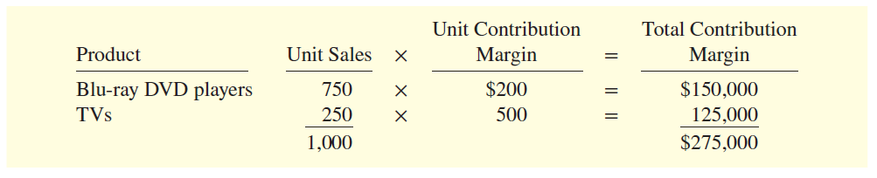
Sales Mix
Break-Even Sales In Units – Example (4 of 4)
Verify the number of DVDs and TVs to be sold to break-even with a sales mix of 75% DVDs, 25% TVs, and with fixed costs of $200,000:
Break-even proof—sales units
At any level of units sold, operating income will be greater if more high contribution margin units are sold than low contribution margin units.

Slide 44
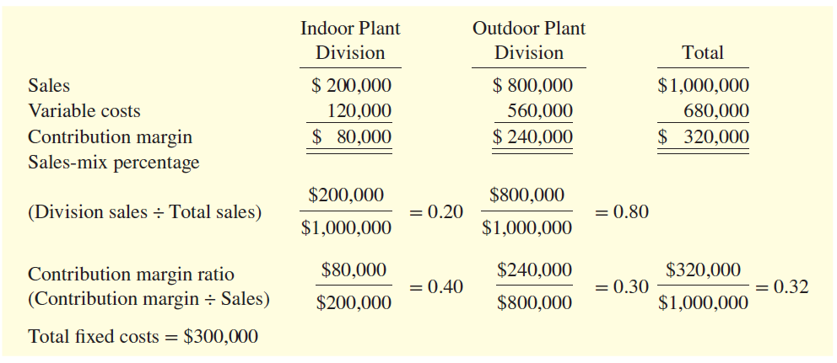
Sales Mix
Break-Even In Sales Dollars -Example
Kale Garden Supply
  Sells both indoor and outdoor plants
  Fixed costs of $300,000
Cost-value-profit data for Kale Garden Supply

Slide 45
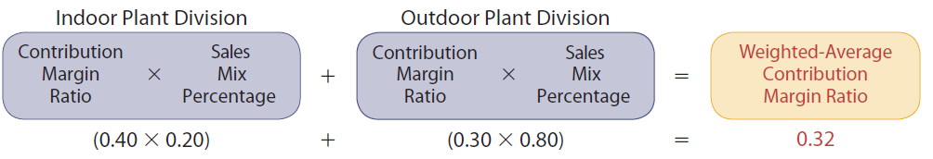
Sales Mix
Break-Even Sales in Units – Example (1 of 2)
Step 1: Determine weighted-average unit contribution margin ratio for the sales mix of 20 percent indoor plants and 80 percent outdoor:
Calculation of weighted-average contribution margin

Slide 46
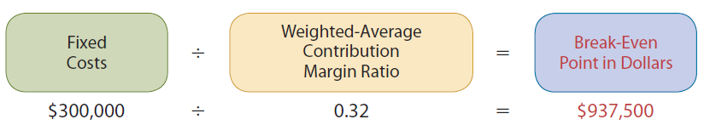
Sales Mix
Break-Even Sales in Units – Example (2 of 2)
Step 2: Determine the break-even point in dollars:
Calculation of break-even point in dollars

Slide 47
Let’s Review 6
In a multiproduct CVP analysis, the weighted average unit contribution margin is simply
  the contribution margin per unit.
  the contribution margin per average unit.
  the contribution margin per segment.
  the contribution margin per business unit.

Slide 48
Let’s Review 6: Solution
In a multiproduct CVP analysis, the weighted average unit contribution margin is simply
  the contribution margin per unit.
  the contribution margin per average unit.
  the contribution margin per segment.
  the contribution margin per business unit.

Slide 49
Cost Structure
Appendix 6 A
Cost structure refers to the relative proportion of fixed versus variable costs that a company incurs. Cost structure can have a significant effect on profitability.
  Effect on Contribution Margin Ratio
  Effect on Break-Even Point
  Effect on Margin of Safety Ratio

Slide 50
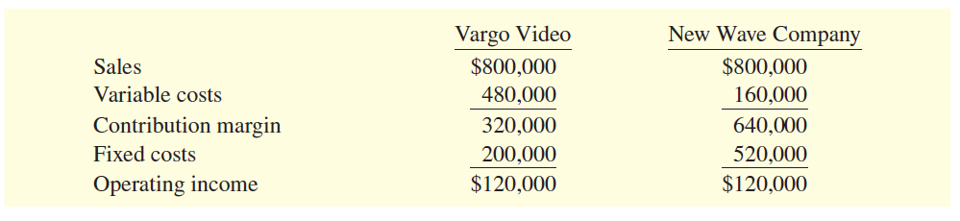
Cost Structure
Example (1 of 4)
CVP Income Statements for two companies:
CVP income statement for two companies

Slide 51
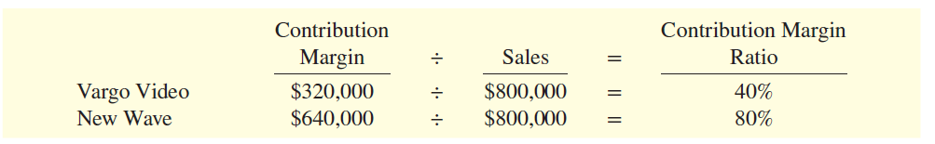
Cost Structure
Example (2 of 4)
Effect on Contribution Margin Ratio
Contribution margin ratio for two companies

Slide 52
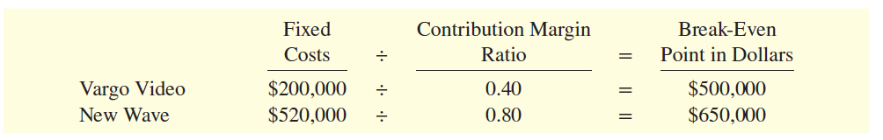
Cost Structure
Example (3 of 4)
Effect on Break-Even Point
Calculation for break-even point for two companies

Slide 53
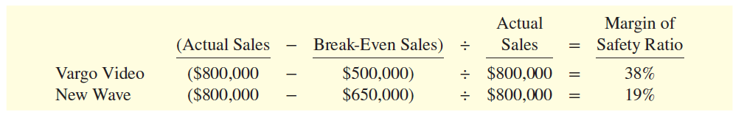
Cost Structure
Example (4 of 4)
Effect on Margin of Safety Ratio
Calculation for margin of safety ratio for two companies

Slide 54
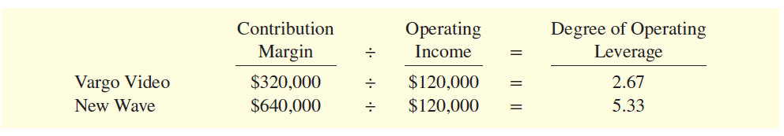
Operating Leverage: Appendix 6 A
The degree of operating leverage provides a measure
of a company’s earnings volatility and can be used to
compare companies.
Degree of Operating Leverage = Contribution Margin ÷ Operating Income
If both companies record a 10% decrease in sales.
Vargo Video’s operating income will decrease by 26.7% (2.67 x 10%).
New Wave’s operating income will decrease by 53.3 or (5.33 x 10%).

Slide 55
Let’s Review 7
Cost structure refers to the relative proportion of
  selling expenses versus administrative expenses.
  selling and administrative expenses versus cost of goods sold.
  gross margin versus sales.
  fixed costs versus variable costs.

Slide 56
Let’s Review 7: Solution
Cost structure refers to the relative proportion of
  selling expenses versus administrative expenses.
  selling and administrative expenses versus cost of goods sold.
  gross margin versus sales.
  fixed costs versus variable costs.

Slide 57
Copyright
Copyright © 2018 John Wiley & Sons Canada, Ltd.
All rights reserved. Reproduction or translation of this work beyond that permitted by Access Copyright (The Canadian Copyright Licensing Agency) is unlawful. Requests for further information should be addressed to the Permissions Department, John Wiley & Sons Canada, Ltd. The purchaser may make back-up copies for his or her own use only and not for distribution or resale. The author and the publisher assume no responsibility for errors, omissions, or damages caused by the use of these programs or from the use of the information contained herein.

