Slide 2
Chapter Overview
Developmental Issues, Prenatal Development, and the Newborn
Infancy and Childhood
Adolescence
Adulthood

Slide 3
Developmental Psychology’s Major Issues
Nature and nurture
  How is our development influenced by the interaction between our genetic inheritance and experiences?
Continuity and stages
  What parts of development are gradual and continuous and what parts change abruptly?
Stability and change
  Which of our traits persist and which change through life?

Slide 4
Prenatal Development
Zygote
  The life cycle begins at conception, when one sperm cell unites with an egg to form a zygote--fertilized egg; it enters a 2-week period of rapid cell division and develops into an embryo
Embryo
  The zygote’s inner cells become the embryo, and the outer cells become the placenta--developing human organism from about 2 weeks after fertilization through the second month
Fetus
  In the next 6 weeks, body organs begin to form and function, and by 9 weeks, the fetus is recognizably human.

Slide 5
Prenatal Development
Prenatal development is not risk-free.
  Teratogen
    Agent, such as a chemical or virus, that can reach the embryo or fetus during prenatal development and cause harm.
  Fetal alcohol syndrome (FAS)
    Physical and mental abnormalities in children caused by a pregnant woman’s heavy drinking. In severe cases, signs include a small, out-of-proportion head and abnormal facial features.

Slide 6
The Competent Newborn
Newborn
  Arrives with automatic reflex responses that support survival: Sucking, tonguing, swallowing, and breathing
  Cries to elicit help and comfort
  Searches for sights and sounds linked to other humans, especially mother
  Smells and sees well and uses sensory equipment to learn
  Possess a biologically rooted temperament
Notes:
Research equipment
Eye-tracking machines and pacifiers wired to electronic gear
Habituation
Fetuses adapted to vibrating, honking device on mother’s abdomen
Preferences
Newborns prefer face-like images and smell of mother’s body

Slide 7

NEWBORNS’ PREFERENCE FOR FACES
When shown these two images with the same three elements, newborns spent nearly twice as long looking at the facelike image on the left (Johnson & Morton, 1991).
Newborns—average age just 53 minutes in one study—seem to have an inborn preference for looking toward faces (Mondloch et al., 1999).

Slide 8
Infancy and Childhood: Physical Development
Brain cells are sculpted by heredity and experience.
  Birth: Neuronal growth spurt and synaptic pruning
  3-6 months: Rapid frontal lobe growth and continued growth into adolescence and beyond
  Early childhood: Critical period for some skills (i.e., language and vision)
  Throughout life: Learning changes brain tissue
Notes:
Nature and nurture together sculpt our synapses. Brain maturation provides us with a wealth of neural connections.
Experience—sights and smells, touches and tugs—activate and strengthen some neural pathways while others weaken from disuse.

Slide 9

Physical Development
Brain maturation and infant memory
  Infants are capable of learning and remembering.
  Infantile amnesia may reflect conscious memory.
Aurelie and Morgan David de Lossy/Cultura/Getty Images
INFANT AT WORK
Babies only 3 months old can learn that kicking moves a mobile, and they can retain that learning for a month. (From Rovee-Collier, 1989, 1997.)
Notes:
What the conscious mind does not know and cannot express in words, the nervous system and our two-track mind somehow remember.

Slide 10
Infancy and Childhood: Motor Development
Motor skills
  Develop as nervous system and muscles mature
  Are primarily universal in sequence, but not in timing
  Are guided by genes and influenced by environment
  Involve the same sequence throughout the world

Slide 11
Motor Development: Walking
In U.S., 25% walk by 11 mos; 50% walk by 12 mos; 90% by 15 mos.
Novice walkers
  Fell 32 times in average hour
  Took 1500 steps per hour
  Traveled three times distance as crawlers
  Saw whole room
Back to sleep position associated with later crawling, but not later walking

Slide 12
Infancy and Childhood: Cognitive Development
Piaget
  Children are active thinkers
  Minds develops through series of universal, irreversible stages from simple reflexes to adult abstract reasoning
  Children’s maturing brains build schemas which are used and adjusted through assimilation and accommodation

Slide 13
Piaget’s Theory and Current Thinking
Sensorimotor stage (birth to nearly 2 years)
  Tools for thinking and reasoning change with development
    Adaptation
    Assimilation
    Accommodation
  Object permanence
    Awareness that things continue to exist even when not perceived
Notes:
Schema
Concept or framework that organizes and interprets information
Assimilation
Interpreting our new experiences in terms of our existing schemas
Accommodation
Adapting our current understandings (schemas) to incorporate new information

Slide 14
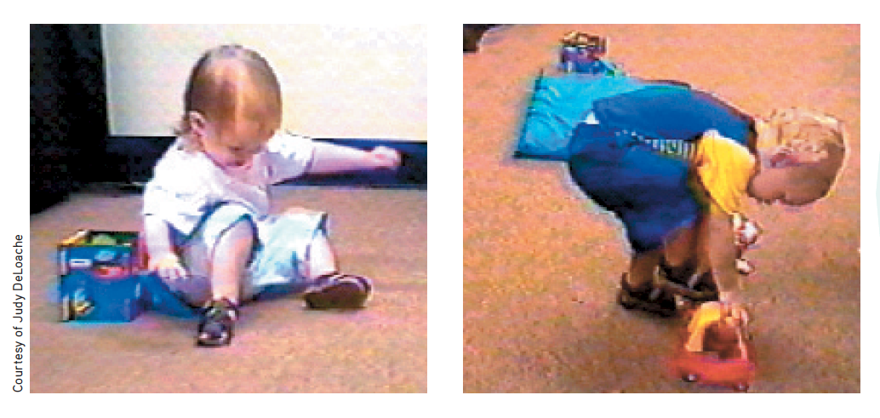
SCALE ERRORS
Children age 18 to 30 months may fail to take the size of an object into
account when trying to perform impossible actions with it. At left, a 21-month-old attempts to slide down a miniature slide. At right, a 24-month-
old opens the door to a miniature car and tries to step inside (DeLoache et al., 2004).

Slide 15
Piaget’s Theory and Current Thinking
Preoperational stage (about 2 to 7 years)
  Child learns to use language but cannot yet perform the mental operations of concrete logic
  Conservation
  Egocentrism/curse of knowledge
Notes:
Conservation
Principle (which Piaget believed to be a part of concrete operational reasoning) that properties such as mass, volume, and number remain the same despite changes in shapes.

Slide 16
Piaget’s Theory and Current Thinking
Theory of mind
  Involves ability to read mental state of others
  Between 3½ and 4½, children worldwide use theory of mind to realize others may hold false beliefs
  By 4 to 5, children anticipate false beliefs of friends
Notes:
Figure 15.9 (Inspired by Baron-Cohen et al., 1985.)

Slide 17
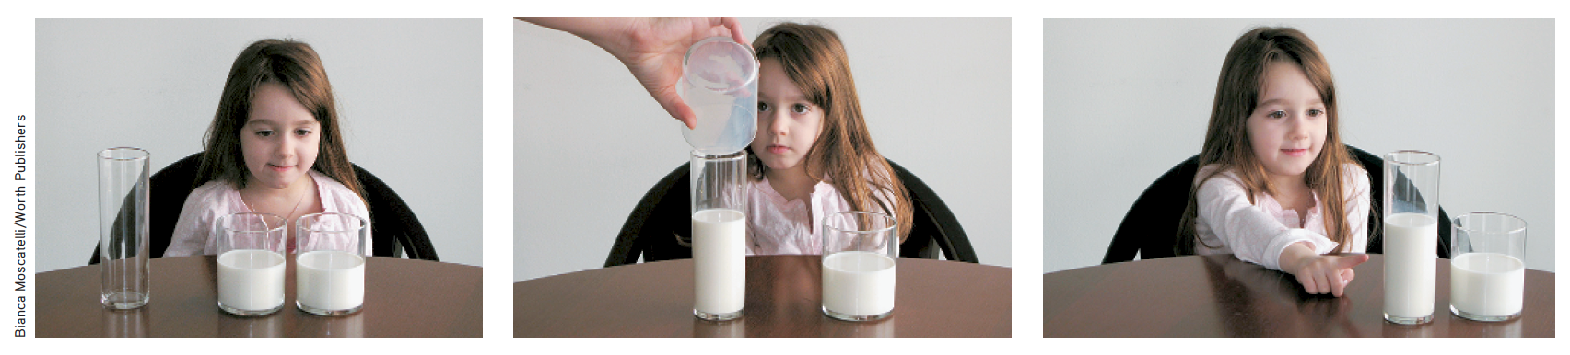
PIAGET’S TEST OF CONSERVATION
This preoperational child does not yet understand the principle of conservation. When the milk is poured into a tall, narrow glass, it suddenly seems like “more” than when it was in the shorter, wider glass. In another year or so, she will understand that the amount stays the same even though it looks different.
Notes:
PLEASE INSERT FIGURE 15.8 HERE

Slide 18
Piaget’s Theory and Current Thinking
Concrete operational (7 to 11 years)
  Children gain the mental operations that enable them to think logically about concrete events.
  They begin to understanding change in form before change in quantity and become able to understand simple math and conservation.
Formal operational (12 through adulthood)
  Children are no longer limited to concrete reasoning based on actual experience.
  They are able to think abstractly.

Slide 19
An Alternative Viewpoint: Vygotsky and the Social Child
Children’s minds grow through interaction with the physical environment.
By age 7, children are able to think and solve problems with words.
Parents and others provide a temporary scaffold to facilitate a child’s higher level of thinking.
The language of the child’s culture in internalized, inner speech is used.

Slide 20
Reflecting on Piaget’s Theory
Piaget identified significant cognitive milestones and stimulated global interest in cognitive development.
Research findings suggest that the sequence of cognitive milestones unfold basically as Piaget proposed.
Development is more continuous than Piaget theorized.
Children may be more competent than Piaget’s theory revealed.
Notes:
It is useful to remember
Young children are incapable of adult logic.
Children are not passive but active learners.
Child cognition flourishes when adults build on what children know, engage them in concrete demonstrations, and stimulate creative thinking.
Children’s cognitive immaturity is adaptive.

Slide 21
Autism Spectrum Disorder (ASD)
Children with ASD have impaired theory of mind, social deficiencies, and repetitive behaviors.
  Reading faces and social signals is challenging for those with ASD.
  Underlying cause of ASD is attributed to poor communication among brain regions that facilitate theory of mind skills and genetic influences
Notes:
ASD has differing levels of severity.

Slide 22
Autism Spectrum Disorder (ASD)
Prevalence of ASD
  Four boys for every girl
  Higher when prenatal testosterone/extreme male brain exists
  Higher among elite math students and progeny of engineers and MIT graduates
  Higher when identical co-twin has ASD; younger ASD sibling heightens risk
Notes:
By age 8, 1 in 68 U.S. children now gets diagnosed with ASD, though the reported rates vary by place. The increase in ASD diagnoses has been offset by a decrease in the number of children with a “cognitive disability” or “learning disability,” suggesting a relabeling of children’s disorders.

Slide 23
Social Development
Infant attachment
  Emotional tie with another person; shown in young children by their seeking closeness to the caregiver, and showing distress on separation
  At about 8 months, soon after object permanence develops, children separated from their caregivers display stranger anxiety.
  Infants form attachments not simply because parents gratify biological needs but, more importantly, because they are comfortable, familiar, and responsive.
Notes:
Stranger anxiety
Fear of strangers that infants commonly display, beginning by about 8 months of age

Slide 24
Social Development
Another key to attachment is familiarity.
  Critical period: Optimal period early in the life of an organism when exposure to certain stimuli or experiences produces normal development
  Imprinting: Process by which certain animals form strong attachments during early life (Lozenz, 1937)

Slide 25
Social Development
Studying attachment
  Strange situation experiments show that some children are securely attached and others are insecurely attached
  Infants’ differing attachment styles reflect both their individual temperament and the responsiveness of their parents and child-care providers
  Early attachment has impact on later adult relationships and comfort with affection and intimacy
Notes:
Adult relationships seem to reflect the attachment styles of early childhood, lending support to Erik Erikson’s idea that basic trust is formed in infancy by our experiences with responsive caregivers.

Slide 26
Social Development
Attachment differences as measured by strange situation: Ainsworth (1979)
  Secure attachment
  Insecure attachment
Notes:
Secure attachment
Shown by 60 percent of infants
In their mother’s presence, they play comfortably, happily exploring their new environment. When she leaves, they become upset. When she returns, they seek contact with her.
Sensitive, responsive mothers had infants who were securely attached.
Insecure attachment
Infants avoid attachment or show insecure attachment, marked by either anxiety or avoidance of trusting relationships. They are less likely to explore their mother. When she leaves, they might cry loudly and remain upset.
Avoidantly attached infants seem not to notice or care about her departure and return.
Insensitive, unresponsive mothers often had infants who were insecurely attached

Slide 27
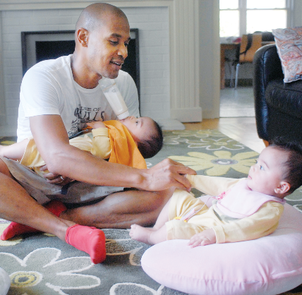
Social Development
Temperament and attachment
  Difficult: Irritable, intense, and unpredictable.
  Easy: Cheerful, relaxed, and feeding and sleeping on predictable schedules
Parenting programs
  Some programs can increase parental sensitivity and infant attachment security
d85/ZUMA Press/Newscom
FULL TIME DAD Financial analyst Walter Cranford, shown here with his baby twins, is one of a growing number of stay-at-home dads. Cranford says the experience has made him appreciate how difficult the work can be: “Sometimes at work you can just unplug, but with this you’ve got to be going all the time.”
Notes:
Temperament—a person’s characteristic emotional reactivity and intensity; temperament is genetically influenced.

Slide 28
Dual Parenting Facts
Some hard facts about declining father care: | Some encouraging findings:
Increased father separation. From 1960 to 2010, the number of children in the United States living apart from their fathers more than doubled (Livingston & Parker, 2011). | Active dads are caregiving more. Today’s co-parenting fathers are more engaged, with a doubling in the weekly hours spent with their children, compared with 1965 fathers (Livingston & Parker, 2011).
Increased father absence. Only one in five absent fathers say they visit their children more than once a week, and 27 percent say they have not seen their children in the last year (Livingston & Parker, 2011). | Couples that share housework and child care are happier in their relationships and less divorce prone (Wilcox & Marquardt, 2011).
Nonmarital births predict father separation. Increased father absence accompanies increased nonmarital births. Even among couples cohabiting when a first child is born, the 39 percent odds of their relationship ending during the child’s first years are triple the 13 percent odds of parental breakup among those who are married when their first baby is born (Hymowitz et al., 2013). | Dual parenting supports children, regardless of parent gender. The American Academy of Pediatrics (2013) reports that what matters is competent, secure, nurturing parents, regardless of their gender and sexual orientation. The American Sociological Association (2013) concurs: Decades of research confirm that parental stability and resources matter. “Whether a child is raised by same-sex or opposite-sex parents has no bearing on a child’s well-being.”
Notes:
Table 15.2

Slide 29
Social Development
Deprivation of attachment
  Most children growing up in adversity or experiencing abuse are resilient, but those who are severely neglected by their parents, or otherwise prevented from forming attachments at an early age, may be at risk for attachment problems
  Without a sharp break from an abusive past, children do not readily recover.

Slide 30

THE DEPRIVATION OF ATTACHMENT
Mike Carroll mike@carrollmj.com
In this 1980s Romanian orphanage, the 250 children between ages 1 and 5 outnumbered caregivers 15 to 1. When such children were tested after Romania’s dictator was assassinated, they had lower intelligence scores and double the 20 percent rate of anxiety symptoms found in children assigned to quality foster care settings (Nelson et al., 2009).

Slide 31
Self-Concept
Self-concept, an understanding and evaluation of who we are, emerges gradually.
6 months: Self-awareness begins with self recognition in mirror (Darwin)
15-18 months: Schema of how face should look apparent
School age: More detailed descriptions of gender, group membership, psychological traits, and peer comparisons
By 8-10 years: Self-image stable by 8 to 10 years

Slide 32
Parenting Styles
Parenting styles reflect varying degrees of control (Baumrind)
  Authoritative parents tend to have children with the highest self-esteem, self-reliance, and social competence.
  Permissive parents tend to have children who are more aggressive and immature.
  Authoritarian parents tend to have children with less social skills and self-esteem.

Slide 33
Parenting Styles
Culture
  Cultural values vary from place to place and from one time to another within the same place.
  Children have survived and flourished throughout history under various child-rearing systems.
  Diversity in child rearing should be a reminder that no single culture has the only way to raise children successfully.

Slide 34
Adolescence: Physical Development
Adolescence is the transition from puberty to social independence.
  Early maturing boys: More popular, self-assured, and independent; more at risk for alcohol use, delinquency, and premature sexual activity.
  Early maturing girls: Mismatch between physical and emotional maturity may encourage search for older teens; teasing or sexual harassment may occur.
  Teens: Frontal lobe development and synaptic pruning occur and may produce irrational and risky behaviors.

Slide 35
Adolescence: Cognitive Development
Developing reasoning power: Piaget
  Develop new abstract thinking tools (formal operations)
  Reason logically and develop moral judgment
Developing moral reasoning: Kohlberg
  Use moral reasoning that develops in universal sequence to guide moral actions
Notes:
Lawrence Kohlberg proposed a stage theory of moral reasoning, from a preconventional morality of self-interest, to
a conventional morality concerned with upholding laws and social rules, to (in some people) a postconventional morality of universal ethical principles.

Slide 36
Adolescence: Cognitive Development
Moral intuition
  Haidt: much of morality rooted in moral intuitions that are made quickly and automatically
  Greene: Moral cognition is often automatic but can be overridden.
Moral action
  Moral action feeds moral attitudes.
  Mischel: ability to delay gratification linked to more positive outcomes in adulthood

Slide 37
Kohlberg’s Levels of Moral Thinking
Level (approximate age) | Focus | Example
Preconventional morality (before age 9) | Self-interest; obey rules to avoid punishment or gain concrete rewards | “If you save your dying wife, you’ll be a hero.”
Conventional morality (early adolescence) | Uphold laws and rules to gain social approval or maintain social order | “If you steal the drug for her, everyone will think you’re a criminal.”
Postconventional morality (adolescence and beyond) | Actions reflect belief in basic rights and self-defined ethical principles | “People have a right to live.”
Notes:
Table16.1

Slide 38
Adolescence: Social Development
Adolescence struggle involves identity versus role confusion-continuing into adulthood.
Social identity involves the “we” aspect of self-concept that comes from group memberships.
Healthy identity formation is followed by a capacity to build close relationships.
Notes:
The task is to solidify a sense of self by testing and blending various roles

Slide 39
Adolescence: Parent and Peer Relationships
People seek to fit in and are influenced by their groups, especially during childhood and teen years. Influence of parents and peers is complementary.
Parents
  Parent-child arguments increase but most adolescents report liking their parents. Argument content often gender-related.
Peers
  Peers influence behavior, social networking is often extensive, and exclusion can be painful or worse.

Slide 40
Adolescence: Parent and Peer Relationships
Parents
Are more important when it comes to education, discipline, charitableness, responsibility, orderliness, and ways of interacting with authority figures
Peers
Are more important for learning cooperation, for finding the road to popularity, for inventing styles of interaction among people of the same age

Slide 41
What Happens Next?
Emerging adulthood
  Includes the time from 18 to mid-twenties in a not-yet-settled phase of life
  Characterized by not yet assuming adult responsibilities and independences and feelings of being “in between”
  May involve living with and still being emotionally dependent on parents
  Found mostly in today’s Western cultures

Slide 42

Adulthood
What do you think? What
age range would you put in
each blank?
Early adulthood: ________
Middle adulthood: ________
Late adulthood: ________
Remember, though, that within each of these stages, people vary widely in physical, psychological, and social development.
Rick Doyle/CORBIS
Notes:
Early adulthood: Roughly twenties and thirties
Middle adulthood: To age 65
Late adulthood: Years after 65
In 2008, George Blair (93 yo) maintained his place in the record books as the world’s oldest barefoot water skier.

Slide 43
Adulthood: Physical Development
Early adulthood
  Muscular strength, reaction time, sensory keenness and cardiac output peak in mid-twenties.
Middle adulthood
  Physical vigor more closely linked to health and exercise than age
  Physical decline is gradual; gradual decline in fertility
  Female: menopause; Male: gradual decline in sperm count, testosterone level, erection and ejaculation speed

Slide 44
Adulthood: Physical Development
Late adulthood
  Life expectancy worldwide increased from 46.5 to 70 years; telomeres tips shorten
  Visual sharpness, distance perception, and stamina diminish; pupils shrink and become less transparent
  Immune system weakens and susceptibility to life-threatening disease increases
  Neural processing lag occurs; brain regions related to memory begin to atrophy; speech slows
  Exercise slows aging and stimulates brain cell development and neural connections

Slide 45
Adulthood: Aging and Memory
Early adulthood is peak time for some learning and memory.
Middle adulthood shows greater decline in ability to recall rather than recognize memory.
Late adulthood is characterized by better retention of meaningful than meaningless information, longer word production time.
End of life is characterized by terminal decline; typically occurs during last four years of life
Notes:
Developmental researchers study age-related changes such as in memory with cross-sectional studies (comparing
people of different ages) and longitudinal studies (retesting the same people over a period of years).

Slide 46
Neurocognitive disorders (NCD) and Alzheimer’s disease
Neurocognitive disorders (NCDs)
  Acquired (not lifelong) disorders marked by cognitive deficits
  Often related to Alzheimer’s disease, brain injury or disease, or substance abuse
  Results in the erosion of mental abilities that is not typical of normal aging
Alzheimer’s disease
  Marked by neural plaques, often with an onset after age 80
  Entails a progressive decline in memory and other cognitive abilities

Slide 47
Neurocognitive disorders (NCD) and Alzheimer’s disease
Disease progression
  Memory, then reasoning, deteriorates. As the disease continues to run its course: Emotional flatness, disorientation and disinhibition, incontinence, and mental vacancy occurs
Neural involvement
  Loss of brain cells and deterioration of acetylcholine-producing neurons; protein fragments that accumulate as plaque
  Degeneration of critical brain cells and activity in Alzheimer’s related brain area

Slide 48
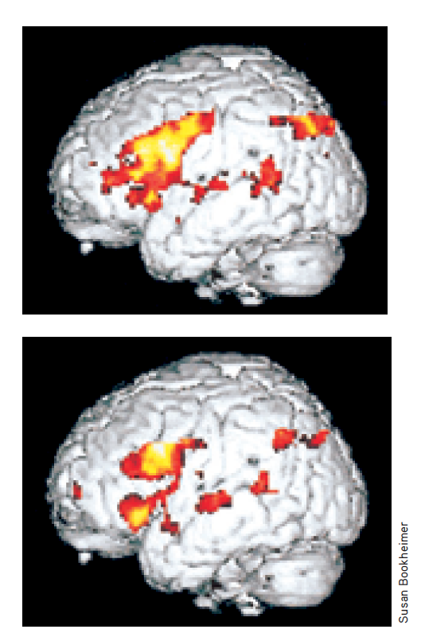
PREDICTING ALZHEIMER’S DISEASE
During a memory test, MRI scans of the brains of people at risk for Alzheimer’s (top) revealed more intense activity (yellow, followed by orange and red) when compared with normal brains (bottom).
As brain scans and genetic tests make it possible to identify those likely to suffer Alzheimer’s, would you want to be tested?
At what age?

Slide 49
Adulthood: Ages and Stages
Transitions
  Midlife transition occurs in early forties
  Social clock varies from era to era and culture to culture
  Change events have lasting impact
Commitments
  Intimacy (forming close relationships)
  Generativity (being productive and supporting future generations)

Slide 50
Adulthood: Social Development
Adulthood’s commitments: Love
  Pair-bonding
  Romantic attraction and chance encounters
  Proximity
Notes:
Sigmund Freud (1935) put it most simply: The healthy adult, he said, is one who can love and work.

Slide 51
Adulthood Commitments
Marriage
  Satisfaction related to shared interests and values, mutual emotional and material support, and self-disclosure
  Marriage is predictive of happiness, sexual satisfaction, income and mental health.
Divorce
  Divorce rates related to women’s increased ability to support themselves and their higher expectations for a mate
  Trial marriage related to higher divorce rates

Slide 52
Adulthood: Social Development
Adult’s commitments: Work
  Work provides a sense of competence, accomplishment, and self-definition for many adults.

Slide 53
Well-Being Across the Life Span
Positive feelings grow after midlife and negative feelings decline.
Older adults report less anger, stress, and worry and have fewer social relationship problems.
Brain-wave reactions to negative images diminish with age.
At all ages, people are happiest when they are not alone.
Notes:
People over 65 report as much happiness and satisfaction with life as younger people do.

Slide 54
Death and Dying
Grief
  Grief is severe when loved one’s death comes suddenly and before expected time.
  Grief reactions vary by culture and individuals within cultures
Unconfirmed beliefs
  Immediately expressed grief is not necessarily purged faster.
  Adjustment time with or without grief counseling are about equally effective.
  Terminally ill and grief-stricken people do not go through identical stages.
Notes:
Strong expressions of emotion do not purge grief, and bereavement therapy is not significantly more effective
than grieving without such aid. Erikson viewed the late-adulthood psychosocial task as developing a sense of integrity (versus despair).

