Slide 1
COIS 2020H
Data Structures and Algorithms

Slide 2
About your instructor
Brian Srivastava – AKA Sri
BSc Theoretical Physics, Guelph 2002. MSc, Trent Comp sci 2009.
Currently PhD Student at Western in Comp Sci, game development

Slide 3
Overview
This course is about how to represent data in computer memory
And how to organize it for efficiency (searching and sorting), while keeping in mind what types of things you might be searching or sorting for

Slide 4
Schedule
Lecture 1: Big Oh Notation Asymptotic Analysis
Lecture 2: Classes and Objects, Information Hiding, Data Members/Methods
Lecture 3: Array Lists
Lecture 4: Linked List
Lecture 5: More Big Oh Analysis, Abstract classes, Dynamic Binding
Lecture 6: Stacks, Queues, Hash Table
Lecture 7: Introduction to Trees
Lecture 8: Binary Search Trees
Lecture 9: Searching and Sorting
Lecture 10: AVL Tree, Red-Black Tree, Splay Tree
Lecture 11: 2-3 Tree, B-Tree
Lecture 12: Overall Review

Slide 5
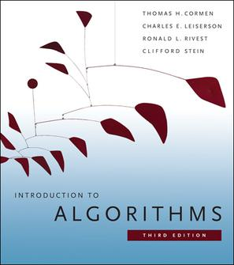
Textbook – ugh…
This is the standard book on algorithms
It’s language agnostic
There are a number of algorithms we won’t get to (3020 maybe?)
It’s the standard algorithms book in industry and academia

Slide 6
Is there another book?
Why not others? Because C# is not the most popular language to teach data structures in, that’s more C++ or Java (or maybe Python now). But you still need to have data structures in C#, so there’s documentation on how to do it (largely through MSDN), and we have to muddle through.
MSDN for C# programming: https://docs.microsoft.com/en-us/dotnet/csharp/index

Slide 7
So Why C# Then?
Well because that’s what you use in 1020 basically
C# and Java aren’t wildly different.
In fact if you copy and paste most Java code except for the ‘print’ type commands it all works, notably all of the stuff relevant to building a data structure. If it works in Java it probably works in C#
We aren’t a Java shop and don’t really want to be (it’s in other courses), and you need to learn to write actual applications somewhere.

Slide 8
Alternatives
Given the rising popularity of Python, you can use python
Locally C/C++ are quite popular with manufacturing companies (and they remain quite popular globally) so you can go that route too

Slide 9
Evaluations
5 Assignments 50% (10% each)
10 Lab exercises 20% (2% each)
Final Examination 30%

Slide 10
Labs
Labs are intended to be done in class (and evaluated starting this week) bring your laptop, if you don’t have one you can work with someone else, or you can use an IT computer in OC 202 (what we call the ATOP lab)
But! We realize some of you cannot make it here on time so as long as you show me a completed lab by the next week it’s fine

Slide 11
Visual Studio
For this course you will need VS 2017 or 2019. I believe this was to do with building template classes (which is pretty key to the whole thing)
IIRC 2019 is smaller than 2017.. So use 2019 like a sane person

Slide 12
Today We’ll do Theory
So today we’ll talk theory, next class we will lead into programming tutorials and so on.

Slide 13
1020
1020H is largely about working through the logic of a program and getting it do what you want (loops, if statements, declaring variables etc.)
That crops up in 2020H as well, but now we are primarily interested in efficiently organizing our data, so that when we, for example loop over all of the data that operation is as quick as possible.
Which takes us to… data

Slide 14
Structures and Classes
The most rudimentary of constructs in object oriented programming are the structure, and a class.
These are the blueprint for data you want to keep together in some way.
E.g. a struct student might contain
{ string: student number
string: name (or maybe two strings one for first and last name)
int/string/????/: date of birth
int/float: account balance
list of courses taken and grades… what’s a list exactly? hmmm
}

Slide 15
A Class vs. A Struct
A struct is really just a collection of types glued together with a common name
A class takes a struct, and adds the ability to perform operations on it
Class student
{ all the variables of the struct on previous slide
Method: create new student
Method: change account balance
Method: add/remove courses
Method: change grade in a course
etc…
}

Slide 16
Programs
Real programs tend to work with a large collection of classes of objects (an object is an instance of a class)
The idea is to efficiently organise these collections of data
Classes isolate themselves from each other, so you can change, for example, what a ‘character’ is without changing any code related to terrain, or change the data student has without changing anything related to faculty.

Slide 17
2240
2240 is about the design of appropriate responsibility for each class and how to interrelate them. 2240 asks: what should the software do?
2020 is about how to organize data within a class, or how to have many objects organized in a way that you can search or sort for the correct one (in whatever sense you mean ‘correct’). 2020 asks: how does the software do it?

Slide 18
Class Responsibility
E.g. Your assignment 1, you are going to make a grid, and objects that are somewhere on the grid
Does the object know it’s location on the grid? Does the grid (or cells on the grid) know which objects are on it?
Do you have one master ‘list’ of cells and objects? How do they pass information to each other?
Do cells on the grid need to have a quick way to access their neighbours?
What if you want to know the nearest object to another object?
What if you want to know all objects within X distance of an object?

Slide 19
Other Data Structures Problems
How difficult is it to find the oldest student in the room? (or the tallest or shortest?)
How about sorting the class alphabetically?
Could we store lists of those things – and if so how much memory would it take?
Does anyone at the university have a 86% average?
Could you find a list of everyone who has ever graduated with > 86?
How do we do that efficiently?

Slide 20
Two Questions for today
1. What is data?
2. How do we analyse our algorithm?

Slide 21
What is Data?
Data is the stuff we want to store
But importantly we need to build that data into some sort of structure, and then figure out a way to represent it
We then need to find a way to save and load and transmit that data
And we may need to represent it in binary

Slide 22
Built in Data Types
Bool
Byte
sbyte (signed byte)
Char
Decimal
Double
Float
Int
Uint
Long
Ulong
Object
Short
Ushort
String

Slide 23
2300H
The representation of values, particularly the tricky ones is the realm of 2300H
A bool is just a bit. A byte is 8 bits, a signed byte is a byte, where the first bit means a sign.
More complicated are decimal and float, where some bits are allocated to the sign, the mantissa (fraction part) and the exponent

Slide 24
Two Problems
Saving and transmitting – what does it mean to take data and transmit it, and then reconstruct the form it was in?
Binary representation of non trivial types (e.g. structs) are mostly outside the scope of this course.

Slide 25
Term: “Data Structure”
They are a full implementation of an abstract data type
Abstract data types are what a user thinks some data represents and should do. (Queue, a list, a priority queue etc.)
Working with data structures is the basis of algorithms. An inefficient data structure results in inefficient algorithms (for a particular problem).
Real data structures worry a lot about trade-offs between competing goals (mostly speed – storage usage, and sometimes how difficult it is to implement)

Slide 26
Data Structures
At a basic level it’s just a collection of primitives and some way to connect them together
In the parlance these are collections, and different types of collections will have different properties. Some will be easy to search, or easy to sort, maybe they will get created in a sorted fashion, some are easy to add things to, some aren’t.
Searching and sorting is the business of computer science. We are going to start into how to do this well.

Slide 27
Some Simple Data Structures
An Array: A bunch of objects/structs stored in a fix size in order block
A (linked) list: A list where each object is only connected to the next element in the list
A doubly linked list: each object is connected to the previous and next elements
A stack… like a stack of books. You put something on top of the stack, and you take things off the top of the stack
Queue: Like a line at a ticket counter, first in, first out
Priority Queue: Like a line at a hospital, the person most likely to die goes first
(There are others as well, we will get there)

Slide 28
Simple Standard Operations
Create Data Structure
Add/Insert
Remove one element
Delete the whole thing
Find (search)
Print All

Slide 29
Build Your Own Data Structures?
Most common data structures (including the ones in this course) have been implemented better by someone else.
So they exist in libraries (C++ STL, Microsoft .NET framework etc.)
If you are tasked with a problem were you need to make a data structure though, you need to know how to build the easy stuff first
So I’m making you (partially) build most of the data structures we’re going to talk about.

Slide 30
Analysing Algorithms
There are two things to consider when thinking about algorithms
How quickly does it run (in an absolute sense)?
How well does it scale with a larger input size?
And of course, how to do you measure and calculate these things?

Slide 31
Two Methods
One is scientific observation of how your program runs
We’ll come back to that in other classes to, but in the simplest sense, you are timing it, and if you’re interested, timing it for different sets of input values.
The other is a mathematical model of how code behaves.

Slide 32
Building a Mathematical model of Code
We look at the cost of executing each statement
  That is to some degree a function of the system we are running on and outside our control (we might be able to pick better from the list of available instructions but that’s about it unless we do some hardware engineering)
And the frequency of execution of those statements
  So if we just compare the efficiency of a system with respect to input size we should be good? Maybe, maybe not. Some statements are easier to analyse than others

Slide 33
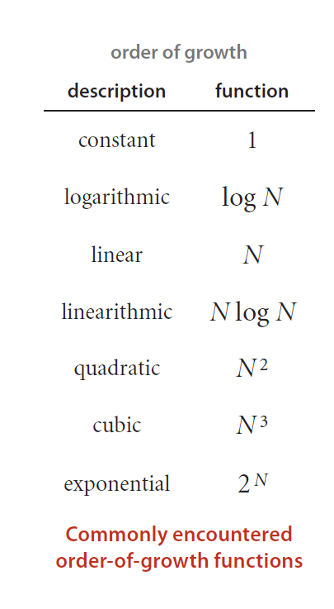
Ways Functions Grow
When we do this we are assuming a reasonably large N, that follows a trend
And that there aren’t execution level break points for whatever reason

Slide 34
Approximate Running Time
What we are looking at then is the approximate running time
We are doing this by estimating the order of growth
Generally we express this using what is called “Big-Oh” Notation. (there are other types of notation for other things)

Slide 35
Developing a Mathematical Model of Running Time
Develop an input model, including a definition of the problem size.
Identify the inner loop.
Define a cost model that includes operations in the inner loop.
Determine the frequency of execution of those operations for the given input.

Slide 36
Multiple Methods?
Most software has many methods
Consider each independently.
Figure out if they are multiplicative or additive, if they are additive usually we only worry about the one that grows fastest.

Slide 37
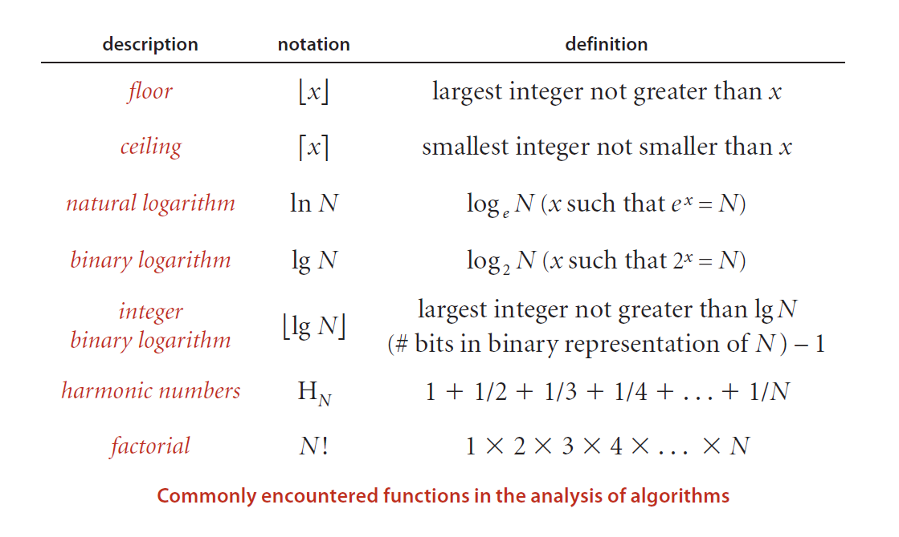
Some Semi-Common Notation

Slide 38
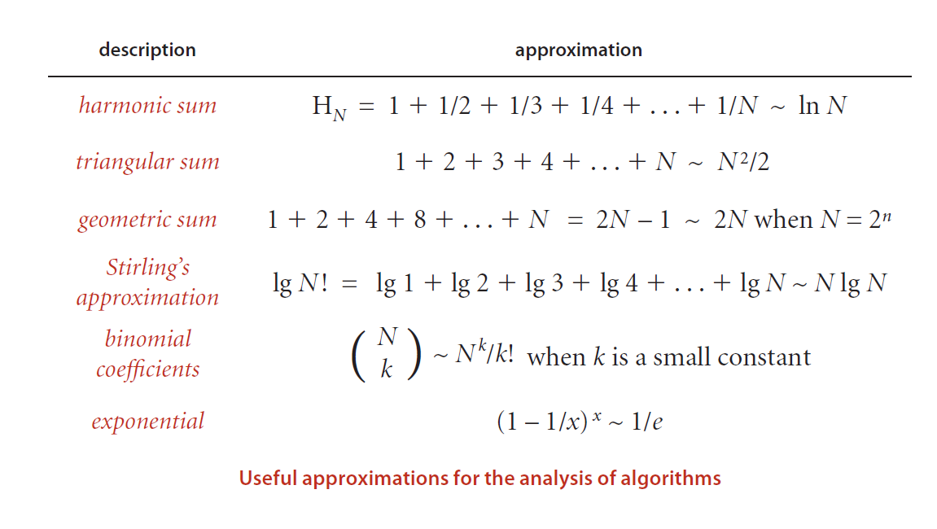
Some Useful Approximations

Slide 39
What Do I do With Those?
Until you have some code to analyse there isn’t much to do with that yet
But when you look at a data structure and an algorithm that does something with it you’ll need to be able to figure out how it grows

Slide 40
Order of Growth Classification
statements
conditionals
loops
nesting
method calls
That basically defines an algorithm.

Slide 41
Constant
Constant functions don’t depend on the input size
Most functions are actually constant in time, so we don’t think about it
int a = 5;
if (a == 5)
O(1)

Slide 42
Logarithmic
The next best thing to constant. This is O(logN)
It’s important to note – we don’t actually care about the base of the logarithm (2, e, 10 etc.) since they are all related by a constant factor
The easiest example of this is a binary search

Slide 43
Linear
This is where there is a constant running time per input
For each element in list
  Process the element
That’s O(N) assuming process the element is O(1), but you do it N times for N elements in a list
(E.g. Find the tallest person in the room)

Slide 44
Linearithmic
Linearithmic is only slightly worse than linear, NlogN
Take our previous example
For each element in list
  Process the element
If process element involved say a simple (binary) search or the like it could be linearithmic

Slide 45
Quadratic
This is where typical running time is O(N²).
For each element in list
  Process in relation to every element in the list
Numerous sorts are quadratic
Find how many of us have the same name/birthday etc (naïve implementation)

Slide 46
Cubic
Same thing only one more nested N
O(N³)

Slide 47
Exponential
This is when things go to hell fast
Here running times are proportional to 2^{N} or worse

Slide 48
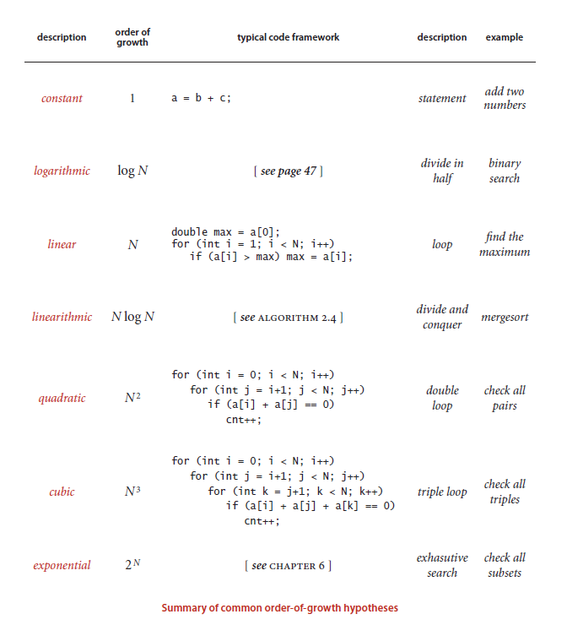
I clarify “page 47” “Algorithm 2.4” and
“chapter 6” on the next few slides

Slide 49
Page 47 (Binary Search)
BinarySearch(A[0..N-1], value) {
low = 0
high = N - 1
while (low <= high) {
// invariants: value > A[i] for all i < low
value < A[i] for all i > high
mid = (low + high) / 2
if (A[mid] > value)
high = mid - 1
else if (A[mid] < value)
low = mid + 1
else
return mid
}
return not_found // value would be inserted at index "low"
}

Slide 50
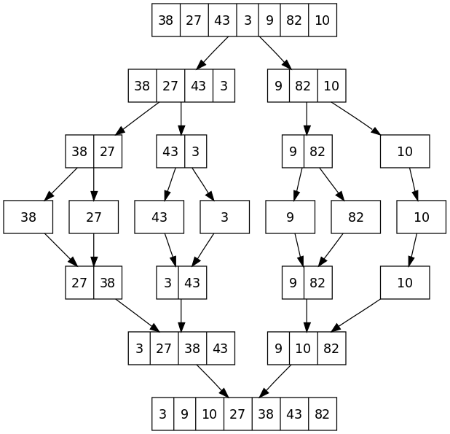
Algorithm 2.4 - MergeSort
Notes:
"Merge sort algorithm diagram" by Original uploader was VineetKumar at en.wikipedia - Transferred from en.wikipedia; transferred to Commons by User:Eric Bauman using CommonsHelper.. Licensed under Public Domain via Wikimedia Commons - http://commons.wikimedia.org/wiki/File:Merge_sort_algorithm_diagram.svg#/media/File:Merge_sort_algorithm_diagram.svg

Slide 51
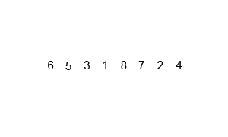
Notes:
"Merge-sort-example-300px" by Swfung8 - Own work. Licensed under CC BY-SA 3.0 via Wikimedia Commons - http://commons.wikimedia.org/wiki/File:Merge-sort-example-300px.gif#/media/File:Merge-sort-example-300px.gif

Slide 52
Quicksort example
function partition ( int A[ ], int low, int high )
{
  int pivot = A [ low ];
  int i = low - 1;
  int j = high + 1; // Partition A around the pivot
  do
  {
    while ( A [ --j ] > pivot );
    while ( A [ ++i ] < pivot );
    if ( i < j ) swap ( A [ i ], A [ j ] );
  }
  while ( i < j );
}

Slide 53
Quicksort
Best case: nlogn
Worst case: n²

Slide 54
“Chapter 6”
This is the worst case, where you can end up with problems that just start to explode in complexity quickly
The classic example is a Fibonacci series which just keeps doubling in size for each number but there are many other problems.
What is the longest path from here to Toronto using only roads?
What is the longest path from here to Toronto?
Those questions are sort of nonsense, but you need to detect that and avoid trying to solve it in any big system

Slide 55
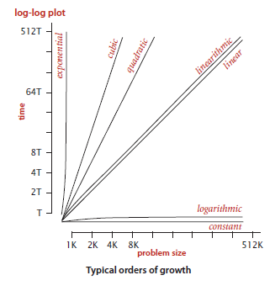
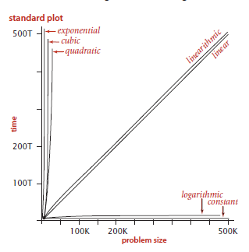
Order of growth

Slide 56
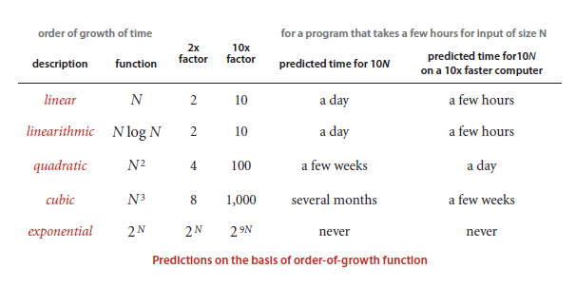
Just buy a faster computer!

Slide 57
Large constants.
When we say a function is O(N²) we really mean the run time is some constant c*N². As long as c is small this is fine. But c might not be small, and if the constant cost of an operation is very high, well that’s bad.
A simple example might be fetching some small file from the Internet, which is slow as molasses compared to fetching something from cache.

Slide 58
Nondominant inner loop.
When we do our analysis we look for some main program loop that is the one doing most of the work
But in practice that’s not exactly the case. You may have a few hundred thousand lines of code strewn out over hundreds of files. But the thing slowing you down is 15 lines in some obscure section of code that processes some tricky thing.
The idea that there is a single dominant loop makes analysis easy but it’s not always right. (and the same analysis process works anyway)

Slide 59
Instruction time.
Caching is wonderful and terrible.
The same instruction can have completely different characteristics depending on whether or not it is cached (or cacheable).

Slide 60
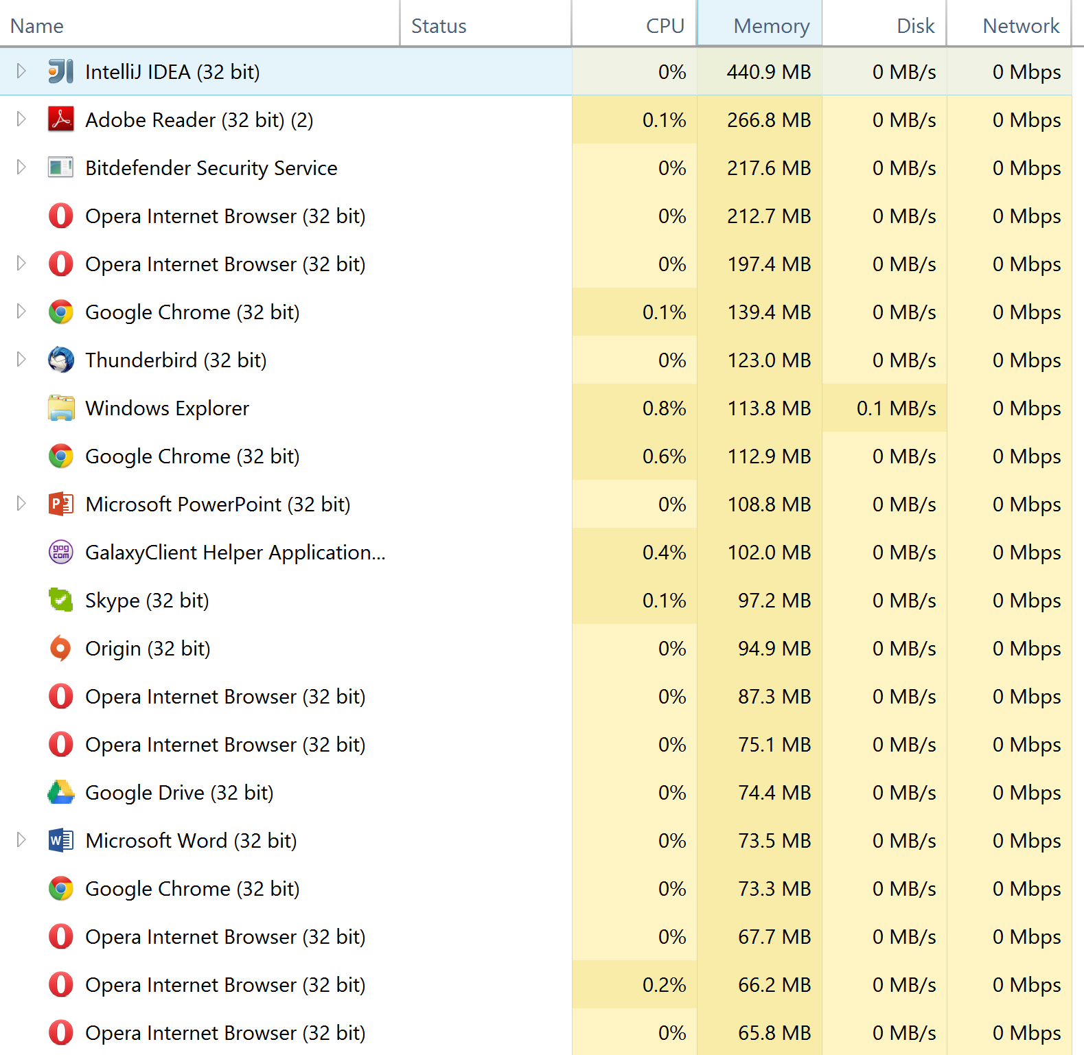
System considerations
Why is adobe using 266MB of memory to open a 9MB PDF?
What browser tabs do I have that need ~200 MB of memory, each?
Other stuff can slow your program down

Slide 61
Too close to call
Different programs can be situationally faster (or more correct or whatever)
And you can’t necessarily know just by timing a handful of cases which is best

Slide 62
Strong dependence on inputs
If you make our input processing a conditional, it can mean that the minimum, average, and worst case running times of a program are completely different big O’s
Lets say we read in a bunch of photo’s and batch process them (fix the lighting for example). 24Megapixel photos are going to take longer than 2megapixel ones.

Slide 63
Multiple problem parameters
What if we read in multiple file types? (Pictures and video)?
Lets say we have a data structure (with some data) and then we do some stuff with that data later
Both creating the data structure and the operations we do after are distinct problems, and which one is the dominant factor at run time depends on the data, and the operations.

Slide 64
Dependence on Input
We are making assumptions about what it means to read in data
Let’s say we have a program that we test with integers. Will it be the same with floats? Doubles? Some other number type?

Slide 65
Worst-case performance
This is when you are designing around the worst case scenario – where every operation every piece of data etc. is assumed to be the slowest possible
This is for things where timing and reliability are of the utmost importance
This is also potentially a security problem.

Slide 66
Randomized algorithms.
One of the odd quirks of data manipulation is that sometimes randomizing data is actually preferable.
With some sorting algorithms the worst case is when the data is already sorted (either sorted correctly, or sorted in the reverse order), in those cases it’s better to randomize your data – then sort it.
(Think sort by name on file explorer in Windows)

Slide 67
Sequences of operations
AKA- users suck
Lets say you have a stack. Putting down a bunch of data into the stack and taking one off at a time is easy
Putting in one thing onto the stack, then taking it off, then putting the next thing on the stack, and taking it off has very different performance characteristics

Slide 68
Amortized analysis
This where we are worried about the overall system cost. Some expensive operations are ok, as long as we don’t have too many of them
Or for too long
Lets say you have an array, but you want to add one more element to it than it can store, well expanding the array, as long as its rare isn’t a problem. Unless you expand it too much and break something.

Slide 69
Memory
Has all sorts of performance characteristics depending on type
SSDs vs HDDs. RAM properties, cache, network access etc.
You can count of memory used from the primitive types used in the data structures
Most structures (lists etc.) have some small amount of inherent overhead. Memory constrained people can care (e.g. embedded systems)

Slide 70
The Big Oh Today was from

Slide 71
Don’t buy it (well not for this course)
It’s a good book, but A: it’s java, B: it’s for 3rd year algorithms, C: it’s 969 pages long, and D: the only thing we need is chapter 1.5…which I just covered. The other 930 pages of the book are… uh… not suited to our problem.

Slide 72
Perspective
Performance comes in different flavours levels of concern.
Better performing applications are preferable, but programming and optimization time matter a lot.

Slide 73
Before We Get Into C#
So before we get into C# and looking at actual data structures and analysing them we needed a bit of a toolkit for how to have this discussion.
Some theory to mull over before we finish today:
Who is the oldest person in the room?
Who is the third oldest person in the room?

Slide 74
Overload
Because today is the first day I don’t want to overload people
This course combines programming, as an extension of 1020H, with some drawing/boardwork sort of theory on understanding how to organize data, and then there’s a little bit of maths to figure out how fast things are
It’s like this course actually involves science, in computing…

Slide 75
Administrative question:
Does anyone here not have a laptop capable of running visual studio 2017?
(We should be able to get by with 2012 in OC202 as well)
How many of you have Macs? In principle this should work on mac, in practice your easiest time might be installing windows but we can discuss that.

