Slide 1
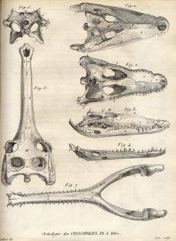
Chapter 2
Evolutionary Thinking Before Darwin
2.1 Transformism in Antiquity
  2.1.1 Anaximander (610-546)
  2.1.2 Empedocles(483-423)
  2.1.3 Democritus(460-360)
2.2 Classical thinkers
  2.2.1 Socrates (469-399) and Plato (427-347)
  2.2.2 Aristotle (384-322)
2.3 The impact of Christianity
2.4 From fixity of species to transformism
  2.4.1 Linnaeus (1707-1778)
  2.4.2 Buffon (1707-1788)
  2.4.3 Lamarck (1774-1829)
  2.4.4 Cuvier (1769-1832)
  2.4.5 Hutton (1728-1799) et Lyell (1797-1875)
Complementary Notes :
Chapter 2-complementary notes.pdf
Campbell biology: Chapter 22 :492-495
Notes:
Know the names and association of these people. These scientists influenced Darwin in his theory of evolution

Slide 2
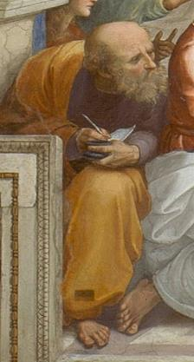
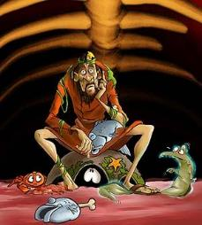
2.1 Transformism in Antiquity
2.1.1 Anaximander (610-546 BCE )
First philosopher to write his thoughts.
“Animals are born from the sea, by solar heat on water. They were first wrapped in spiny bark...as they aged, they migrated on the mainland. When the bark burst, they survived briefly in their new lifestyle.”
Thus, humans originated from fishes that attempted to invade the mainland.
Water is the central element of the universe.

Slide 3
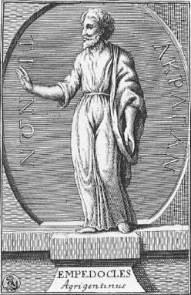
2.1 Transformism in Antiquity
2.1.2 Empedocles (483-423)
All structures of the world (matter) are made of four elements: earth,water,air and fire.
These elements are simple, eternal and unalterable
Two major forces interact constantly on these elements; love (attraction or harmony) and strife or hate (repulsion or discord).
Notes:
The interaction b/w love and hate resulted in the formation of beings. These forces were a part of the elements.

Slide 4
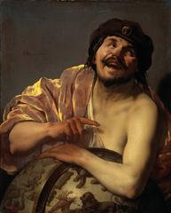
2.1 Transformism in Antiquity
2.1.3 Democritus (460-360)
The most “scientific” of the Greek philosophers.
Two realities: atoms and emptiness.
Matter: group of atoms in movement. An atom cannot be created of destroyed (atomic theory).
There is an intrinsic property, a force of atoms that creates shapes.
Humans and animals are born directly from dirt (spontaneous generation).
Notes:
Last of the pre Socratics. He found out about atoms through deduction.you can split an object into two pieces repeatedly until you discover a small object that can not be divided, this is known as an atom
The force of atoms was considered random.
Spontaneous generation was beloved to be true for a long period of time until it was falsified.

Slide 5
2.1 Transformism in Antiquity
Conclusion
Acts of creation are not due to gods_, but rather due to the innovative power of matter.
2. The origin of all things is not teleological (namely, with an ultimate goal), but is the result of chance.
Notes:
The appearance of species was considered random instead of having a purpose.
One can say that Darwin came back to this method.

Slide 6
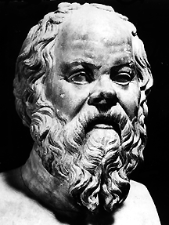
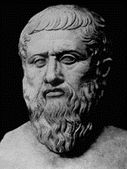
2.2 Classical Thinkers
2.2.1 Socrates (469-399 A.D.) – Plato (427-347 A.D.)
With the classical tradition, the materialistic approach of past philosophers gives way to more abstract questions and to the contemplation of the soul.
The important questions are not materialistic, but rather linked to a search and an understanding of the concepts of beauty, kindness, justice and sanity.
Arguments about logical, ethical and political questions are more interesting than the search for truth.
The answers are not found in nature, but within the self.
Notes:
Socrates was a great debater and viewed a question form both sides, philosophers ceased to look outside and began to look within.

Slide 7

2.2 Classical Thinkers
2.2.1 Socrates (469-399) – Plato (427-347)
Theories of Ideal Forms (Essentialism_): the visible, imperfect and changing realm which surrounds us is a poor imitation of an Ideal World (permanent and perfect that we possess at birth: the world of Ideal Forms).
The variation of forms is not important. Only the quest to define and understand the Ideal Form is important.
This philosophy will have a lasting impact on our perception of nature.
Gods are the creative forces.
Notes:
We are all born with a perfect view of the world and know the ideal images of everything and spend our lives trying to discover this, Compared to the ideal form, nature was filled with imperfection, Plato believed that nature in fact confused people with tits imperfections, nature was therefore not useful in learning in anything as we already knew everything.

Slide 8
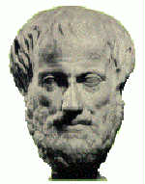
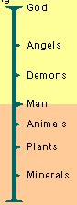
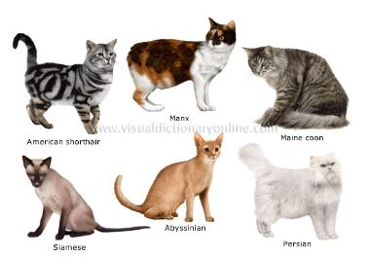
2.2 Classical Thinkers
2.2.2 Aristotle (384-322)
Does not believe in the innate aspect of the world of Ideal Forms.
It is important to describe the essence of living beings and this essence is observed in nature.
Believes that species are static (unchangeable). Thus, morphological variability is illusion and imperfection.
He is a vitalist and perceives multiple levels of soulswith cumulative effects: vegetal (plants), animate (animals) and rational (humanity).
Created the __scala naturae( great scale of beings) _____________) in which species are organised in a static and unchangeable hierarchy.
Notes:
We are not born with an ideal view of the world but we could find out the essence of things by looking at nature.
He viewed variations I. Nature as imperfections. He believed that species were fixed and morphological evolution was not possible.
Classical philosophers used god, Aristotle moved away from this. Aristotle believed in a hierarchy of the soul:
All plants had a vegetative soul, their soul allowed them to grow and reproduce
Animated soul: allowed animals to move and lower functions.
Rational souls: this was humans only
Surreal: god and angels
He bought a herachy onto nature and braught order into the natural world.

Slide 9
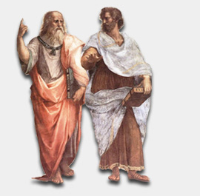
There is a world of Ideas or Forms that is totally separate from the material world. Every things or living beings that we observe with our senses is just a poor imitation of its perfect representation in the world of Forms. The world of forms is innate
.
There is no need to postulate the hypothetical existence of an innate world of Ideas or Forms. We determine the essence of things by __carefully examining the world around us.
Painting from Raphaël: public domain
2.2 Classical Thinkers
Plato
427-347 BCE
Aristotle
384-322 BCE
2.2 Classical Thinkers
Notes:
Aristotle believed that the innate idea was not possible.

Slide 10
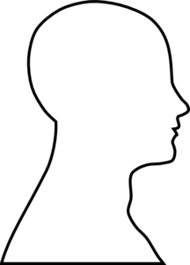
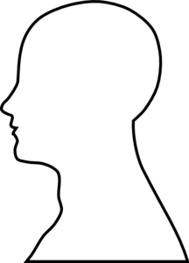


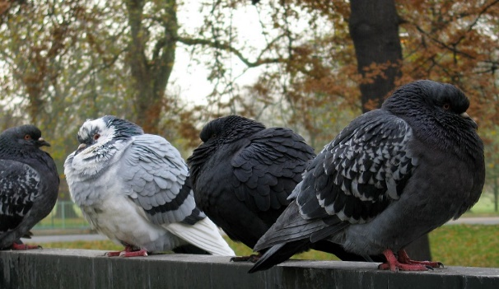
2.2 Classical Thinkers
Two visions of the Theory of Forms (Essentialism)
Plato
Aristotle
Notes:
Illustrons ces concepts avec un exemple.
Tout le monde a déjà observé la grande diversité de coloration du pigeon domestique.
Selon Platon, nous avons dès la naissance une image de la forme idéale d’un pigeon. La nature n’offre au sens que des formes imparfaites par rapport à cette forme idéale.
Pour Platon, la connaissance provient du raisonnement plutôt que de l’utilisation des sens et de l’observation de la nature.
Pour Aristote, l’utilisation des sens est nécessaire pour acquérir la connaissance. C’est en observant les pigeons que l’on peut définir l’essence d’un pigeon. Contrairement à l’approche abstraite de Platon, Aristote aurait fondé sa description du pigeon sur des caractéristiques communes aux individus de l’espèce. Probablement qu’il se serait attardé à la forme du corps, du bec et des ailes.
Un autre point important est que pour Platon et Aristote, la variabilité entre les pigeons, par exemple au niveau de la couleur du plumage n’est pas particulièrement importante ou intéressante puisqu’elle ne permet pas de reconnaître la forme idéale ou l’essence de l’espèce.
Il est intéressant de constater que 2000 ans plus tard, Charles Darwin sera le premier scientifique à comprendre l’importance de cette variabilité morphologique.
De fait, il en fera le matériau qui sera utilisé par son processus évolutif, la sélection naturelle, pour expliquer les adaptations et la diversité de la vie.
Wikimedia commons

Slide 11
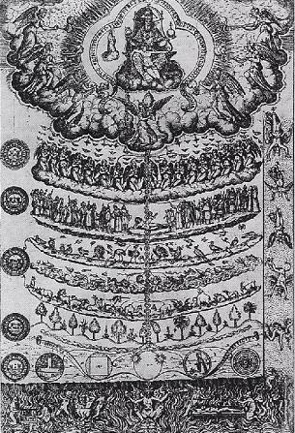
2.3 The Impact of Christianism
With the decline of the Roman empire, _christianity becomes the main ideology in the western world.
This will be the dark age for tranformism (evolutionary thought)
God becomes the measure of all things, and the Christian bible, the word of the day.
The concept of scala naturae becomes purely metaphysical, proclaiming the perfection of the Creator.
God
Angels
Humanity
Animals
Vegetation
minerals
Drawing of scala naturæ by Didadus Valades, Rhetorica Christiana (1579)
Notes:
The Christians viewed the chain of being and made it a fixed way of how god created the world. This was static and was never questioned.
Transformism is was no longer a part of the conversation.

Slide 12
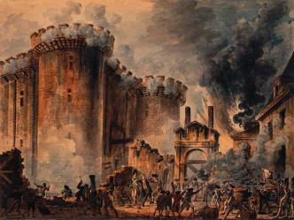
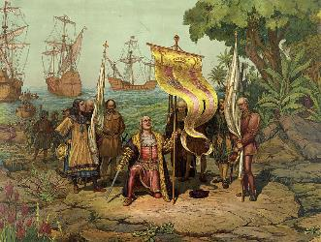
2.4 From Fixity of Species to Transformism
Renaissance in Europe (14th to 17th century):
  Back to nature (great expeditions + discoveries)
  Power of religion is progressively challenged
French Revolution (end of the 18th century)
  Challenge of ordered systems (monarchy) for an active pursuit of progress.
  More open-mindedness towards science.
Capture of the Bastille; 14 July 1789
Arrival of Christopher Columbus in America 1492
Notes:
Scientific advancement and the industrial revolution challenged the older ideas. The quest for order was replaced by a quest for progress.

Slide 13
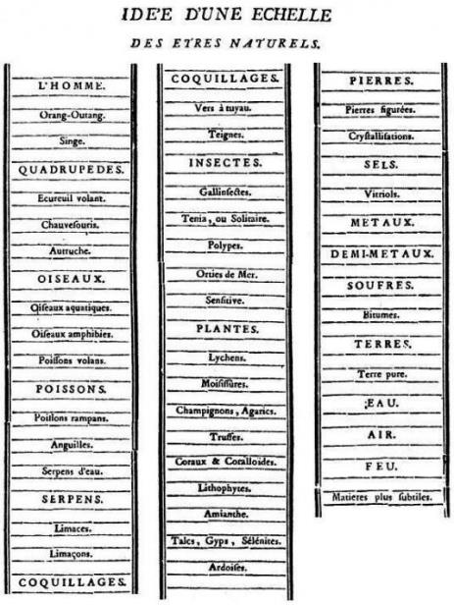
2.4 From Fixity of Species to Transformism
During and immediately after the Renaissance, there’s a return towards experimentation and the observation of nature.
Attempts to classify living organisms were done within the framework of the _____ ______________.
Bonnet (1745)
Notes:
This was a graphical representation of how to world was organised and created. No attempt for evolution was created.

Slide 14
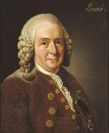
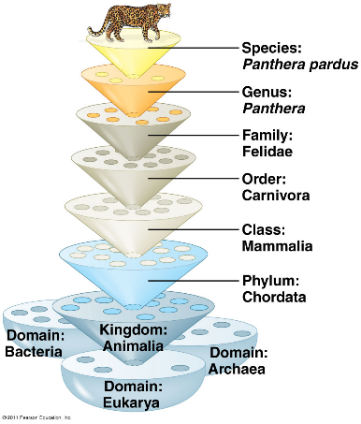
2.4 From Fixity of Species to Tranformism
2.4.1 Linnaeus (1707-1778)
Linnaeus, influential Swedish scientist, father of modern taxonomy (Systema Naturae, 1758)
  Hierarchical classification
  _binomial system of nomenclature (e.g. Homo sapiens).
Discovering each piece of the ultimate puzzle, the Plan of Creation.
Linnaeus’s concepts remain valid today
It is a excellent application of the essentialism of Aristotle.
Notes:
Any species should be name via genus and species.
Eg Homo Sapiens: wise man
Linnaeus tried to find out how god created the world. This was considered a noble task at the time.
He defined things through the essence of the species.
Linnaeus at the end of his life suggested towards the end of his career suggested that since species were so similar, they may have had a common ancestor rather than god creating them.

Slide 15
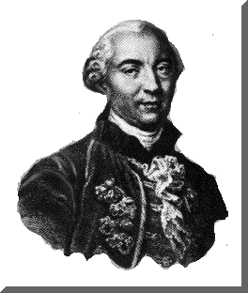
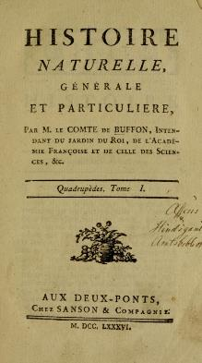
2.4 From Fixity of Species to Transfromism
2.4.2 Buffon (1707-1788)
Objective: describe nature (44 volumes)
He wrote (around 1740):
  “every family, from animals to plants, has a common origin, all animals derive from one animal, which through time produced all animal species in existence today”.
  His theory established the age of Earth to be around 75 000 years. According to Buffon, the initial temperature of the Earth was very high. Since then the climate has mellowed out.
The faculty of Theology of the Sorbonne censored, in 1751, many of Buffon’s theories because of conflicts with religious views.
He then decided to abandon his evolutionary ideas and to focus on observing nature.
Notes:
Came form a wealthy family, he wanted to describe nature as it was. Spent a lot of time studying nature, was in the elite of the Parisian nobility. How’s the changes that were occurring in the thought of the time. Buffon believed that the planet was much older than 10k years old and that the world started as a ball of fire. He observed that the planet was warmer than it was today. The Sorbonne consorship was a dangerous thing at the time.
Buffon then began to simply describe the world and gave up his evolutionary ideas. Society was not ready for such revolutionary ideas.

Slide 16
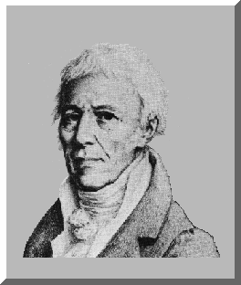
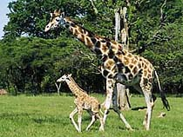
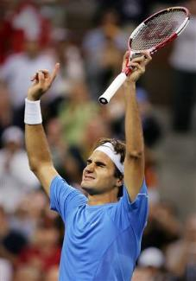
2.4 From Fixity of Species to Transfromism
2.4.3 Lamarck (1774-1829)
First evolutionist (species modify their morphology through time).
Uses the environment as a factor of change (environmental determination)
2 principles (affects individuals):
  Principle of usage and non-usage
  Principle of inheritance of acquired characteristics
Gradual mechanism, adaptive and involves an innate ability (internal force) of an organisms to become more complex (i.e., the static “ladder” or “chain” becomes an escalator)
Spontaneous generation explains the presence of simple organisms.
Theory not well received by his peers because it contradicted the religious view of the creation of life.
Notes:
Published the idea that species chaneged with time and he was not censored, this meant that society was more open to new ideas.
Species were not created by god but were changing with time. Species evolve in a way to fit their environment that is transferred to the next generation.
What you did in your life impacted the evened transferred to the next generation.
Controversial. Eg. Federer was asymmetrical, the arm that does the service was much stronger that the other side, according to Lamarck, these traits would be transferred to his kids. However, this is not true as his children are normal.
This theory was therefore falsified.
The static world, the chain of being was no longer static but was moving, this showed that society was open to discussion of Lamarck ideas,

Slide 17

Bonsai tree
Problem with Lamarck’s theory : __acquired traits can not be inherited

Slide 18
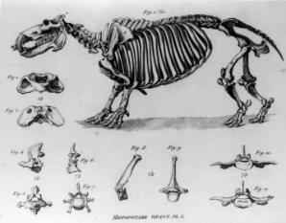
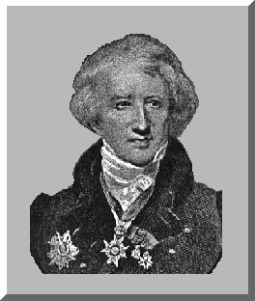
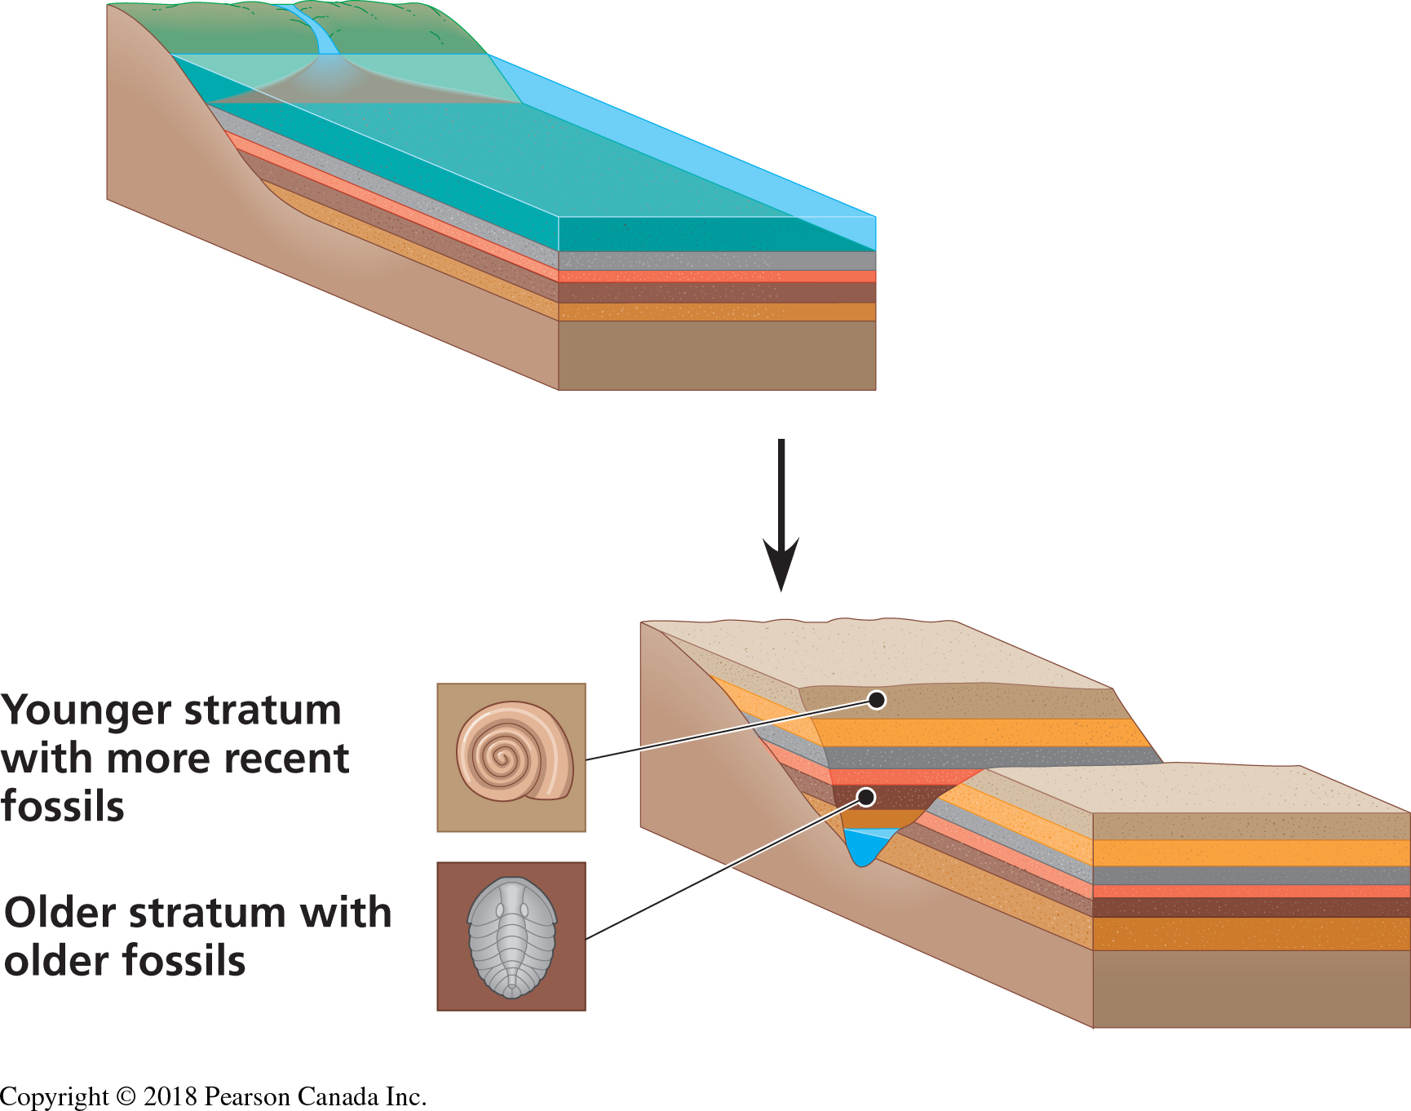
2.4 From Fixity of Species to Transfromism
2.4.4 Cuvier (1769-1832)
French scientist interested in mammal fossils
Established the science of _palentology_.
  The older the stratum, the more dissimilar its fossils are to current species
  From one layer to the next, species appear and disappear.
Theory of _correlation of parts (organs).
Notes:
The older the layer( stratum) the species were more dissimilar to modern species.
If god created the world then he created fossils, species that were different form modern ones.
He still believed that the world was young and was a creationist.
He was able to reconstruct an animal from a few bones, a telnet that leave d the way for palentology,
The carnivore bone bioCarnational teeeth, the jaw moves in a scissor movement, the jaw joint is in the same line as a row of teeth, the shape of the jaw joint fit tightly into the cranium and when you add muscle, the jaw joint would be extrem,y strong, this is typical of carnivores, their jaws can not disarticulate. This is the only type fo jaw that is present in carnivores, as it is well adapted to its function. This jaw is also present in carnivorous dinosaurs. In humans, the jaw joint is much higher than the teeth,typical f herbivores. The teeth must touch each other at the same time and will be on top on one and other allowing them to crush vegetation.The jaw piece belonged to a young seal.
The carnivore bone bioCarnational teeeth, the jaw moves in a scissor movement, the jaw joint is in the same line as a row of teeth, the shape of the jaw joint fit tightly into the cranium and when you add muscle, the jaw joint would be extrem,y strong, this is typical of carnivores, their jaws can not disarticulate. This is the only type fo jaw that is present in carnivores, as it is well adapted to its function. This jaw is also present in carnivorous dinosaurs. In humans, the jaw joint is much higher than the teeth,typical f herbivores. The teeth must touch each other at the same time and will be on top on one and other allowing them to crush vegetation.The jaw piece belonged to a young seal.

Slide 19
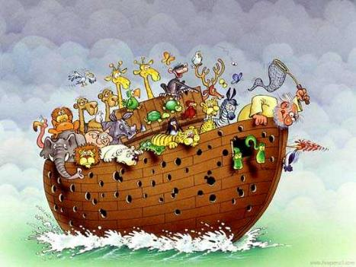
2.4 From Fixity of Species to Transfromism
2.4.4 Cuvier (1769-1832)
Cuvier believed in the fixity of species, extinction and catastrophism
Progressive creationism
Notes:
God triggered the extinction of many other species, compatible with the bible.
Every species became more advanced than the one before, god was “becoming Better “ this idea was reconciled with the finding of fossils
Progressive creationism: the idea that each species created by god was better than the last.

Slide 20
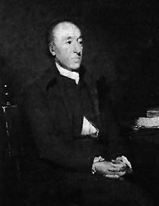
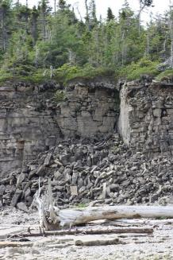
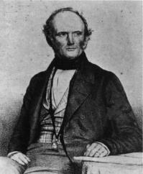
2.4 From Fixity of Species to Transfromism
2.4.5 Hutton (1728-1797) and Lyell (1797-1875)
Hutton
Hutton and Lyell (geologists)
  Geological changes are the result of a slow, gradual and continuous process.
  Principle of uniformity (_uniformitairiansim) :The laws of nature are not affected by the passage of time.
  So,“the present is the key to the past”
  Vision of the world: “with respect to human observation, this world has neither a beginning nor an end”.
  Lyell is the first to establish geology as a scientific discipline.
Lyell
Notes:
People were less threatened by geology compared to biology. Geology slowly adopted a different world view from the prevailing view.
Lyell established goeology a a science
Hutton Believed that the world was older than 10k years ago. He explained the creation of land by volcanoes.
Wanted to explain nature by nature itself.
These laws of nature were present for a really long time, he could see this through his observations( rivers progressively eroded) the key to studying the past is to observe the present.
Uniformitarianism meant that the plant was much older Than 10k years ago. The world had neither a beginning or an end,
Darwin was strongly influenced by Lyell and applied tthis his theory to biology.

Slide 21
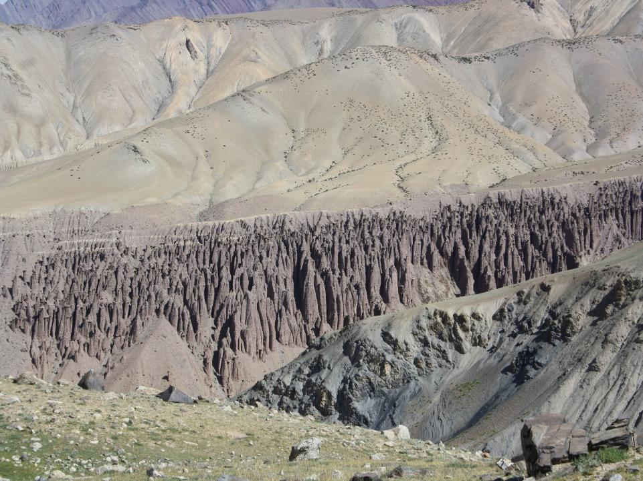
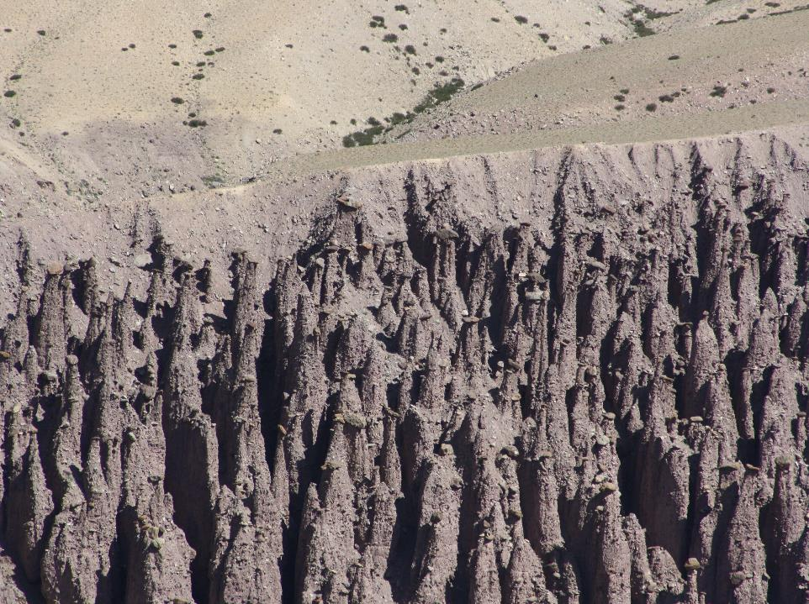
Hoodoo (tent rock)
Himalaya (Ladahk , India) : 5,000 m
Notes:
This occurs when erosion is vertical, if the dirt is protected by a rock the. Erosion did not occur, resulting in long columns,

Slide 22
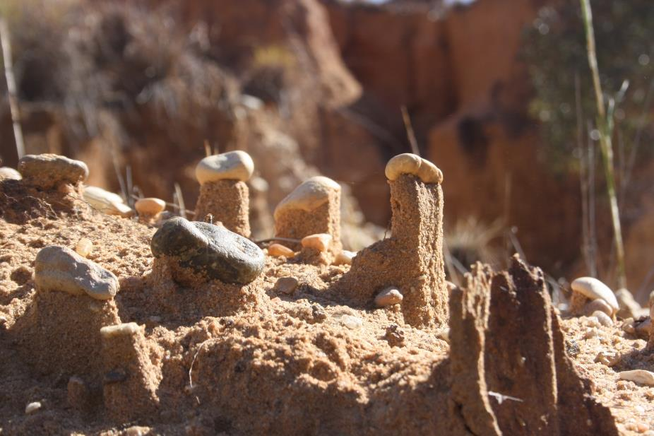
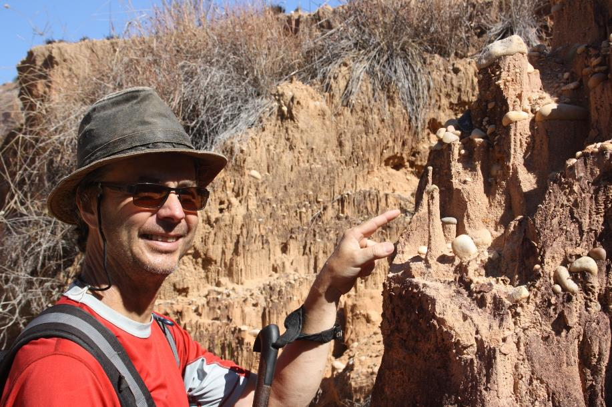
Madagascar
hoodoo
Notes:
The same thing was observed in Madagascar. Studying the present can therefore give us an impression of the past. This changed the way the world saw the world and that the reality of nature was slow.

