Slide 1
BU111 MIDTERM REVIEW
Attend any session for a small $20 donation that will all go towards developing education in Latin America!
Wednesday October 16th, 7pm-10pm (BA111)
Students can pre-register at www.lauriersos.com
OR
Show up to the session with the donation in hand!

Slide 2
AGENDA
External Analysis and Critical Success Factors
  Critical Success Factors
    Understand factors and their interrelationships
  Diamond-E
    Relationship between firm and its external environment
  What is an “External Analysis”?
    PEST
    Porter’s Five Forces
    Data Sources
  Benefits and Challenges
Technology
Exam Tips!

Slide 3
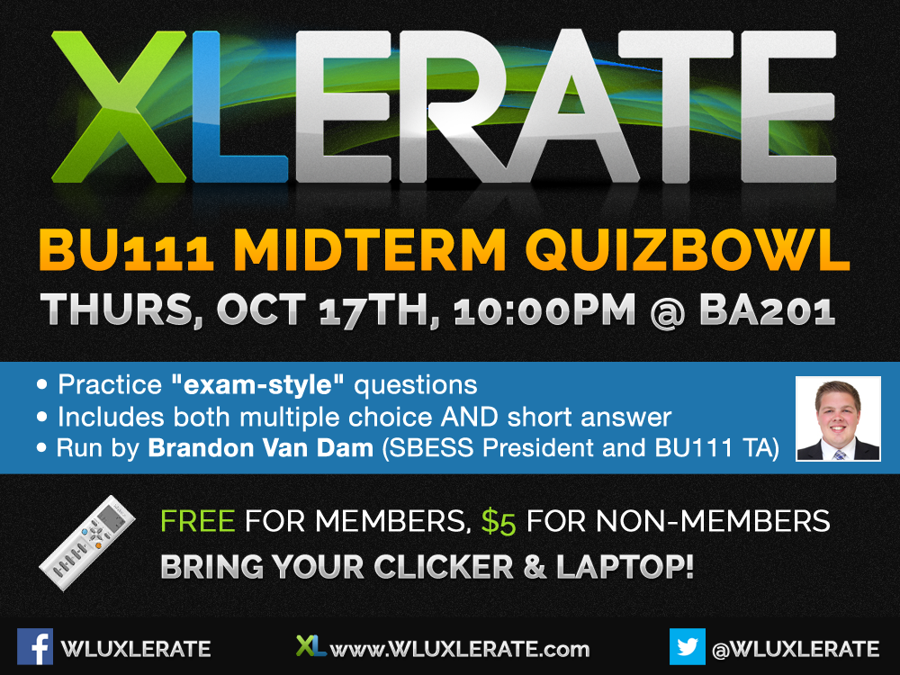

Slide 4
Critical Success Factors
Vital to the success of the company
  Must achieve all of these factors in order to ensure success of company (all factors have kind of an interrelated relationship, as they are all intertwined and linked together in someway)

Slide 5
Critical Success Factors
Critical Success Factor | How to Achieve | Why it is Important
Achieving Financial Performance | generating income/revenue | required for business to be sustainable survival of the company is dependent on financial growth and utilization of retained earnings (money is necessary)

Slide 6
Critical Success Factors
Critical Success Factor | How to Achieve | Why it is Important
Meeting Customer Needs | Customers desire… reliability, variety, timeliness, quality, safety | Satisfy what the market wants and needs May not necessarily know exactly what they want, so it is up to YOU to discover what the market wants and provide that and in doing so… customers provide revenue/sales

Slide 7
Critical Success Factors
Critical Success Factor | How to Achieve | Why it is Important
Building Quality Products & Services | quality assurance consistently give customer a good value for their money and an up to par product Need to consider universal standard laws – longevity of product, quality it was produced with | Encourages customers to buy products/services Builds reputation – provides good product means returning business (HOWEVER don’t create such an amazing quality product that no one needs to buy a new product → ex: dyson)

Slide 8
Critical Success Factors
Critical Success Factor | How to Achieve | Why it is Important
Encouraging Innovation & Creativity | training programs Incentives Open forum Anticipating customer’s needs | Providing customers with a new innovation to keep them coming back for more Businesses should be constantly changing and adapting to the environment Ex: Apple
Google Garage Video

Slide 9
Critical Success Factors
Critical Success Factor | How to Achieve | Why it is Important
Gaining Employee Commitment | Incentive plans Training Participation in mgmt decision-making Enthusiasm for job | Employees are the driving force behind the business (keep them happy) Should be proud of their company and want to represent it

Slide 10
Critical Success Factors
Critical Success Factor | How to Achieve | Why it is Important
Creating a distinctive competitive advantage | adding value – by providing something other companies don’t provide, consumers are able to pay more for that product | To encourage customers and outcompete competitors Businesses want a monopoly (think about LCBO, blueray+sony)

Slide 11
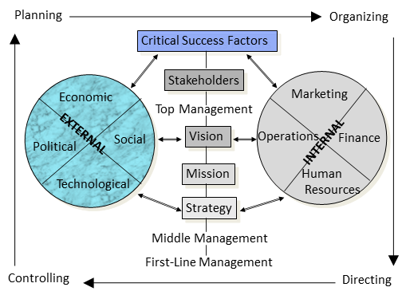
Diamond – E
Identifies key variables to be considered in strategic analysis
Double-headed arrows mean that both aspects influence each other

Slide 12
Diamond E
Strategy: what opportunities the business is pursuing
  determines the resources, organizational capabilities, and the management preferences
The critical linking variable in the model → Any variable can either drive or constrain
Principal logic: consistency or alignment
  strategy must be consistent with internal workings of company (preferences, resources, etc.)
  strategy must align with the external environment…may have the best strategy but may not be right for that environment → environment is changing, so strategy must adapt
First task: deal with strategy-environment linkage → assess forces at work, and their implications

Slide 13
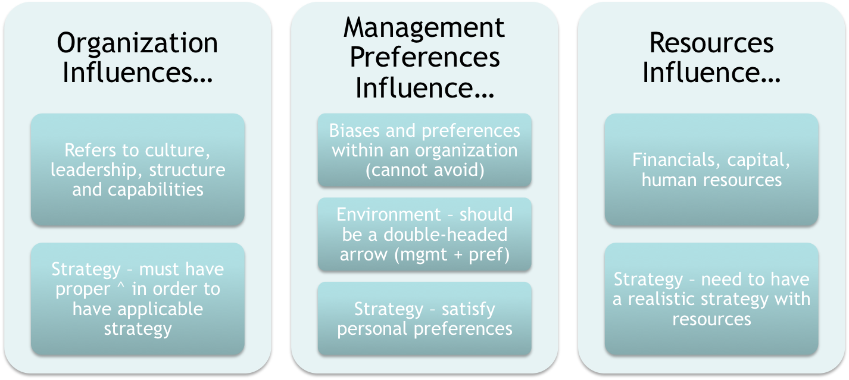
Diamond – E

Slide 14
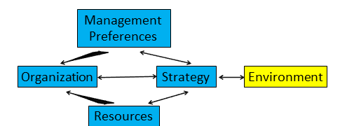
Diamond – E

Slide 15
External Analysis
The process of…
  Scanning + evaluating the external environment
    Need to look for data, statistics, trends, forecast things… et c
Need to determine “SWOT,”
  Strengths
  Weaknesses
  Opportunities – positive external trends/changes
  Threats – negative external trends/changes
Firms have multiple environments to analyze…

Slide 16
External Analysis
But first…What are the benefits/challenges of conducting an external analysis?
Benefits | Challenges
Makes managers proactive Provides information used in planning Helps organization acquire necessary resources Cope with uncertainty Improves consistency and performance | Rapidly changing environment – hard to keep up with Time consuming Trends and forecasts may not always be 100% accurate (room for error)

Slide 17
External Analysis
General Environment – affects all businesses (have no control over)
PEST – identifies general trends/changes

Slide 18
External Analysis
PEST Factor | Definition/Elements | Effect on Business
Poli-Legal | Laws and regulations Taxes Trade agreements and conditions Political system Political stability | Reflections relationship between businesses and government Affects uncertainties, risk and costs faced by the firm
Economic | Economic growth Trade balance National debt Economic stability Interest and exchange rates | Influences costs, potential sales, and financial uncertainity More government borrowing = less funds for businesses = higher interest rates & taxes Exchange rates affect trade balance

Slide 19
External Analysis
PEST Factor | Definition/Elements | Effect on Business
Economic | Economic growth Trade balance National debt Economic stability Interest and exchange rates | Influences costs, potential sales, and financial uncertainity More government borrowing = less funds for businesses = higher interest rates & taxes Exchange rates affect trade balance

Slide 20
External Analysis
PEST Factor | Definition/Elements | Effect on Business
Socio-Cultural | Customs, values, attitudes and demographic characteristics | Influences and customer preferences Influences worker attitudes and behaviours Influences standards of business

Slide 21
External Analysis
PEST Factor | Definition/Elements | Effect on Business
Technological | Technology transfer | * Affects buying, selling, communication and information access

Slide 22
External Analysis
Specific Environment – affects all industry participants
  Each industry has it’s own environment that needs to be analysed to gather appropriate information

Slide 23
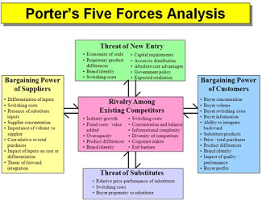

Slide 24
Porter’s Five Forces
Model of industry analysis
Influenced by 5F → strategic managers must compete to gain “edge”
Compete against direct competitors
Result in price competition and increased costs
  Caused by: growth rate of industry, consumer switching costs, products are commodities/perishable/many competitors

Slide 25
Porter’s Five Forces
Force | Importance
Suppliers | Fewer suppliers/high switching costs (less substitutes) = more bargaining power Use strategic alliance with other buyers/internal supply to reduce dependence on outside suppliers

Slide 26
Porter’s Five Forces
Force | Importance
Potential Entrants | New entrants not usually in same industry Ease of entry = increased competition Enter with new ideas/models/better technology – change the rules of the game Businesses should make it difficult for new entrants to enter by creating barriers

Slide 27
Porter’s Five Forces
Force | Importance
Substitutes | Many substitutes = increased competition (Ex: glasses vs. surgery) Puts a ceiling on the price that can be charged Consumers like to stick with what they already know how to use

Slide 28
Porter’s Five Forces
Force | Importance
Buyers | Few concentrated buyers, standardized products, low switching costs (not tied to you) Standardized products Discretionary products

Slide 29
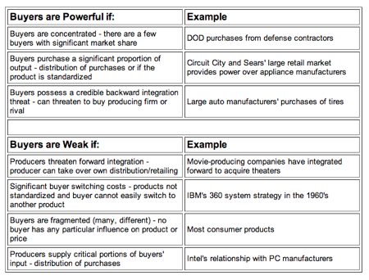
Porter’s Five Forces

Slide 30
Porter’s Five Forces
Force | Importance
Rivalry Amongst Existing Firms | Most powerful of the 5 forces Amount of rivalry varies across industries Causes of rivalry (number of competitors, industry growth rate, consumer switching costs, products are commodities or perishable) Rivalry amongst firms drives profits to zero (too many players competing for the same share of market) Low rivalry = industry is disciplined Competitive moves

Slide 31
Value of 5 Forces Model
Predicts industry profitability → idea of the factors that drive profitability
Helps determine whether a firm should enter a particular industry
Helps determine whether and/or how it can carve out an attractive position in that industry
Manipulating/ taking advantage of/ changing some of the effects that the forces have on profitability → or at least making the product different/valuable in a way

Slide 32
Questions NV Should Answer Through 5F Analysis…
Is the industry a realistic place for a new venture to enter? If yes, then…
  Can we do a better job than incumbents (holders of the position) at avoiding/diminishing factors that suppress profitability?
  Is there a unique position we can pursue?
  Is there a superior business model that incumbents would find hard to duplicate?

Slide 33


Slide 34
What is technology?
What is TECHNOLOGY? (from a business perspective)
  Anything tangible that affects what is produced, how it is produced and sold, and how the organization is managed.
  Is always changing, demands constant adaptation
  NOT limited to computers, internet and information tech.
    (Stone age tools, for example)

Slide 35
Technology – Positives
Speeds up production
  Reduces cost
  Enables larger quantities
  Increases efficiency
Better products
  Quality – innovation
  Consistent Quality
Communication gaps are bridged
  Letters vs texting
Affects Porter’s forces
  Ex. Customers can check prices online

Slide 36
Technology - Negatives
Easy to recreate (imitate)
Excessive Information
Unfamiliarity to organizations
Constant change can be a hassle
Differences in standards through evolution
  DVDs vs VHS

Slide 37
IT – Information technology
The various devices for creating, storing, exchanging, and using information
ATM, email, inventory software
Makes collection and access easy and efficient
  Distance work possible
  Instant access
  Ex. Google Docs, Dropbox

Slide 38
Concepts - Technology
Installed base
  More customers means more influence
Sunk investment (lock-in)
  Larger = greater resistance to switch
Switching costs
Complementary goods – needed for value; creates vicious or virtuous cycle
Network effects
  value depends on users – if no one uses, it’s pointless

Slide 39
Technology Standards
Determine compatibility with other products
Similar idea done different ways
  Market picks a side, loser is out
  Blu-Ray vs HD-DVD
    What did Blu-Ray (Sony) do right?
      Bundled Blu-Ray with the PS3 taking a loss (about $200 per unit)
      Cheapest HD player on the market
      Won market share

Slide 40
VIDEO ☺
http://youtu.be/9oKkqpA2ZoI

Slide 41
Types of Innovations
 | Knowledge/capabilities challenged: | Knowledge/capabilities unchallenged:
Architecture/ Organization structure challenged: | RADICAL INNOVATION (e.g. calculator compared to slide rule) | ARCHITECTURAL INNOVATION (e.g. desktop computers compared to IBM mainframes)
Architecture/ Organization structure unchallenged: | MODULAR INNOVATION (e.g. digital camera compared to film camera) | INCREMENTAL INNOVATION (e.g. image stabilizing feature added to digital cameras)

Slide 42
Exam Tips
Multiple Choice
  Skip if you don’t know
  Go back at the end
  Why?
Start with easier questions
Manage time
  Look at mark allocation

Slide 43
Exam Tips
Mark your exam
  Avoid missing a question – slashes
Usually better to have a complete exam with errors than a perfect, but incomplete exam
  Can always add more if you have time

Slide 44
Exam Tips
Look over your exam
Re-read questions and make sure everything has been answered
Can only improve your grade

Slide 45
Exam Tips
Don’t Stress
  One exam won’t make or break you
Be confident
Bring water

Slide 46
That’s all folks.
Good-luck on the 111 Midterm!
Any Questions?

