Slide 1

Claims
The first step in critical thinking is to identify the author’s claim
the major conclusion of a piece of writing
what the author is trying to convince you of
A claim is usually a broad issue
most of an article is evidence to support the claim
these are often examples and reasoning
Sometimes a claim is explicitly stated & easy to find
may be found in the title, or at the beginning or end of the
article
often follows words like – therefore, thus, in summary,
I believe that, the data shows, in fact, etc.
Sometimes finding the claim is more challenging
it is implicit or buried in the author’s statements
Page 1 of 7

Slide 2
Claims
Two Types of Claims
Uncontested Claims
we accept the claim without examining the evidence
why?
it is consistent with our own experiences & observations
most experts in a field agree with the author
it is so obvious – no interpretation is necessary
a technical or mathematical claim
Accepting something as uncontestable now does not mean
that we must always continue to accept it as
unproblematic
Page 2 of 7

Slide 3

Claims
Two Types of Claims Cont’d.
Contestable Claims
based on not commonly accepted knowledge
political commentaries
editorials in newspapers
etc.
they are not necessarily wrong
they may even be inspiring
causing people to think about things in a new way
authors must provide much more evidence to support
contestable claims
without solid evidence, discussing the claim will rapidly
degenerate into “my opinion versus your opinion”
Page 3 of 7

Slide 4
Claims
Presenting Claims as the Author
when stating a claim, try to present the essence of what you
want to convey in an accurate & concise manner
present your main ideas with clarity and emphasis
make every effort so that there is no confusion as to what
your claim is
the title and subtitles of your article should make your logic
transparent to the reader
use pictures & other vivid images to make your claim clear
and memorable for your readers
Other Ways of Presenting Claims
provide a list of important concepts
also a series of propositions about how concepts relate
present claim graphically as a diagram or drawing
a concept map
A Concept Map can help you remember material you read
Page 4 of 7

Slide 5
Claims
Creating a Concept Map
Start with a list of the main ideas to be presented
The structure of your map may be:
boxes and arrows
pictorial representations
timelines
a tree-and-branch organization
overlapping circles, triangles, etc.
Some common relationships
arrows usually denote cause & effect relationships
circles or other boundaries are used to group related ideas
Make sure:
the concept is well labeled
that it is well explained & clearly described in your text
it should NEVER exceed one page
a few well-chosen words much better than sentences
Page 5 of 7

Slide 6
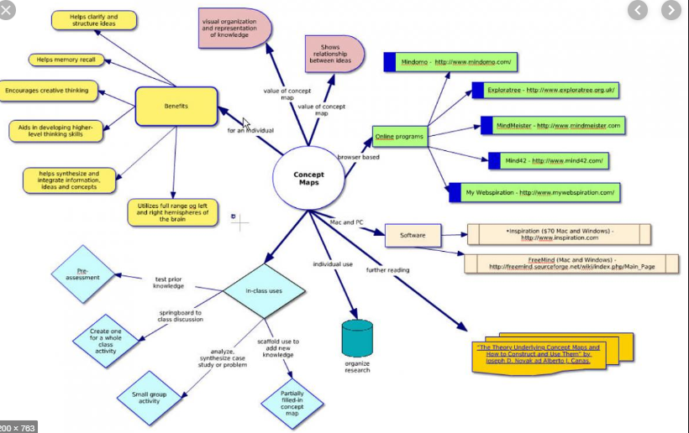
Claims
Example of a Concept Map
Page 6 of 7

Slide 7
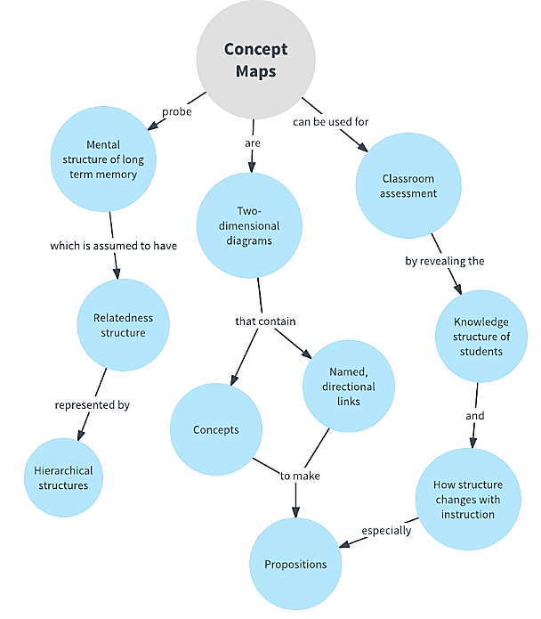
Claims
Another Example of a Concept Map
Page 7 of 7

