Slide 1
BPS 4102
April 1st, 2019
Course Review

Slide 2
Food & Drug Act and Regs
Intro to drug products

Slide 3
History of the Department of Health in Canada
1854 Cholera outbreak: Led to the establishment of ad hoc patchwork health boards in New Brunswick and Upper Canada to deal with outbreak.
  Infections spread, resorted to quarantine to avert pandemic
  Patchwork health system inadequate
Notes:
Note, pre-confederation era + pre germ theory
1854 – outbreak of cholera in the UK
Seven epidemics of cholera in Canadian history – have killed 20,000 people
Poor sanitation – contaminated water → spread
Dukoral = vaccine (sanofi-pasteur – now Crucell)
1995-2004: 1-8 cases annually

Slide 4
History of the Department of Health in Canada
After confederation, Parliament passed
Quarantine Act – to allow federal officials to inspect arriving ships for sick passengers
Sick Mariners Act – which provided special medical services for seaman that fall ill on Canadian waters or at Canadian ports.
Act vs Regulation
  Act: Legislation (law). A Bill requires Royal Assent to become Law.
  Regulation: Subordinate legislation. Defines the application and enforcement of an Act.

Slide 5
History of Food and Drugs Legislation in Canada
1963: F&D Regulations
  New Drug Submission (NDS)
  New definition of a “new drug”
  Review to take 120 days versus previous 90 days
  Content of NDS to include:
    Decription of new drug, proper name, brand name
    A quantitative list of all ingredients and specifications
    Names, address of manufacturers of ingredients
    Description of manufacturing process
    Description of controls used in manufacturing
    Details of the tests performed on the drug product (to control potency, purity, stability, safety)
    Reports of above safety tests
    Evidence of clinical effectiveness
    Labels to be used, route of admin, proposed dosage, contra-indications, side effects
    Pharmaceutical form drug will be sold
“(a) a drug that contains or consists of a substance, whether as an active or inactive ingredient, carrier, coating, excipient, menstruum or other component, that has not been sold as a drug in Canada for sufficient time and in sufficient quantity to establish in Canada the safety and effectiveness of that substance for use as a drug;”

Slide 6
Recent amendments!
2014: Protecting Canadians from Unsafe Drugs Act (Vanessa's Law) Amendments to the Food and Drugs Act (Bill C-17)
  First reading on December 6, 2013
    Bill brought before Parliament by MP Terrence Young
    Bill in response to the death of 15 year old Vanessa Young (2001)
      Cisapride (Prepulsid) serotonin 5-HT₄ receptor agonist used to increase GI motility
      Bulemic (electrolyte imbalance)
      Young’s pharmacist was not aware of ventricular arrhythmias
        80 serious (fatal) ADRs associated with Cisapride at the time in US/CAN
        Currently 16 ADRs for Cisapride and arrhythmias in Canada
  Royal Assent on November 11, 2014
CMAJ May 1, 2001 vol. 164 no. 9

Slide 7
Recap
C.01.014 (1) → DIN
C.08.002 (1) → NDS
  C.08.002 (2) → safety and effectiveness
    (e) details of the method of manufacture and the controls
    (g) detailed reports of the tests made to establish the safety
    (h) substantial evidence of the clinical effectiveness
C.01.014 (3) → NDS = DIN

Slide 8
NOC/c
History:
Policy (1998)
Revised Guidance (2002) (priority review)
Revised Guidance (2016) (ANDS)
Objective: Accelerate access to promising new drugs for serious, life-threatening or severely debilitating diseases or conditions for which there is currently no drug therapy.
  Also applies if significant increase in effectiveness, or decrease in risk

Slide 9
NOC/c: How it works
Submission process based on Policy.
NDS submitted with evidence for safety and quality data, reduced clinical data.
  Establish risk
  Further characterize benefits
NOC/c Qualifying Notice
Letter of Undertaking (LoU)
Risk Management Plan (RMP)

Slide 10
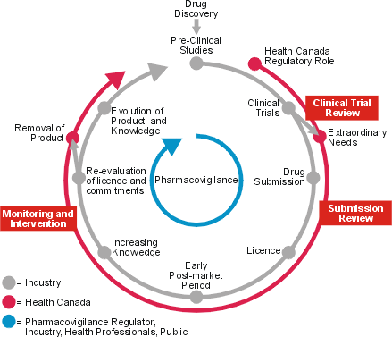
Lifecycle of a drug

Slide 11
Biologics versus Conventional Pharmaceuticals
Raw materials used for biologics are variable in nature
  Eg. serum derivatives, enzymes, cell substrates
Manufacturing processes are biological in nature and variable
  Eg. prokaryotic or eukaryotic cell systems
Biologics are highly susceptible to microbial growth (biologic: mixture of protein or polysaccharides)
  Microbial contamination must be considered at every step during the manufacture of a biologic.
Heat sensitive (heat labile); most are stored continuously at 2 to 8 ⁰C, some are not only stored cold or frozen but are shipped in a frozen state e.g. live polio vaccine.
  manufacturing process may require temperatures below 10 ⁰C depending on the nature of the product being manufactured and the length of time required to complete the manufacturing process.
The stages of manufacture are often carried out under conditions that cannot meet the same standards as conventional pharmaceuticals
  no terminal sterilization
  aseptic processing

Slide 12
Biologics versus Conventional Pharmaceuticals
Test methods needed to characterize batches of the product are variable in nature
  potency, purity and safety of most biologics can not be adequately tested by chemical or physical means alone
  bioassays have a high degree of variability/invalidity
Complex structure of final product
-molecular weight and structure undefined
-composition undefined (vaccines)
A system of in-process controls required for biologic production
Quality can not be established entirely by tests on the final product
  “Quality is built into a product and not just tested into a finished product.”
    Consistency in production/product
    Absence of Contamination

Slide 13
Definitions
CTA: Clinical Trial Application
NDS: New Drug Submission
  To obtain a licence for a new drug.
SNDS: Supplemental New Drug Submission
  To make substantial changes to a drug that already has a Notice of Compliance (NOC). Eg. method of manufacture, labelling, recommended route of administration, or a new indication.
ANDS: Abbreviated New Drug Submission
  To market a generic drug. Demonstrate that the drug is as safe and efficacious as the brand-name drug.
NOC: Notice of Compliance
  NOC/c: Notice of compliance with conditions
    Qualifying Notice letter
    Letter of Undertaking
  NON: Notice of Non-Compliance
  NOD: Notice of Deficiency
DIN: Drug Identification Number

Slide 14
Drug Manufacturing
Drug submissions

Slide 15
Drug Manufacturing and submissions
Challenges with manufacturing biologics…
Submission types…
Possible outcomes of a drug submission review…

Slide 16
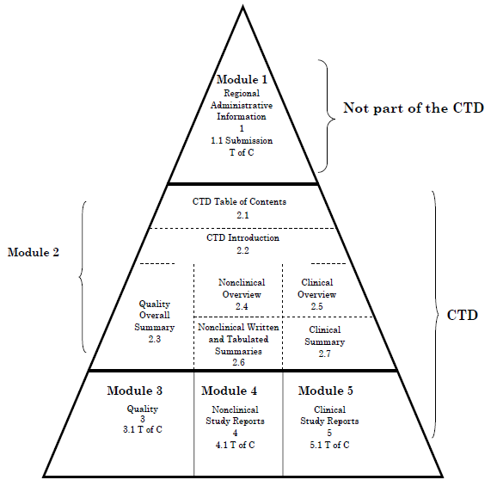
Common technical document

Slide 18
Clinical Trials

Slide 19
The Clinical Evidence
Proof of safety
Proof of efficacy
‘Evaluable evidence’ generated under GCP
  Randomised controlled trials (gold standard)
  Systematic reviews (especially for NHPs)
  Case control studies
  Others

Slide 20
Clinical Trials
The clinical trial is the foundation of therapeutic product development
  In human, highly controlled experiments
  Goals
    Assess pharmacology of drug product including dose-finding
    Prove safety of drug product
    Prove efficacy of drug product

Slide 21
Clinical R&D
The Clinical Trial-Phase I
Phase I
  Open-label; historically, healthy volunteers
  Focus on pharmacokinetics and pharmacodynamics parameters in humans
  Safety, tolerability
  N=<20

Slide 22
Clinical R&D
The Clinical Trial-Phase II
Phase II
  Controlled studies in target patient population
  Dose-finding
  Primary focus on proving safety
  Secondary focus on efficacy
  Traditionally 1 centre
  N=30-100

Slide 23
Clinical R&D
The Clinical Trial-Phase III
Phase III
  Pivotal controlled studies in target patient population
  Focus on efficacy
  N=100-1000’s (exposure of 300-600 patients required for most drugs)

Slide 24
The RCT
Randomised, double-blind, placebo-controlled clinical trial
  Allocation of patients to treament vs placebo done randomly and allocation concealed
  Patient (subject) and investigator blinded to treatment allocation
Controls/minimizes bias

Slide 25
Clinical R&D
The Clinical Trial-Phase IV
Phase IV
  Post-market studies
  New indications, patient populations, doses, routes of delivery
  Used to increase market penetration

Slide 26
Ethics Considerations
Declaration of Helsinki
International Conference on Harmonisation (ICH)
IRB/REB
Informed Consent
  A process, not a form
  Full disclosure of risk

Slide 27
Operational Responsibilities 1
Sponsors
  A product manufacturer or independent investigator duly qualified; complies with regulatory requirements; takes overall responsibility for the trial
  For industry funded trials, Sponsor usually manufacturer of investigational product
  Responsible for ensuring Investigators and sites are operating in compliance with guidelines and regulations

Slide 28
Operational Responsibilities 2
Investigators
  Trials are run out of investigational sites by Qualified Investigators (physicians, dentists)
  Investigators are responsible for supervising study drug administration and patient care according to accepted standards of care and ICH GCP.
  Pharma companies recruit investigators to recruit/treat patients
    NB. Bias

Slide 29
On Study Regulatory Compliance
Major changes to protocol must be submitted as a Prtocol Amendment Application (CTA-A) for review
Major protocol deviations for acute safety must be reported to HC
  Off protocol intervention for safety reported after patient treated
Minor (administrative) changes to protocol may be instituted before permission is granted
ICH GCP

Slide 30
Cell therapy
Review the complete lecture!
*********************************************
In the context of determining regulatory pathways:
What are established therapies
What are and innovative therapies?
Why are cell-based products so variable?

Slide 31
Acts: legislation - provides scope, and legal authority to make regulations
Regulations: subordinate leg - developed under the authority of the Act for different types of products -- interpret the Act and provide policies/standards having the force of law
Policies/Guidelines/Guidance:
  Interpret and provide details on how to meet the regulations
  Allow flexibility and adaptation to change, faster and simpler to introduce than Regulations
  They are not legally binding and cannot contradict or override regulations

Slide 32
CBPs are subject to one or more of three regulations developed under the Food and Drugs Act.
  Cells, Tissues and Organs (CTO) Regulations
  Food and Drug Regulations
  Medical Device Regulations
For embryonic stem cells, certain provisions of the Assisted Human Reproduction (AHR) Act of Canada apply: (http://www.tbs- sct.gc.ca)
Covers ethical issues related to the use of embryos for research
Prohibits the creation of embryos for research
Regulates access to embryos for research (i.e., allows use of only left-over embryos, prohibits commercialization and requires donor informed consent)
Does not regulate access to embryos derived outside Canada

Slide 33
The regulatory approach is based on various factors:
  Diversity of cell types (tissue origin, donor origin {autologous or allogeneic} level of differentiation)
  Degree of manipulation (impact on cell function and increased potential for introduction of adventitious agents)
  Intended use (homologous or non-homologous, routine clinical practice or new indications)
  Local or systemic effects/metabolic activity

Slide 34
Somatic cells – differentiated/specialized cells isolated from blood, tissue or organs (e.g., myoblasts from skeletal muscle; islet cells from pancreas; hepatocytes from liver; leukocytes from peripheral blood; keratinocytes and fibroblasts from skin, etc.)
Multipotent stem cells (SCs)– unspecialized adult or cord blood cells that divide and differentiate into a limited number of specialized cell types. Can be isolated from various tissues, e.g.,
Hematopoietic SCs from bone marrow, peripheral blood and cord blood (form blood cells)
Mesenchymal SCs from bone marrow and adipose tissue (form bone, cartilage, fat, etc.)
Neural SCs, skin SCs, etc.
Pluripotent SCs (form almost all cell types of the body)
Embryonic SCs isolated from the inner cell mass of blastocytes
Induced pluripotent SCs (somatic cells reprogrammed to behave like embryonic SCs by the introduction of defined reprogramming factors)

Slide 35
Q5E - General Principles
The demonstration of comparability does not necessarily mean that the quality attributes of the pre-change and post-change products are identical; but that they are highly similar and that the existing knowledge is sufficiently predictive to ensure that any differences in quality attributes have no adverse impact upon safety or efficacy of the drug product.

Slide 36
Minimally manipulated
➢Tissue – processing that does not alter the original characteristics that are relevant to its claimed utility for reconstruction, repair, or replacement
➢Cells and non-structural tissues – processing does not alter the biological characteristics that are relevant to their claimed utility
More than minimally manipulated (MMM) i.e., extensive manipulation or modification, e.g.,
➢Cell culture, cell activation/differentiation
➢Exposure to photochemical agents and/or irradiation
➢Introduction of genes to correct genetic defects or reprogram somatic cells
Combined with non-biologic material, e.g.,
➢Encapsulation
➢Tissue-engineered products involving the use of cells and supporting structures (e.g., bone, cartilage, blood vessel, skin substitutes)

Slide 37
WHERE DO SEBs FIT?
Chemical Drugs: Generics New Chemicals
Identical
Regulatory Pathway
ANDS
NDS
Identical?
Biological Drugs:
SEBs
New Biologics
Adapted from Mary Hefford, 2008

Slide 38
“Manufacturing Drift”
What are the consequences of manufacturing changes over time on the maintenance of “similarity” to the reference biologic?
What are the implications for substitution/interchange of “manufacturing drift”?

Slide 39
Radiopharmaceuticals
All radiolabeled compounds or substances used for the purpose of diagnosis and/or therapy have been defined as radioactive drugs or radiopharmaceuticals. They contain a radionuclide (metal or non-metal) attached to a molecule that will convey the radioisotope to a specific organ, tissue or cell.
The choice of radionuclide and targeting molecule depend on the application.

Slide 40
Radionuclide production
Radionuclides are primarily produced in a cyclotron, reactor or generator.
The type of radionuclide produced in a reactor or cyclotron depends on:
  The irradiating particle (neutron vs proton)
  The energy of the particle
  The target nuclide

Slide 41
Diagnostic Agents
Non-invasive assessment of diseases
Monitor treatment effect
SPECT (Single Photon Emission Computed Tomography): gamma-emitting isotopes.
PET (Positron Emission computed Tomography): positron emitting isotopes.
  Positrons are emitted. They are slowed down and then collide with electrons in matter at low speed creating 2 photons of 511keV at 180º.
Low conc: 10⁻⁶ - 10⁻⁸ M, little pharmacological effect.
Systemic administration (IV or oral).

Slide 42
Therapeutic Agents
Deliver therapeutic doses of ionizing radiation to disease sites, in sufficient concentration.
Use β⁻ ,α or auger emitting isotopes.
Higher concentration than diagnostic agents.
Delivery:
External beam irradiation
Implantable seeds: Brachytherapy
Systemic administration: IV injection, oral
Clear rapidly from blood and normal organs.

Slide 43
Targeting Molecule
Antibodies
Peptides
Proteins

Slide 44
Regulatory information
  Division 3: Schedule C drugs
    Radiopharmaceuticals are defined as drug that exhibits spontaneous disintegration of unstable nuclei with the emission of nuclear particles or photons.
  Division 5: Drugs for Clinical Trials Involving Human Subjects.
  Division 8: New Drugs.

Slide 45
Basic Research
15 days default-time. Authorisation of Sale is granted if accepted or a Not-Satisfactory-Notice (NSN) if rejected.
Only for PER’s
API already used in human
Summary of study protocol
Attestation of Approval by REB
Statement of good clinical practice and good manufacturing practice

Slide 46
Seed Lot and Cell Bank System

Slide 47
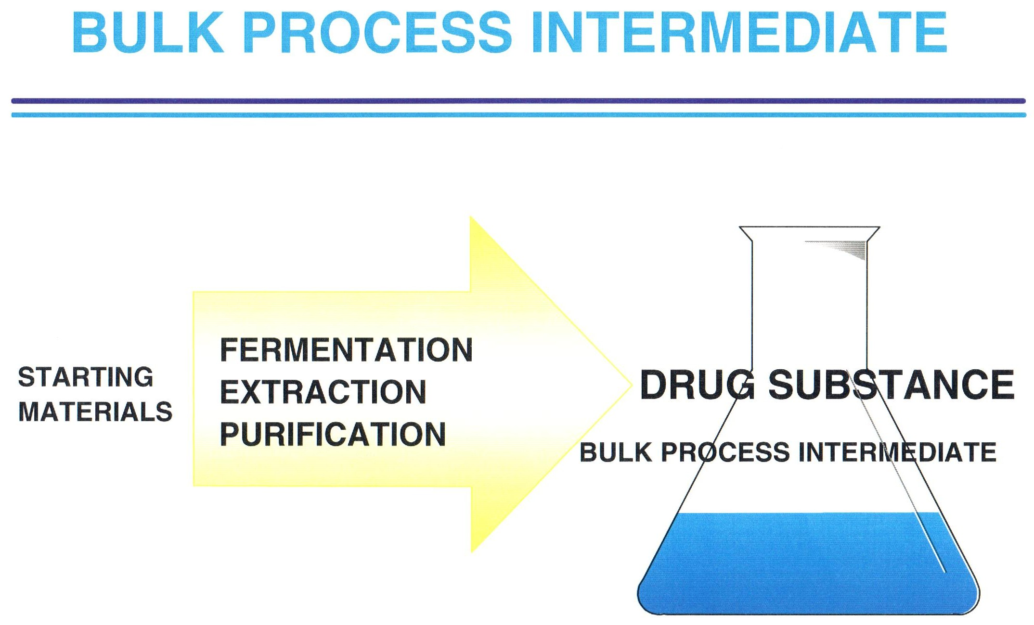

Slide 48
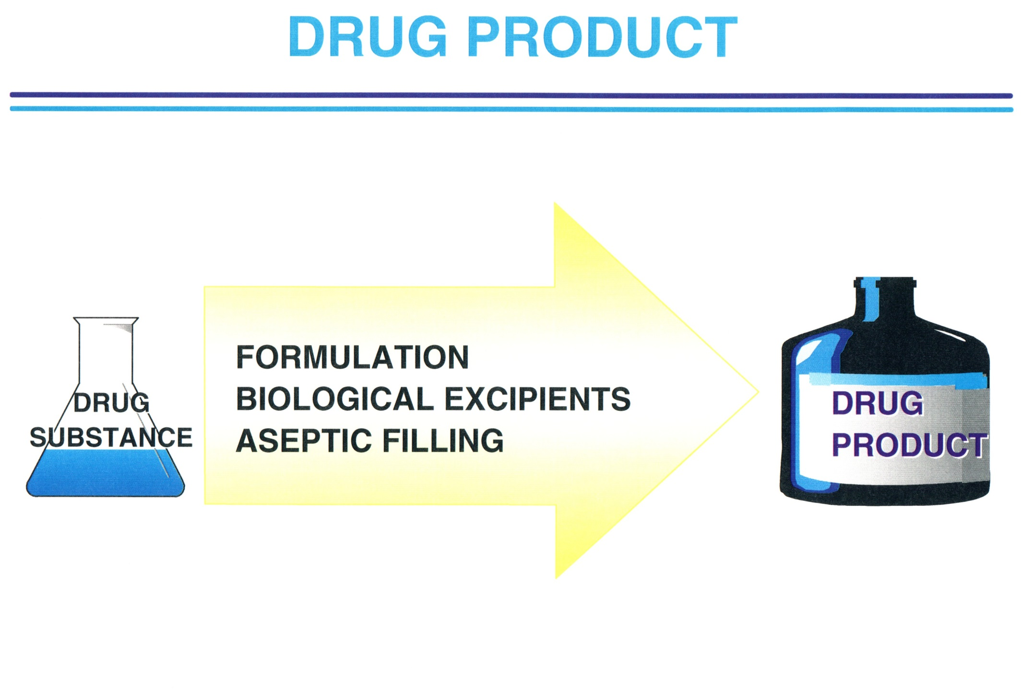

Slide 49
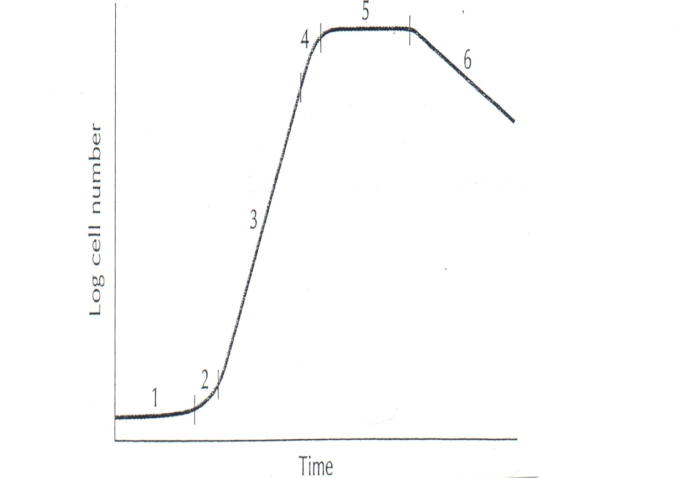
Growth Phases
lag
  cells adapt to new conditions
acceleration
  activities for division
log
  cell doublings, constant growth rate
stationary
  increase in cell mass ceases
death
  Metabolic activity ceases

Slide 50
In Canada GMP is regulated under Division 2, Part C of the Food and Drug regulations

Slide 51
Risk group classification
1 - Low individual and low community risk
2 - Moderate Individual Risk, Limited Community Risk
3 - High individual risk, Low community risk
4 - High individual risk, High community risk

Slide 52
Grades: Environmental limits
Grade | Maximum permitted # of particles / m³ |  | Class | Maximum permitted # of particles / ft³
 | 0.5 µ | 5 µ |  | 0.5 µ | 5 µ
A | 3500 | 0 | 100 | 100
B | 3500 | 0 | 1000 | 1000
C | 350000 | 2000 | 10000 | 10000
D | 3500000 | 20000 | 100000 | 100000

Slide 53
Cellular therapy regulation
Homologous use – the CTO performs the same basic function after transplantation (e.g., HSCs and islet cells)
Routine medical practice (e.g., stem cells for hematopoietic reconstitution) or new indications (e.g., stem cells for cardiac repair)
Mechanism of Action
Local effect (e.g., cornea) or systemic effects and depend on their metabolic activity for their primary function
Cell engraftment, differentiation, migration
Release of biologically active molecules that facilitate self-healing via anti-inflammatory or anti-apoptotic mechanisms or angiogenesis)
Release of hormones or enzymes by islet or liver cells

Slide 54
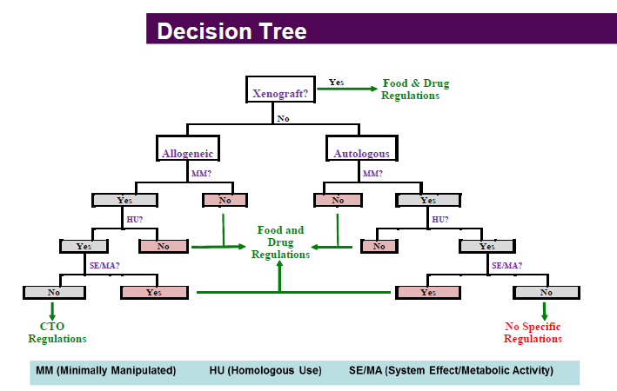

Slide 55
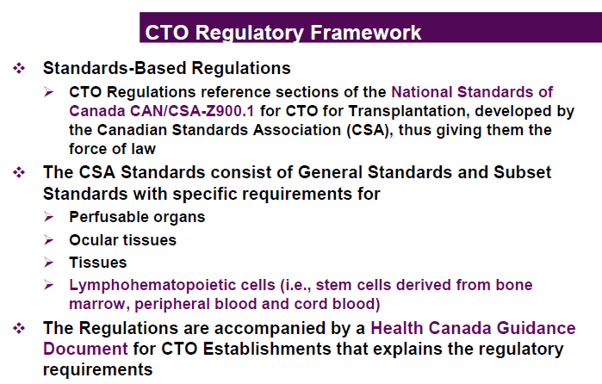

Slide 56
OSE: Role in Review Process
OSEs also allow for:
Familiarization of Review Staff with the manufacturing environment
  >90% of BGTD Quality review staff have been in manufacturing facilities
  Try to ensure product specialist attends OSE’s
Building rapport with industry: Production, Quality and Regulatory
  Understanding emerging issues and trends
  Discuss current thinking

Slide 57
Typical Day
Start up
  Agenda review
  Ensure nothing is missed
  Discuss out-standing issues
Wrap up
  Discuss observations or comments from the day.
Notes:
We generally meet in the morning to discuss the schedule for the day and include any revisions necessary to accommodate changes in the manufacturing schedule. The morning meeting is often used to clear up outstanding issues from the previous day. At the end of each day, we will usually meet for a brief wrap up of what we have seen during the day. You may invite whomever you wish to these sessions.

Slide 58
Observations
Rated according to risk
1 critical
2 major
3 minor
Linked to a specific regulation in the Canadian GMP or sections of the submission, as appropriate.
  Liberal interpretation to reflect submission review function rather than Establishment Licencing.

Slide 59
Exit Notice
Official Document of OSE
Contains:
  Observations
    Resolved during inspection
    Resolved within 21 days of E.N.
      Detailed plan with reasonable timelines may be acceptable
  Facility Rating
    Compliant, non-compliant or not rated
    Suitability to manufacture of the biologic
    Considered in disposition of the submission
Notes:
There should not be any surprises since they will have all been discussed throughout the week.

Slide 61
General Regulatory Considerations for Vaccine Development
Demonstration of safety, purity, efficacy, manufacturing reproducibility and compliance with current good manufacturing practice (cGMP)
Requires extensive research and development, clinical trails for both safety and efficacy (the latter in the context of disease challenge)
For a typical vaccine, from concept to licensed product can involve 10 to 30 years lead time and potentially hundreds of millions of dollars

Slide 62
Challenges for Emergency Preparedness Vaccine Development and Regulation
“Legacy” vaccines may not be compatible with new regulations
New vaccines may not be able to demonstrate efficacy due to practical or ethical reasons
Time frames demanded are short and funding may only be available for the public purchase of a product but not the long term development for a product that may never be required

Slide 63
Overview For Smallpox Vaccine Development and “Reverse Regulation”
Lessons from early smallpox control
Introduction to the immunology of poxviruses
Vaccinia virus strains and protection from disease
1st and 2nd generation vaccines and their delivery
3rd generation live vaccines: safety vs. efficacy
The smallpox vaccines currently in development and 2 are now approved

Slide 64
Smallpox (Variola) Encapsulates the History of Vaccines
Developed in Africa perhaps 10,000 years ago
No natural reservoir other than humans
Its persistence and virulence has shaped history*
Remains infectious in lesion scab crusts
“Variolation” likely began in India then to China….
Variolation greatly improved one’s odds but….

Slide 65
Variolation to vaccination with Jenner
“Cowpox” Vaccination & challenge studies 1796
Cow (or horse) to human; then human to human
Proposed life time protection
Occasionally contaminated with variola or other pathogens (“great pox” = syphilis)
Competition from colleagues using Variolation
Variolation banned/vaccination enforced 1853 (UK)
Adverse events even with “good quality” vaccine
Declared eradicated in 1980 by WHO (only 2 labs?)

Slide 66
Genus Orthopoxvirus
Members: variola, cowpox, vaccinia, monkeypox, ectromelia, raccoonpox, taterapox, camelpox, Uasin Gishu disease virus
All are morphologically indistinguishable
All are immunologically related and confer some protection against other members of the genus
Adapted from G. Smith et al.

Slide 67
Properties of vaccinia virus
Vaccinia virus is the only vaccine to have eradicated a disease, yet its origin and natural host are unknown.
Broad host range
Downie (1939) showed that the smallpox vaccines of the 20th century were all distinct from cowpox and were called vaccinia virus. Properties: pock morphology (large white or opaque), ceiling temperature (40°C), growth in rabbit skin (non-haemorrhagic).
Restriction profiles distinct from other orthopoxviruses. Genome sequence determined for strain Copenhagen (Goebel et al., 1990), MVA (Antoine et al., 1998), Tian Tan and WR.
Adapted from G. Smith et al.

Slide 68
Origin of vaccinia virus
From cowpox virus by passage and mutation.
From variola virus by passage and mutation.
By recombination between cowpox and variola viruses.
A distinct species of orthopoxvirus from an unrecognised host or from a host in which it is no longer endemic. Horsepox?
Adapted from G. Smith et al.

Slide 69
Early Plasma Fractionation
First industrial scale manufacture of protein therapeutics from human blood
Innovator: E.J. Cohn, Harvard, 1940’s
Cold (sub zero) ethanol, membrane purification and centrifugation to precipitate and purify plasma proteins
Modifications:
  Cohn-Oncley
  Kistler-Nitschmann

Slide 70
Innovations in Plasma Fractionation
Caprylate (octanoate; C8 fatty acid)
  1960’s; C6-12 fatty acids ppt gamma globulins
  Conc. And pH-dependent, chromatography used
Polyethylene glycol (PEG)
  Mild precipitant; albumin and gamma globulins
  Removed by ultra filtration (microns)
Chromatographic fractionation
  Deplete residual proteins e.g. albumin, IgA, IgM

Slide 71
Emerging Pathogens
Global surveillance
Testing innovation
  Global and national
Strategies
  Exclusion of donors by geographic region
    West Nile, Zika
  Growth of recombinants

Slide 72
SPE/TSE and Prions
Untreatable/fatal neurodegenerative diseases
Animals and humans; Homologous and heterologous transmission
Prion induces conformational change in endogenous proteins
TSE infectivity inactivation not possible in production
  Infectivity titres low
  Seems to segregate in cryo fraction
  No pre-clinical human test available
Per FDA test submissions, most manufacturing methods include at least one, usually more, provable TSE reduction step

