Slide 1
CVG 2132
Fundamentals of Environmental Engineering
WATER CHEMISTRY
Professor Chris Kinsley
Office: A-514
Email: ckinsley@uottawa.ca

Slide 2
DISSOCIATION OF WATER – pH
Slide 2
Notes:
What dies “material balance mean” and “where did material balance”.

Slide 3
CHEMICAL EQUILIBRIUM OF WATER
Slide 3
Chemical equilibrium constant for water:
  Dissociation or Ionization Constant of Water (K_{w}).
Water dissociates according to the equation:
H₂O ↔ H⁺ + OH⁻
  K_{w} = [OH⁻] x [H⁺]

Slide 4
pH
Slide 4
The dissociation of water controls the acidic and basic nature of the solution.
  A solution is considered acidic if [H⁺] is greater than [OH⁻].
  A solution is considered alkaline/basic if [OH⁻] is greater than [H⁺].
  A solution is considered neutral if [H⁺] = [OH⁻] = 10⁻⁷ M.
K_{w} =10⁻¹⁴ (pK_{w} = 14) at 25°C

Slide 5
pH
Slide 5
Neutral pH: pH = - log [H⁺] = 7
Neutral pH: pOH = - log [OH⁻] = 7
At 25°C: pH + pOH = 14
The pH scale is logarithmic: Each pH unit below 7 is ten times more acidic than the previous unit.
  pH 4 is ten times more acidic than pH 5 and 100 times (10 times 10) more acidic than pH 6
  pH 10 is ten times more alkaline than pH 9 and 100 times more alkaline than pH 8

Slide 6
SOLUBILITY
Slide 6
Notes:
What dies “material balance mean” and “where did material balance”.

Slide 7
SOLUBILITY
Slide 7
All compounds are soluble in water to a certain extent.
An equilibrium reaction is used to describe this phenomena:
Where K_{s} is the solubility product constant.
Simplified form:

Slide 8
SOLUBILITY
Slide 8
Example:
  How many milligrams of CaF₂ can be dissolved in 1 L of water that contains 1 mg/L of F⁻ at 25°C? What are the final concentrations (mg/L) of Ca²⁺ and F⁻ in the water. Assume that the water does not contain any Ca²⁺. The pK_{s} = 10.52.
(Example 1.8, Droste, 1997)

Slide 9
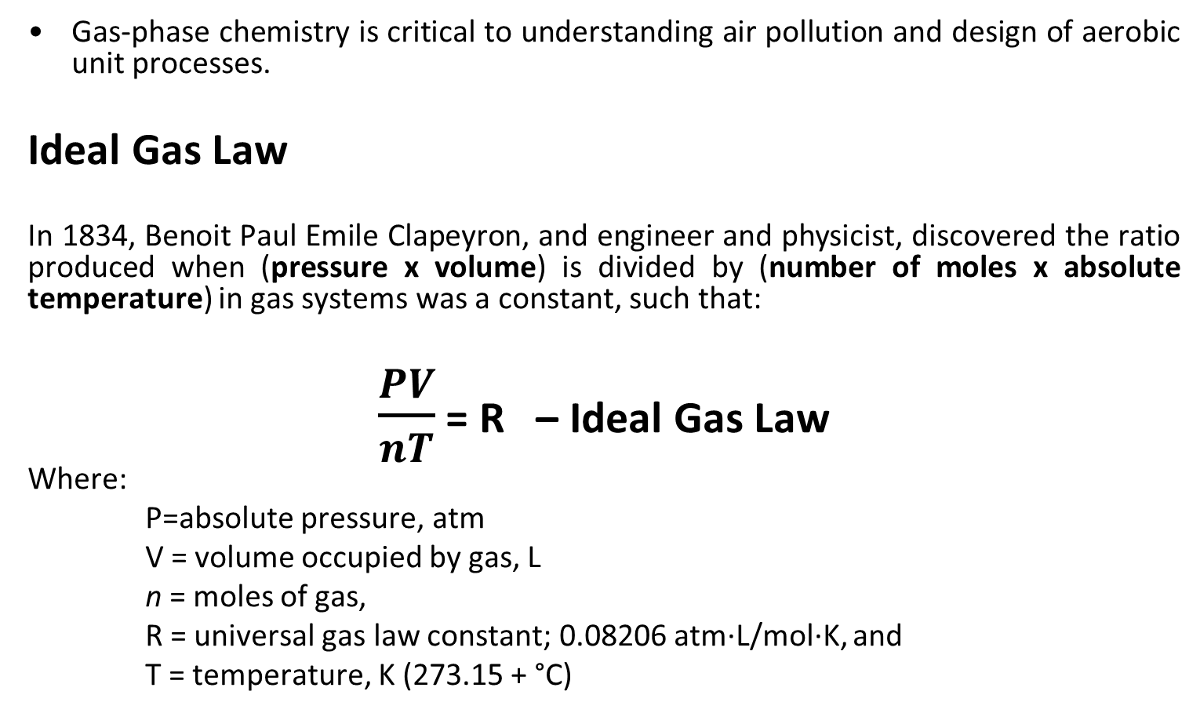
SOLUBILITY – GAS PHASE
Slide 9
Gas-phase chemistry is critical to understanding air pollution and design of aerobic unit processes.
Ideal Gas Law
In 1834, Benoit Paul Emile Clapeyron, and engineer and physicist, discovered the ratio produced when (pressure x volume) is divided by (number of moles x absolute temperature) in gas systems was a constant, such that:
$\frac{PV}{nT}$ = R – Ideal Gas Law
Where:
P=absolute pressure, atm
V = volume occupied by gas, L
n = moles of gas,
R = universal gas law constant; 0.08206 atm·L/mol·K, and
T = temperature, K (273.15 + °C)

Slide 10
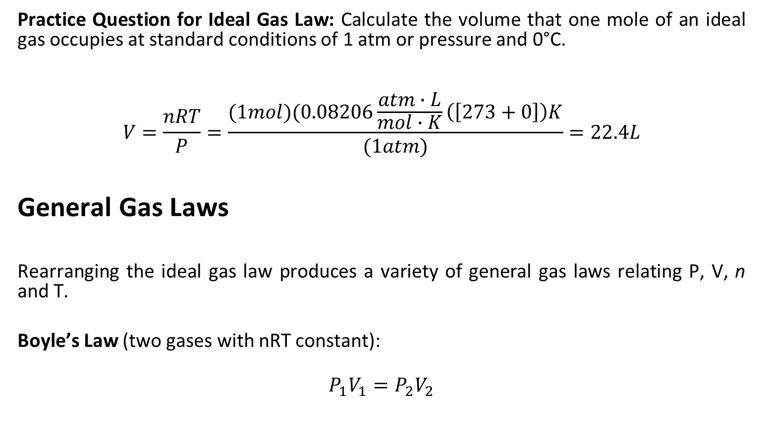
SOLUBILITY – GAS PHASE
Slide 10
Practice Question for Ideal Gas Law: Calculate the volume that one mole of an ideal gas occupies at standard conditions of 1 atm or pressure and 0°C.
$$V=\frac{nRT}{P}=\frac{(1mol)(0.08206\frac{atm∙L}{mol∙K}\left(\left[273+0\right]\right)K}{(1atm)}=22.4L$$
General Gas Laws
Rearranging the ideal gas law produces a variety of general gas laws relating P, V, n and T.
Boyle’s Law (two gases with nRT constant):
$$P_{1}V_{1}=P_{2}V_{2}$$

Slide 11
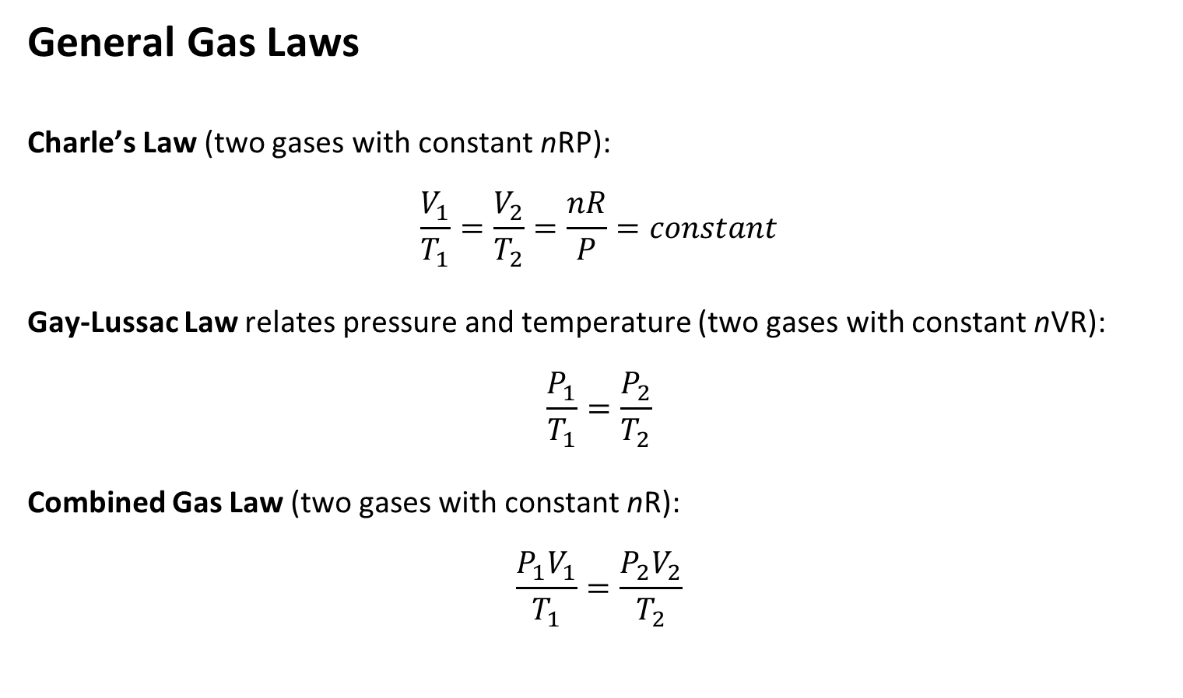
SOLUBILITY – GAS PHASE
Slide 11
General Gas Laws
Charle’s Law (two gases with constant nRP):
$$\frac{V_{1}}{T_{1}}=\frac{V_{2}}{T_{2}}=\frac{nR}{P}=constant$$
Gay-Lussac Law relates pressure and temperature (two gases with constant nVR):
$$\frac{P_{1}}{T_{1}}=\frac{P_{2}}{T_{2}}$$
Combined Gas Law (two gases with constant nR):
$$\frac{P_{1}V_{1}}{T_{1}}=\frac{P_{2}V_{2}}{T_{2}}$$

Slide 12
SOLUBILITY – GAS PHASE
Slide 12
Example calculation: A gas stack of an industrial furnace has an operating temperature of 400°C. The air flowrate into the furnace is 200 cubic meters per second (m³/s) at standard conditions of 20°C and 1 atm. Find the volumetric flow rate exiting the stack.
Solution:

Slide 13
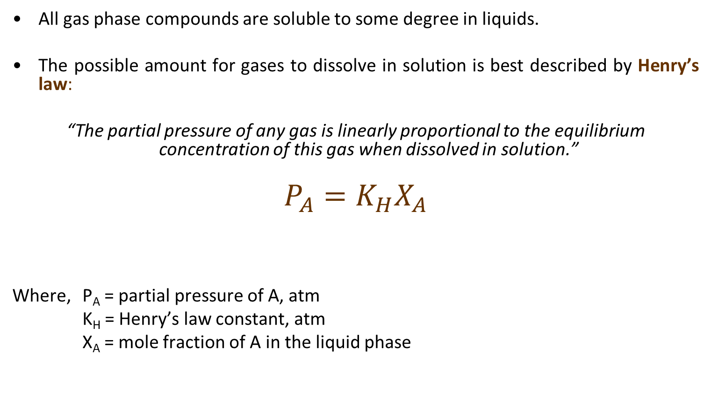
SOLUBILITY – GASES/LIQUID
Slide 13
All gas phase compounds are soluble to some degree in liquids.
The possible amount for gases to dissolve in solution is best described by Henry’s law:
“The partial pressure of any gas is linearly proportional to the equilibrium concentration of this gas when dissolved in solution.”
$$P_{A}=K_{H}X_{A}$$
Where, P_{A} = partial pressure of A, atm
K_{H} = Henry’s law constant, atm
X_{A} = mole fraction of A in the liquid phase

Slide 14
SOLUBILITY – GASES/LIQUID
Slide 14
Henry’s Law example Calculation: The concentration of oxygen in the atmosphere is approximately 20.9% by volume. Oxygen, however, is only slightly soluble in water, and its solubility is a function of temperature. Use Henry’s law to estimate the maximum oxygen concentration available to aquatic life during both summer and winter months in Ottawa, assuming 1 atm (101.3 Kpa) of pressure. Assume average water temperatures rise to 20°C in summer and decline to 5°C during winter. The K_{H} for oxygen in water is 4.01 x 10⁴ atm at 20°C and 2.91 x 10⁴ atm at 5°C.
Solution:

Slide 15
ACIDS & BASES
Slide 15
Notes:
What dies “material balance mean” and “where did material balance”.

Slide 16
ACIDS & BASES
Slide 16
Strong acids dissociate completely:
HA → H⁺ + A⁻
Weak acids do not dissociate completely:
HA ↔ H⁺ + A⁻

Slide 17
ACIDS & BASES
Slide 17
Strong acids:
  Hydrochloric acid HCl → H⁺ + Cl⁻
  Nitric acid HNO₃ → H⁺ + NO₃⁻
  Sulfuric acid H₂SO₄ → 2H⁺ + SO₄²⁻
Weak acids:
  Acetic acid CH₃COOH ↔ H⁺ + CH₃COO⁻
  Hydrogen sulfide H₂S ↔ H⁺ + HS⁻ and HS⁻ ↔ H⁺ + S₂⁻
  Hypochlorous acid HOCl ↔ H⁺ + OCl⁻
  Phosphoric acid H₃PO₄ ↔ H⁺ + H₂PO₄⁻ and
  H₂PO₄⁻ ↔ H⁺ + HPO₄²⁻ and
  HPO₄²⁻ ↔ H⁺ + PO₄³⁻

Slide 18
ACIDS & BASES
Slide 18
Understanding weak acid dissociation:
  What is the dissociation of a weak acid if pH ≈ pK_{a}?
  If [H⁺] is 2 orders magnitude greater than Ka (i.e. pH ‹‹ pK_{a})
  Conversely, if pH ›› pKa then the acid will be primarily in the dissociated form (A⁻)

Slide 19
ACIDS & BASES
Slide 19
If 100 mg of H₂SO₄ is added to 1 L of H₂O, what is the final pH?
(Example 4.6, Davis & Cornell, 2008)

Slide 20
ACIDS & BASES
Slide 20
If 15 mg/L of HOCl is added to a potable water for disinfection and the final pH is 7.0, what percent of the HOCl is not dissociated? (pKa = 7.54 @ 25°C)
(Example 4.7, Davis & Cornell, 2008)

Slide 21
ACIDS & BASES
Slide 21

Slide 22
BUFFERS
Slide 22
Notes:
What dies “material balance mean” and “where did material balance”.

Slide 23
BUFFERS
Slide 23
Buffer: A solution that resist changes in pH when an acid or base is added or when the solution is diluted.
  Buffers have obvious importance for life forms that usually can survive only within a narrow pH range.
An example of a buffered solutions is a solution that contains....

Slide 24
BUFFERS
Slide 24
Consider a solution containing weak acid (acetic acid) and its salt (sodium acetate).
CH₃COOH ↔ CH₃COO⁻ + H⁺
  The equilibrium expression is:
  Henderson – Hasselbach equation:

Slide 25
BUFFERING CAPACITY
Slide 25
Acidity: The ability of a solution to resist changes in pH due to the addition of a base.
Alkalinity: The ability of a solution to neutralize acids; the sum of all titratable bases to a pH of 4.5.
  In freshwaters the dominant species that contribute to alkalinity:
    Aqueous Carbon Dioxide:
    Carbonate ion:
    Bicarbonate ion:
    Hydrogen proton:
    Hydroxide ion:

Slide 26
CARBONATE BUFFERING CAPACITY
OF WATER
Slide 26
Notes:
What dies “material balance mean” and “where did material balance”.

Slide 27
CARBONATE BUFFERING CAPACITY
Slide 27
Atmospheric carbon dioxide (CO₂) produces a natural buffer in water through the carbonate buffer system:
CO_{2(g)} ←→ CO₂ + H₂O ←→ H₂CO₃ ←→ H⁺ + HCO₃⁻ ←→ 2H⁺ + CO₃²⁻
(in solution)
(carbonate ion)
(carbonic acid)
(bicarbonate ion)

Slide 28
CARBONATE BUFFERING CAPACITY – OPEN SYSTEM
Slide 28
CO_{2(g)} ←→ CO₂ + H₂O ←→ H₂CO₃ ←→ H⁺ + HCO₃⁻ ←→ 2H⁺ + CO₃²⁻
If acid is added (i.e. H⁺ is added to the solution):
  [H⁺] is increased
  CO₃²⁻ combines with H⁺ to form HCO₃⁻
  [HCO₃⁻] is increased
  HCO₃⁻ combines with H⁺ to form H₂CO₃
  [H₂CO₃] is increased
  H₂CO₃ produces H₂O & CO₂ in solution
  Excess CO₂ volatilizes (forms CO_{2(g)}) and is released into the atmosphere

Slide 29
CARBONATE BUFFERING CAPACITY – OPEN SYSTEM
Slide 29
CO_{2(g)} ←→ CO₂ + H₂O ←→ H₂CO₃ ←→ H⁺ + HCO₃⁻ ←→ 2H⁺ + CO₃²⁻
If base is added (i.e. H⁺ is consumed):
  [H⁺] is reduced
  CO_{2(g)} replenishes the CO₂ in solution
  [CO₂] is increased
  CO₂ combines with H₂O to form H₂CO₃
  [H₂CO₃] is increased
  H₂CO₃ produces H⁺ and HCO₃⁻ …stabilizing the rise in pH
  [HCO₃⁻] is increased
  HCO₃⁻ produces H⁺ and CO₃²⁻ … stabilizing the rise in pH

Slide 30
CARBONATE BUFFERING CAPACITY – OPEN SYSTEM
Slide 30
CO_{2(g)} ←→ CO₂ + H₂O ←→ H₂CO₃ ←→ H⁺ + HCO₃⁻ ←→ 2H⁺ + CO₃²⁻
In natural systems the replenishment or release to air occurs “fast enough” for the waters to be buffered through the carbonate buffer system.
In water and wastewater treatment plants the CO₂ cannot be replenished quick enough.
  Bubble (add) CO₂ to the system
  Strip CO₂ from the system (adding an inert gas like N₂)

Slide 31
CARBONATE BUFFERING CAPACITY – OPEN SYSTEM
Slide 31
CO_{2(g)} ←→ CO₂ + H₂O ←→ H₂CO₃ ←→ H⁺ + HCO₃⁻ ←→ 2H⁺ + CO₃²⁻
If CO₂ is bubbled:
  [CO_{2(g)}] is increased
  Reaction shifts to the right (just like adding base)
  H⁺ will be released

Slide 32
CARBONATE BUFFERING CAPACITY
Slide 32
CO_{2(g)} ←→ CO₂ + H₂O ←→ H₂CO₃ ←→ H⁺ + HCO₃⁻ ←→ 2H⁺ + CO₃²⁻
If CO₂ is stripped:
  [CO₂] is decreased
  Reaction shifts to the left (just like adding acid)
  H⁺ will be consumed

Slide 33
CARBONATE BUFFERING CAPACITY – CLOSED SYSTEM
Slide 33
Carbon dioxide (CO₂) Species Distribution plots can be drawn:
  Davis and Masten: pp 69 – 71
  where [H₂CO₃]* = the carbonic acid and the dissolved carbon dioxide concentration.
  [H₂CO₃] & [CO_{2(aq)}] are often difficult to distinguish analytically.

Slide 34
CARBONATE BUFFERING CAPACITY – CLOSED SYSTEM
Slide 34
Carbon dioxide (CO₂) Species Distribution plots can be drawn: (T = 25°C)

Slide 35
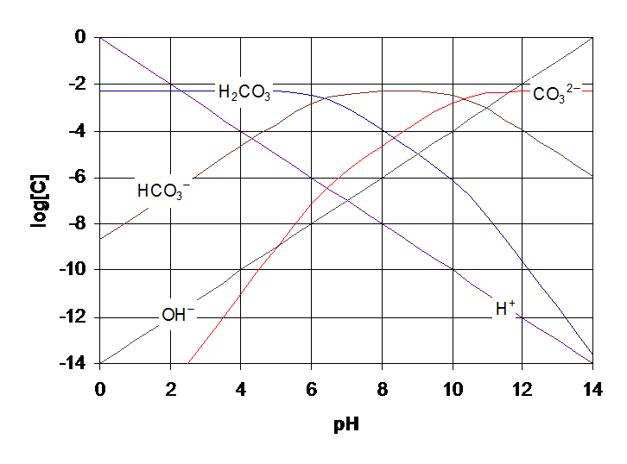
CARBONATE BUFFERING CAPACITY – CLOSED SYSTEM
Slide 35
Carbon dioxide (CO₂) Species Distribution plots can be drawn: (T = 25°C)

Slide 36
CARBONATE BUFFERING CAPACITY
ALKALINITY & ACIDITY
Slide 36
Notes:
What dies “material balance mean” and “where did material balance”.

Slide 37
CARBONATE BUFFERING CAPACITY - ALKALINITY
Slide 37
Alkalinity = [HCO₃⁻] + [CO₃²⁻] + [OH⁻] – [H⁺]
  Units: N or [eq/L]
  pH 6-8: [OH⁻] and [H⁺] are negligible
Alkalinity = [HCO₃⁻] + 2[CO₃²⁻] + [OH⁻] – [H⁺]
  Units: M or [mol/L]
  pH 6-8: [OH⁻] and [H⁺] are negligible

Slide 38
CARBONATE BUFFERING CAPACITY - ALKALINITY
Slide 38
Alkalinity = [HCO₃⁻] + [CO₃²⁻] + [OH⁻] – [H⁺]
  Units: mg CaCO₃ / L
  pH 6-8: [OH⁻] and [H⁺] are negligible

Slide 39
CARBONATE BUFFERING CAPACITY - ACIDITY
Slide 39
Acidity = [H₂CO₃]* + [HCO₃⁻] + [H⁺] - [OH⁻]
  Units: N or [eq/L]
Acidity = 2[H₂CO₃]* + [HCO₃⁻] + [H⁺] - [OH⁻]
  Units: M or [mol/L]
Note: If present other ions may contribute to the acidity of the system
  Example: H₃PO₄, H₂PO₄⁻, HPO₄²⁻

Slide 40
WATER HARDNESS
Slide 40
Notes:
What dies “material balance mean” and “where did material balance”.

Slide 41
WATER HARDNESS
Slide 41
Hardness: Sum of all the polyvalent cations (in consistent units) in solution.
  Important water quality parameter: scaling in pipes.
  Water gains hardness as it travels in the subsurface:
    CO₂ is produced by micro communities.
    pH decreases.
    Limestone (CaCO₃ and MgCO₃) dissolve into the water.
Water Quality:
  Soft water: < 17.1 mg CaCO₃/L
  Slightly hard water: 17.1 – 60 mg CaCO₃/L
  Moderately hard water: 60 – 120 mg CaCO₃/L
  Hard water: 120 – 180 mg CaCO₃/L
  Very hard water: > 180 mg CaCO₃/L

Slide 42
WATER HARDNESS
Slide 42
Electron Balance: Sum of all cations and anions in solution must be equal, units of N or mg CaCO₃ / L.
Total Hardness (TH) = Sum of all polyvalent cations
= (Ca²⁺) + (Mg²⁺) + (Fe³⁺) + (Fe²⁺) + …
Carbonate Hardness (CH) = TH or Alk, whichever is less.
      Called “temporary hardness” because it can be removed by heating the water.
      Calcium and magnesium carbonates & bicarbonates solubility deceases with increased temperatures.
Noncarbonate Hardness (NCH) = Amount of total hardness (TH) in excess of the alkalinity.
      Called “permanent hardness” because heating won’t remove it.
      If Alkalinity > TH then NCH = zero.

Slide 43
WATER HARDNESS
Slide 43
Total Hardness (TH) = (Ca²⁺) + (Mg²⁺) = CH + NCH
Example: A water contains 100.0 mg/L CO₃²⁻ and 75.0 mg/L HCO₃⁻ at a pH of 10 (T = 25°C).
(a) Calculate the exact alkalinity in mg/L CaCO₃
(b) Calculate the CH in mg/L CaCO₃

Slide 44
WATER HARDNESS
Slide 44

Slide 45
WATER HARDNESS

