Slide 1
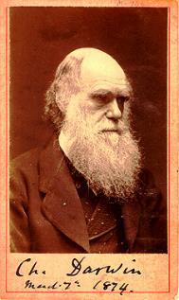
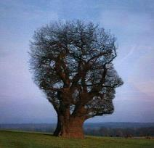
Chapter 3
Charles Darwin (1809- 1882) and Evolution
3.1 Charles Darwin: Education and Family
3.2 The Voyage on the Beagle
3.3 Evolution and Natural Selection
3.4 Proofs of Evolution: Homologies, Fossils, Vestigial Structures
Campbell Biology: p. 495-508

Slide 2
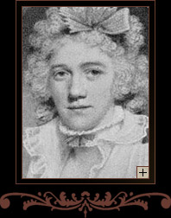
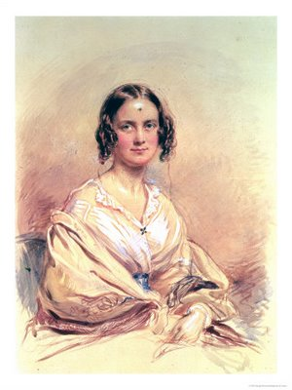

3.1 Charles Darwin: Education and Family
Born February 12th, 1809
Father was a doctor.
Mother was from the Wedgwood family (porcelain).
Married (1838) to his cousin Emma Wedgwood (1808-1896)
Had 10 children
Stops his studies in ________ (U. Edinburgh) and takes a more serious interest in religion (CambridgeU).
  Prerequisite to become a pastor: Bachelor of Arts
Develops an interest in nature: taxidermy, insect collecting, botany, etc.
Notes:
(medicine)

Slide 3
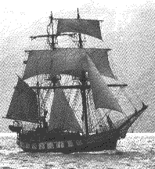
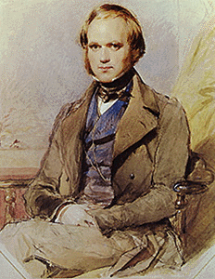
3.2 The Voyage on the Beagle
In 1831, he leaves on the Beagle, a ship commissioned by the British government to do the cartography of the coast of South America.
Darwin was invited on board as a companion of the captain Fitzroy but quickly became the _________ of the voyage.
He traveled the world and spends most of his time on land to sample the fauna and flora and to study South-American geology.
The trip was planned for two years but lasted five years.
Notes:
(naturalist)
Naturalist and cartographer quited so Darwin replaced them
Spent little time on sea, most of the time was collecting and preserving in rum (alcohol) for other ships to come and pick them up
He published his adventure which made him popular

Slide 4

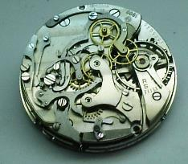
3.2 The Voyage on the Beagle
During the trip, two books had an impact on Darwin
  William Paley (1743-1805): “Theology, or evidences of the existence and attributes of the deity”.
    Paley is the father of the _________________.
      Advocates that harmony and design in nature are indicators of the existence and the acts of God (today = _______________).
  Charles Lyell : “Principles of Geology”.
    Darwin began his travels thinking like a good protestant: believing in the Great Flood and in Cuvier’s catastrophism.
    When he returned five years later, he was in total agreement with Lyell and Hutton’s ___________________.
Notes:
(Theology of Nature)
(Intelligent design)
Some things are so complex they cannot be explained by evolution
Some supervisor is regulating (god)
Tried to falsify Paley
(Principle of uniformity)

Slide 5
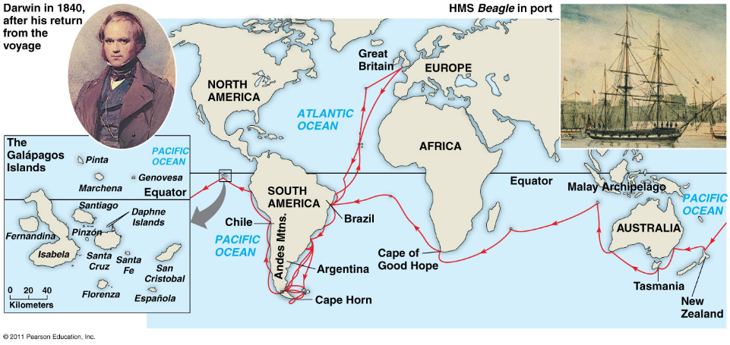
3.2 The Voyage on the Beagle
Fig. 22.5 The voyage of the HMS Beagle (December 1831- October 1836)
Notes:
Darwin did not concentrate in just south America he stopped in a lot of areas
After cape of good hope he realized he made mistakes of cartopgraphy so he went back to south America and then back to Europe
In chile he did cartography before and after earthquake (it changed)
He found shell fossils 3000 above sea level
Did not believe in creation of the world
Slow changes modifying the world

Slide 6
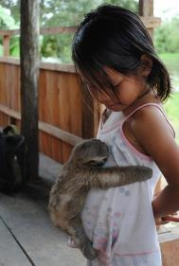
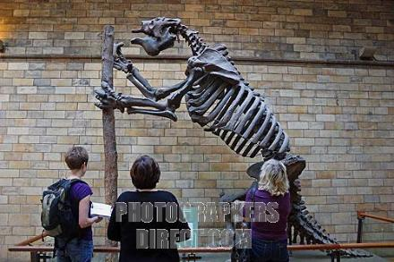
3.2 The Voyage on the Beagle
Three-Toed
Sloth
Giant
Sloth
The very distinct fauna of _____________ had a profound effect on Darwin:
  Why do fauna and flora of Africa, Europe, Australia and South America have relatively few species in common?
  Why are the animals and plants of the temperate zones of South America resemble the species living in the tropical zones of South America but not the species in temperate Europe?
  Why are the mammal fossils of South America absent from the current fauna (e.g. Giant Sloth)? Why do these fossils show resemblance with current species found only in South America (e.g. Three-toed Sloth)?
Notes:
(south America)

Slide 7
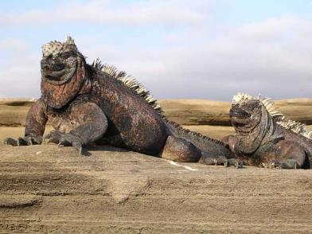
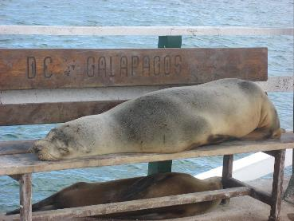
3.2 The Voyage on the Beagle
Fauna on the Galápagos Islands surprises Darwin.
  The fauna on the Islands is unique. Why?
  Why does it show resemblance with species on the American continent?
Galápagos ____________ (Amblyrhynchus cristatus)
Galápagos Sea lions (closely related to the Californian sea lion)
Notes:
(marine iguana)

Slide 8
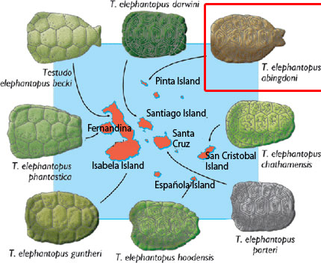
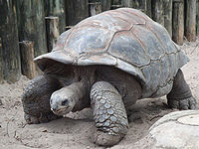
The Voyage on the Beagle
Why so much shell ________ in tortoises in the Galápagos?
GalápagosTortoise
Giant Galápagos Tortoise (15 different subspecies on the Islands)
http://www.galapagosexpeditions.com/islets/lonesome-george-tortoise.php
Notes:
(variability)

Slide 9
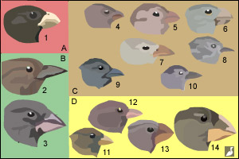
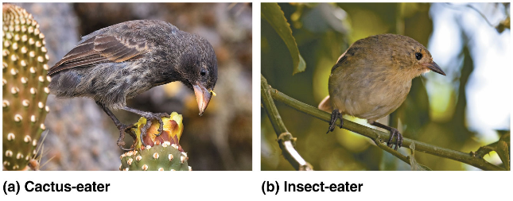
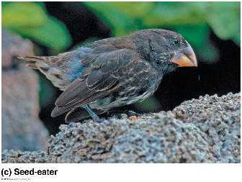
3.2 The Voyage on the Beagle
Finches of the Galápagos Islands
Why so much morphological variability in one group?
Why does each island, in most cases, have their own species?
Notes:
Same body with different beaks

Slide 10
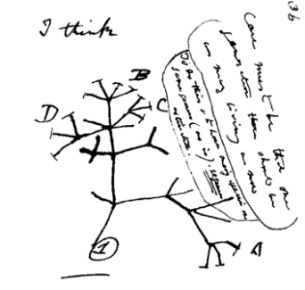
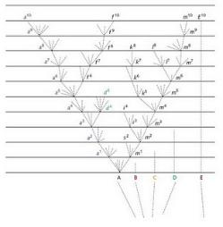
3.3 Evolution and Natural Selection
In 1837, we find in Darwin's notes the first mention that species show resemblance to each other because they share a ________________ (not a common environment).
  Rejects the fixity (no change) of species and accepts the concept of descent with modifications (evolution).
  Very materialistic view of life in contradiction with the religious dogma of the time.
  Rejects Lamarck’s evolutionary mechanism (environmental determinism)
Then, he begins the search for an evolutionary mechanism.
Darwin’s first phylogenetic tree (1837)
Darwin’s tree published in 1859
Notes:
(common ancestor)
Descent with modification (did not like the word evolution because its refereed to human society evolving)

Slide 11
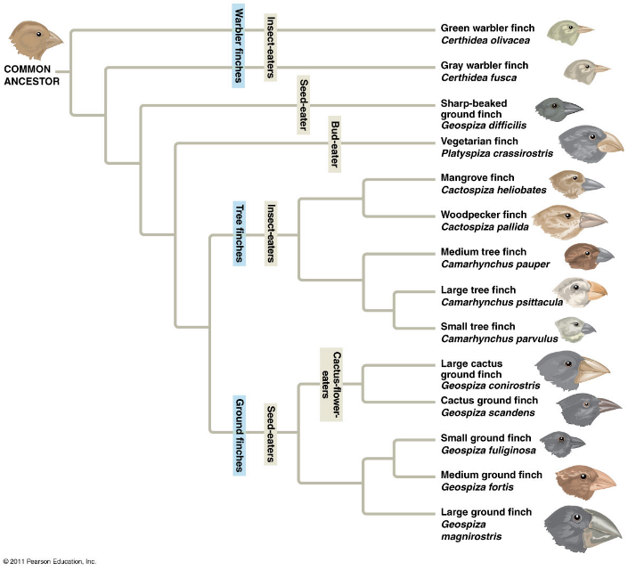
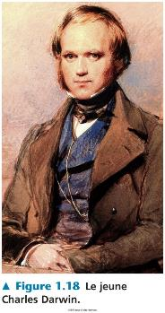
3.2 The Voyage on the Beagle
South-
American
Finches of the Galápagos Islands
The finches show morphological similarities because they _______ ________________.
Fig 1.22
Notes:
Dispertial factors finch came from south America

Slide 12
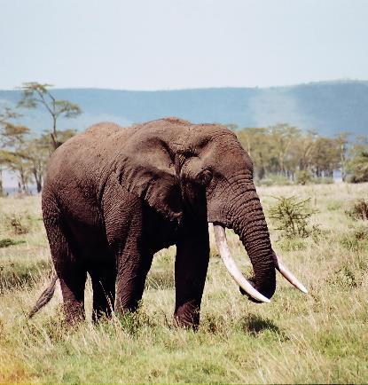
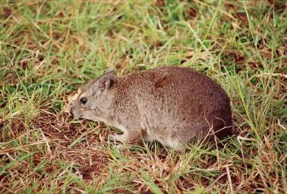
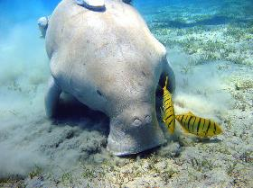
3.3 Evolution and Natural Selection
Rock hyrax
African elephant
Dugong
Notes:
Some are really distinct
All three are related but there are big jumps in morphology

Slide 13
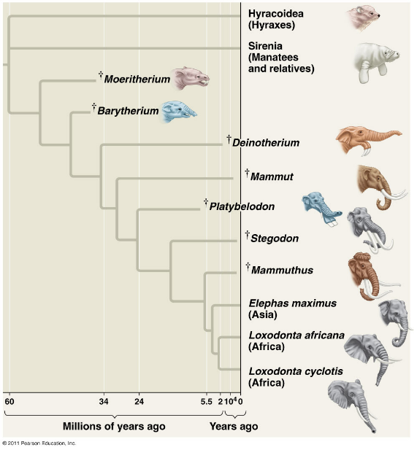
3.3 Evolution and Natural Selection
__% of species that have lived on Earth are extinct.
Most of the evolutionary branches finish in a dead-end (extinction).

Slide 14
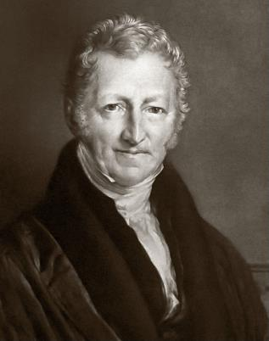
3.3 Evolution and Natural Selection
In 1838, Darwin read “ An essay on the principle of population” written by the economist Thomas R. Malthus
This became one of the main sources that inspired him to formulate his famous theory on natural selection.
Thomas Malthus
1766-1834

Slide 15
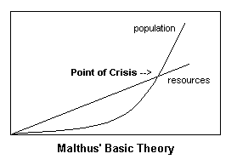
3.3 Evolution and Natural Selection
In his book An essay on the principle of population (1798), Malthus wrote that:
Every human population has a tendency to increase ____________, whereas the available resources to feed these populations increase ____________.
Population
Number of individuals
Crisis point
Nutritional resources or other
time
Malthus’s principle of population

Slide 16
3.3 Evolution and Natural Selection
The human population increases faster than its capacity to feed itself. This leads to _____ (famine, sickness, war, etc.) and eventually to a substantial reduction in population size.
Population
Number of individuals
Crisis point
Nutritional resources or other
time
Malthus’s principle of population

Slide 17
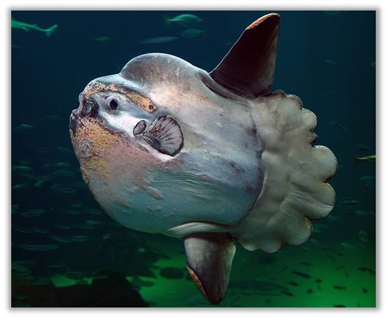
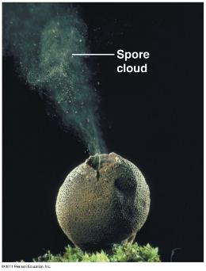
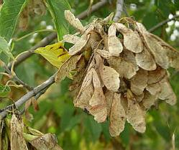
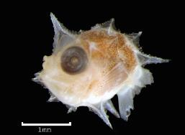
3.3 Evolution and Natural Selection
Darwin’s first observation:
All species can produce more offspring than their environment can sustain and many of these ________ fail to survive and reproduce
Fig. 22-11
Maple tree and its samaras
Puffball
Mola mola
(Ocean sunfish)

Slide 18
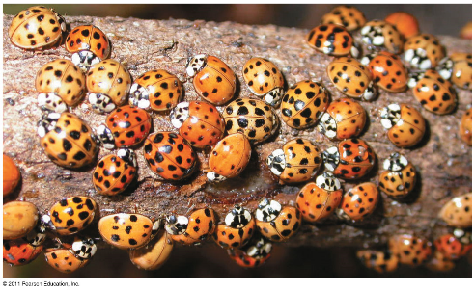
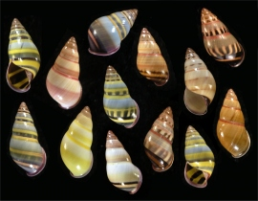
3.3 Evolution and Natural Selection
1’9”
8’1”
Darwin’s second observation : Members of a population often vary in their _____________.
2’5”
8’3”
Fig. 22-10
Amphidromus adamsii
Asian ladybird beetles

Slide 19
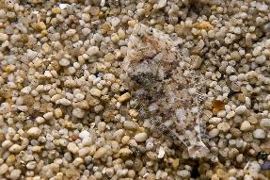
3.3 Evolution and Natural Selection
Flatfish
Two inferences:
  Individuals whose ________ traits gives them a higher probability of surviving and reproducing in a given environment tend to leave more offspring than other individuals
  From generation to generation, this unequal capacity to survive and to reproduce (_____________________ _______) results in an accumulation of favourable traits in a population.
    This is _______________. It enables the emergence of adaptations.

Slide 20
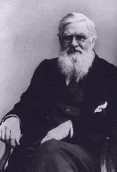
3.3 Evolution and Natural Selection
It is a letter from Alfred Russel Wallace (1823-1913), received in 1853, that forced Darwin to publicly release his ideas.
Wallace had come to the same conclusions as Darwin concerning the theory of natural selection by observing the fauna of Indonesia.
Thus, it was _______ after his voyage on the Beagle that Darwin publicly released his views on the evolution of species.
Wallace

Slide 21
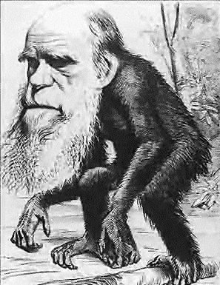
3.3 Evolution and Natural Selection
On the same day, in 1858, Darwin and Wallace presented a summary of their ideas on natural selection to the Linnean Society of London.
In 1859, Darwin publishes the first edition of his book “_____________________”. The book became an instant bestseller and created great controversy.
The 6th and last edition of his book, published in 1872, contains a chapter dedicated to the most important arguments against his theory. Most of these arguments came from his creationist colleagues.

Slide 22
3.3 Evolution and Natural Selection
Important notions linked with natural selection:
  Individuals do not evolve, __________ evolve.
  Only hereditary traits with variability can evolve.
  Individuals that have set of traits that leads to greater survivorship and reproductive success are « fitter » compare with other individuals.
  If a trait is well-adapted to its environment, it confers a higher relative _______ (reproductive success) to its bearer.
  Environmental factors vary in time and space. Thus, selective forces are variable and a trait that increases fitness in a specific environment might loose this fitness in a changed environment.
  Traits in populations may change and may modify the species.

Slide 23
3.3 Evolution and Natural Selection
For Darwin this mechanism is valid because:
  It respects the principle of uniformity of Lyell and Hutton.
  The results are visible in nature.
  The mechanism can be verified on current populations (e.g. artificial selection).
  It is a materialistic concept (no need for divine intervention):
    The mechanism is __________. Natural selection enables individuals that are better adapted to their environment to become more abundant than those who are not (differential reproductive success).
    Not a quest for _________ (evolution is not a directed process). It does not lead to the appearance of “perfect” traits. Organisms only adapt to their environment.

Slide 24
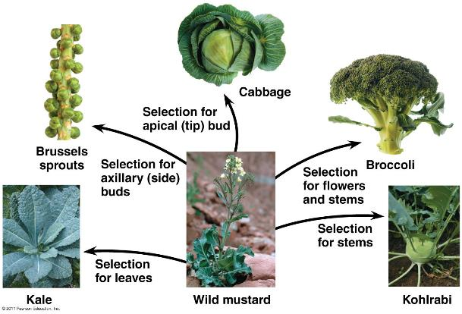
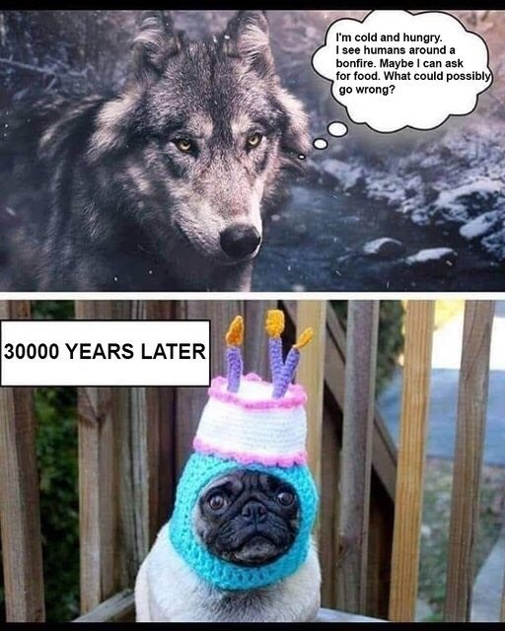
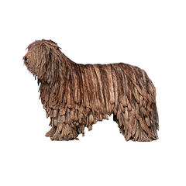
3.3 Evolution and Natural Selection
What have we done?
Fig.22-9
Bergamasco Dog
________________ is finalized because the goal, fixed well in advance, precedes the causes. The end result can be obtained in a few generations.
_______________is not finalized. It can take a long time for changes to occur (geological time scale).

Slide 25
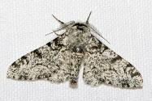
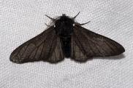
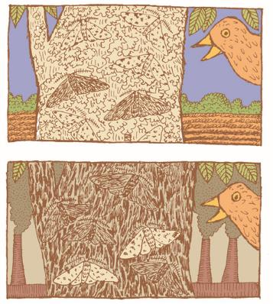
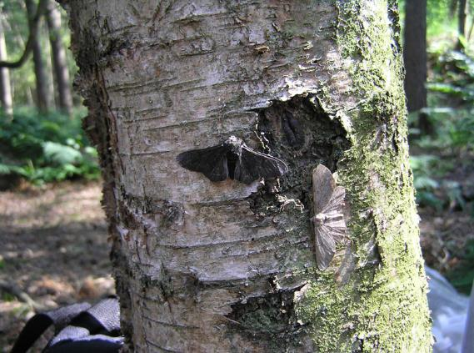
3.3 Evolution and
Natural Selection
Peppered moth
(Biston betularia)

Slide 26
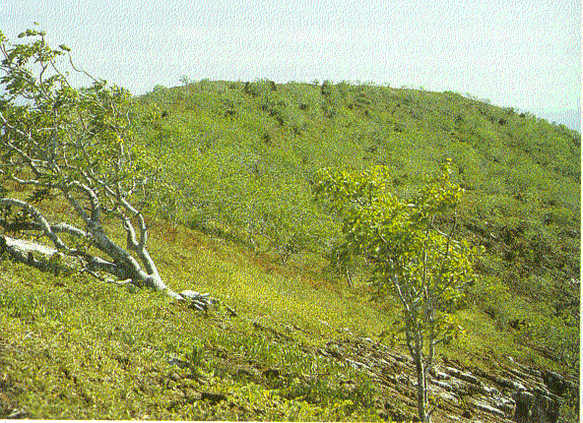
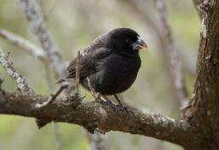
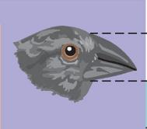
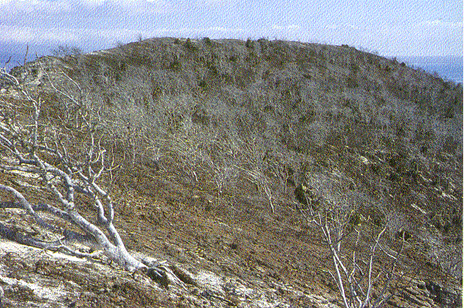
3.3 Evolution and Natural Selection:
Climate and the Medium Ground Finch
Medium ground finch
(Geospiza fortis)
Height of the beak
- Drought in 1977 (also in 1980, 1982)
- Population ____ adults to __.
- Selection favouring individuals that have bigger and stronger beaks to break available seeds during the drought.
Daphne Major
(Galápagos)

Slide 27
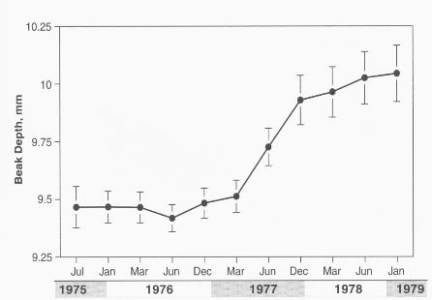
3.3 Evolution and Natural Selection:
Climate and the Medium Ground Finch
Height of beak mm
Changes in the height of the Medium groundfinch’s beak (Geospiza fortis) on Daphne Major Island during the 1977 drought.
Graphics adapted from Grant and Grant.2008. How and why species multiply; the radiation of Darwin's finches. Princeton Univ. Press.

Slide 28
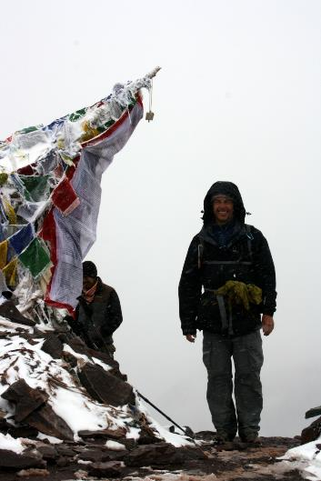
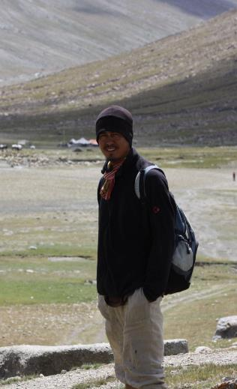
3.3 Evolution and Natural Selection:
Humans and Altitude
Kongmaru Pass (Himalaya – India; 5150m)
Guide from Ladakh was born on the Qinghai–Tibet Plateau in the Himalayas and comes from a population which lives over 3500m above sea level for at least 3000 years.
Mountain life: ____________ ______
François Chapleau: Comes from a population that has always lived under 500m above sea level.

Slide 29


3.3 Evolution and Natural Selection:
Humans and Altitude
Over 2 000m, the partial pressure of O₂ is insufficient for normal saturation of hemoglobin for a traveller in high altitudes.
  Shortness of breath, altitude sickness
  Physiological response (_____________): After a few days at high altitude, the body compensates the low partial pressure of O₂ by increasing the concentration of red blood cells in our blood. Serious health risks: thrombosis, pulmonary edema, etc.).
2,000m
(respiratory stress)

Slide 30
3.3 Evolution and Natural Selection:
Humans and Altitude
Generation 0
More than 3,000 years ago
Qinghai–Tibet Plateau
3,500 m
= Individuals who have the genetic traits allowing for survival and reproduction in high altitudes.
= Individuals who do not have the genetic traits allowing for survival and reproduction in high altitudes.
Lowlands of Asia

Slide 31

3.3 Evolution and Natural Selection:
Humans and Altitude
Generation 0
Human dispersion
Qinghai–Tibet Plateau
3,500 m
= Individuals who have the genetic traits allowing for survival and reproduction in high altitudes.
= Individuals who do not have the genetic traits allowing for survival and reproduction in high altitudes.
Lowlands of Asia

Slide 32
3.3 Evolution and Natural Selection:
Humans and Altitude
Generation 50
Qinghai–Tibet Plateau
3,500 m
= Individuals who have the genetic traits allowing for survival and reproduction in high altitudes.
= Individuals who do not have the genetic traits allowing for survival and reproduction in high altitudes.
Lowlands of Asia

Slide 33
3.3 Evolution and Natural Selection:
Humans and Altitude
Generation 100
Qinghai–Tibet Plateau
3,500 m
= Individuals who have the genetic traits allowing for survival and reproduction in high altitudes.
= Individuals who do not have the genetic traits allowing for survival and reproduction in high altitudes.
Lowlands of Asia
Notes:
.

Slide 34
3.3 Evolution and Natural Selection:
Humans and Altitude
Generation 150
(now)
Qinghai–Tibet Plateau
3,500 m
= Individuals who have the genetic traits allowing for survival and reproduction in high altitudes.
= Individuals who do not have the genetic traits allowing for survival and reproduction in high altitudes.
Lowlands of Asia

Slide 35

3.3 Evolution and Natural Selection:
Humans and Altitude
Many regions in high altitude were independently colonized by humans.
On the Qinghai–Tibet Plateau, human _________ to high altitude differs from the Andes.
Andes
(11,000 Years)
550 generations
Qinghai–Tibet Plateau
3,000 years ; 150 generations

Slide 36
3.3 Evolution and Natural Selection:
Humans and Altitude
Adaptations
  Andes
    Higher alveolar surface in lungs, same hemoglobin concentration in blood but each molecule has a higher oxygen capacity;
  Qinghai –Tibet Plateau
    Deeper breath, faster breathing cycle; larger pulmonary capacity and increased _________; lower hemoglobin concentration.
      Origin of adaptation : _________________EPAS1

Slide 37
3.3 Evolution and Natural Selection
(modified slide)
In the three cases (moths, finches and humans), the ______________ that give a _____________________(i.e. adaptation) to individuals in a population will be favoured. Thus, from generation to generation, there will be a higher percentage of individuals carrying the adaptation. This is _______________. It’s Darwin’s descent with modification. It’s evolution.
These adaptations can sometimes redefine a species and, in certain circumstances, define a new species.
Another example in the book : fig. 22.13

Slide 38

3.4 Proof of Evolution: Homology
Descent with modification theory (theory of evolution) explains the resemblance between certain traits even if the functions are different.
(____________ _________)

Slide 39

3.4 Proof of Evolution: Homology

Slide 40

3.4 Proof of Evolution: Homology

Slide 41


3.4 Proof of Evolution: Fossils
Evolution of the horse:
Hyracotherium
Classic
Interpretation
(linear evolution)

Slide 42

3.4 Proof of Evolution: Fossils
Evolution of the horse:
More realistic interpretation
(phylogenetic tree)
See fig. 25.27

Slide 43


3.4 Proof of Evolution: Fossils
Poster human evolution - © Lionel Bret, Science Photo Library - Image No. 649727

Slide 44



3.4 Proof of Evolution: Fossils
Fig. 22.19 (Astragalus)
Pakicetus
Fig. 22.20

Slide 45

3.4 Proof of Evolution: Vestigial Structures
Museum of Melbourne
Skeleton of a dwarf subspecies of a blue whale (Balaenoptera musculus)
(max length: 24 m).
Take note of the reduced vestigial posterior limb, the pelvis reduced to a floating pelvic bone under the spine.
________________: anatomic structure that has lost almost all of its initial function.

Slide 46





3.4 Proof of Evolution: Vestigial Structures
stomach
Human
colon
Small
intestine
Nictitating membrane or third eyelid.
________
__________________
Chicken

Slide 47

3.4 Proof of Evolution: Vestigial Structures
Epiglottis
Phrenic Nerve
4thcervical vertebra
The _______ :
A heritage from fishes and amphibians
diaphragm

Slide 48

Discovery of _ ________________ ___________ _________ ________ would be sufficient to refute our concept of evolution
3.4 Proof of Evolution
Ray Troll art

