Slide 1
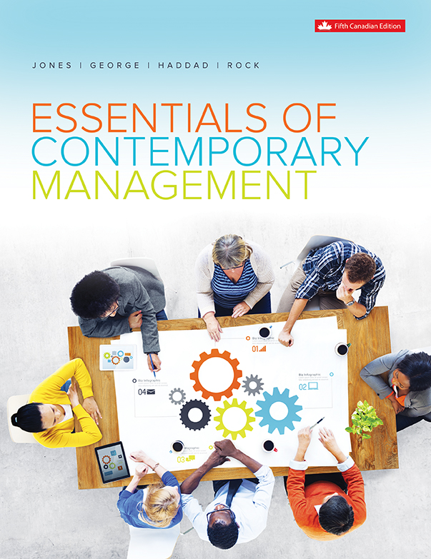
Chapter 12
Managing Organizational Change

Slide 2
Learning Outcomes
Understand what organizational change is and how it relates to the internal and external environment.
Explain some common models of organizational change.
Understand how organizational change relates to an organization’s culture.
Explain the relationship between entrepreneurship, innovation and organizational change.
Describe the challenges managers face in managing organizational change in a unionized workplace.

Slide 3
Organizational Change and Culture
  Organizational change is the movement of an organization away from its present state and toward some desired future state to increase its efficiency and effectiveness.
    Must alter policies, structures, behaviours, and beliefs in order to move forward.
    Implementing the change is often meet with resistance.
Notes:
LO1 Understand what organizational change is and how it relates to the internal and external environment.
Organizational change can bring alterations in the ways managers carry out the critical tasks of planning, organizing, leading, and controlling and the ways they perform their managerial roles.

Slide 4
Organizational Change and Culture
There are two ways for organizational change to come about - it is either imposed or induced.
  1. Induced Change:
    Planned new institutional arrangements
    Involves strategy, technology, human resources, and organizational structure
    Is a response to changes in the task and general organizational environments made to gain a competitive advantage
Notes:
LO1 Understand what organizational change is and how it relates to the internal and external environment.
Even induced change that comes from within the organization is risky and challenging.
In a recent online survey 600 global leaders were interviewed about change and business transformation.
Fifty-eight percent of the respondents said that over the past five years, half or fewer of their change initiatives had been successful.

Slide 5
Organizational Change and Culture
  2. Imposed Change:
    Brought about by new institutional arrangements
    set out by changes in legislation and law.
    Considered forced change in order to comply
    with the new rules.
Notes:
LO1 Understand what organizational change is and how it relates to the internal and external environment.
Example: When the city of Toronto legislated a ban on smoking in restaurants, all organizations had to accept that change and implement alternative strategies that targeted smokers, even though it had been imposed rather than induced.

Slide 6
Organizational Change and Culture
  Structural changes - changes in the way the organization is designed, planned and controlled including how authority is allocated and how departments and activities are integrated and coordinated.
  Technological changes - occur when operational processes are redesigned to be more efficient.
Notes:
LO1 Understand what organizational change is and how it relates to the internal and external environment.
Structural changes: Example - Bombardier changed its structure when it created a skunkworks for the ‘C’ series jet.
Technological changes: Example - Point of sale technology allows organizations in retail and food services to track sales and order inventory in one transaction.

Slide 7
Organizational Change and Culture
  Product changes - occur when new ideas are developed and innovation occurs i.e. creative ideas are implemented resulting in new products or services.
  Cultural changes - shifts in the shared set of beliefs, expectations, values, norms, and work routines that influence how members of an organization relate to one another and work together to achieve organizational goals.
Notes:
LO1 Understand what organizational change is and how it relates to the internal and external environment.
Product changes – Example: creative ideas are implemented resulting in new products or services. The ‘C’ series regional jet is a new product from Bombardier.
Cultural changes – Example: Training and development play a critical role in moving people’s beliefs and attitudes from the way things have always been done to the new desired state.

Slide 8
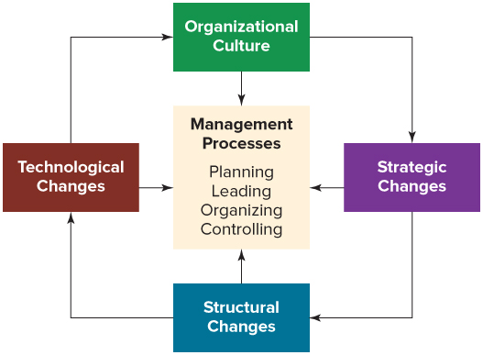
Organizational Change and Culture
Notes:
LO1 Understand what organizational change is and how it relates to the internal and external environment.
Text Figure 12.2– Types of Organizational Change affect Management Processes

Slide 9
Steps in Managing
Organizational Change
  Assess need for change: recognize a problem exists and find its source.
    Look inside and outside the firm for sources.
  Decide on the change to make: determine the ideal future state.
    Decide exactly what the future company will look like.
    What obstacles need to be changed to get there?
Notes:
LO2 Explain some common models of organizational change.
Often, a performance gap, the disparity between desired and actual performance, signals that there is a problem.
Performance measures - such as falling market share or profits, rising costs, or employees’ failure to meet their established goals or stay within budgets - can indicate to managers whether change is needed.

Slide 10
Steps in Managing
Organizational Change
  Implement the change: a top-down change is quickest, bottom-up is more gradual.
    Bottom-up is more effective at eliminating obstacles.
  Evaluate the change: Was it successful?
    Benchmark (compare) your change to others.
Notes:
LO2 Explain some common models of organizational change.
Top-down change is implemented quickly: Top managers identify the need for change, decide what to do, and then move quickly to introduce the changes throughout the organization. For example, top managers may decide to restructure and downsize the organization and then give divisional and departmental managers specific goals to achieve. With top-down change, the emphasis is on making the changes quickly and dealing with problems as they arise.
Bottom-up change is typically more gradual. Top managers consult with middle and first-line managers about the need for change. Then, over time, these low-level managers work with non-managerial employees to develop a detailed plan for change. A major advantage of bottom-up change is that it can reduce uncertainty and resistance to change. The emphasis in bottom-up change is on participation and on keeping people informed about what is going on, thus minimizing resistance from employees.

Slide 11
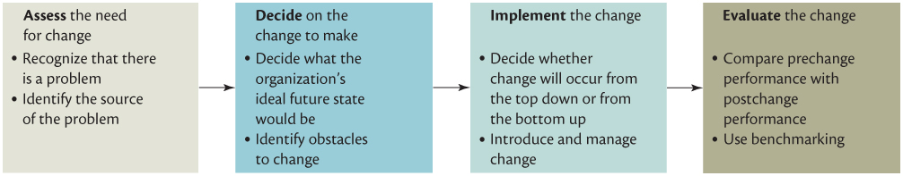
Four Steps in the
Organizational Change Process
Notes:
LO2 Explain some common models of organizational change.
Text Figure 12.3 – Four Steps in the Organizational Change Process

Slide 12
Introducing Change
No one likes change forced on them. However, sometimes change is the only alternative.
Think through why change is necessary in the work you do and the people you manage.
Ponder the following statement: “Change is the only constant.”
Use effective communication skills and get all levels of managers involved in determining what changes need to be made to reduce resistance.
Notes:
LO2 Explain some common models of organizational change.

Slide 13
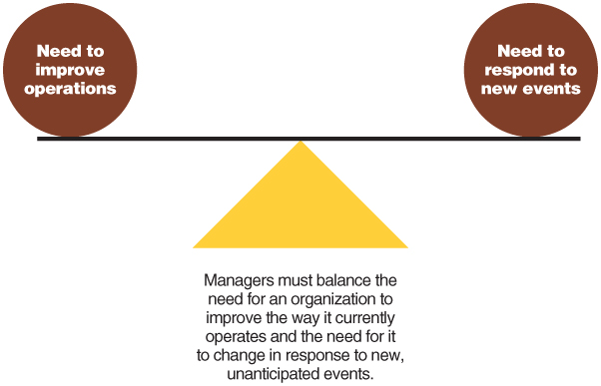
Models of Organizational Change
Notes:
LO2 Explain some common models of organizational change.
Figure 12.4 Organizational Control and Change

Slide 14
Models of Organizational Change
Lewin’s Three-Stage Model of Change:
Unfreezing: overcoming the resistance to change
Moving: getting the change process underway
Refreezing: cements into place the new changes so that people don’t fall back to old habits
Notes:
LO2 Explain some common models of organizational change.
Kurt Lewin identified a three-step process that organizations could use to manage change successfully: unfreeze the status quo, move to a new state, and refreeze the new change to make it permanent.

Slide 15
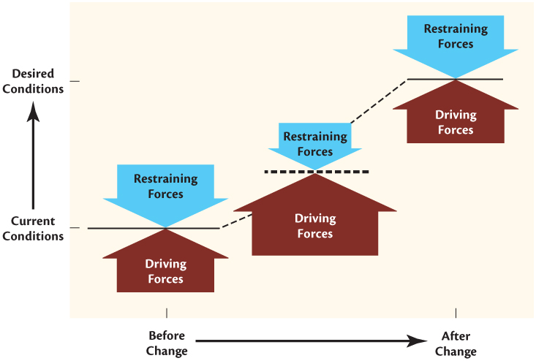
Lewin’s Model of Change
Notes:
LO2 Explain some common models of organizational change.
Text Figure 12.5

Slide 16
Models of Organizational Change
Individuals generally resist change for two primary reasons:
  Fear - People fear the unknown.
    Change can lead to a loss of power
    Economic uncertainty
  Doubt - If people doubt the legitimacy of the change they may act as a restraining force against the change.
Notes:
LO2 Explain some common models of organizational change.
Ask students if they’ve ever had difficulty keeping New Year’s resolutions, beginning of term resolutions, or other resolutions they often make to themselves.
How successful where they?
What were their biggest challenges in making changes?
What factors led to success?

Slide 17
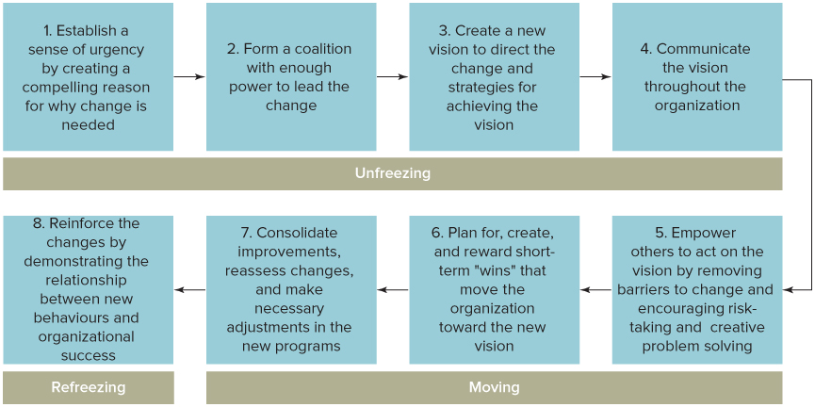
Kotter's Eight Step Plan for Implementing Change
Notes:
LO2 Explain some common models of organizational change.

Slide 18
Four D's Appreciative Inquiry
Discovery: Identify what is good about their jobs, what the strengths of the organization are as a whole and the positive aspects of how their department or work groups operate.
Dreaming: Employees envision possible futures for the organization over a period of time, say five years.
Design: Members develop a common vision of what qualities the organization will have and how it will be structured.
Destiny: Participants discuss how to implement the dream and design. Action plans are written and implementation strategies developed to facilitate the creation of the new desired state for the organization.
Notes:
LO2 Explain some common models of organizational change.

Slide 19
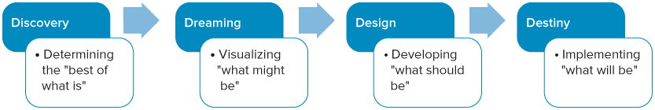
The Four D's of
Appreciative Inquiry
Notes:
LO2 Explain some common models of organizational change.
Figure 12.7 The "Four D's" of Appreciative Inquiry

Slide 20
Complexity Theory
Complexity Theory - organizations respond best to change if they are on the “edge of chaos,” or not perfectly aligned with their environments.
Notes:
LO2 Explain some common models of organizational change.
Complexity theory suggests that organizations respond best to fundamental change if they are poised on the “edge of chaos,” that is, not perfectly aligned with their environments.
Ralph Stacey suggests that too much “fit” can prevent an organization from making the necessary changes that would allow it to compete in a dynamic organizational environment.

Slide 21
Complexity Theory
To achieve this state, managers have to do the following:
  Increase the channels of communication
  Not dictate agendas
  Rotate people regularly
  Avoid overreliance on an incumbent management team.
  Tolerate parallel developments.
  Avoid excessive “fit.”
  Try to reduce anxiety.
Notes:
LO2 Explain some common models of organizational change.

Slide 22
Organizational Change and Culture: Adaptive Cultures vs. Inert Cultures
  Adaptive Culture:
    Encourages positive attitudes and behaviours
    Fosters creativity and innovation
    Examples: WestJet and 3M Canada
  Inert Culture:
    Leads to values and norms that fail to motivate or inspire employees
    Leads to stagnation and often failure over time.
Notes:
LO3 Understand how organizational change relates to an organization’s culture.
In adaptive cultures employees often receive rewards linked directly to their performance and to the performance of the company as a whole. Sometimes, employee stock ownership plans are developed in which workers as a group are allowed to buy a significant percentage of their company’s stock. Workers who are owners of the company have additional incentive to develop skills that allow them to perform highly and search actively for ways to improve quality, efficiency, and performance.
An adaptive culture develops an emphasis on entrepreneurship and respect for the employee and allows the use of organizational structures, such as the cross-functional team structure, that empower employees to make decisions and motivate them to succeed.
With an inert culture, employees are content to be told what to do and have little incentive or motivation to perform beyond minimum work requirements. As you might expect, the emphasis is on close supervision and hierarchical authority, which result in a culture that makes it difficult to adapt to a changing environment.

Slide 23
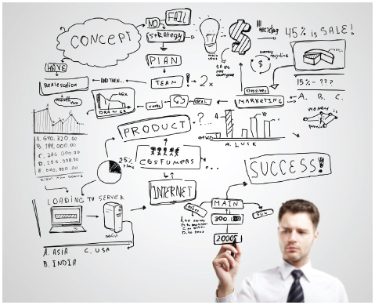
Innovation and Entrepreneurship
Organizations need to promote a culture of intrapreneurship to raise the level of innovation, the implementation of creative ideas in an organization.
Entrepreneurs - notice opportunities and take responsibility for mobilizing the resources necessary to produce new and improved goods and services.
Notes:
LO4 Explain the relationship between entrepreneurship, innovation and organizational change.

Slide 24
Innovation and Entrepreneurship
Social entrepreneurs are individuals who pursue initiatives and opportunities to address social problems and needs in order to improve society and well-being.
Social entrepreneurs are motivated by the desire to help - not primarily private profit maximization.
Notes:
LO4 Explain the relationship between entrepreneurship, innovation and organizational change.
Social entrepreneurs are motivated by the desire to help others.
Social entrepreneurs seek to mobilize resources to solve social problems through creative solutions.
Social entrepreneurs create enterprises with social missions.
The Focus on the Social Economy box is a good example of innovative social entrepreneurship.

Slide 25
Innovation and Entrepreneurship
Intrapreneurs - Employees of existing organizations who notice opportunities for product or service improvements and are responsible for managing the development process.
Product Champion - A manager who takes “ownership” of a project and provides the leadership and vision that takes a product from the idea stage to the final customer.
Notes:
LO4 Explain the relationship between entrepreneurship, innovation and organizational change.
An interesting relationship exists between entrepreneurs and intrapreneurs. Many intrapreneurs become dissatisfied when their superiors decide not to support or to fund new product ideas and development efforts that the intrapreneurs think will succeed.
Organizations with rigid, inflexible organizational cultures do not support the kind of creative risk taking that is necessary to foster innovation.
What do intrapreneurs do who feel that they are getting nowhere? Very often intrapreneurs decide to leave their employers and start their own organizations to take advantage of their new product ideas. In other words, intrapreneurs become entrepreneurs and found companies that may compete with the companies they left.

Slide 26
Innovation and Entrepreneurship
A skunkworks is a group of intrapreneurs who are deliberately separated from the normal operation of an organization.
  Feel ownership for a project
  Act like outside entrepreneurs
Notes:
LO4 Explain the relationship between entrepreneurship, innovation and organizational change.
The term skunkworks was coined at the Lockheed Corporation, which formed a team of design engineers to develop special aircraft such as the U2 spy plane. The secrecy with which this unit functioned and speculation about its goals led others to refer to it as “the skunkworks.”

Slide 27
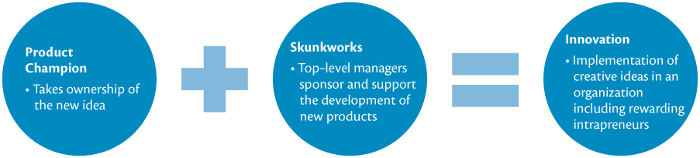
The Process of Innovation
Notes:
LO4 Explain the relationship between entrepreneurship, innovation and organizational change.
Textbook Figure 12.8

Slide 28
Managing Change in a
Unionized Environment
There are four essential elements to managing change in a unionized environment:
  An effective system for resolving day-to-day issues.
  A jointly administered business education process.
  A jointly developed strategic vision for the organization.
  A nontraditional, problem-solving method of negotiating collective agreements.
Notes:
LO5 Describe the challenges managers face in managing organizational change in a unionized workplace.
Students are often cynical about unions, seeing only the negative actions and outcomes.
However:
Change is possible in a unionized setting, but it takes a great deal of communication.
Managers in a unionized setting would do well to consider ways to have employees buy into the changes so that they understand the benefits.

Slide 29
Summary and Review
LO1 Organizational Change
Organizational change is the movement of an organization away from its present state and toward some desired future state to increase its efficiency and effectiveness.
When organizational change is either induced from inside the organization or imposed from outside, changes in the technology, structure, strategy and organizational culture affect the management processes of planning, organizing, leading and controlling.

Slide 30
Summary and Review
LO2 Models of Organizational Change
Four steps in the organizational change process are assessing the need for change, deciding on the change to make, introducing the change, and evaluating how successful the change effort has been.
Kurt Lewin suggests a three-step process to manage change: (1) the status quo is unfrozen, (2) the organization moves to the desired state, and (3) the changes are refrozen to make them permanent. Complexity theory suggests that to effectively deal with change, managers must create flexible systems that teeter on the “edge of chaos” rather than rigid, permanent structures.

Slide 31
Summary and Review
LO3 Organizational Change and Culture
Adaptive organizational cultures are better able to embrace change than are inert cultures, because the positive attitudes and behaviours help the organization build momentum toward the new environment and reduce resistance.

Slide 32
Summary and Review
LO4 Innovation, Entrepreneurship, and Organizational Change
Innovation is the implementation of creative ideas within an organization.
Employees are more motivated to initiate change and innovate when the organizational culture is supportive and flexible.
Managers can promote innovation by creating product champions, creating skunkworks, and rewarding employees for taking risks.

Slide 33
Summary and Review
LO5 Managing Change in a Unionized Environment
To manage change in a unionized environment it is important to resolve day-to-day issues, provide education about the change, work together on developing a vision for the organization, and establish new, cooperative problem-solving arrangements.
A high performance culture based on norms and values that support innovation and risk taking is better adapted to organizational change.

