Slide 1
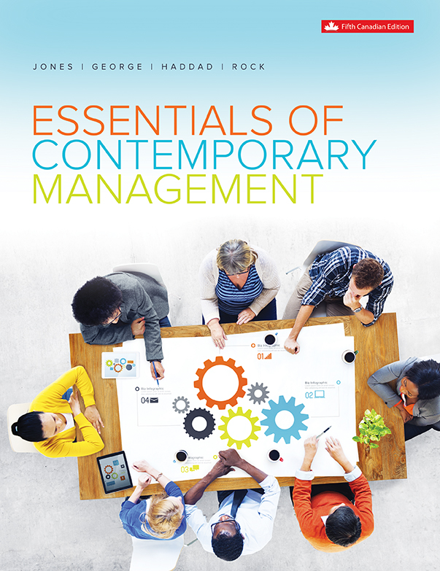
Chapter 11
Managing Control and Operations

Slide 2
Learning Outcomes
Define organizational control and describe the steps in the process of control.
Describe three systems of control used in operations-management.
Identify how output and behavioural controls regulate and motivate employees to achieve organizational goals.
Discuss how appropriate control mechanisms contribute to high performance.
Explain how innovative and conservative cultures control managerial action in gaining a competitive advantage.

Slide 3
What is Organizational Control?
Anticipating events and problems that might occur (feedforward measures)
Keeping an organization on the best track to achieve goals (concurrent measures)
Changing the organization to respond to whatever opportunities or threats have been identified (feedback measures)
Notes:
LO1 Define organizational control and describe the steps in the process of control.

Slide 4
The Control Process
  Establish standards, goals, or targets against which performance is to be evaluated.
  Measure performance.
  Compare actual performance against chosen standards.
  Evaluate the result and take corrective action.
Notes:
LO1 Define organizational control and describe the steps in the process of control.
The first step, establishing standards, is the defining stage of the control process. The standards must be accurate, challenging and consistent with the strategy of the firm. Standards are best set by managers at the level that does the actual task.
Complex tasks are hard to measure (such as the act of managing). It is not surprising that as a result, we then tend to measure other parts of the task that can be measured. Point out that this trend is NOT a good substitute.

Slide 5
Steps in the Control Process
Behavioural standards: customer responsiveness, absenteeism, punctuality
Output standards: productivity, profitability, market share
The criteria against which results are measured
Establish Standards for Performance
Notes:
LO1 Define organizational control and describe the steps in the process of control.

Slide 6
Steps in the Control Process
Measure Performance
What is the actual rate of productivity?
Determine the return on investment.
Measure the market share.
Monitor customer complaints, rates of absenteeism and punctuality.
Notes:
LO1 Define organizational control and describe the steps in the process of control.

Slide 7
Steps in the Control Process
Compare the Actual Performance with the Expected Performance
Is performance higher than expected?
Is performance as expected?
Is performance lower than expected?
Evaluate the reasons for variances between the standard and actual performance
Notes:
LO1 Define organizational control and describe the steps in the process of control.

Slide 8
Steps in the Control Process
Compare the Actual Performance with the Expected Performance
Is performance higher than expected?
Is performance as expected?
Is performance lower than expected?
Evaluate the reasons for variances between the standard and actual performance
Notes:
LO1 Define organizational control and describe the steps in the process of control.

Slide 9
Control Systems &
Operations Management
  Control Systems
  A good control system should:
    Be flexible so managers can respond as needed.
    Provide accurate information about the organization.
    Provide information in a timely manner.
Notes:
LO2 Describe three systems of control used in operations-management.
Managers can gain valuable information by “wandering around”, but this must be augmented by some formal system that will continually keep management informed.
Example: Walmart uses a sophisticated information system to track inventory and sales levels. If sales of a particular product suddenly change, managers are automatically informed and can alter advertising or product ordering.

Slide 10
Control Systems &
Operations Management
Operations Management
  Operations managers are managers who are responsible for managing an organization’s production system.
  Production system - The system that an organization uses to acquire inputs, convert the inputs into outputs, and dispose of the outputs.
Notes:
LO2 Describe three systems of control used in operations-management.

Slide 11
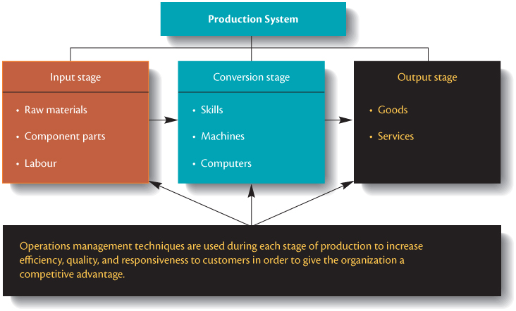
Production System
Notes:
LO2 Describe three systems of control used in operations-management.
Text Figure 11.4 – Production System

Slide 12
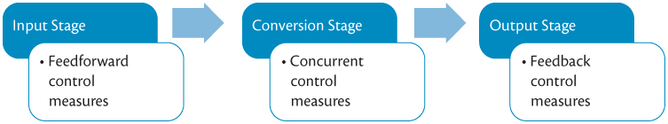
Three Systems of Control
Notes:
LO2 Describe three systems of control used in operations-management.
Text Figure 11.5 – Three Systems of Control

Slide 13
Control Systems
  Feedforward
    Managers anticipate problems before they arise.
  Concurrent
  Feedback
    Provides ‘after-the-fact’ information managers can use in the future.
Notes:
LO2 Describe three systems of control used in operations-management.
Feedforward control is a very powerful system that helps managers anticipate problems before they occur. The Walmart system described earlier is an example of this control since managers can anticipate possible inventory problems before they happen.

Slide 14

Output Control
  Financial Controls are objective and allow comparison to other firms.
    Profit ratios
    Liquidity ratios
    Leverage ratios
    Activity ratios
Notes:
LO3 Identify how output and behavioural controls regulate and motivate employees to achieve organizational goals.
Students have all heard of these controls.
Bring in some newspapers let students evaluate several different firms. Point out that it is hard to compare firms between industry but Profit ratios and other financial ratios allow for a common system of comparison.
Ratios also allow firms such as GE to compare the performance of different divisions.

Slide 15
Financial Measures of Performance
Profit Ratios Return on investment | = |  | Measures how well managers are using the organization’s resources to generate profits.
Gross profit margin | = |  | The difference between the amount of revenue generated from the product and the resources used to produce the product.
Liquidity Ratios Current ratio | = |  | Do managers have resources available to meet claims of short-term creditors?
Quick ratio | = |  | Can managers pay off claims of short-term creditors without selling inventory?
Notes:
LO3 Identify how output and behavioural controls regulate and motivate employees to achieve organizational goals.

Slide 16
Financial Measures of Performance
Leverage Ratios Debt-to-assets ratio | = |  | To what extent have managers used borrowed funds to finance investments?
Times-covered ratio | = |  | Measures how far profits can decline before managers cannot meet interest charges. If ratio declines to less than 1, the organization is technically insolvent.
Activity Ratios Inventory turnover | = |  | Measures how efficiently managers are turning inventory over so excess inventory is not carried.
Days sales outstanding | = |  | Measures how efficiently managers are collecting revenues from customers to pay expenses.
Notes:
LO3 Identify how output and behavioural controls regulate and motivate employees to achieve organizational goals.

Slide 17
Output Control
  Organizational Goals: after corporate financial goals are set, each division is given specific goals that must be met to attain the overall goals.
    Goals, and thus output controls, will be set for each area of the firm.
    Goals are specific and difficult (not impossible) to achieve.
    Goal setting is a management skill developed over time.
Notes:
LO3 Identify how output and behavioural controls regulate and motivate employees to achieve organizational goals.
Highly effective managers develop the ability to set high, achievable goals for their workers and divisions. They then use budgets to allocate the firm’s resources to see that the goals are met.
The best managers know that a budget is a planning and control tool. It should not dictate strategy and if need be, the budget should be changed if the situation warrants.

Slide 18
Output Control
  Operating Budgets: a blueprint showing how managers can use resources.
    Managers are evaluated by how well they meet goals and stay in budget.
    Each division is often evaluated on its own budgets for cost, revenue or profit.
Notes:
LO3 Identify how output and behavioural controls regulate and motivate employees to achieve organizational goals.

Slide 19
Problems with Output Control
  Managers must create output standards that motivate at all levels.
  Be careful of creating short-term goals that motivate managers to forget the future.
  If standards are too high, workers may follow unethical behaviour to attain them.
Notes:
LO3 Identify how output and behavioural controls regulate and motivate employees to achieve organizational goals.

Slide 20
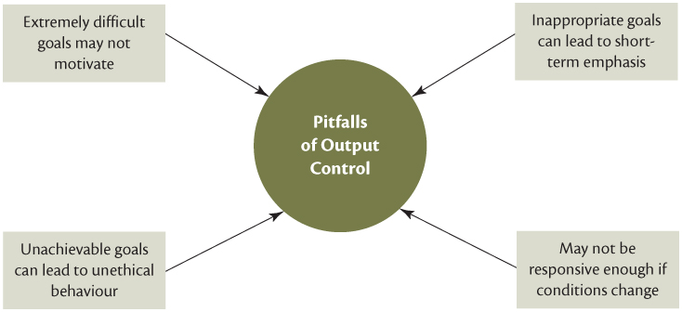
Pitfalls of Output Control
Notes:
LO3 Identify how output and behavioural controls regulate and motivate employees to achieve organizational goals.

Slide 21
Behaviour Control
  Managers must motivate and shape employee behaviour to meet organizational goals.
  Direct Supervision
    Very expensive since only a few workers can be managed by one manager.
    Can de-motivate workers who desire more autonomy.
    Hard to do in complex job settings.
Notes:
LO3 Identify how output and behavioural controls regulate and motivate employees to achieve organizational goals.
Managers must do more than just set and measure goals. They must motivate the workers to achieve these goals. This may be one of the most challenging and rewarding parts of the manager’s job.
Compare the manager’s job to that of a football coach who must motivate different players to work as a team. Each player (and worker) is different and must be treated as such.

Slide 22
Behaviour Control
Output Controls
Financial ratios
Organizational Goals
Behaviour Controls
Direct Supervision
Bureaucratic rules and Standard Operating Procedures (SOPs)
Operating Budgets
Management By Objectives
Clan Control
Notes:
LO3 Identify how output and behavioural controls regulate and motivate employees to achieve organizational goals.
Text Figure 11.7 – Types of Control Measures to Coordinate and Motivate Employees

Slide 23
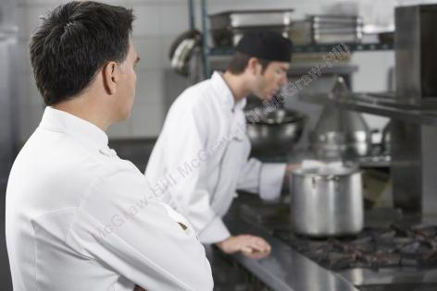
Direct Supervision
The most immediate and potent form of behaviour control is direct supervision by managers who actively monitor and observe the behaviour of their subordinates
It is very expensive
It can demotivate
Sometimes not feasible
Notes:
LO3 Identify how output and behavioural controls regulate and motivate employees to achieve organizational goals.

Slide 24
Management by Objectives
  Management by Objectives (MBO)
    Goals are set at each level of the firm.
    Goal setting is participatory with manager and worker.
    Reviews held looking at progress toward goals.
    Teams are also measured in this way with goals and performance measured for the team.
Notes:
LO3 Identify how output and behavioural controls regulate and motivate employees to achieve organizational goals.
MBO seeks to highlight the differences between workers and tasks by allowing managers and workers to jointly set goals.
A common problem with MBO systems comes from managers that set the worker’s goals without worker input.

Slide 25
Bureaucratic Control
  Control through a system of rules and standard operating procedures (SOPs) that shape the behaviour of divisions, functions, and individuals.
    Rules and SOPs tell the worker what to do.
    Standardized actions so outcomes are predictable.
    Still need output control to correct mistakes.
Notes:
LO3 Identify how output and behavioural controls regulate and motivate employees to achieve organizational goals.
SOPs are common in all organizations (particularly Universities and colleges). Rules can be helpful for recurring issues but ask students how easy it is to create rules and never delete them.
Dell Computer “broke” the rules by offering a no question 30 day money back guarantee on its mail order computers. This new idea met with resounding customer success.
It is very hard to be creative when a firm is governed by thousands of rules.

Slide 26
Bureaucratic Control
  Problems of Bureaucratic Control:
    Rules easier to make than delete. Leads to “red tape.”
    Firm can become too standardized and not flexible.
    Best used for routine problems.
Notes:
LO3 Identify how output and behavioural controls regulate and motivate employees to achieve organizational goals.
SOPs are common in all organizations (particularly Universities and colleges). Rules can be helpful for recurring issues but ask students how easy it is to create rules and never delete them.
Dell Computer “broke” the rules by offering a no question 30 day money back guarantee on its mail order computers. This new idea met with resounding customer success.
It is very hard to be creative when a firm is governed by thousands of rules.

Slide 27
Clan Control
  Clan Control:
    Both culture and clan control accept the norms and values as their own and then work within them.
    These methods provide control where output and behavioural control does not work.
    Strong culture and clan control help worker to focus on the organization and enhance its performance.
Notes:
LO3 Identify how output and behavioural controls regulate and motivate employees to achieve organizational goals.
Students are familiar with clan control in the form of peer pressure. They will attest to its power.
IBM and others have built effective firms based on a work ethic that was enforced through clan control. The real beauty of this method is that the workers enforce it, not the manager.

Slide 28
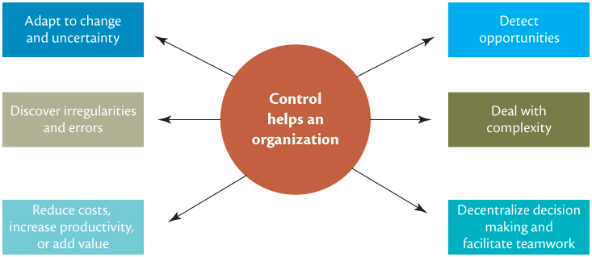
The Importance of Control
Notes:
LO4 Discuss how appropriate control mechanisms contribute to high performance.

Slide 29
The Importance of
Organizational Control
  Control systems help managers to:
    Adapt to change and uncertainty
    Discover irregularities and errors
    Reduce costs, increase productivity, or add value
    Detect opportunities
    Deal with complexity
    Decentralize decision making and facilitate teamwork
Notes:
LO4 Discuss how appropriate control mechanisms contribute to high performance.
Control systems help managers adapt to change and uncertainty, discover irregularities and errors, reduce costs, increase productivity or add value, detect opportunities, deal with complexity, decentralize decision making and facilitate teamwork

Slide 30
How Culture Controls
Managerial Action
 | Type of Organization
Managerial Function | Conservative | Innovative
Planning | Formal, top-down planning | All managers encouraged to participate in decision making
Organizing | Well-defined hierarchy of authority and clear reporting relationships | Organic, flexible structure
Leading | Rigid MBO and constant monitoring | Managers lead by example Encourage risk-taking
Controlling | Bureaucratic control Closed door corporate governance | Clan control Transparent corporate governance
Notes:
LO5 Explain how innovative and conservative cultures control managerial action in gaining a competitive advantage.
Text Table 11.2 – How Culture Controls Managerial Functions

Slide 31
Summary and Review
LO1 Organizational Control and Steps in the Control Process
Controlling is the process that managers use to regulate, monitor and evaluate how efficiently and effectively an organization and its members are performing the activities necessary to reach organizational goals.
When goals are not met, managers can take corrective action to get back on track. Controlling is a four-step process: (1) establishing performance standards, (2) measuring actual performance, (3) comparing actual performance against expected performance, and (4) correcting deviations after determining the cause.

Slide 32
Summary and Review
lo2 Control Systems in Operations
Control systems set targets, monitor and evaluate performance, and help managers make sure the organization is working effectively and efficiently to reach its goals.
Three systems of control are used by operations and supply chain managers: feedforward control used to control inputs; concurrent control, used during the conversion stage; and feedback control, used to provide information to managers in the post-production stage.

Slide 33
Summary and Review
LO3 Types of Controls
To regulate, coordinate and motivate employees, output controls and behavioural controls are used.
Corporate governance practices control managerial behaviour, while the main mechanisms to shape employee behaviour and induce them to work toward achieving organizational goals, are direct supervision, management by objectives, bureaucratic control based on standard operating procedures, and clan control which operates on strong organizational culture where individuals and groups share values, norms, standards of behaviour, and expectations.

Slide 34
Summary and Review
LO4 The Importance of Control
Establishing appropriate control measures help managers adapt to change and uncertainty, discover irregularities and errors, reduce costs, increase productivity or add value, detect opportunities, deal with complexity, decentralize decision making and facilitate teamwork.

Slide 35
Summary and Review
LO5 Control Mechanisms and Gaining a Competitive Advantage
Managers in organizations with innovative cultures carry out the managerial functions of planning, leading, organizing, and controlling very differently from managers in organizations with conservative cultures.
Control processes allow managers to assess how efficiently the organization is producing goods and services, how responsive they are to customer needs, how innovative is the culture and how to increase the quality of goods and services produced to gain a competitive advantage.
Organizational control is important because it helps managers increase performance.

