Slide 1

Chapter 10
Managing Teams

Slide 2
Learning Outcomes
Explain why groups and teams are key contributors to organizational effectiveness.
Identify the different types of groups and teams that help managers and organizations achieve their goals.
Explain how different elements of group dynamics influence the functioning and effectiveness of groups and teams.
Explain how group decision making can be improved.
Describe how managers can create high-performing teams.

Slide 3
Groups, Teams, and
Organizational Effectiveness
Group: two or more people who interact with each other to accomplish a goal.
Team: a group that works intensively with each other to achieve a specific common goal.
  All teams are groups, BUT, not all groups are teams.
Teams can be difficult to form.
  Takes time for members to learn to work together.
  Teams can improve organizational performance.
Notes:
LO1 Explain why groups and teams are key contributors to organizational effectiveness.
Students have probably already worked in groups to complete class projects so this is a great time to ask them what they thought of the process.
Usually, students will voice many of the classic problems that involve groups. Point out that there is a big difference between groups and teams and that you can appoint a group, but a team must be built by the members.

Slide 4
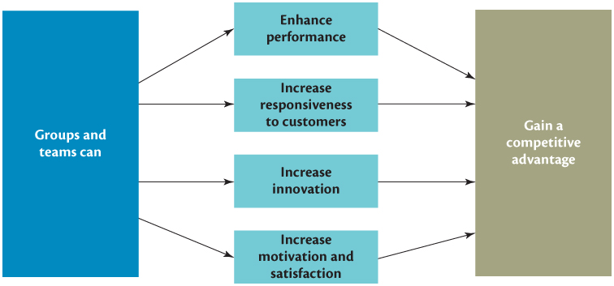
Groups, Teams, and
Organizational Effectiveness
Notes:
LO1 Explain why groups and teams are key contributors to organizational effectiveness.
Business is focusing on the use of teams and groups because it helps performance in many ways. One point that students might not immediately see is that the team can manage many of its own functions and therefore reduce the need for other managers.

Slide 5
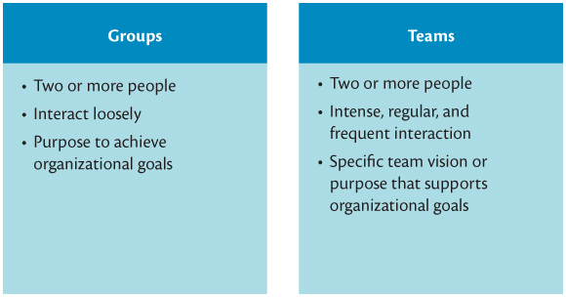
Differences Between Groups and Teams
Notes:
LO1 Explain why groups and teams are key contributors to organizational effectiveness.

Slide 6

Groups, Teams, and
Organizational Effectiveness
Performance Enhancement
  Synergy
  Responsiveness to Customers
  Teams and Innovation
  Groups and Teams as Motivators
Notes:
LO1 Explain why groups and teams are key contributors to organizational effectiveness.

Slide 7
Types of Groups and Teams
  FORMAL GROUPS
    Cross-functional: members of different departments.
    Cross-cultural: members of different cultures.
  TOP MANAGEMENT TEAMS
    Help develop firm’s direction.
    Important to have diversity in the management team to avoid group think.
Notes:
LO2 Identify the different types of groups and teams that help managers and organizations achieve their goals.
The most common teams usually found in businesses are the cross-functional, R&D, command, and self-managed. Naturally, most firms will have each of the other group types as well, but students can expect to encounter these four types frequently.

Slide 8
Types of Groups and Teams
  Research and Development Teams: create new products.
  Task Forces: created to meet a given objective.
    Standing committees are permanent task forces.
Notes:
LO2 Identify the different types of groups and teams that help managers and organizations achieve their goals.

Slide 9
Types of Groups and Teams
  Self-Managed Work Teams: members empowered to complete given work.
    Team decides how to do the task.
Notes:
LO2 Identify the different types of groups and teams that help managers and organizations achieve their goals.

Slide 10
Types of Groups and Teams
  Keys to Effective Self-Managed Teams:
    Give the team responsibility and autonomy
    The team’s task should be complex enough to include many different steps.
    Select members carefully. Look for diversity, skills, and enthusiasm.
    Manager should guide and coach, not supervise.
    Determine training needs and be sure it is provided.
Notes:
LO2 Identify the different types of groups and teams that help managers and organizations achieve their goals.
Self-managed teams have become very popular during the past decade as they provide a number of benefits when compared to more traditional management formats.
Many managers have a difficult time working with self-managed teams. Perhaps the biggest problem is that managers want to “mange” the team by directing it toward the manager’s goals. To be effective, self-managed teams must have considerable autonomy.

Slide 11
Types of Groups and Teams
  Virtual team - A team whose members rarely or never meet face to face and interact by using various forms of information technology such as email, computer networks, telephones, faxes, and video conferences.
  Friendship group - An informal group composed of employees who enjoy one another’s company and socialize with one another.
  Interest group - An informal group composed of employees seeking to achieve a common goal related to their membership in an organization.
Notes:
LO2 Identify the different types of groups and teams that help managers and organizations achieve their goals.

Slide 12
Group Dynamics
Dynamics will affect how a group or team functions when they are brought together.
Group size: affects how a group performs.
    Normally, keep group small (2 to 9 members).
    Small groups interact better and tend to be more motivated.
    Use large groups when more resources are needed.
    Division of labour is possible with large group.
Notes:
LO3 Explain how different elements of group dynamics influence the functioning and effectiveness of groups and teams.
Group size should be determined by the group goals. Typically, the smaller groups are more cohesive and motivated.
Task interdependence measures the extent to which one member tasks relies on another’s output. When interdependence is high, the group by necessity must work close together. Student groups often exhibit high task interdependence in that the successful completion of the project depends on each member performing some task.

Slide 13

Group Roles
  Role: set of behaviours a group member is expected to perform because of their position in the group.
    In cross-functional teams, members perform roles in their specialty.
    Managers need to clearly describe expected roles to group members when they are assigned to the group.
    Self-managed teams may assign the roles to members themselves.
Notes:
LO3 Explain how different elements of group dynamics influence the functioning and effectiveness of groups and teams.
Group roles are the most clear in the cross-functional teams since members perform in their specialty.
Other roles, such as group leader, need to be assigned when the group is formed. If it is a standing group, group role assignment systems need to be identified. This is often left up to the group itself as one of its first agenda items.

Slide 14
Stages of Group Development
  Forming: members get to know each other and reach common goals.
  Storming: members disagree on direction and leadership.
  Norming: close ties and consensus begin to develop between members.
  Performing: group does its real work.
  Adjourning: only for task forces that are temporary.
Notes:
LO3 Explain how different elements of group dynamics influence the functioning and effectiveness of groups and teams.
Managers often are surprised that effective group output takes quite a bit of time. Notice that group production really begins in step four. Many managers appoint a group and then expect immediate results. This is not only unrealistic, but it will also lead to frustration on the part of the group and the manager.

Slide 15
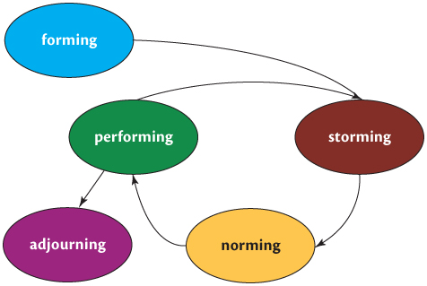
Stages of Group Development
Notes:
LO3 Explain how different elements of group dynamics influence the functioning and effectiveness of groups and teams.
Figure 10.7 shows why it takes time to create a real team. Only after the early group formation steps are completed, can a true team emerge.
You should also note that many groups never reach the team level.

Slide 16
Group Norms
  Group Norms: shared rules that members follow.
    Roles and group norms control behaviour in groups
    Groups may set working hours, behaviour rules, etc.
    Managers should encourage members of a group to develop norms that contribute to group performance and the attainment of group goals
Notes:
LO3 Explain how different elements of group dynamics influence the functioning and effectiveness of groups and teams.
Students will describe situations in which student members of groups fail to perform as they initially agreed to. What can the group do about this? All to often, other group members end up picking up the slack and carrying the non-performing member.
Managers need to be alert for this behaviour and the group should be empowered with the authority to enforce its assignments.

Slide 17
Conformity and Deviance to Group Norms
Group members conform to norms for three reasons:
  They want to obtain rewards and avoid punishments.
  They want to imitate group members whom they like and admire.
  They have internalized the norm and believe it is the right and proper way to behave
Notes:
LO3 Explain how different elements of group dynamics influence the functioning and effectiveness of groups and teams.

Slide 18
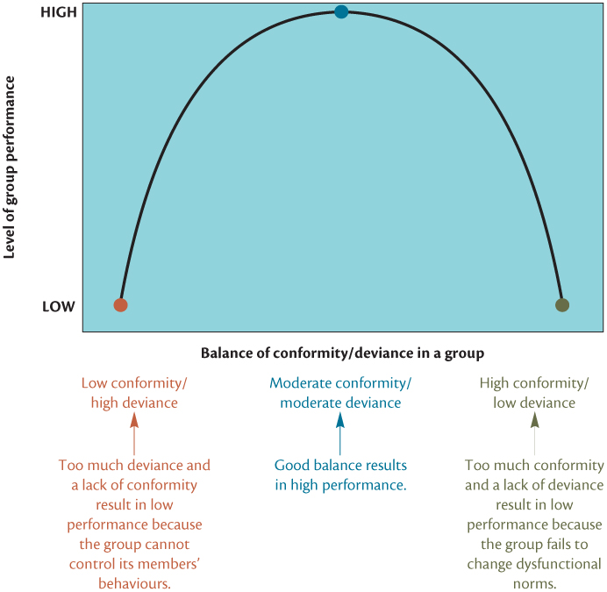
Balancing Conformity and Deviance in Groups
Notes:
LO3 Explain how different elements of group dynamics influence the functioning and effectiveness of groups and teams.
Text Figure - Balancing Conformity and Deviance in Groups
Deviation from group norms is often needed to make significant progress. However, too much deviation can slow the group down or cause it to fail.

Slide 19
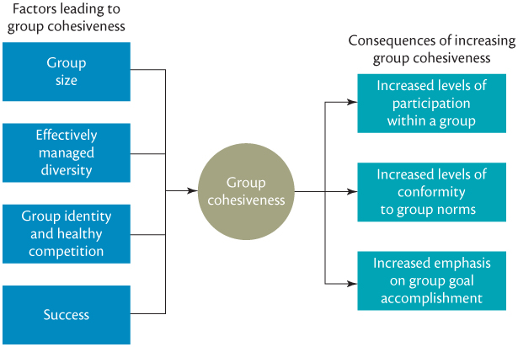
Determinants and Consequences of Group Cohesiveness
Notes:
LO3 Explain how different elements of group dynamics influence the functioning and effectiveness of groups and teams.
There are many examples of significant group cohesiveness with cult membership perhaps being one of the most extreme.
Organizations should seek for a balance with strong cohesiveness in the group but not so strong that group members are loyal first to the group and then the organization.

Slide 20
Group Decision Making
Groupthink
  Group members become too focused on reaching agreement and prevent the full expression of deviant, minority, or unpopular views within the group.
  Symptoms:
    Illusion of invulnerability
    Assumption of morality
    Rationalized resistance
  Peer pressure
  Minimized doubts
  Illusion of unanimity
Notes:
LO4 Explain how group decision making can be improved
Groupthink does not have to occur, but group leaders must be sure to seek alternative opinions from group members, and encourage dissent when members disagree so that all options can be explored.

Slide 21
Improving Group Decision Making
Devil’s Advocacy: one member of the group acts as the devil’s advocate and critiques the way the group identified alternatives.
Dialectical inquiry: two different groups are assigned to the problem and each group evaluates the other group’s alternatives.
Promote diversity: by increasing the diversity in a group, a wider set of alternatives may be considered.
Notes:
LO4 Explain how group decision making can be improved
The group exercise above probably uncovered some of the following.
Devil’s Advocacy: one member of the group acts as the devil’s advocate and critiques the way the group identified alternatives. Points out problems with the alternative selection.
Students should be aware that the Devil’s advocate must have top management support or will not serve well.

Slide 22
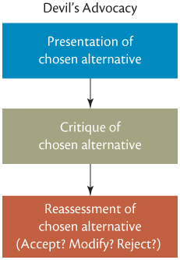
Devil’s Advocacy
Notes:
LO4 Explain how group decision making can be improved
Text Figure 10.12 – Devil’s Advocacy

Slide 23

Promoting Group Creativity
Brainstorming
Nominal Group Technique
Delphi technique
Notes:
LO4 Explain how group decision making can be improved
An additional idea is the Nominal Group Technique which provides a more structured way to generate alternatives in writing. It avoids the production blocking problem.
Similar to brainstorming except that each member is given time to first write down all alternatives he or she would suggest. Alternatives are then read aloud without discussion until all have been listed. Then discussion occurs and alternatives are ranked.
Both nominal group technique and brainstorming require people to meet together to generate creative ideas and engage in joint problem solving. What happens if people are in different cities or in different parts of the world and cannot meet face to face? Videoconferencing is one way to bring distant people together to brainstorm.

Slide 24
Reducing Social Loafing in Groups
Social loafing is the tendency of individuals to put forth less effort when they work in groups than when they work alone
  To eliminate social loafing:
    Make individual contributions to a group identifiable.
    Emphasize the valuable contributions of individual members.
    Keep group size at an appropriate level.
Notes:
LO5 Describe how managers can create high-performing teams
Social loafing happens when one or more members do very little but still benefit from the group performance as a whole.
To reduce loafing, it is necessary that individual performance be measurable either by the group or outside manager. Not surprisingly, loafing gets easier as group size increases.

Slide 25
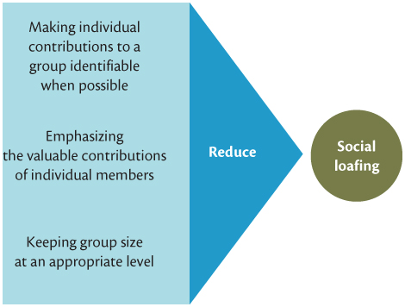
Three Ways to Reduce Social Loafing
Notes:
LO5 Describe how managers can create high-performing teams
Text Figure 10.13 Three Ways to Reduce Social Loafing

Slide 26
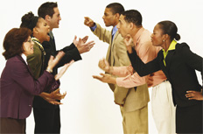
Helping Groups to Manage
Conflict Effectively
Task-related conflict
Relationship conflict
Organizational conflict
Notes:
LO5 Describe how managers can create high-performing teams

Slide 27
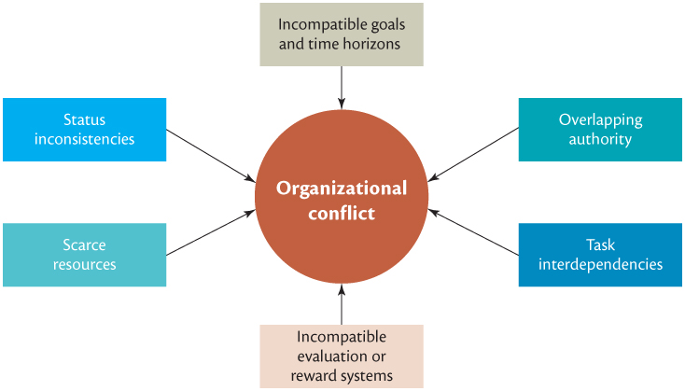
Sources of Conflict
Notes:
LO5 Describe how managers can create high-performing teams
Figure 10.14 describes the common sources of conflict. Ask students how many sources involve the distribution of resources (most). Ask if this is also a problem when people are dealing individually with each other—of course, it is.

Slide 28
Conflict Resolution Approaches
When handling conflict, individuals vary in their degrees of cooperativeness and assertiveness.
Resulting behaviours:
    Avoiding: withdrawing from conflict
    Competing: satisfying one’s own needs only
    Compromising: parties look for concessions
    Accommodating: pleasing the other party rather than self
    Collaborating: make both parties better off
Notes:
LO5 Describe how managers can create high-performing teams
Managers should be trained in the resolution of conflict.
Managers should be sure to focus on the common goals of the organization (or department) and try to seek common ground between the groups. Ask students for examples of collaboration in which someone comes up with a brand new idea that can eliminate the conflict. It is ironic that frequently, such collaboration can lead to dramatic breakthroughs in performance.
Example: Ford Motor Co. found itself in serious sales and profit difficulty in the late 1980’s. They experienced great conflict between dealers, production and other groups. By collaborating and focusing on Total Quality Management instead of short range cost solutions they made great strides in becoming a world class producer of autos.

Slide 29
Summary and Review
LO1 Groups, Teams, and Organizational Effectiveness
A group is two or more people who interact with each other to reach certain goals or meet certain needs.
A team is a group whose members work intensely with each other to achieve a specific common goal or objective.
Groups and teams can contribute to organizational effectiveness by enhancing performance, increasing responsiveness to customers, increasing innovation, and being a source of motivation for their members.

Slide 30
Summary and Review
LO2 Types of Groups and Teams
Formal groups are groups that managers establish to achieve organizational goals; they include cross-functional teams, cross-cultural teams, top-management teams, research and development teams, departments, task forces, self-managed work teams, and virtual teams.
Informal groups are groups that employees form because they believe that the groups will help them achieve their own goals or meet their needs; they include friendship groups and interest groups.

Slide 31
Summary and Review
LO3 Group Dynamics
Key elements of group dynamics are group size and roles, group leadership, group development, group norms, and group cohesiveness.
Five stages of development that many groups pass through are forming, storming, norming, performing, and adjourning. Group norms are shared rules of behaviour that most group members follow.
Group cohesiveness is the attractiveness of a group or team to its members.

Slide 32
Summary and Review
LO4 Group Decision Making
Managers must be aware of the perils of groupthink
Managers can minimize groupthink by playing the devil’s advocate
foster creativity and innovation to improve decision making by using three techniques. (1) Brainstorming (2) The nominal group technique (3) The Delphi technique

Slide 33
Summary and Review
LO5 Managing Groups and Teams for High Performance
To make sure that groups and teams perform at a high level, managers need to motivate group members to work toward the achievement of organizational goals and reduce social loafing and conflict.
Managers can motivate members of groups and teams to work toward the achievement of organizational goals by making sure that members personally benefit when the group or team performs at a high level.

