Slide 1

Chapter 9
Managing Leadership
Notes:
Chapter Two: Managing the Organizational Environment

Slide 2
Learning Outcomes
Explain what leadership is and on what bases of power leaders influence others.
Describe the early trait and behavioural theories of leadership and their limitations.
Explain how contingency models of leadership enhance our understanding of effective leadership and management in organizations.
Compare and contrast visionary leadership.
Explain how gender, culture, and emotional intelligence affect leadership effectiveness.

Slide 3

The Nature of Leadership
Leadership is the process by which a person exerts influence over others and inspires, motivates, and directs their activities to achieve goals.
Effective leadership increases the firm’s ability to meet new challenges.
Notes:
LO1 Explain what leadership is and on what bases of power leaders-influence others.
Managers at all levels of the organization lead in some fashion. It is interesting to note that some of this leadership is not productive. If a worker sees their manager leading in a non-productive manner, it is common for the worker to follow in this same path.

Slide 4
Leadership Style and Managerial Tasks
  Leader - the person exerting the influence over other people.
  Personal Leadership Style: the ways leaders choose to influence others.
    Some leaders delegate and support subordinates, others are very authoritarian.
    Managers at all levels have their own leadership style.
Notes:
LO1 Explain what leadership is and on what bases of power leaders-influence others.

Slide 5
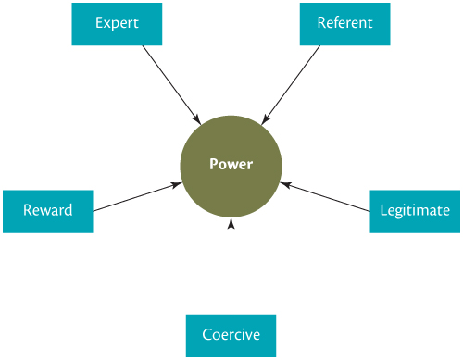
Power: The Key to Leadership
Notes:
LO1 Explain what leadership is and on what bases of power leaders-influence others.
Students have all heard of power but have probably not thought much about where the power can come from. Usually, they will find this information very interesting.
Try to get students to provide examples of each type of power as you describe them in the coming slides.

Slide 6
Power: The Key to Leadership
  Legitimate Power: authority resulting from position
  Reward Power: based on the ability to give rewards.
  Coercive Power: based in ability to punish others.
  Expert Power: based on special skills of leader.
  Referent Power: results from personal characteristics of the leader which earn worker’s respect and loyalty.
Notes:
LO1 Explain what leadership is and on what bases of power leaders-influence others.
Legitimate Power: found in your supervisor or manager and comes from their position in the organization. When the manager leaves the organization, their legitimate power remains at the firm.
Reward power goes along with legitimate power. Students should be able to see that these two power bases compliment each other. To provide a supervisor with legitimate power but no reward power can limit their effectiveness.

Slide 7
Early Models of Leadership
  The Trait Model: sought to identify personal characteristics responsible for effective leadership.
    Research shows that traits do appear to be connected to effective leadership.
      Many “traits” are the result of skills and knowledge.
      Not all effective leaders possess all these traits.
Notes:
LO2 Describe the early trait and behavioural theories of leadership and their limitations.
What makes for an effective leader? These models seek to identify traits or behaviours that effective leaders exhibit. Then, perhaps firms could look for future managers with these same traits and expect them to be effective leaders.
Unfortunately, effective leaders often exhibit very different traits and there is evidence to indicate that some traits are actually learned skills.

Slide 8
Traits and Personal Characteristics
Trait Description
Intelligence Helps managers understand complex issues and solve problems
Knowledge and expertise Helps managers make good decisions and discover ways to increase efficiency and effectiveness
Dominance Helps managers influence their subordinates to achieve organizational goals
Self-confidence Contributes to managers’ effectively influencing subordinates and persisting when faced with obstacles or difficulties
High energy Helps managers deal with the many demands they face
Tolerance for stress Helps managers deal with uncertainty and make difficult decisions
Integrity and honesty Helps managers behave ethically and earn their subordinates’ trust and confidence
Maturity Helps managers avoid acting selfishly, control their feelings, and admit when they have made a mistake
Notes:
LO2 Describe the early trait and behavioural theories of leadership and their limitations.

Slide 9
The Behavioural Model
The Behavioural Model: identifies types of behaviour.
  Consideration (employee-centered behaviour): leaders show care, trust, and respect toward workers.
  Initiating Structure (task–oriented behaviour): managers take steps to make sure work is done. Subordinates perform their job and the organization is efficient and effective.
Notes:
LO2 Describe the early trait and behavioural theories of leadership and their limitations.

Slide 10

Contingency Models of Leadership
Contingency Models - Leadership that takes into account the variables in the situation and the context when leadership occurs.
  Fiedler’s Contingency Model
  Relationship-oriented
  Task-oriented
Notes:
LO3 Explain how contingency models of leadership enhance our understanding of effective leadership and management in organizations.
Fiedler suggests that leadership depends on the leader and the situation. This explains why many managers who were not highly effective in one situation become very successful in another.
This also suggests that top managers should seek out different situations for their managers in an attempt to best fit the manager and situation.

Slide 11
Fiedler’s Contingency Model
  Can combine leader-member relations, task structure, and position power to identify leadership situations.
    Identifies situations where given types of managers might perform best.
  Leader style is a characteristic managers cannot change. Thus, managers will be most effective when:
      1. They are placed in leadership situations that suit their style.
      2. The situation can be changed to fit the manager.
Notes:
LO3 Explain how contingency models of leadership enhance our understanding of effective leadership and management in organizations.
Notice that Fiedler states that leadership styles cannot be changed. This means that leaders should be placed in situations where their style will work or that the situation must be altered to fit the manager.
You might want to have a discussion on the above notion. Should the word “easily” be inserted before “change” so that the statement reads: “Leader style is a characteristic managers cannot change”?

Slide 12
Fiedler’s Contingency Model
  Situational Characteristics: how favourable a given situation is for leading to occur.
    Leader-member relations: determines how much workers like and trust their leader.
    Task structure: extent to which workers tasks are clear-cut.
    Position Power: amount of legitimate, reward, and coercive power a leader has due to their position.
Notes:
LO3 Explain how contingency models of leadership enhance our understanding of effective leadership and management in organizations.
Fieldler describes situation characteristics that can lead to effective leadership.
Example: a poor leadership opportunity would exist when the new manager had little position power, is not trusted by her workers and the tasks that workers perform are complex. If a manager finds herself in such a position, she should immediately attempt to increase the position power and gain the trust of the workers.

Slide 13
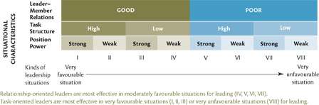
Fiedler’s Contingency Theory of Leadership
Notes:
LO3 Explain how contingency models of leadership enhance our understanding of effective leadership and management in organizations.
Figure 9.3 shows that different manager orientations can benefit the organization.
Ask students why a task-oriented manager might be preferred in sector VIII.
Answer: The manager already has poor relations, a complex task structure, and weak position power. The task offers the best hope of success as there is little to build a strong relationship upon.
Perhaps a better answer would be for the manager to alter the situation to include more positional power.

Slide 14
Hersey-Blanchard’s
Situational Leadership Theory
Situational Leadership Theory (SLT) focuses on followers readiness.
  Leader should match behaviours to employees’ ability and motivation.
    Telling / Selling / Participating / Delegating
Notes:
LO3 Explain how contingency models of leadership enhance our understanding of effective leadership and management in organizations.
Paul Hersey and Ken Blanchard’s situational leadership theory (SLT) has been incorporated into leadership training programs at numerous Fortune 500 companies. More than one million managers a year are taught its basic elements.

Slide 15
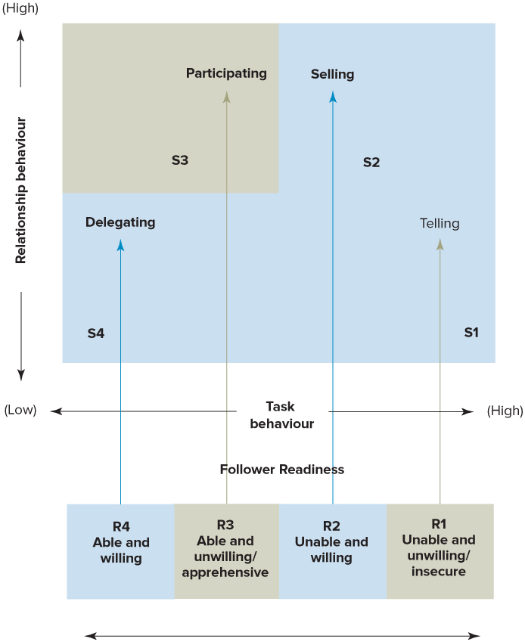
Hersey-Blanchard’s
Situational Leadership Theory
Notes:
LO3 Explain how contingency models of leadership enhance our understanding of effective leadership and management in organizations.
Text Figure 9.4

Slide 16
Path-Goal Theory
  Effective leaders motivate workers to achieve by:
    Identifying the outcomes workers are trying to achieve.
    Rewarding high-performance and attainment.
    Clarifying the paths to the attainment of the goals.
      Path-Goal is a contingency model since it proposes the steps managers should take to motivate their workers.
      Based on Expectancy Theory.
Notes:
LO3 Explain how contingency models of leadership enhance our understanding of effective leadership and management in organizations.
The path-goal model is based on expectancy and suggests that managers motive by identifying desired outcomes and rewarding for the attainment of outcomes.
Perhaps most important (and the main extension to expectancy) is managers need to clarify the path so that goals can be attained. This means that managers must do more than simply put the goal (example: bonus pay) in place but also help the worker find the right path.

Slide 17
Path-Goal Theory
  Path-goal identifies four behaviours leaders can use:
    Directive behaviours
    Supportive behaviour
    Participative behaviour
    Achievement-oriented behaviour
  Which behaviour should be used depends on the worker and the tasks.
Notes:
LO3 Explain how contingency models of leadership enhance our understanding of effective leadership and management in organizations.
Effective path-goal management forces the manager into a much closer relationship with the worker. Usually, managers find that two or three behaviours are needed to provide the best results.

Slide 18
The Leader Substitutes Model
  What is meant by Leadership Substitute?
    Characteristics of Subordinates: their skills, experience, motivation.
    Characteristics of context: the extent to which work is interesting and fun.
  Worker empowerment or Self-managed work teams reduce leadership needs.
  Managers need to be aware that they do not always need to directly exert influence over workers.
Notes:
LO3 Explain how contingency models of leadership enhance our understanding of effective leadership and management in organizations.
Effective leaders are hard to find. Thus, it is not surprising that firms try to substitute leaders with other means. One of the most promising of these is the self-managed work team. Here, the team becomes the leader and does many of the leadership tasks.
This idea allows firms such as Nucor Steel to have few managers but highly empowered workers and worker teams.

Slide 19
Visionary Models of Leadership: Transactional Leadership
Transactional leadership occurs when managers guide or motivate their subordinates in the direction of established goals.
  Results:
    Employees generally meet, but do not exceed performance goals.
    Discourages innovation and initiative.
Notes:
LO4 Compare and contrast visionary leadership.

Slide 20
Visionary Models of Leadership:
Transformational Leadership
  Dramatic improvements in management effectiveness.
  Transformational managers:
    Make subordinates aware of how important their jobs are by providing feedback.
    Make subordinates aware of their own need for personal growth and development.
    Motivate workers to work for the good of the organization, not just themselves.
Notes:
LO4 Compare and contrast visionary leadership.
Transformational leadership seems to be just common sense (an uncommon commodity) but it certainly works!
Ask students how many would like to work at a firm that believed in these traits. Ask them to think about their current employer – Do they see any of these traits in their current leadership?

Slide 21
Transformational Leadership
  Transformational leaders are charismatic and have a vision of how good things can be.
  Transformational leaders openly share information with workers.
  Transformational leaders engage in development of workers (developmental consideration).
Notes:
LO4 Compare and contrast visionary leadership.
The bottom line is that transformational leaders are enthusiastic and enjoy their job. They are glad they are at the firm and are pleased you are as well.
The sharing of information is crucial. When workers know there are problems, they can help find solutions. This has been a key reason for the success of Toyota Motor Company.

Slide 22
Charismatic Leadership
Key Traits of Charismatic Leaders:
  Vision and articulation
  Personal risk
  Environmental sensitivity
  Sensitivity to follower needs
  Unconventional behaviour
Notes:
LO4 Compare and contrast visionary leadership.

Slide 23
Turnaround Leadership
In leading a company that requires turning around:
  Dialogue with customers and employees
  Re-focus strategy
  Add value to customers
  Be honest and realistic
Examples: Blackberry / Girl Scouts of America
Notes:
LO4 Compare and contrast visionary leadership.

Slide 24
Gender and Leadership
The number of women managers is rising but still relatively low in top levels.
Stereotypes suggest:
  Women are supportive and concerned with interpersonal relations. Men are seen as task-focused.
Research indicates that there is no gender-based difference in leadership effectiveness.
Women tend to be more participative than men.
Notes:
LO5 Explain how gender, culture, and emotional intelligence affect-leadership effectiveness.
Ask students what they think about men/women managers. Are they aware that research indicates little difference in effectiveness? How would they feel about working for a manager of a different gender?
You might want also to have students research current articles on women managers.
Three companies worth noting that have supported women in leadership roles are:
Canadian Pacific Railway—which has instituted a range of female-friendly workplace policies, supported by a strong communications program.
Manitoba Lotteries Corporation—which has developed a comprehensive competency model and leveraged it to drive key changes to their talent systems.
TD Bank Financial Group—which has a Women in Leadership committee and helps women network with and mentor each other.

Slide 25
Leadership Styles Across Cultures
European managers tend to be more people-oriented than American or Japanese managers.
Japanese culture is very collective-oriented, while American’s tend to focus more on profitability.
Time horizons also are affected by cultures.
  Canadian and U.S. firms often focus on short-run efforts.
  Japanese firms take a longer-term outlook.
Notes:
LO5 Explain how gender, culture, and emotional intelligence affect-leadership effectiveness.
Leadership style is a personal issue. As a result, cultural issues impact leadership styles.
Given the global nature of firms today, it is not uncommon to have American workers reporting to a German manager. It is helpful for everyone to recognize that differences exist and learn to deal with them.

Slide 26
Emotional Intelligence and Leadership
Emotional intelligence is the ability to understand and manage one’s own moods and emotions and the moods and emotions of other people.
Notes:
LO5 Explain how gender, culture, and emotional intelligence affect-leadership effectiveness.
Ask students this question: Do the moods and emotions leaders experience on the job influence their behaviour and effectiveness as leaders?
Research suggests that this is likely to be the case.

Slide 27
Emotional Intelligence and Leadership
Ways to Cultivate Emotional Intelligence
  Develop self-awareness, including managing your emotions.
  Marshall your positive emotions and passions for a full life.
  Develop empathy, sensing how other people are feeling and a general social awareness, and, put that all together during social interactions.
Notes:
LO5 Explain how gender, culture, and emotional intelligence affect-leadership effectiveness.
Emotional intelligence also plays a crucial role in how leaders relate to and deal with their followers, particularly when it comes to encouraging followers to be creative.
Leaders who are high on emotional intelligence are more likely to understand all the emotions surrounding creative endeavors, to be able to awaken and support the creative pursuits of their followers, and to provide the kind of support that enables creativity to flourish in organizations.

Slide 28
Summary and Review
LO1 The Nature of Leadership
Leadership is different from management.
Leaders have their own personal leadership style that influences how they go about planning, organizing and controlling.
Leaders are able to influence others because they possess power
The five types of power available to managers are legitimate power, reward power, coercive power, expert power, and referent power

Slide 29
Summary and Review
LO2 Early Models of Leadership
The trait model of leadership describes personal characteristics or traits that contribute to effective leadership.
The behaviour model of leadership describes two kinds of behaviour that most leaders engage in: consideration or employee-oriented leaders and initiating structure or production-oriented leaders.

Slide 30
Summary and Review
LO3 Contingency Models of Leadership
Fiedler’s contingency model explains why managers may be effective leaders in one situation and ineffective in another.
Hersey-Blanchard’s Situational Leadership theory examines the need for leaders to adjust their style to match their followers’ level of ability and motivation.
Path-goal theory describes how effective managers motivate their subordinates by clarifying the paths to goal attainment.
The leader substitutes model suggests that sometimes managers do not have to play a leadership role because their subordinates perform highly without the manager having to exert influence over them.

Slide 31
Summary and Review
LO4 Visionary Models of Leadership
Transactional leaders motivate their subordinates to meet expectations by rewarding high performance and extinguishing undesirable behaviours,
Transformational leadership occurs when managers have dramatic effects on their subordinates and on the organization as a whole
Charismatic leadership inspires extra-ordinary performance by followers by articulating a vision that challenges the status quo and relys heavily on referent power.
Turnaround leadership relies on seeing a better future for struggling organizations and making the necessary changes to achieve renewed success.

Slide 32
Summary and Review
LO5 Gender, Culture, Emotional Intelligence, and Leadership
Female and male managers do not differ in the leadership behaviours that they perform.
Female managers are sometimes more participative than are male managers.
Studies have found differences in leadership styles across cultures.
Emotional intelligence has the potential to contribute to leadership effectiveness in multiple ways, including encouraging and supporting creativity among followers.

