Slide 1

Chapter 8
Managing Motivation

Slide 2
Learning Outcomes
Describe the nature of motivation and how it leads to the attainment of intrinsic and extrinsic outcomes.
Explain how need theories of motivation help managers determine the needs of employees and provide outcomes that satisfy them.
Describe how process theories of motivation help managers explain high and low performance levels.
Identify the motivation lessons that managers can learn from learning theories of motivation.
Explain how managers use reward systems to increase employee motivation.

Slide 3
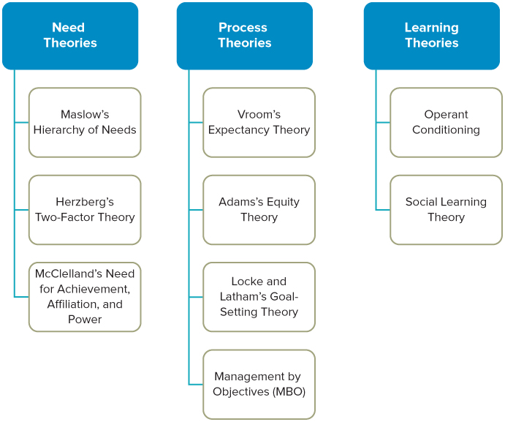
Theories of Motivation
Notes:
LO1 Describe the nature of motivation and how it leads to the attainment of intrinsic and extrinsic outcomes.
Text Figure 8.1 Important Theories of Motivation

Slide 4
The Nature of Motivation
Defined as the psychological forces within a person that determine:
    1. The direction of behaviour in an organization
    2. The effort or how hard people work
    3. The persistence displayed in meeting goals
  Intrinsically Motivated Behaviour
  Extrinsically Motivation Behaviour
  Prosocially Motivated Behaviour
Notes:
LO1 Describe the nature of motivation and how it leads to the attainment of intrinsic and extrinsic outcomes.
Students often focus on extrinsic motivation when considering job performance given society’s focus on pay and rewards. However, ask them if they feel it is stronger than intrinsic motivation. Ideally, managers should be motivated by both sources.

Slide 5
The Nature of Motivation
  Regardless of the source of motivation, people seek outcomes.
    Outcome: anything a person gets from a job.
  Organizations hire workers to obtain inputs:
    Input: anything a person contributes to their job.
  Managers thus use outcomes to motivate workers to provide inputs.
Notes:
LO1 Describe the nature of motivation and how it leads to the attainment of intrinsic and extrinsic outcomes.
Firms want their employees to “work hard” and provide the most output for the least input. Therefore, it becomes very important to determine those outputs that are desired more than others.
The real challenge with this concept is that each individual often desires a different type of outcome and is motivated differently.

Slide 6
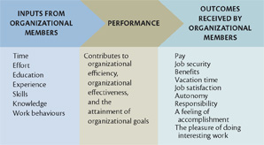
The Motivation Equation
Notes:
LO1 Describe the nature of motivation and how it leads to the attainment of intrinsic and extrinsic outcomes.
Text Figure 8.2 – The Motivation Equation

Slide 7
Need Theories of Motivation
  People are motivated to obtain outcomes at work to satisfy their needs.
    A need is a requirement for survival and well being.
    To motivate a person:
      1) Managers must determine what needs worker want satisfied.
      2) Ensure that a person receives the outcomes when performing well.
  Several needs theories exist.
    Maslow’s Hierarchy of Needs.
    Herzberg’s Motivator-Hygiene Theory
Notes:
LO2 Explain how need theories of motivation help managers determine the needs of employees and provide outcomes that satisfy them.
There are many motivational theories. One group focuses on the needs of individuals.
These theories suggest that all people have different needs and are motivated to satisfy these needs. Therefore, managers must first identify the need and then seek ways to satisfy them so that the workers will be motivated.

Slide 8
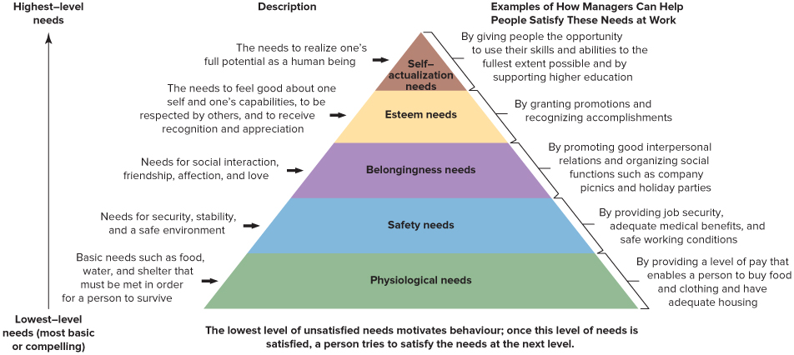
Maslow’s Hierarchy of Needs
Notes:
LO2 Explain how need theories of motivation help managers determine the needs of employees and provide outcomes that satisfy them.
Maslow’s model focuses on five levels. It is important that students understand Need models assume that all lower-level needs are satisfied before workers are motivated by higher level issues.
Example: Workers will not be worried about job security when their pay level is insufficient to provide for basic food and shelter.

Slide 9
Herzberg’s Motivation-Hygiene Theory
  Focuses on outcomes that can lead to high motivation, job satisfaction, and those that can prevent dissatisfaction.
    Motivator needs: related to the nature of the work and how challenging it is.
    Hygiene needs: related to the physical & psychological context of the work.
Notes:
LO2 Explain how need theories of motivation help managers determine the needs of employees and provide outcomes that satisfy them.
Needs can be broken into two categories: motivator and hygiene. The important difference is that satisfying hygiene needs does not lead to higher motivation (but when these hygiene needs are not met, lower motivation will result).
Example: When working conditions are poor, motivation will be lower. Here, work conditions are considered a hygiene factor.
Ask students if health benefits are a motivator or hygiene need. (Most managers consider this to be a hygiene need).

Slide 10
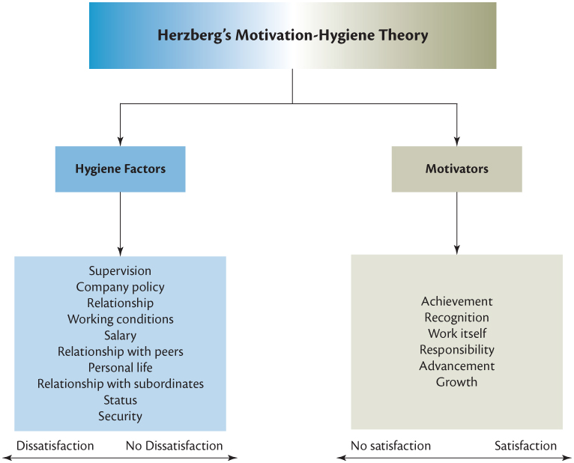
Herzberg’s Motivation-Hygiene Theory
Notes:
LO2 Explain how need theories of motivation help managers determine the needs of employees and provide outcomes that satisfy them.
Text Figure 8.4 - Herzberg’s Motivation-Hygiene Theory

Slide 11
McClelland’s Need for Achievement, Affiliation, and Power
The need for achievement – how strong is one’s desire to perform challenging tasks well and meet personal standards.
The need for affiliation – how concerned is an individual with establishing good -interpersonal relations, being liked, and having the people around him or her get along with each other.
The need for power – how concerned is an individual with their ability to control or influence others.
Notes:
LO2 Explain how need theories of motivation help managers determine the needs of employees and provide outcomes that satisfy them.
Psychologist David McClelland has extensively researched the needs for achievement, affiliation, and power.

Slide 12
Expectancy Theory
Developed by Victor Vroom and is a very popular theory of work motivation.
Vroom suggests that motivation will be high when workers feel:
  High levels of effort lead to high performance.
  High performance will lead to the attainment of desired outcomes.
Consists of three areas:
  Expectancy, Instrumentality, and Valence.
Notes:
LO3 Describe how process theories of motivation help managers explain high and low performance levels.
Point out that Vroom connects high performance with effort and outcomes. He feels that workers look for the connection between these factors and if the connection is not there in any one of the three, then motivation will suffer.

Slide 13
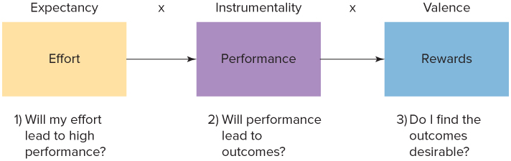
Expectancy, Instrumentality, and Valance
Notes:
LO3 Describe how process theories of motivation help managers explain high and low performance levels.

Slide 14
Expectancy Theory
  Expectancy is the perception that effort (input) will result in a level of performance.
    You will work hard if it leads to high performance.
  Instrumentality: Performance leads to outcomes.
    Workers are only motivated if they think performance leads to an outcome.
  Valence: How desirable each outcome is to a person.
Notes:
LO3 Describe how process theories of motivation help managers explain high and low performance levels.
Students understand these concepts. A good example is to consider their reaction to a major class paper.
Example:
Expectancy: If a student worked very hard, they know they can write an excellent paper. This relationship shows that the expectancy value will be high.
Instrumentality: The student knows that her high performance (the excellent paper) will lead to an excellent grade. This means the instrumentality is strong.
Valence: The student desires an excellent grade, therefore, the valence is high.
This example provides for strong motivation. Point out that if any one factor is low, then motivation will be low.

Slide 15
Expectancy Theory
Expectancy
Instrumentality
Valence
Effort is linked to Performance
Performance is linked to Rewards
Rewards are linked to Personal Goals
"No matter how much I study, I will never achieve an A+ in the course"
"The professor does not often award A+"
"I only need to pass the course in order to graduate"
Low expectancy level
Low instrumentality
Low or negative valence
Am I motivated to achieve an A+ in this course? No
I am not motivated to achieve an A+ in this course.
Notes:
LO3 Describe how process theories of motivation help managers explain high and low performance levels.
Text Figure 8.5 – Expectancy, Instrumentality, and Valence

Slide 16
Expectancy Theory
Expectancy
Instrumentality
Valence
Effort is linked to Performance
Performance is linked to Rewards
Rewards are linked to Personal Goals
"If I study hard, I will achieve an A+ in the course"
"The professor will give me an A+ if I achieve 90%"
"I really need to get an A+ to graduate with honours"
High expectancy level
High instrumentality
Positive valence
Am I motivated to achieve an A+ in this course? Yes
I am motivated to achieve an A+ in this course.
Notes:
LO3 Describe how process theories of motivation help managers explain high and low performance levels.
Text Figure 8.5 – Expectancy, Instrumentality, and Valence

Slide 17
Bringing It All Together:
Expectancy Theory
According to the Expectancy Theory, high motivation results from high levels of Expectancy, Instrumentality, and Valence.
  If just one value is low, motivation will be low.
  This means that even if desired outcomes are closely linked to performance, the worker must feel the task is possible to achieve for high motivation to result.
  Managers need to consider this relationship to build a high performance firm.
Notes:
LO3 Describe how process theories of motivation help managers explain high and low performance levels.
Example: If a student learned from prior experience that the professor grading the project routinely awards the same grades to students regardless of performance, then instrumentality will be low and as a result, motivation will be low.

Slide 18
Equity Theory
  Considers worker’s perceptions of the fairness of work outcomes in proportion to their inputs.
    It is the relative rather than the absolute level of outcomes a person receives.
    The outcome/input ratio is compared by worker with another person called a referent.
    Equity exists when a person perceives their outcome/input ratio to be equal to the referent’s ratio.
    If the referent receives more outcomes, they should also give more inputs to achieve equity.
Notes:
LO3 Describe how process theories of motivation help managers explain high and low performance levels.
Students relate well to the concept of fairness and equity. Adam’s equity theory can be explained best through the use of examples.
Example: Ask students to describe how they might decide if the grade they receive on a project is fair. Probably, some students will compare the grade they received vs. the amount of work they performed as a ratio. They will then compare this perceived ratio with the assumed ratio of some other student (or referent). This would be a classic example of the equity theory.

Slide 19
Inequity
    Inequity exists when worker’s outcome/input ratio is not equal to referent.
      Underpayment inequity: ratio is less than the referent. Worker feels they are not getting the outcomes they should given inputs.
      Overpayment inequity: ratio is higher than the referent. Worker feels they are getting more outcomes then they should given inputs.
Notes:
LO3 Describe how process theories of motivation help managers explain high and low performance levels.
Students will have heard the comment “It is not fair. Jane did less than I did and got a better grade.” This illustrates a condition of inequity.
Notice that it is the worker that will attempt to achieve equity. If the worker perceives the situation incorrectly (the referent appears to do less work, but in reality does more), then management can help by ensuring accurate information is received.

Slide 20
Inequity
  Restoring Equity: Inequity creates tension in workers to restore equity.
    In underpayment, workers reduce input levels to correct.
    In overpayment, worker can change the referent to adjust.
  If inequity persists, worker will often leave the firm.
Notes:
LO3 Describe how process theories of motivation help managers explain high and low performance levels.

Slide 21
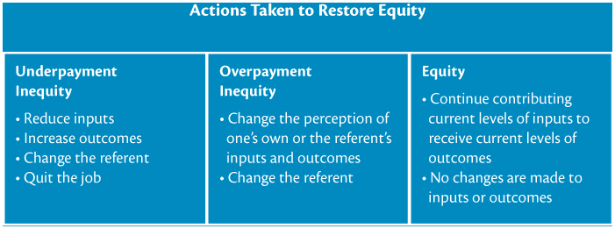
Inequity
Notes:
LO3 Describe how process theories of motivation help managers explain high and low performance levels.
Text Figure 8.8 Possible Actions taken to Restore Equity

Slide 22
Goal-Setting Theory
  Focus worker’s inputs in the direction of high performance & achievement of organizational goals.
    A goal is what a worker tries to accomplish.
    Workers must accept and be committed to them.
    Managers should encourage workers to develop action plans to attain goals.
    Management by Objectives (MBO)
Notes:
LO3 Describe how process theories of motivation help managers explain high and low performance levels.
High performance organizations achieve challenging organizational goals. These overall goals are in turn broken down until there are goals for individual workers.
Workers will be motivated to achieve these goals ONLY if they are committed to them. This means that mangers must relate the goal to the worker such that the worker knows the goal is important to the firm.

Slide 23
Learning Theories
Learning theories - theories that focus on increasing employee motivation and performance by linking the outcomes that employees receive to the performance of desired behaviours and the attainment of goals.
  Learning - a relatively permanent change in knowledge or behaviour that results from practice or experience.
Notes:
LO4 Identify the motivation lessons that managers can learn from operant conditioning theory and social learning theory.
The basic premise of learning theories as applied to organizations is that managers can increase employee motivation and performance by the ways they link the outcomes that employees receive to the performance of desired behaviours and the attainment of goals.
Learning theory focuses on the linkage between performance and outcomes in the motivation equation (refer back to Figure 8.2).

Slide 24
Operant Conditioning Theory
Operant conditioning theory (reinforcement theory) looks at the relationship between behaviour and its consequences.
    Positive Reinforcement: people get desired outcomes when they perform needed work behaviours.
      Positive reinforcers: pay raises, promotions.
    Negative Reinforcement: manager eliminates undesired outcomes once the desired behaviour occurs.
      Worker performs to avoid an undesired outcome (Work harder or you are fired).
Notes:
LO4 Identify the motivation lessons that managers can learn from operant conditioning theory and social learning theory.

Slide 25
Operant Conditioning Theory
    Extinction: used when workers are performing behaviour detrimental to the firm.
      Manager does not reward the behaviour and over time, the worker will stop performing it.
    Punishment: used when the manager does not control the reward the worker receives (perhaps it is outside the job).
      Manager administers an undesired consequence to worker (verbal reprimands to pay cuts).
Notes:
LO4 Identify the motivation lessons that managers can learn from operant conditioning theory and social learning theory.
Extinction assumes that the actions performed by the worker (good and bad) are to attain outcomes. By not rewarding the behaviour in any way, over time the worker will cease to perform the behaviour.
Example: a auto dealer wants to avoid the use of pressure sales tactics. When a car is sold through the use of such tactics, the manager does not praise the sales rep. Praise is only given when appropriate methods are used.
Punishment is a technique that should be sparingly used as it builds resentment toward managers and does nothing to enhance motivation.

Slide 26
Social Learning Theory
    Social Learning Theory - motivation results from direct experience of rewards and punishments and from a person’s thoughts and beliefs.
    It explains:
      Vicarious learning
      Self-reinforcement
      Self-efficacy
Notes:
LO4 Identify the motivation lessons that managers can learn from operant conditioning theory and social learning theory.
Vicarious learning, often called observational learning, occurs when a person (the learner) becomes motivated to perform a behaviour by watching another person (the model) perform the behaviour and be positively reinforced for doing so.
Self-reinforcers are any desired or attractive outcomes or rewards that people can give to themselves for good performance, such as a feeling of accomplishment, going to a movie, having dinner out, buying a new CD, or taking time out for a golf game.
Self-efficacy is a person’s belief about his or her ability to perform a behaviour successfully

Slide 27
Total Reward Strategy
A total reward strategy encompasses both intrinsically and extrinsically motivating factors such as:
  Career development opportunities
  Merit increases
  Base pay amounts
  Non-financial recognition
  Employee development and training
Notes:
LO5 Explain how managers use reward systems to increase employee -motivation.
Research by Gallup, shows that in world-class organizations, the ratio of engaged to actively disengaged employees is about 10:1. In average organizations, the ratio of engaged to actively disengaged employees is less than 2:1.

Slide 28
Pay and Motivation
  Pay can help motivate workers.
    Need Theory
    Expectancy
    Goal-Setting Theory
    Reinforcement Theory
    Equity Theory
  Pay should be based on performance, many firms do this with a Merit Pay Plan.
Notes:
LO5 Explain how managers use reward systems to increase employee -motivation.
Pay is a common and effective motivator. However, be sure to stress that it is not the only motivator!
Pay also has a tendency to lose motivational value over time and can be difficult to directly associate with performance.

Slide 29
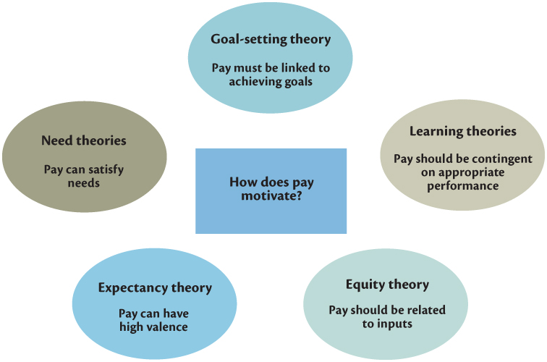
How Pay Motivates
Notes:
LO5 Explain how managers use reward systems to increase employee -motivation.
Text Figure 8.9 – How Pay Motivates

Slide 30
Summary and Review
LO1 The Nature of Motivation
Managers strive to motivate employees to contribute their inputs to an organization, to focus these inputs in the direction of high performance, and to ensure that people receive the outcomes they desire when they perform at a high level.
People are motivated to work hard extrinsically to acquire material rewards or avoid punishment, intrinsically for its own sake, and prosocially to help others.

Slide 31
Summary and Review
LO2 Need Theories of Motivation
Need theories suggest that to motivate their workforces, managers should determine what needs people are trying to satisfy in organizations and then ensure that people receive outcomes that satisfy these needs when they perform at a high level and contribute to organizational effectiveness.
Managers can design jobs with five core dimensions in mind to make them more interesting and motivating.

Slide 32
Summary and Review
LO3 Process Theories of Motivation
Process theories help managers explain why people act the way they do and thus help managers understand the roots of high and low performance levels among employees.

Slide 33
Summary and Review
LO4 Learning Theories
Learning theories help managers see the link between giving rewards for high performance behaviour and the repetition of that behaviour among employees.

Slide 34
Summary and Review
LO5 Total Reward Strategy
Each of the motivation theories discussed in this chapter alludes to the importance of pay and suggests that pay should be based on performance.
Pay is only one part of a total reward strategy, which includes both extrinsic elements such as pay and intrinsic elements such as providing opportunities for growth and development and non-financial recognition.

