Slide 1
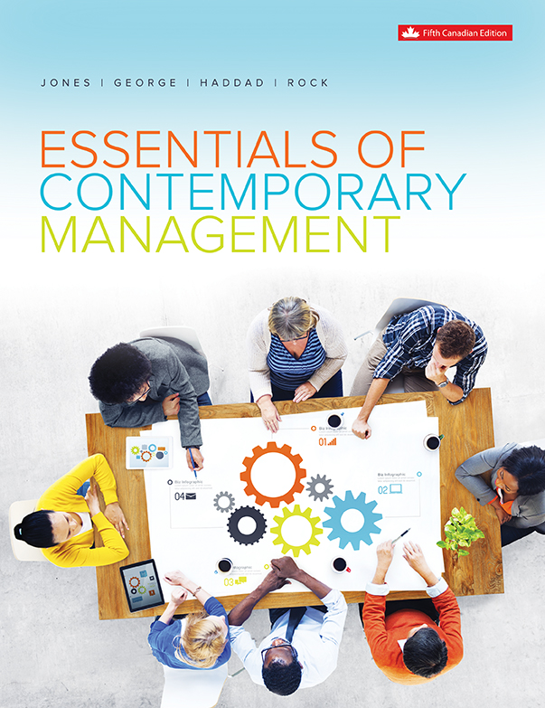
Chapter 7
Managing Human Resources

Slide 2
Learning Outcomes
Describe the legal framework of human resource management in Canada and why managing diversity effectively is good for business.
Explain why strategic human resource management and human resources planning can help an organization gain a competitive advantage.
Describe the five components of human resources management and explain how they fit together with the strategy and structure of the organization.
    i. Recruitment and Selection
    ii. Training and Development
    iii. Performance Appraisal and Feedback
    iv. Pay and Benefits
    v. Employee Relations
Explain the role of the Human Resources Manager in Dealing with Workplace Harassment

Slide 3
The Legal Framework of Human Resource Management in Canada
    Employment Standards Act:
      Minimum standards for the private sector in federal, provincial, and territorial legislation.
      Minimum age for employment, hours of work and overtime pay, minimum wages, equal pay, the weekly rest-day, general holidays with pay, annual vacations with pay, parental leave, and individual and group terminations of employment.
      Mandatory retirement / whistleblower protection.
Notes:
LO1 Describe the legal framework of human resource management in Canada and why managing diversity effectively is good for business.

Slide 4
The Legal Framework of Human
Resource Management in Canada
  The Canadian Human Rights Act:
    Covers all businesses under federal jurisdiction.
    Each province and territory has its own human rights legislation that prohibits discrimination based on specific grounds.
    There are differences across the nation.
Notes:
LO1 Describe the legal framework of human resource management in Canada and why managing diversity effectively is good for business.
There are differences across the nation. For example, in British Columbia, Prince Edward Island, Quebec, and Yukon, it is considered discriminatory to reject an applicant for employment based on a record of criminal conviction. This is not a prohibited ground of discrimination in any other of the 14 jurisdictions in Canada.
All jurisdictions prohibit discrimination on the grounds of race, colour, religion or creed, physical and mental disability, sex (including pregnancy and childbirth), and marital status. All areas have policies related to discrimination on the basis of age; however, the protected age groups differ.
Human resource managers must act according to the legislation that governs their jurisdiction in hiring and firing employees. Failure to do so, may result in charges of discrimination and may lead to increasingly large fines and settlements.

Slide 5
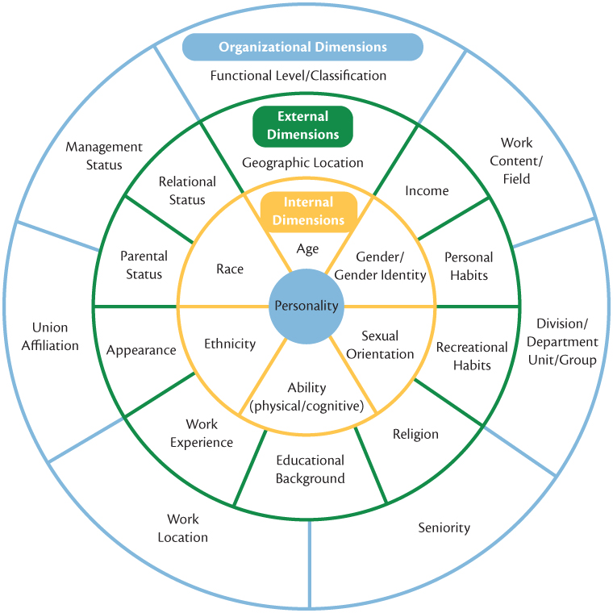
Diversity
Notes:
LO1 Describe the legal framework of human resource management in Canada and why managing diversity effectively is good for business.
There are differences across the nation. For example, in British Columbia, Prince Edward Island, Quebec, and Yukon, it is considered discriminatory to reject an applicant for employment based on a record of criminal conviction. This is not a prohibited ground of discrimination in any other of the 14 jurisdictions in Canada.
All jurisdictions prohibit discrimination on the grounds of race, colour, religion or creed, physical and mental disability, sex (including pregnancy and childbirth), and marital status. All areas have policies related to discrimination on the basis of age; however, the protected age groups differ.
Human resource managers must act according to the legislation that governs their jurisdiction in hiring and firing employees. Failure to do so, may result in charges of discrimination and may lead to increasingly large fines and settlements.

Slide 6
Managing a Diverse Workforce
Perceptions of Generation Y (Millennials):
  Disrespectful and vocal if dissatisfied
  Lack a strong work ethic
  Not loyal
  High maintenance
  Technologically dependent
  Sense of entitlement
  Supportive relationships
Notes:
LO1 Describe the legal framework of human resource management in Canada and why managing diversity effectively is good for business.
There are differences across the nation. For example, in British Columbia, Prince Edward Island, Quebec, and Yukon, it is considered discriminatory to reject an applicant for employment based on a record of criminal conviction. This is not a prohibited ground of discrimination in any other of the 14 jurisdictions in Canada.
All jurisdictions prohibit discrimination on the grounds of race, colour, religion or creed, physical and mental disability, sex (including pregnancy and childbirth), and marital status. All areas have policies related to discrimination on the basis of age; however, the protected age groups differ.
Human resource managers must act according to the legislation that governs their jurisdiction in hiring and firing employees. Failure to do so, may result in charges of discrimination and may lead to increasingly large fines and settlements.

Slide 7
Strategic Human Resource Management
Human Resource Management includes all activities used to attract and retain employees and to ensure they perform at a high level in meeting organizational goals.
These activities are made up of:
    1. Recruitment and Selection
    2. Training and Development
    3. Performance Appraisal and Feedback
    4. Pay and Benefits
    5. Labour Relations
Notes:
LO2 Explain why strategic human resource management and human resources planning can help an organization gain a competitive advantage.
HR is a wide-ranging field that changes constantly. This is a great field for students to enter that want to spend time with people in an area of critical importance to the success of the firm.

Slide 8
Human Resource Planning
HR Planning includes all activities managers do to forecast current and future HR needs.
Must be done prior to recruitment and selection
  Demand forecasts made by managers estimate the number & qualifications the firm will need.
  Supply forecasts estimate the availability and qualifications of current workers and those in the labour market.
Notes:
LO2 Explain why strategic human resource management and human resources planning can help an organization gain a competitive advantage.
The first step of effective HR is the forecast of human resource needs. This obviously depends on the input from other managers in the organization.
The HR professional will need to forecast the supply and demand for the labour market.
Students will be surprised to learn that this can change rapidly and can be hard to predict.

Slide 9
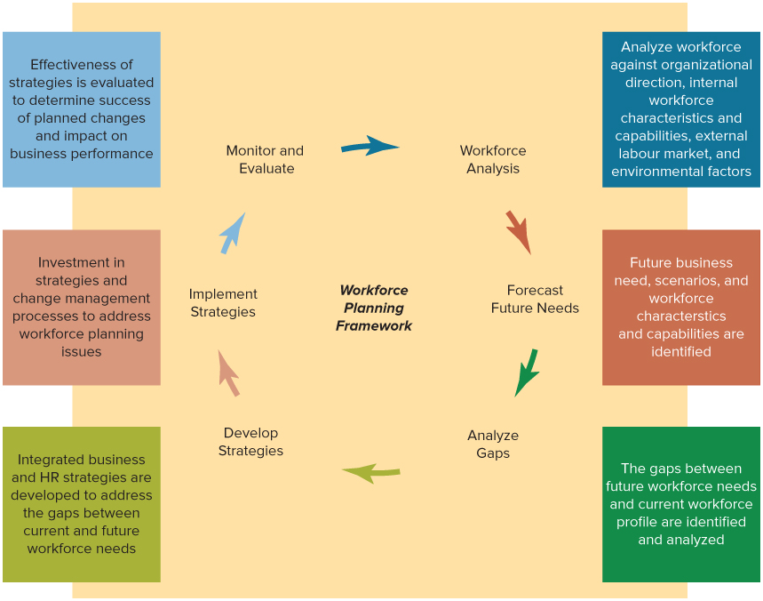
Resource Workforce Planning Cycle
Notes:
LO2 Explain why strategic human resource management and human resources planning can help an organization gain a competitive advantage.
Components of a Human Resource Management System

Slide 10
Human Resource Planning
HR planning sometimes results in outsourcing to fill human resource needs.
  Instead of recruiting and selecting employees from within the organization, managers contract with people who are not members of their organization to produce goods and services.
  Example: Managers in publishing companies, for example, frequently contract with freelance editors to copyedit books that they intend to publish.
Notes:
LO2 Explain why strategic human resource management and human resources planning can help an organization gain a competitive advantage.
Two reasons why human resource planning sometimes leads managers to outsource are flexibility and cost.
Outsourcing can give managers increased flexibility, especially when accurately forecasting human resource needs is difficult, human resource needs fluctuate over time, or finding skilled workers in a particular area is difficult.
Outsourcing can sometimes allow managers to make use of human resources at a lower cost. When work is outsourced, costs can be lower for a number of reasons: The organization does not have to provide benefits to workers; managers are able to contract for work only when the work is needed; and managers do not have to invest in training. Outsourcing can be used for functional activities such as after-sales service on appliances and equipment, legal work, and the management of information systems.

Slide 11
Advantages and Disadvantages of Outsourcing Human Resources
Examples | Advantages | Disadvantages
Computer software companies outsourcing programming work to India Contracting out activities to companies that specialize in HRM | Takes advantage of lower labour costs Provides flexibility by allowing the company to focus on core competencies Reduces costs: when a company outsources, it does not have to provide benefits to full-time workers or invest in training | Lose control over the quality of goods and services. Companies hired to do the work have less knowledge of organizational practices, procedures, and goals. Outsourced employees have less commitment to an organization than do regular, full-time employees. The potential to eliminate members’ jobs creates resistance to outsourcing by labour unions.
Notes:
LO2 Explain why strategic human resource management and human resources planning can help an organization gain a competitive advantage.

Slide 12
HRM Planning: Job Analysis
  Succession planning – personal replacement charts
  Job analysis determines the tasks, duties and responsibilities of the job.
    A job analysis should be done for each job in the
    organization.
    Current trends are toward flexible jobs where duties are
    not easily defined in advance.
Notes:
LO2 Explain why strategic human resource management and human resources planning can help an organization gain a competitive advantage.
Job analysis allows HR managers to identify the tasks and therefore skills that new and current workers require.
This sounds great but given the increased use of flexible jobs and structures, these tasks become very hard to identify. Further, the task set will likely change in a short time, particularly in a high tech firm such as Oracle or Microsoft.

Slide 13
Recruitment and Selection
  External Recruiting
    Managers advertise in newspapers, hold open houses, recruit at universities, and on the Internet.
    External recruitment is difficult since many new jobs have specific skill needs.
  Internal Recruiting
    Workers know the firm’s culture, may not have new ideas.
    Managers likely already know the candidates.
    Internal advancement can motivate employees.
Notes:
LO3 Describe the five components of human resources management and explain how they fit together with the strategy and structure of the organization.
There are pros and cons for each method. External recruiting can be riskier since you are unfamiliar with the applicant’s abilities. However, there can also be great rewards since the new hire can bring new ideas and concepts to the firm.

Slide 14
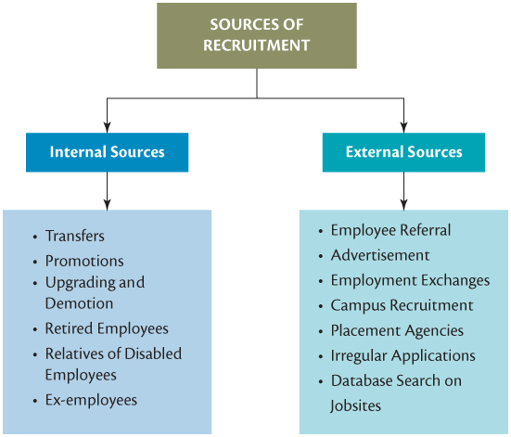
Recruitment and Selection
Notes:
LO3 Describe the five components of human resources management and explain how they fit together with the strategy and structure of the organization.
There are pros and cons for each method. External recruiting can be riskier since you are unfamiliar with the applicant’s abilities. However, there can also be great rewards since the new hire can bring new ideas and concepts to the firm.

Slide 15
The Selection Process
  Selection tools must be reliable and valid.
    Reliability: the degree to which the tool measures the same thing each time it is used.
    Validity:
    Does the test measure
    what it is supposed to measure?
Selection
Background information and reference checks
Interviews
Performance- Simulation Tests
Written tests
Notes:
LO3 Describe the five components of human resources management and explain how they fit together with the strategy and structure of the organization.
The characteristics of reliability and validity are very important to effective HR managers. Managers must ensure that any tests stay reliable and valid over time. Given that many jobs experience changing tasks and duties over time, this concern is heightened even more.

Slide 16
The Selection Process
  Once a pool of applicants are identified qualifications must be determined.
    Background Information
    Interviews: Structured and Unstructured
    A realistic job preview Two types:
Notes:
LO3 Describe the five components of human resources management and explain how they fit together with the strategy and structure of the organization.
Most students have already been involved in submitting background information on a job application or resume. They have also probably been through an interview and can describe some of their reactions.
One of the big problems with any interview is that the manager’s individual views can lead to bias. For this reason, structured interviews that seek the same information are more effective.

Slide 17
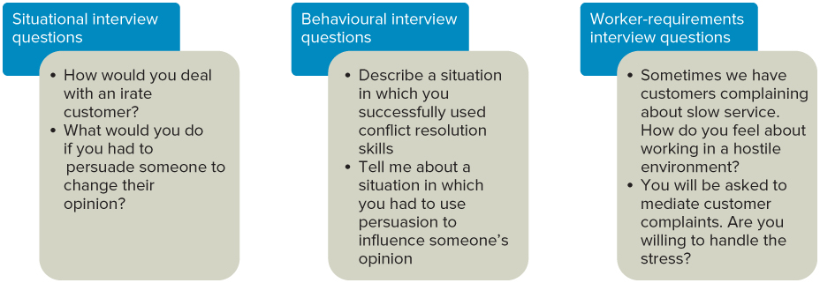
The Selection Process: Examples of Interview Question Types
Notes:
LO3 Describe the five components of human resources management and explain how they fit together with the strategy and structure of the organization.

Slide 18
The Selection Process: Testing
    Testing: includes testing of ability, personality, physical ability, and performance
      Ability test: assess if applicant has right skills for the job.
      Personality test: seek traits relevant to job performance.
      Physical ability test: assesses whether applicant has physical ability to do job tasks
Notes:
LO3 Describe the five components of human resources management and explain how they fit together with the strategy and structure of the organization.
A variety of tests can be used during the selection process. Be sure to stress that any test must be a good predictor of on-the-job performance.
Example: you provide a written IQ test during the selection process. If subsequent evaluation showed that workers who did poorly on the test still performed well on the job, managers would know that the test was not well correlated to the job requirements. Such a test cannot be used.

Slide 19
Selection Process
    Performance Tests
      Typing speed test is one example.
      Assessment Center: candidates assessed on job- related activities over a period of a few days.
    References
      Can be hard to get accurate, unbiased information.
Notes:
LO3 Describe the five components of human resources management and explain how they fit together with the strategy and structure of the organization.

Slide 20
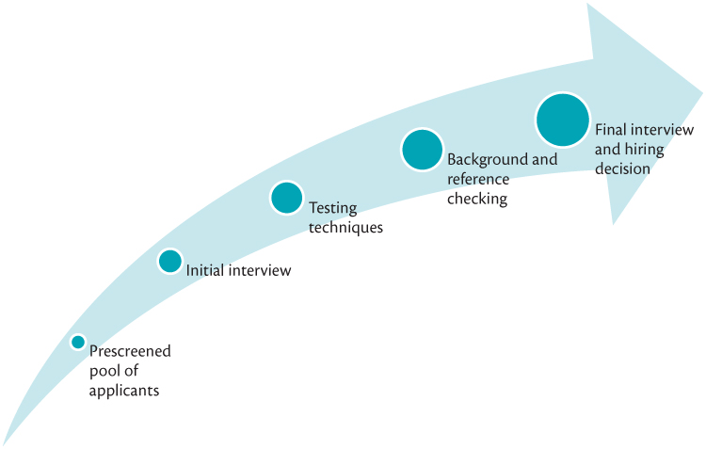
Typical Steps in the Hiring Process
Notes:
LO3 Describe the five components of human resources management and explain how they fit together with the strategy and structure of the organization.

Slide 21
Orientation, Training and Development
  Orientation the introduction to the culture, norms, policies, values, vision and mission of the organization
  Training: teach organizational members how to perform current jobs.
  Development: builds worker’s skills to enable them to take on new duties.
    Training used more often at lower levels of firm, development is common with managers.
    A Needs Assessment should be taken first to determine who needs which program and what topics should be stressed.
Notes:
LO3 Describe the five components of human resources management and explain how they fit together with the strategy and structure of the organization.
Training is an ongoing effort. Students often think about training of assembly line workers but be sure to mention the training required for a physician who is learning a new surgical procedure or for a bank teller learning a new banking software system.
The Needs assessment is crucial since it determines where workers are lacking knowledge and how much training must be provided.
A good exercise is to have students research what senior managers do regarding development opportunities. As many of these managers are getting older, there is more and more a need for pre-retirement workshops, ‘spirituality in the workplace’ workshops, and pension and benefits sessions.

Slide 22
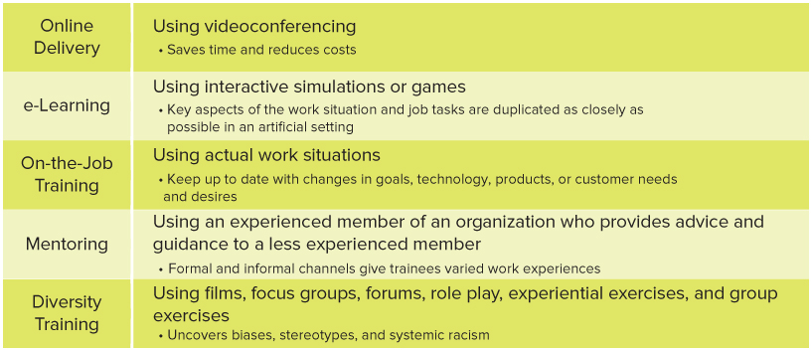
Training and Development Methods
Notes:
LO3 Describe the five components of human resources management and explain how they fit together with the strategy and structure of the organization.
Training is an ongoing effort. Students often think about training of assembly line workers but be sure to mention the training required for a physician who is learning a new surgical procedure or for a bank teller learning a new banking software system.
The Needs assessment is crucial since it determines where workers are lacking knowledge and how much training must be provided.
A good exercise is to have students research what senior managers do regarding development opportunities. As many of these managers are getting older, there is more and more a need for pre-retirement workshops, ‘spirituality in the workplace’ workshops, and pension and benefits sessions.

Slide 23
Performance Appraisal & Feedback
Performance Appraisal - The evaluation of employees’ job performance and contributions to their organization.
Performance Feedback - The process through which managers share performance appraisal information with subordinates, give subordinates an opportunity to reflect on their own performance, and develop, with subordinates, plans for the future.
Notes:
LO3 Describe the five components of human resources management and explain how they fit together with the strategy and structure of the organization
Performance appraisal and feedback contribute to the effective management of human resources in two ways.
Performance appraisal gives managers important information on which to base human resource decisions. Decisions about pay raises, bonuses, promotions, and job moves all hinge on the accurate appraisal of performance.
Performance appraisal also can help managers determine which workers are candidates for training and development and in what areas. Performance feedback encourages high levels of employee motivation and performance. It alerts good performers that their efforts are valued and appreciated and alerts poor performers that their lacklustre performance needs improvement.

Slide 24
Types of Performance Appraisals
  Trait Appraisals: Evaluate on traits (skills, abilities) related to the job.
    Problem: Even though a worker has the trait, they may not use it in the job and it is hard to give feedback.
  Behaviour Appraisals: How a worker does the job.
    Focuses on what a worker does and provides good feedback options.
Notes:
LO3 Describe the five components of human resources management and explain how they fit together with the strategy and structure of the organization
There are many ways to appraise workers. Ideally, managers should focus on results but this can be hard to measure. As a result, managers often focus on traits and behaviours.
Example: a sales representative should be a good communicator (trait), so it may be easy to evaluate if the sales rep is a good communicator rather than if he or she is a good sales rep. This would also be an example of a subjective appraisal since it is based on a manager’s perception.

Slide 25
Types of Performance Appraisal
  Graphic Rating Scale Method
    Appraiser scores the employee on a number of performance characteristics
    Specific behavioural descriptions are used for each area that relate to the current job requirements.
    Points are assigned for each rating and are totalled and averaged for an overall performance score
Notes:
LO3 Describe the five components of human resources management and explain how they fit together with the strategy and structure of the organization

Slide 26
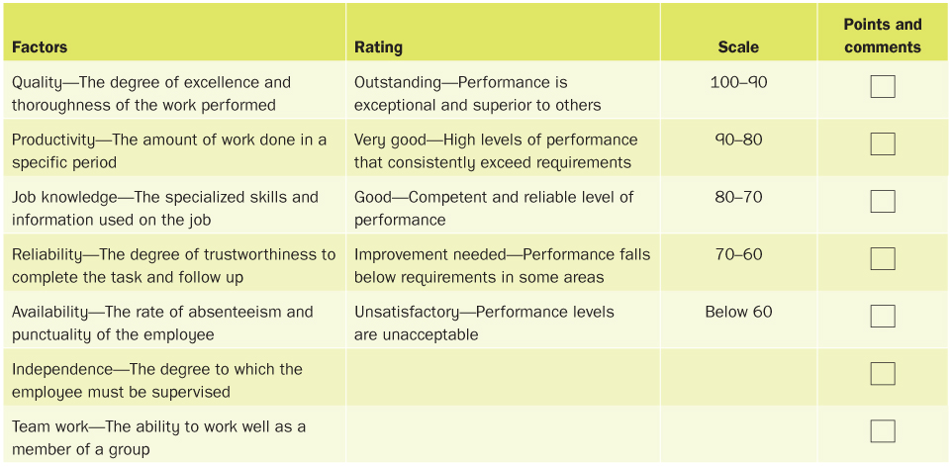
Graphic Rating Scale
Notes:
LO3 Describe the five components of human resources management and explain how they fit together with the strategy and structure of the organization

Slide 27
Types of Performance Appraisal
  Results Appraisals: managers appraise performance by the results / outcomes of work behaviours.
  Example:
    Two new-car salespersons - each individual has a different approach to how they do the job. Each salesperson is equally productive.
    The manager uses result appraisals (sales numbers and customer satisfaction surveys) to evaluate performance because it does not matter which behaviour salespeople use to sell cars as long as they meet goals.
Notes:
LO3 Describe the five components of human resources management and explain how they fit together with the strategy and structure of the organization

Slide 28
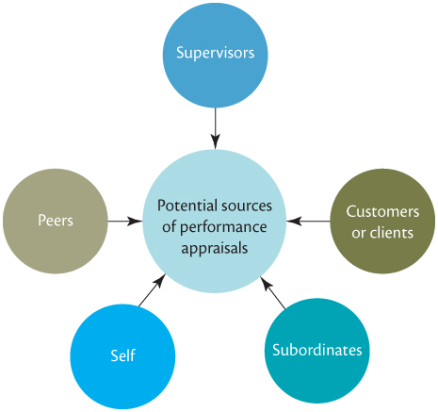
Who Appraises Performance?
Notes:
LO3 Describe the five components of human resources management and explain how they fit together with the strategy and structure of the organization

Slide 29
Who Appraises Performance?
  Self: self appraisals can supplement manager view.
  Peer appraisal: coworker provides appraisal; common in team settings.
  Subordinates
  Clients and customers
  360-Degree Performance Appraisals: provides appraisal from a variety of people able to evaluate a manager.
Notes:
LO3 Describe the five components of human resources management and explain how they fit together with the strategy and structure of the organization
Students may be surprised to learn that self appraisals are often very effective. When coupled with peer and customer input (to form a 360 degree), these appraisals provide a very accurate view of performance.
Effective managers will usually provide both a formal appraisal and numerous informal appraisals over a year. The informal action as are particularly important and can be as simple as a statement “That was a great job last week.”

Slide 30
Effective Performance Feedback
  Effective feedback: appraisals must provide feedback:
  Formal appraisals: conducted at set times of the year
    Provides valuable, but infrequent feedback.
  Informal appraisals: manager provides frequent feedback informally.
Notes:
LO3 Describe the five components of human resources management and explain how they fit together with the strategy and structure of the organization

Slide 31
Effective Performance Feedback
  Be specific and focus on correctable behaviour. Provide a suggested improvement.
  Focus on problem-solving and improvement, not criticism.
  Express confidence in worker’s ability to improve.
  Use formal and informal feedback.
  Treat subordinates with respect and praise achievements.
  Set a timetable for agreed changes.
Notes:
LO3 Describe the five components of human resources management and explain how they fit together with the strategy and structure of the organization
The most accurate appraisals will do little to help performance without appropriate feedback being provided to the worker. Students have likely seen feedback that was poorly done. It is important to focus on the work and NOT the worker.

Slide 32
Pay and Benefits
  Pay level: how the firm’s pay incentives compare to other firms in the industry.
    Managers can decide to offer low or high relative wages.
  Pay Structure: clusters jobs into categories based on importance, skills, and other issues.
Notes:
LO3 Describe the five components of human resources management and explain how they fit together with the strategy and structure of the organization
Pay levels are clearly important but the critical issue is how the firm’s pay levels compare with comparable firms in the same area.
Students are often surprised at the cost of benefits to the firm. Many firms pay 25% or more of the salary in benefits. Students should be sure to understand that these costs are as real as the pay checks paid to employees.

Slide 33
Pay and Benefits
  Benefits: Some are required (social security, workers compensation)
  Others (extended health insurance, day care) are provided at the employer’s option.
  Cafeteria-style plan: employee can choose the best mix of benefits for them. Can be hard to manage.
Notes:
LO3 Describe the five components of human resources management and explain how they fit together with the strategy and structure of the organization

Slide 34
Employee Relations
Employee relations are the activities that managers engage in to ensure that fair and consistent treatment of all employees is maintained
  Requires cooperation between managers and an HR employee relations representative
  Employee Attitude surveys
  Employee Assistance Programs (EAPS)
Notes:
LO3 Describe the five components of human resources management and explain how they fit together with the strategy and structure of the organization.
Students (and most employees) focus first on the pay rate when looking at a given job. They should also understand that benefits cost significant amounts of resources and that pay alone is not a great long-term motivating force for most people.
All managers should be well familiar with collective bargaining and union representation.

Slide 35
Labour Relations
  Considers all activities managers perform to ensure there is a good relationship with labour unions.
  There are laws regulating some areas of employment.
    Canada Labour Code
    Canadian Human Rights Act
    Provincial Employment Standards laws
  Collective bargaining
  Collective agreement
Notes:
LO3 Describe the five components of human resources management and explain how they fit together with the strategy and structure of the organization

Slide 36
Trends in Labour Relations
Unions represent worker’s interests in organizations. Unions tend to shift the balance of power in organizations.
  Once a collective agreement is signed, the HR department typically expands to include a labour relations specialist.
  Managers may lose some decision-making power as union leaders increase their participation in issues affecting members.
  Reward power is lessened, as pay levels and pay structures are set out in the terms of the collective agreement.
  HR managers tend to keep more paper records of employee assignments and behaviours, as this is crucial at grievance and arbitration hearings.
Notes:
LO3 Describe the five components of human resources management and explain how they fit together with the strategy and structure of the organization

Slide 37
Harassment in the Workplace
Workplace harassment - Any behaviour directed toward an employee that is known to be or ought to be known to be offensive and unwelcome.
Two Types:
  Abuse of authority and sexual harassment
Notes:
LO4 Explain the role of the human resource manager in dealing with workplace harassment

Slide 38

Sexual Harassment
Quid pro quo sexual harassment
Hostile work environment sexual harassment
Notes:
LO4 Explain the role of the human resource manager in dealing with workplace harassment

Slide 39
Steps Managers Can Take to Eradicate Workplace Harassment
Clearly communicate the policy
Use a complaint procedure and investigate
If harassment has taken place, take immediate corrective actin
Education employees
Notes:
LO4 Explain the role of the human resource manager in dealing with workplace harassment
Develop and clearly communicate a workplace harassment policy endorsed by top management. This policy should include prohibitions against both general workplace and sexual harassment. It should contain: (1) examples of types of behaviour that are unacceptable, (2) a procedure for employees to use to report instances of harassment, (3) a discussion of the disciplinary actions that will be taken when harassment has taken place, and (4) a commitment to educate and train organizational members about sexual harassment.
2. Use a fair complaint procedure to investigate charges of workplace harassment. Such a procedure should (1) be managed by a neutral third party, (2) ensure that complaints are dealt with promptly and thoroughly, (3) protect and fairly treat victims, and (4) ensure that alleged harassers are fairly treated.
3. When it has been determined that workplace harassment has taken place, take corrective actions as soon as possible. These actions can vary depending on the severity of the harassment. When harassment is extensive, prolonged over a period of time, of a quid pro quo nature, or severely objectionable in some other manner, corrective action may include firing the harasser.
4. Provide workplace harassment education and training to organizational members, including managers. Managers at Du Pont, for example, developed Du Pont’s “A Matter of Respect” program to help educate employees about workplace harassment and prevent it from happening.

Slide 40
Summary and Review
LO1 The Legal Framework of Human Resource Management in Canada and Managing Diversity Effectively
Several key pieces of legislation govern the management of human resources in Canada.
Managing diversity effectively can improve organizational effectiveness that leads to gaining a competitive advantage, engages all employees and is ethically and legally sound.

Slide 41
Summary and Review
LO2 Strategic Human Resource Management
Strategic HRM is the process by which managers design the components of an HRM system to be consistent with each other, and with the organization’s strategies, structure, and goals.
Human resource planning includes all the activities managers engage in to forecast their current and future needs for human resources. Job analysis is the process of identifying (1) the tasks, duties, and responsibilities that make up a job and (2) the knowledge, skills, and abilities needed to perform the job.

Slide 42
Summary and Review
LO3 The Components of HRM
The five major components of human resource management are: (i) recruitment and selection, (ii) training and development, (iii) performance appraisal and feedback, (iv) pay and benefits, and (v) employee relations.

Slide 43
Summary and Review
LO4 Dealing with Workplace Harassment
Human resource managers can deal with unwanted behavior that is offense and abusive by communicating anti-harassment policies and procedures, investigating complaints and taking corrective action such as discipline and training, to eradicate it in the workplace.

