Slide 1

Chapter 5
Managing Organizational Structure

Slide 2
Designing Organizational Structure
Organizing: the process by which managers establish working relationships among employees to achieve goals.
  Organizational Structure: formal system of task and reporting relationships showing how workers use resources to reach organizational goals.
  Organizational Design: the process by which managers make specific choices resulting in a given organizational structure.
Notes:
Lo1 Identify the elements involved in designing organizational structures.
Chapter 4 focused on the development of strategy. Once the strategy has been established by management, then the structure of the firm should be developed to execute the strategy.
The key point here is to recall that strategy must dictate the structure. All to often, management will decide the strategy based on the current structure. This is usually an invitation for a innovative competitor to gain strength.
The implementation of the structure is the organizational design.

Slide 3
Designing Organizational Structure
In general, managers design organizational structures with four important elements in mind:
  How to group tasks into individual jobs that are interesting and motivating for employees.
  How to group jobs into departments and divisions as organizations grow.
  How to allocate authority among functional areas and divisions to ensure coordination and integration.
  Whether to pursue a more formal or flexible structure.
Notes:
Lo1 Identify the elements involved in designing organizational structures.

Slide 4
Grouping Tasks into Jobs: Job Design
Job Design: The process by which managers decide how to divide tasks into specific jobs.
  Results in a division of labour between workers that is effective and efficient.
  Work specialization
Notes:
LO2 Explain how managers arrange tasks to create jobs that are motivating and satisfying for employees.
The first step in organizational design is job design, the process by which managers decide how to divide into specific jobs the tasks that have to be performed to provide customers with goods and services. The result of the job design process is a division of labour among employees.
In deciding how to assign tasks to individual jobs, however, managers must be careful not to go too far with job simplification—the process of reducing the number of tasks that each employee performs.

Slide 5
Grouping Tasks into Jobs: Job Simplification
Job Simplification: Reduction of the number of tasks each worker performs. Intended to increase employee productivity and efficiency.
  Too much simplification and boredom results.
Notes:
LO2 Explain how managers arrange tasks to create jobs that are motivating and satisfying for employees.

Slide 6
Grouping Tasks into Jobs: Job Enlargement
Job Enlargement: Increase tasks for a given job by changing the division of labour.
  Increasing the range of tasks performed by an employee will reduce boredom and fatigue and may increase motivation to perform at a high level—increasing both the quantity and the quality of goods and services provided.
Notes:
LO2 Explain how managers arrange tasks to create jobs that are motivating and satisfying for employees.

Slide 7
Grouping Tasks into Jobs: Job Enrichment
Job Enrichment: Increases the degree of responsibility a worker has over a job.
    Empowering employees
    Encouraging employees to develop new skills
    Allowing employees to decide how to do the work
    Allowing employees to monitor and measure their own performance
Notes:
LO2 Explain how managers arrange tasks to create jobs that are motivating and satisfying for employees.

Slide 8
The Job Characteristics Model
Job Characteristics Model - model of job design that explains how managers can make jobs more interesting and motivating.
  Five characteristics:
    Skill Variety
    Task Identity
    Task Significance
  Autonomy
  Feedback
Notes:
LO2 Explain how managers arrange tasks to create jobs that are motivating and satisfying for employees.
Hackman and Oldham argue that these five job characteristics affect an employee’s motivation because they affect three critical psychological states.
The more employees feel that their work is meaningful and that they are responsible for work outcomes and responsible for knowing how those outcomes affect others, the more motivating work becomes and the more likely employees are to be satisfied and to perform at a high level.

Slide 9
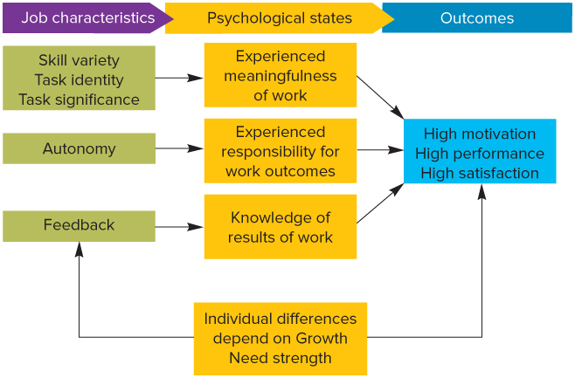
The Job Characteristics Model
Notes:
LO2 Explain how managers arrange tasks to create jobs that are motivating and satisfying for employees.

Slide 10
Departmentalization: Simple Structure
Departmentalization - how to group jobs together into units to best match the needs of the organization’s environment, strategy, technology, and human resources
Small businesses and entrepreneurial start-ups often adopt a very simple structure
The owner is the general manager responsible for the activities in all the functions
Notes:
LO3 Describe how managers cluster jobs into departments and work units.
Small businesses and entrepreneurial start-ups often adopt a very simple structure where the owner is the general manager responsible for the activities in all the functions

Slide 11
Grouping Jobs – Functional Structure
Functional structure consists of all departments such as marketing, production, and finance, that an organization uses to produce its good or service.
      Workers can learn from others doing similar tasks.
      Easy for managers to monitor and evaluate workers.
      Hard for one department to communicate with others.
      Managers can become preoccupied with their department and forget the firm.
Pros
Cons
Notes:
LO3 Describe how managers cluster jobs into departments and work units
Functional structure is still the most common form of organizational structure, probably due to its simplicity.
The big drawback is the potential loss of communication. A good example is to consider the various departments at any university and how they relate to each other. Ask students if this has ever caused them problems.

Slide 12
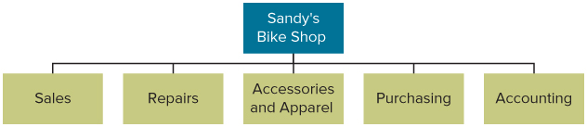
Functional Structure
Notes:
LO3 Describe how managers cluster jobs into departments and work units

Slide 13
Grouping Jobs: Divisional Structure
  Divisional Structure: An organizational structure composed of separate business units which produce a specific kind of product for a specific kind of customer.
    Divisions create smaller, manageable parts of a firm.
    Divisions develop a business-level strategy to compete.
    A division has marketing, finance, and other functions.
    Functional managers report to divisional managers who then report to corporate management.
Notes:
LO3 Describe how managers cluster jobs into departments and units.
General Motors Corp. provides an easy example of this concept with the Chevrolet, Buick, Oldsmobile, Pontiac, GMC, and Cadillac divisions (as well as many other parts divisions).

Slide 14
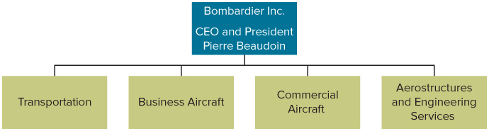
Product Structure: Product Divisions
  Product division: divisions created according to the type of product or service.
Notes:
LO3 Describe how managers cluster jobs into departments and units.
Using a product structure managers place each distinct product line or business in its own self-contained division and give divisional managers the responsibility for devising an appropriate business-level strategy to allow the division to compete effectively in its industry or market.

Slide 15
Product Structure: Geographic Division
  Geographic division: divisions based on the area of a country or world served.
Notes:
LO3 Describe how managers cluster jobs into departments and units.
Geographic structure: divisions based on the area of a country or world served.
In adopting a global geographic structure (refer to Figure 6.4A), managers locate different divisions in each of the world regions where the organization operates.
Managers are most likely to do this when they pursue a multi-domestic strategy, because customer needs vary widely by country or world region.
Example: If products that appeal to Canadian customers do not sell in Europe, the Pacific Rim, or South America, then managers must customize the products to meet the needs of customers in those different world regions; a global geographic structure with global divisions will allow them to do this.
In a global product structure, each product division, not the country and regional managers, takes responsibility for deciding where to manufacture its products and how to market them in countries worldwide (see Figure 6.4B).

Slide 16
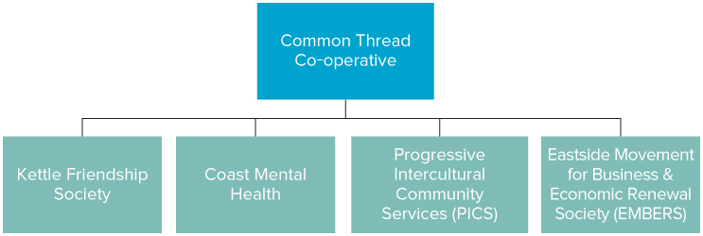
Market Structure
  Market segmented: divisions based on the types of customers served.
Notes:
LO3 Describe how managers cluster jobs into departments and units.
When managers organize divisions according to the types of customers they focus on, they adopt a market structure.
To satisfy the needs of diverse customers, TELUS adopts a market structure (also called a customer structure), which groups divisions according to the particular kinds of customers they serve (see Figure 6.3C).

Slide 17
Team-Based Organizational
Structures: Matrix Teams
  Matrix structure: managers group people by function and product teams simultaneously.
    Results in a complex network of reporting relationships.
    Very flexible and can respond rapidly to change.
    Each employee has two bosses which can cause problems.
    Functional manager gives different directions than product manager and employee cannot satisfy both.
Notes:
LO3 Describe how managers cluster jobs into departments and units.
Matrix structures are rising in popularity especially in high-tech firms that face rapid change.

Slide 18
Team-Based Organizational
Structures: Product Teams
Product teams - An organizational structure in which employees are permanently assigned to a cross-functional team and report only to the project team manager or to one of his or her direct subordinates.
Cross-functional team - A group of individuals from different departments brought together to perform organizational tasks.
Notes:
LO3 Describe how managers cluster jobs into departments and units.

Slide 19
Hybrid Structure
Notes:
LO3 Describe how managers cluster jobs into departments and units.
(Text Figure 5.9)
A large organization that has many divisions and simultaneously uses many different structures has a hybrid structure.
Most large organizations use product division structures and create self-contained divisions; then each division’s managers select the structure that best meets the needs of the particular environment, strategy, and so on.

Slide 20
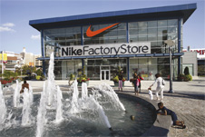
B2B Network Structures
Network Structure: a series of global strategic alliances that organizations create with suppliers, manufacturers, and distributers to produce and market a product.
  Created between suppliers, manufacturers, and distributors.
  Example: Toyota and Honda
Network structures allow firms to bring resources together in a boundaryless organization.
    Example: Nike
Notes:
LO3 Describe how managers cluster jobs into departments and units.
More and more Canadian, American, and European organizations are relying on global network structures to gain access to low-cost foreign sources of inputs. This approach allows managers to keep costs low.
A boundaryless organization is composed of people who are linked by computers, computer-aided design systems, and video teleconferencing, and who rarely, if ever, see one another face to face.
Nike, the most profitable shoe manufacturer in the world, also uses a network structure to produce and market shoes

Slide 21
Outsourcing
Outsourcing offers opportunities to reduce costs and increase organizational flexibility.
    Choosing the wrong activities to outsource
    Choosing the wrong vendor
    Writing a poor contract
    Failing to consider personnel issues
    Losing control over the activity
    Ignoring the hidden costs
    Failing to develop an exit strategy
Notes:
LO3 Describe how managers cluster jobs into departments and units.
Example: Canadian Pacific Railway (CPR) outsources the maintenance of applications for which it does not need to develop in-house expertise. For example, it has outsourced the maintenance of some of its legacy applications to RIS and also outsources its mainframe infrastructure to IBM. When CPR did the work itself in-house everything was not running smoothly. decision to outsource has left CPR free to concentrate on what it does best.

Slide 22
Allocating Authority
To ensure sufficient coordination between functions, managers delegate authority.
  Authority: the power vested in the manager to make decisions and use resources.
  Hierarchy of Authority: describes the relative authority each manager has from top to bottom.
  Span of Control: refers to the number of workers a manager manages.
Notes:
LO4 Explain the ways that managers allocate authority and decision making responsibilities.
Students often confuse power and authority. Be sure they understand authority is vested in the manager’s position by the organization.
Typically, higher level managers have more authority and thus can allocate more resources, hire/fire employees and the like.
Downsizing usually involves increasing the span of control which means more employees report to a manager.

Slide 23
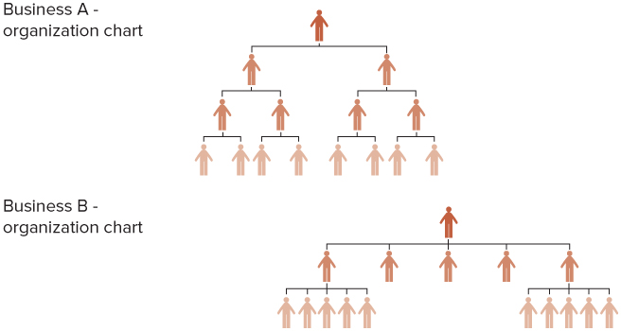
Span of Control
Notes:
LO4 Explain the ways that managers allocate authority and decision making responsibilities.

Slide 24
Tall and Flat Organizations
  Tall structures - many levels of authority.
    As levels in the hierarchy increase, communication gets difficult.
    The extra levels result in more time being taken to implement decisions.
  Flat structures - few levels but wide spans of control.
    Results in quick communications but can lead to overworked managers.
Notes:
LO4 Explain the ways that managers allocate authority and decision making responsibilities.
The tall structure was typical of large firms in the past. Today, the rapid rate of change makes many tall structures obsolete. A main benefit of this type of organization is the relative clarity lower managers can have in terms of their job expectations.
The flat structure has very few managers and most of them must deal with a wide range of issues. For this form to work well, it is critical that employees have the authority to communicate and solve problems directly. Otherwise, the managers will be overwhelmed.

Slide 25
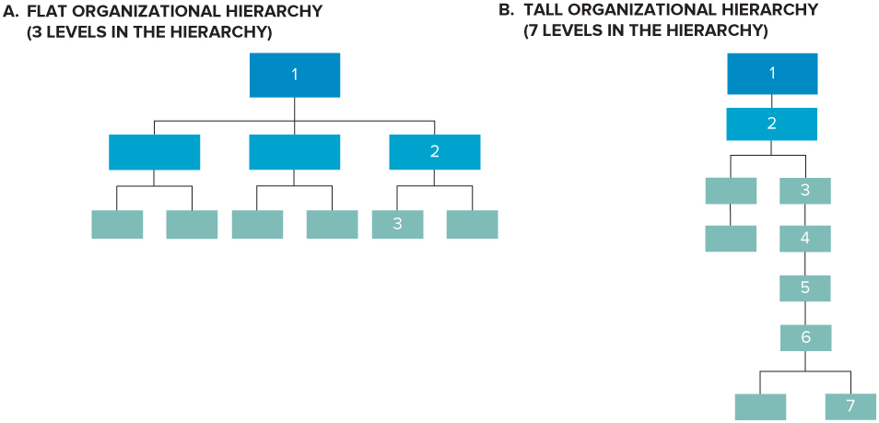
Flat Organizational Hierarchy
Notes:
LO4 Explain the ways that managers allocate authority and decision making responsibilities.
Figure 5.12 A

Slide 26
Tall Organizational Hierarchy
Notes:
LO4 Explain the ways that managers allocate authority and decision making responsibilities.
Figure 5.12 B

Slide 27
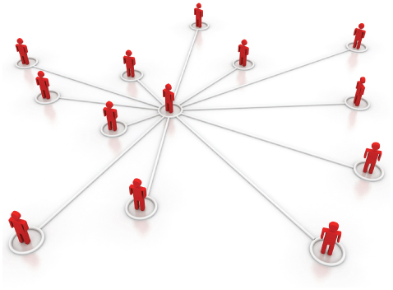
Minimum Chain of Command
  Managers should consider:
    Do they have the right number of middle managers?
    Can the structure be altered to reduce levels?
  Centralized vs. Decentralized
  Decentralized operations puts more authority at lower levels and leads to flat organizations.
Notes:
LO4 Explain the ways that managers allocate authority and decision making responsibilities.
Most top managers now seek to reduce managerial layers wherever possible. This means authority must be moved down the organization to lower managers and workers.

Slide 28
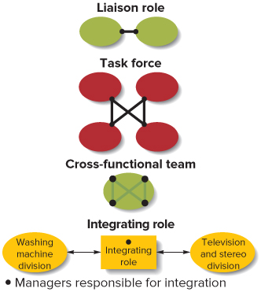
Types and Examples of Integrating Mechanisms
Integrating mechanisms
Liaison roles
Integrating role
Notes:
LO4 Explain the ways that managers allocate authority and decision making responsibilities.
Figure 5.13 Types and Examples of Integrating Mechanisms

Slide 29
Choosing a Formal or Flexible Structure Overall
Two basic ways in which managers can organize and control an organization’s activities to respond to characteristics of its external environment:
  Mechanistic Structure
  Organic Structure
Notes:
LO5 Evaluate the factors that managers consider when deciding on a formal or flexible overall structure.
In a mechanistic structure, authority is centralized at the top of the managerial hierarchy, and the vertical hierarchy of authority is the main means used to control subordinates’ behaviour.
In an organic structure, authority is decentralized to middle and first-line managers to encourage them to take responsibility and act quickly to pursue scarce resources.

Slide 30
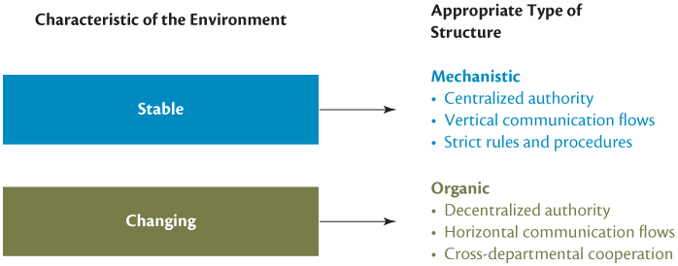
Mechanistic vs. Organic Organizations
Notes:
LO5 Evaluate the factors that managers consider when deciding on a formal or flexible overall structure.

Slide 31
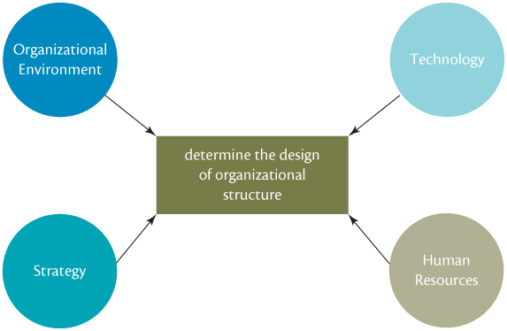
Factors Affecting
Organizational Structure
Notes:
LO5 Evaluate the factors that managers consider when deciding on a formal or flexible overall structure.
Text Figure 5.15 Factors Affecting Overall Organizational Structure.

Slide 32
General Motors Global Research Network
GM’s top managers realized that the organization was too self-contained and that to increase its competitiveness they needed to change the company’s business model.
How does technology influence organizational structure at GM? What other factors should managers at GM consider when selecting a structure?
What organizational structures do you equate with the new model?
What must GM managers consider as they move from the old structure to the new structure?
Notes:
LO5 Evaluate the factors that managers consider when deciding on a formal or flexible overall structure.
In a mechanistic structure, authority is centralized at the top of the managerial hierarchy, and the vertical hierarchy of authority is the main means used to control subordinates’ behaviour.
In an organic structure, authority is decentralized to middle and first-line managers to encourage them to take responsibility and act quickly to pursue scarce resources.

Slide 33
ONEX CORP.
Go to the website of Onex Corp (www.onex.com). Onex is one of Canada’s largest companies that acquires attractive businesses and builds them up in partnership with management. “Since 1983, we acquire attractive companies at fair prices and, in partnership with operating managers, we grow them and ultimately realize on the value we’ve created through a variety of strategies.” Review the Onex Corp. website.
What are Onex Corp.’s mission and corporate goals?
What kind of organizational structure does Onex Corp. have?
What is Onex Corp.’s approach to managing its structure (its approach to decentralization, delegation, etc.)
Notes:
LO5 Evaluate the factors that managers consider when deciding on a formal or flexible overall structure.
In a mechanistic structure, authority is centralized at the top of the managerial hierarchy, and the vertical hierarchy of authority is the main means used to control subordinates’ behaviour.
In an organic structure, authority is decentralized to middle and first-line managers to encourage them to take responsibility and act quickly to pursue scarce resources.

Slide 34
DISCOVERY
Search for a website that tells the story of how an organization changed its structure in some way to increase its efficiency and effectiveness.
HINT: Try searching for “corporate restructuring” or “organizational redesign”.
Notes:
LO5 Evaluate the factors that managers consider when deciding on a formal or flexible overall structure.
In a mechanistic structure, authority is centralized at the top of the managerial hierarchy, and the vertical hierarchy of authority is the main means used to control subordinates’ behaviour.
In an organic structure, authority is decentralized to middle and first-line managers to encourage them to take responsibility and act quickly to pursue scarce resources.

Slide 35
MIDTERM PRACTICE
Read the business case at this site.
http://www.bloomberg.com/news/articles/2015-07-21/this-man-spent-3-million-to-make-instant-jello-shots
Notes:
LO5 Evaluate the factors that managers consider when deciding on a formal or flexible overall structure.
In a mechanistic structure, authority is centralized at the top of the managerial hierarchy, and the vertical hierarchy of authority is the main means used to control subordinates’ behaviour.
In an organic structure, authority is decentralized to middle and first-line managers to encourage them to take responsibility and act quickly to pursue scarce resources.

Slide 36
MIDTERM PRACTICE
JEVO
What is the purpose of a SWOT analysis?
Analyze Food + Beverage Innovation’s Jevo machine using the SWOT framework.
What is the difference between centralized and decentralized organizational decision-making?
Should Food + Beverage Innovations use more of a centralized or decentralized approach in their organizational structure? Why?
Define “barriers to entry”. What are the two main factors that create barriers to entry and how do these factors apply to this company?
Notes:
LO5 Evaluate the factors that managers consider when deciding on a formal or flexible overall structure.
In a mechanistic structure, authority is centralized at the top of the managerial hierarchy, and the vertical hierarchy of authority is the main means used to control subordinates’ behaviour.
In an organic structure, authority is decentralized to middle and first-line managers to encourage them to take responsibility and act quickly to pursue scarce resources.

Slide 37
TERM PAPER PREP
  Read the business case at this site.
Tim Hortons
  https://www.theglobeandmail.com/report-on-business/tim-hortons-franchisee-row-moves-south-of-the-border/article35461090/
  Uber
  https://www.nytimes.com/2017/03/03/technology/uber-greyball-program-evade-authorities.html
  Tesla
  https://www.forbes.com/sites/peterlyon/2017/07/11/the-inevitable-happens-as-carmakers-opt-for-electric-car-future/#27f86a25a2e6
  https://www.bloomberg.com/news/articles/2017-07-10/tesla-rolls-out-its-first-model-3-and-it-s-elon-s
Notes:
LO5 Evaluate the factors that managers consider when deciding on a formal or flexible overall structure.
In a mechanistic structure, authority is centralized at the top of the managerial hierarchy, and the vertical hierarchy of authority is the main means used to control subordinates’ behaviour.
In an organic structure, authority is decentralized to middle and first-line managers to encourage them to take responsibility and act quickly to pursue scarce resources.

Slide 38
TERM PAPER PREP
Introduction & Analysis of Organization’s Environment (~2 pages)
  Clearly describe what organization you have selected and what you are setting out to accomplish in this paper.
  Conduct a PESTI analysis for this organization. You do not need to cover all elements of the PESTI framework, just the ones that are most relevant to this organization. Your analysis should include secondary research evidence.
  Conduct a SWOT analysis for this organization. Your analysis need not be exhaustive, but should focus on the most important aspects that will be relevant for the rest of your paper. Your analysis should include secondary research evidence.
2) Focal issue (~0.5 pages) a) Based on your organizational analysis, clearly identify the primary issue facing this organization. Note that your eventual recommendation must address this focal issue.
Notes:
LO5 Evaluate the factors that managers consider when deciding on a formal or flexible overall structure.
In a mechanistic structure, authority is centralized at the top of the managerial hierarchy, and the vertical hierarchy of authority is the main means used to control subordinates’ behaviour.
In an organic structure, authority is decentralized to middle and first-line managers to encourage them to take responsibility and act quickly to pursue scarce resources.

Slide 39
TERM PAPER PREP
Tim Hortons
Section 1 – Introduction and Analysis of Organization’s Environment
  Key elements from external business environment include:
  Economic forces
  Legal forces
  Key elements from SWOT include:
  Strengths: strong brand, well-capitalized
  Weaknesses: complicated organizational structure, unprofitable US locations
  Opportunities: International (US) expansion, leveraging partnerships with franchisees
  Threats: class-action law suit from franchisees, competition
Section 2 – Focal Issue
  Restaurant Brands International’s (RBI) expertise lays in improving profitability through identifying efficiencies and cutting costs. This is, in part, accomplished through their organizational structure and decision-making processes. Recently, RBI has experienced conflict from their franchise owners. RBI faces many challenges in navigating this issue as they attempt to expand their Tim Horton’s brand to the U.S.
Notes:
LO5 Evaluate the factors that managers consider when deciding on a formal or flexible overall structure.
In a mechanistic structure, authority is centralized at the top of the managerial hierarchy, and the vertical hierarchy of authority is the main means used to control subordinates’ behaviour.
In an organic structure, authority is decentralized to middle and first-line managers to encourage them to take responsibility and act quickly to pursue scarce resources.

Slide 40
TERM PAPER PREP
Uber
Section 1 – Introduction and Analysis of Organization’s Environment
  Key elements from external business environment include:
  Political and Legal Forces
  Technological Forces
  Economic Forces
  Key elements from SWOT include:
  Strengths: first mover, strong brand, superior technology
  Weaknesses: negative headlines
  Opportunities: expand to new markets, develop new services
  Threats: changes to laws/regulations, shift in public perception, competition
Section 2 – Focal Issue
  Uber’s use of its ‘Greyball’ software is a controversial business practice. Uber must consider the interests of its key stakeholders as they evaluate the ethics of using this software.
Notes:
LO5 Evaluate the factors that managers consider when deciding on a formal or flexible overall structure.
In a mechanistic structure, authority is centralized at the top of the managerial hierarchy, and the vertical hierarchy of authority is the main means used to control subordinates’ behaviour.
In an organic structure, authority is decentralized to middle and first-line managers to encourage them to take responsibility and act quickly to pursue scarce resources.

Slide 41
TERM PAPER PREP
Tesla
Section 1 – Introduction and Analysis of Organization’s Environment
  Key elements from external business environment include:
  Environmental Forces
  Economic Forces
  Technological Forces
  Political and Legal Forces
  Key elements from SWOT include:
  Strengths: established brand, well financed, strong leadership
  Weaknesses: highly capital intensive business, little large-scale manufacturing experience
  Opportunities: corporate-level strategies: vertical integration, international expansion, strategic alliances; business-level strategies: both cost leadership and product differentiation possible, continuing regulations in favor of non-fossil fuel energy sources
  Threats: rivals, changes to laws/regulations
Section 2 – Focal Issue
  Telsa is known for high quality, innovative, luxurious vehicles, and this move to toward the more affordable end of the luxury car market will bring significant challenges. Tesla must select corporate- and business-level strategies that will allow them to create a competitive advantage against their rivals.
Notes:
LO5 Evaluate the factors that managers consider when deciding on a formal or flexible overall structure.
In a mechanistic structure, authority is centralized at the top of the managerial hierarchy, and the vertical hierarchy of authority is the main means used to control subordinates’ behaviour.
In an organic structure, authority is decentralized to middle and first-line managers to encourage them to take responsibility and act quickly to pursue scarce resources.

Slide 42
TERM PAPER PREP
Focal Issues
Tim Hortons
Restaurant Brands International’s (RBI) expertise lays in improving profitability through identifying efficiencies and cutting costs. This is, in part, accomplished through their organizational structure and decision-making processes. Recently, RBI has experienced conflict from their franchise owners. RBI faces many challenges in navigating this issue as they attempt to expand their Tim Horton’s brand to the U.S.
Uber
Uber’s use of its ‘Greyball’ software is a controversial business practice. Uber must consider the interests of its key stakeholders as they evaluate the ethics of using this software.
Tesla
Telsa is known for high quality, innovative, luxurious vehicles, and this move to toward the more affordable end of the luxury car market will bring significant challenges. Tesla must select corporate- and business-level strategies that will allow them to create a competitive advantage against their rivals.
Notes:
LO5 Evaluate the factors that managers consider when deciding on a formal or flexible overall structure.
In a mechanistic structure, authority is centralized at the top of the managerial hierarchy, and the vertical hierarchy of authority is the main means used to control subordinates’ behaviour.
In an organic structure, authority is decentralized to middle and first-line managers to encourage them to take responsibility and act quickly to pursue scarce resources.

