Slide 1

Chapter 6
Managing Communication and Information Technology

Slide 2
Learning Outcomes
Explain why effective communication helps an organization gain a competitive advantage.
Describe the communication process and communication styles.
Describe the organizational communication networks and channels available to managers.
Explain how the utilization of Information Technology (IT) can be vital to organizational communication.
Describe how managers are using social media in communication.

Slide 3
The Importance of
Communication in Organizations
Good Communication allows a firm to:
  Increase efficiency.
  Improve quality of their product or service.
  Become more responsive to customers.
  Foster innovation.
Notes:
LO1 Explain why effective communication helps an organization gain a competitive advantage.
Ask students to describe problems that can result from poor communication in an organization.
Example: It is critical for a physician and patient to communicate effectively when discussing health issues.
Managers attempting to improve customer service need to listen carefully to comments made by workers and customers. Frequently, managers hear phrases such as “Yes, the service was OK” and not realize that the customer was really saying the service was very poor.

Slide 4
The Communication Process
  Communication consists of two phases:
    Transmission phase: information is shared by 2 or more people.
    Feedback phase: a common understanding is assured.
Notes:
LO2 Describe the communication process and communication styles.
Communication starts with a sender. The sender must be sure to encode the message into a form the receiver will understand.
Example: Ask students to say Good Morning in various languages. You will likely have several people who speak other languages and while they are sending a message, many people will not understand it.
This same problem occurs in many technical fields where workers communicate with abbreviations causing outsiders not to understand.

Slide 5
The Communication Process
  Communication starts with the sender who wants to share information.
    Sender must decide on a message to share
    Sender also puts the message into symbols or language, a process called encoding
  Noise is anything harming the communication process.
Notes:
LO2 Describe the communication process and communication styles.
Communication starts with a sender. The sender must be sure to encode the message into a form the receiver will understand.
Example: Ask students to say Good Morning in various languages. You will likely have several people who speak other languages and while they are sending a message, many people will not understand it.
This same problem occurs in many technical fields where workers communicate with abbreviations causing outsiders not to understand.

Slide 6
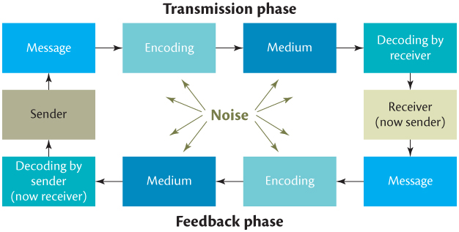
The Communication Process
Notes:
LO2 Describe the communication process and communication styles.
The steps in the communication process. Notice that communication can be impaired at any stage.

Slide 7
The Communication Process
  Messages are transmitted over a medium to a receiver.
    Medium: pathway the message is transmitted on (phone, letter, newspaper).
    Receiver: person getting the message.
Notes:
LO2 Describe the communication process and communication styles.
Ask students to give examples of various mediums (phone, written word, signals, speech, hand signals, etc.).
The choice of a medium is important to a manager since both sender and receiver must have access to and understand the medium used. Many senders are frustrated by a lack of communication caused by the selection of the wrong medium.
Example: You choose to phone a worker to describe a complex new task. The worker does not fully understand and the task fails. The fault in this case is mostly due to using the phone as a medium rather than writing the instructions down so that the worker can refer to them as needed.

Slide 8
The Communication Process
  Receiver next decodes the message.
    Decoding allows the receiver to understand the message.
    This is a critical point, can lead to misunderstanding.
  Feedback is started by receiver and states that the message is understood or that it must be re-sent.
Notes:
LO2 Describe the communication process and communication styles.
Ask students to give examples of various mediums (phone, written word, signals, speech, hand signals, etc.).
The choice of a medium is important to a manager since both sender and receiver must have access to and understand the medium used. Many senders are frustrated by a lack of communication caused by the selection of the wrong medium.
Example: You choose to phone a worker to describe a complex new task. The worker does not fully understand and the task fails. The fault in this case is mostly due to using the phone as a medium rather than writing the instructions down so that the worker can refer to them as needed.

Slide 9
The Communication Process
  Encoding of messages can be done verbally or non-verbally
    Verbal: spoken or written communication.
    Nonverbal: facial gestures, body language, dress.
Notes:
LO2 Describe the communication process and communication styles.
Students are aware of many non-verbal forms of communication. The most common is body language. As for some examples.
Examples:
› Looking at your watch at a meeting signals you are ready to conclude.
› Crossed arms during conversation often indicates a closed mindset and a lack of support for the idea under discussion.
› Looking down and not at the sender may indicate discomfort.

Slide 10
The Communication Process
  Sender and receiver communicate based on their perception.
    Subjective perception can lead to biases and stereotypes that hurt communication.
    Effective managers avoid communicating based on a pre-set belief.
Notes:
LO2 Describe the communication process and communication styles.
Students are aware of many non-verbal forms of communication. The most common is body language. As for some examples.
Examples:
› Looking at your watch at a meeting signals you are ready to conclude.
› Crossed arms during conversation often indicates a closed mindset and a lack of support for the idea under discussion.
› Looking down and not at the sender may indicate discomfort.

Slide 11
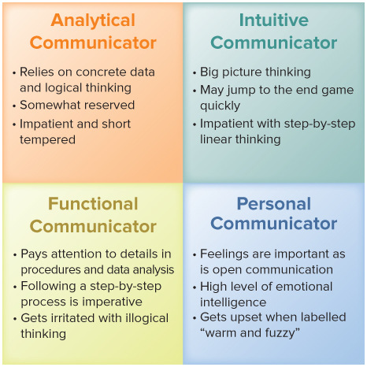
Communication Styles
Notes:
LO2 Describe the communication process and communication styles.
The four communication styles are:
The Relator, also known as Cognitive. While managers with the cognitive style of communication tend be take quite a bit of time to encode and send messages, they are open, cooperative and supportive of others.
The Socializer, also known as Affective. Managers with this style of communication prefer to work in teams and often emerge as leaders as they are willing to take risks.
The Thinker, also known as Cognitive. Managers who communicate in the Cognitive style are cautious and reserved and tend to work well alone at their own pace.
The Director, also known as Behavioural. The behavioural communication style is often seen as aggressive. They are highly goal oriented and do not tend to open up to colleagues.

Slide 12
Verbal and Nonverbal Communication
Verbal communication The encoding of messages into words, either written or spoken.
Nonverbal communication The encoding of messages by means of facial expressions, body language, and styles of dressing.
Notes:
LO2 Describe the communication process and communication styles.

Slide 13
Improving the Communication Process: Communication Skills for Senders
  Send clear and complete messages.
  Encode messages in symbols the receiver understands.
  Select a medium appropriate for the message.
  Select a medium that the receiver monitors.
  Avoid filtering (holding back information) and distortion as the message passes through other workers.
  Ensure a feedback mechanism is included in the message.
  Provide accurate information to avoid rumors.
Notes:
LO2 Describe the communication process and communication styles.

Slide 14
Communication Skills for Receivers
  Pay Attention to message being sent.
  Be a good listener:
    Make eye contact
    Exhibit affirmative nods and appropriate facial expressions
    Avoid distracting actions or gestures (shuffling papers)
    Ask questions / Paraphrase / Avoid interrupting
    Do not overtalk
    Make smooth transitions between the roles
Notes:
LO2 Describe the communication process and communication styles.
Managers must learn to communicate effectively. This task is becoming more important as the workforce becomes more diverse. Further, global business dealings make understanding communication issues crucial.

Slide 15
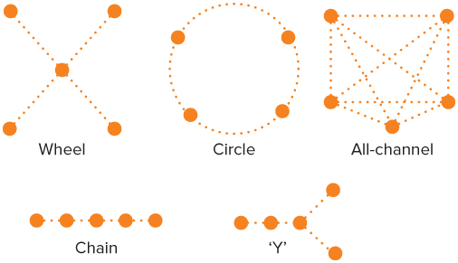
Formal Communication Networks
Notes:
LO3 Describe the organizational communication networks available to managers.

Slide 16
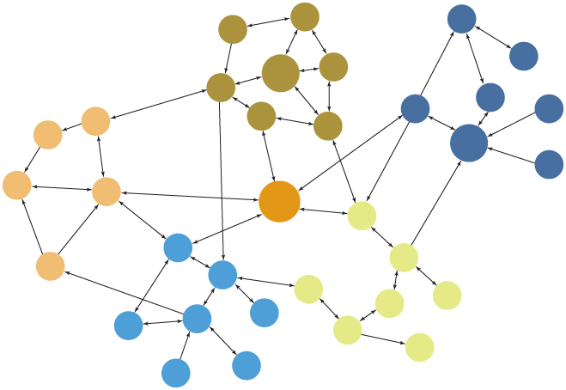
The Grapevine Communication Network
Notes:
LO3 Describe the organizational communication networks available to managers.

Slide 17
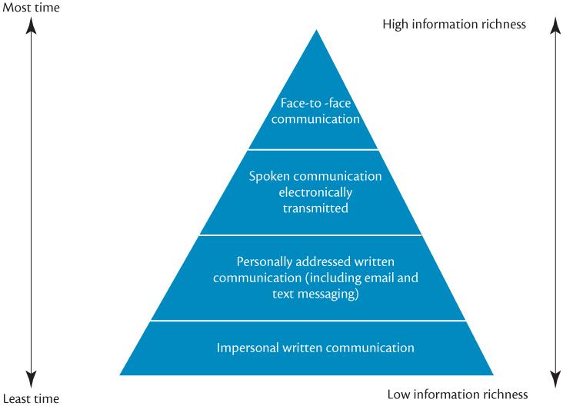
Information Richness and Communication Media
Notes:
LO3 Describe the organizational communication networks available to managers.
Figure 6.5 shows the available richness in mediums. Notice particularly that face-to-face communication is the richest medium. Usually managers use this form of communication for important communication that conveys significant information.

Slide 18
Face-to-Face Communication
  Face-to-Face: highest information richness
    Can take advantage of verbal and nonverbal signals.
    Provides for instant feedback.
    Management by wandering around (MBWA) takes advantage of this with informal talks to workers.
    Video Conferences: provide much of this richness.
Notes:
LO3 Describe the organizational communication networks available to managers.
Face-to-face communication offers many advantages but requires a substantial amount of time and therefore is expensive. Still, it excels in critical communication.
Ask your students if the richness of face-to-face might explain why our education system is oriented to face-to-face communication.

Slide 19
Spoken Communication
Electronically Transmitted
  Spoken communication electronically transmitted has next highest richness level.
    Phone conversations, but no visual nonverbal cues.
    Do have tone of voice, sender’s emphasis and quick feedback.
Notes:
LO3 Describe the organizational communication networks available to managers.
Ask students what they think of video conferencing. Can it replace face-to-face and still provide the same level of richness?

Slide 20
Personally Addressed Written Communication
  This form of communication has lower richness than the verbal forms, but is directed at a given person.
    Personal addressing helps ensure receiver reads it.
    Cannot provide instant feedback to sender but can get feedback later.
    Excellent for complex messages needing follow-up.
Notes:
LO3 Describe the organizational communication networks available to managers.
Written mediums are highly effective but must be used correctly. When rapid response is needed, this is a poor choice.
Ask students their opinion of email. Many firms are starting to find managers are overloaded with email simply because it is so easy to send.

Slide 21
Email, Twitter, Facebook and Blogs
  Senders and receivers communicating through personally addressed words on a computer screen.
  Email and text messaging - so widespread that managers are developing their own etiquette (‘shouty’ capitals are interpreted as screaming) .
  Negative effects:
    Email overload
    Junk mail clogging system
    Ethical concerns / privacy issues
Notes:
LO3 Describe the organizational communication networks available to managers.
Ask students about their use of various social medium and try to get them to think about the interpretation of messages in those contexts, compared with face-to-face.
Many students will be able to think of an instance where they misinterpreted the message, because of a lack of personal contact.

Slide 22
Email, Twitter, Facebook and Blogs
In this NBC feature, Forbes editor Dennis Neal tries to go a week without his cell phone, BlackBerry, and email and finds it nearly impossible to do his job, communicate with his family, and manage personal business.
Notes:
LO3 Describe the organizational communication networks available to managers.
Ask students about their use of various social medium and try to get them to think about the interpretation of messages in those contexts, compared with face-to-face.
Many students will be able to think of an instance where they misinterpreted the message, because of a lack of personal contact.

Slide 23
Email, Twitter, Facebook and Blogs
How do cell phones and email rank on the information richness scale?
When would making a phone call be more effective than sending an email, and vice versa?
What are the advantages and disadvantages of using email to communicate?
What are some indications—from Dennis Neal’s experience and your observations— that people may be too dependent on communications technology?
Notes:
LO3 Describe the organizational communication networks available to managers.
Ask students about their use of various social medium and try to get them to think about the interpretation of messages in those contexts, compared with face-to-face.
Many students will be able to think of an instance where they misinterpreted the message, because of a lack of personal contact.

Slide 24
Impersonal Written Communication
  Impersonal written communication has the lowest richness.
    Good for messages to many receivers. Little feedback is expected.
    Newsletters, reports are examples.
    Can lead to information overload
Notes:
LO3 Describe the organizational communication networks available to managers.

Slide 25
Advances in Information technology
Rapid growth of wireless communication
Networking – exchange of information through a group of interlinked computers
Clients
Servers
Local area network
Mainframe computers
Notes:
LO4 Explain how the utilization of Information Technology (IT) can be vital to organizational communication.
A manager with a personal computer hooked into a three-tier system can access data and software stored in the local server, in the mainframe, or through the Internet in computers based in another organization. When the storage of organizational data happens on an external mainframe, it is called ‘cloud computing.’ A manager can therefore communicate electronically with other individuals hooked into the system, whether they are in the manager’s LAN, in another LAN within the manager’s organization, or in another organization altogether. Moreover, because of the growth of wireless communications, an individual with the proper equipment can hook into the system from any location—at home, on a boat, on the beach, in the air—anywhere a wireless communications link can be established.

Slide 26
Software Developments
Operating system software tells the computer hardware how to run.
Applications software, such as programs for word processing, spreadsheets, graphics, and database management, is software developed for a specific task or use
Notes:
LO4 Explain how the utilization of Information Technology (IT) can be vital to organizational communication.
The increase in the power of computer hardware has allowed software developers to write increasingly powerful programs that are, at the same time, increasingly user-friendly. By harnessing the rapidly growing power of microprocessors, applications software has vastly increased the ability of managers to acquire, organize, manipulate, and transmit information.

Slide 27
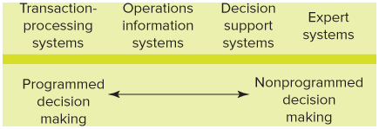
Management Information Systems (MIS)
Notes:
LO4 Explain how the utilization of Information Technology (IT) can be vital to organizational communication.
Four types of computer-based management information systems can be particularly helpful in providing managers with the information they need to make decisions and to coordinate and control organizational resources: transaction-processing systems, operations information systems, decision support systems, and expert systems. In Figure 6.5, these systems are arranged along a continuum according to their increasing usefulness in providing managers with the information they need to make nonprogrammed decisions.

Slide 28
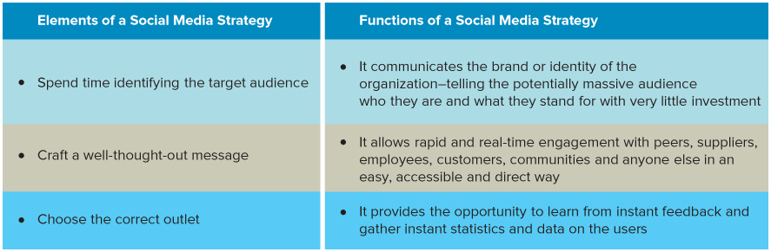
Elements of a Social Media Strategy
Notes:
LO5 Describe how managers are using social media in communication.

Slide 29
Functions of a Social Media Strategy
Notes:
LO5 Describe how managers are using social media in communication.

Slide 30
Summary and Review
LO1 Effective communication and gaining a competitive advantage
Effective communication is the sharing of information between two or more individuals or groups to reach a common understanding.
Good communication is essential for attaining increased efficiency, quality, responsiveness to customers, and innovation- the four goals for gaining a competitive advantage.

Slide 31
Summary and Review
LO2 The communication process and communication styles
Communication takes place in a cyclical process that has two phases: transmission and feedback.
Communication occurs verbally and nonverbally. Communication styles differ along the lines of how reserved or open one is to relationships and the pace at which they interact with others.
There are four distinct approaches to communication.

Slide 32
Summary and Review
LO3 The organizational communication networks and channels available to managers
Communication networks are established mechanisms by which communication flows throughout the organization.
Four categories of communication channels are face-to-face communication, spoken communication electronically transmitted, personally addressed written communication, and impersonal written communication.
Each channel varies in the extent to which it enables the sender and receiver to reach a common understanding.

Slide 33
Summary and Review
LO4 Information Technology (IT) can be vital to organizational communication
Computer-based information gathering and processing systems are central to the operation of most organizations today.
Management information systems (MIS) are electronic systems of interconnected components designed to collect, process, store, and disseminate information to facilitate management decision making, planning, and control.

Slide 34
Summary and Review
LO5 How managers use social media in communication
As social media continues to change the way people communicate, it is an increasingly important tool for managers.
A social media strategy includes 3 important elements and has 3 interrelated functions.

