Slide 1
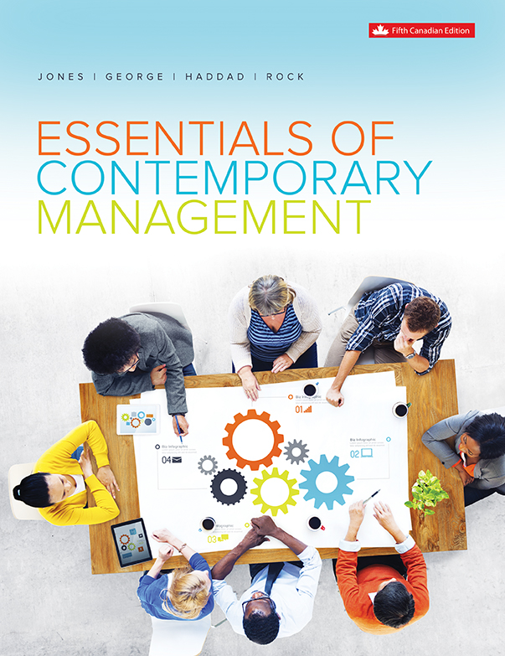
Chapter 4
Managing Planning and Strategy

Slide 2
Learning Outcomes
Describe what planning is, the levels of planning, types of plans, why it is important, and what qualities make plans effective.
Describe planning as a five-step process.
Explain how managers use planning techniques to evaluate the opportunities and threats in the organization’s environment.
Differentiate among corporate-level, business-level, and functional-level strategies.
Describe how managers implement strategy and evaluate its success.

Slide 3
An Overview of the Planning Process
Planning is the process used by managers to identify and select goals and actions for the organization.
The organizational plan that results from the planning process details the goals to be attained.
The cluster of decisions and actions managers take to reach these goals is the organization’s strategy.
Notes:
LO1 Describe what planning is, the levels of planning, types of plans, why it is important, and what qualities make plans effective.
There are two old sayings about planning:
“Planning without action is futile but action without planning is fatal!”
“Those who fail to plan, plan to fail!”
Planning is the key to high performance in an organization or in our individual lives. Few successful firms have just happened.

Slide 4
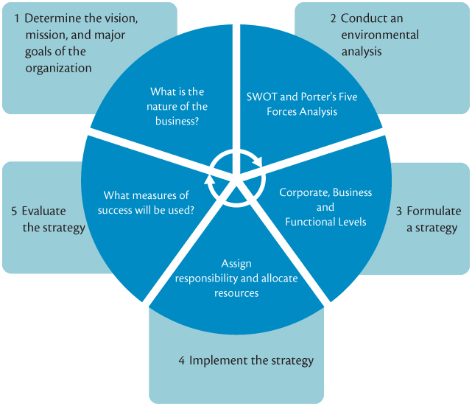
An Overview of the Planning Process
Notes:
LO1 Describe what planning is, the levels of planning, types of plans, why it is important, and what qualities make plans effective.
Point out that the mission and goals provide a goal or target of where the firm wants to go and what it wants to achieve. If we do a poor job of setting the goals, it really does not matter what we do later on.

Slide 5
Why Planning is Important
Planning determines where the organization is now and where it will be in the future. Good planning provides:
  Participation
  Sense of direction & purpose
  Coordination
  Control
Notes:
LO1 Describe what planning is, the levels of planning, types of plans, why it is important, and what qualities make plans effective.
It makes sense that managers that are involved in the development of a plan will be more enthusiastic about implementing it.
This ownership also provides personal goals for the managers involved in the development.
Finally, it must be clear who is in charge of controlling how the goal is accomplished.

Slide 6
Effective Plans
Effective plans have four qualities:
  Unity
  Continuity
  Accuracy
  Flexibility
Notes:
LO1 Describe what planning is, the levels of planning, types of plans, why it is important, and what qualities make plans effective.

Slide 7
Levels and Types of Planning
Corporate level planning is done by top managers.
  Also approve business and functional level plans.
Business level planning is done by divisional and functional managers.
  Both management levels should also seek information from other levels.
Notes:
LO1 Describe what planning is, the levels of planning, types of plans, why it is important, and what qualities make plans effective.
The key point here is to stress the need for managers to communicate. Many top managers have failed by assuming they knew all the answers and did not need to listen to middle and lower level managers.
Ideally, all levels of management should be involved in the planning process.

Slide 8
Levels and Types of Planning
A functional-level plan
  States the goals that the managers of each function will pursue.
Functional-level strategy
  Adds value to an organization’s goods and services.
Notes:
LO1 Describe what planning is, the levels of planning, types of plans, why it is important, and what qualities make plans effective.
The key point here is to stress the need for managers to communicate. Many top managers have failed by assuming they knew all the answers and did not need to listen to middle and lower level managers.
Ideally, all levels of management should be involved in the planning process.

Slide 9
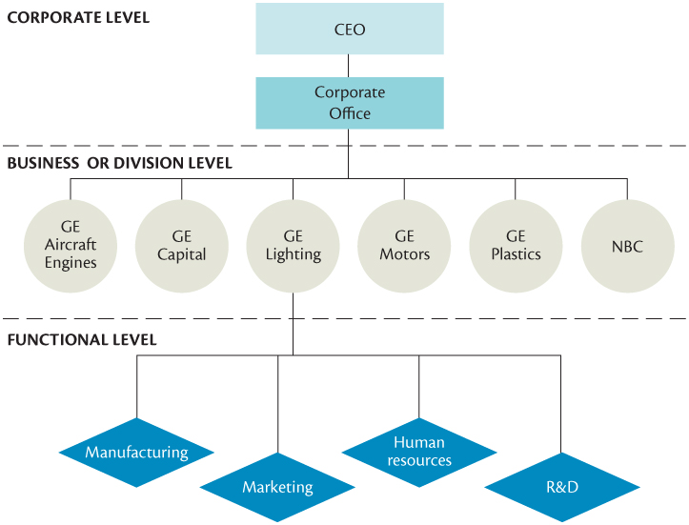
Levels and Types of Planning
Notes:
LO1 Describe what planning is, the levels of planning, types of plans, why it is important, and what qualities make plans effective.
Text Figure 5.2 - Levels of Planning at General Electric

Slide 10
Time Horizons of Plans
  Long-term
  Intermediate-term
    Corporate and business level plans usually long and intermediate terms.
  Short-term
    Functional plans focus on short to intermediate term.
  Rolling plans are frequently amended to reflect changes in the external environment.
Notes:
LO1 Describe what planning is, the levels of planning, types of plans, why it is important, and what qualities make plans effective.
All plans need to consider these time horizons.
Consider the personal computer market. Ask students to describe the current state of the art system. Now, ask them to describe one five years old. Finally, ask them to describe one five years into the future.
This example tends to focus them on the need to continually evaluate long-term plans.

Slide 11
Standing Plans and Single-Use Plans
Standing Plans: for programmed decisions.
  Managers develop policies, rules, and standard operating procedures (SOP).
Single-Use Plans: developed for a one-time, non-programmed issue.
Notes:
LO1 Describe what planning is, the levels of planning, types of plans, why it is important, and what qualities make plans effective.
Managers would be overwhelmed if they had to make decisions for every situation each time it occurred. Therefore, we have developed plans that are used whenever a common issue occurs.
For example, the hiring of a new employee follows a standing plan that describes how the advertisements are placed, the screening of resumes,
interviewing candidates and so forth.
If you have not done the action before, a single-use plan will be used. Naturally, the more complex the event, the more complex the plan will be.

Slide 12
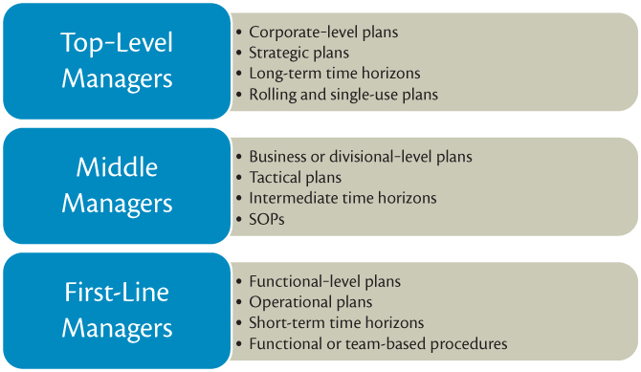
Level of Manager
Responsible for Types of Plans
Notes:
LO1 Describe what planning is, the levels of planning, types of plans, why it is important, and what qualities make plans effective.
Text Figure 5.3 - Level of Manager Responsible for Types of Plans

Slide 13
Scenario Planning and Crisis Management
Scenario Planning: The generation of multiple forecasts of future conditions followed by an analysis of how to respond effectively to each of those conditions.
Crisis Management Plans are formulated to deal with possible future crisis.
Notes:
LO1 Describe what planning is, the levels of planning, types of plans, why it is important, and what qualities make plans effective.
Crisis Management Example: In the early 2000s, Maple Leaf Foods recalled the entire stock of meat products from one of its plants that was shut down after being found to be the source of food-borne bacteria called Listeria monocytogenes. The listeriosis outbreak caused several deaths and illnesses.
How did CEO Michael McCain handle the crisis?
In an effort to protect the company and its customers, he gave press releases, media interviews, and posted up-to-date information on the efforts the company was taking to get rid of the bacteria.
His highly apparent candour was praised by the public.
Communication was the key to their crisis management strategy. What could have ruined the business turned out to be a short-lived crisis with a quick recovery.
Another famous example: Johnson & Johnson's response to the case of tampered Tylenol.

Slide 14
Five Steps in the Planning Process
Step 1: Determining Vision, Mission and Goals
  Determining the Vision
    Vision statement – reveals the big picture
  Setting the mission
    Mission statement
  Establishing major goals
    Sense of direction
    Strategic leadership
Notes:
LO2 Describe planning as a five-step process.
The most crucial issue managers must address is to accurately identify their customer and determine why they buy from the manager’s firm.
› For example, a car dealer might decide to focus on a customer set that values an easily understood sales process and superb service (Saturn).
› This process can also pinpoint competitors that might target the same customer set.
Managers of all levels will set goals that guide their efforts. While goals should be challenging, they must also be attainable. Too often, managers set goals that are not attainable. As a result, the goals are ignored.

Slide 15
Five Steps in the Planning Process
Qualities of Good Goal Formulation:
  Make them SMART + C
Specific
Measurable
Assignable (Achievable, Attainable, Action oriented, Acceptable, Agreed-upon, Accountable)
Realistic (Relevant, Result-Oriented)
Time-related (Timely, Time-bound, Tangible, Traceable)
+ Communicated
Notes:
LO2 Describe planning as a five-step process.
To be effective, goals should be; specific, not vague; measurable- that is quantifiable whenever possible; attainable; realistic, fall within an appropriate timeframe and be communicated to all stakeholders.

Slide 16
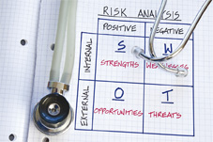
Five Steps in the Planning Process
Step 2: Analyzing the Environment
  Strategy Formulation - Managers analyze the current situation to develop strategies achieving the mission.
Notes:
LO3 Explain how managers use diagnostic techniques to evaluate the opportunities and threats in the organization’s environment.
A SWOT analysis provides managers with a tool to evaluate the firm.
Ask students to build their own, personal SWOT as they seek a new job. Here are some examples of the kinds of items that might be included.
› Strengths: helpful and important personal skills, abilities.
› Weakness: poor organization skills, lack of specific training.
› Opportunities: emerging trends that the student can capitalize on.
› Threats: a recession that slows hiring for all students.

Slide 17
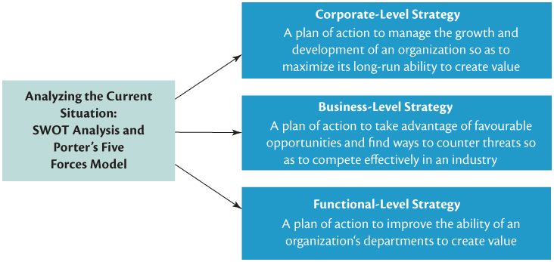
Analyzing the Environment
Notes:
LO3 Explain how managers use diagnostic techniques to evaluate the opportunities and threats in the organization’s environment.
Notice the SWOT concept can be used by all levels of management. Naturally, each level of management will focus on different types of issues.

Slide 18
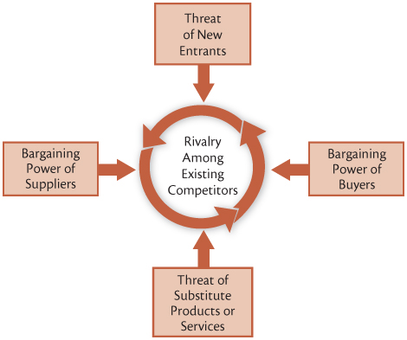
The Five Forces Model
Notes:
LO3 Explain how managers use diagnostic techniques to evaluate the opportunities and threats in the organization’s environment.
Rivalry is usually the most critical of the five forces. Typically, when there are many competitors of about the same size and ability, there will be more competition.
Potential entry: students realize that the easier it is to enter a business, the more firms will enter the business. This leads to higher competition.

Slide 19
Step 3: Developing Strategy
Corporate-level strategy
  Concerns which industries and countries an organization should invest its resources in to achieve its mission and goals
Corporate level plans
  Decisions relating to the organization’s mission and goals, overall strategy, and structure that facilitate growth.
Notes:
LO4 Differentiate among corporate-level, business-level, and functional-level strategies.
There are many ways to succeed at business. Stress that while firms ins single type of business can focus on it but if the environment changes, the firm can totally lose the market. A good example might be large, rear-wheel drive automobiles that were displaced by smaller, front wheel drive cars.

Slide 20
Step 3: Developing Strategy
The principal corporate-level strategies are:
  Concentration on a single business
  Diversification
  Vertical integration
  International expansion
Notes:
LO4 Differentiate among corporate-level, business-level, and functional-level strategies.
Diversification can spread business risk over more ventures but then it becomes much harder for managers to control the business.
› The bottom line is that there is no sure-fire recipe for success.
› Point out that this uncertainty is why management can be so interesting and rewarding.

Slide 21
Business Level Strategies
  Cost Leadership: gain a competitive advantage by driving down organizational costs.
    Managers manufacture at lower cost, reduce waste.
    Lower costs than competition mean lower prices.
Notes:
LO4 Differentiate among corporate-level, business-level, and functional-level strategies.
Students often confuse low-cost with low selling price. Stress that this is NOT the case.
› Example: during IBM’s domination of the computer business, they actually were the low-cost leader of large computers while selling for the highest price.
› BMW auto company seeks to differentiate themselves based on handling and performance. The key is to find a source of differentiation that is valued by the consumer

Slide 22
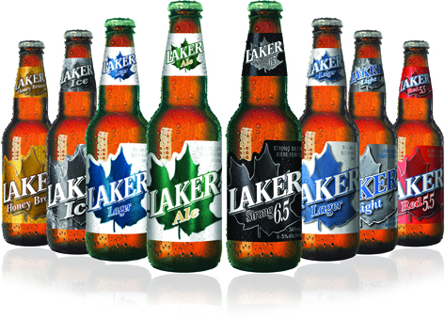
Business Level Strategies
  Differentiation: gain a competitive advantage by making your products different from competitors.
    Differentiation must be valued by the customer.
    Successful differentiation allows you to charge more for a product.
  “Stuck in the middle”
Notes:
LO4 Differentiate among corporate-level, business-level, and functional-level strategies.

Slide 23
Business Level Strategies
Firms also choose to serve the entire market or focus on a few segments.
  Focused low-cost: try to serve one segment of the market but be the lowest cost in that segment.
Notes:
LO4 Differentiate among corporate-level, business-level, and functional-level strategies.
Most firms concentrate on one or a very few segments of a market. Low cost is hard to achieve but can dominate the segment. It is important to realize that cost structures change over time based on consumer demand and production technology.

Slide 24
Business Level Strategies
  Focused differentiated: Firm again seeks to focus on one market segment but is the most differentiated in that segment.
    BMW provides a good example.
Notes:
LO4 Differentiate among corporate-level, business-level, and functional-level strategies.
Most firms concentrate on one or a very few segments of a market. Low cost is hard to achieve but can dominate the segment. It is important to realize that cost structures change over time based on consumer demand and production technology.

Slide 25
Functional Level Strategies
Seeks to have each department add value to a good or service.
Marketing, service, production all add value to a good or service.
Value is added by:
  Lowering the operational costs of providing the value in products
  Adding new value to the product by differentiating.
Notes:
LO4 Differentiate among corporate-level, business-level, and functional-level strategies.
Adding value is a critical concept and one that is embraced by the Total Quality Management concept.
› Value is added when the product or service is desired more by the customer.
› Example: No value is added when the firm needs to repair products that are poorly constructed. Further, no value is added by inspecting products to identify broken products.

Slide 26
Gaining a Competitive Advantage
  Attain superior efficiency: the measure of outputs for a given unit of input.
  Attain superior quality: products that reliably do the job they were designed for.
  Attain superior innovation: new, novel features about the product or process.
  Attain superior responsiveness to customers: know the customer needs and fill them.
Notes:
LO4 Differentiate among corporate-level, business-level, and functional-level strategies.
Functional strategies describe how we can build a product that will provide us with a competitive advantage.
› Note that there is usually room in the market for several firms that can each follow a different functional strategy.
› Be sure to mention that for the functional strategy to be effective, the workers building the product must also embrace the strategy. This is a key issue for managers.

Slide 27
Step 4: Strategy Implementation
1. Allocate responsibility for implementation
2. Draft detailed action plans that specify implementation.
3. Establish a timetable for implementation
    A Gantt chart can be used to manage the project.
4. Allocate appropriate resources
5. Hold specific individuals or groups responsible for
reaching corporate, divisional, and functional goals.
Notes:
LO5 Describe how managers implement strategy and evaluate its success.
Recall Steps 1 through 3:
After conducting a SWOT analysis and analyzing the forces in the organization’s industry using Porter’s Five Forces Model, managers formulate appropriate strategies at the corporate, business, and functional level that support the organization’s vision, mission, and goals.
The next step in the planning process, implementation, now confronts managers with the challenge of how to put those strategies into action

Slide 28
Step 5: Evaluating Strategy
  How do managers know when they are successful?
  Managers must monitor progress, evaluate performance levels, and make corrective adjustments if results deviate between the goal and the actual performance.
  This is the controlling process (Chapter 12)
Notes:
LO5 Describe how managers implement strategy and evaluate its success.
Here is an example which teaches this point:
Campbell’s Soup company did an about face after it lost its competitive advantage to General Mills when the latter began offering a more health conscious line of soup in the early 2000s.
Campbell’s responded to this threat by realigning its products to meet the changing nutrition needs of consumers. Among the changes, it reduced the amount of sodium in soups.
By 2011, sales were sluggish and incoming CEO Denise Morrison reversed the low sodium strategy to try to regain market share.
When goals are unmet, strategy must be rethought in such a way as to stay true to the vision and mission of the organization.

Slide 29
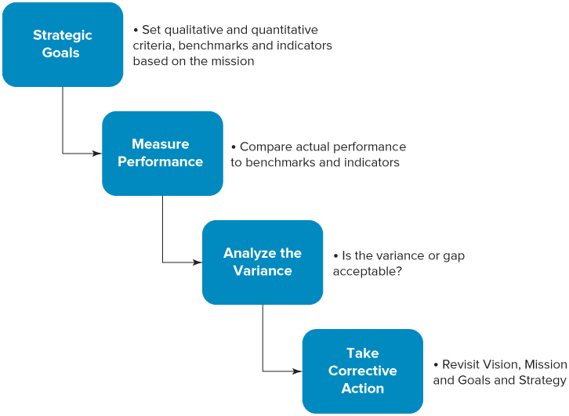
Strategy Evaluation Framework
Notes:
LO5 Describe how managers implement strategy and evaluate its success.

Slide 30
Summary and Review
LO1 An Overview of the Planning Process
Planning is setting goals and finding the best strategy to achieve them. This is done by management at all three levels of the organization.
Scenario or contingency planning is managers forecasting what may happen in the future and then gathering resources to meet these anticipated needs, opportunities, and threats.
Crisis management occurs when unanticipated and unplanned contingencies arise.

Slide 31
Summary and Review
LO2 Five Steps in the Planning Process
  Determining an organization’s vision, mission, and goals
  Analyzing the forces in the organizational environment
  Formulating strategy
  Implementing strategy
  Evaluating strategy

Slide 32
Summary and Review
LO3 Step Two in the Planning Process
SWOT analysis examines the internal strengths and weaknesses of the organization.
Porter’s Five Forces model looks at the degree of competitive rivalry, the ease of entry, the power of buyers, the power of suppliers, and the threat of substitute products.
Managers use these techniques to evaluate what strategy would gain them a competitive advantage.

Slide 33
Summary and Review
LO4 Step Three in the Planning Process: Developing Strategy
Corporate level: concentration on a single business, diversification, vertical integration, and international expansion
Business or divisional level: low-cost or differentiation strategy, Functional level, departmental managers try to add value to the product or service by differentiation or increasing efficiencies by reducing costs.
All managers attempt to gain a competitive advantage by increasing quality, responsiveness to customers, and efficiencies and innovations.

Slide 34
Summary and Review
LO5 Steps Four and Five in the Planning Process: Implementing and Evaluating Strategy
These steps require managers to allocate responsibilities to individuals or groups, draft detailed action plans, establish a timetable for implementation, allocate necessary resources, and hold the individuals or groups accountable for reaching goals.
Managers monitor the progress of goal achievement and make corrective adjustments when strategies fail to accomplish the organization’s mission and goals.

