Slide 1

Chapter 3
Managing Decision Making

Slide 2
Learning Outcomes
Differentiate between programmed and nonprogrammed decisions, and explain why nonprogrammed decision making is a complex, uncertain process.
Compare the assumptions that underlie two models of decision making.
Describe the seven steps managers should take to make sound decisions.
Explain how cognitive biases can affect decision making and lead managers to make poor decisions.
Explain the role that ethics, corporate social responsibility and organizational learning, play in helping managers improve their decisions.

Slide 3
The Nature of Managerial
Decision Making
Decision making - the process by which managers respond to opportunities and threats by analyzing options, and making decisions about goals and courses of action.
  In response to opportunities: managers seek to improve performance to benefit stakeholders.
  In response to threats: events inside or outside the organization are adversely affecting organizational performance and managers are searching for ways to increase performance.
Notes:
LO1 Differentiate between programmed and nonprogrammed decisions, and explain why nonprogrammed decision making is a complex, uncertain process.
Students (and everyone else) make thousands of decisions each week. Some are simple, programmed decisions such as shopping for food, or driving through traffic.
› Ask students to describe the thought process that enters some routine decisions. Next, contrast this with decisions involving the selection of a job, or choosing a college or university to attend.
Decision-making is the process by which managers respond to opportunities and threats by analyzing options, and making decisions about goals and courses of action.
Students should realize that decisions are made in response to opportunities as managers respond to ways to improve organizational performance. Decisions are also made in response to threats and occur when managers are impacted by adverse events to the organization.

Slide 4
Programmed Decision Making
Programmed decisions: routine, almost automatic process.
  Managers have made the decision many times before.
  There are rules or guidelines to follow.
  Example: Deciding to reorder office supplies.
Notes:
LO1 Differentiate between programmed and nonprogrammed decisions, and explain why nonprogrammed decision making is a complex, uncertain process.
The most common form of decisions are Programmed Decisions. These follow a routine, almost automatic process.
› Example: students make the decision of the route they will use to come to class. They have made this decision many times before. There are also certain are rules or guidelines to follow (traffic signals, class start times).
› Example: A manager decides to reorder office supplies such as paper.

Slide 5
Nonprogrammed Decision Making
Nonprogrammed decisions: non-routine decision making that occurs in response to unpredictable opportunities and trends.
  No rules to follow since the decision is new.
  These decisions are made based on information, and a manager’s intuition and judgment.
  Example: Should the firm invest in a new technology?
Notes:
LO1 Differentiate between programmed and nonprogrammed decisions, and explain why nonprogrammed decision making is a complex, uncertain process.
A much more involved form of decision-making is the non-programmed Decision. These involve unusual situations that have not been often addressed.
› Example: The student went through this type of decision when deciding to attend this University. There were no rules to follow since the decision is new to the student.
› Example: Should the firm invest in a new technology? This decision is made based on available information, a manger’s intuition, and judgment.

Slide 6
The Classical Model
Classical model of decision making: a prescriptive model that tells how the decision should be made.
  Assumes managers have access to all the information needed to reach the optimal decision.
  Managers can then make the optimum decision by easily ranking their own preferences among alternatives.
Unfortunately, managers often do not have all (or even most) required information.
Notes:
LO2 Compare the assumptions that underlie two models of decision making.
The classical model of decision-making is a prescriptive model that tells how the decision should be made.
Assumes managers have access to all the information needed to reach a decision. Managers can then make the optimum decision by easily ranking their own preferences among alternatives.
Students readily see that this model is flawed as mangers often do not have all (or even most) required information.

Slide 7
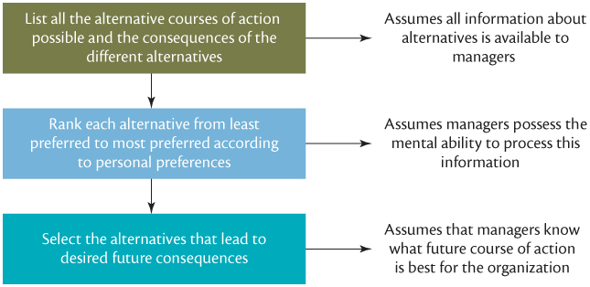
The Classical Model
Notes:
LO2 Compare the assumptions that underlie two models of decision making.
Figure 3.1 shows the Classical decision model. Full details on the decision processes are provided later in the text, but emphasize the assumption that managers have complete data during this slide.

Slide 8
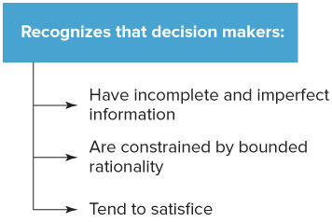
The Administrative Model
Administrative Model of Decision Making: Decision making is always uncertain and risky. (March and Simon)
Notes:
LO2 Compare the assumptions that underlie two models of decision making.
The Administrative Model of decision making challenged the classical assumptions that managers have and process all the information.
› Point out to students that the fundamental concept of the Administrative model is that decision making is risky. There are many reasons decision-making involves risk.

Slide 9
The Administrative Model
Bounded Rationality: there is a large number of alternatives and information is vast so that managers cannot consider it all.
  Decisions are limited by people’s cognitive abilities.
  People’s ability to interpret, process and act on information is bounded or limited.
Incomplete Information: most managers do not see all possible alternatives and make decisions based on incomplete information.
Notes:
LO2 Compare the assumptions that underlie two models of decision making.
Bounded rationality refers to the large number of alternatives available. Further, information is so vast that mangers cannot consider it all.
› Therefore, decision quality is limited by people’s cognitive abilities.
Managers must also deal with Incomplete information since most managers can not see all possible alternatives and must decide based on incomplete information.

Slide 10
The Administrative Model
Incomplete information exists for three reasons:
  Risk and uncertainty: probabilities cannot be given for outcomes and the future is unknown.
  Ambiguous Information: information whose meaning is not clear or there may exist multiple interpretations.
  Time constraints and search cost for alternative solutions can be prohibitive.
Notes:
LO2 Compare the assumptions that underlie two models of decision making.
Students often confuse these factors. Point out the difference is in the outcome of the decision. If you know the possible outcome and can assign probabilities to each outcome, then it involves risk.
› Example: Many decision outcomes are not known such as a new product introduction. This involves uncertainty.
› Decisions are also impacted by ambiguous information. This is information whose meaning is not clear. This means the information can be interpreted in different ways.
Time constraints and Information costs impact decision-making.
› Point out that decisions cost money and time and managers do not enough of either to search for all alternatives. These leads the manager to again decide based on incomplete information.

Slide 11
The Administrative Model
Satisficing: Managers explore a limited number of options and choose an acceptable decision rather than the optimum decision.
  This is the response of managers when dealing with incomplete information.
  Managers assume that the limited options they examine represent all options.
Notes:
LO2 Compare the assumptions that underlie two models of decision making.
When a manager uses satisficing, it means that they explore a limited number of options and choose an acceptable decision rather than the optimum decision.
› Example: ask students how many dealers they might go to when buying a car. Perhaps they went 5 or even 10 and then purchased. Probably, there was a better deal at one of the thousands of deals they did not visit. This is an example of satisficing and dealing with incomplete information. Students assume that the limited options they examined adequately represented all options.

Slide 12
The Decision-Making Process
The conditions for an optimum decision rarely exist.
There are seven steps that managers should consciously follow to make a good decision
Notes:
LO3 Describe the seven steps managers should take to make sound decisions.

Slide 13
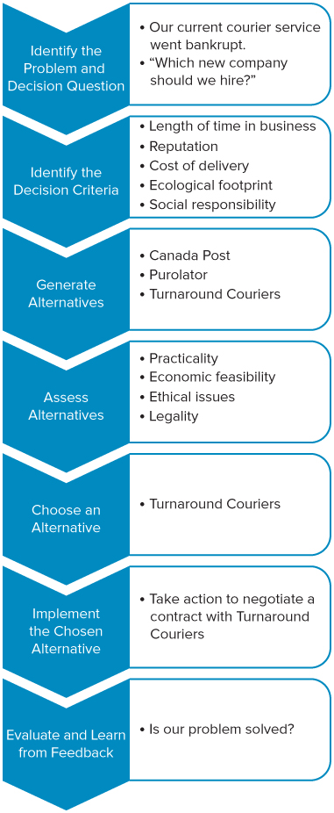
Step 1: Recognize the Need for a Decision
Managers must first realize that a decision must be made.
    Sparked by an event such as environment changes.
Notes:
LO3 Describe the seven steps managers should take to make sound decisions.
NOTE: a common error is to try and evaluate alternatives before they are specified. This occurs when managers say “I already know how that works.”

Slide 14
Step 2: Identify Decision Criteria
What variables are important?
Notes:
LO3 Describe the seven steps managers should take to make sound decisions.

Slide 15
Step 3: Generate Alternatives
Managers must develop feasible alternative courses of action.
  If good alternatives are missed, the result may be poor.
  It is hard to develop creative alternatives, so managers need to look for new ideas.
Notes:
LO3 Describe the seven steps managers should take to make sound decisions.
NOTE: a common error is to try and evaluate alternatives before they are specified. This occurs when managers say “I already know how that works.”

Slide 16
Step 4: Assess Alternatives
What are the advantages and disadvantages of each alternative?
    Managers should specify criteria, then evaluate.
Notes:
LO3 Describe the seven steps managers should take to make sound decisions.
NOTE: a common error is to try and evaluate alternatives before they are specified. This occurs when managers say “I already know how that works.”

Slide 17
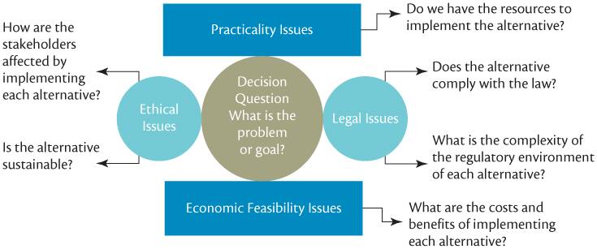
Step 4: Assess Alternatives
Notes:
LO3 Describe the seven steps managers should take to make sound decisions.
NOTE: a common error is to try and evaluate alternatives before they are specified. This occurs when managers say “I already know how that works.”

Slide 18
Assessing Alternatives: Criteria
Practicality
  Do I have the capabilities and resources to do it?
Economic feasibility
  Can our performance goals sustain this alternative?
Ethicalness
  Alternatives must be ethical and cause no harm to stakeholders.
Legality
  Managers must ensure the alternative is legal both in this country and abroad (for exports).
Notes:
LO3 Describe the seven steps managers should take to make sound decisions.
How should students and managers evaluate alternatives? This is a good list.
Ask students about some current decisions in the press. How do these compare to this list?

Slide 19
Step 5: Choose Among Alternatives
Once a set of alternatives has been evaluated, they have to be ranked.
  When ranking, all information needs to be considered.
Notes:
LO3 Describe the seven steps managers should take to make sound decisions.
Notice that even if a decision is made and not implemented, it fails.
A critical point: Without feedback, managers never learn from experience and can make the same mistake over.

Slide 20
Step 6: Implement the Chosen Alternative
Often a decision is made and not implemented.
Notes:
LO3 Describe the seven steps managers should take to make sound decisions.
Notice that even if a decision is made and not implemented, it fails.
A critical point: Without feedback, managers never learn from experience and can make the same mistake over.

Slide 21
Step 7: Evaluate and Learn from Feedback
Without feedback, managers never learn from experience and make the same mistake over.
Notes:
LO3 Describe the seven steps managers should take to make sound decisions.
Notice that even if a decision is made and not implemented, it fails.
A critical point: Without feedback, managers never learn from experience and can make the same mistake over.

Slide 22
Biases in Decision Making
Suggests decision makers use heuristics to deal with bounded rationality.
  A heuristic is a rule of thumb to deal with complex situations.
  If the heuristic is wrong, however, then poor decisions result from its use.
Systematic errors can result from use of an incorrect heuristic.
  These errors will appear over and over since the rule used to make decision is flawed.
Notes:
LO4 Explain how cognitive biases can affect decision making and lead managers to make poor decisions.
Decisions can be complex and it is only natural that people try to simplify them. One way this is done is through heuristics to deal with bounded rationality.
› A heuristic is a rule of thumb designed to deal with complex situations. If the heuristic is wrong, then poor decisions result from its use.
Systematic errors can result from use of an incorrect heuristic. These errors will appear over and over since the rule used to make decision is flawed.
› Ask students to give some examples of poor decisions in this light.

Slide 23
Biases in Decision Making
Escalating Commitment
Prior Hypothesis Bias
Recency Effect
Clustering Illusion
Representativeness Bias
Confirmation Bias
Fundamental Attribution Error
Illusion of Control and
Overconfidence Bias
Notes:
LO4 Explain how cognitive biases can affect decision making and lead managers to make poor decisions.
Figure 3.8 Examples of Cognitive Bias and Errors in Decision Making
Prior hypothesis bias: manager allows strong prior beliefs about a relationship between variables makes decisions based on these beliefs even when evidence shows they are wrong.
Representativeness bias: decision-maker incorrectly generalizes a decision from a small sample or one incident.
Illusion of control: manager over-estimates their ability to control events.
Escalating commitment: manager has already committed considerable resource to project and then commits more even after feedback indicates problems.

Slide 24
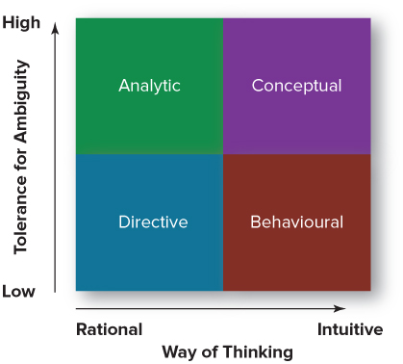
Decision Making Styles
Notes:
LO4 Explain how cognitive biases can affect decision making and lead managers to make poor decisions.

Slide 25
Decision Making in
Learning Organizations
Organizational Learning vs. Learning Organization
  Promote Individual Creativity
  Intrapreneurs
  Innovation
Notes:
LO4 Explain the role that a sustainability strategy, organizational learning, and creativity play in helping managers improve their decisions.
A learning organization is one in which managers do everything possible to maximize the ability of individuals and groups to think and behave creatively and thus maximize the potential for organizational learning to take place.
At the heart of organizational learning is creativity, the ability of a decision maker to discover original ideas that lead to feasible alternative courses of action.
Encouraging creativity among managers is such a pressing organizational concern that many organizations hire outside experts to help them develop programs to train their managers in the art of creative thinking and problem solving.
Organizations can build an environment supportive of creativity.
› Many of these issues are the same as for the learning organization.
› Managers must provide employees with the ability to take risks
If people take risks, they will occasionally fail. Thus, to build creativity, periodic failures must be rewarded. This idea is hard to accept for some managers.

Slide 26
Ethics and Decision Making
Ethics are moral principles or beliefs about what is right or wrong.
  Ethics help people determine moral responses to situations
  in which the best course of action is unclear.
Ethical dilemma
  The quandary people find themselves in when they have to decide if they should act in a way that might help another person or group even though doing so might go against their own self-interest.
Notes:
LO5 Explain the role that ethics, corporate social responsibility and organizational learning, play in helping managers improve their decisions.
Ethics guide people in dealings with stakeholders and others, to determine appropriate actions. Managers often must choose between the conflicting interest of stakeholders.

Slide 27
Making Ethical Decisions
Lobby groups and laws exist to govern businesses.
Laws also specify what sanctions or punishments will follow if those laws are broken
Neither laws nor ethics are fixed principles
Ethical beliefs alter and change as time passes, and as they do so, laws change to reflect the changing ethical beliefs of a society.
Notes:
LO5 Explain the role that ethics, corporate social responsibility and organizational learning, play in helping managers improve their decisions.

Slide 28
Codes of Ethics
An organization’s code of ethics derives from three main sources in the organizational environment:
  Societal ethics governing how everyone deals with each other on issues such as fairness, justice, poverty, and the rights of the individual.
  Professional ethics governing how members of the profession make decisions when the way they should behave is not clear-cut.
  Individual ethics or personal standards for interacting with others, of the organization’s top managers.
Notes:
LO5 Explain the role that ethics, corporate social responsibility and organizational learning, play in helping managers improve their decisions.

Slide 29
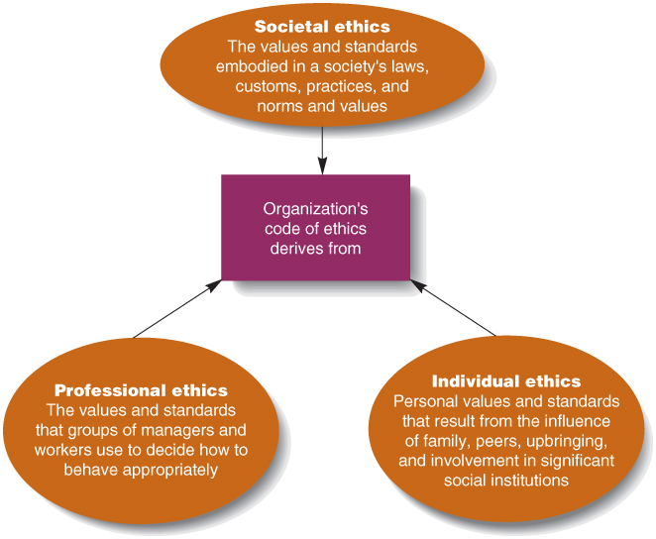
Codes of Ethics
Notes:
LO5 Explain the role that ethics, corporate social responsibility and organizational learning, play in helping managers improve their decisions.

Slide 30
Codes of Ethics
An organization’s code of ethics derives from three main sources in the organizational environment:
  Societal ethics
  Professional ethics
  Individual ethics
Notes:
LO5 Explain the role that ethics, corporate social responsibility and organizational learning, play in helping managers improve their decisions.

Slide 31
Social Responsibility
Social Responsibility
  The manager’s duty or obligation to make decisions that promote the well-being of stakeholders and society as a whole.
Notes:
LO5 Explain the role that ethics, corporate social responsibility and organizational learning, play in helping managers improve their decisions.
What social responsibility does a manager really have? Ask students if they agree that the manager’s duty is to nurture, protect and enhance the welfare of stakeholders. This can be done in many ways:
Some managers simply choose not to be socially responsible, a position called the Obstructionist response.
> Here managers behave illegally and unethically by design and hide and cover-up problems.
> Recall that the tone of the organization is set at the top and so middle managers acting this way likely get their cue from the top management.

Slide 32
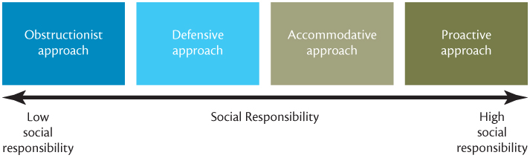
Approaches to Social Responsibility
Notes:
LO5 Explain the role that ethics, corporate social responsibility and organizational learning, play in helping managers improve their decisions.
Typically, people are motivated to perform in a given way to receive benefits.
What benefits can managers accrue by being responsible?

Slide 33
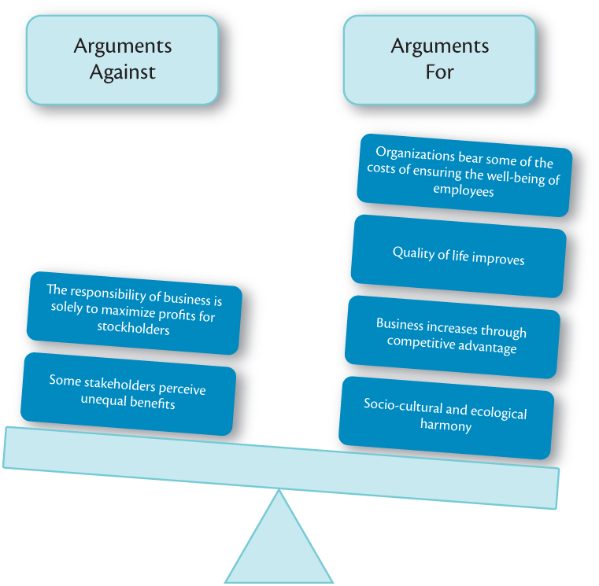
Why Be Socially Responsible?
Notes:
LO5 Explain the role that ethics, corporate social responsibility and organizational learning, play in helping managers improve their decisions.

Slide 34
Why Be Socially Responsible?
Managers accrue benefits by being responsible.
  Workers and society benefit.
  Quality of life in society will improve.
  It is the right thing to do.
  Improves the businesses reputation.
Impact investing
Social audit
Notes:
LO5 Explain the role that ethics, corporate social responsibility and organizational learning, play in helping managers improve their decisions.
Certainly, the manager’s workers benefit from ethical treatment.
› The quality of life in the firm and society will improve. This might mean that the firm is a much nicer and enjoyable place to work. Plus, it is the right thing to do which has a number of personal benefits.
Impact investing involves investing in solving social or environmental challenges, while generating a return of principal capital or a better than market financial return.
> There is a recognition that societies cannot rely solely on community and government agencies to solve social problems.
A social audit allows managers to consider both the organizational and the social effects of particular decisions.
> The audit ranks various courses of action according to both their profitability and their social benefits.

Slide 35
Chapter Summary
LO1 The Nature of Managerial Decision Making
Programmed decisions are routine decisions that are made so often that managers have developed decision rules to be followed automatically.
Nonprogrammed decisions are made in response to situations that are unusual or unique; they are nonroutine decisions.

Slide 36
Chapter Summary
LO2 Assumptions underpinning models of decision making
The classical model of decision making assumes that decision makers have complete information, are able to process that information in an objective, rational manner, and make optimum decisions.
March and Simon in the administrative model argue that managers are subject to bounded rationality, rarely have access to all the information they need to make optimum decisions, and consequently satisfice and rely on their intuition and judgment when making decisions.

Slide 37
Chapter Summary
LO3 Steps in the Decision-Making Process
When making decisions, managers should take these seven steps: recognize the need for a decision, develop decision criteria, generate alternatives, assess alternatives, choose among alternatives, implement the chosen alternative, and evaluate and learn from feedback.

Slide 38
Chapter Summary
LO4 Biases in Decision Making
Managers are often fairly good decision makers. However, problems result when human judgment is adversely affected by the operation of cognitive biases.
Cognitive biases are caused by systematic errors in the way decision-makers process information to make decisions.

Slide 39
Chapter Summary
LO5 The Role of Ethics, Social Responsibility, and Organizational learning in decision making
Managers can make better decisions when they examine their ethics and approaches to social responsibility.
But to make optimum decisions, managers should make decisions that promote sustainability.
They must become a learning organization and encourage creativity to ensure that new, innovative ideas are not overlooked in the decision making process.

