Slide 1

Chapter 2
Managing the Organizational Environment
Notes:
Chapter Two: Managing the Organizational Environment

Slide 2
Learning Outcomes
Explain why the ability to perceive, interpret, and respond appropriately to the organizational environment is crucial for managerial success.
Identify the main forces in an organization’s external environment and the challenges these forces present to managers.
Explain the changes in the global economy that lead to opportunities and threats.
Explain the ways managers can minimize threats and uncertainty from forces in the external environment.
Evaluate the major challenges managers face in gaining a competitive advantage in the global economy.

Slide 3
What is the Organizational Environment?
Organizational Environment: the set of forces and conditions that can affect the way an organization operates.
  Forces can change over time and are made up of opportunities and threats.
  Opportunities are openings for managers to enhance revenues or open markets. Examples: new technology, markets or innovation.
  Threats are issues that can harm an organization. Examples: recessions, political unrest or oil shortages.
Notes:
LO1 Explain why the ability to perceive, interpret, and respond appropriately to the organizational environment is crucial for managerial success.
Relate the environment to issues surrounding the university or college such as regional government, student councils, economic issues, and transportation issues.
Opportunities: openings for managers to enhance revenues or open markets.
There are many examples including new technologies, new markets and ideas. Students relate well to these and identify with them.
Threats: issues that can harm an organization
Include regulation concepts and ask students what impact these might have.
Can one firm’s threat be another’s opportunity? (Absolutely!)
Managers constantly seek opportunities and avoid threats, but must also maintain other duties in the firm.

Slide 4
What is the Organizational Environment?
The organizational environment is divided into two broad categories:
    Internal environment
    External environment
Stakeholders are the people, groups and institutions that are affected by internal and external environments.
Notes:
LO1 Explain why the ability to perceive, interpret, and respond appropriately to the organizational environment is crucial for managerial success.
The internal environment includes things like organizational strategy, human resources, and technology capabilities.
The external environment is divided into two major categories: the task environment and the general environment.
Ask students to identify probable elements of the internal and external environment of the college or university.
Ask students to identify the stakeholders of the college or university.

Slide 5
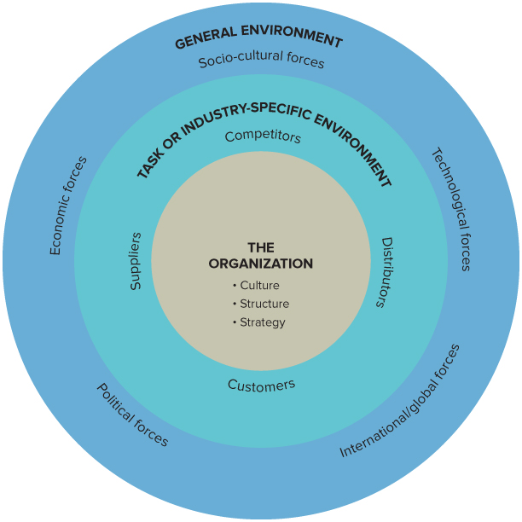
Forces in the Organizational Environment
Notes:
LO1 Explain why the ability to perceive, interpret, and respond appropriately to the organizational environment is crucial for managerial success.

Slide 6
The Task Environment
Task Environment:
  Immediate and direct impact on the organization.
Suppliers:
  Suppliers provide input resources (raw materials, labour)
  Managers need reliable suppliers in a global economy - with a trend towards outsourcing this can be challenging.
  Working with suppliers can be hard due to shortages, unions, and lack of substitutes.
  Managers often prefer to have many, similar suppliers of each item.
Notes:
LO2 Identify the main forces in an organization’s external environment and the challenges these forces present to managers.
Suppliers: provide organization with inputs
Suppliers provide raw materials, components, and even labour.
Example: List the suppliers to a hospital: students will suggest pharmaceuticals, linen firms and others, but be sure to note that physicians, nurses and staff are also a supplier of valuable skills.
Managers need to secure reliable input sources but working with suppliers can be hard due to shortages, unions, and lack of substitutes.
Suppliers with scarce items can raise the price and is in a good bargaining position. As a result, managers prefer to have many, similar suppliers of each item, but this is not always easy to do, particularly for skilled workers.

Slide 7
The Task Environment
Distributors: organizations that help others to sell goods or services to customers.
  For many years, Apple Computer refused to let others sell its computers, which meant that customers had to buy directly from Apple.
  Some distributors (i.e. Chapters) have strong bargaining power. They can threaten not to carry your product.
Notes:
LO2 Identify the main forces in an organization’s task and general environments and the challenges these forces present to managers.
Distributors: organizations that help others to sell goods.
Students often call these firms the “middle person” but they serve a valuable purpose. Have students list some value that distributors provide: (fast delivery, product availability, enhanced service, customer satisfaction, etc,)
Walmart is a powerful distributor has strong bargaining power since they can threaten not to carry your product and is powerful force in the market.
Customers: people who buy the goods.
Students should be able to list several groups of customers: For example, there are business, home, & government buyers.
Some firms may only sell to one type of customer.

Slide 8
The Task Environment
Customers: individuals and groups that buy the goods and services an organization produces.
  Usually, there are several groups of customers.
  Example: Dell Canada - business, home, and government buyers.
Notes:
LO2 Identify the main forces in an organization’s task and general environments and the challenges these forces present to managers.
Distributors: organizations that help others to sell goods.
Students often call these firms the “middle person” but they serve a valuable purpose. Have students list some value that distributors provide: (fast delivery, product availability, enhanced service, customer satisfaction, etc,)
Walmart is a powerful distributor has strong bargaining power since they can threaten not to carry your product and is powerful force in the market.
Customers: people who buy the goods.
Students should be able to list several groups of customers: For example, there are business, home, & government buyers.
Some firms may only sell to one type of customer.

Slide 9
The Task Environment
Competitors: organizations that produce goods or services that are similar to a particular organization’s goods or services.
  Rivalry between competitors is a serious force facing managers.
  High levels of rivalry often means lower prices.
  Potential competitors – have the resources to enter
Notes:
LO2 Identify the main forces in an organization’s task and general environments and the challenges these forces present to managers.
Competitors: other organizations that produce similar goods.
Rivalry between competitors is usually the most serious force facing managers.
Students should be aware that the more numerous the competitors in a market, the stronger the rivalry usually is and the lower prices and profits are.
Firms will seek barriers to entry to keep new competitors out of a market:
Economies of scale: cost advantages due to large-scale production such as the auto industry or computer chip production.
Brand loyalty: customers prefer a given product; very common in the food and consumer market.

Slide 10
The General Environment
Consists of the wide range of broader forces including: political, economic, socio-cultural, technological, and international
  Managers usually cannot impact or control these.
  Managers have to constantly analyze the forces impacting the general environment in order to manage effectively.
Notes:
LO2 Identify the main forces in an organization’s task and general environments and the challenges these forces present to managers.
Consists of the wide economic, technological, demographic, socio-cultural and legal and political forces and similar issues.
Students should see these as forces managers cannot impact or control. These forces have a profound impact on the firm.
Ask students to think of trying to do business during a severe depression, or highly inflationary times.

Slide 11
The General Environment
Political and legal forces are outcomes of changes in laws and regulations.
  Laws constrain the operations of organizations and managers, creating both opportunities and threats.
  Today, there is increasing deregulation of many public sector organizations.
  A trend towards privatization presents challenges for organizations.
  Employee Safety and Health / Environmental protection
Notes:
LO2 Identify the main forces in an organization’s task and general environments and the challenges these forces present to managers.
Political and legal forces: result from changes in the political arena.
Deregulation has changed many industries. In Canada there is a trend towards deregulation.
Example: airlines used to be fully regulated, now, they are not. This has resulted in lower fares but also several issues of safety and workforce trauma.
Look for more deregulated firms in the future.

Slide 12
The General Environment
Economic forces include interest rate changes, unemployment rates, economic growth, and other forces that affect the national economy and the general health and well-being of a national organization.
  When there is a strong economy, people have more money to spend on goods and services.
Notes:
LO2 Identify the main forces in an organization’s task and general environments and the challenges these forces present to managers.
Economic forces: affect the national economy and the organization.
Includes interest rate changes, unemployment rates, and economic growth.
Example: when unemployment rates are low, managers find it harder to hire good workers.
The recent appreciation in the value of the Canadian dollar has had serious effects on certain groups/sectors in the Canadian economy. Ask students about what they perceive these effects to be?

Slide 13
The General Environment
Socio-cultural forces are pressures coming from the social structure of a country or society or from the national culture.
  The social structure refers to the arrangement of individuals or groups in a society.
  National culture refers to the set of values that a society considers important /the norms of behaviour that are acceptable in society.
Notes:
LO2 Identify the main forces in an organization’s task and general environments and the challenges these forces present to managers.
Social-cultural forces: result from changes in the social or national culture of society.
Social structure refers to the relationships between people and groups. National culture includes the values that characterize a society.
Ask students to relate our culture today to the 1950’s or 70’s. There are huge differences affecting both the firm and the customer.

Slide 14
The General Environment
  Social structure and national culture not only differ across societies but also change within societies over time.
    Differences among national cultures have important implications for managers.
    Management practices that are effective in Canada might not work elsewhere.
    A culturally diverse management team can be a source of strength in the global marketplace.
Notes:
LO2 Identify the main forces in an organization’s task and general environments and the challenges these forces present to managers.

Slide 15
The General Environment
Demographic forces result from of changes in the nature, composition, and diversity of a population.
  Includes gender, age, ethnic origin, race, sexual orientation
  Many industrial countries have an aging population.
    Creates opportunities for firms competing in these areas.
    Demand for healthcare and assisted living can be expected.
    Likely to put a strain on the labour resources of many countries including Canada.
Notes:
LO2 Identify the main forces in an organization’s task and general environments and the challenges these forces present to managers.
Demographic forces: result from changes in the nature, composition and diversity of a population.
These include gender, age, ethnic origin, etc.
Women have entered the workforce in large numbers. Ask how this has changed the need for different products and services (day care, two automobile family, cell phones).
Currently, most industrial countries are facing a crisis with the aging of the population.
Baby boomers will impact the retirement market in a large way. What items will they need?

Slide 16
The General Environment
Technological forces results from changes in technology that managers use to design, produce and distribute goods and services.
  Results in new opportunities or threats to managers.
  Often renders existing products obsolete.
  Can impact management styles and behaviours.
Notes:
LO2 Identify the main forces in an organization’s task and general environments and the challenges these forces present to managers.
Technological forces: skills & equipment used in design, production, and distribution.
Students are well aware of this. Bring in a computer magazine and consider the state of the art in personal computers now and just two years ago.
This powerful force often makes products obsolete quickly!

Slide 17
The General Environment
International/Global forces result from changes in international relationships, changes in nations’ economic, political, and legal systems, and changes in technology.
  Critical factor: increasing economic integration of countries.
  Free-trade agreements (NAFTA, EU) designed to reduce barriers to trade. These are enforced by the World Trade Organization (WTO).
  Growth of representative democracies and reliable and instantaneous communications.
Notes:
LO2 Identify the main forces in an organization’s task and general environments and the challenges these forces present to managers.
International/Global forces: result from changes in international relationships between countries.
Free-trade agreements (NAFTA and EU) decrease former barriers to trade.
Ask students to describe some of the new opportunities and threats facing managers in this country as a result of NAFTA.
Falling trade barriers have created opportunities for organizations in one country to sell goods and services in other countries. But by allowing foreign companies to compete for an organization’s domestic customers, falling trade barriers also pose a serious threat because they increase competition in the task environment.

Slide 18
The Global Environment
What drives globalization?
  The path of globalization is shaped by the movement of capital.
  Capital moves seeking the highest return.
Four Principal Forms of Capital
  Human capital
  Financial capital
  Resource capital
  Political capital
Notes:
LO3 Explain the changes in the global economy that lead to opportunities and threats.
The faster the flow, the more capital is being utilized where it can create the most value, in the sense of people moving to where their skills earn them more money, or investors switching to the stocks or bonds that give them higher dividends or interest, or companies finding lower-cost sources of inputs.
That said, a fast flow of capital also means that individual countries or world regions can find themselves in trouble when companies and investors move their capital to invest it in more productive ways in other countries or world regions, often those with lower labour costs or rapidly expanding markets. When capital leaves a country, the result is higher unemployment, recession, and a lower standard of living for its people.

Slide 19
Declining Barriers to
Trade and Investment
1920s – 1930s: High tariffs
GATT and the rise of free trade
  The free-trade doctrine
  NAFTA
Declining barriers of distance and culture
Notes:
LO3 Explain the changes in the global economy that lead to opportunities and threats.

Slide 20
Managing the External Environment
Managers must measure the complexity of the environment and rate of environmental change.
Environmental complexity: deals with the number and possible impact of different forces in the environment.
  Managers must pay closer attention to forces with larger impact.
  Usually, the larger the organization, the greater the number of forces managers must oversee.
Notes:
LO4 Explain the ways managers can minimize threats and uncertainty from forces the external environment
Managers must measure the complexity of the environment and rate of environmental change.
Environmental complexity: deals with the number and possible impact of different forces in the environment.
Students should be able to identify many forces that might impact a firm such as Chrysler (economy, unemployment, raw materials prices, emission’s regulation, safety laws, etc.). Naturally, managers must pay more attention to forces with larger potential impact.

Slide 21
Managing the External Environment
Environmental change refers to the degree to which forces in the task and general environments change over time.
Managers cannot be sure that actions taken today will be appropriate in the future given new changes.
  Example: MacDonald’s was able to adapt to changes in nutrition preferences and the aging population.
  Sony was unable to adapt quickly to changes in technology and foreign competition.
Notes:
LO4 Explain the ways managers can minimize threats and uncertainty from forces the external environment
Environmental change: refers to the degree to which forces in the task and general environments change over time.
Change rates are hard to predict.
Few managers saw the impact that the personal computer would have on the business world. Even fewer could have predicted the current Internet when working in the late 1980’s.
To provide students with a feel for this, ask them what they will be doing in 5 years.

Slide 22
Managing the External Environment
Managers can counter environmental threats by reducing the number of forces.
  To reduce uncertainty, reduce the number of suppliers.
  Top management - devise suitable strategies.
All levels of managers should work to minimize the potential impact of environmental forces.
Managers can also be proactive and act as agents of change.
Notes:
LO4 Explain the ways managers can minimize threats and uncertainty from forces the external environment
Managers can counter environmental threats by reducing the number of forces it deals with.
Example: Many firms have sought to reduce the number of suppliers it deals with which reduces uncertainty. However, there is a tradeoff as this also limits the firm’s flexibility.
Managers should seek to reduce threats by scanning the environment and controlling what they can.
Examples include reduction of waste by first line managers, determining competitor’s moves by middle managers, or the creation of a new strategy by top managers.

Slide 23
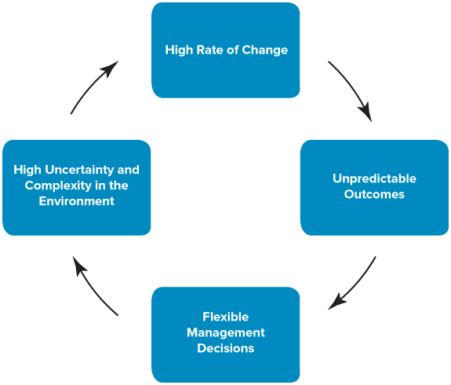
Managers as Agents of Change
Notes:
LO4 Explain the ways managers can minimize threats and uncertainty from forces the external environment

Slide 24
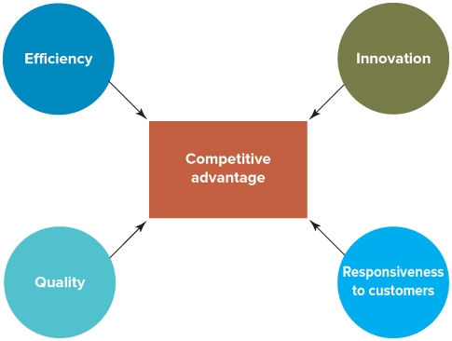
Challenges for Management in a Global Environment
Global organizations
Creating shared value
Building a competitive advantage
Notes:
LO5 Evaluate the major challenges managers face in gaining a competitive advantage in the global economy.

Slide 25
Shared Value Thinking
Michael Porter BSE MBA PhD
Professor Porter is the author of 18 books and numerous articles including Competitive Strategy, Competitive Advantage, Competitive Advantage of Nations, and On Competition. A six-time winner of the McKinsey Award for the best Harvard Business Review article of the year, Professor Porter is the most cited author in business and economics.
What is the vicious cycle between business and society and how does Porter suggest we fix it?
Notes:
LO5 Evaluate the major challenges managers face in gaining a competitive advantage in the global economy.

Slide 26

Shared Value Thinking
Notes:
LO5 Evaluate the major challenges managers face in gaining a competitive advantage in the global economy.

Slide 27
Summary and Review
LO1 The organizational environment and managerial success
The organizational environment has two components: the internal environment and the external environment.
Internal environment: strategy, structure, human resources, organizational culture and control mechanisms of the organization.
The external environment can be divided into the industry-specific or task environment and the general environment.

Slide 28
Summary and Review
LO2 The External Organizational Environment
The industry-specific or task environment is the set of forces and conditions that originate with suppliers, distributors, customers, and competitors and that influence managers ability to obtain inputs and sell outputs, on a daily basis.
The general environment includes wider-ranging political, economic, socio-cultural, technological and international/global forces (PESTI) that affect an organization more indirectly.

Slide 29
Summary and Review
LO3 Forces behind the Changing Global Environment
Shift toward a more open global environment
Hastened the process of globalization
The process of globalization has been furthered by declining barriers to international trade and investment and declining barriers of distance and culture.

Slide 30
Summary and Review
LO4 Managing the External Environment
Two factors affect the nature of the opportunities and threats that organizations face:
  The level of complexity in the environment
  The rate of change in the environment.
Managers must learn how to analyze the forces in the environment in order to respond effectively to opportunities and threats.

Slide 31
Summary and Review
LO5 Challenges for Management in a Global Environment
Challenge of creating shared value
Building a competitive advantage through increasing efficiency, quality, innovation, and responsiveness to customers;
Behaving ethically toward stakeholders inside and outside the organization; and utilizing new information systems and technologies.

