Slide 1
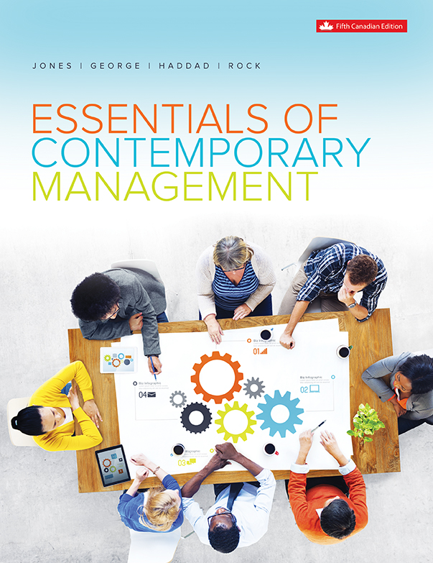
Chapter 1
Managing
and Management

Slide 2
Learning Outcomes
Describe what management is, what managers do, and how managers use resources to achieve organizational goals.
Distinguish among planning, organizing, leading, and controlling, and explain how managers’ abilities to handle each one affect organizational performance.
Differentiate among the types and levels of management, and understand the responsibilities of managers at different levels in the organizational hierarchy.
Understand how organizational culture affects managerial behaviour.
Distinguish among the kinds of managerial skills and roles that managers perform.

Slide 3
What is Management?
Organizations: People working together and coordinating their actions to achieve specific goals.
Management: The process of using organizational resources to achieve the organization’s goals by ...
I. PLANNING
III. LEADING
IV. CONTROLLING
II. ORGANIZING
Notes:
LO1 Describe what management is, what managers do, and how managers use the resources of their organizations effectively and efficiently to achieve organizational goals.
Management Key Concepts:
Organizations: Refer to large businesses such as GM as well as a local, small business known to students. Be sure to also mention non-profit, service groups such as a hospital.
Goals: Ask students what their personal goal might be. Business examples might be growth rates, profitability, customer service levels.
Planning, Organizing, Leading, and controlling
Focus on individual goals to drive the point home. All of us perform the 4 functions: ask students how these can help in goal attainment.

Slide 4
Henry Mintzberg OC OQ FRSC BA BEng SM PhD
internationally renowned academic and author on business and management. He is currently the Cleghorn Professor of Management Studies at the Desautels Faculty of Management, McGill University in Montreal, Quebec, where he has been teaching since 1968.
Professor Mitzberg talks about the concept of Communityship (9:40 min).
Describe how society is like a three-legged stool, according to Mintzberg. What does each leg represent?
How will the world be different in 10 years, according to Mintzberg?
What advice does he have for the future?
Notes:
LO1 Describe what management is, what managers do, and how managers use the resources of their organizations effectively and efficiently to achieve organizational goals.
Management Key Concepts:
Organizations: Refer to large businesses such as GM as well as a local, small business known to students. Be sure to also mention non-profit, service groups such as a hospital.
Goals: Ask students what their personal goal might be. Business examples might be growth rates, profitability, customer service levels.
Planning, Organizing, Leading, and controlling
Focus on individual goals to drive the point home. All of us perform the 4 functions: ask students how these can help in goal attainment.

Slide 5
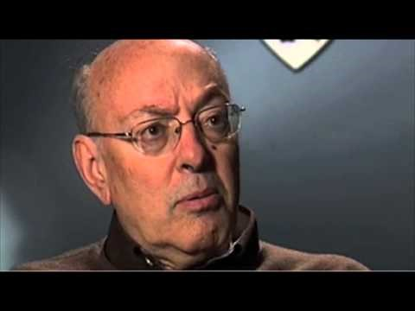
Henry Mintzberg OC OQ FRSC BA BEng SM PhD
14 Apr 2014
Notes:
LO1 Describe what management is, what managers do, and how managers use the resources of their organizations effectively and efficiently to achieve organizational goals.
Management Key Concepts:
Organizations: Refer to large businesses such as GM as well as a local, small business known to students. Be sure to also mention non-profit, service groups such as a hospital.
Goals: Ask students what their personal goal might be. Business examples might be growth rates, profitability, customer service levels.
Planning, Organizing, Leading, and controlling
Focus on individual goals to drive the point home. All of us perform the 4 functions: ask students how these can help in goal attainment.

Slide 6
What is Management?
Social Economy:
Organizations that have social objectives central to their mission and their practice, and either have explicit economic objectives or generate economic value thorough the services they provide or the purchases they undertake.
  Also referred to as the ‘third pillar’ of the economy, joining the for-profit organizations (FP) and the non-profit structures (NFP).
Notes:
LO1 Describe what management is, what managers do, and how managers use the resources of their organizations effectively and efficiently to achieve organizational goals.
Social enterprises, social ventures and social purpose businesses combine social and commercial missions to varying degrees and are collectively referred to as organizations in the social economy.
The concept of the social economy applies to all the organizations that have social objectives central to their mission and their practice, and either have explicit economic objectives or generate some economic value through the services they provide and purchases that they undertake.
The goal of social enterprise is to use market-mechanisms to produce or sell goods and services that provide a social or environmental benefit. Social enterprises often employ the clients they serve and thereby provide valuable experience to marginalized groups who can use the skills in the wider economy.

Slide 7
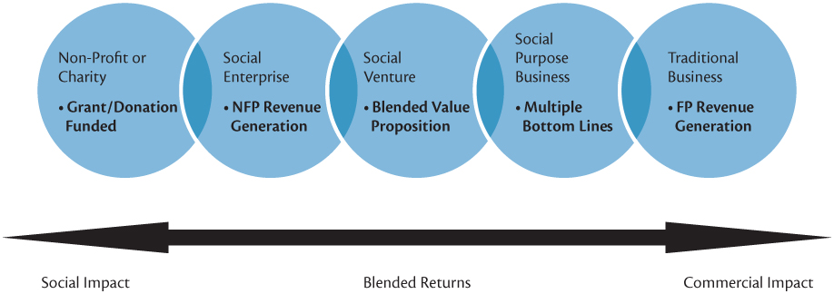
Spectrum of Types of Organizations
Notes:
LO1 Describe what management is, what managers do, and how managers use the resources of their organizations effectively and efficiently to achieve organizational goals.

Slide 8
What is Management?
Resources are organizational assets and include:
  people
  machinery
  raw materials
  information, skills
  financial capital
Managers are the people responsible for supervising the use of an organization’s resources to meet its goals.
Notes:
LO1 Describe what management is, what managers do, and how managers use the resources of their organizations effectively and efficiently to achieve organizational goals.
Students usually relate to machinery and people as common business resources, but be sure to stress raw materials, information, and capital.
Many firms today have information as their prime resource and this can be expected to grow in the future.
Managers have the exciting task of deciding how to use these resources to meet goals. Again, consider an individual and their use of scarce resources to achieve goals. Most students will relate to this.

Slide 9
Organizational Performance
Measures how efficiently and effectively managers use resources to satisfy customers and achieve goals.
  Efficiency: A measure of how well resources are used to achieve a goal.
  Effectiveness: A measure of the appropriateness of the goals the organization is pursuing, and the degree to which the organization achieves the goals.
Notes:
LO1 Describe what management is, what managers do, and how managers use the resources of their organizations effectively and efficiently to achieve organizational goals.
Managers need to do a good job in using scarce resources.
If a firm could only be efficient or effective, which should it be? The answer is, of course, effective.
› Example: if a firm may be the most efficient producer of slide rules, however, they are vulnerable to a very inefficient (but effective) calculator firm.
› Naturally, The efficient firm that is also effective is very strong (like the Japanese car producers in the 1980’s)

Slide 10
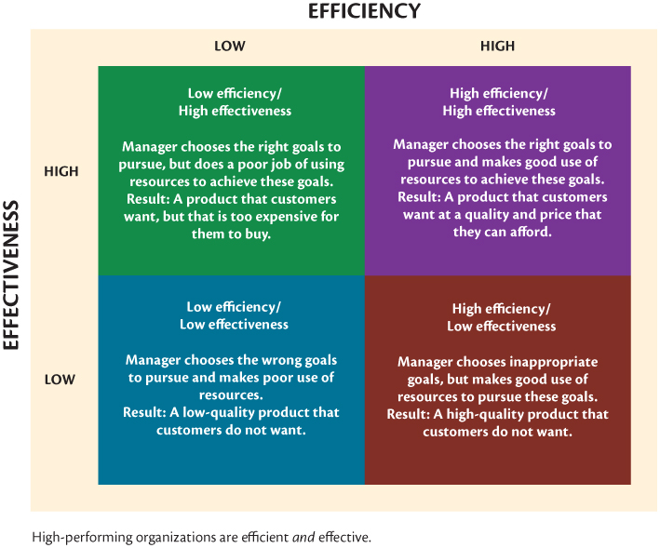
Organizational Performance
Notes:
LO1 Describe what management is, what managers do, and how managers use the resources of their organizations effectively and efficiently to achieve organizational goals.
Figure 1.2 Effectiveness, Efficiency and Performance in an Organization

Slide 11
Managerial Tasks and Functions
Henri Fayol described the four managerial functions when he was the CEO of a large mining company in the late 1800s.
Fayol noted the following management functions:
    planning
    organizing
    leading
    controlling
Notes:
LO2 Distinguish among planning, organizing, leading, and controlling, and explain how managers’ abilities to handle each one affect organizational performance.
Henri Fayol (1916)
› Fayol was a top-level manager, not a theorist. He paid special attention to the manager’s job and noticed all used the four functions. (planning, organizing, leading, controlling)
› Mention to students that ALL managers (and all people) use these four functions to differing degrees in their jobs and life itself.

Slide 12
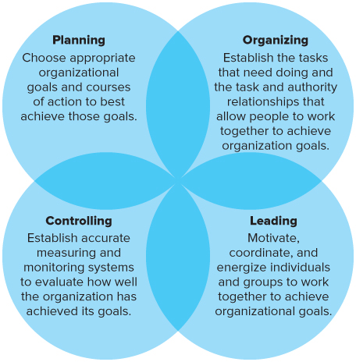
Four Functions of Management
Notes:
LO2 Distinguish among planning, organizing, leading, and controlling (the four principal managerial tasks or functions), and explain how managers’ ability to handle each one affects organizational performance.

Slide 13
Planning
5 Steps:
  Deciding which goals the organization will pursue
  Analyzing the organizational environment for threats and opportunities
  Deciding what courses of action or strategy to adopt
  Deciding how to allocate organizational resources to implement the plan.
  Evaluating whether the strategy achieved the goals.
The outcome of planning is strategy
Notes:
LO2 Distinguish among planning, organizing, leading, and controlling (the four principal managerial tasks or functions), and explain how managers’ ability to handle each one affects organizational performance.
Planning is the process used by managers to identify and select appropriate goals and courses of action for an organization.
Point out that effective prior planning is the essence of good management.
These steps should be followed in order:
Deciding which goals the organization will pursue,
Analyzing the organizational environment for threats and opportunities
Deciding what courses of action or strategy to adopt
Deciding how to allocate organizational resources to implement the plan.
Evaluating whether the strategy achieved the goals.
Good planning determines how effective and efficient the organization. It also helps managers determine the strategy of the organization.
› Focus these concepts at the student’s personal level. They must plan everything from choosing a major, selecting classes, and allocate study time between them.

Slide 14
Organizing
  Managers will group people into departments according to the tasks performed.
  Managers will lay out lines of authority and responsibility for members.
    The outcome of organizing is an organizational structure. This structure coordinates and motivates employees so that they work together to achieve goals.
Notes:
LO2 Distinguish among planning, organizing, leading, and controlling (the four principal managerial tasks or functions), and explain how managers’ ability to handle each one affects organizational performance.
Organizing: managers create the structure of working relationships between organizational member that best allows them to work together and achieve goals.
The key is to bring people together so that the goals can be achieved. This is a difficult task since managers must deal with people. Further, point out that this is always changing.
People are grouped into departments according to the tasks performed. Some examples include Marketing, Finance, Production, etc.
Managers will also layout lines of authority and responsibility for members. This depicts how workers report to managers through the firm and is called an organizational structure. This structure is the outcome of organizing.

Slide 15
Leading
  Leadership involves a manager using power, influence, vision, persuasion, and communication skills.
  The outcome of the leading function is motivation and commitment from employees to the organization.
  In leading, managers must:
    determine direction;
    state a clear vision for employees to follow; and
    help employees understand the role they play in attaining goals.
Notes:
LO2 Distinguish among planning, organizing, leading, and controlling (the four principal managerial tasks or functions), and explain how managers’ ability to handle each one affects organizational performance.
Leading is a critical function of management.
›Ask students to give examples of great leaders. Why were these leaders seen as leaders?
Managers must state a clear vision for employees to follow, and help employees in attaining goals.
Effective leadership involves using power, influence, vision, persuasion, and communication skills. Try to relate these concepts to the examples of leaders provided by students above. Good leadership is usually found in the high performing organization such as General Electric (Jack Welch), David Johnson of Campbell Soup.

Slide 16
Controlling
  Evaluate how well the organization is achieving its goals
  Take corrective action to improve performance
  Managers will:
    monitor individuals, departments, and the organization to determine if goals are being met; and
    take action to increase performance as required.
  The outcome of the controlling function is the accurate measurement of performance and regulation of efficiency and effectiveness.
Notes:
LO2 Distinguish among planning, organizing, leading, and controlling (the four principal managerial tasks or functions), and explain how managers’ ability to handle each one affects organizational performance.
In controlling, managers evaluate how well the organization is achieving its goals and takes corrective action to improve performance.
All organizations run into the unexpected, or errors can be made. Managers must be prepared to first identify that a problem exists and then correct it.
Managers monitor individuals, departments, and the organization to determine if desired performance has been reached.
The controlling function must accurately measure performance and then determine if it can be improved. This task is done at all levels of management.

Slide 17
Types and Levels of Managers
  First-line Managers:
    Responsible for day-to-day operations. Supervise the employees performing the activities required to make the good or service.
  Middle Managers:
    Supervise first-line managers . Responsible for finding the best way to use departmental resources to achieve goals.
  Top Managers:
    Responsible for the performance of all departments and have cross-departmental responsibility. Establish organizational goals and monitor middle managers.
Notes:
LO3 Differentiate among the types and levels of management, and understand the tasks and responsibilities of managers at different levels in the organizational hierarchy.
Who Runs the Organization?
Ask the students to provide examples of each level of manager as found in the College:
› First-line Managers: responsible for day-to-day operation. Example: Department Head or Chair.
› Middle Managers: Supervise first-line managers. Example: Dean
› Top Managers: Responsible for the performance of all departments and have cross-departmental responsibility. Example: President, Vice-President.

Slide 18
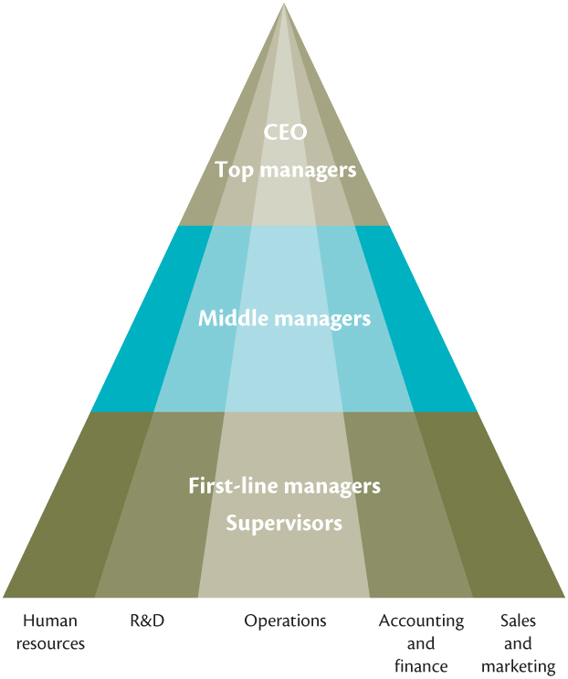
Management Hierarchy
Notes:
LO3 Differentiate among the types and levels of management, and understand the tasks and responsibilities of managers at different levels in the organizational hierarchy.

Slide 19
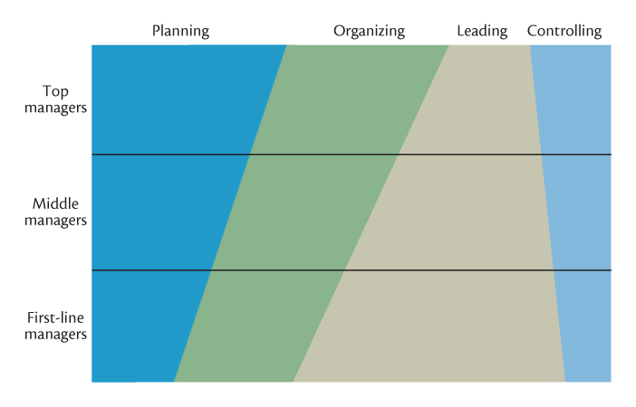
Time Spent on Managerial Functions
Notes:
LO3 Differentiate among the types and levels of management, and understand the tasks and responsibilities of managers at different levels in the organizational hierarchy.

Slide 20
Recent Changes in
Managerial Hierarchies
Restructuring
  Simplifying, shrinking, or downsizing an organization’s operations to lower operating costs as many companies do in times of recession and/or dramatic change that occur with mergers and acquisitions
  Downsizing – the elimination of jobs at different levels of management to improve efficiency.
    Can lead to low employee morale and customer complaints about service.
    Loss of institutional knowledge and experience.
Notes:
LO4 Discuss some major changes in management practices today that have occurred as a result of globalization and the use of advanced technology.
Restructuring—Right or Wrong?
Top Management has sought methods to restructure their organizations and save costs.
Downsizing: eliminate jobs at all levels of management to generate higher efficiency
Ask students if they know of someone that has lost their job as a result of downsizing.
What is the students’ opinion of this?
Notice that efficiency gains can be lost if downsizing results in low moral and customer complaints about service.

Slide 21
The Impact of Values and Attitudes on Managerial Behaviour and Organizational Culture
Values, attitudes, and moods and emotions capture how managers experience their jobs as individuals.
  Values describe what managers are trying to achieve through work and how they think they should behave.
  Attitudes capture their thoughts and feelings about their specific jobs and organizations.
  Moods and emotions encompass how managers actually feel when they are managing.
Notes:
LO4 Understand how organizational culture affects managerial behaviour.

Slide 22
Values: Terminal and Instrumental
The two kinds of personal values:
  Terminal value is a personal conviction about lifelong goals or objectives
  Instrumental value is a personal conviction about desired modes of conduct or ways of behaving.
Terminal values often lead to the formation of norms
Notes:
LO4 Understand how organizational culture affects managerial behaviour.

Slide 23
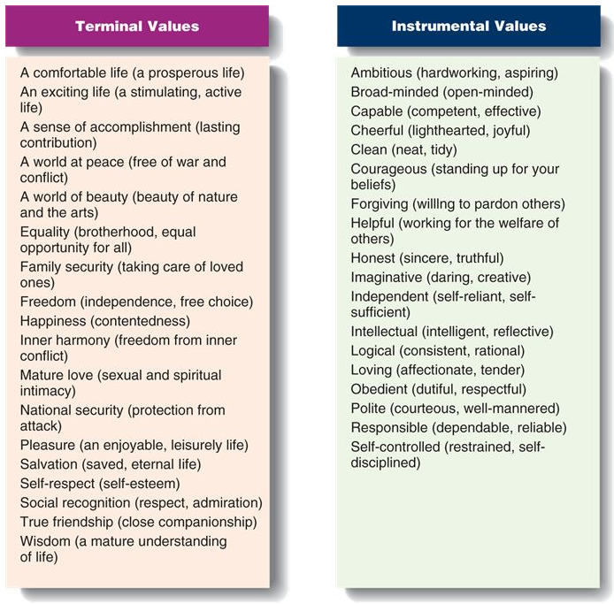
Terminal Values
Notes:
LO4 Understand how organizational culture affects managerial behaviour.

Slide 24
Instrumental Values
Notes:
LO4 Understand how organizational culture affects managerial behaviour.

Slide 25
Attitudes
Two of the most important attitudes in this context are job satisfaction and organizational commitment.
Job Satisfaction - The collection of feelings and beliefs
that managers have about their current jobs
Organizational Citizenship Behaviours - not required of organizational members but contribute to and are
necessary for organizational efficiency, effectiveness, and
competitive advantage.
Notes:
LO4 Understand how organizational culture affects managerial behaviour.

Slide 26
Moods and Emotions
A mood is a feeling or state of mind. When people are in a positive mood, they feel excited, enthusiastic, active, or elated.
Emotions are more intense feelings than moods, are often
directly linked to whatever caused the emotion, and are more
short-lived.
Emotional intelligence is the ability to understand and
manage one’s own moods and emotions and the moods and
emotions of other people.
Notes:
LO4 Understand how organizational culture affects managerial behaviour.

Slide 27
Organizational Culture
Organizational Culture - Reflects the distinctive ways in which organizational members perform their jobs and relate to others inside and outside the organization
  Attraction-selection-attrition (ASA) framework
Shared terminal and instrumental values play an important role in organizational culture.
  Terminal values signify what an organization and its employees are trying to accomplish.
  Instrumental values guide how the organization and its members achieve organizational goals.
Notes:
LO4 Understand how organizational culture affects managerial behaviour.

Slide 28
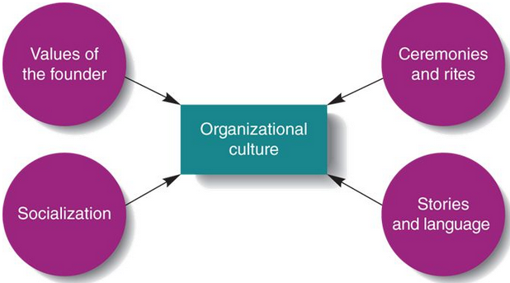
Factors that Maintain and
Transmit Organizational Culture
Notes:
LO4 Understand how organizational culture affects managerial behaviour.

Slide 29
Organizational Culture
Organizational Socialization
  Process by which newcomers learn an organization’s values and norms and acquire the work behaviours necessary to perform jobs effectively.
Ceremonies and rites
Stories and language
Material symbols
Culture and managerial action
Notes:
LO4 Understand how organizational culture affects managerial behaviour.

Slide 30
Ceremonies and Rites
Type of Rite | Example of Rite | Purpose of Rite
Rite of passage | Induction and basic training | Learn and internalize norms and values
Rite of integration | Office holiday party | Build common norms and values
Rite of enhancement | Presentation of annual award | Motivate commitment to norms and values
Notes:
LO4 Understand how organizational culture affects managerial behaviour.

Slide 31
Managerial Skills and Roles
There are three skill sets that managers need to perform effectively:
    1. Conceptual skills
    2. Interpersonal skills
    3. Technical skills
These skills are enhanced through formal education, training, and practice.
Notes:
LO5 Distinguish among the kinds of managerial skills and the roles that managers perform.
It is hard to find out the real problem in a situation. Managers must ask many questions and listen carefully to determine problems. Ironically, it is often lower-level managers that can best see the problem but they often have no ability to fix it.
A good manager is usually a “people-person”; that is, someone who likes to work with others.
Most managers begin their career in a given area. Students major in these areas and will branch-out based on skills and experience.
Negotiator role: negotiate solutions between other managers, unions, customers, or shareholders.

Slide 32
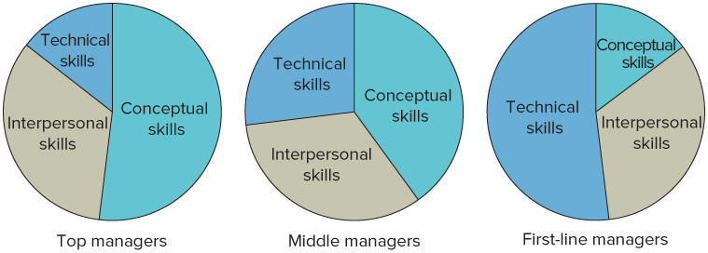
Managerial Skills and Roles
Notes:
LO5 Distinguish among the kinds of managerial skills and the roles that managers perform.

Slide 33
Managerial Skills and Roles
Described by Mintzberg (early 1970s)
  A role is a set of specific tasks a person performs because of the position they hold.
Roles are directed inside as well as outside the organization.
Mintzberg grouped the roles into 3 broad categories:
    Interpersonal
    Informational
    Decisional
Notes:
LO5 Distinguish among the kinds of managerial skills and the roles that managers perform.
Described by McGill University professor Henry Mintzberg.
A role is a set of specific tasks a person performs because of the position they hold.
Students perform roles in many college positions—ask for examples for each of the 3 role categories
Interpersonal Roles: Roles managers assume to coordinate and interact with employees and provide direction to the organization.

Slide 34
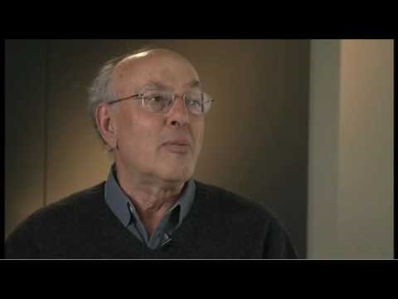
Managerial Skills and Roles
17 Sep 2009
Notes:
LO5 Distinguish among the kinds of managerial skills and the roles that managers perform.
Described by McGill University professor Henry Mintzberg.
A role is a set of specific tasks a person performs because of the position they hold.
Students perform roles in many college positions—ask for examples for each of the 3 role categories
Interpersonal Roles: Roles managers assume to coordinate and interact with employees and provide direction to the organization.

Slide 35
Summary and Review
Learning Objective 1: WHAT IS MANAGEMENT?
A manager is responsible for supervising the use of resources to meet goals.
An organization is a group of people working together to achieve goals.
Management is the process of using organizational resources to achieve organizational goals effectively and efficiently through planning, organizing, leading, and controlling.

Slide 36
Summary and Review
Learning Objective 2: MANAGERIAL Tasks
  The four main functions are planning, organizing, leading, and controlling.
  Managers at all levels of the organization and in all departments perform these functions in varying degrees.
  Effective management means managing these activities successfully.

Slide 37
Summary and Review
LEARNING OBJECTIVE 3: TYPES and Levels OF MANAGERS
  Managers are characterized by level and function.
  Functions typically include marketing, operations, human resources, accounting and finance, and research and development.
  Organizations typically have three levels of management: First-line managers, Middle managers, and Top managers.

Slide 38
Summary and Review
LEARNING OBJECTIVE 4: MANAGERIAL VALUES, ATTITUDES AND ORGANIZATIONAL CULTURE
  The values, attitudes, moods and emotions of managers affect the organizational culture- which shapes how managers plan, organize, lead and control organizational resources to achieve goals.
  Organizational socialization - newcomers learn an organization`s values and norms and acquire the work behaviours necessary to perform jobs effectively.

Slide 39
Summary and Review
LEARNING OBJECTIVE 5: MANAGERIAL SKILLS AND ROLES
  Three types of skills help managers perform their roles effectively: conceptual, human, and technical skills.
  Mintzberg: Managers play 10 specific roles in their daily activities: figurehead, leader, liaison, monitor, disseminator, spokesperson, entrepreneur, disturbance handler, resource allocator, and negotiator.

