Slide 1
Comm 215: Business Statistics
Midterm Review

Slide 2
Midterm Outline
20 to 25 multiple choice questions
  10 easy, 10 medium, 5 hard
  Data mining is about 5 question but either on midterm or final
4 to 5 problems
  One on descriptive statistics (stem leaf, box and whiskers, Pareto)
  One on probability (probability chart)
  One on probability and binomial distributions
  One on z-scores (may include binomial distributions)

Slide 3
Descriptive Statistics

Slide 4
Definitions
Statistics: the science that deals with the collection, classification, analysis, and interpretation of numerical facts or data, and that, by use of mathematical theories of probability, imposes order and regularity on aggregates of more or less disparate elements.
Two types of statistics
  Descriptive Statistics: the science of describing the important aspects of a set of measurements
  Inferential Statistics: the science of using samples to make assumptions about the population

Slide 5
Definitions
Population: the set of all elements about which we wish to draw conclusions.
Sample: a subset of the elements of a population
Statistical Interference: the science of using a sample of measurements to make generalizations about the important aspects of a population of measurements.

Slide 6
Definitions
Random sample: when every element of a population has the same chance of being in the sample
Sample with replacement: once we pick an element from the population, we put it back before picking again
Sample without replacement: once an element is picked it can not be picked again

Slide 7
Definitions: Type of sampling
Probability sampling: select randomly, based on probability
  1)Simple random ( randomly selecting from a population)
  2) Stratified (dividing the population into subgroups, randomly selecting parts of each group)
  3) Cluster (similar to stratified, divide population, then divide the subgroups again)
  4) Systemic (Picking every nth element)
Convenience sampling: select elements based on convenience, they were easy to pick
Voluntary response sampling: only selecting people who want to be selected
Judgement Sampling: when someone selects a sample based on his or her own judgement
***Only probability sampling may be used to make statistical inferences

Slide 8
Definitions: Ethical Issues
1) Improper sampling: purposely selecting a biased sample, selecting a specific sample in order to get a desired response
2) Misleading charts, graphs and descriptive measures: manipulating graphs or data to minimize or maximize any part of the gathered information
3) Inappropriate statistical analysis or inappropriate interpretation of statistical results : continuing to sample a population until a selected sample has the desired characteristics

Slide 9
Definitions: types of quantitative variables
Quantitative: represents quantities
Ratio variable: a quantitative variable measured on a scale such that the ratios of its values are meaningful and there is an inherently defined zero value
Interval variable: a quantitative variable where ratios of its value are not meaningful and there is not an inherently defined zero.
Simplified definitions
Ratio variable: the values are mathematically comparable value A is 2 times smaller than value B and 0 is a value with no meaning, weighting 0 pounds means there is no weight
Interval Variable: the values are not mathematically comparable and 0 is a value with meaning. Think of temperature: 60 degrees F is not twice as hot as 30 degrees F and 0 degrees does not mean there no temperature

Slide 10
Definitions
Response rate: the proportion of all people whom we attempted to contact to those that actually responded to a survey.
Target population: the entire population of interest to us in a particular study.
Sample frame: a list of sampling elements from which the sample will be selected.
Sampling error: the difference between a numerical descriptor of the population and the corresponding descriptor of the sample.
Undercoverage: when some population elements are excluded from the process selecting the sample.
Nonresponse: whenever some of the individuals who were supposed to be included in the sample are not.

Slide 11
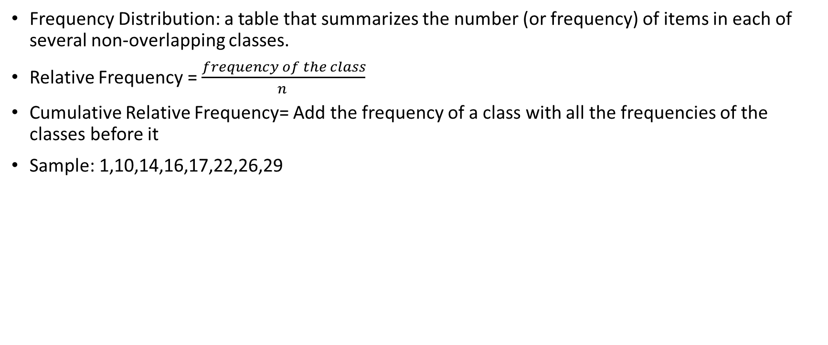
Frequency Distributions
Frequency Distribution: a table that summarizes the number (or frequency) of items in each of several non-overlapping classes.
Relative Frequency = $\frac{frequency of the class}{n }$
Cumulative Relative Frequency= Add the frequency of a class with all the frequencies of the classes before it
Sample: 1,10,14,16,17,22,26,29
Classes | Frequency | Relative Frequency | Cumulative Relative Frequency
[0-11[ | 2 | 2/8 = .25 | .25
[11-21[ | 3 | 3/8 = .375 | .25+.375 = .675
[21-31[ | 3 | 3/8 = .375 | .675+.375= 1
Total | 8 | 1

Slide 12

Making classes
Step 1: Find the number of classes using $2^{K}>N,$K being the number of classes (start at K=1, and go up until $2^{K}>N$)
Step 2: Find the class length using $\frac{largest value −smallest value }{number of classes }$
Step 3: Using the numbers found in step 1 & 2 make the classes
Step 4: Count the numbers of elements in each frequency

Slide 13
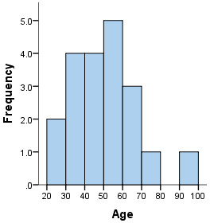
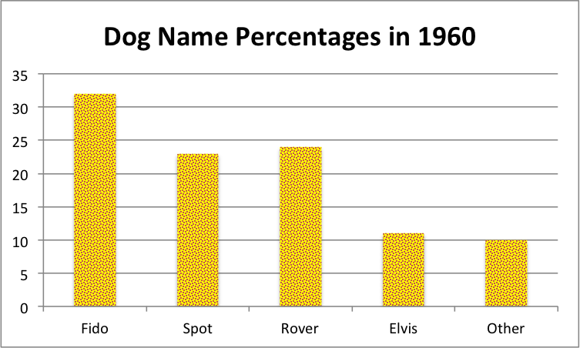
Histogram and Bar chart
Histogram: the bars touch each other and it is used for quantitative values. (Percentage, frequency, salaries)
Bar chart: the bars not touch and it is used for qualitative values. (eye color)

Slide 14
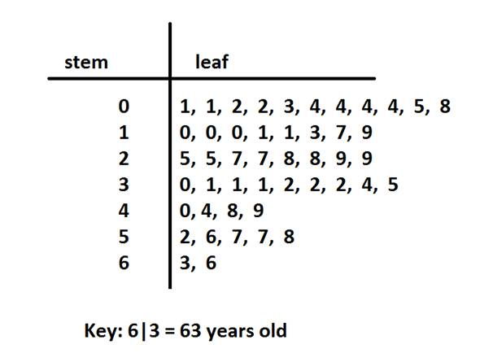
Stem and Leaf graph (example on slide 29)
Place all numbers in order
Choose a stem unit, if one is not given
Find the leaf unit, leaf unit = stem unit divided by 10
  The leaf unit is equal to stem unit x10
Remember a leaf unit can only be one integer
Build the graph

Slide 15
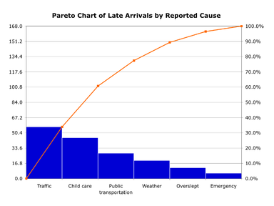
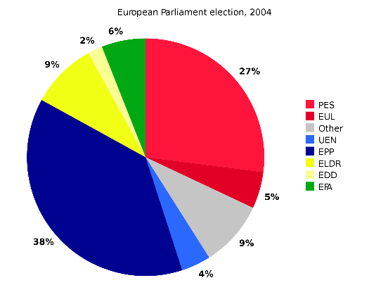
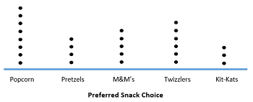
Other types of Charts
Pareto chart
  A histogram or bar chart with a line showing cumulative frequency drawn over it
Pie Chart
  A circle with a slice colored for each classes or type of value with the size of the slice depending on the frequency of the class or value
Dot Plot
  Draw a straight line
  Write all the possible values in order on that line
  Place 1 dot above each value of every time it appears in the sample

Slide 16


Describing Central Tendency
Mean, median, mode
All three are used to determine the distribution of a population or sample
Mean(µ for a population, Xbar for a sample)
  Mean is the average
Median
  Median is the middle number or 50th percentile
Mode
  Mode is the most frequent number
$$μ=\frac{x}{N}$$
$$\overline{x}=\frac{x}{n}$$

Slide 17
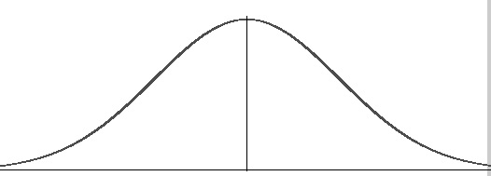
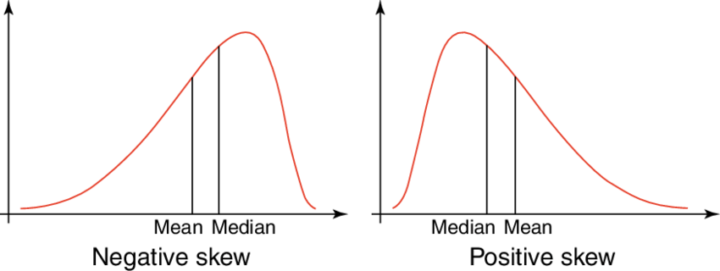
Types of distributions
Normal/Bell Shaped/Symmetric
  when the mean, median and mode are all equal
  Most common type for this class
Skewed to the left(Mean<median) Skewed to the right right (Mean>median)
Mean
Median
Mode
The words left and right indicate where the tail is. (tail is the skinny part)

Slide 18
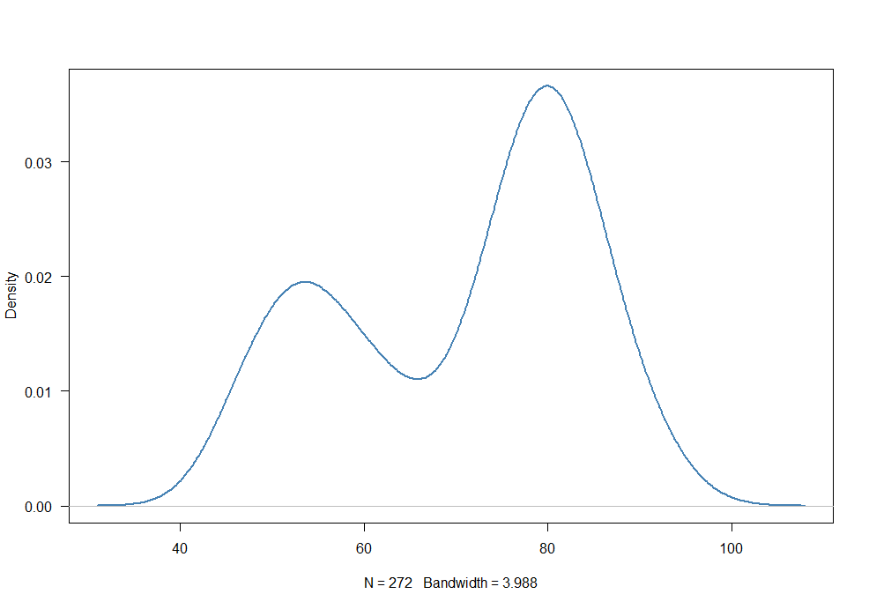
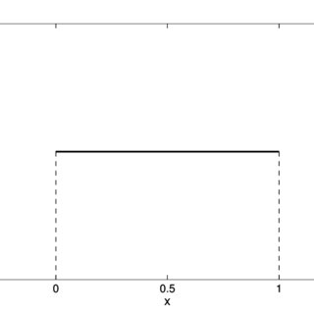
Other less common types of Distribution
Binomial
Uniform

Slide 19


Standard deviation and variance
Standard deviation is the average of all distances from the mean and the individual values of a population or sample
StD of a population StD of a sample
$$σ=\sqrt{\frac{\sum_{i=0}^{n}{{(x−μ)}^{2}}}{N}}$$
S $=\sqrt{\frac{\sum_{i=0}^{n}{{(x−X(par))}^{2}}}{n−1}}$
.5
1
1
2.5
Variance is the same formula as standard deviation but without the square root

Slide 20
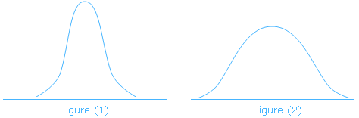

Coefficient of Variation
Coefficient of variation indicates how much a population varies in percentage, which allows us to compare one population to another
Coefficient of variation = $\frac{standard deviation }{mean}x100$
A lower coefficient of variation means that most of the values are closer to the mean, which is normally considered better
The higher CV is the wider the distribution will be

Slide 21
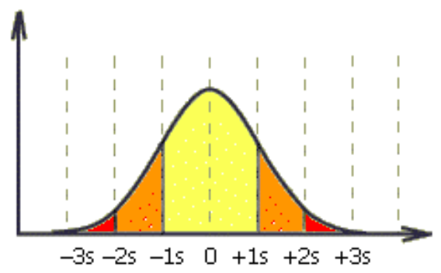
Empirical rule
Only useful for Normal/Bell Shaped/Symmetric
µ-3Ó
µ-2Ó
µ-Ó
µ
µ+Ó
µ+2Ó
µ+3Ó
68.26%
95.44%
99.73%

Slide 22
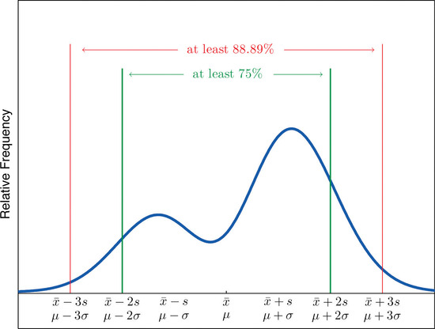
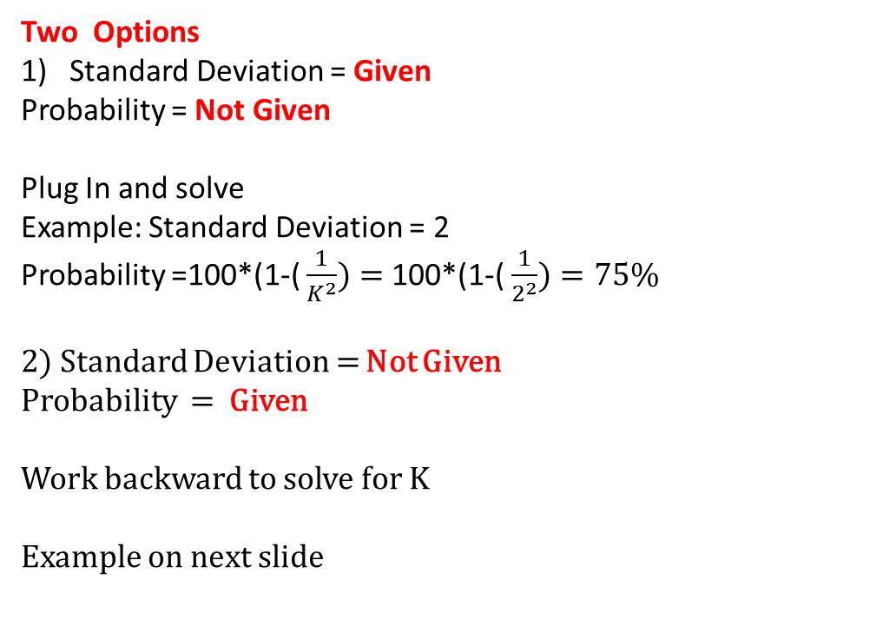
Chebyshev’s rule (for very skewed or non-normal distribution)
The formula, Percentage= 100*(1-(1/K^2))
K is the number of standard deviations
Two Options
Standard Deviation = Given
Probability = Not Given
Plug In and solve
Example: Standard Deviation = 2
Probability =100*(1-( $\frac{1}{K^{2}})=$100*(1-( $\frac{1}{2^{2}})=75\%$
2) Standard Deviation = Not Given
Probability = Given
Work backward to solve for K
Example on next slide

Slide 23
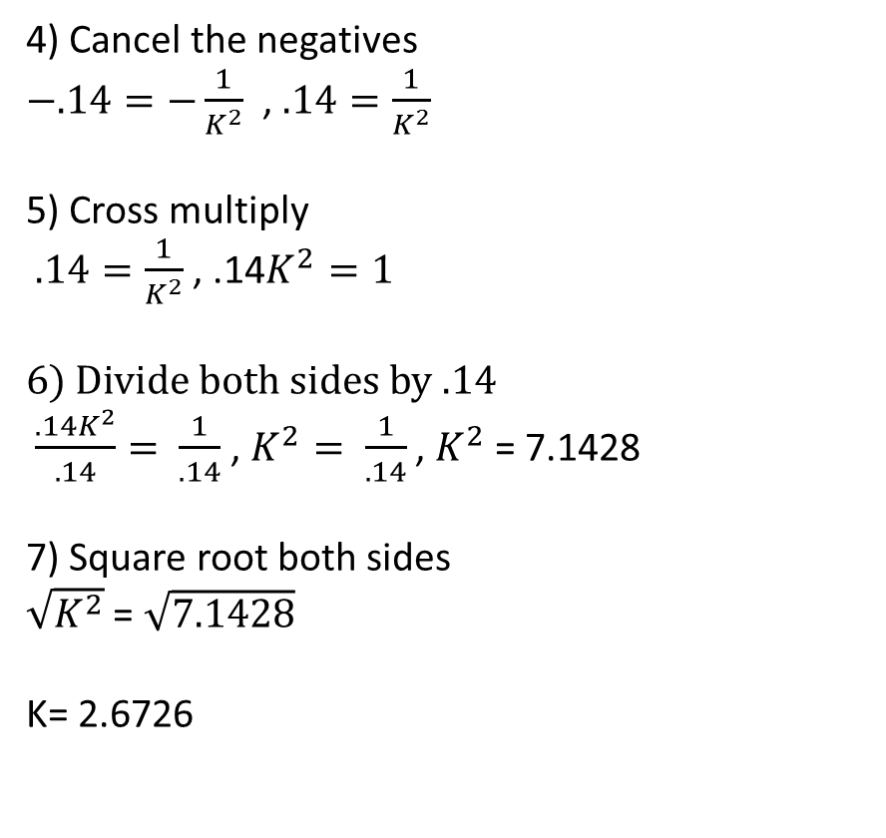

Chebyshev’s Rule Solve for K
Probability = 86%
Standard Deviation = Not Given
Probability =100*(1-( $\frac{1}{K^{2}})$
Plug in the probability
86 = 100*(1-( $\frac{1}{K^{2}})$
2) Divide both sides by 100
$\frac{86}{100}=\frac{100∗(1−(\frac{1}{K^{2}})}{100}$ , .86 = (1-( $\frac{1}{K^{2}})$
3) Bring over the 1
.86 – 1 = $\frac{1}{K^{2}} , −.14=−\frac{1}{K^{2}}$
4) Cancel the negatives
$−.14=−\frac{1}{K^{2}}$ , $.14=\frac{1}{K^{2}}$
5) Cross multiply
$.14=\frac{1}{K^{2}}$ , .14$K^{2}=1$
6) Divide both sides by .14
$\frac{.14K^{2}}{.14}= \frac{1}{.14}$ , $K^{2}= \frac{1}{.14}$ , $K^{2}$ = 7.1428
7) Square root both sides
$\sqrt{K^{2}}$ = $\sqrt{7.1428}$
K= 2.6726

Slide 24
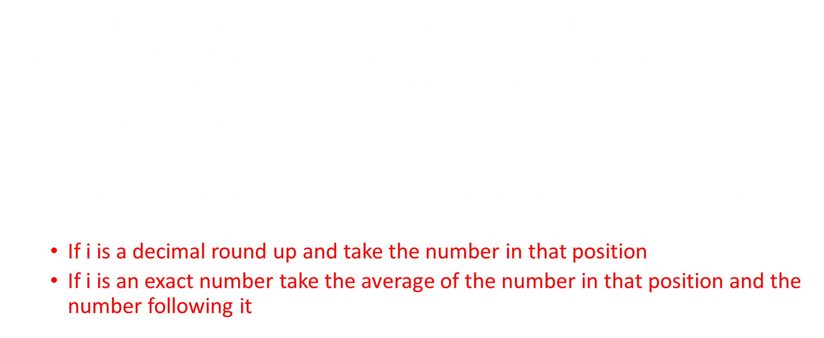
Percentile
Once all the numbers are placed in increasing order, the percentile formula will find the number that is at the border of being equal to or less than any given percentage of the rest of the population or sample
Percentile formula
  i=$\left(\frac{percentile }{100}\right)n$
  I is not the value, it is the position of the number that represents that given percentile
  If i is a decimal round up and take the number in that position
  If i is an exact number take the average of the number in that position and the number following it

Slide 25
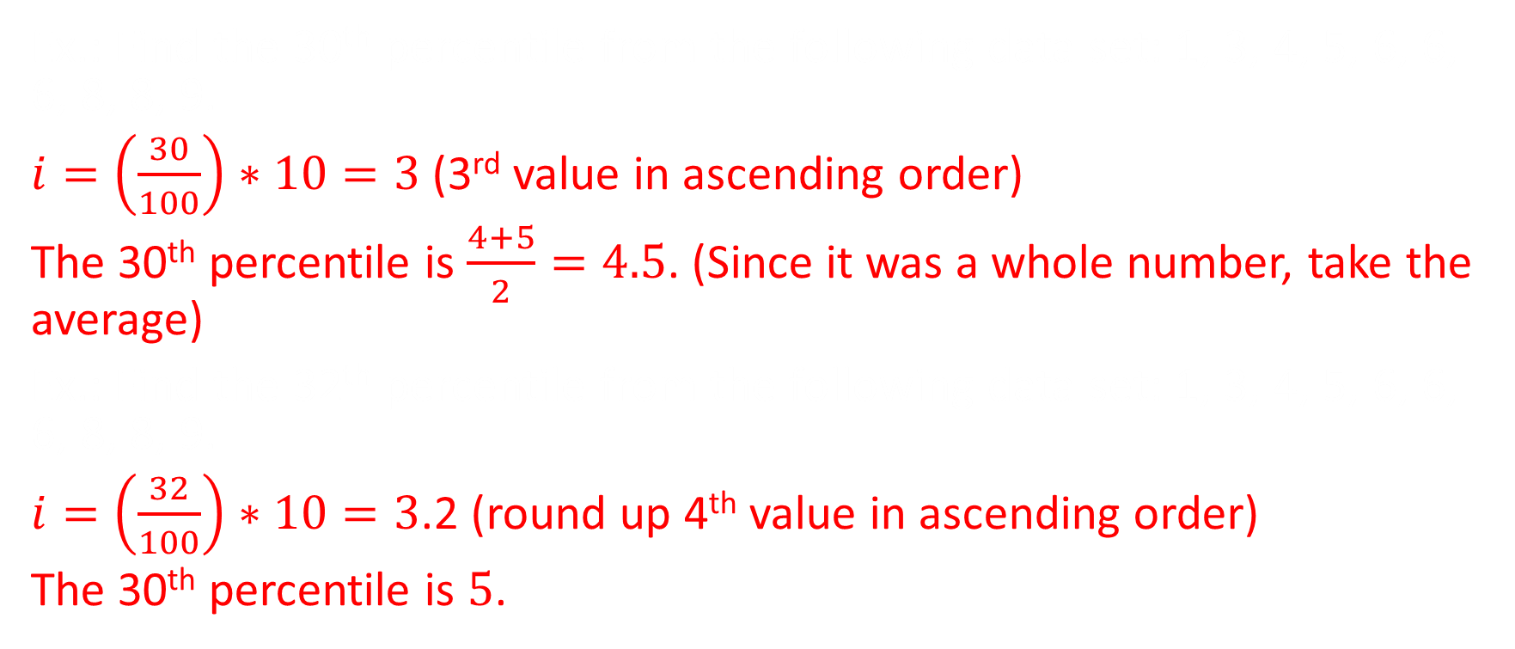
Percentile examples
Ex.: Find the 30th percentile from the following data set: 1, 3, 4, 5, 6, 6, 6, 8, 8, 9.
$i=\left(\frac{30}{100}\right)∗10=3$ (3rd value in ascending order)
The 30th percentile is $\frac{4+5}{2}=4.5$. (Since it was a whole number, take the average)
Ex.: Find the 32th percentile from the following data set: 1, 3, 4, 5, 6, 6, 6, 8, 8, 9.
$i=\left(\frac{32}{100}\right)∗10=3$.2 (round up 4th value in ascending order)
The 30th percentile is $5$.

Slide 26
5 Number Summary or box plot
The Median (50th percentile)
The first Quartile (25th percentile)
The Third Quartile (75th percentile)
The smallest number in the dataset
The largest number in the dataset

Slide 27
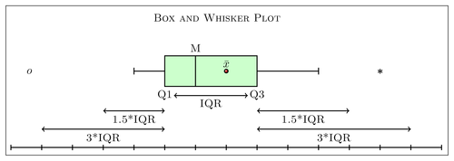
Box and whiskers
Find the median or 50th percentile
Find the First Quarter/25th percentile and the third Quarter/75th percentile
Find the Interquartile Range IQR= Q3-Q1
Find the fences
  Lower fence = Q1 – (1.5 x IQR)
  Upper Fence = Q3 + (1.5 x IQR)
Draw the Box and Whiskers
  The whiskers should extend until the fences if there are outliers or to the largest and smallest value if there is none

Slide 28
Stem and Leaf Example
A researcher has obtained the number of hours worked per week during the summer for a sample of twelve students. The results are shown below: 40 25 35 30 22 43 35 24 38 10 8 15
a. Construct a stem-and-leaf display for the number of hours worked per week.
b. Provide the five numbers required in order to draw the boxplot.
c. Compute the mean and standard deviation of the distribution.
d. Determine the 40th percentile of the data set.

Slide 29
A) Construct a stem-and-leaf display for the number of hours worked per week.
40 25 35 30 22 43 35 24 38 10 8 15
Step 1: Place elements in ascending order
8,10,15,22,24,25,30,35,35,38,40,43
Step 2: Pick a Leaf or Stem unit
Stem unit = 10 | Leaf unit = 1
0 | 8
1 | 0 5
2 | 2 4 5
3 | 0 5 5 8
4 | 0 3

Slide 30

B) Provide the five numbers required in order to draw the boxplot.
8,10,15,22,24,25,30,35,35,38,40,43
Boxplot is the same as a 5 number summary
  1-First quartile (25th percentile)
    $i=\left(\frac{Percentile}{100}\right)n=\left(\frac{25}{100}\right)12=3$
    3 is a whole number, take the average of the 3rd and 4th value
    25th percentile is equal to $\frac{15+22}{2}=18.5$
  2-Second quartile (50th percentile)
    $i=\left(\frac{Percentile}{100}\right)n=\left(\frac{50}{100}\right)12=6$
    6 is a whole number, take the average of the 6th and 7th value
    50th percentile is equal to $\frac{25+30}{2}=27.5$
  3-Third quartile (75th percentile)
    $i=\left(\frac{Percentile}{100}\right)n=\left(\frac{75}{100}\right)12=9$
    9 is a whole number, take the average of the 9th and 10th value
    75th percentile is equal to $\frac{35+38}{2}=36.5$
  4- largest value = 43
  5-smallest value = 8

Slide 31

C) Compute the mean and standard deviation of the distribution.
X | (x-xbar)^2 | result
8 | (8-27.0833)^2 | 364.1723
10 | (10-27.0833)^2 | 291.8391
15 | (15-27.0833)^2 | 146.0061
22 | (22-27.0833)^2 | 25.8399
24 | (24-27.0833)^2 | 9.5067
25 | (25-27.0833)^2 | 4.3401
30 | (30-27.0833)^2 | 8.5071
35 | (35-27.0833)^2 | 62.6741
35 | (35-27.0833)^2 | 62.6741
38 | (38-27.0833)^2 | 119.1743
40 | (40-27.0833)^2 | 166.8411
43 | (43-27.0833)^2 | 253.3413
Mean $\overline{x}=\frac{x}{n}$
  8,10,15,22,24,25,30,35,35,38,40,43
  $\frac{8+10+15+22+24+25+30+35+35+38+40+43}{12}$
  Mean = 27.0833
Standard Deviation S $=\sqrt{\frac{\sum_{i=0}^{n}{{(x−X(par))}^{2}}}{n−1}}$
$\sqrt{\frac{1514.2494}{12−1}}=11.7328$
Sum= 1514.2494

Slide 32
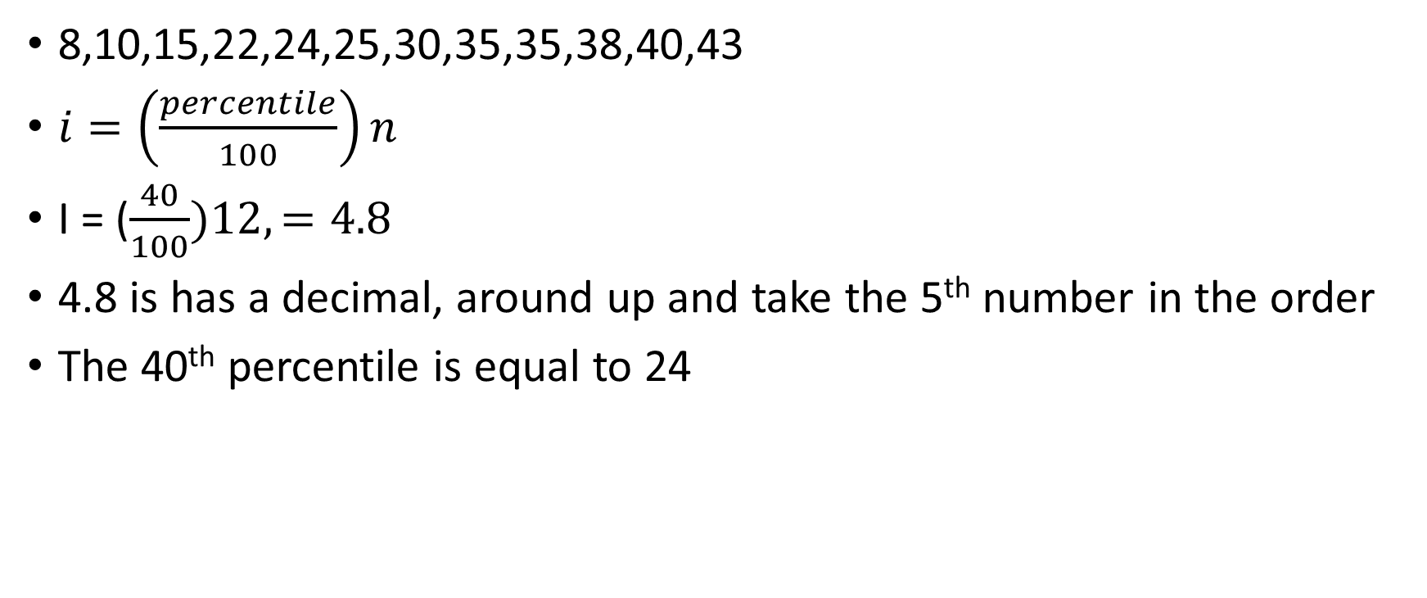
D) Determine the 40th percentile of the data set.
8,10,15,22,24,25,30,35,35,38,40,43
$i=\left(\frac{percentile}{100}\right)n$
I = ($\frac{40}{100})12,=4.8$
4.8 is has a decimal, around up and take the 5th number in the order
The 40th percentile is equal to 24

Slide 33
Probability

Slide 34
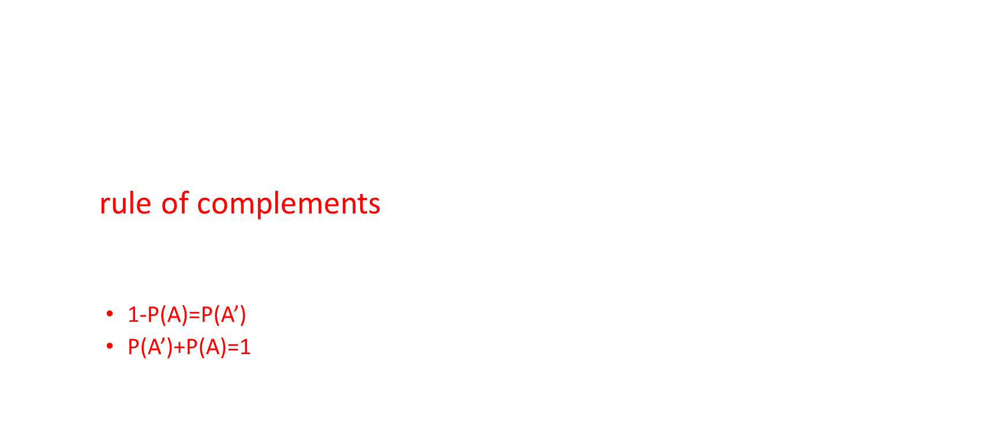
Probability
Probability: the chance or percentage of an outcome occurring
Probability of any event =P(A)=$\frac{all desired outcomes }{all possible outcomes}$
  Probability of flipping head $\frac{desired outcome H}{possible outcomes H+T}=\frac{1}{2}=.50$
The rule of complements
  The complement is the probability of what you do not want P(A’)
  If all probability equals one
    1-P(A)=P(A’)
    P(A’)+P(A)=1

Slide 35
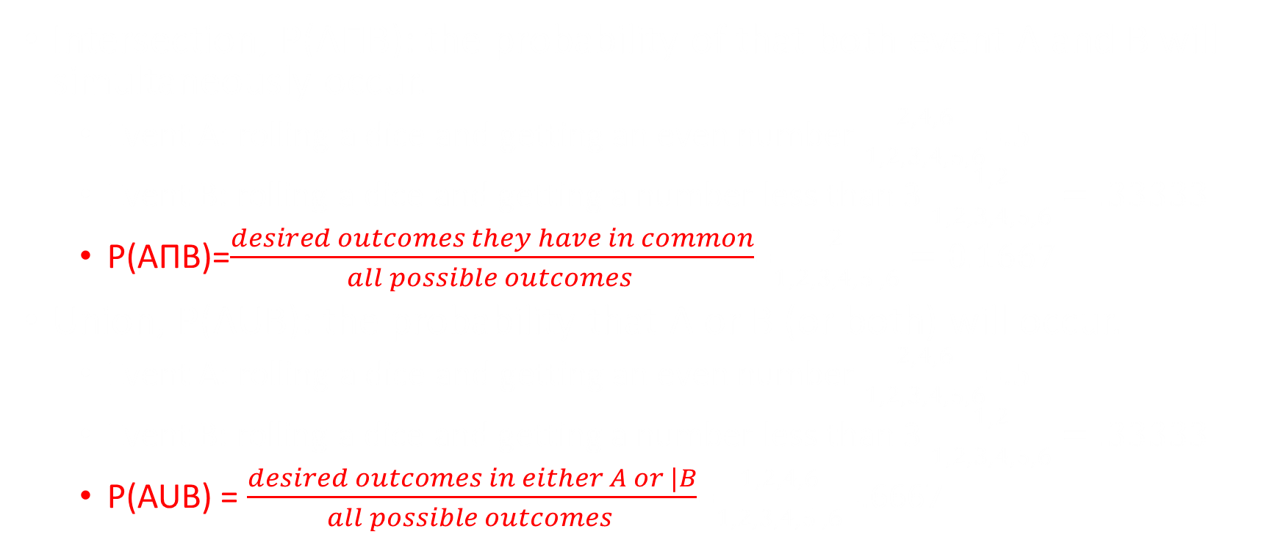
Intersection and union
Intersection, P(AΠB): the probability of that both event A and B will simultaneously occur.
  Event A: rolling a dice and getting an even number $\frac{2,4,6}{1,2,3,4,5,6}$=.5
  Event B: rolling a dice and getting a number less than 3 $\frac{1,2}{1,2,3,4,5,6}=.33333$
  P(AΠB)=$\frac{desired outcomes they have in common}{all possible outcomes }$=$\frac{2}{1,2,3,4,5.,6}=0.1667$
Union, P(AUB): the probability that A or B (or both) will occur.
  Event A: rolling a dice and getting an even number $\frac{2,4,6}{1,2,3,4,5,6}$=.5
  Event B: rolling a dice and getting a number less than 3 $\frac{1,2}{1,2,3,4,5,6}=.33333$
  P(AUB) = $\frac{desired outcomes in either A or |B}{all possible outcomes }$=$\frac{1,2,4,6}{1,2,3,4,5.,6}$=.6667

Slide 36
Theoretical example
From this slide on the following population will be referenced
1= Female, 12, likes bacon
2= Female, 25, likes bacon
3= Female, 42, likes bacon
4= Female, 58, likes bacon
5= Male, 11, likes bacon
6 = Male, 15, likes bacon
7 = Male, 27, dislikes bacon
8 = Male, 32, dislikes bacon
9 = Male, 49, dislikes bacon
10= Male, 51, dislikes bacon

Slide 37
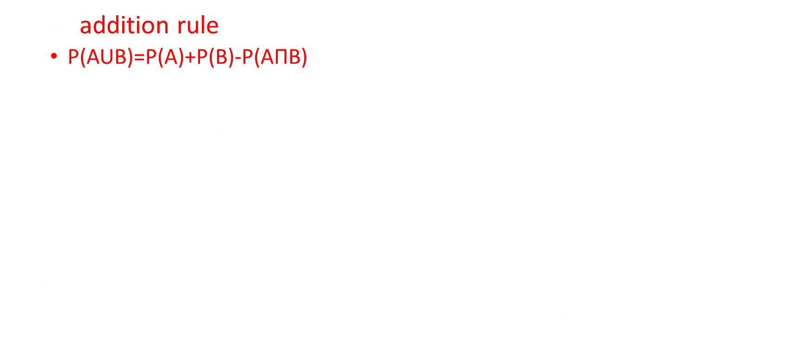
The addition rule
The addition rule
  P(AUB)=P(A)+P(B)-P(AΠB)
Example
  P(A)= someone liking bacon $\frac{6}{10}$=.6
  P(B)=someone being over 40 $\frac{4}{10}$=.4
  P(AΠB)=someone being over 40 and liking bacon $\frac{2}{10}= .2$
  P(AUB)=someone liking bacon or being over bacon = .6+.4-.2 = .8
If we did not subtract the people over 40 and liking bacon we would be double, person 3 and 4, since they counted in both event A and B

Slide 38
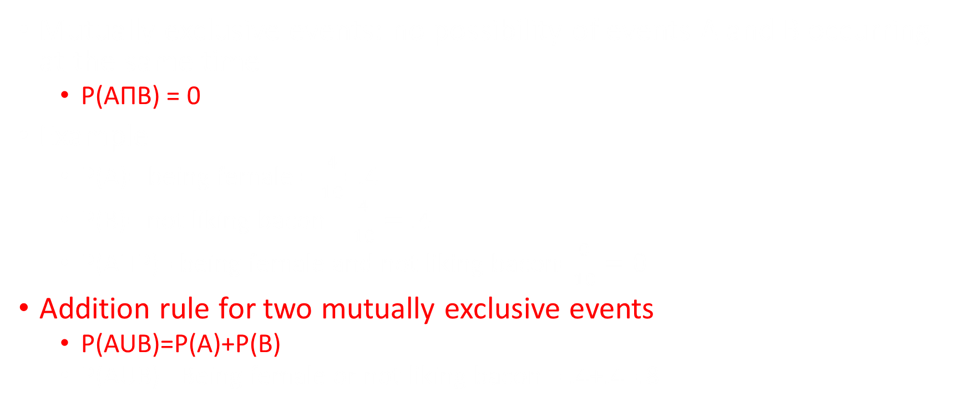
Mutually exclusive events
Mutually exclusive events: no possibility of events A and B occurring at the same time
  P(AΠB) = 0
Example
  P(A)= being female = $\frac{4}{10}$=.4
  P(B)= not liking bacon = $\frac{4}{10}=.4$
  P(AΠP)= being female and not liking bacon=$\frac{0}{10}=0$
Addition rule for two mutually exclusive events
  P(AUB)=P(A)+P(B)
  P(AUB)= Being female or not liking bacon = .4+.4=.8

Slide 39
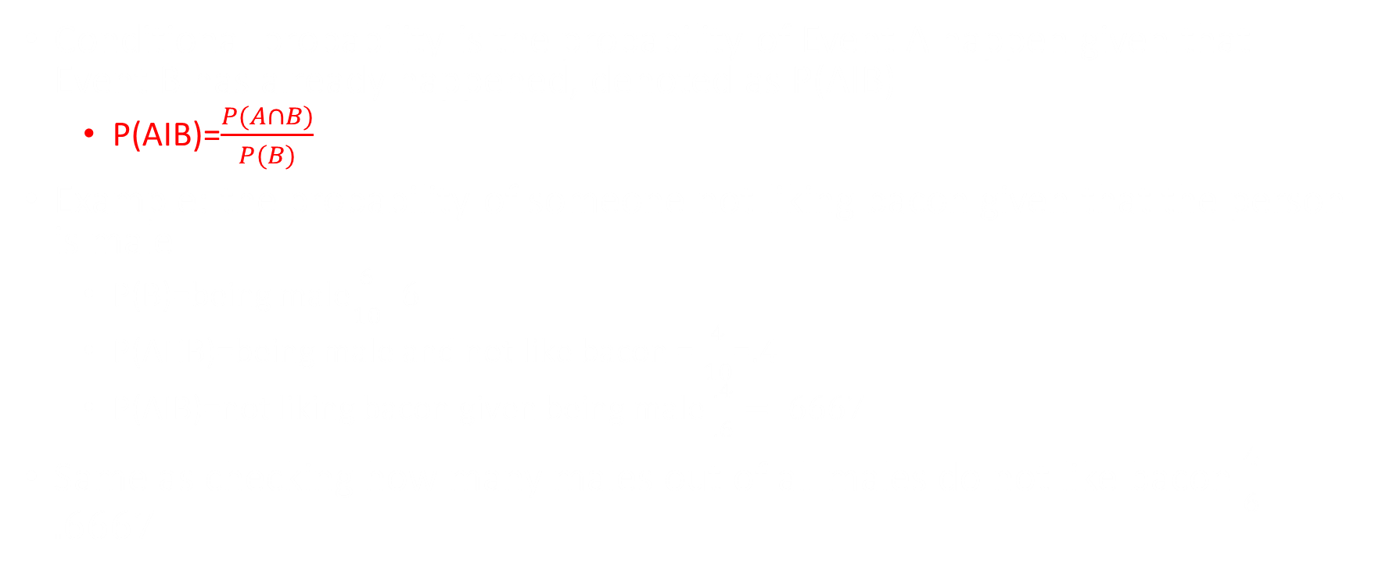
Conditional Probability
Conditional probability is the probability of Event A happen given that Event B has already happened, denoted as P(AIB)
  P(AIB)=$\frac{P(A∩B)}{P(B)}$
Example: the probability of someone not liking bacon given that the person is male
  P(B)=being male$\frac{6}{10}.6$
  P(AΠB)=being male and not like bacon = $\frac{4}{10}$=.4
  P(AIB)=not liking bacon given being male $\frac{.4}{.6}=.6667$
Same as checking how many males out of all males do not like bacon $\frac{4}{6}=.6667$

Slide 40
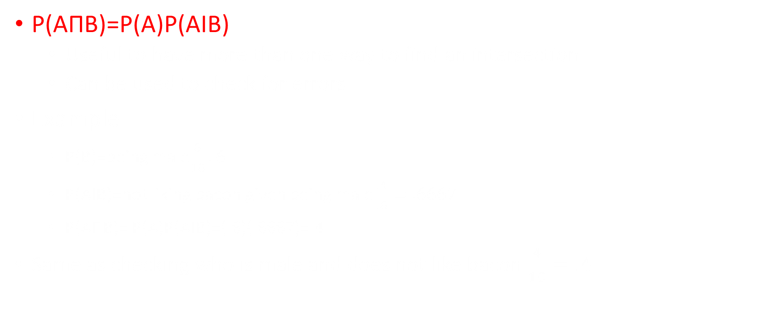
General multiplication Rule
P(AΠB)=P(A)P(AIB)
  Useful to have more than one way to find an intersection
  Can be used to check for errors
Example
    P(B)=being male$\frac{6}{10}.6$
    P(AIB)=not liking bacon given being male $\frac{.4}{.6}=.6667$
    P(AΠB)= P(A)P(AIB)=(.6)(.6667)=.4
  Same as checking who is male and does not like bacon $\frac{4}{10}=.4$

Slide 41
Independent events
Independent events are two events who's probability have no effect on the others
Two events are considered independent if and only if
  P(AIB)=P(A) or
  P(AIB)=P(B)
Example:
  Flipping a coin once and getting heads, has no effect on the outcome of a second flip
  The probability on the second flip is still 50/50

Slide 42
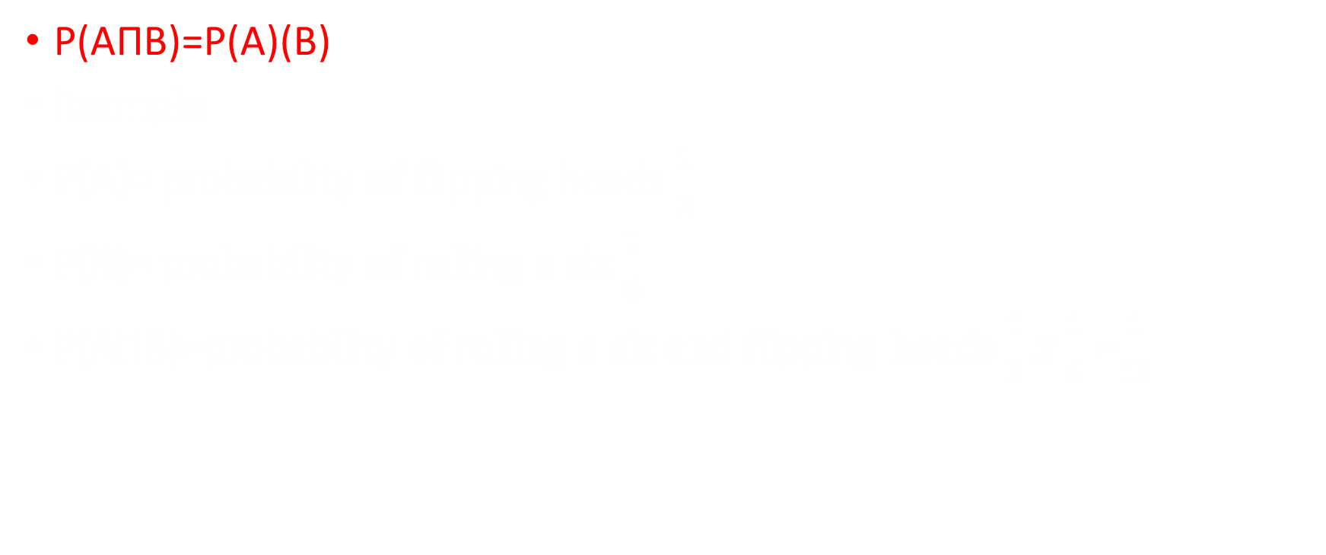
Multiplication Rule for two independent Events
P(AΠB)=P(A)(B)
Example
P(A)= probability of flipping heads $\frac{1}{2}$
P(B)= probability of rolling a six $\frac{1}{6}$
P(AΠB)=probability of rolling a six and flipping heads $\frac{1}{2}x\frac{1}{6}$ =$\frac{1}{12}$

Slide 43
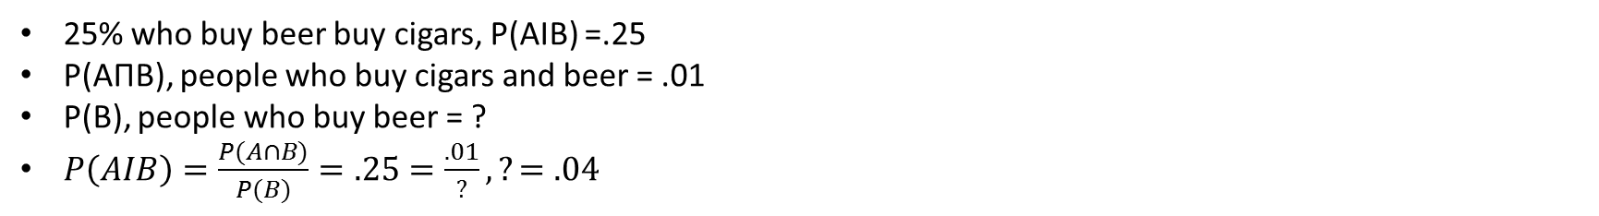
Example: Two percent (2%) of the customers of a store buy cigars. Half of the customers who buy cigars buy beer. 25 percent who buy beer buy cigars. What is the probability that the customer who buys beer will buy cigar?
 | Beer | No Beer | total
Cigars | .01 | .01 | .02
No Cigars |  |  | 1-.02=.98
 |  |  | 1
25% who buy beer buy cigars, P(AIB) =.25
P(AΠB), people who buy cigars and beer = .01
P(B), people who buy beer = ?
$P\left(AIB\right)=\frac{P(A∩B)}{P(B)}=.25=\frac{.01}{?},?=.04$
 | Beer | No Beer | Total
Cigars | .01 | .01 | .02
No Cigars | .04-.01=.03 | .96-.01=.95 | .98
 | .04 | 1-.04=.96 | 1

Slide 44
Discrete Random Variable

Slide 45
Random variable
A random variable is a variable whose value is numerical and is determined by the outcome of an experiment. A random variable assigns one and only one numerical value to each experimental outcome.
Rolling a dice, possible outcomes are 1,2,3,4,5,6
  Before rolling, X could be 1,2,3,4,5,6
  After rolling, X = 5
Two types of random variable
1) Discrete random variable (Chapter 5)
  Dice only have 6 possible outcome
  Ex.: Number of students in this class
2) Continuous random variable (Chapter 6)
  The height of all Concordia students
  Ordered by classes
  Ex.: Weight

Slide 46
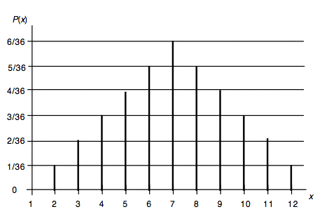
Probability distribution
For discrete random variable the data is normally show in 1 of 2 forms
Important to remember that the sum of all probability must always equal to 1
Possible outcomes (x) | Probability of each outcome
1 | 20%
2 | 10%
3 | 20%
4 | 35%
5 | 15%

Slide 47
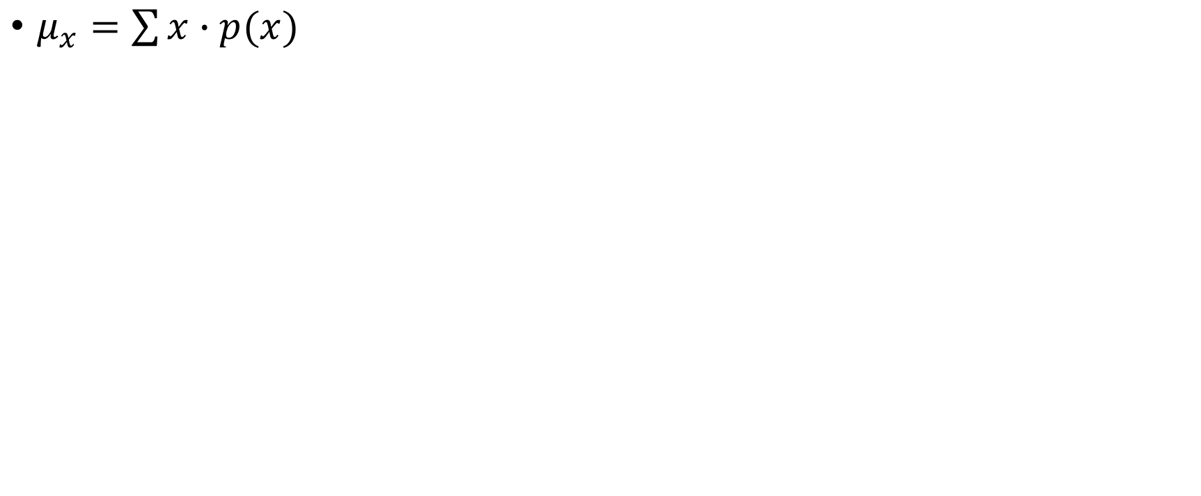
Expected Value (mean)
$μ_{x}=\sum{x∙p(x)}$
Outcome (x) | Probability | Expected value
$5 | 20% or .20 | 5 x .20 = 1
$10 | 20% or .20 | 10 x .20 = 2
$20 | 20% or .20 | 20 x .20 = 4
$50 | 20% or .20 | 50 x .20 = 10
$100 | 20% or .20 | 100 x .20 = 20
Total | 100% or 1 | µ = 37

Slide 48
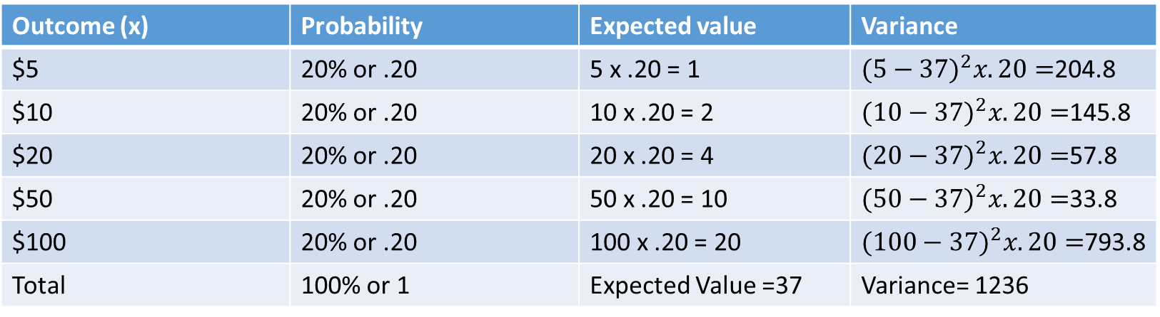
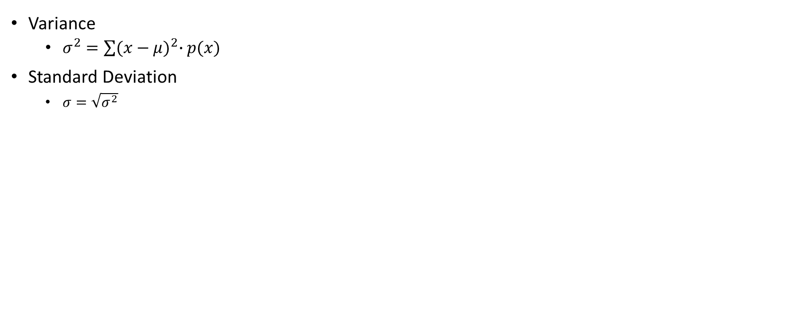
Variance and Standard Deviation
Variance
  $σ^{2}=\sum{{(x−μ)}^{2}∙p(x)}$
Standard Deviation
  $σ=\sqrt{σ^{2}}$
Outcome (x) | Probability | Expected value | Variance
$5 | 20% or .20 | 5 x .20 = 1 | ${(5−37)}^{2}x.20=$204.8
$10 | 20% or .20 | 10 x .20 = 2 | ${(10−37)}^{2}x.20=$145.8
$20 | 20% or .20 | 20 x .20 = 4 | ${(20−37)}^{2}x.20=$57.8
$50 | 20% or .20 | 50 x .20 = 10 | ${(50−37)}^{2}x.20=$33.8
$100 | 20% or .20 | 100 x .20 = 20 | ${(100−37)}^{2}x.20=$793.8
Total | 100% or 1 | Expected Value =37 | Variance= 1236
Std=35.1568

Slide 49
Binomial
4 Rules for Binomials
  Experiment consists of n identical trials
  Each trial results in either “success” or “failure”
  Probability of success, p, is constant from trial to trial
    The probability of failure, q, is 1 – p
  Trials are independent (the probability of one event does not effect the probability of another)

Slide 50

Binomial Formula
P= $\frac{n!}{x!\left(n−x\right)!}∗p^{x}∗{(1−p)}^{n−x}$
The first part is the combination formula
  $\frac{n!}{x!\left(n−x\right)!}$
  N is the number of trials
  X is the number of desired outcomes
$P^{x}$ , the probability of success to the power of the X
  X being the number of desired outcomes
${(1−p)}^{n−x} or q^{n−x }$
  The probability of the event not happening to the power of n-x
  N-x, being the number of trials minus the number of desired outcomes

Slide 51

Binomial Theoretical example
What are the chances of rolling a dice 3 times and rolling a 4 two times.
Long way:
  P(1,4,4)+P(2,4,4)+P(3,4,4)+P(5,4,4)+P(6,4,4)+P(4,1,4)+P(4,2,4)+P(4,3,4)+P(4,5,4)+P(4,6,4)+P(4,4,1)+P(4,4,2)+P(4,4,3)+P(4,4,5)+P(4,4,6)= .06944 or 6.9444%
Short way: P= $\frac{n!}{x!\left(n−x\right)!}∗p^{x}∗{(1−p)}^{n−x}$
  P= $\frac{3!}{2!\left(3−2\right)!}∗{\frac{1}{6}}^{2}∗{(1−\frac{1}{6})}^{3−2}$ = .06944 or 6.9444%

Slide 52

Mean, Variance, Standard Deviation for Binominals
Mean
  $μ_{x}=np$
Variance
  $σ_{x}^{2}=npq$
Standard Deviation
  $σ_{x}=\sqrt{npq}$
n= number of trials, p = probability of positive outcome, q= probability of negative outcome (1-p)

Slide 53
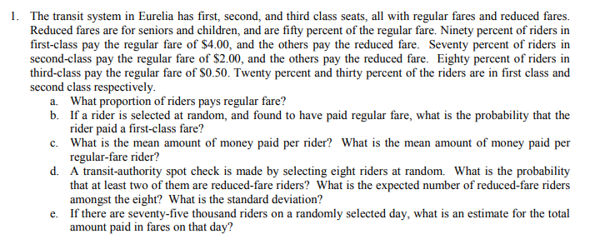
Question 1: From the midterm review, under the section called Discrete Probability Distributions/ Binomial Distribution

Slide 54
Before starting, build a chart with the information given in the problem
 | 1st class | 2nd class | 3rd class | Total
Regular Price | 90% in first class pay regular (given) 20% of all riders are in first class (given) Number of people in first class that pay full price .90 x .20 = .18 First class regular price, $4 (given) | 70% in second class pay regular (given) 30% of all riders are in second class (given) Number of people in second class that pay full price .70 x .30 = .21 Second class regular price, $2 (given) | 80% in third class pay regular (given) If 20% are in first class and 30% are in second 1 -.2 -.3 = .5, 50% are in third class Number of people in third class that pay full price .50 x .80 = .40 Third class regular price, $0.50 (given) | Total riders paying regular price .18+.21+.40= .79
Reduced Price | People in first class who pay reduced 1-.9 = .1 20% of all riders are in first class (given) Number of people in first class that pay reduced .1 x .2= .02 First class reduced price, $2 (given) | People in second class who par reduced 1 - .7 = .3 30% of all riders are in second class (given) Number of people in second class that pay reduced .3 x .3 = 0.09 Second class reduced price, $1 (given) | People in third class who pay reduced 1 - .8 = .2 50% of all riders are in third class ( calculated above) Number of people in third class that pay reduced .2 x .5 = .10 Third class reduced price, $0.25 (given) | Total riders paying reduced price .02+.09+.10=.21
Total | 18% in first class regular 2% in first class reduced Total in first class .18 + .02 = 20% | 21% in second class regular 9% in second class reduced Total in second class .21 + .09 = 30% | 40% in third class regular 10% in third class reduced Total in third class .40 + .10 = 50% | Total in 1st, 2nd, and 3rd class .20+.30+.50= 1 Total riders paying regular or reduced, .21 + .79 = 1

Slide 55
A) What proportion of riders pay regular fare?
Look at chart
  18% of all riders are in first class and pay regular
  21% of all riders are in second class and pay regular
  40% of all riders are in third class and pay regular
  .18 + .21 .40 = .79
Proportion of riders that pay regular fare is .79 or 79%

Slide 56
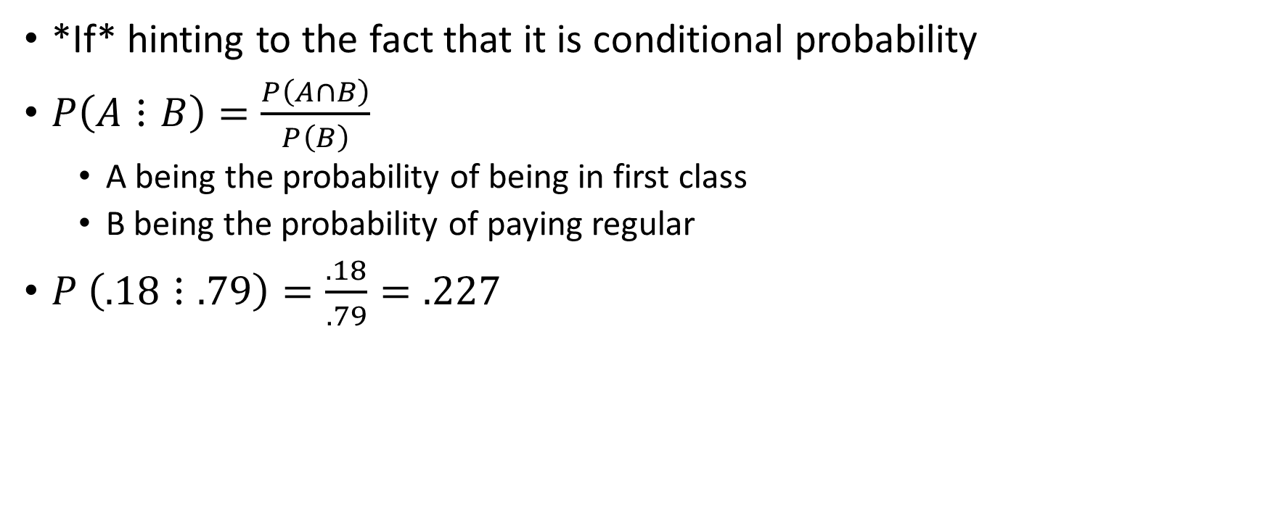
B)If a rider is selected at random, and found to have paid regular fare, what is the probability that the rider paid a first-class fare?
*If* hinting to the fact that it is conditional probability
$P\left(A⋮B\right)=\frac{P\left(A∩B\right)}{P\left(B\right)}$
  A being the probability of being in first class
  B being the probability of paying regular
$P \left(.18⋮.79\right)=\frac{.18}{.79}=.227$

Slide 57

C) (A)What is the mean amount of money paid per rider? (B)What is the mean amount of money paid per regular-fare rider?
(A)What is the mean amount of money paid per rider?
Expected value $μ_{x}=\sum{x∙p(x)}$
.18($4) + .21($2) + .4($.50) + .02($2)+.09($1) + .10($.25) = $1.495
(B)What is the mean amount of money paid per regular-fare rider?
$\frac{.18\left(4\right)+ .21\left(2\right)+ .4(.5)}{.79}$
* why divided by .79?
  In part A, there is technically an invisible 1 dividing the entire equation but since for part B the percentages (.18,.21,.4) do not represent the probability for the whole population (1) but the problem is only about 79% of the population, we need to divide by .79.

Slide 58

D) A transit-authority spot check is made by selecting eight riders at random. (A) What is the probability that at least two of them are reduced-fare riders? (B) What is the expected number of reduced-fare riders amongst the eight? (C)What is the standard deviation?
(A)Use Binomial, since a rider is either reduced or not
P= $\frac{n!}{x!\left(n−x\right)!}∗p^{x}∗{(1−p)}^{n−x}$
  It is faster to find the probability of 0 and 1 reduced fare riders and finding the compliment rather than finding the probability of 2,3,4,5,6,7,8 reduced fare riders
  P= $\frac{8!}{0!\left(8−0\right)!}∗{.21}^{0}∗{\left(1−.21\right)}^{8−0}=$ .1517
  P= $\frac{8!}{1!\left(8−1\right)!}∗{.21}^{1}∗{(1−.21)}^{8−1}$= .3226
  .1517+.3226=.4743
  1-.4743= .5257
  The probability of at least two riders out of eight being reduced fare riders equals .5257 or 52.57%

Slide 59

D continued…
  (B) Expected value = $μ_{x}=np$
    Number of trials(N) = 8
    Probability of any rider being reduced fare(p) = .21
    $μ_{x}=\left(8\right).21=1.68$
  (C) Standard Deviation = $\sqrt{npq}$
    Number of trials(N) = 8
    Probability of any rider being reduced fare(p) = .21
    The probability of any rider not being a reduced fare (q) = 1-.21 = .79
    $\sqrt{\left(8\right)\left(.21\right)(.79)}=1.15$

Slide 60
E) If there are seventy-five thousand riders on a randomly selected day, what is an estimate for the total amount paid in fares on that day?
How much does the average rider pay?
Found in C, the average rider pays an expected price of $1.495
Therefore, if there are 75,000 riders
  75,000 x 1.495 = $112,125
75,000 riders should bring in an estimated $112,125 on any given day

Slide 61
Continuous Random Variable

Slide 62
Continuous random variables
The curve f(x) is the continuous probability distribution of the random variable x if the probability that x will be in a specified interval of numbers is the area under the curve f(x) corresponding to the interval. (also called probability curve or probability density function)
In short: continuous random variables can be any number under a distribution curve.
In the this chapter, the distribution will be bell shaped or normal

Slide 63
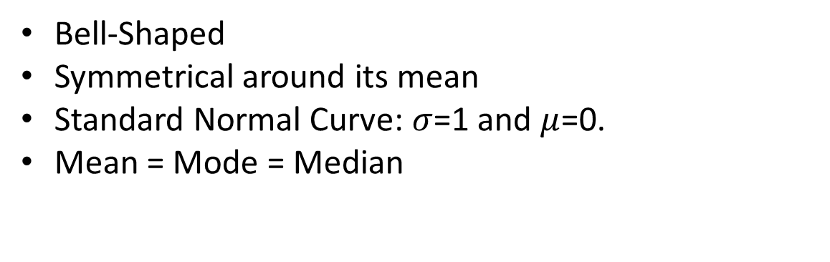
Normal Distribution
Bell-Shaped
Symmetrical around its mean
Standard Normal Curve: $σ$=1 and $μ$=0.
Mean = Mode = Median
.5
.5
Mean
Median
Mode

Slide 64
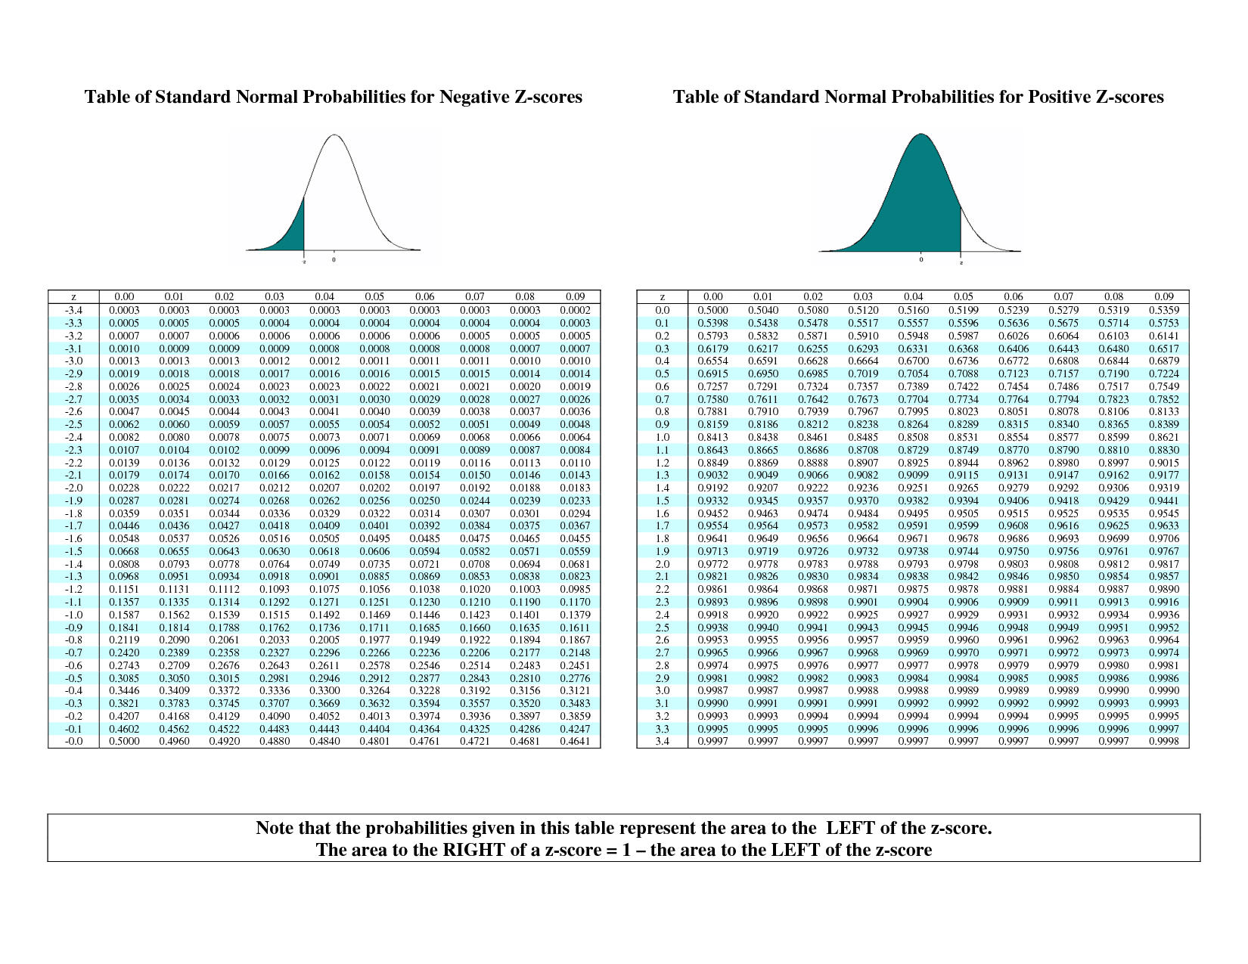
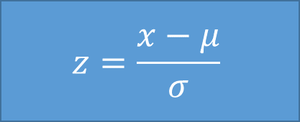
Z Score
$$z=\frac{x−μ}{σ}$$
A measure of the how many standard deviations away your x is from the µ.
After finding a z score, looking in up on the table and it tells the probability of any number in the distribution being below your x value.
  Always look at area to the left

Slide 65
A
A z-score question will be asked in 1 of 4 ways.

Slide 66
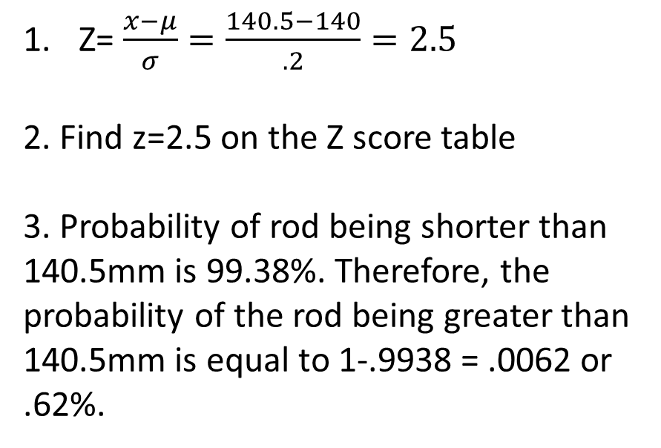
Option 1: Find the probability on either side of X
Compute the probability that a randomly selected rod is longer than 140.5mm. (Ơ=.2,µ=140)
Z= $\frac{x−μ}{σ}=\frac{140.5−140}{.2}=2.5$
2. Find z=2.5 on the Z score table
3. Probability of rod being shorter than 140.5mm is 99.38%. Therefore, the probability of the rod being greater than 140.5mm is equal to 1-.9938 = .0062 or .62%.
?
140mm
140.5mm

Slide 67
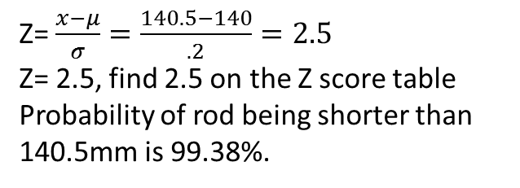
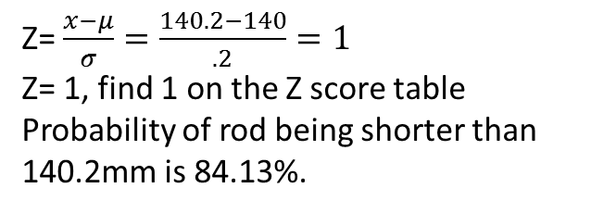
Option 2: Find the probability between two points (x)
Compute the probability that a randomly selected rod is between 140.2mm and 140.5mm. (Ơ=.2,µ=140)
Z= $\frac{x−μ}{σ}=\frac{140.5−140}{.2}=2.5$
Z= 2.5, find 2.5 on the Z score table
Probability of rod being shorter than 140.5mm is 99.38%.
99.38%
140mm
140.5mm
Z= $\frac{x−μ}{σ}=\frac{140.2−140}{.2}=1$
Z= 1, find 1 on the Z score table
Probability of rod being shorter than 140.2mm is 84.13%.
84.13%
140mm
140.2mm
99.38 – 84.13 = 15.25
The probability of a selected rod being between 140.2mm and 140.5mm is 15.25%.
15.25%
140mm
140.2mm
140.5mm

Slide 68
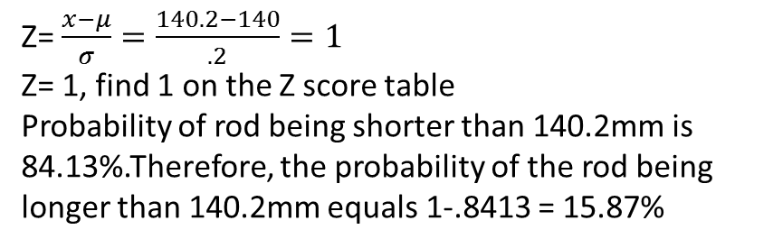
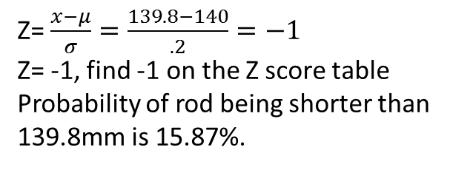
Option 3:Find the probability at both ends of the distribution
A rod is considered defective if it is less than 139.8mm or if it is longer than 140.2mm. Compute the probability that a random selected rod will be defective. (Ơ=.2,µ=140)
Z= $\frac{x−μ}{σ}=\frac{139.8−140}{.2}=−1$
Z= -1, find -1 on the Z score table
Probability of rod being shorter than 139.8mm is 15.87%.
15.87
139.8mm
140mm
Z= $\frac{x−μ}{σ}=\frac{140.2−140}{.2}=1$
Z= 1, find 1 on the Z score table
Probability of rod being shorter than 140.2mm is 84.13%.Therefore, the probability of the rod being longer than 140.2mm equals 1-.8413 = 15.87%
15.87
140mm
140.2mm
Since we are looking for the probability of the rod being shorter than 139.8mm or longer than 140.2mm , we can simply add the two probabilities found above. 15.87 + 15.87 = 31.74%
15.87
15.87
139.8mm
140mm
140.2mm

Slide 69

Z score Option 4 (special case)
Normally in any Z-score problem, the x, µ, and $σ$ are given.
However in some cases, the $σ$, µ, and a percentage is given and the question asks to find the X.
In order to solve
  1- Find the given percentage on the inside of the Z score table and the matching z score value.
    Remember the percentage represents the probability to the left of X and not the actual z score
  2- Plug in your z score, $σ$, and µ into the z score formula and solve for X.

Slide 70

Option 4 Example
A population has a mean of 3 and a standard deviation of .5. Find the 60th percentile.
Understand that the 60th percentile means what value(x) is greater than 60% of the value when dealing with continuous distributions.
Find 60% on the z-score table. 60% equals a z-score between 0.25 and 0.26.
Take the average of both z scores =$\frac{.25+.26}{2}$=.255
Plug all the values in the z score formula, $z=\frac{x−μ}{σ}$ =.255=$\frac{x−3}{.5}$
Isolate X,
  .2$55=\frac{x−3}{.5}$
  X-3=.1275
  X=3.1275
Final statement; 60% of the values in the distribution are less than or equal to 3.1275.

Slide 71

Final tips
Always start by putting the numbers of sample in order
If you forget the empirical rule, look them up on the Z table
Coefficient of variation is not on your formulae sheet, $\frac{standard deviation }{mean}x100$
If the goal for this class is an A or A+, try to do the midterm review package 3 times
  Keep in mind that exam is fairly long for time given and time will be a factor

Slide 72
Frequently Asked Questions

Slide 73

Where can I find the shortcut formula for standard deviation?
$S^{2}=\frac{1}{n−1}(\sum_{i−1}^{n}{x^{2}}−\frac{({\sum_{i=1}^{n}{x)}}^{2}}{2})$
Only works for samples
$\sum_{i=1}^{n}{x^{2}};$means square each x individually, then add them up
${(\sum_{i=1}^{n}{x})}^{2};means$add up all the x as they are given, then square the total
This formula can save a lot of time, however it is not on the formula sheet

Slide 74
How do I find the ‘’bounded probability’’ using Chebyshev’s formula?
For this example, let’s say the µ=20,Ơ=4, and the problem is asking for the values that bounding 75% of all values in the distribution.
Before beginning, make sure the question is asking for the Chebyshev’s formula and not z-scores. Normally, if it states that the distribution is not symmetrical, non-bell shaped, or very skewed, these are all sights that Chebyshev’s formula is needed.
However, if it is normally distributed or bell shaped, the z score formula can be used and the process would be similar to options 2 and 4 in the slides related to z scores.

Slide 75


If Chebyshev’s is needed
Step 1: Plug in the percentage and solve for K
Probability = 75%
K = Not Given
Probability =100*(1-( $\frac{1}{K^{2}})$
Plug in the probability
75 = 100*(1-( $\frac{1}{K^{2}})$
2) Divide both sides by 100
$\frac{75}{100}=\frac{100∗(1−(\frac{1}{K^{2}})}{100}$ , .75 = (1-( $\frac{1}{K^{2}})$
3) Bring over the 1
.75 – 1 = $\frac{1}{K^{2}} , −.25=−\frac{1}{K^{2}}$
4) Cancel the negatives
$−.25=−\frac{1}{K^{2}}$ , $.25=\frac{1}{K^{2}}$
5) Cross multiply
$.25=\frac{1}{K^{2}}$ , .25$K^{2}=1$
6) Divide both sides by .14
$\frac{.25K^{2}}{.25}= \frac{1}{.25}$ , $K^{2}= \frac{1}{.25}$ , $K^{2}$ = 4
7) Square root both sides
$\sqrt{K^{2}}$ = $\sqrt{4}$
K= 2

Slide 76
Once K has been found;
Step 2: Understand the mean of K
K is not the standard deviation (Ơ=5), it is the number of standard deviations away from the mean we must go to bound a given probability.
To find the values that bound 75% of the distribution;
A- find the upper value, µ+KƠ, 20+(2x5) = 30
B- find the lower value, µ-kƠ, 20-(2x5) = 10
(This step is similar to finding the fences for a box and whiskers plot)

Slide 77
Interpreting the results
Step 3: Final statement
Once the upper and lower values have been found, formulate a sentence explaining their meaning.
75% of the values are between the values 30 and 10.
75%
10
30

Slide 78
Problem 2: A commission studying employment in towns hard hit by a recession has collected data on which the following questions have been based. In Town A, twenty percent of the work force is unemployed. Sixty percent of the unemployed are women, and thirty percent of the women in the work force are unemployed.
 | Employed | Unemployed | Total
Men | .52 (8) | .08 (3) | .60 (.6)
Women | .28 (7) | .12 (2) | .40(4&5)
 | .80 (1) | .20 (Given)
1-If .20 of the workforce is unemployed, .80 must be employed, 1-.20=.80
2-If .60 of all the unemployed are women, .12 out of the unemployed .20 must be women, .60x.20=.12
3-If .12 out of the .20 are women, .08 must be men, .20-.12=.08
4-The last statement states that 30% of all women are unemployed, this can be written algebraically as .3W, W meaning all the women in the workforce including both the working and unemployed
5-If we already know that .12 of all women are unemployed and that to find the number of unemployed women would have to multiply all the women in workforce by .30, we can extract this equation .3W=.12
Solve for W, W=.40
6-If .40 of the workforce is made up of women, .60 must be made of men, 1-.40=.60
7-If .40 of the workforce is made up of women and .12 of the .40 are unemployed, .28 must be employed, .40-.12=.28
8-If .60 of the workforce is made up of men and .08 of the .60 are unemployed, .52 must be employed, .60-.08=.52

Slide 79
Problem 2 continued
a. What percentage of the workforce is female?
  .40 or 40%, found in the chart
b. What percentage of the men in the workforce is unemployed?
  .08 or 8%, found in the chart

