Slide 1
Comm 215: Business Statistics
Final Review
By Robert Pereira

Slide 2
Table of Contents
Chapter 1-3: Descriptive Statistics
Chapter 4: Probability
Chapter 5: Discrete Random Variable
Chapter 6: Continuous Random Variable
Chapter 7: Sampling Distributions
Chapter 8: Confidence intervals
Chapter 9: Hypothesis Testing
Chapter 10: Chi-Squared Tests
Chapter 13: Simple Linear Regression Analysis
Chapter 14: Multiple Regression and Model Building

Slide 3
Descriptive Statistics

Slide 4
Chapters Overview
Textbook Definition
Frequency Distributions
Stem and Leaf
Central Tendency
Percentile
5 number summary
Box and Whiskers

Slide 5
Definitions
Statistics: the science that deals with the collection, classification, analysis, and interpretation of numerical facts or data, and that, by use of mathematical theories of probability, imposes order and regularity on aggregates of more or less disparate elements.
Two types of statistics
  Descriptive Statistics: the science of describing the important aspects of a set of measurements
  Inferential Statistics: the science of using samples to make assumptions about the population

Slide 6
Definitions
Population: the set of all elements about which we wish to draw conclusions.
Sample: a subset of the elements of a population
Statistical Interference: the science of using a sample of measurements to make generalizations about the important aspects of a population of measurements.

Slide 7
Definitions
Random sample: when every element of a population has the same chance of being in the sample
Sample with replacement: once we pick an element from the population, we put it back before picking again
Sample without replacement: once an element is picked it can not be picked again

Slide 8
Definitions: Type of sampling
Probability sampling: select randomly, based on probability
  1)Simple random ( randomly selecting from a population)
  2) Stratified (dividing the population into subgroups, randomly selecting parts of each group)
  3) Cluster (similar to stratified, divide population, then divide the subgroups again)
  4) Systemic (Picking every nth element)
Convenience sampling: select elements based on convenience, they were easy to pick
Voluntary response sampling: only selecting people who want to be selected
Judgement Sampling: when someone selects a sample based on his or her own judgement
***Only probability sampling may be used to make statistical inferences

Slide 9
Definitions: Ethical Issues
1) Improper sampling: purposely selecting a biased sample, selecting a specific sample in order to get a desired response
2) Misleading charts, graphs and descriptive measures: manipulating graphs or data to minimize or maximize any part of the gathered information
3) Inappropriate statistical analysis or inappropriate interpretation of statistical results : continuing to sample a population until a selected sample has the desired characteristics

Slide 10
Definitions: types of quantitative variables
Quantitative: represents quantities
Ratio variable: a quantitative variable measured on a scale such that the ratios of its values are meaningful and there is an inherently defined zero value
Interval variable: a quantitative variable where ratios of its value are not meaningful and there is not an inherently defined zero.
Simplified definitions
Ratio variable: the values are mathematically comparable value A is 2 times smaller than value B and 0 is a value with no meaning, weighting 0 pounds means there is no weight
Interval Variable: the values are not mathematically comparable and 0 is a value with meaning. Think of temperature: 60 degrees F is not twice as hot as 30 degrees F and 0 degrees does not mean there no temperature

Slide 11
Definitions
Response rate: the proportion of all people whom we attempted to contact to those that actually responded to a survey.
Target population: the entire population of interest to us in a particular study.
Sample frame: a list of sampling elements from which the sample will be selected.
Sampling error: the difference between a numerical descriptor of the population and the corresponding descriptor of the sample.
Undercoverage: when some population elements are excluded from the process selecting the sample.
Nonresponse: whenever some of the individuals who were supposed to be included in the sample are not.

Slide 12
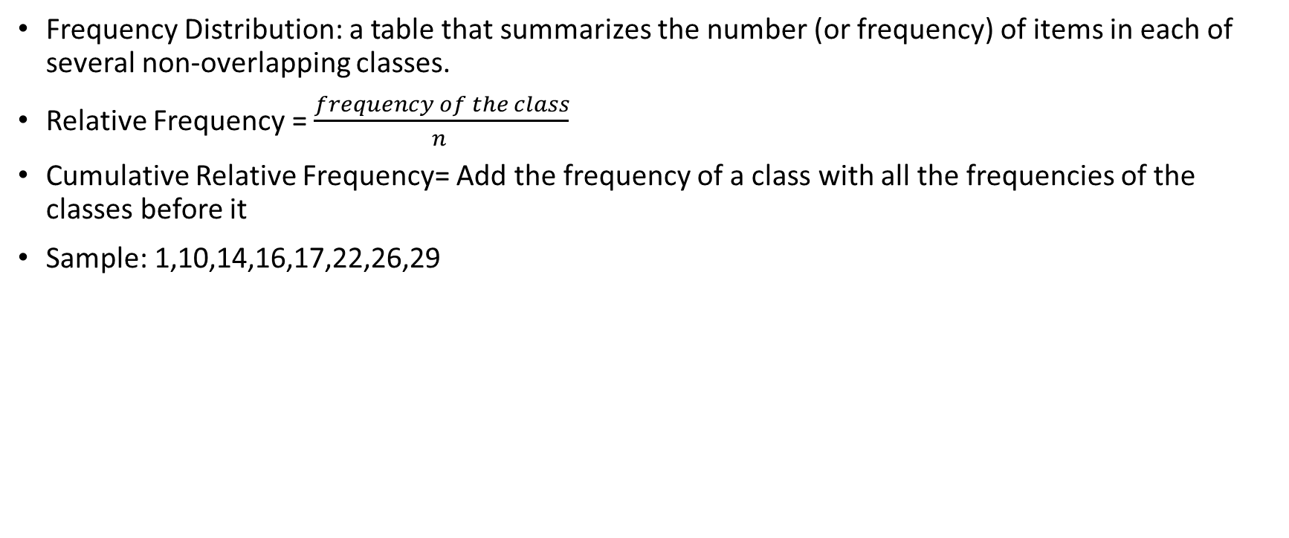
Frequency Distributions
Frequency Distribution: a table that summarizes the number (or frequency) of items in each of several non-overlapping classes.
Relative Frequency = $\frac{frequency of the class}{n }$
Cumulative Relative Frequency= Add the frequency of a class with all the frequencies of the classes before it
Sample: 1,10,14,16,17,22,26,29
Classes | Frequency | Relative Frequency | Cumulative Relative Frequency
[0-11[ | 2 | 2/8 = .25 | .25
[11-21[ | 3 | 3/8 = .375 | .25+.375 = .675
[21-31[ | 3 | 3/8 = .375 | .675+.375= 1
Total | 8 | 1

Slide 13

Making classes
Step 1: Find the number of classes using $2^{K}>N,$K being the number of classes (start at K=1, and go up until $2^{K}>N$)
Step 2: Find the class length using $\frac{largest value −smallest value }{number of classes }$
Step 3: Using the numbers found in step 1 & 2 make the classes
Step 4: Count the numbers of elements in each frequency

Slide 14
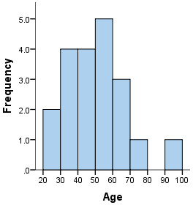
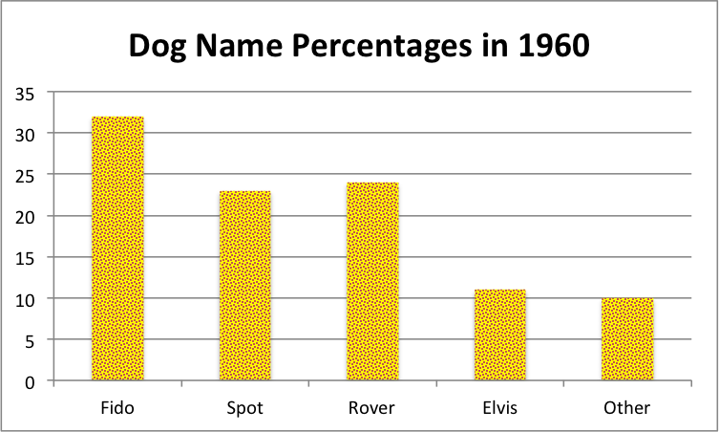
Histogram and Bar chart
Histogram: the bars touch each other and it is used for quantitative values. (Percentage, frequency, salaries)
Bar chart: the bars not touch and it is used for qualitative values. (eye color)

Slide 15
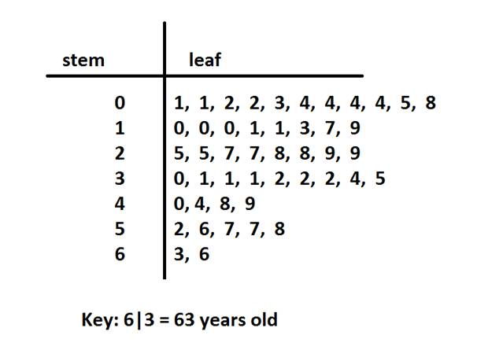
Stem and Leaf graph
Place all numbers in order
Choose a stem unit, if one is not given
Find the leaf unit, leaf unit = stem unit divided by 10
  The leaf unit is equal to stem unit x10
Remember a leaf unit can only be one integer
Build the graph

Slide 16
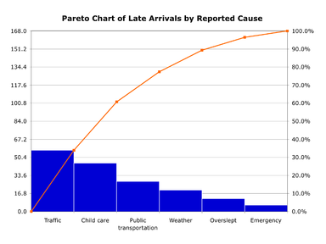
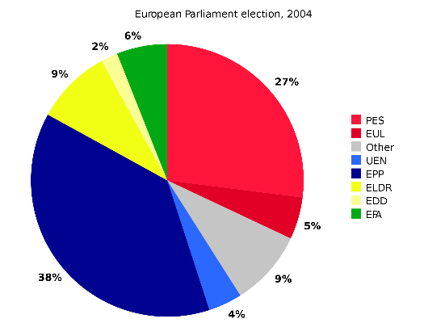
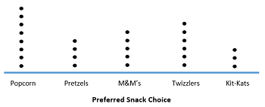
Other types of Charts
Pareto chart
  A histogram or bar chart with a line showing cumulative frequency drawn over it
Pie Chart
  A circle with a slice colored for each classes or type of value with the size of the slice depending on the frequency of the class or value
Dot Plot
  Draw a straight line
  Write all the possible values in order on that line
  Place 1 dot above each value of every time it appears in the sample

Slide 17


Describing Central Tendency
Mean, median, mode
All three are used to determine the distribution of a population or sample
Mean(µ for a population, Xbar for a sample)
  Mean is the average
Median
  Median is the middle number or 50th percentile
Mode
  Mode is the most frequent number
$$μ=\frac{x}{N}$$
$$\overline{x}=\frac{x}{n}$$

Slide 18
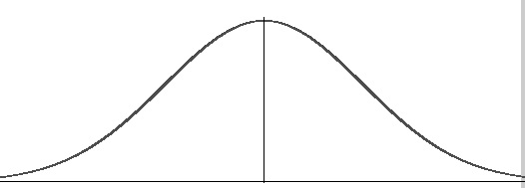
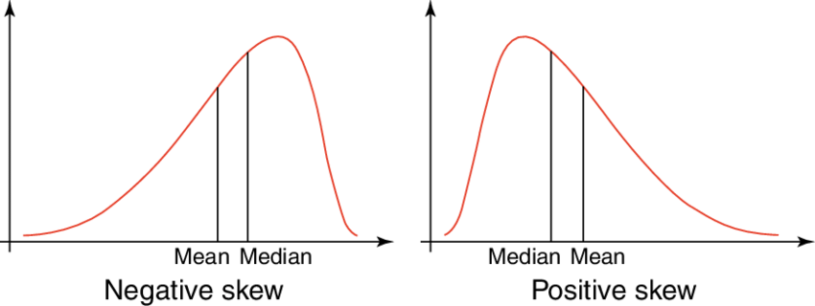
Types of distributions
Normal/Bell Shaped/Symmetric
  when the mean, median and mode are all equal
  Most common type for this class
Skewed to the left(Mean<median) Skewed to the right right (Mean>median)
Mean
Median
Mode
The words left and right indicate where the tail is. (tail is the skinny part)

Slide 19
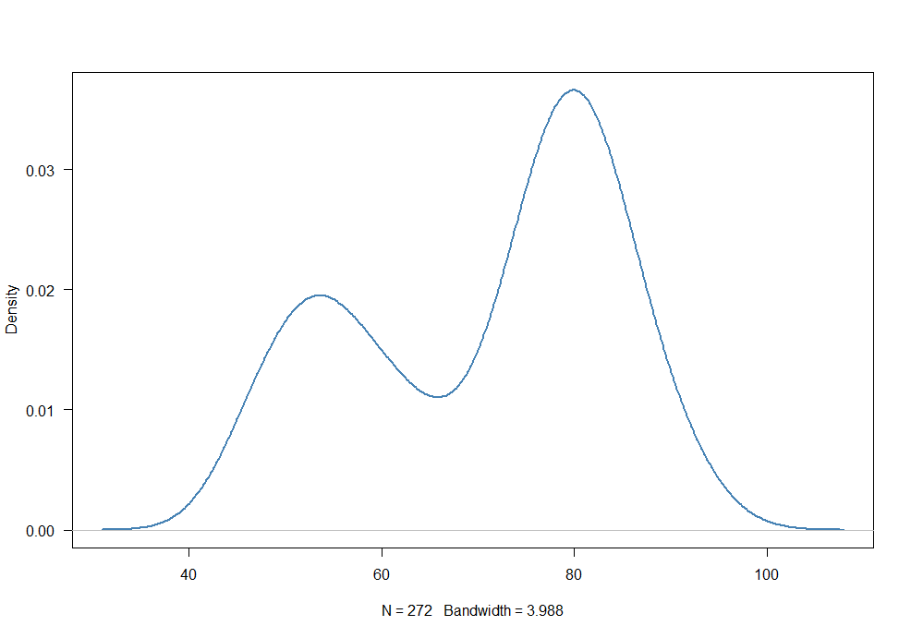
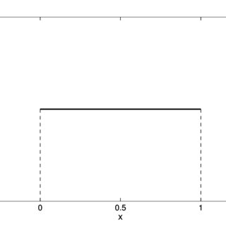
Other less common types of Distribution
Binomial
Uniform

Slide 20


Standard deviation and variance
Standard deviation is the average of all distances from the mean and the individual values of a population or sample
StD of a population StD of a sample
$$σ=\sqrt{\frac{\sum_{i=0}^{n}{{(x−μ)}^{2}}}{N}}$$
S $=\sqrt{\frac{\sum_{i=0}^{n}{{(x−X(par))}^{2}}}{n−1}}$
.5
1
1
2.5
Variance is the same formula as standard deviation but without the square root

Slide 21
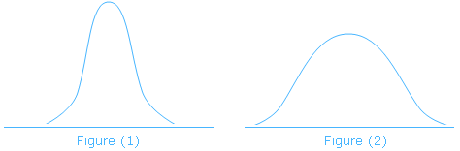

Coefficient of Variation
Coefficient of variation indicates how much a population varies in percentage, which allows us to compare one population to another
Coefficient of variation = $\frac{standard deviation }{mean}x100$
A lower coefficient of variation means that most of the values are closer to the mean, which is normally considered better
The higher CV is the wider the distribution will be

Slide 22
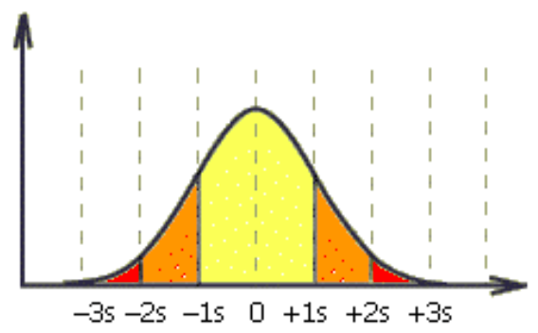
Empirical rule
Only useful for Normal/Bell Shaped/Symmetric
µ-3Ó
µ-2Ó
µ-Ó
µ
µ+Ó
µ+2Ó
µ+3Ó
68.26%
95.44%
99.73%

Slide 23
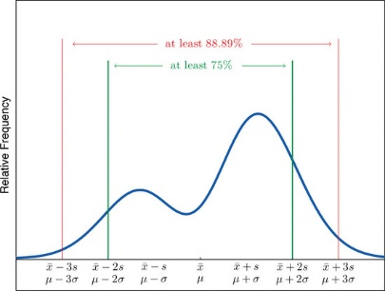
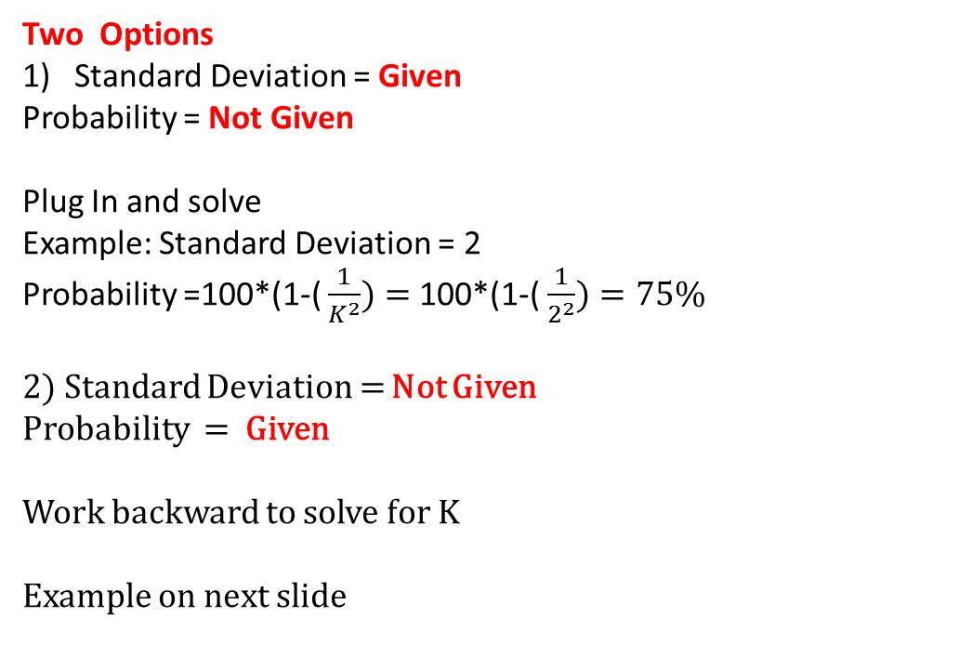
Chebyshev’s rule (for very skewed or non-normal distribution)
The formula, Percentage= 100*(1-(1/K^2))
K is the number of standard deviations
Two Options
Standard Deviation = Given
Probability = Not Given
Plug In and solve
Example: Standard Deviation = 2
Probability =100*(1-( $\frac{1}{K^{2}})=$100*(1-( $\frac{1}{2^{2}})=75\%$
2) Standard Deviation = Not Given
Probability = Given
Work backward to solve for K
Example on next slide

Slide 24
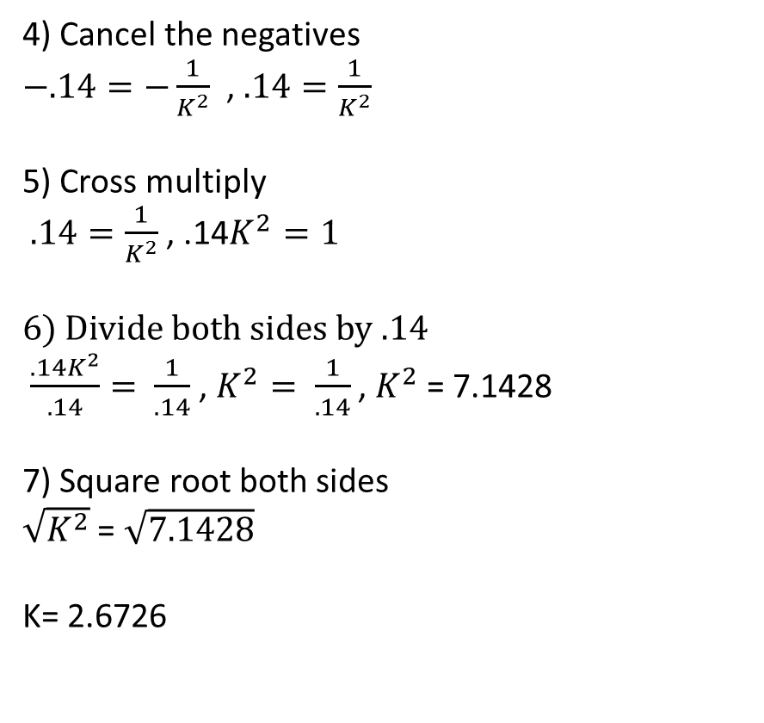

Chebyshev’s Rule Solve for K
Probability = 86%
Standard Deviation = Not Given
Probability =100*(1-( $\frac{1}{K^{2}})$
Plug in the probability
86 = 100*(1-( $\frac{1}{K^{2}})$
2) Divide both sides by 100
$\frac{86}{100}=\frac{100∗(1−(\frac{1}{K^{2}})}{100}$ , .86 = (1-( $\frac{1}{K^{2}})$
3) Bring over the 1
.86 – 1 = $\frac{1}{K^{2}} , −.14=−\frac{1}{K^{2}}$
4) Cancel the negatives
$−.14=−\frac{1}{K^{2}}$ , $.14=\frac{1}{K^{2}}$
5) Cross multiply
$.14=\frac{1}{K^{2}}$ , .14$K^{2}=1$
6) Divide both sides by .14
$\frac{.14K^{2}}{.14}= \frac{1}{.14}$ , $K^{2}= \frac{1}{.14}$ , $K^{2}$ = 7.1428
7) Square root both sides
$\sqrt{K^{2}}$ = $\sqrt{7.1428}$
K= 2.6726

Slide 25
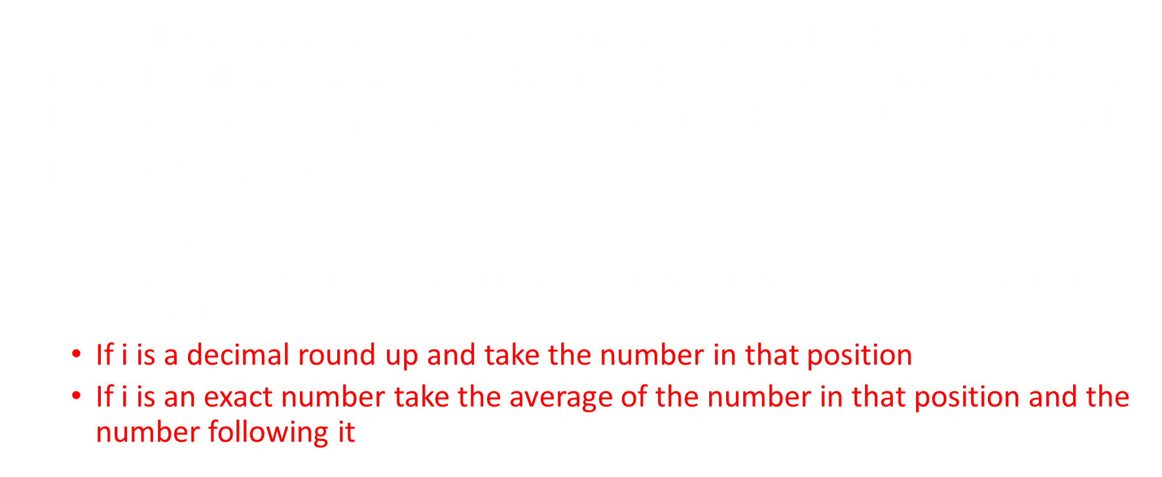
Percentile
Once all the numbers are placed in increasing order, the percentile formula will find the number that is at the border of being equal to or less than any given percentage of the rest of the population or sample
Percentile formula
  i=$\left(\frac{percentile }{100}\right)n$
  I is not the value, it is the position of the number that represents that given percentile
  If i is a decimal round up and take the number in that position
  If i is an exact number take the average of the number in that position and the number following it

Slide 26
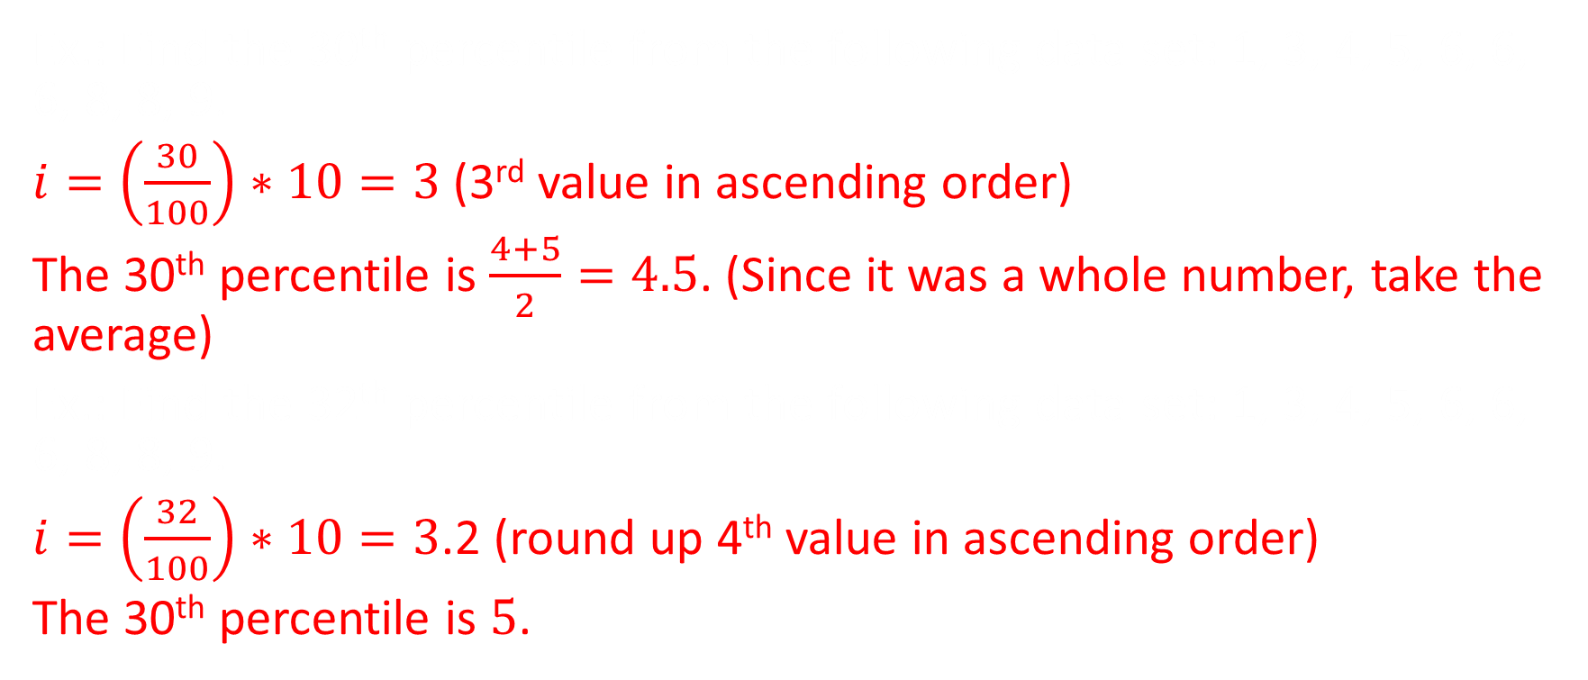
Percentile examples
Ex.: Find the 30th percentile from the following data set: 1, 3, 4, 5, 6, 6, 6, 8, 8, 9.
$i=\left(\frac{30}{100}\right)∗10=3$ (3rd value in ascending order)
The 30th percentile is $\frac{4+5}{2}=4.5$. (Since it was a whole number, take the average)
Ex.: Find the 32th percentile from the following data set: 1, 3, 4, 5, 6, 6, 6, 8, 8, 9.
$i=\left(\frac{32}{100}\right)∗10=3$.2 (round up 4th value in ascending order)
The 30th percentile is $5$.

Slide 27
5 Number Summary or box plot
The Median (50th percentile)
The first Quartile (25th percentile)
The Third Quartile (75th percentile)
The smallest number in the dataset
The largest number in the dataset

Slide 28
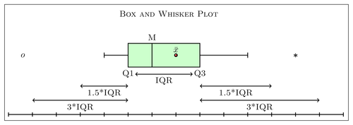
Box and whiskers
Find the median or 50th percentile
Find the First Quarter/25th percentile and the third Quarter/75th percentile
Find the Interquartile Range IQR= Q3-Q1
Find the fences
  Lower fence = Q1 – (1.5 x IQR)
  Upper Fence = Q3 + (1.5 x IQR)
Draw the Box and Whiskers
  The whiskers should extend until the fences if there are outliers or to the largest and smallest value if there is none

Slide 29
Video Practice Problems
https://www.youtube.com/watch?v=BfmnF0l1CAw

Slide 30
Probability

Slide 31
Chapter Overview
Probability Rules
Tree diagram
Contingency table

Slide 32
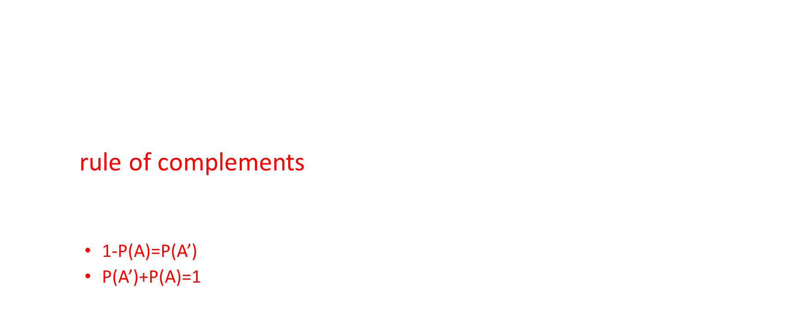
Probability
Probability: the chance or percentage of an outcome occurring
Probability of any event =P(A)=$\frac{all desired outcomes }{all possible outcomes}$
  Probability of flipping head $\frac{desired outcome H}{possible outcomes H+T}=\frac{1}{2}=.50$
The rule of complements
  The complement is the probability of what you do not want P(A’)
  If all probability equals one
    1-P(A)=P(A’)
    P(A’)+P(A)=1

Slide 33
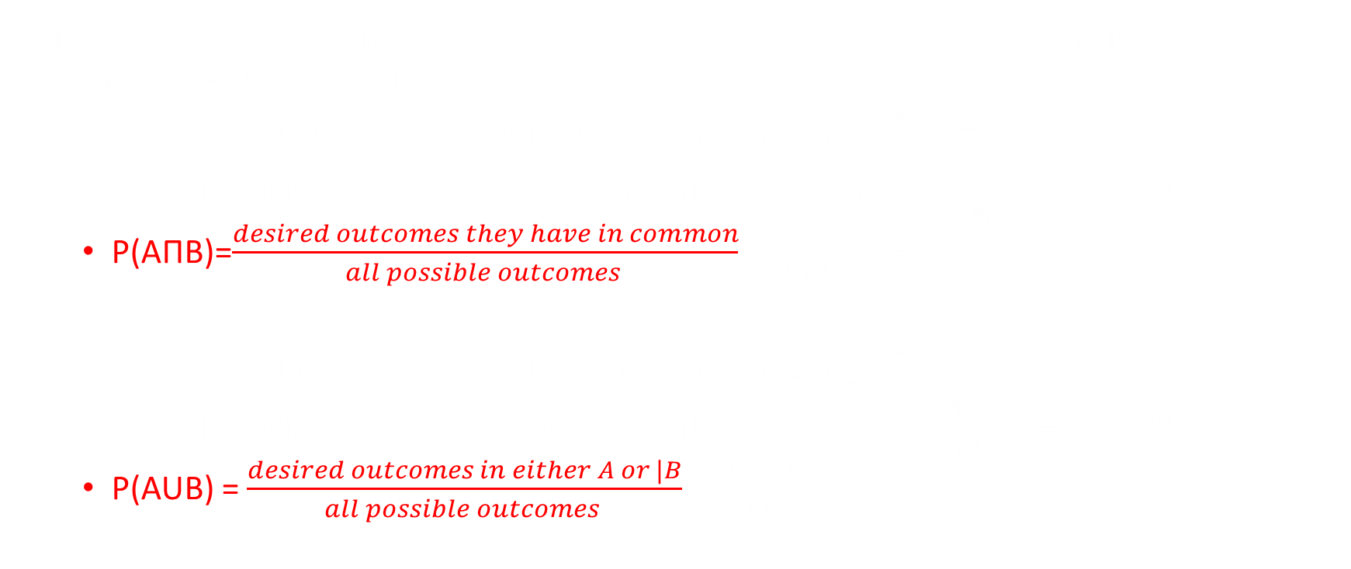
Intersection and union
Intersection, P(AΠB): the probability of that both event A and B will simultaneously occur.
  Event A: rolling a dice and getting an even number $\frac{2,4,6}{1,2,3,4,5,6}$=.5
  Event B: rolling a dice and getting a number less than 3 $\frac{1,2}{1,2,3,4,5,6}=.33333$
  P(AΠB)=$\frac{desired outcomes they have in common}{all possible outcomes }$=$\frac{2}{1,2,3,4,5.,6}=0.1667$
Union, P(AUB): the probability that A or B (or both) will occur.
  Event A: rolling a dice and getting an even number $\frac{2,4,6}{1,2,3,4,5,6}$=.5
  Event B: rolling a dice and getting a number less than 3 $\frac{1,2}{1,2,3,4,5,6}=.33333$
  P(AUB) = $\frac{desired outcomes in either A or |B}{all possible outcomes }$=$\frac{1,2,4,6}{1,2,3,4,5.,6}$=.6667

Slide 34
Theoretical example
From this slide on the following population will be referenced
1= Female, 12, likes bacon
2= Female, 25, likes bacon
3= Female, 42, likes bacon
4= Female, 58, likes bacon
5= Male, 11, likes bacon
6 = Male, 15, likes bacon
7 = Male, 27, dislikes bacon
8 = Male, 32, dislikes bacon
9 = Male, 49, dislikes bacon
10= Male, 51, dislikes bacon

Slide 35
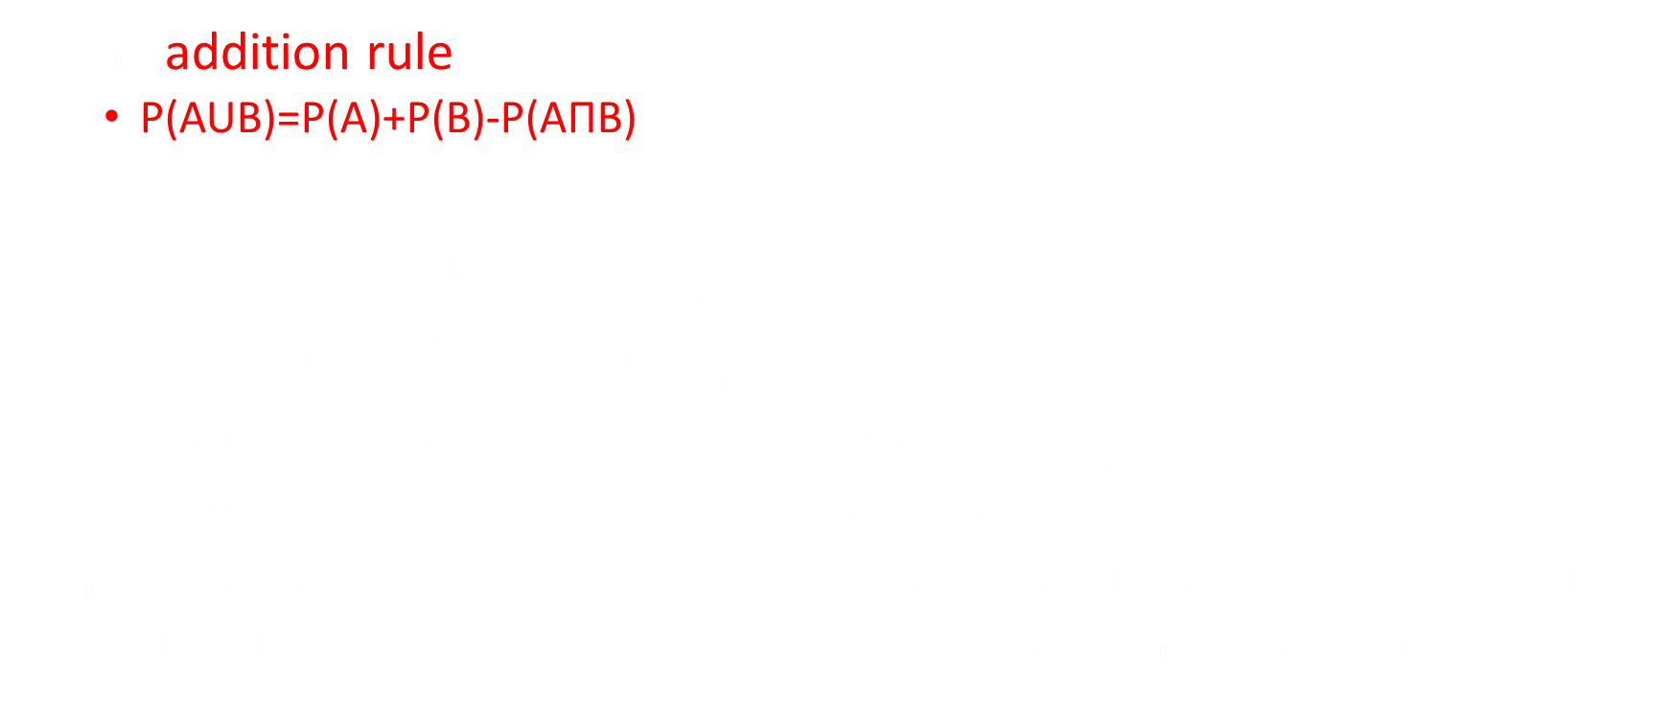
The addition rule
The addition rule
  P(AUB)=P(A)+P(B)-P(AΠB)
Example
  P(A)= someone liking bacon $\frac{6}{10}$=.6
  P(B)=someone being over 40 $\frac{4}{10}$=.4
  P(AΠB)=someone being over 40 and liking bacon $\frac{2}{10}= .2$
  P(AUB)=someone liking bacon or being over bacon = .6+.4-.2 = .8
If we did not subtract the people over 40 and liking bacon we would be double, person 3 and 4, since they counted in both event A and B

Slide 36
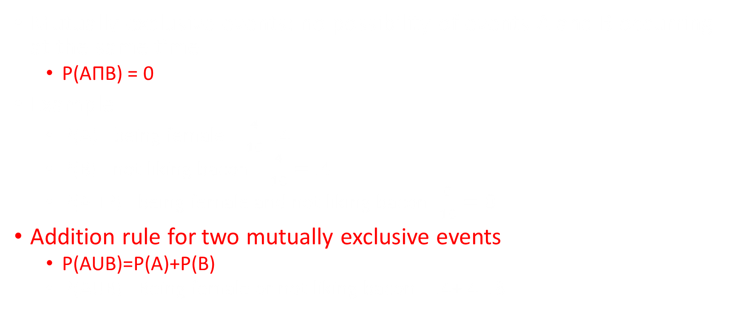
Mutually exclusive events
Mutually exclusive events: no possibility of events A and B occurring at the same time
  P(AΠB) = 0
Example
  P(A)= being female = $\frac{4}{10}$=.4
  P(B)= not liking bacon = $\frac{4}{10}=.4$
  P(AΠP)= being female and not liking bacon=$\frac{0}{10}=0$
Addition rule for two mutually exclusive events
  P(AUB)=P(A)+P(B)
  P(AUB)= Being female or not liking bacon = .4+.4=.8

Slide 37
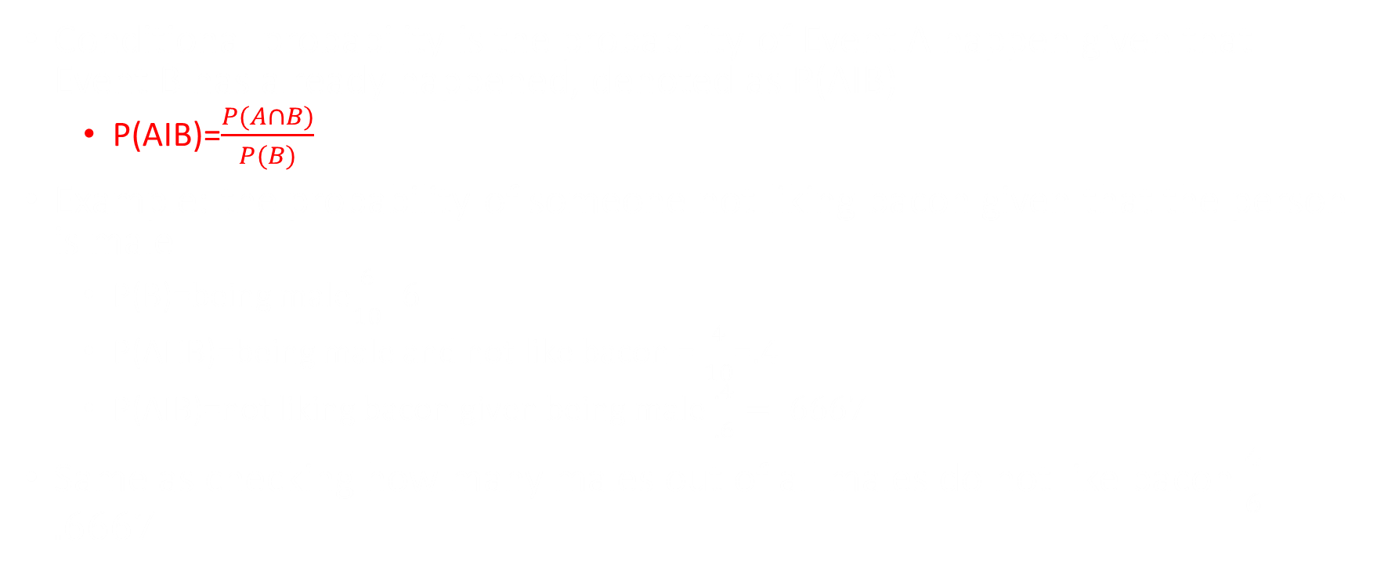
Conditional Probability
Conditional probability is the probability of Event A happen given that Event B has already happened, denoted as P(AIB)
  P(AIB)=$\frac{P(A∩B)}{P(B)}$
Example: the probability of someone not liking bacon given that the person is male
  P(B)=being male$\frac{6}{10}.6$
  P(AΠB)=being male and not like bacon = $\frac{4}{10}$=.4
  P(AIB)=not liking bacon given being male $\frac{.4}{.6}=.6667$
Same as checking how many males out of all males do not like bacon $\frac{4}{6}=.6667$

Slide 38
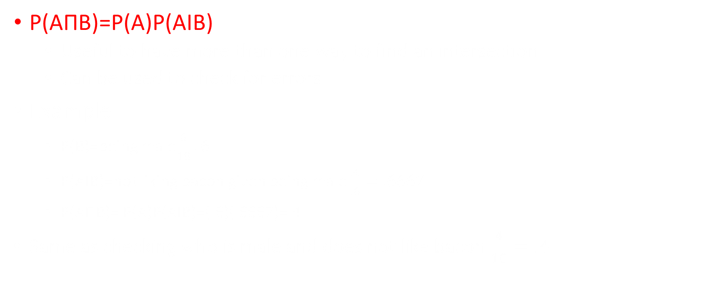
General multiplication Rule
P(AΠB)=P(A)P(AIB)
  Useful to have more than one way to find an intersection
  Can be used to check for errors
Example
    P(B)=being male$\frac{6}{10}.6$
    P(AIB)=not liking bacon given being male $\frac{.4}{.6}=.6667$
    P(AΠB)= P(A)P(AIB)=(.6)(.6667)=.4
  Same as checking who is male and does not like bacon $\frac{4}{10}=.4$

Slide 39
Independent events
Independent events are two events who's probability have no effect on the others
Two events are considered independent if and only if
  P(AIB)=P(A) or
  P(AIB)=P(B)
Example:
  Flipping a coin once and getting heads, has no effect on the outcome of a second flip
  The probability on the second flip is still 50/50

Slide 40
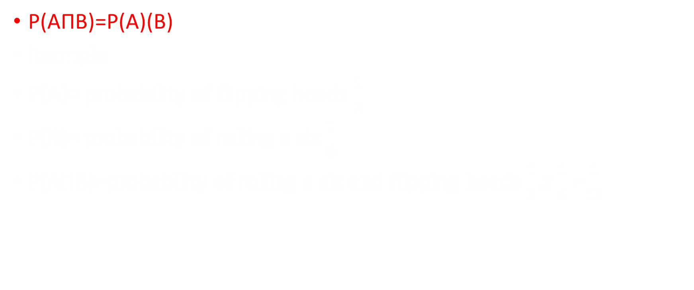
Multiplication Rule for two independent Events
P(AΠB)=P(A)(B)
Example
P(A)= probability of flipping heads $\frac{1}{2}$
P(B)= probability of rolling a six $\frac{1}{6}$
P(AΠB)=probability of rolling a six and flipping heads $\frac{1}{2}x\frac{1}{6}$ =$\frac{1}{12}$

Slide 41
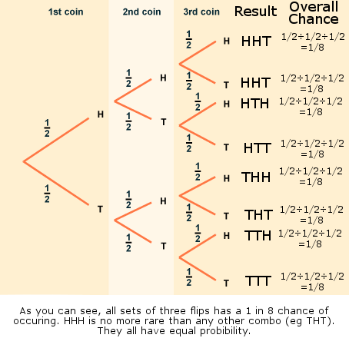
Probability Tree

Slide 42
Contingency Table
 | Event C | Event D | Total
Event A | P(AΠC) | P(AΠC) | P(Event A)
Event B | P(AΠC) | P(AΠC) | P(Event B)
Total | P(Event C) | P(Event D) | 1

Slide 43
Video Practice Problems
https://www.youtube.com/watch?v=79Jp-codRkw

Slide 44
Discrete Random Variable

Slide 45
Chapter overview
Expected value
Binomials

Slide 46
Random variable
A random variable is a variable whose value is numerical and is determined by the outcome of an experiment. A random variable assigns one and only one numerical value to each experimental outcome.
Rolling a dice, possible outcomes are 1,2,3,4,5,6
  Before rolling, X could be 1,2,3,4,5,6
  After rolling, X = 5
Two types of random variable
1) Discrete random variable (Chapter 5)
  Dice only have 6 possible outcome
  Ex.: Number of students in this class
2) Continuous random variable (Chapter 6)
  The height of all Concordia students
  Ordered by classes
  Ex.: Weight

Slide 47
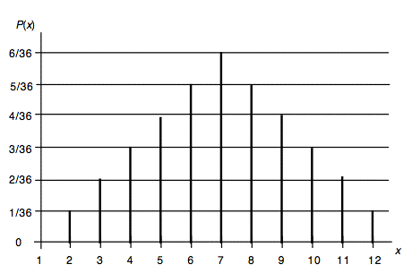
Probability distribution
For discrete random variable the data is normally show in 1 of 2 forms
Important to remember that the sum of all probability must always equal to 1
Possible outcomes (x) | Probability of each outcome
1 | 20%
2 | 10%
3 | 20%
4 | 35%
5 | 15%

Slide 48
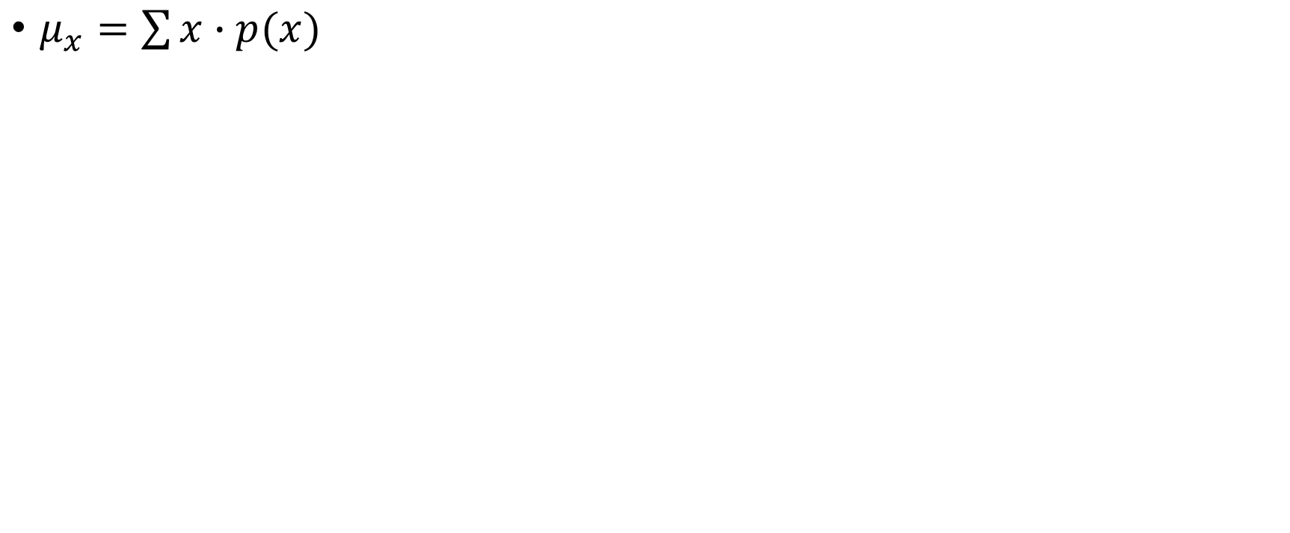
Expected Value (mean)
$μ_{x}=\sum{x∙p(x)}$
Outcome (x) | Probability | Expected value
$5 | 20% or .20 | 5 x .20 = 1
$10 | 20% or .20 | 10 x .20 = 2
$20 | 20% or .20 | 20 x .20 = 4
$50 | 20% or .20 | 50 x .20 = 10
$100 | 20% or .20 | 100 x .20 = 20
Total | 100% or 1 | µ = 37

Slide 49
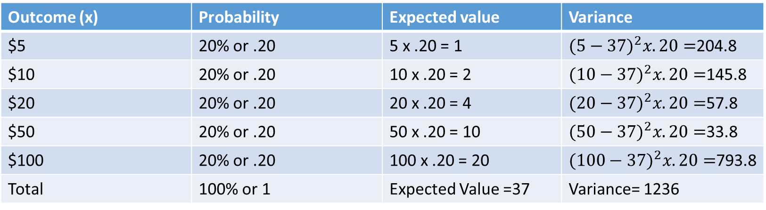
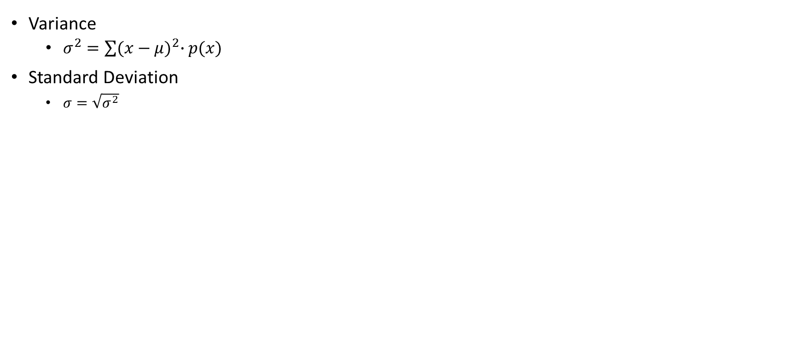
Variance and Standard Deviation
Variance
  $σ^{2}=\sum{{(x−μ)}^{2}∙p(x)}$
Standard Deviation
  $σ=\sqrt{σ^{2}}$
Outcome (x) | Probability | Expected value | Variance
$5 | 20% or .20 | 5 x .20 = 1 | ${(5−37)}^{2}x.20=$204.8
$10 | 20% or .20 | 10 x .20 = 2 | ${(10−37)}^{2}x.20=$145.8
$20 | 20% or .20 | 20 x .20 = 4 | ${(20−37)}^{2}x.20=$57.8
$50 | 20% or .20 | 50 x .20 = 10 | ${(50−37)}^{2}x.20=$33.8
$100 | 20% or .20 | 100 x .20 = 20 | ${(100−37)}^{2}x.20=$793.8
Total | 100% or 1 | Expected Value =37 | Variance= 1236
Std=35.1568

Slide 50
Binomial
4 Rules for Binomials
  Experiment consists of n identical trials
  Each trial results in either “success” or “failure”
  Probability of success, p, is constant from trial to trial
    The probability of failure, q, is 1 – p
  Trials are independent (the probability of one event does not effect the probability of another)

Slide 51

Binomial Formula
P= $\frac{n!}{x!\left(n−x\right)!}∗p^{x}∗{(1−p)}^{n−x}$
The first part is the combination formula
  $\frac{n!}{x!\left(n−x\right)!}$
  N is the number of trials
  X is the number of desired outcomes
$P^{x}$ , the probability of success to the power of the X
  X being the number of desired outcomes
${(1−p)}^{n−x} or q^{n−x }$
  The probability of the event not happening to the power of n-x
  N-x, being the number of trials minus the number of desired outcomes

Slide 52

Binomial Theoretical example
What are the chances of rolling a dice 3 times and rolling a 4 two times.
Long way:
  P(1,4,4)+P(2,4,4)+P(3,4,4)+P(5,4,4)+P(6,4,4)+P(4,1,4)+P(4,2,4)+P(4,3,4)+P(4,5,4)+P(4,6,4)+P(4,4,1)+P(4,4,2)+P(4,4,3)+P(4,4,5)+P(4,4,6)= .06944 or 6.9444%
Short way: P= $\frac{n!}{x!\left(n−x\right)!}∗p^{x}∗{(1−p)}^{n−x}$
  P= $\frac{3!}{2!\left(3−2\right)!}∗{\frac{1}{6}}^{2}∗{(1−\frac{1}{6})}^{3−2}$ = .06944 or 6.9444%

Slide 53

Mean, Variance, Standard Deviation for Binominals
Mean
  $μ_{x}=np$
Variance
  $σ_{x}^{2}=npq$
Standard Deviation
  $σ_{x}=\sqrt{npq}$
n= number of trials, p = probability of positive outcome, q= probability of negative outcome (1-p)

Slide 54
Video Practice Problems
https://www.youtube.com/watch?v=aXAdcyp8_s0

Slide 55
Continuous Random Variable

Slide 56
Chapter Overview
Normal Distributions
Z scores (4 options)

Slide 57
Continuous random variables
The curve f(x) is the continuous probability distribution of the random variable x if the probability that x will be in a specified interval of numbers is the area under the curve f(x) corresponding to the interval. (also called probability curve or probability density function)
In short: continuous random variables can be any number under a distribution curve.
In the this chapter, the distribution will be bell shaped or normal

Slide 58
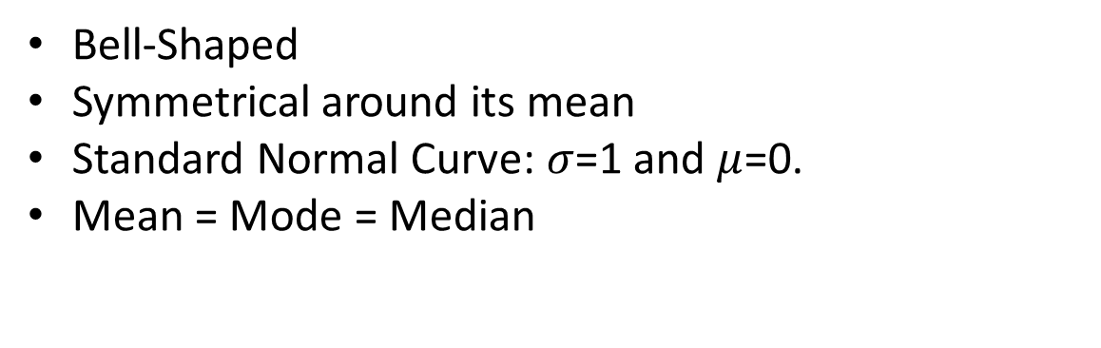
Normal Distribution
Bell-Shaped
Symmetrical around its mean
Standard Normal Curve: $σ$=1 and $μ$=0.
Mean = Mode = Median
.5
.5
Mean
Median
Mode

Slide 59
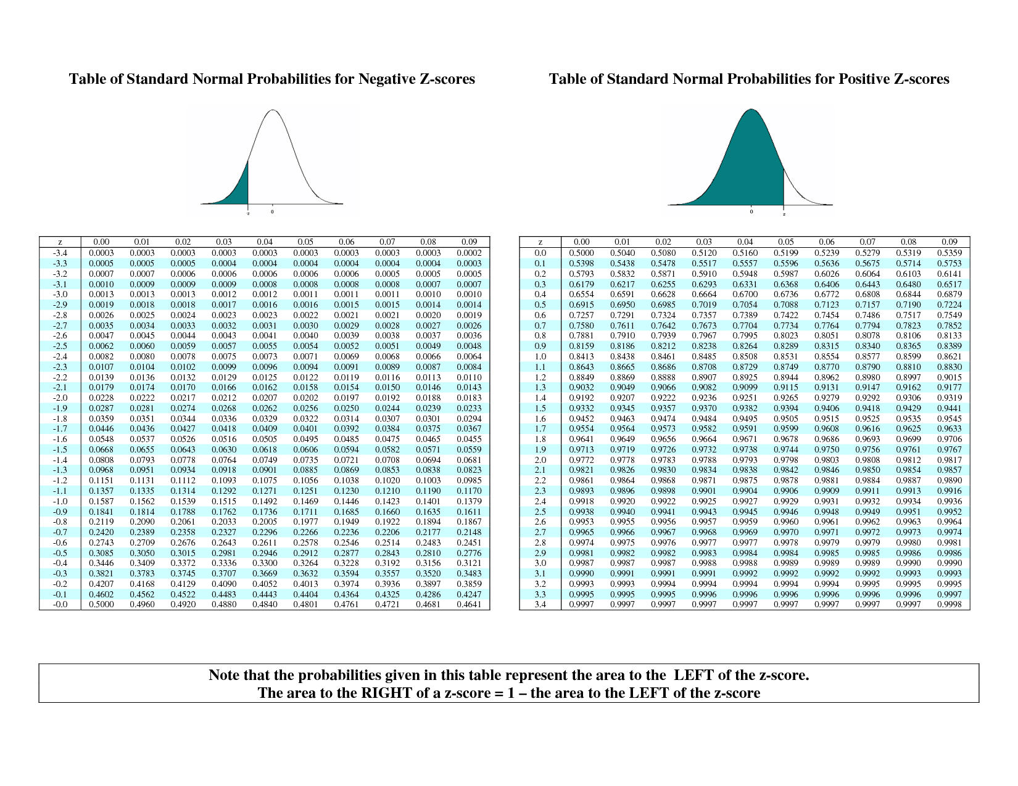
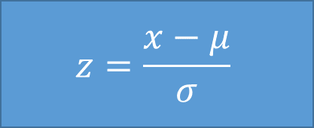
Z Score
$$z=\frac{x−μ}{σ}$$
A measure of the how many standard deviations away your x is from the µ.
After finding a z score, looking in up on the table and it tells the probability of any number in the distribution being below your x value.
  Always look at area to the left

Slide 60
A
A z-score question will be asked in 1 of 4 ways.

Slide 61
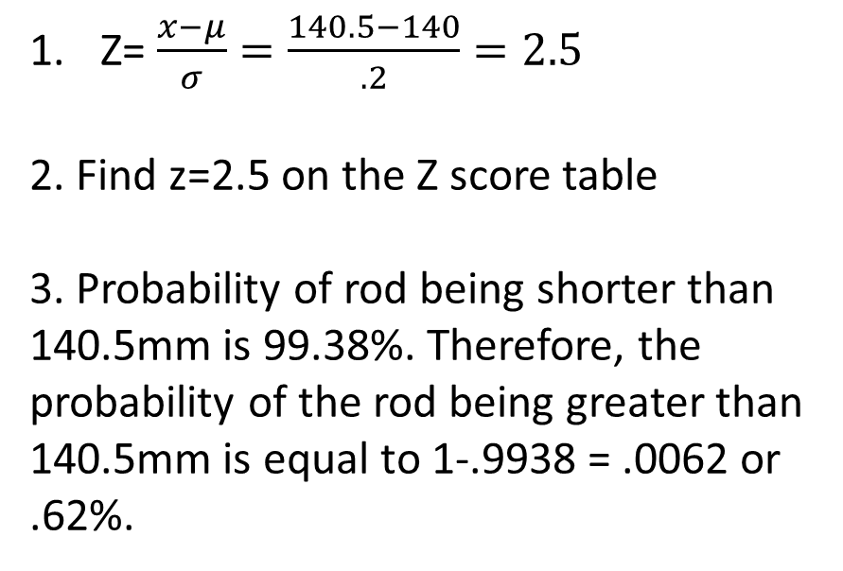
Option 1: Find the probability on either side of X
Compute the probability that a randomly selected rod is longer than 140.5mm. (Ơ=.2,µ=140)
Z= $\frac{x−μ}{σ}=\frac{140.5−140}{.2}=2.5$
2. Find z=2.5 on the Z score table
3. Probability of rod being shorter than 140.5mm is 99.38%. Therefore, the probability of the rod being greater than 140.5mm is equal to 1-.9938 = .0062 or .62%.
?
140mm
140.5mm

Slide 62
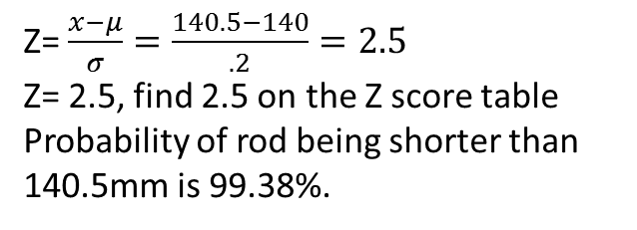
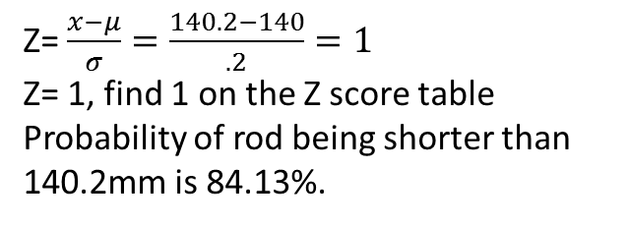
Option 2: Find the probability between two points (x)
Compute the probability that a randomly selected rod is between 140.2mm and 140.5mm. (Ơ=.2,µ=140)
Z= $\frac{x−μ}{σ}=\frac{140.5−140}{.2}=2.5$
Z= 2.5, find 2.5 on the Z score table
Probability of rod being shorter than 140.5mm is 99.38%.
99.38%
140mm
140.5mm
Z= $\frac{x−μ}{σ}=\frac{140.2−140}{.2}=1$
Z= 1, find 1 on the Z score table
Probability of rod being shorter than 140.2mm is 84.13%.
84.13%
140mm
140.2mm
99.38 – 84.13 = 15.25
The probability of a selected rod being between 140.2mm and 140.5mm is 15.25%.
15.25%
140mm
140.2mm
140.5mm

Slide 63
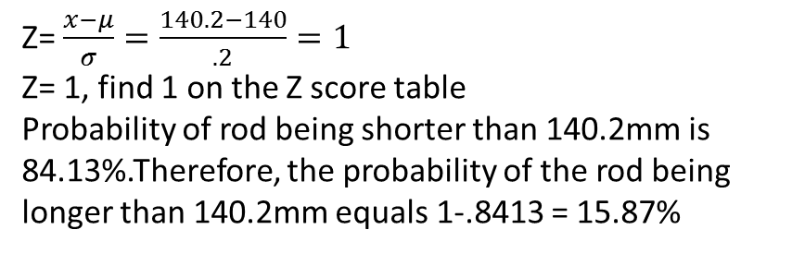
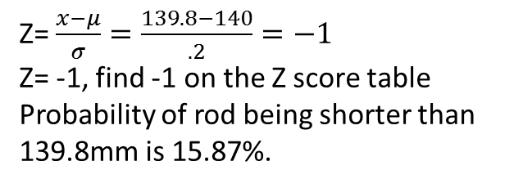
Option 3:Find the probability at both ends of the distribution
A rod is considered defective if it is less than 139.8mm or if it is longer than 140.2mm. Compute the probability that a random selected rod will be defective. (Ơ=.2,µ=140)
Z= $\frac{x−μ}{σ}=\frac{139.8−140}{.2}=−1$
Z= -1, find -1 on the Z score table
Probability of rod being shorter than 139.8mm is 15.87%.
15.87
139.8mm
140mm
Z= $\frac{x−μ}{σ}=\frac{140.2−140}{.2}=1$
Z= 1, find 1 on the Z score table
Probability of rod being shorter than 140.2mm is 84.13%.Therefore, the probability of the rod being longer than 140.2mm equals 1-.8413 = 15.87%
15.87
140mm
140.2mm
Since we are looking for the probability of the rod being shorter than 139.8mm or longer than 140.2mm , we can simply add the two probabilities found above. 15.87 + 15.87 = 31.74%
15.87
15.87
139.8mm
140mm
140.2mm

Slide 64

Z score Option 4 (special case)
Normally in any Z-score problem, the x, µ, and $σ$ are given.
However in some cases, the $σ$, µ, and a percentage is given and the question asks to find the X.
In order to solve
  1- Find the given percentage on the inside of the Z score table and the matching z score value.
    Remember the percentage represents the probability to the left of X and not the actual z score
  2- Plug in your z score, $σ$, and µ into the z score formula and solve for X.

Slide 65

Option 4 Example
A population has a mean of 3 and a standard deviation of .5. Find the 60th percentile.
Understand that the 60th percentile means what value(x) is greater than 60% of the value when dealing with continuous distributions.
Find 60% on the z-score table. 60% equals a z-score between 0.25 and 0.26.
Take the average of both z scores =$\frac{.25+.26}{2}$=.255
Plug all the values in the z score formula, $z=\frac{x−μ}{σ}$ =.255=$\frac{x−3}{.5}$
Isolate X,
  .2$55=\frac{x−3}{.5}$
  X-3=.1275
  X=3.1275
Final statement; 60% of the values in the distribution are less than or equal to 3.1275.

Slide 66

Z Score Process
X
$$µ$$
$$Ơ$$
Z Score
Probability

Slide 67
Video Practice Problems
https://www.youtube.com/watch?v=Q6Q2ICyt7iI

Slide 68
Sampling Distributions
Chapter 7

Slide 69
Chapter Overview
Central limit Theorem
Modified Z Score Formula
Proportions

Slide 70

Central limit Theorem Explained
µӿ=µ: The mean of the entire population can be found using the average of all the means from every possible sample of the given population
Ơӿ$=\frac{Ơ}{\sqrt{n}}$: the average standard deviation of all possible samples can also be found by using the standard deviation of the entire population and the square root of the sample size, n
***These relationships will be used in this chapter as well as later chapters to make estimations about the entire sample.

Slide 71


Theory explained
# of possible samples: $\frac{20!}{7!\left(20−7\right)!}=77520$
Population 1,2,3,4,5,6,7,8,9,10,11,12,13,14,15,16,17,18,19,20 µ=10.5
Sample 1: 2,7,10,12,13,16,18 ӿ= 11.14
Sample 2: 5,7,11,15,18,19,20 ӿ=13.57
Sample 3: 1,2,4,5,7,8,20 ӿ=6.71
Sample 4: 4,6,9,10,11,17,19 ӿ=10.86
Sample 5: 1,3,6,9,12,15,18 ӿ=9.14
$$\frac{11.14+13.57+6.71+10.86+9.14…}{77520}=10.5$$

Slide 72
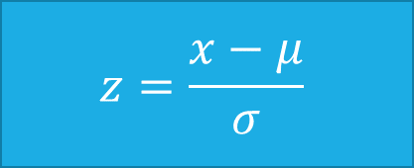
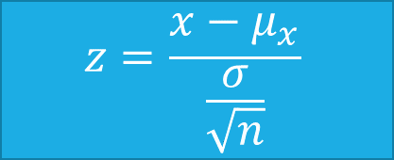
Modified Z Score formula
Chapter 6; normal distributions
$$z=\frac{x−μ}{σ}$$
The Z score will always give the probability to the left of the x value
The formula has been modified by replacing the mean and standard deviation of the population by the average mean and standard deviation of all possible samples.
Chapter 7; sampling distributions
$$z=\frac{x−μ_{x}}{\frac{σ}{\sqrt{n}}}$$

Slide 73

Example: The size of servings of soft ice cream in a fast-food chain is monitored carefully so that the mean serving is 250g, with a standard deviation of only 7.5g. Treat the weights as being normally distributed.
A) Inspectors select 20 servings at random, and weigh them. What is the probability that the mean weight is either below 240g or above 260g?
The key step for problems related to sampling distributions is to understand if problem is about a sample or a population and if the values given are related to the sample or population.
Step 1: Interpret the values given in the problem
Mean = 250g and standard deviation = 7.5g, both are based the population
Step 2: Understand if the problem is about a sample or population
Select 20 servings; therefore the is about a sample
Step 3: Convert the values from population to sample
µӿ=µ; µ=250g=µӿ
Ơӿ$=\frac{Ơ}{\sqrt{n}}, \frac{7.5}{\sqrt{20}}=1.6771$

Slide 74


A) Inspectors select 20 servings at random, and weigh them. What is the probability that the mean weight is either below 240g or above 260g?
$$z=\frac{x−μ_{x}}{\frac{σ}{\sqrt{n}}}=z=\frac{240−250}{\frac{7.5}{\sqrt{20}}}=−5.9628$$
The value is off the z score table assume the probability equals 0
0
240
250
$$z=\frac{x+μ_{x}}{\frac{σ}{\sqrt{n}}}=z=\frac{260−250}{\frac{7.5}{\sqrt{20}}}=5.9628$$
The value is off the z score table assume the probability equals 0
0
250
260
Since both probability of the mean being below 240 or above 260, the probability of it being either above or below is zero
0
0
240
250
260

Slide 75

B) At least how much ice cream is there in a serving that is among the heaviest 15% of servings? (Note: the question is asking about the whole population and not the sample therefore use the chapter 6 or unmodified z score formula)
Step 1: Since the z score table shows the probability to the left ( the lightest), 1-.15=.85
Step 2: Find the closest z score value to the probability of .85
Z=1.04
Step 3: Solve for x $z=\frac{x−µ}{Ơ}$
$$1.04=\frac{x−250}{7.5}$$
X= 257.8

Slide 76
Proportions
A proportion is a part or percentage of all total that fits a certain characteristic
Example: A watch manufacturer reports that 2 out of every 10 watches made are defective
Therefore, it can be said that .2 or 20% of the watches represent the defective proportion of all watches.

Slide 77

The sampling Distribution of the Sample proportion ℗
Approximately has a normal distribution, if the sample size n is large
  NP>=5
  N(1-p)=5
2) µ℗=P
3) Ơ℗=$\sqrt{\frac{p(1−p)}{n}}$

Slide 78

Example: The inspections at Acme reveal that 8% of the transistors are defective. In a sample of 400 transistors, what is the probability that at least 10% of them are defective? What is the standard error of the proportion of defectives?
Step 1: identify the proportion
8% or .08 of the transistors are defective
Step 2: Find the standard deviation using the appropriate formula
Ơ℗=$\sqrt{\frac{p(1−p)}{n}}$, $\sqrt{\frac{.08(1−.08)}{400}=.01356}$
Step 3: use the z score formula
Z=$\frac{.1−.08}{.01356}=1.475$, probability = .9292
Step 4: Since the table gives the percentage to the left of x
1-.9292=.0708
The probability of at least 10% being defective = 0.0708

Slide 79
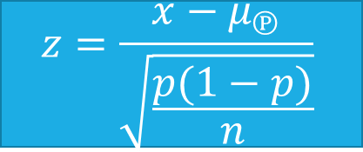
Modified Z Score formula for proportions
Chapter 6; normal distributions
$$z=\frac{x−μ}{σ}$$
The z score formula behaves in the same manner, the only difference is how the standard deviation is calculated
Chapter 7; sampling distributions proportions
$$z=\frac{x−μ_{℗}}{\sqrt{\frac{p(1−p)}{n}}}$$

Slide 80
Video Practice Problems
https://www.youtube.com/watch?v=uRzs2qjZoc0&feature=youtu.be

Slide 81
Confidence intervals
Chapter 8

Slide 82
Chapter Overview
Confidence Intervals
T table
Margin of Error

Slide 83

Confidence Interval Theory
In chapter 7, we used the values found in a sample to estimate the values of the entire population (point estimates)
  µӿ=µ
  Ơӿ$=\frac{Ơ}{\sqrt{n}}$
However, how can we be sure that the values founded from the sample are a fair representation of the values for a population?

Slide 84
Example
If a watch manufacturer reports that this week an average of 2 watches were defective per day.
How do we know where the real population mean of defective watches will be or even what will next week’s average be?
µx=2

Slide 85
Confidence interval
The truth: we can not precisely predict the exact population mean, however we can predict a range of values which should include the exact population mean
  It is important to note, that even the range can not be 100% certain therefore we must pick a certainty percentage or confidence level and leave some room for error
3 possible methods
  Z score confidence intervals
  T-based confidence intervals
  Proportion based confidence intervals

Slide 86





Z-score Confidence Interval (Ơ Known)
(ӿ-$Z_{\frac{ᵅ}{2}}\frac{Ơ}{\sqrt{n}})$(ӿ$+Z_{\frac{ᵅ}{2}}\frac{Ơ}{\sqrt{n}}$)
Alpha ᵅ:is the probability of error or 1-condfience level
$$\frac{ᵅ}{2}$$
$$\frac{ᵅ}{2}$$
ӿ-$Z_{\frac{ᵅ}{2}}\frac{Ơ}{\sqrt{n}}$
ӿ
ӿ+$Z_{\frac{ᵅ}{2}}\frac{Ơ}{\sqrt{n}}$

Slide 87



How to find the Z or T value for a given confidence level (Example (95% confidence)
Step 1: Find the alpha given the confidence level
1-confidence level = alpha
1-.95=.05
Step 2: interpret the alpha and confidence
If the confidence level represents the bounded section of the distribution, the alpha represents the tails of the distribution
Step 3: Find the z score by looking up the probability to the left of the highlighted tail on the z score table
1-highlighted tail = 1-.025=.9725
Look up .9725 on the z score able = z score =1.96
1.96 would be the value used for $Z_{\frac{a}{2}}$in both the + or – confidence formulas
95%
$$\frac{A}{2}=\frac{5\%}{2}=2.5\%$$
$$\frac{A}{2}=\frac{5\%}{2}=2.5\%$$

Slide 88

T-based confidence level (Ơ Unknown)
(ӿ-$t_{\frac{ᵅ}{2}}\frac{s}{\sqrt{n}})$(ӿ$+t_{\frac{ᵅ}{2}}\frac{s}{\sqrt{n}}$)
Very similar to Z confidence level
Find the Alpha
  Usually the confidence level is given, alpha = 1-confidence level
  Do not forget to divide alpha by two
Find the Degree of Freedom
  The number of values in your sample,n, minus 1 (df=n-1)
Find the confidence interval

Slide 89
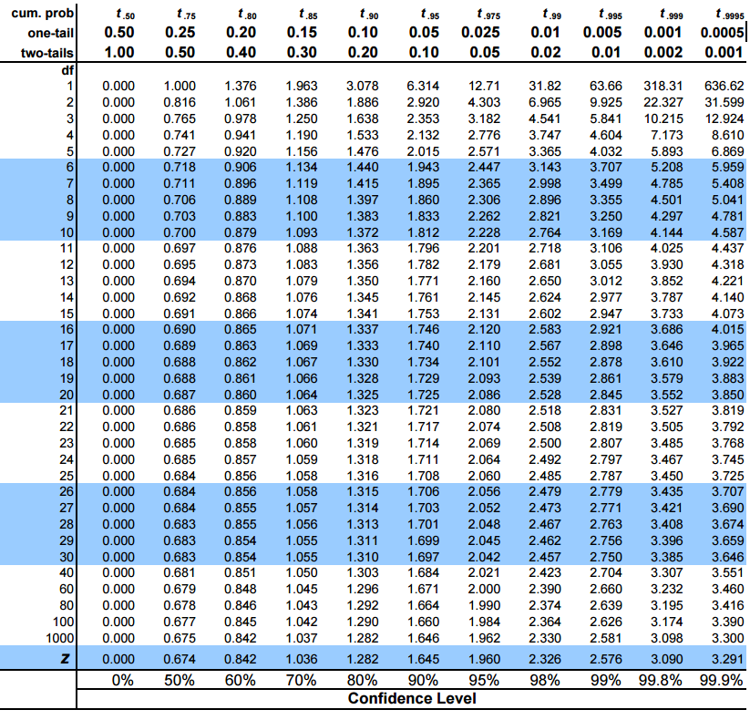

Slide 90

Proportion based confidence level
(℗-$z_{\frac{ᵅ}{2}}\sqrt{\frac{℗(1−℗)}{n}})$, (℗+$z_{\frac{ᵅ}{2}}\sqrt{\frac{℗(1−℗)}{n}})$
A case where ℗=.5 will have the greatest result
In this case: it is important to remember that it deals with a percentage or proportion of the sample/population

Slide 91
How to tell when to use Z, T, or Proportion
If the question states a proportion or a percentage f the same use proportion
If not
N>=50?
Yes
No
Z
Is Ơ given?
Yes
No
Z
T

Slide 92
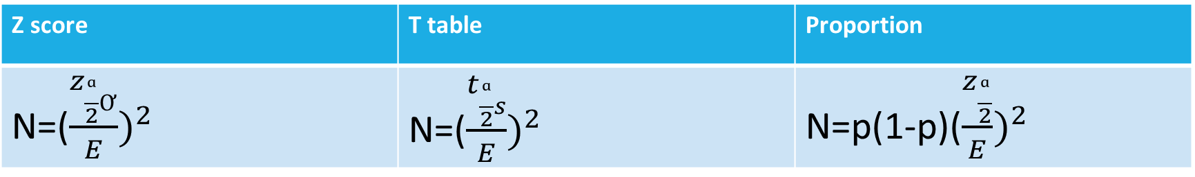
How find the sample needed for a for a specific margin of error
Z score | T table | Proportion
N=(${\frac{z_{\frac{ᵅ}{2}Ơ}}{E})}^{2}$ | N=(${\frac{t_{\frac{ᵅ}{2}s}}{E})}^{2}$ | N=p(1-p)(${\frac{z_{\frac{ᵅ}{2}}}{E})}^{2}$
E=margin of error
N=sample size
Questions can be asked in 1 of 2 ways
Find the sample size(n) for a given margin of error
Find the margin error(E) for a given sample size

Slide 93
Video Practice Problems
https://www.youtube.com/watch?v=QmzRxXYQjUI&feature=youtu.be

Slide 94
Hypothesis Testing
Chapter 9

Slide 95
Chapter Overview
Testing a Hypothesis
Types of Errors
P value

Slide 96
Hypothesis testing
Hypothesis testing is used to mathematically accept or reject a hypothesis (assumption or inference) about a given population.
Null hypothesis,H0, which is the initial assumption. The standard at which the population is thought to be currently at.
Alternative hypothesis,H1, which is the new statement which contradicts the null hypothesis, enforcing new standard.
Law approach: innocent until proven guilty

Slide 97
Examples of H0 vs H1
A sock manufacturer makes on average 300 socks per day. Recently, an inspector came to the conclusion that the factory is under producing and only makes 225 socks per day. Identity H0 and H1.
H0= 300 socks per day (300 is the current standard)
H1= 225 socks per day (225 is a new claim that needs to be proven)

Slide 98
Types of hypothesis testing
Do not reject H0
Left tailed Test
Less than problem
Do not divide Alpha by 2
Reject H0
Right tailed Test
Great than problem
Do not divide Alpha by 2
Do not reject H0
Reject H0
Do not reject H0
Two tailed Test
In between values
Divide Alpha by 2, due to two tails
Reject H0
Reject H0

Slide 99
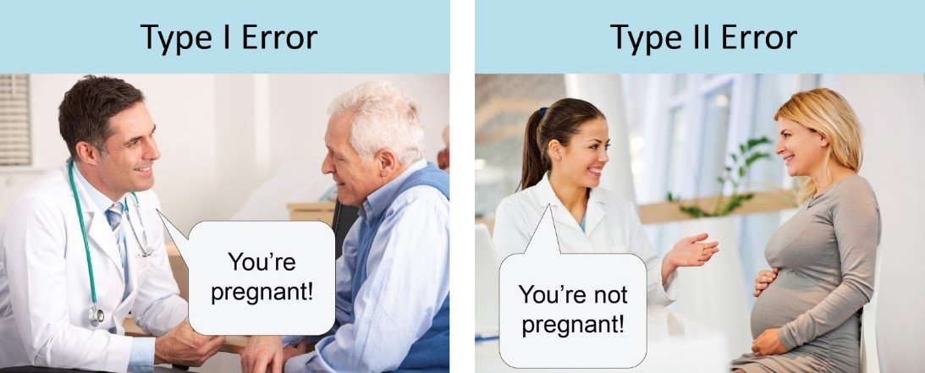
Types of error
Type 1 error = Alphaᵅ
Type 2 error = Beta ϐ
Type 1 and 2 error are inversely correlated, as one increases, the other decreases
Type 1 error: If we reject H0 when it is True
Type 2 error: If we do not reject H0 when it is False

Slide 100
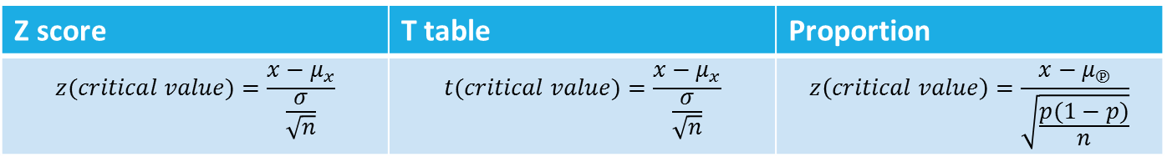
Steps to solve any Hypothesis Question
Step1: State the Null,H0, and Alternative,H1, hypothesis
Based on the law approach
Step 2: Identify the significance, Alpha
Alpha = 1-confidence level
Step 3: Determine which method to use (Z,T, or Proportion)
Step 4: Find the cut-off point or points using the confidence level
Step 5: Find the critical Value using the appropriate modified z score formula, find the value equal to the mean of the Alternative hypothesis
Z score | T table | Proportion
(ӿ-$Z_{\frac{ᵅ}{2}}\frac{Ơ}{\sqrt{n}})$(ӿ$+Z_{\frac{ᵅ}{2}}\frac{Ơ}{\sqrt{n}}$) | (ӿ-$t_{\frac{ᵅ}{2}}\frac{s}{\sqrt{n}})$(ӿ$+t_{\frac{ᵅ}{2}}\frac{s}{\sqrt{n}}$) | (℗-$z_{\frac{ᵅ}{2}}\sqrt{\frac{℗(1−℗)}{n}})$, (℗+$z_{\frac{ᵅ}{2}}\sqrt{\frac{℗(1−℗)}{n}})$
Z score | T table | Proportion
$$z(critical value)=\frac{x−μ_{x}}{\frac{σ}{\sqrt{n}}}$$ | $$t(critical value)=\frac{x−μ_{x}}{\frac{σ}{\sqrt{n}}}$$ | $$z\left(critical value\right)=\frac{x−μ_{℗}}{\sqrt{\frac{p(1−p)}{n}}}$$

Slide 101







Testing the hypothesis
Do not reject H0
Step 1: Graph $z_{a}$
Step 2: Graph the critical value
Step 3: if the critical value is to left of $z_{a},$reject H0 and if it is to the right do not reject H0
Reject H0
$$−z_{a}$$
Step 1: Graph $z_{a}$
Step 2: Graph the critical value
Step 3: if the critical value is to left of $z_{a},$do not reject H0 and if it is to the right reject H0
Do not reject H0
Reject H0
$$z_{a}$$
Do not reject H0
Step 1: Graph $z_{a/2}$
Step 2: Graph the critical value
Step 3: if the critical value is between ${−z}_{a/2}andz_{a/2},$do not reject H0 and if not reject H0
Reject H0
Reject H0
$${−z}_{\frac{a}{2}}$$
$$z_{\frac{a}{2}}$$

Slide 102
P-Value
P-value is an alternate method of testing H0
The p-value is the probability of getting a value less than the critical value
If the p-value is less than the Alpha, reject H0
If the p-value is greater than the Alpha, do not reject H0

Slide 103
Example of P-value
A sample of 50 values has a mean of 34 and a standard deviation of 5.
H0: at least 35 will meet the company standard
H1: less than 35 will meet the company standard
Use a significance level of 5%
Step 1: Determine which method to use, Z or T
Since n is greater than of equal to 50 use z score

Slide 104


Example of P-value continued
Step 2: Find the cut-off point
Since H1 only states less than, this problem only involves one tail
Step 3: Find the critical value
Critical value=$\frac{x−μ}{\frac{s}{\sqrt{n}}}$=$\frac{34−35}{\frac{5}{\sqrt{50}}}=$-1.414
Look up the z score equivalent to the Alpha, -1.645 is the z score that leaves 5% to the left of it
$$−z_{a}$$

Slide 105
P-value example continued
Step 4: Find the probability to the left of the critical value
Look up -1.414 or round down to -1.41 the z score table
The probability to the left of -1.41 equals .0793 or 7.9%
Step 5: Compare the probability to the Alpha
Alpha equal 5%
Probability equals 7.9%
Since 7.9>5, we do not have sufficient evidence to reject H0

Slide 106
Video Practice Problems
https://www.youtube.com/watch?v=Ow6onH38-9Y&feature=youtu.be

Slide 107
Chi-Squared Tests
Chapter 10

Slide 108
Chapter Overview
A goodness of fit test for Multinomial Probability
A Goodness-of-fit Test for a Normal Distribution
A chi-square test for independence

Slide 109
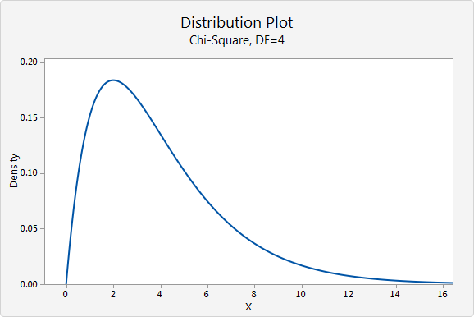
Chi square Test
Hypothesis testing
  Main goal is to prove Ho or Ha (Always one tail)
Multinomial Experiment
  Binomial (Chapter 5) = 2 possible outcomes
  Multinomial = multiple possible outcomes (at least 3)
  200 Sales days
 | Low (K1) | Medium (K2) | High (K3) | Very High (K4)
Probability (P) | 24% | 17% | 56% | 3%
Expected Units (E) | 48 | 34 | 112 | 6

Slide 110

A goodness of fit test for Multinomial Probability
Goal: To compare the frequency of a sample to the expected frequency of the experiment
Step 1: Find the necessary variables
  F=the observed frequency of each class
  E=np, the expected frequency
Step 2: Identify H0 and Ha
  H0=the probability of getting a value in the first class is p1, the probability of getting a value in the second class is p2…..
  Ha= at least one of the multinomial probabilities is not equal to the value stated in H0
Step 3: Find the Chi-square goodness-of-fit statistic
  $x^{2}=\sum_{i=1}^{k}{\frac{{(f−E)}^{2}}{E}}$
Step 4: Find the Cut-off value
  Use alpha
  K-1 degrees of freedom
Step 5: Evaluate H0, reject if
  $x^{2}>x_{a}^{2}$
  P-value < a

Slide 111
Example Case 1:Multinomial Probability
n=50 a=.05 | Poor | Average | Great
Probability | 30% | 50% | 20%
Sample | 9 | 30 | 11
Step 1: Find the necessary variables
  F=the observed frequency of each class
  E=np, the expected frequency
n=50 a=.05 | Poor | Average | Great
Probability | 30% | 50% | 20%
Sample | 9 | 30 | 11
Expected (np) | 50x.30=15 | 50x.5=25 | 50.20=10

Slide 112

Example Case 1:Multinomial Probability
Step 2: Identify H0 and Ha
  H0=the probability of getting a value in the first class is p1, the probability of getting a value in the second class is p2…..
  Ha= at least one of the multinomial probabilities is not equal to the value stated in H0
Step 3: Find the Chi-square goodness-of-fit statistic
  $x^{2}=\sum_{i=1}^{k}{\frac{{(f−E)}^{2}}{E}}$
$$X^{2}=\frac{{(9−11)}^{2}}{11}+\frac{{(30−25)}^{2}}{25}+\frac{{(11−10)}^{2}}{10}$$
$$X^{2}=1.463$$

Slide 113

Example Case 1:Multinomial Probability
Step 4: Find the Cut-off value
  Use alpha
  K-1 degrees of freedom
Degrees of freedom= 3-1 = 2
$$X_{a=.05}^{2}=5.99$$
Step 5: Evaluate H0
  $x^{2}>x_{a}^{2}$
  P-value < a
1.463<5.99
We can not reject H0

Slide 114

A Goodness-of-fit Test for a normal distribution
Goal: to determine if the distribution is normally distributed
Step 1: Identify H0 and Ha (always the same)
  H0: The population is normally distributed
  H1: The population is not normally distributed
Step 2: Select a random sample, n
  Find the sample mean
  Find the sample standard Deviation
Step 3: Determine the number of intervals for the test, K
  Find the classes using $2^{k}>n$
Step 4: Measure the observed frequency, f
Step 5: Calculate the expected frequency, E
  Use the sample mean and sample standard deviation to find the probability of each class
Step 6: Find the Chi-square statistic
  $x^{2}=\sum_{i=1}^{k}{\frac{{(f−E)}^{2}}{E}}$
  K-3 degrees of freedom
  K-1-m, m being the number of population estimates used (mean and standard deviation)
Step 7: Test H0, reject if
  $x^{2}>x_{a}^{2}$
  P-value < a

Slide 115
Example Case 2: Normal Distribution
Interval | Frequency | Z Score distribution | Z Score | Probability | Expected (np)
0-10 | 5 | 10 or below | -1.49 | 6.81% | 3
11-20 | 6 | Between 11 and 20 | -1.49=-.6556 | 18.65% | 9
21-30 | 20 | Between 21 and 30 | -.6556=.1796 | 31.68% | 16
31-40 | 10 | Between 31 and 40 | .1796=1.0147 | 27.47% | 14
41-50 | 9 | Above 41 | 1.0147< | 15.4% | 8
Total | 50 |  |  | 1 | 50
Mean = 27.85
Standard Deviation = 11.9737
Alpha = .05

Slide 116

Example Case 2: Normal Distribution
Step 2:
How to find the mean when the sample is organized in classes
Find the midpoint of each classes
$\sum{\frac{\left(frequency x midpoint of class 1\right)+\left(frequency x midpoint of classes 2\right)…..}{n}}$
Ex: $\frac{\left(5x5\right)+\left(6x15.5\right)+\left(20x25.5\right)+\left(10x35.5\right)+(9x45.5)}{50}=$ 27.85
How to find the Standard Deviation when the sample is classes
1)$\sqrt{\frac{\sum{{Frequency(midpoint−mean)}^{2}}}{n−1}}$
Ex:$\sqrt{\frac{{5(5−27.85)}^{2}+{6(15.5−27.85)}^{2}+{20(25.5−27.85)}^{2}+{10(35.5−27.85)}^{2}+{9(45.5−27.85)}^{2}}{50−1}}$
= 11.9737

Slide 117

Example Case 2: Normal Distribution
Step 5: Calculate expected frequency
Find the probability using Z score
Ex:
$z=\frac{10−27.85}{11.9737}=$ -1.49, 6.81%
2) Multiple the probability for each class by the sample size
.0681 x 50 = 3(rounded)
We would expected 3 values to be below 10.
10
27.85

Slide 118

Example Case 2: Normal Distribution
Step 6: Find the Chi-square Statistic
$$x^{2}=\sum_{i=1}^{k}{\frac{{(f−E)}^{2}}{E}}$$
$$X^{2}=\frac{{(5−3)}^{2}}{3}+\frac{{(6−9)}^{2}}{9}+\frac{{(20−16)}^{2}}{16}+\frac{{(10−14)}^{2}}{14}+\frac{{(9−8)}^{2}}{8}$$
$$X^{2}=4.6012$$
$$x_{\begin{aligned}a=.05, 5−3=2df=5.99 \\ \end{aligned}}^{2}$$
Step 7: Test H0
4.6012<5.99, do not reject H0

Slide 119

A chi-square test for independence
Goal: To determine if the groups of values are independent from one another
Step 1: Identify key values f, r, and c.
  F, frequency per cell
  R, the totals of each row
  C, the totals of each column
Step 2: Calculate the expected frequency
  $E=\frac{r_{i}c_{i}}{n}$
Step 3: State H0 and Ha
  H0: independent
  Ha: dependent
Step 4: Find the Chi-square Statistic
  $x^{2}=\sum_{i=1}^{k}{\frac{{(f−E)}^{2}}{E}}$
  Degrees of freedom = (r-1)(c-1)
Step 5: Test H0, reject if
  $x^{2}>x_{a}^{2}$
  P-value < a

Slide 120
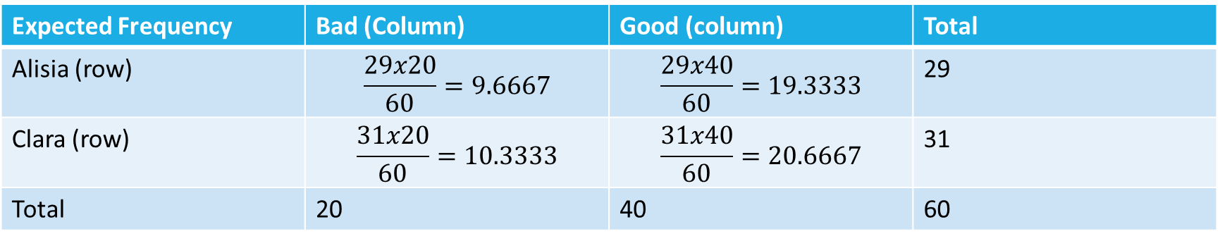
Example Case 3: Independence
Given | Bad (Column) | Good (column) | Total
Alisia (row) | 11 | 18 | 29
Clara (row) | 9 | 22 | 31
Total | 20 | 40 | 60
Expected Frequency | Bad (Column) | Good (column) | Total
Alisia (row) | $$\frac{29x20}{60}=9.6667$$ | $$\frac{29x40}{60}=19.3333$$ | 29
Clara (row) | $$\frac{31x20}{60}=10.3333$$ | $$\frac{31x40}{60}=20.6667$$ | 31
Total | 20 | 40 | 60

Slide 121

Example Case 3: Independence
Step 3: State H0 and Ha
  H0: independent
  Ha: dependent
Step 4: Find the Chi-square Statistic
  $X^{2}=\frac{{(11−10)}^{2}}{10}+\frac{{(9−10)}^{2}}{10}+\frac{{(18−19)}^{2}}{19}+\frac{{(22−21)}^{2}}{21}=x^{2}=.3003$
  Degrees of freedom = (r-1)(c-1)
  Degrees of freedom = (2-1)(2-1)=1
  $x_{a=.05,df=1}^{2}=3.841$
Step 5: Test H0, reject if
  $x^{2}>x_{a}^{2}$
  .3003 < 3.841, do not reject H0

Slide 122
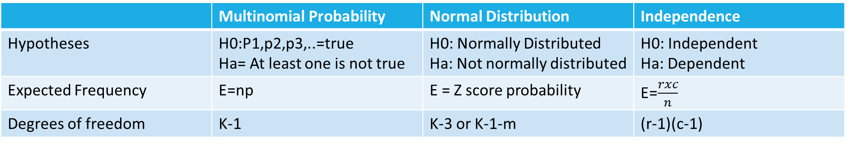
The difference between the 3 cases
 | Multinomial Probability | Normal Distribution | Independence
Hypotheses | H0:P1,p2,p3,..=true Ha= At least one is not true | H0: Normally Distributed Ha: Not normally distributed | H0: Independent Ha: Dependent
Expected Frequency | E=np | E = Z score probability | E=$\frac{rxc}{n}$
Degrees of freedom | K-1 | K-3 or K-1-m | (r-1)(c-1)

Slide 123
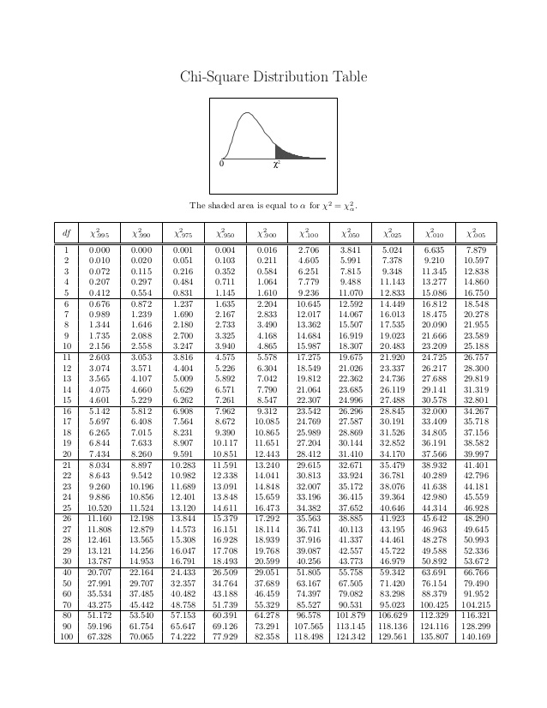

Slide 124
Video Practice Problems
https://www.youtube.com/watch?v=gykyBAn8gyc&feature=youtu.be

Slide 125
Simple Linear Regression Analysis
Chapter 13

Slide 126
Chapter Overview
Least Squares Line
Types of Variation (SST,SSR,SSE)
R-squared
Testing the significance of the Slope (B1)
Confidence Intervals

Slide 127

The Basics
Y=MX+B
M (the slope) = $\frac{y_{2}−y_{1}}{x_{2}−x_{1}}$
X is the independent variable
Y is the dependant variable
B is the y intercept (when x is zero, what is Y)

Slide 128

The simple Regression Model
Y=$B_{0}+B_{1}x+ε \text{Y}\text{=}\text{MX}\text{+}\text{B}$
$B_{0}$= B
$B_{1}$= M
$∗ε=error$
  $ε$ represents any change in y that is not explained by x

Slide 129

Least squares line
The least squares line is the line that minimizes the sum of the squared residuals
  Residual: the distance between the point the and line

Slide 130

Mean value Vs Predictor
$U_{y}=B_{0}+B_{1}X$
  $U_{y}$is the average y based on a given x value
$y\left(hat\right)= b_{0}+b_{1}x$
  Y(hat) the predicted y value for a given x value

Slide 131


How to find $B_{1}$
$b_{1}=\frac{{SS}_{xy}}{{SS}_{xx}}$
  ${Sum of Squares SS}_{xy}=\sum{\left(x−x\left(avg\right)\right)∗\left(y−y\left(avg\right)\right)=\sum{XY−\frac{\sum{x}\sum{y}}{n}}}$
  $Sum of Squares {SS}_{xx}=\sum{{(x−x\left(avg\right))}^{2}=\sum{x^{2}−\frac{{(\sum{x})}^{2}}{n}}}$

Slide 132


How to find $B_{0}$
$b_{0}=y\left(avg\right)−b_{1}x$(avg)
  Y(avg)=$\frac{\sum{y}}{n}$
  X(avg)=$\frac{\sum{x}}{n}$

Slide 133

y(hat)=$b_{0}+b_{1}X$
Point estimate
  We are estimating that the real y should be somewhere near the y our model gives us
Point Prediction
  We assume that the error in our model is equal to zero and therefore we predict the true y will be equal to our predicted y

Slide 134

Total Variation
Total variation = Explained variation + unexplained variation
  SST = SSR + SSE
  SST=$\sum{{(y(true)−y\left(avg\right))}^{2}}$
Explained variation = the difference between our predicted y and the average y
  SSR=$\sum{{(y\left(pre\right)−y\left(avg\right))}^{2}}$
Unexplained variation = the difference between the true y and our predicted y
  SSE=$\sum{{(y(true)−y\left(hat\right))}^{2}}$
  SSE=$\sum{y^{2}−b_{0}\sum{y−b_{1}\sum{xy}}}$

Slide 135


Slide 136


$$R^{2}and R$$
$R^{2}=$ the simple Coefficient of Determination
  $R^{2}=\frac{Explained Variation}{Total varaition }=\frac{SSR}{SST}$
  $R^{2}$provides the percentage of variation in y explained by x
  Example: $R^{2}=90\%$, means 90% of the change in y is explained by the change in x
R = Simple Correlation Coefficient
  R= $+\sqrt{R^{2}}$if $b_{1}is positive or$R= $−\sqrt{R^{2}}$if $b_{1}is negative$
  R=$\frac{{SS}_{xy}}{\sqrt{{SS}_{xx}{SS}_{xy}}}$
  R is always between -1 and +1
  R measures how strong the relationship between X and Y is
    0 means there is no correlation and -1/+1 means there is a perfect correlation

Slide 137

The Regression Assumptions
The mean value of the error term is zero
Constant Variance Assumption: all populations of error have equal variances, denoted as $σ^{2}$
Normality Assumption: the population of potential error term is normally distributed
Independence Assumption: The error terms (ϵ) are independent of each other

Slide 138

Mean Square error and Standard error
Point estimate of $σ^{2}$, mean square error
  $s^{2}=\frac{SSE}{n−2}$
Point estimate of Ơ, standard error
  $s=\sqrt{\frac{SSE}{n−2}}$
Estimate of standard error of the slope, B1
  $s_{b1}=\frac{s}{\sqrt{SSxx}}$

Slide 139

Testing the significance of the slope
Step1: State hypothesis
$H_{0}=B_{1}=0$
Step 2: Identify the significance, Alpha
Alpha = 1-confidence level
Step 3: Determine which method to use (always t)
Step 4: Find the cut-off point or points using the confidence level
(ӿ-$t_{\frac{ᵅ}{2}}\frac{s}{\sqrt{n}})$(ӿ$+t_{\frac{ᵅ}{2}}\frac{s}{\sqrt{n}}$), df = n-k-1
Step 5: Find the critical Value using the following formula
$t=\frac{b_{1−B1}}{s_{b1}} where s_{b1}=\frac{s}{\sqrt{{SS}_{xx}}}$, s = $\sqrt{\frac{SSE}{n−k−1}}, SSxx=\sum{x^{2}−\frac{{(\sum{x})}^{2}}{n}}$

Slide 140

F Test for the Simple Linear Regression Model
Step1: State hypothesis
$H_{0}=B_{1}=0$ and $H_{a}=B_{1}≠0$
Step 2: Identify the significance, Alpha
Alpha = 1-confidence level
Step 3: Determine which method to use (always F)
Step 4: Find the cut-off point or points using the confidence level
$F_{a}=based on a numerator of 1 and df=n−2$
Step 5: Find the critical Value using the following formula
$F model=\frac{Explained Variation (SSR) }{\frac{Unexplained varaition (SSE)}{(n−2)}}$

Slide 141

Confidence Intervals
Based on DF = n-2
Confidence interval for slope $B_{1}$
  $b_{1}±t_{\frac{a}{2}}s_{b1}$
Confidence interval for mean value of y
  Y(hat) $±t_{\frac{a}{2}}s\sqrt{\frac{1}{n}+\frac{{(x−x\left(avg\right))}^{2}}{{SS}_{xx}}}$
Prediction Interval for an individual value of y
  Y(hat) $±t_{\frac{a}{2}}s\sqrt{1+\frac{1}{n}+\frac{{(x−x\left(avg\right))}^{2}}{{SS}_{xx}}}$

Slide 142
Video Practice Problems
https://www.youtube.com/watch?v=-eEVwW-MZeg&feature=youtu.be

Slide 143
Multiple Regression and Model Building
Chapter 14

Slide 144
Chapter Overview
Multiple Regression Line
Testing the significance of the entire model (F test)
  a. Anova Table
Testing the significance of a single X ( T Test)

Slide 145
The Regression Assumptions
The mean value of the error term is zero
Constant Variance Assumption: all populations of error have equal variances, denoted as $σ^{2}$
Normality Assumption: the population of potential error term is normally distributed
Independence Assumption: The error terms (ϵ) are independent of each other

Slide 146

Total Variation
Total variation = Explained variation + unexplained variation
  SST = SSR + SSE
  SST=$\sum{{(y(true)−y\left(avg\right))}^{2}}$
Explained variation = the difference between our predicted y and the average y
  SSR=$\sum{{(y\left(pre\right)−y\left(avg\right))}^{2}}$
Unexplained variation = the difference between the true y and our predicted y
  SSE=$\sum{{(y(true)−y\left(pre\right))}^{2}}$
  SSE=$\sum{y^{2}−b_{0}\sum{y−b_{1}\sum{xy}}}$

Slide 147
The Regression Assumptions
The mean value of the error term is zero
Constant Variance Assumption: all populations of error have equal variances, denoted as $σ^{2}$
Normality Assumption: the population of potential error term is normally distributed
Independence Assumption: The error terms (ϵ) are independent of each other

Slide 148


The Multiple Regression Model
Y=${B_{0}+B}_{1}X_{1}+B_{2}X_{2}+B_{3}X_{3}+E$
$y\left(hat\right)= b_{0}+b_{1}x+b_{2}x$

Slide 149

Mean Square Error and the Standard Error
The mean square error,$S^{2}$
  $S^{2}=\frac{SSE}{n−k−1}$
The Standard Error, S
  $s=\sqrt{\frac{SSE}{n−k−1}}$

Slide 150

F Test for the Multiple Regression Model
Step1: State hypothesis
$H_{0}=B_{1}=B_{2}=B_{3}=0$
Step 2: Identify the significance, Alpha
Alpha = 1-confidence level
Step 3: Determine which method to use (always F)
Step 4: Find the cut-off point or points using the confidence level
$F_{a}=alpha, {Df}_{1},{Df}_{2}$
Step 5: Find the critical Value using the following formula
$F model=\frac{\frac{SSR}{K} }{\frac{SSE}{N−K−1}}$=$\frac{MSR}{MSE}$

Slide 151


Slide 152

ANOVA Table
ANOVA | DFs | SS0 | MS | F
Regression | K | SSR | $$MSR=\frac{SSR}{K}$$ | $$F=\frac{MSR}{MSE}$$
Residual | N-K-1 | SSE | $$MSE=\frac{SSE}{N−K−1}$$
Total | N-1 | SST

Slide 153


$$R^{2}and Adjusted R^{2}$$
$R^{2}=$ the simple Coefficient of Determination
  $R^{2}=\frac{Explained Variation}{Total varaition }=\frac{SSR}{SST}$
  $R^{2}$provides the percentage of variation in y explained by x
  Example: $R^{2}=90\%$, means 90% of the change in y is explained by the change in x
$R^{2}$ = the adjusted multiple coefficient of determination
  $R^{2}=(R^{2}−\frac{K}{n−1})(\frac{n−1}{n−\left(k+1\right)})$

Slide 154

Testing the significance of an independent X
Step1: State hypothesis
$H_{0}=B_{1}=0$
Step 2: Identify the significance, Alpha
Alpha = 1-confidence level
Step 3: Determine which method to use (always t)
Step 4: Find the cut-off point or points using the confidence level
(ӿ-$t_{\frac{ᵅ}{2}}\frac{s}{\sqrt{n}})$(ӿ$+t_{\frac{ᵅ}{2}}\frac{s}{\sqrt{n}}$), df = n-k-1
Step 5: Find the critical Value using the following formula
$t=\frac{b_{1−B1}}{s_{b1}}$

Slide 155

Confidence Interval for a single B
B+/-$t_{\frac{a}{2}}S_{b1}$
  Based on df = n-k-1

Slide 156
Video Practice Problems
https://www.youtube.com/watch?v=2dEAJK0pzkQ&feature=youtu.be

Slide 157
Frequently Asked Questions

Slide 158
Final Exam Break Down
20-25 Multiple Choice Questions
4 to 5 Long answer questions
  Hypothesis Testing
  Chi-Square Test
  Single Linear Regression
  Multiple Linear Regression

Slide 159
Materials for Multiple Choice Questions
Types of Errors (Alpha and Beta)
Z Scores
Empirical rule
Graphs (Histogram Vs Bar chart)
Margin of Error
P value
Independent Vs Mutual Exclusive

Slide 160

Where can I find the shortcut formula for standard deviation?
$S^{2}=\frac{1}{n−1}(\sum_{i−1}^{n}{x^{2}}−\frac{({\sum_{i=1}^{n}{x)}}^{2}}{2})$
Only works for samples
$\sum_{i=1}^{n}{x^{2}};$means square each x individually, then add them up
${(\sum_{i=1}^{n}{x})}^{2};means$add up all the x as they are given, then square the total
This formula can save a lot of time, however it is not on the formula sheet

Slide 161
Which distribution to Use?
 | Ch. 6 | Ch. 7 | Ch. 8 | Ch.9 | Ch. 10 | Ch. 13 | Ch. 14
Z score | X | X | X | X
T Table |  |  | X | X |  | X | X
Chi Distribution |  |  |  |  | X
F Table |  |  |  |  |  | X | X

