Slide 1
The Respiratory System
Part A - Anatomy
Chapter 22

Slide 2
INTRODUCTION
• major function of respiratory system is to supply O₂ and dispose of CO₂
• 4 distinct processes:
1) Pulmonary ventilation: movement of air in and out of lungs
2) External respiration: exchange of gases between blood & air of alveoli
3) Transport of respiratory gases: role of blood in transport of gases between lungs & tissues of body
4) Internal respiration: at the level of the tissues, exchange of gases between blood in systemic capillaries and tissue cells
• first 2 functions handled by respiratory system; other two by CV system
J. Carnegie, UofO

Slide 3
6.1 Describe the structure of each one of the components of the conduction and respiratory zones
• respiratory zone: (= site of gas exchange) »» composed of respiratory bronchioles, alveolar ducts & alveoli (microscopic)
• conducting zone: (passageways) »» nose, nasal cavity, pharynx, larynx, trachea, bronchi, bronchioles, terminal bronchioles
• as well as providing a passageway, conducting zone organs also cleanse, humidify & warm incoming air

Slide 4
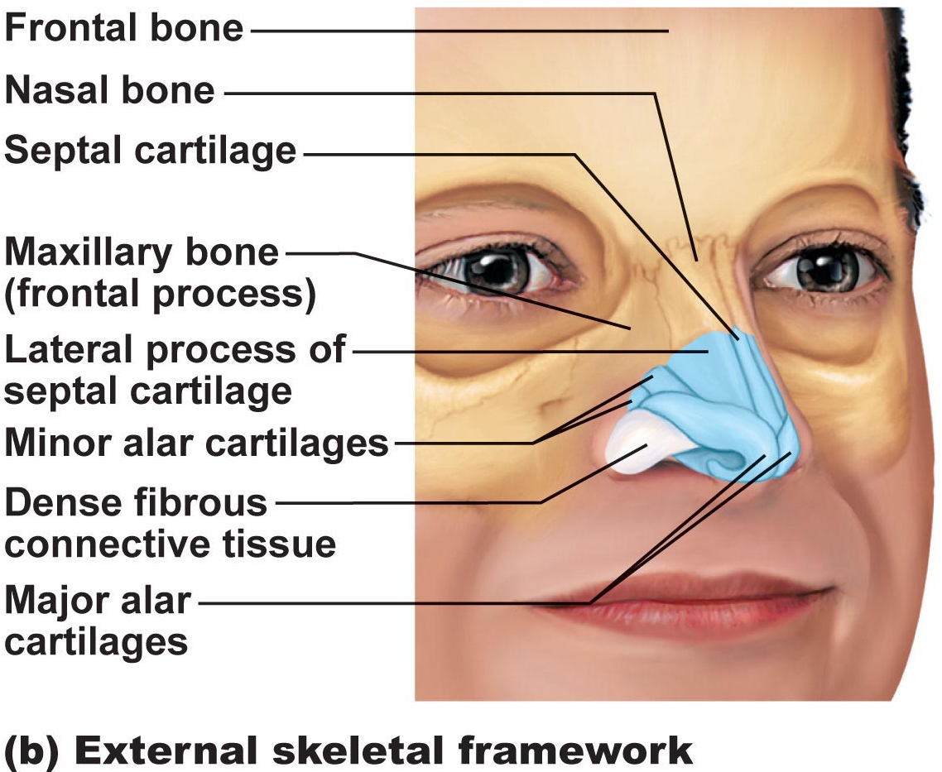
1. Nose
Functions:
a) airway for respiration
b) moistens & warms incoming air
c) filters & cleans inspired air
d) resonating chamber for speech
e) olfactory (smell) receptors
• structure of external nose: differences in nose size/shape due to differences in nasal cartilages
skin covering dorsal/lateral aspects of nose is thin; contains many sebaceous glands
philtrum
Fig. 22.2b

Slide 5
air enters nasal cavity via external nares (nostrils) - divided by midline nasal septum (cartilage » bone); air then goes via internal nares to nasopharynx
• roof of nasal cavity formed by ethmoid & sphenoid bones of skull
• floor of nasal cavity formed by palate (anterior is hard; posterior is soft)
• vibrissae: what are these?
• nasal cavity lined by 2 types of mucosa
a) olfactory mucosa: contains receptors for sense of smell
Fig. 22.3

Slide 6
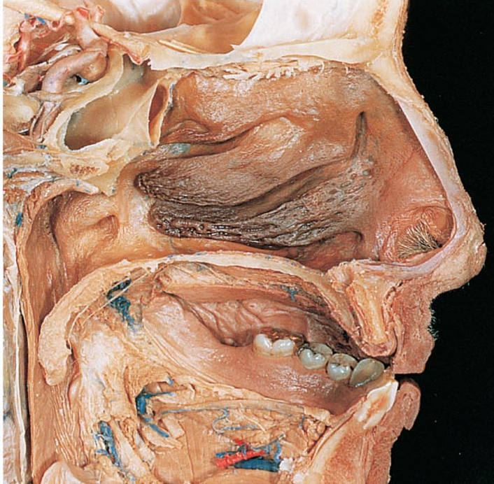
b) respiratory mucosa: pseudostratified ciliated columnar epithelium with goblet cells; lamina propria has mucous & serous glands (1 L/day sticky mucus containing lysozyme)
• resp mucosa cilia move contaminated mucus posteriorly to pharynx
• cold air slows cilia → runny nose
• thin-walled veins under nasal epithelium ➢ role? cold air & nosebleeds?
• What are nasal conchae?
• nasal mucosa richly supplied with sensory nerves ➢ irritants trigger sneeze reflex
Fig. 22.3b
J. Carnegie, UofO

Slide 7
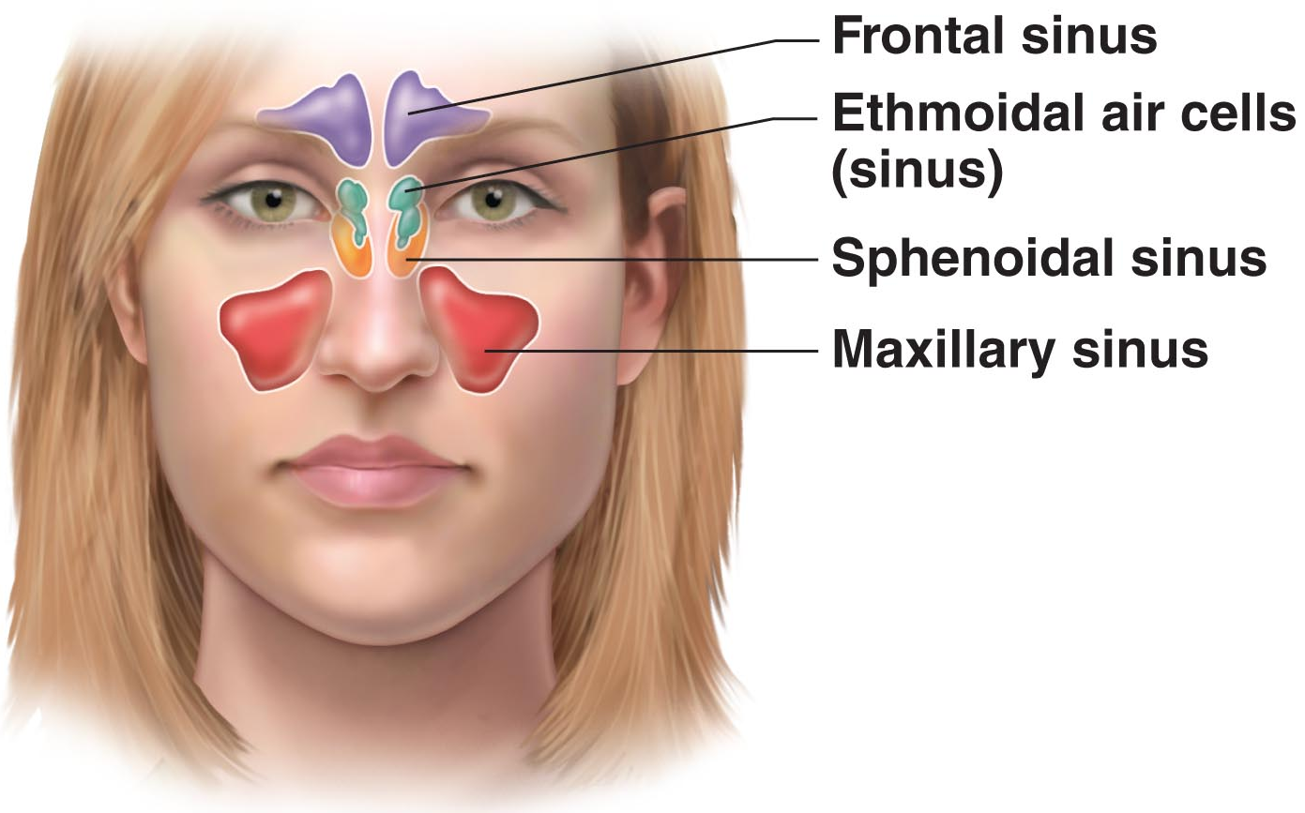
Fig. 7.11a
Paranasal Sinuses
surround nasal cavity
frontal, sphenoid, ethmoid, maxillary bones
lighten skull, produce mucus, also warm & moisten air
sinus mucosa continuous with nasal mucosa »» spread of infections
sinus headache: passageways connecting sinuses to nasal cavity blocked » air in sinus absorbed » partial vacuum

Slide 8
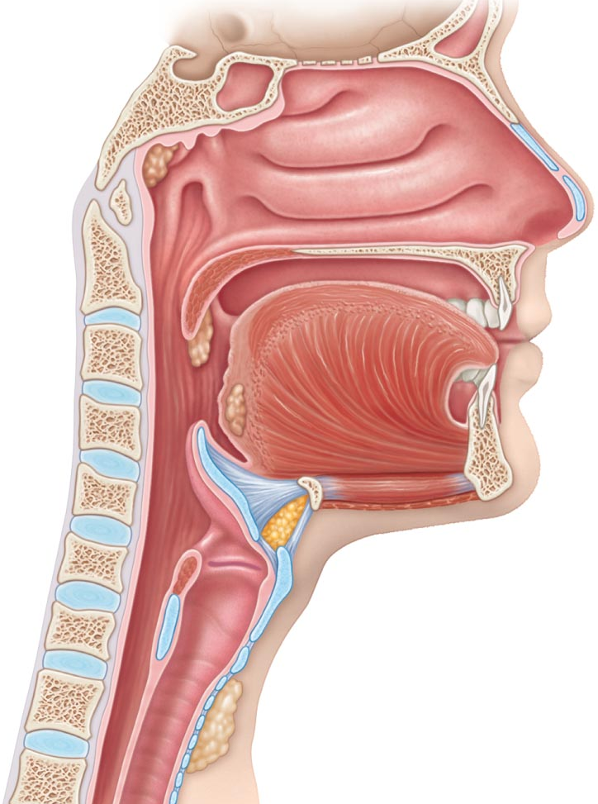
Pharynx
• common pathway for food and air
• wall composed of skeletal muscle throughout ~13 cm length; mucosal lining varies
3a) Nasopharynx
• below sphenoid bone, above soft palate
• only an air passageway
• what happens when swallowing?
• pseudostratified ciliated epithelium
• pharyngeal tonsils
• pharyngotympanic (auditory) tubes drain from middle ear
Fig. 22.4

Slide 9
3b) Oropharynx
• fauces connects oral cavity with oropharynx
• from soft palate to epiglottis (air and food)
• epithelium becomes stratified squamous (Why??)
• paired palatine tonsils + single lingual tonsil
3c) Laryngopharynx
• also both food and air
• stratified squamous
• from epiglottis to larynx – then respiratory & GI pathways diverge
• during swallowing, food has “right-of-way”

Slide 10
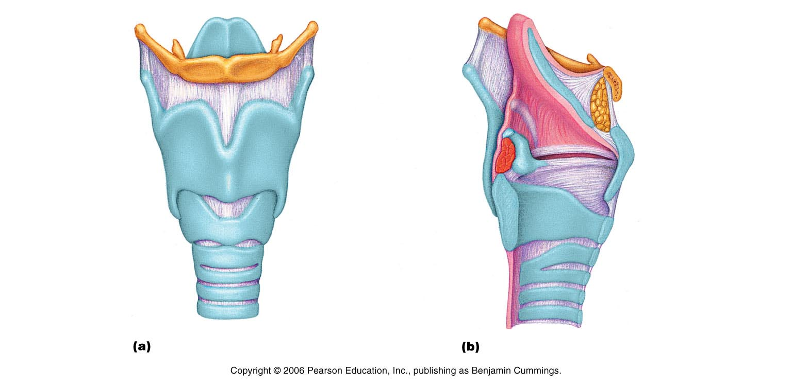
Larynx
• ~5 cm (4th-6th cervical vertebrae)
• attached to hyoid bone (above); continuous with trachea (below)
• 3 functions:
(i) open, 2-directional airway
(ii) switching: food vs air
(iii) voice production
• 9 cartilages in total
thyroid cartilage: large, shield-shaped cartilage in front (puberty in males?)
arytenoid cartilages (2): lateral, pyramid-shaped, anchor vocal cords
9th cartilage is epiglottis: elastic cartilage, anchored to anterior rim of thyroid cartilage & extends up to base of tongue
true vocal cords: white (avascular); vibrate in response to air movement up from lungs (what is the glottis?)
false vocal cords: above true vocal cords
• epithelial lining of upper versus lower larynx?
Where is the cricoid cartilage?
Figs. 22.5a &b
J. Carnegie, UofO

Slide 11
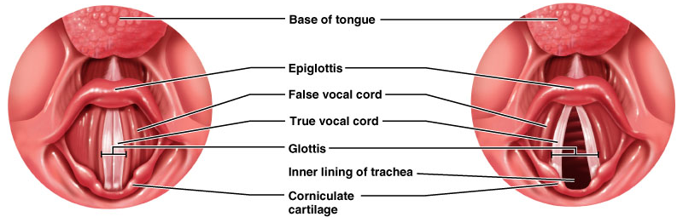
Voice Production:
• speech = intermittent release of expired air + opening & closing of glottis
• length of vocal cords & size of glottis altered by action of laryngeal muscles that move arytenoid cartilages
• male voice at puberty: vocal cords vibrate more slowly – why?
• loudness of voice: force of air across vocal cords
• laryngitis: inflammation of vocal cords ⇒ vibration impaired
• sphincter functions of vocal cords:
(i) epiglottis closes respiratory tract during swallowing
(ii) Valsalva’s maneuver: What is this?
What is the Heimlich maneuver??

Slide 12
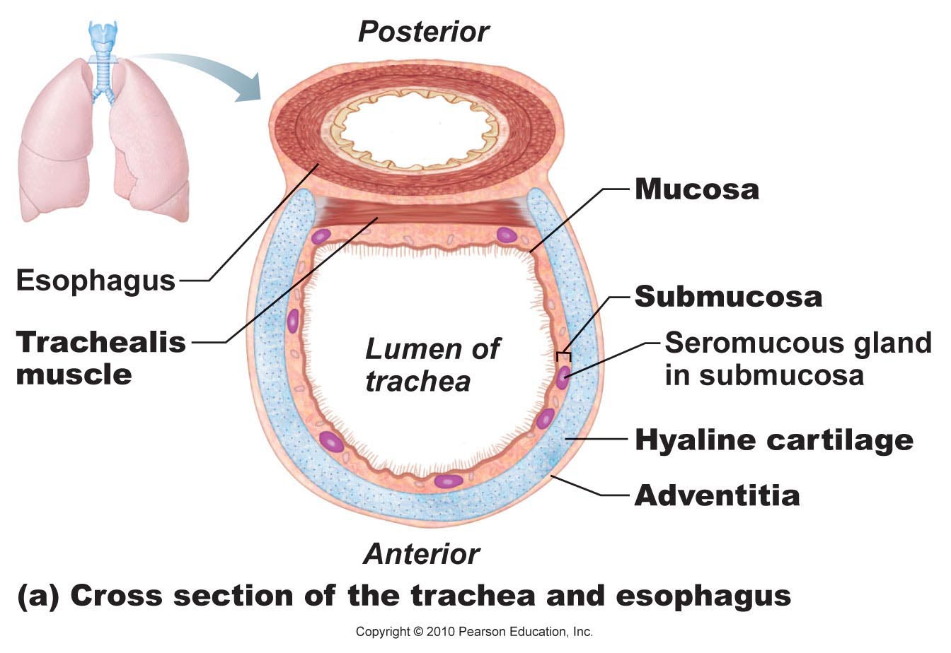
Trachea
• 10-12 cm long; ~2.5 cm diameter; flexible, mobile
• pseudostratified ciliated columnar; cilia move mucus up to pharynx
smoking inhibits & then destroys cilia; only coughing to clear mucus
• submucosa is CT with seromucous glands
• outer adventitia reinforced internally by 16-20 C-shaped cartilaginous rings; keep airway open during pressure changes associated with breathing
Fig. 22.7a

Slide 13
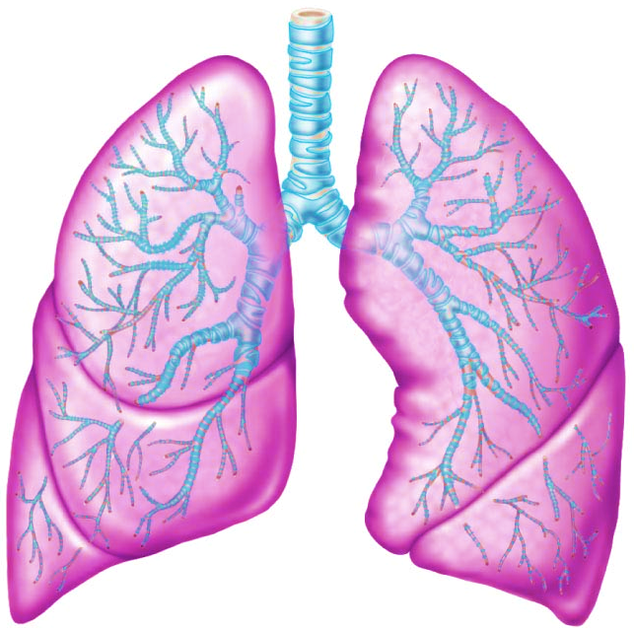
The Bronchial Tree
Conducting zone structures:
• right primary bronchus is wider, shorter, more vertical than left
• air in bronchi is warm, cleansed of most impurities & humidified
• ~23 orders of branching air passages in lungs = bronchial or respiratory tree
bronchi (1⁰, 2⁰, . . )
bronchioles (< 1 mm diam)
terminal bronchioles (< 0.5 mm diam)
• changes in wall composition as one moves through tree:
a) cartilage: rings to plates to none
b) epithelium: pseudostratified columnar to columnar to cuboidal; no cilia or mucous cells in bronchioles
c) smooth muscle: relative amount increases as passages become smaller
Fig. 22.8
J. Carnegie, UofO

Slide 14
2. Respiratory Zone
terminal bronchioles branch into respiratory bronchioles
~300 million alveoli = huge surface for gas exchange
Fig. 22.9a

Slide 15
Fig. 22.10
Identify the cell types shown in this diagram

Slide 16
respiratory membrane = alveolar wall + capillary wall + basal laminae
• respiratory membrane is an air-blood barrier; gas exchange by simple diffusion
• type II cells: scattered among type I cells; secrete surfactant
• other characteristics of lung alveoli:
(i) surrounded by fine elastic fibers
(ii) alveolar pores: allow equalization of air pressure throughout lung; alternate air routes if bronchi collapsed
(iii) alveolar macrophages = dust cells; inner alveolar surface; clear & swallow > 2 million dust cells/hour!
Fig. 22.9
J. Carnegie, UofO

Slide 17
6.2 Describe the gross structure of the lungs and the pleural coverings
• paired lungs occupy entire thoracic cavity except mediastinum
• each lung suspended in own pleural cavity; connected to mediastinum by vascular & bronchial attachments (= root)
• costal surface = anterior, lateral & posterior lung surfaces in close contact with ribs
apex, base; also hilus »» blood vessels enter & leave lungs
1⁰ bronchus enters lungs
fissures: oblique, horizontal » septa subdivide each lung into 10 bronchopulmonary segments (CT divisions; own artery & vein)
pulmonary disease often segmental & can be treated that way
Fig. 22.11

Slide 18
• lobule: smallest subdivision seen with naked eye; hexagon ~ size of pencil eraser; served by large bronchiole
• lung : primarily air spaces; rest is elastic CT
Blood Supply & Innervation
• pulmonary arteries bring blood to be oxygenated
• pulmonary veins return oxygenated blood
• bronchial arteries provide systemic blood to lungs ⇒ bronchial veins
• innervation primarily parasymp (effect?) + some symp (effect?)
Fig. 22.10c

Slide 19
Pleura
• thin, double-layered (parietal & visceral) serosa
• pleural fluid: serous secretion that fills pleural cavity »» lungs slide easily during breathing; surface tension keeps pleurae from separating
• 3 chambers: central mediastinum + 2 lateral pleural compartments
• pleurisy: inflammation of pleurae
J. Carnegie, UofO
http://www.answers.com/topic/pleura

