Slide 1
Econ 102 - Introduction to Macro Economics
Lecture Note - Chapter 2
The Economic Problem
University of Waterloo
Department of Economics
Spring 2019

Slide 2
Why does food cost much more today than it did a few years ago?
One reason is that we now use part of our corn crop to produce ethanol, a clean biofuel substitute for gasoline.
Another reason is that drought in some parts of the world has decreased global grain production.
We use an economic model—the production possibilities frontier—to learn why ethanol production and drought have increased the cost of producing food.
We also use this model to study how we can expand our production possibilities; how we gain by trading with others; and why the social institutions have evolved.

Slide 3
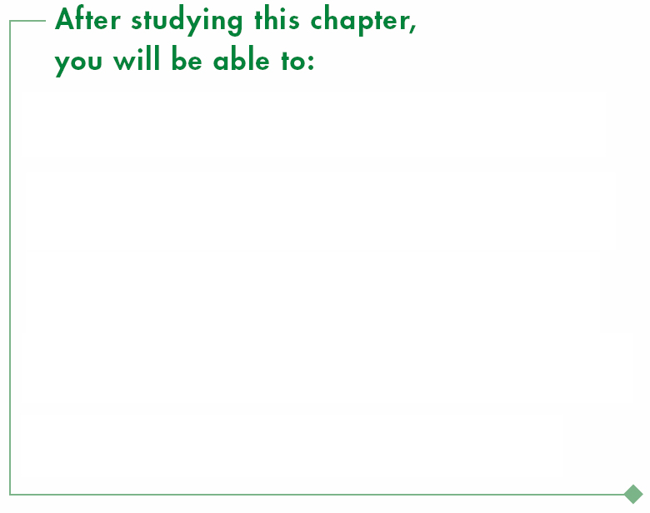
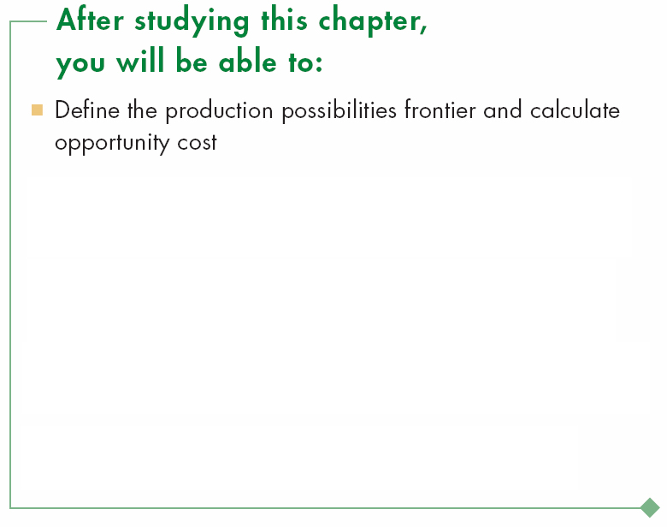
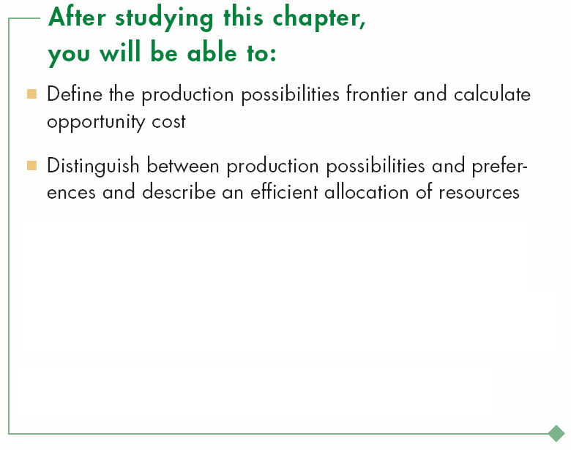
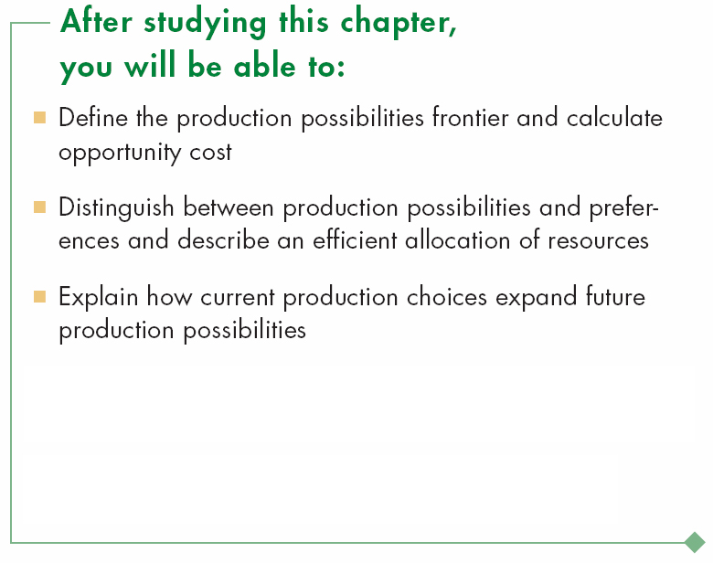
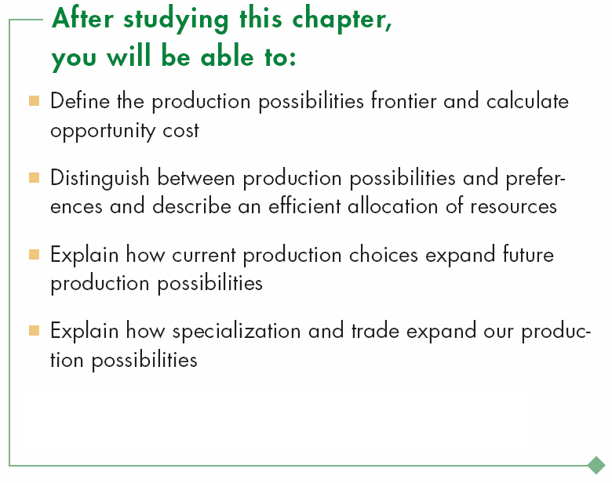
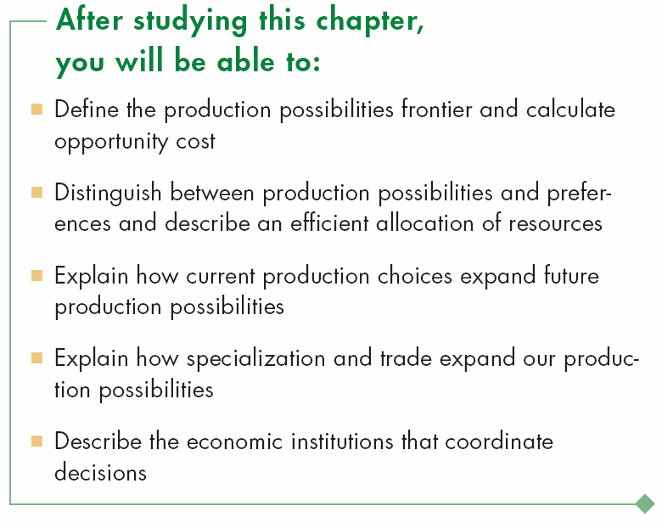

Slide 4
Production Possibilities and Opportunity Cost
  The production possibilities frontier (PPF) is the boundary between those combinations of goods and services that can be produced and those that cannot.
  Put it differently,
  PPF is a graph that shows the combinations of output that the economy can possibly produce given the available factors of production and the available production technology.

Slide 5
Production Possibilities and Opportunity Cost
  To illustrate the PPF, we focus on two goods at a time and hold the quantities of all other goods and services constant.
  That is, we look at a model economy in which everything remains the same (ceteris paribus) except the two goods we’re considering.

Slide 6
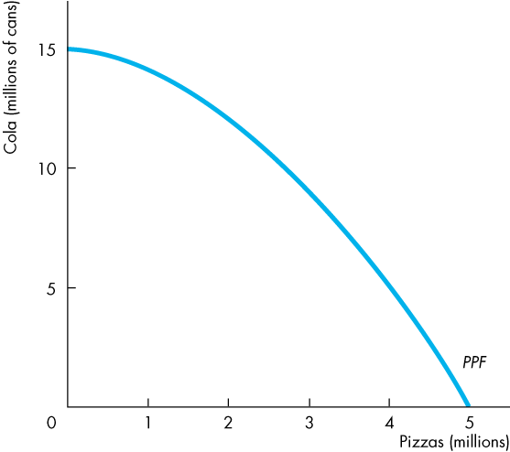
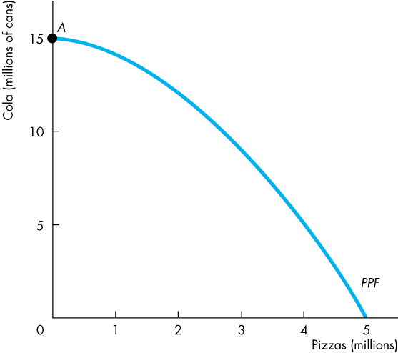
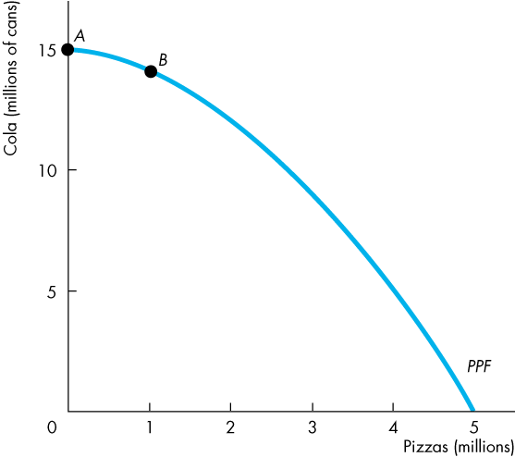
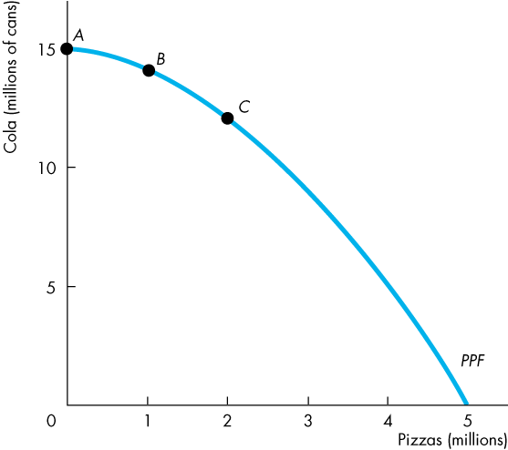
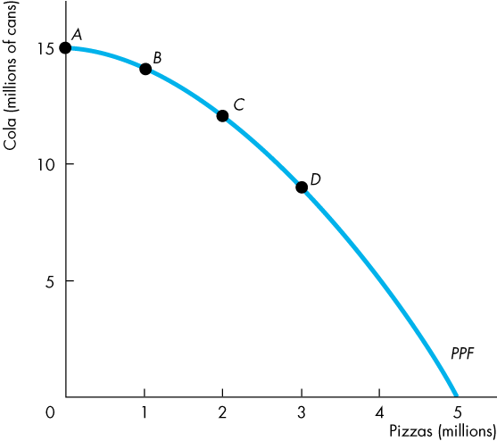
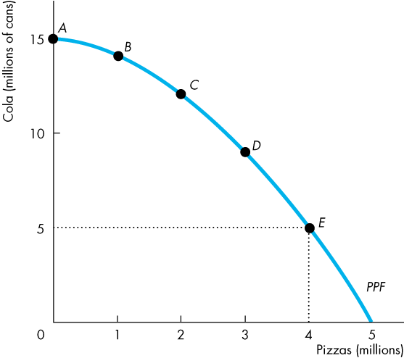
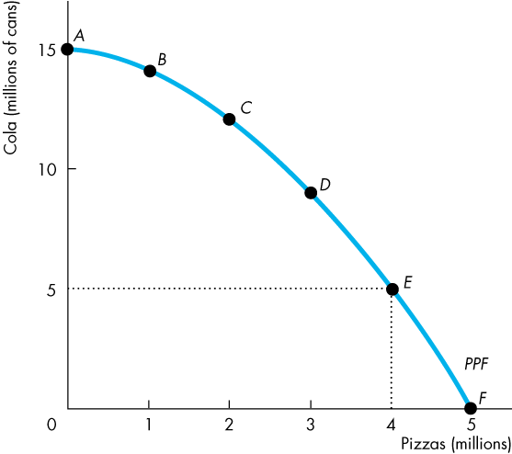
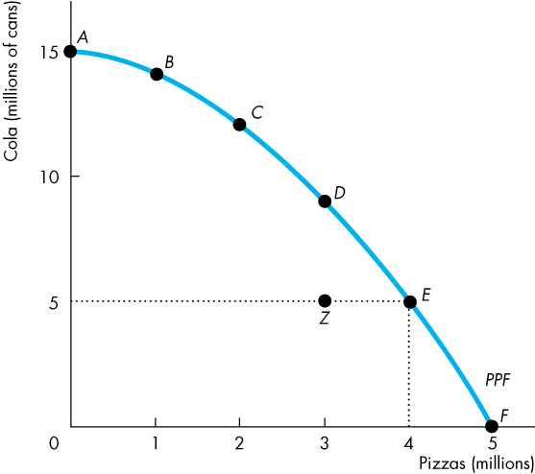
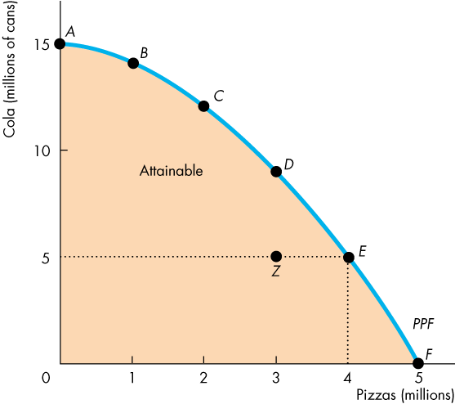
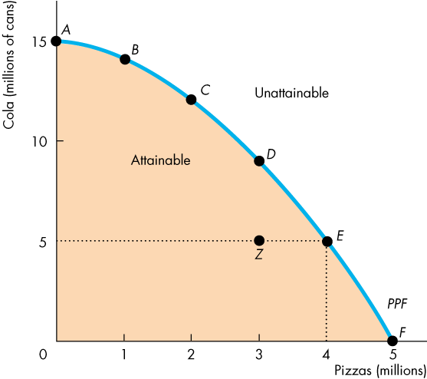
Production Possibilities and Opportunity Cost
  Figure 2.1 shows the PPF for two goods: cola and pizza in a month.
If all resources are devoted to producing cola, the economy can produce 15 million cans of colas and zero pizzas.
If all resources are devoted to producing pizzas, the economy can produce 5 million pizzas and zero cans of colas.
  If resources are divided between the two industries, the feasible combinations of output are shown on the curve.
Notes:
Thinking about everyday events in terms of graphs and tables of numbers. Economic modes in general and the PPF model in particular by using the model to describe the tradeoff between studying and a social life faced every day by each student.
Why do some of the brightest students not get a 4.0 GPA? After sleeping, attending classes, and performing the mundane tasks of life, a student has 8 hours a day available for study and recreation. If the student spends all 8 hours studying, he/she will get a 4.0 GPA. But each hour of recreation lowers the GPA.
The Economics of Campus Life 101. First, assume a constant opportunity cost of recreation equal to a 0.333 drop in the GPA for each hour spent not studying. The highest GPA possible is 4.0, the lowest is 1.333, and the negatively sloped PPF curve is a straight line. Draw the graph based on the description. Interpret the PPF graph: the intercept points reveal the maximum GPA and the maximum recreation hours possible, and the negative slope quantifies the tradeoff the student faces. Points on the curve represent production efficiency and points inside the curve represent a misallocation of the student’s time where opportunities for increases in recreation and/or GPA points are wasted.
Then show that the opportunity cost of each additional hour of recreation (lost GPA points) is constant.

Slide 7
Production Possibilities and Opportunity Cost
  Any point on the frontier such as E and any point inside the PPF such as Z are attainable.
  Points outside the PPF are unattainable.
  The PPF illustrates scarcity because we cannot attain the points outside the frontier.
Notes:
Thinking about everyday events in terms of graphs and tables of numbers. Economic modes in general and the PPF model in particular by using the model to describe the tradeoff between studying and a social life faced every day by each student.
Why do some of the brightest students not get a 4.0 GPA? After sleeping, attending classes, and performing the mundane tasks of life, a student has 8 hours a day available for study and recreation. If the student spends all 8 hours studying, he/she will get a 4.0 GPA. But each hour of recreation lowers the GPA.
The Economics of Campus Life 101. First, assume a constant opportunity cost of recreation equal to a 0.333 drop in the GPA for each hour spent not studying. The highest GPA possible is 4.0, the lowest is 1.333, and the negatively sloped PPF curve is a straight line. Draw the graph based on the description. Interpret the PPF graph: the intercept points reveal the maximum GPA and the maximum recreation hours possible, and the negative slope quantifies the tradeoff the student faces. Points on the curve represent production efficiency and points inside the curve represent a misallocation of the student’s time where opportunities for increases in recreation and/or GPA points are wasted.
Then show that the opportunity cost of each additional hour of recreation (lost GPA points) is constant.

Slide 9
Production Possibilities and Opportunity Cost
Production Efficiency
  We achieve production efficiency if we cannot produce more of one good without producing less of some other good (produce at the lowest possible cost)
  Points on the frontier are efficient.

Slide 10
Production Possibilities and Opportunity Cost
  Any point inside the frontier, such as Z, is inefficient.
  At such a point, it is possible to produce more of one good without producing less of the other good.
  At Z, resources are either unemployed or misallocated.

Slide 11
Production Possibilities and Opportunity Cost
Tradeoff Along the PPF
  Every choice along the PPF involves a tradeoff.
  Every trade offs involve a cost – an opportunity cost.
  On this PPF, we must give up some cola to get more pizzas or give up some pizzas to get cola.

Slide 12
Production Possibilities and Opportunity Cost
Opportunity cost of an action is the highest valued alternative foregone.
It is easy to calculate the opportunity cost using the PPF.
  As we move down along the PPF, we produce more pizzas, but the quantity of cola we can produce decreases.
  The opportunity cost of a pizza is the cola forgone.

Slide 13
Production Possibilities and Opportunity Cost
  In moving from E to F,
  the quantity of pizzas increases by 1 million.
  The quantity of cola decreases by 5 million cans.
  The opportunity cost of the fifth 1 million pizzas is 5 million cans of cola.
  One of these pizzas costs 5 cans of cola.

Slide 14
Production Possibilities and Opportunity Cost
  In moving from F to E, the quantity of cola produced increases by 5 million.
  The quantity of pizzas decreases by 1 million.
  The opportunity cost of the first 5 million cans of cola is 1 million pizzas.
  One of these cans of cola costs 1/5 of a pizza.

Slide 15
Production Possibilities and Opportunity Cost
  Note that the opportunity cost of a can of cola is the inverse of the opportunity cost of a pizza.
  One pizza costs 5 cans of cola.
  One can of cola costs 1/5 of a pizza.

Slide 16
Production Possibilities and Opportunity Cost
  Because resources are not equally productive in all activities, the PPF bows outward—is concave.
  The outward bow of the PPF means that as the quantity produced of each good increases, so does its opportunity cost.

Slide 17
Production Possibilities and Opportunity Cost
  The shape of the production possibilities frontier indicates that the opportunity cost of pizzas in terms of colas increases as the country produces more pizzas and fewer colas. This occurs because some resources are better suited to the production of pizzas than colas (and vice versa).

Slide 18
Using Resources Efficiently
  All the points along the PPF are efficient.
  To determine which of the alternative efficient quantities to produce, we compare costs and benefits.
The PPF and Marginal Cost
  The PPF determines opportunity cost.
  The marginal cost of a good or service is the opportunity cost of producing one more unit of it.

Slide 19
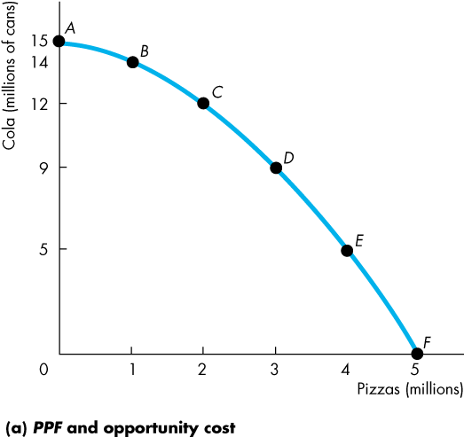
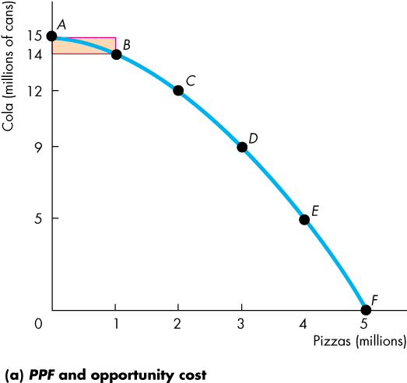
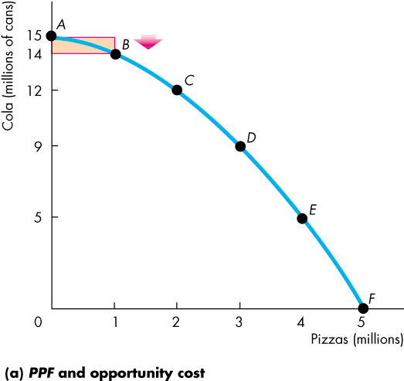
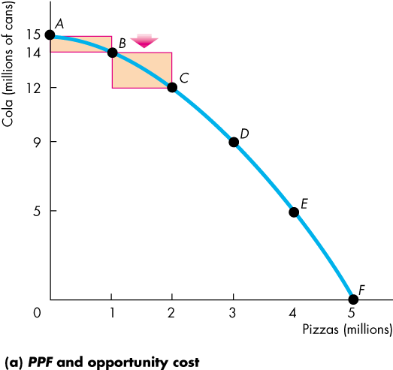
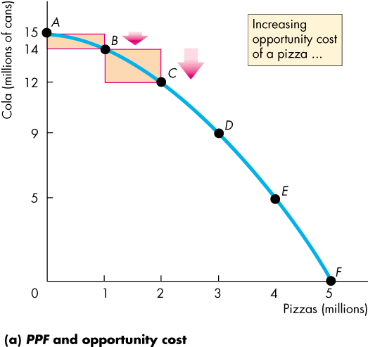
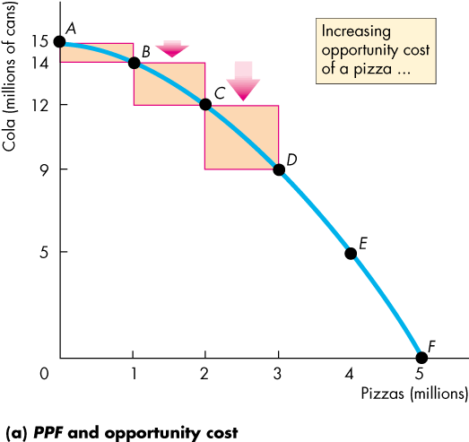
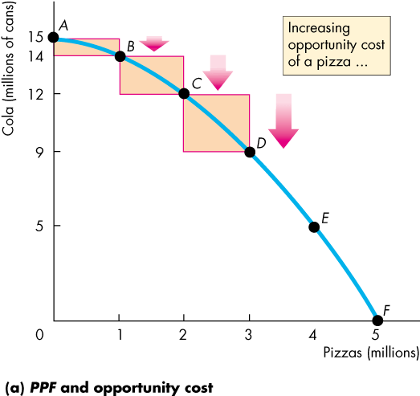
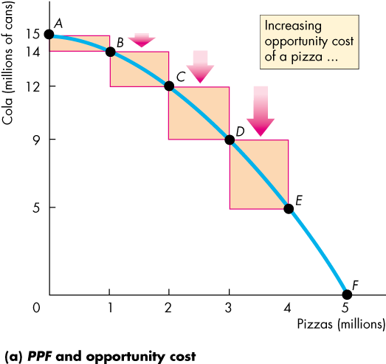
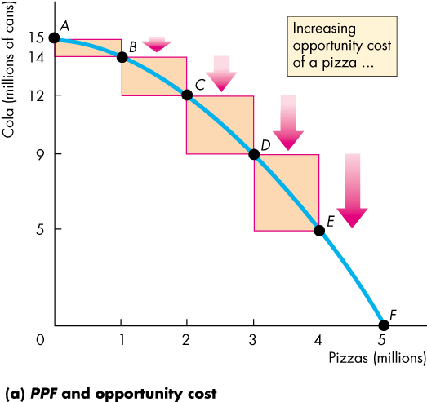
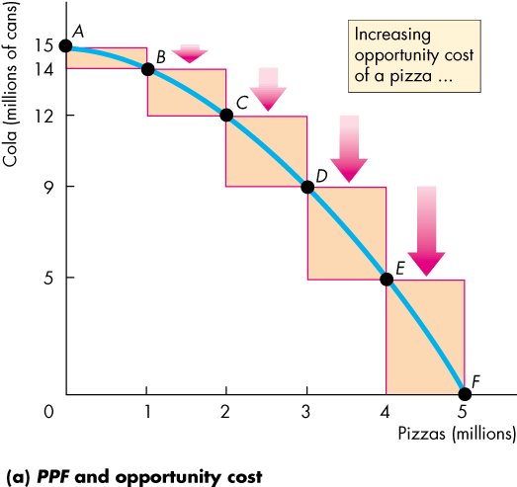
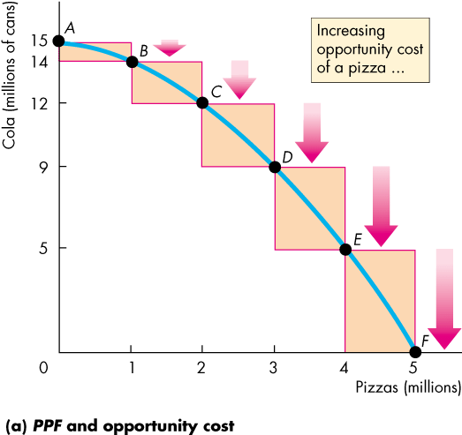
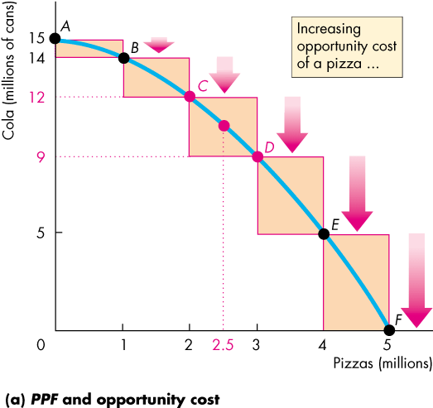
Using Resources Efficiently
  Figure 2.2 illustrates the marginal cost of pizza.
  As we move along the PPF in part (a), the opportunity cost of a pizza increases.
  The opportunity cost of producing one more pizza is the marginal cost of a pizza.

Slide 21
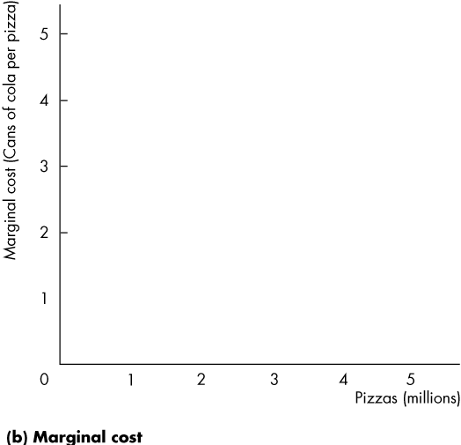
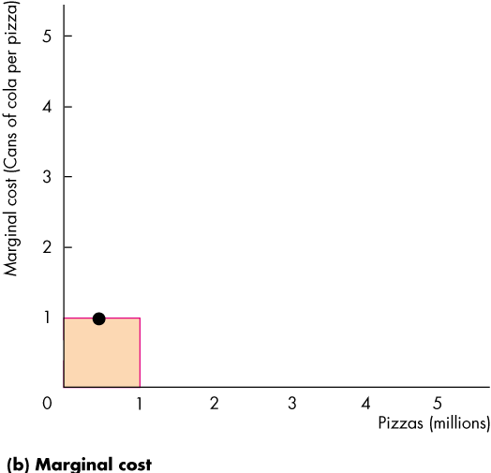
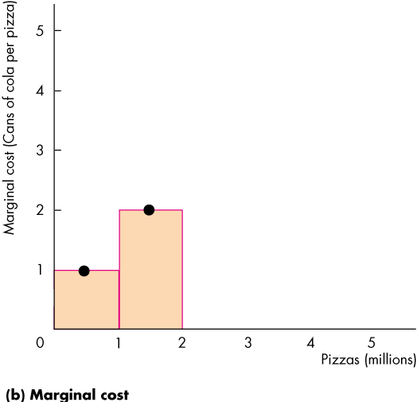
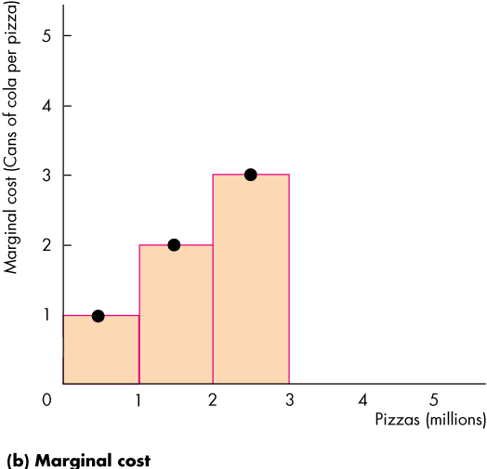
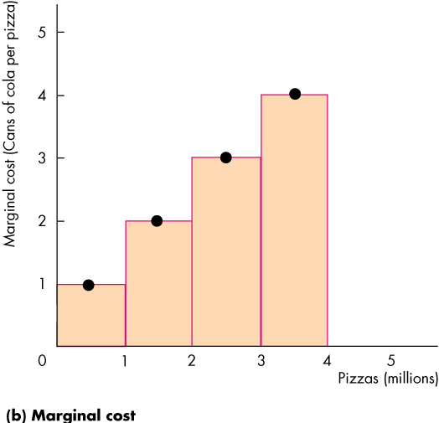
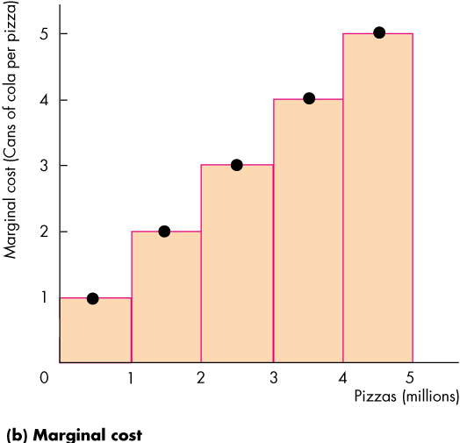
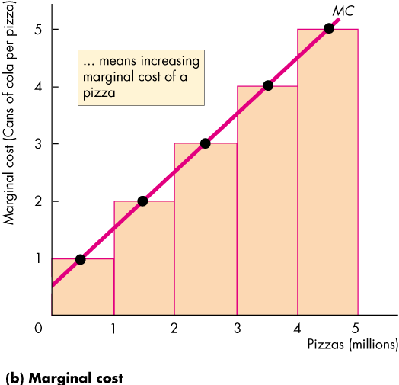

Using Resources Efficiently
  In part (b) of Fig. 2.2, the bars illustrate the increasing opportunity cost of pizza.
  The black dots and the line MC show the marginal cost of pizza.
  The MC curve passes through the centre of each bar.
Notes:
Students always wonder why MC passes through the middle point of the bars.
The height of each bar shows the cost of an average pizza in each of the 1 million pizza blocks. Focus on the 3rd 1 million pizzas. The opportunity cost of producing that 1 million pizzas is 3 million cans of cola. So in this range, the cost of an average pizza is 3 cans of cola.
The dot indicates that 3 cans of cola is the cost of the average pizza, which over this range is the 2.5 millionth pizza.

Slide 23
Why does MC passes through the middle point of the bars?
The height of each bar shows the cost of an average pizza in each of the 1 million pizza blocks.
Focus on the 3rd 1 million pizzas. The opportunity cost of producing that 1 million pizzas is 3 million cans of cola.
So in this range, the cost of an average pizza is 3 cans of cola.
The dot indicates that 3 cans of cola is the cost of the average pizza, which over this range is the 2.5 millionth pizza.

Slide 24
Using Resources Efficiently
Preferences and Marginal Benefit
  Preferences are a description of a person’s likes and dislikes.
  To describe preferences, economists use the concepts of marginal benefit and the marginal benefit curve.
  The marginal benefit of a good or service is the benefit received from consuming one more unit of it.
  We measure marginal benefit by the amount that a person is willing to pay for an additional unit of a good or service.

Slide 25
Using Resources Efficiently
  It is a general principle that the more we have of any good, the smaller is its marginal benefit and the less we are willing to pay for an additional unit of it.
  We call this general principle the principle of decreasing marginal benefit.
  The marginal benefit curve shows the relationship between the marginal benefit of a good and the quantity of that good consumed.

Slide 26
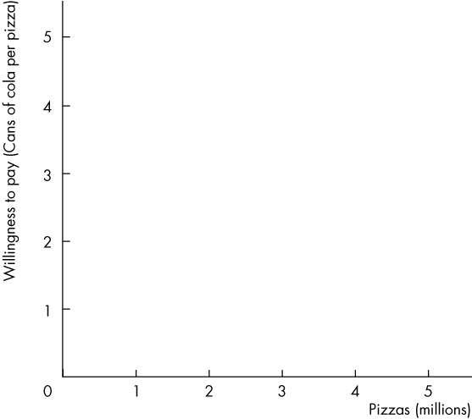
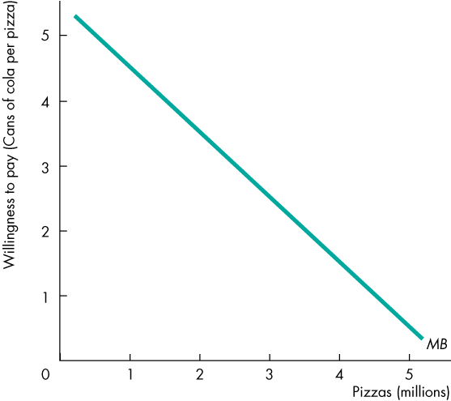
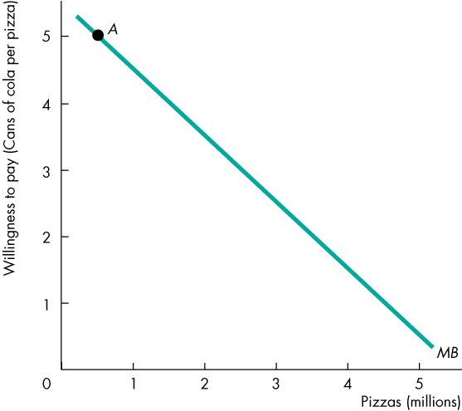
Using Resources Efficiently
  Figure 2.3 shows a marginal benefit curve.
  The curve slopes downward to reflect the principle of decreasing marginal benefit.
  At point A, with pizza production at 0.5 million, people are willing to pay 5 cans of cola for a pizza.

Slide 27
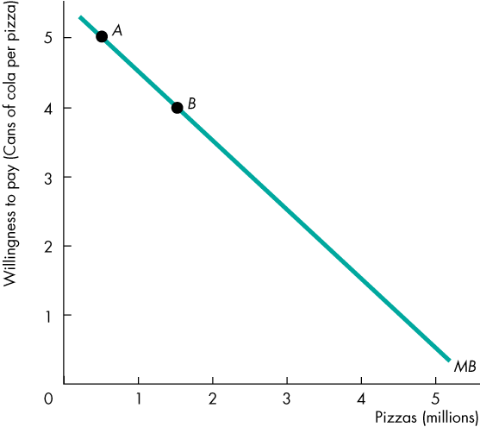
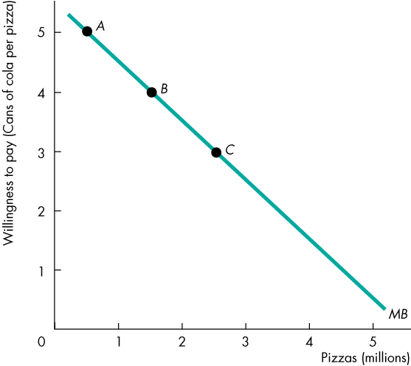
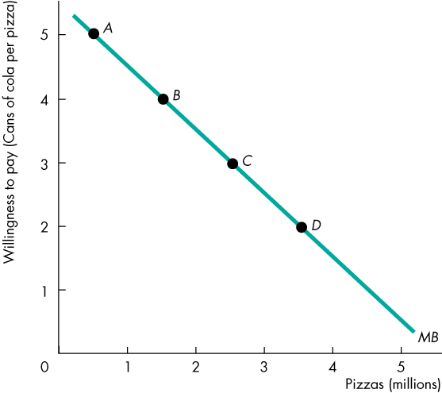
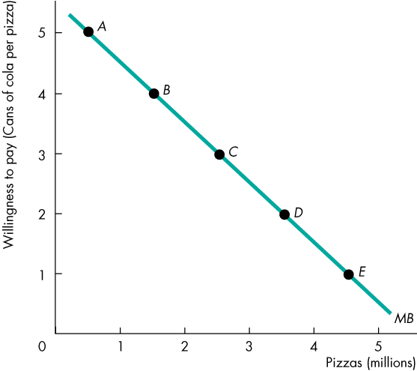
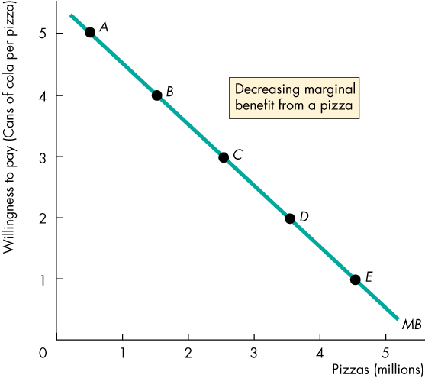

Slide 28
Using Resources Efficiently
  At point B, with pizza production at 1.5 million, people are willing to pay 4 cans of cola for a pizza.
  At point E, with pizza production at 4.5 million, people are willing to pay 1 can of cola for a pizza.

Slide 29
Using Resources Efficiently
Allocative Efficiency
  When we cannot produce more of any one good without giving up some other good, we have achieved production efficiency.
  We are producing at a point on the PPF.
  When we cannot produce more of any one good without giving up some other good that we value more highly, we have achieved allocative efficiency.
  We are producing at the point on the PPF that we prefer above all other points.

Slide 30
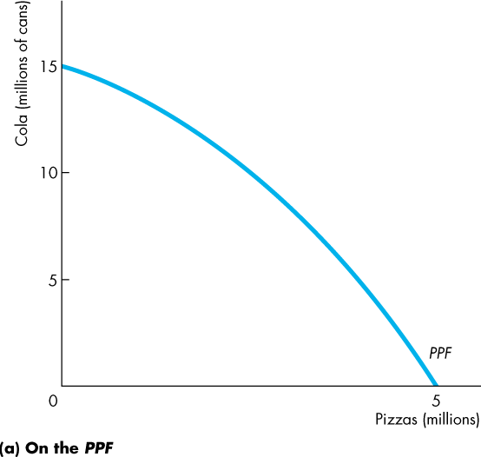
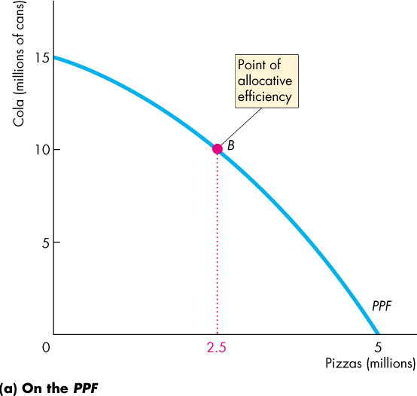
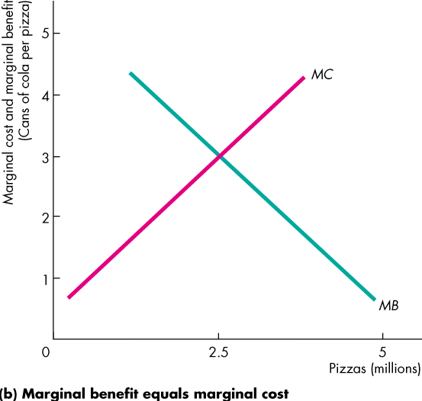
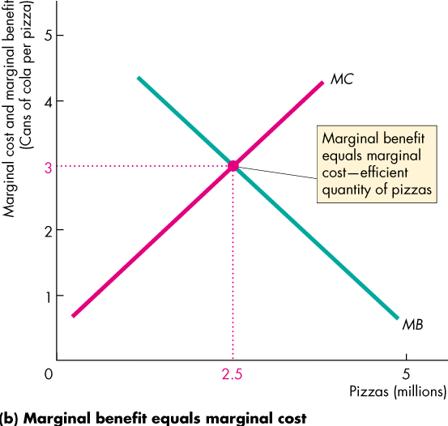
Using Resources Efficiently
  Figure 2.4 illustrates allocative efficiency.
  The point of allocative efficiency is the point on the PPF at which marginal benefit equals marginal cost.
  This point is determined by the quantity at which the marginal benefit curve intersects the marginal cost curve.

Slide 32
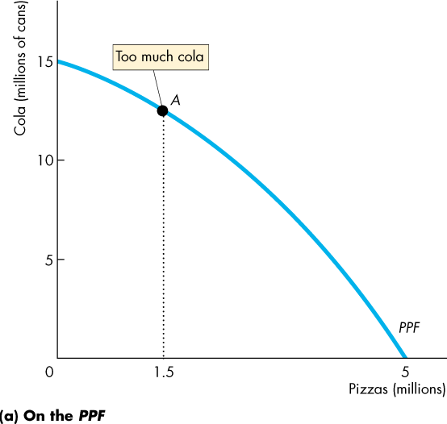
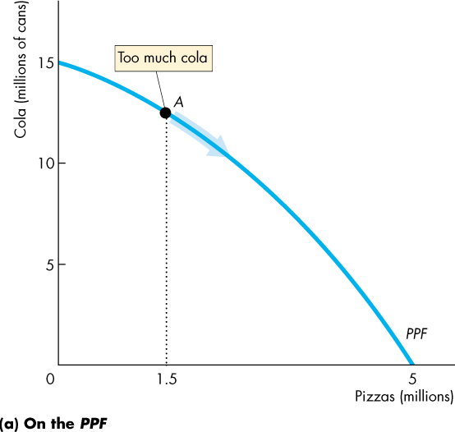
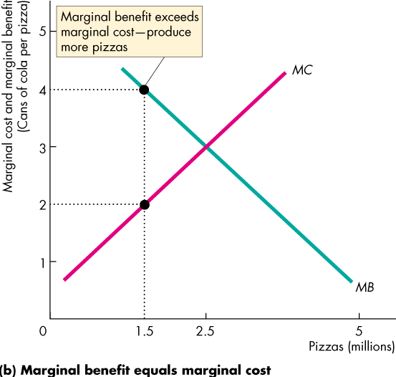

Using Resources Efficiently
  If we produce fewer than 2.5 million pizzas, marginal benefit exceeds marginal cost.
  We get more value from our resources by producing more pizzas.
  On the PPF at point A, we are producing too much cola, and we are better off moving along the PPF to produce more pizzas.

Slide 34




Using Resources Efficiently
  If we produce more than 2.5 million pizzas, marginal cost exceeds marginal benefit.
  We get more value from our resources by producing fewer pizzas.
  On the PPF at point C, we are producing too many pizzas, and we are better off moving along the PPF to produce fewer pizzas.

Slide 36
Using Resources Efficiently
  If we produce exactly 2.5 million pizzas, marginal cost equals marginal benefit.
  We cannot get more value from our resources.
  On the PPF at point B, we are producing the efficient quantities of cola and pizzas.

Slide 38
Economic Growth
  The expansion of production possibilities—and increase in the standard of living—is called economic growth.
  Two key factors influence economic growth:
  Technological change
  Capital accumulation
  Technological change is the development of new goods and of better ways of producing goods and services.
  Capital accumulation is the growth of capital resources, which includes human capital.
Notes:
In 2006, income per person in the United States was about $100 a day. In 1806 it was about 70¢ a day, and if the past growth rate prevails for another 200 years, in 2206 it will be $14,000 a day. Emphasize the magic of compound growth. If they think that $14,000 a day is a big income, get them to do a ballpark estimate of the daily income of Bill Gates (about $20 million!) Encourage a discussion of why scarcity is still present even at these large incomes.

Slide 39
Economic Growth
  The Cost of Economic Growth
  To use resources in research and development and to produce new capital, we must decrease our production of consumption goods and services.
  So economic growth is not free.
  The opportunity cost of economic growth is less current consumption.

Slide 40
  The Cost of Economic Growth
Production and distribution process create a by product : pollution. There are two types of pollution: Stock pollutant and fund pollutant.
Stock pollutant accumulate in the environment. By contrast fund pollutant either dilute to harmless levels or get transformed into harmless substances.
Most people believe that we have a responsibility to control our emissions of stock pollutants and manage the planet’s natural resources as to provide future generations with high quality of life.

Slide 41
The Cost of Economic Growth (Sustainability)
This goal can be defined more formally as sustainability: providing the typical person alive in the future with a standard of living, including both material and environmental welfare, at least as high as that enjoyed by the typical person today.

Slide 42
The Issue of Sustainability
Discussion around sustainability have divided economists into two broad groups, neoclassical and ecological.
The main bone of contention between this two groups is this: to what extend can created capital substitute for natural capital.
Neoclassical economist would say that they are substitute and ecological economists would argue that they are complements.
Notes:
Pg 84, Economics and the environment by Eban S. Goodstein

Slide 43


Economic Growth
  Figure 2.5 illustrates the tradeoff we face.
  We can produce pizzas or pizza ovens along PPF₀.
  By using some resources to produce pizza ovens today, the PPF shifts outward in the future.

Slide 45
Gains from Trade
Comparative Advantage and Absolute Advantage
  A person has a comparative advantage in an activity if that person can perform the activity at a lower opportunity cost than anyone else.
  A person has an absolute advantage if that person is more productive than others.
  Absolute advantage involve comparing productivities while comparative advantage involves comparing opportunity costs.
  Let’s look at Liz and Joe who operate smoothie bars.
Notes:
The gain from trade is a real eye-opener for students. Their first reaction is one of skepticism. Convincing students of the power of trade to raise living standards and the costs of trade restriction is one of the most productive things we will ever do.
Here are some ideas to drive home the idea of comparative advantage:
Why didn’t Billy Sunday do his own typing? Billy Sunday, an evangelist in the 1930s, was reputed to be the world’s fastest typist. Nonetheless, he employed a secretary who was a slower typist than he. Why? Because in one hour of preaching, Billy could raise several times the revenue that he could raise by typing for an hour. So Billy plays to his comparative advantage.
Why doesn’t Martha Stewart bake her own bread? Martha Stewart is probably a better cook than most people, but she is an even better writer and TV performer on the subject of food. So Martha plays to her comparative advantage and writes about baking bread but buys her bread.
Why doesn’t Vinnie Jones play soccer? Vinnie Jones is one of the world’s best soccer players (although now getting a bit old). But he stopped playing soccer and started making movies some years ago. Why? Because, as he once said, “You go to the bank more often when you’re in movies.” Vinnie’s comparative advantage turned out to be in acting.
The costs of trade restrictions need to be driven home. The 2002 steel tariff increase and the EU response is a good story to use.

Slide 46
Gains from Trade
The theory of comparative advantage is one of the
most important concepts in economics.
The original idea of comparative advantage dates
back to the early part of the 19th century. Although
the model describing the theory is commonly referred
to as the “The Ricardian model", the original
description of the idea can be found in an Essay on the External Corn Trade by Robert Torrens in 1815.
Notes:
Source:http://internationalecon.com/Trade/Tch40/T40-0.php

Slide 47
Gains from Trade (cont).
David Ricardo formalized the idea using a compelling, yet
simple, numerical example in his 1817 book titled, On The
Principles of Political Economy and Taxation.
The idea appeared again in James Mill's Elements of
Political Economy in 1821. Finally, the concept became a
key feature of international political economy upon the
publication of Principles of Political Economy by John
Stuart Mill in 1848.

Slide 48
Gains from Trade
Neoclassical approach: Trade allows people to specialize in the production of goods for which they have a comparative advantage and then trade for goods other people produce.
Because of specialization, total output rises and through trade we are all able to share it.
This is as true for countries as it is for individuals. Since everyone can gain from trade, restrictions on trade tend to reduce welfare.

Slide 49
Gains from Trade (The Barter Economy)
Liz's Smoothie Bar
In an hour, Liz can produce 30 smoothies or 30 salads.
Liz's opportunity cost of producing 1 smoothie is 1 salad.
Liz's opportunity cost of producing 1 salad is 1 smoothie.
Liz’s customers buy salads and smoothies in equal number, so she produces 15 smoothies and 15 salads an hour.

Slide 50
Gains from Trade (The Barter Economy)
Joe's Smoothie Bar
In an hour, Joe can produce 6 smoothies or 30 salads.
Joe's opportunity cost of
producing 1 smoothie is 5 salads.
Joe's opportunity cost of
producing 1 salad is 1/5 smoothie.
Joe’s spend 10 minutes making salads and 50 minutes making smoothies, so he produces 5 smoothies and 5 salads an hour.

Slide 51
Gains from Trade (The Barter Economy)
  Liz’s Absolute Advantage
  Liz is three times as productive as Joe.
  Liz can produce 15 smoothies and 15 salads an hour whereas Joe can produce only 5 smoothies and 5 salads an hour.
  Liz has an absolute advantage in producing smoothies and salads.

Slide 52
Gains from Trade (The Barter Economy)
  Liz’s Comparative Advantage
  Liz’s opportunity cost of a smoothie is 1 salad.
  Joe’s opportunity cost of a smoothie is 5 salads.
  Liz’s opportunity cost of a smoothie is less than Joe’s.
  So Liz has a comparative advantage in producing smoothies.

Slide 53
Gains from Trade (The Barter Economy)
  Joe’s Comparative Advantage
  Joe’s opportunity cost of a salad is 1/5 smoothie.
  Liz’s opportunity cost of a salad is 1 smoothie.
  Joe’s opportunity cost of a salad is less than Liz’s.
  So Joe has a comparative advantage in producing salads.

Slide 54


Gains from Trade (The Barter Economy)
Achieving Gains from Trade
  Liz and Joe produce the good in which they have a comparative advantage:
    Liz produces 30 smoothies and 0 salads.
    Joe produces 30 salads and 0 smoothies.

Slide 55




Slide 56
Gains from Trade (The Barter Economy)
  Liz and Joe trade:
    Liz sells Joe 10 smoothies and buys 20 salads.
    Joe sells Liz 20 salads and buys 10 smoothies.
  After trade:
    Liz has 20 smoothies and 20 salads.
    Joe has 10 smoothies and 10 salads.

Slide 57
Gains from Trade (The Barter Economy)
  Gains from trade:
    Liz gains 5 smoothies and
    5 salads an hour
    Joe gains 5 smoothies and 5 salads an hour

Slide 58




Gains from Trade (The Barter Economy)
  Figure 2.6 shows the gains from trade.
  Joe initially produces at point A on his PPF.
  Liz initially produces at point A on her PPF.

Slide 59







Slide 60
Gains from Trade (The Barter Economy)
  Joe’s opportunity cost of producing a salad is less than Liz’s.
  So Joe has a comparative advantage in producing salad.

Slide 61
Gains from Trade
  Liz’s opportunity cost of producing a smoothie is less than Joe’s.
  So Liz has a comparative advantage in producing smoothies.

Slide 62
Gains from Trade
  Joe specializes in producing salad and he produces
  30 salads an hour at point B on his PPF.

Slide 63
Gains from Trade
  Liz specializes in producing smoothies and produces
  30 smoothies an hour at point B on her PPF.

Slide 64
Gains from Trade
  They trade salads for smoothies along the red “Trade line” at a price of 2 salads per smoothie or ½ a smoothie per salad.

Slide 65
Gains from Trade
  Joe buys smoothies from Liz and moves to point C—a point outside his PPF.
  Liz buys salads from Joe and moves to point C—a point outside her PPF.

Slide 66
Gains from Trade
Dynamic Comparative Advantage
  Learning-by-doing occurs when a person (or nation) specializes and by repeatedly producing a particular good or service becomes more productive in that activity and lowers its opportunity cost of producing that good over time.
  Dynamic comparative advantage occurs when a person (or nation) gains a comparative advantage from learning-by-doing.

Slide 67
Free Trade vs. Fair Trade
Free trade is a system of trade policy that allows traders to trade across national boundaries without interference from the respective governments.
According to the law of comparative advantage the policy permits trading partners mutual gains from trade of goods and services.
Under a free trade policy, prices are a reflection of true supply and demand, and are the sole determinant of resource allocation.
Notes:
Source: http://en.wikipedia.org/wiki/Free_trade

Slide 68
Free Trade vs. Fair Trade
Fair trade is a trading partnership, based on dialogue, transparency and respect, that seeks greater equity in international trade.
It contributes to sustainable development by offering better trading conditions to, and securing the rights of, marginalized producers and workers – especially in the South.
Fair trade organizations, backed by consumers, are engaged actively in supporting producers, awareness raising and in campaigning for changes in the rules and practice of conventional international trade.

Slide 69
Economic Coordination
  To reap the gains from trade, the choices of individuals must be coordinated.
  To make coordination work, four complimentary social institutions have evolved over the centuries:
  Firms
  Markets
  Property rights
  Money
Notes:
The point of this short section is to lay the groundwork for the next chapter on demand and supply. You can cover it fast or you can use it as a peg on which to hang a discussion of some of the big-picture of the underpinnings of our subject. Some examples follow:
The “Invisible Hand”: How self-interested individuals promote prosperity for all. Explain that in economics, we take human nature as given (in contrast to political science, philosophy and some other fields) and assume that people are self-interested. Note if you wish that self-interest does not mean selfish.
If everyone is self-interested, how are people encouraged to specialize and exchange to promote prosperity for all? Building on the Tom and Nancy example in the chapter, you can explain how specialization and exchange achieves a higher standard of living that does self sufficiency. So self interest promotes specialization and exchange.
But for specialization and exchange to work, people must be able to trade. That is why property rights and markets are so crucial.
Property Rights and Markets: The key to promoting socially beneficial activity. To reap the gains from specialization, people need access to markets in which voluntary exchange can take place. Markets work only if property rights are established and enforced.

Slide 70
Economic Coordination
  A firm is an economic unit that hires factors of production and organizes those factors to produce and sell goods and services.
  A market is any arrangement that enables buyers and sellers to get information and do business with each other.
  Property rights are the social arrangements that govern ownership, use, and disposal of resources, goods or services.
  Money is any commodity or token that is generally acceptable as a means of payment.

Slide 71





Economic Coordination
Circular Flows Through Markets
  Figure 2.7 illustrates how households and firms interact in the market economy.
  Factors of production and goods and services flow in one direction.
  Money flows in the opposite direction.

Slide 73
Economic Coordination
Coordinating Decisions
  Markets coordinate individual decisions through price adjustments.

