Slide 1
Econ 102 - Introduction to Macro Economics
Lecture Note - Chapter 1
What is Economics?
University of Waterloo
Department of Economics
Spring 2019

Slide 2
You are studying economics at a time of extraordinary change.
If you look at the world today, there are changes worth noticing.
The global economy is slowly recovering from a deep recession.
The earthquake and tsunami severely affected the economy of Japan. European debt crisis is the dominant source of uncertainty.
The value of gold is rising.
There is tremendous rise in the economies of India and China.

Slide 3
These are examples of few current events that might interest you to learn more about the workings of the national and global economy.
Your life will be shaped by the challenges you face and the opportunities that you create in this global environment.
But to face those challenges and seize the opportunities they present, you must understand the powerful forces at play.
The economics that you’re about to learn will become your most reliable guide.

Slide 4
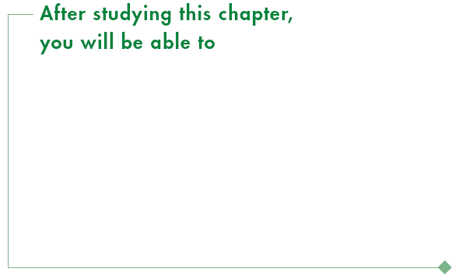
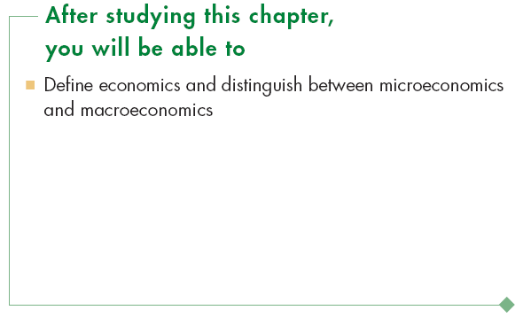
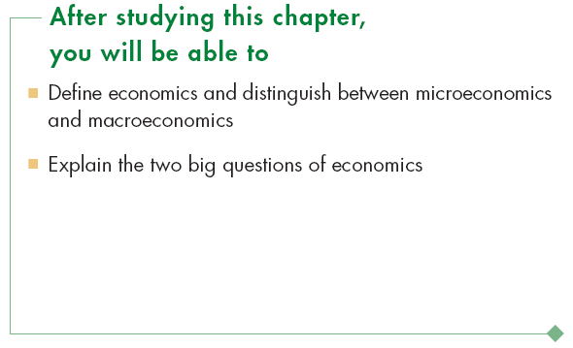
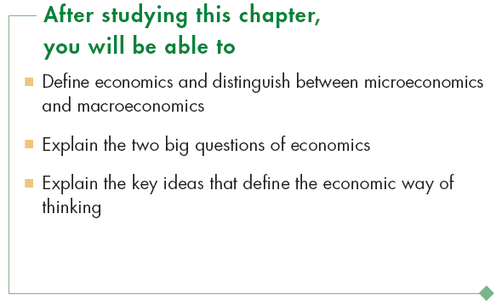
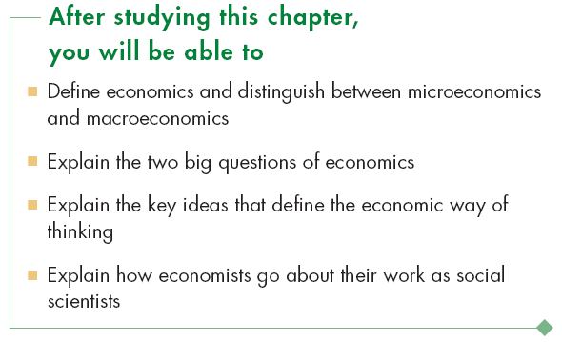

Slide 5
Definition of Economics
  All economic questions arise because we want more than we can get.
  Our inability to satisfy all our wants is called scarcity.
  Because we face scarcity, we must make choices.
  The choices we make depend on the incentives we face.
  An incentive is a reward that encourages an action or a penalty that discourages an action.

Slide 6
Definition of Economics
Forbes lists Bill Gates and Warren Buffet as the two wealthiest Americans.
Question
Do these two men face scarcity?

Slide 7
Definition of Economics
  Economics is the social science that studies the choices that individuals, businesses, governments, and entire societies make as they cope with scarcity and the incentives that influence and reconcile those choices.
Notes:
“the social science that studies the choices that individuals, businesses, and governments, and entire societies make as they cope with scarcity,” is a modern language version of Lionel Robbins famous definition, “Economics is the science which studies human behavior as a relationship between ends and scarce means that have alternative uses.”
Alfred Marshall: “Economics is a study of mankind in the ordinary business of life; it examines that part of individual and social action which is most closely connected with the attainment and with the use of the material requisites of wellbeing.”
Jacob Viner: “Economics is what economists do.”
Jim Duesenberry: “Economics is all about how people make choices. Sociology is about why there isn’t any choice to be made.”

Slide 8
Definition of Economics
Alfred Marshall defines economics as a study of “mankind in the ordinary business of life; it examines that part of individual and social action which is most closely connected with the attainment and with the use of the material requisites of wellbeing.”
Textbook: The Principles of Economics, 1890 (highly influential).
Emphasis: “Methodological individualism”→ explains why individuals behave as they do and broad generalizations about groups or types of people hampers the understanding of human behavior.

Slide 9
Definition of Economics
Jacob Viner: “Economics is what economists do.”
Jim Duesenberry: “Economics is all about how people make choices. Sociology is about why there isn’t any choice to be made.”

Slide 10
Definition of Economics
John Maynard Keynes: “The theory of economics does not furnish a body of settled conclusions immediately applicable to policy. It is a method rather than a doctrine, an apparatus of the mind, a technique of thinking, which helps it possessors to draw correct conclusions.”
Textbook: The General theory of Employment, Interest and Money, 1936.

Slide 11
Definition of Economics
Lionel Robbin: “Economics is the science which studies human behavior as a relationship between ends and scarce means which have alternative uses.”
Modern economics is the child of political economy and the grandchild of philosophy.

Slide 12
Definition of Economics
  Present day economics has two main branches (the two pillars of economics):
  Microeconomics
  Macroeconomics

Slide 13
Definition of Economics
Microeconomics
  Microeconomics is the study of choices that individuals and businesses make, the way those choices interact in markets, and the influence of governments.
Macroeconomics
  Macroeconomics is the study of the performance of the national and global economies.
  Macroeconomics is the study of overall or aggregate performance of an economy.

Slide 14
Examples of Micro and Macroeconomic Questions
  An example of a microeconomic question is: Why are people buying more e-books and fewer hard copy books?
  An example of a macroeconomic question is: Why is the unemployment rate in Canada so high?

Slide 15
Two Big Economic Questions
  Two big questions summarize the scope of economics:
  How do choices end up determining what, how, and for whom goods and services get produced?
  When do choices made in the pursuit of self-interest also promote the social interest?

Slide 16
Two Big Economic Questions
What, How, and For Whom?
  Goods and services are the objects that people value and produce to satisfy human wants.
What?
  In Canada, agriculture accounts for 2 percent of total production, manufactured goods for 20 percent, and services (retail and wholesale trade, health care, and education are the biggest ones) for 78 percent.
  In China, agriculture accounts for 11 percent of total production, manufactured goods for 49 percent, and services for 40 percent.

Slide 17
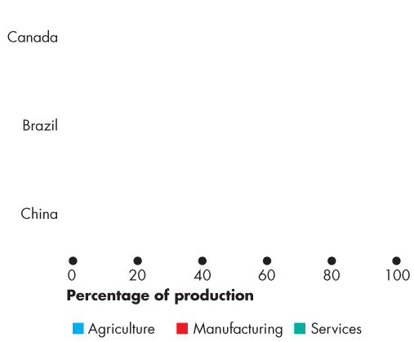
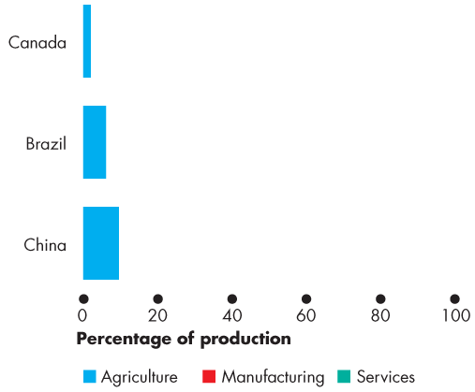
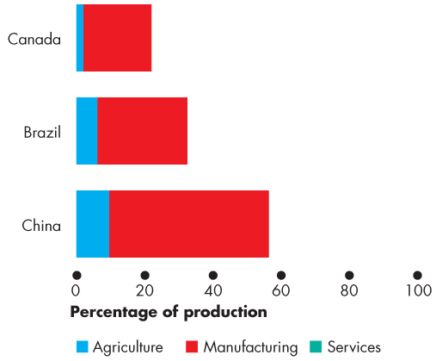
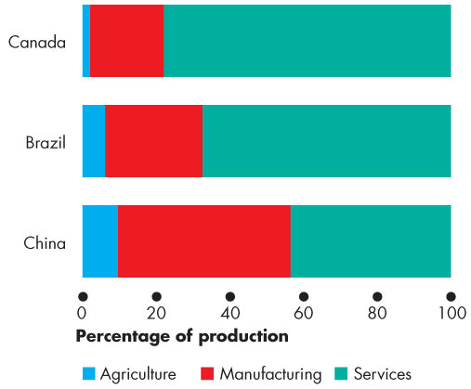
Two Big Economic Questions
  Figure 1.1 shows these numbers Canada and China.
  It also shows the numbers for Brazil.
  What determines these patterns of production?
  How do choices end up determining the quantity of each item produced in Canada and around the world?

Slide 18
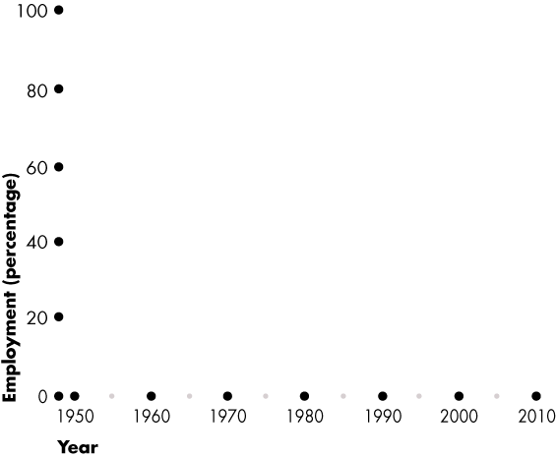
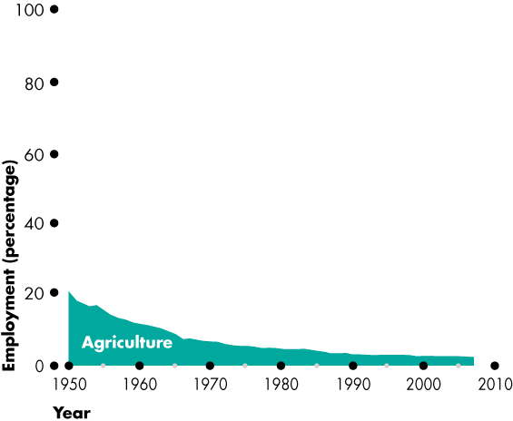
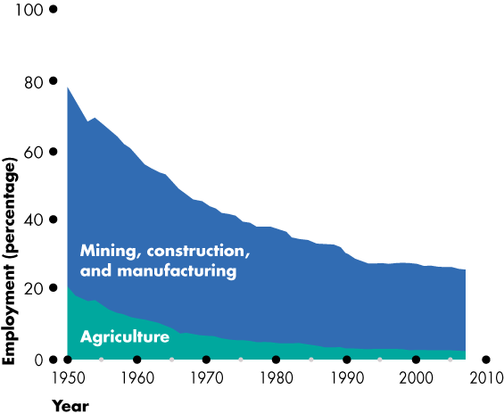
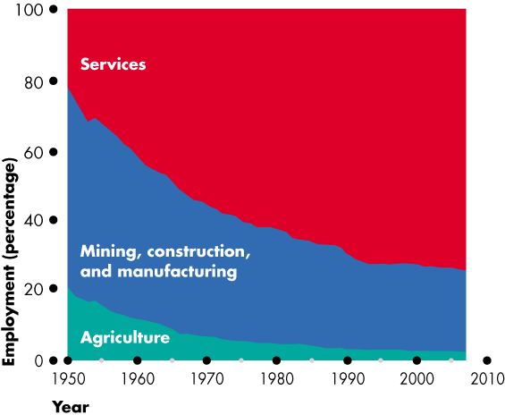
Two Big Economic Questions
  Figure 1.2 shows the trends in what the Canadian economy has produced over the past 60 years.
  It shows the decline of agriculture, mining, construction, and manufacturing, and the expansion of services.

Slide 19
Two Big Economic Questions
  The facts about what we produce raise the deeper question: What determines the quantities of timber, coal, automobiles, new homes, cable TV service, and dental service that we produce?
  Economics provides some answers to these questions.

Slide 20
Two Big Economic Questions
How?
  Goods and services are produced by using productive resources that economists call factors of production.
  Factors of production are grouped into four categories:
  Land
  Labor
  Capital
  Entrepreneurship

Slide 21
Two Big Economic Questions
  The “gifts of nature” that we use to produce goods and services are land (natural resources).
  The work time and work effort that people devote to producing goods and services is labor.
  The quality of labor depends on human capital, which is the knowledge and skill that people obtain from education, on-the-job training, and work experience.
  The tools, instruments, machines, buildings, and other constructions that businesses use to produce goods and services are capital.
  The human resource that organizes land, labor, and capital is entrepreneurship.

Slide 22
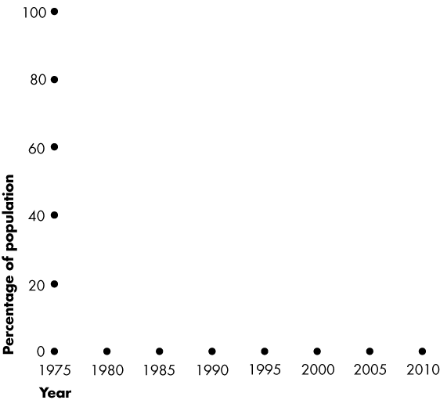
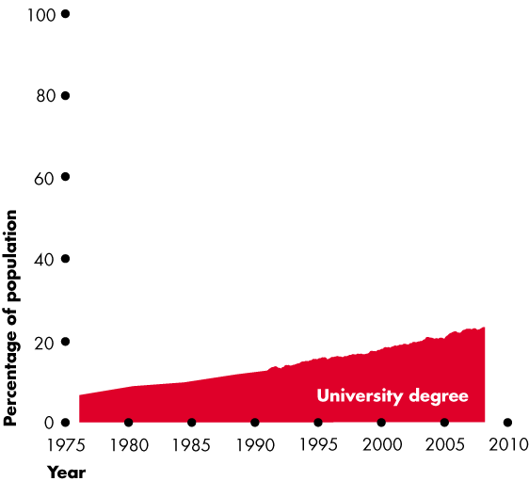
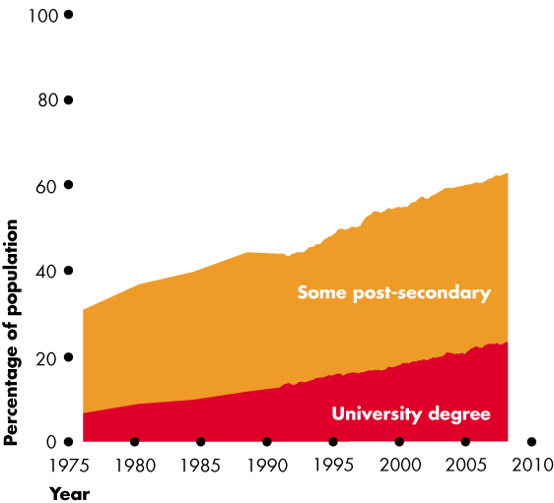
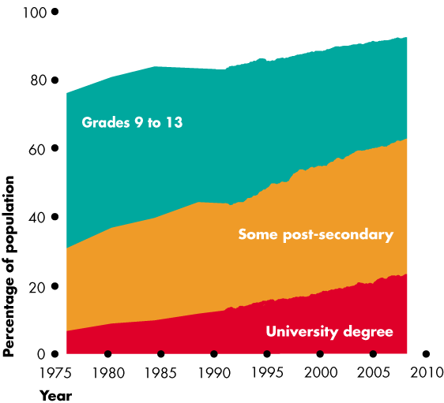
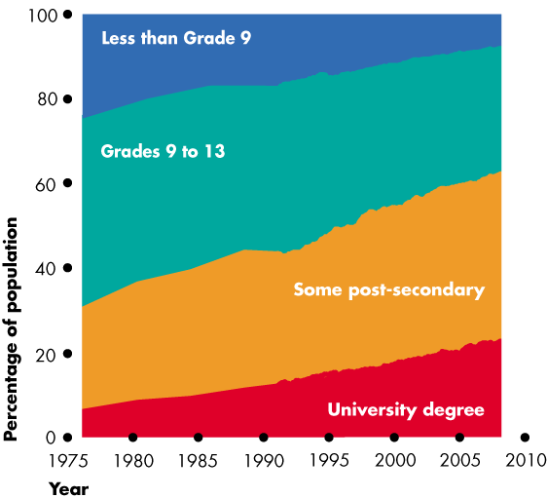
Two Big Economic Questions
  Figure 1.2 shows a measure of the growth of human capital in Canada over the past few decades—the percentage of the population that has completed different levels of education.
  Economics explains these trends.

Slide 23
Two Big Economic Questions
For Whom?
  Who gets the goods and services depends on the incomes that people earn.
  Land earns rent.
  Labor earns wages.
  Capital earns interest.
  Entrepreneurship earns profit.

Slide 24
Two Big Economic Questions
When is the Pursuit of Self-Interest in the Social Interest?
  Every day, 32 million Canadians and 7 billion people in other countries make economic choices that result in What, How, and For Whom goods and services are produced.
  Do we produce the right things in the right quantities?
  Do we use our factors of production in the best way?
  Do the goods and services go to those who benefit most from them?

Slide 25
Two Big Economic Questions
  You make choices that are in your self-interest—choices that you think are best for you.
  Choices that are best for society as a whole are said to be in the social interest.
  An outcome is in the social interest if it uses resources efficiently and distributes goods and services fairly.
  The Big Question
  Is it possible that when each one of us makes choices that are in our self-interest, it also turns out that these choices are also in the social interest?
Notes:
Adam Smith and the Wealth of Nations.
He designed the first systematic attempt to address this big question and that economists have been trying to answer it ever since.
Several Nobel Prizes have been awarded to economists who have worked on the question including Ken Arrow, John Hicks, and Gerard Debreu, as well as John Nash of “Beautiful Mind” fame.

Slide 26
Two Big Economic Questions
  Social interest has two dimensions:
  Efficiency
  Equity

Slide 27
Two Big Economic Questions
  Efficiency is achieved when the available resources are used to produce goods and services:
  At the lowest possible price and
  In quantities that give the greatest possible benefit.
  Equity is fairness, but economists have a variety of views about what is fair.
  The Big Question
  Can choices made in self-interest promote the social interest?

Slide 28
Two Big Economic Questions
  Self-Interest in the Social Interest
  Four topics that generate discussion and that illustrate tension between self-interest and social interest are
  Globalization (sustainable business?)
  The information-age economy
  Global warming & natural resource depletion
  Economic instability

Slide 29
Two Big Economic Questions
  Globalization
  Globalization means the expansion of international trade, borrowing and lending, and investment.
  Globalization is in the self-interest of consumers who buy low-cost imported goods and services and …
  … in the self-interest of the multinational firms that produce in low-cost regions and sell in high-price regions.
  But is globalization in the self-interest of low-wage workers in other countries and Canadian firms that can’t compete with low-cost imports?
  Is globalization in the social interest?

Slide 30
Two Big Economic Questions
  The Information-Age Economy
  The technological change of the past forty years has been called the Information Revolution.
  The information revolution has clearly served your self-interest: It has provided your cell phone, laptop, loads of handy applications, and the Internet.
  It has also served the self-interest of Bill Gates of Microsoft and Gordon Moore of Intel, both of whom have seen their wealth soar.
  But did the information revolution serve the social interest?

Slide 31
Two Big Economic Questions
  Climate Change
  Every day, when you make self-interested choices to use electricity and gasoline, you contribute to carbon emissions.
  You leave your carbon footprint.
  You can lessen your carbon footprint by walking, riding a bike, taking a cold shower, or planting a tree.
  But can each one of us be relied upon to make decisions that affect the Earth’s carbon-dioxide concentration in the social interest?

Slide 32
Two Big Economic Questions
  Economic Instability
  Between 1993 and 2007, the Canadian and global economies expanded strongly. Incomes in Canada increased by 30 percent and incomes in China tripled.
  But in August 2007, a period of financial stress began that soon gripped the entire global financial system.
  The choices of U.S. banks to borrow and lend and the choices of people and business to lend to and borrow from U.S. banks are made in self-interest.
  Does this lending and borrowing serve the social interest?

Slide 33
The Economic Way of Thinking
  Six key ideas define the economic way of thinking:
  A choice is a tradeoff.
  People make rational choices by comparing benefits and costs.
  Benefit is what you gain from something.
  Cost is what you must give up to get something.
  Most choices are “how-much” choices made at the margin.
  Choices respond to incentives.

Slide 34
The Economic Way of Thinking
Making a Rational Choice
  A rational choice is one that compares costs and benefits and achieves the greatest benefit over cost for the person making the choice.
  Only the wants of the person making a choice are relevant to determine its rationality.
  The idea of rational choice provides an answer to the first question: What goods and services will be produced and in what quantities?
  The answer is: Those that people rationally choose to buy!

Slide 35
The Economic Way of Thinking
Cost: What you Must Give Up
  The opportunity cost of something is the highest-valued alternative that must be given up to get it.
  What is your opportunity cost of going to an AC/DC concert?
  Opportunity cost has two components:
  1. The things you can’t afford to buy if you purchase the AC/DC ticket.
  2. The things you can’t do with your time if you go to the concert.

Slide 36
The Economic Way of Thinking
How Much? Choosing at the Margin
You can allocate the next hour between studying and instant messaging your friends.
The choice is not all or nothing, but you must decide how many minutes to allocate to each activity.
To make this decision, you compare the benefit of a little bit more study time with its cost—you make your choice at the margin.

Slide 37
The Economic Way of Thinking
  To make a choice at the margin, you evaluate the consequences of making incremental changes in the use of your time.
  The benefit from pursuing an incremental increase in an activity is its marginal benefit.
  The opportunity cost of pursuing an incremental increase in an activity is its marginal cost.
  If the marginal benefit from an incremental increase in an activity exceeds its marginal cost, your rational choice is to do more of that activity.

Slide 38
The Economic Way of Thinking
Choices Respond to Incentives
  A change in marginal cost or a change in marginal benefit changes the incentives that we face and leads us to change our choice.
  The central idea of economics is that we can predict how choices will change by looking at changes in incentives.
  Incentives are also the key to reconciling self-interest and the social interest.

Slide 39
The Economic Way of Thinking
What, How, and For Whom Tradeoffs
  The questions what, how, and for whom become sharper when we think in terms of tradeoffs.
  What Tradeoffs arise when people choose how to spend their incomes, when governments choose how to spend their tax revenues, and when businesses choose what to produce.
Notes:
Will your tradeoffs improve? You can do your student’s a further favor by helping them to realize that the tradeoffs they face today are as favorable as they will ever be. It’s an old cliché, but effective, to remind them that they are not going to be any more attractive than they are now, nor are they going to gain any additional physical prowess or have any greater capacity to learn than they have at this very moment in their lives. Right now they could do almost anything they set their minds to do. Encourage the students to figure out and be utterly convinced that the benefits they receive from being in college exceed the large opportunity cost that scarcity forces them to bear. Remind them of the relevance of this cost benefit calculation to their decisions to skip classes, not studying for exams, or retake core courses and delay graduation.
Scarcity Versus Poverty Ask the students why they haven’t yet attained all of their personal goals. One reason will be that they lack sufficient money. Ask them if they could attain all of their goals if they were as rich as Bill Gates. They quickly realize that time is a big constraint. They have stumbled on the fact that scarcity, which even Bill Gates faces, is not poverty. You can emphasize this distinction.

Slide 40
The Economic Way of Thinking
  How Tradeoffs arise when businesses choose among alternative production technologies.
  For Whom Tradeoffs arise when choices change the distribution of buying power across individuals.
  Government redistribution of income from the rich to the poor creates the big tradeoff—the tradeoff between equality and efficiency.
Notes:
Who shall live and who shall die? Moving from personal to social decisions, use a “no-win” situation that is of major social importance. Such situations show with stark clarity that scarcity is just as important an issue as poverty. A good example comes from the development of new medical treatments. Every society—even the richest—faces a tradeoff between making new, promising medicines available quickly while assuring that they are also safe. That is why the Food and Drug Administration (FDA) is charged with assessing both the efficacy as well as the safety of each new drug before it is released to the market. Patients who are HIV positive, or who have Alzheimer’s disease or suffer from many types of cancer all require immediate access to the latest, promising medicines in order to have a chance for survival. But without thorough and time-consuming testing procedures, the safety of new drugs is not known. So we must choose between two bad outcomes: 1) lives lost because people take promising drugs that turn out to have unforeseen deadly side-effects, or 2) lives lost because people are denied access to promising drugs until sufficient testing can be performed to check that they are both effective and safe. Regardless of which drug distribution policy we adopt, many people will die. Although depressing, this realty check illustrates drives home the deadly seriousness of the phrase: “There is no such thing as a free lunch.”

Slide 41
The Economic Way of Thinking
Choices Bring Change
  What, how, and for whom goods and services get produced changes over time and the quality of our economic lives improve.
  But the quality of our economic lives and the rate at which they improve depends on choices that involve tradeoffs.
  We face three tradeoffs between enjoying current consumption and leisure time and increasing future production, consumption, and leisure time.

Slide 42
The Economic Way of Thinking
  If we save more, we can buy more capital and increase our production.
  If we take less leisure time, we can educate and train ourselves to become more productive.
  If businesses produce less and devote resources to research and developing new technologies, they can produce more in the future.
  The choices we make in the face of these tradeoffs determine the pace at which our economic condition improves.

Slide 43
The Economic Way of Thinking
Responding to Incentives
  Our choices respond to incentives.
  For any activity, if marginal benefit exceeds marginal cost, people have an incentive to do more of that activity.
  If marginal cost exceeds marginal benefit, people have an incentive to do less of that activity.
  Incentives are also the key to reconciling self-interest and the social interest.

Slide 44
The Economic Way of Thinking
Human Nature, Incentives, and Institutions
  Economists take human nature as given and view people as acting in their self-interest.
  Self-interested actions are not necessarily selfish actions.
  But if human nature is given and people pursue self-interest, how can the social interest be served?
  Economists answer by emphasizing the role of institutions in creating incentives to behave in the social interest.
  Paramount: the rule of law that protects private property and facilitates voluntary exchange in markets.

Slide 45
Economics: A Social Science and Policy Tool
  Economics as Social Science
  Economists distinguish between two types of statement:
    What is—positive statements
    What ought to be—normative statements
  A positive statement can be tested by checking it against facts.
  A normative statement cannot be tested.

Slide 46
Economics: A Social Science and Policy Tool
  Unscrambling Cause and Effect
  The task of economic science is to discover positive statements that are consistent with what we observe in the world and that enable us to understand how the economic world works.
  Economists create and test economic models.
  An economic model is a description of some aspect of the economic world that includes only those features that are needed for the purpose at hand.
Notes:
The value of models. Help the students to appreciate the power of models as tools for understanding reality. The analogy of a model as a map is easy and convincing. Jim Peach, a fine economics teacher at the University of New Mexico, gets his students to make paper airplanes on the first day of class. After flying their paper planes around the classroom (and picking up the debris!) he gets them to talk about what they can learn about real airplanes from experimenting with paper (and other model) planes.

Slide 47
Economics: A Social Science and Policy Tool
  A model is tested by comparing its predictions with the facts.
  But testing an economic model is difficult, so economists also use
  Natural experiments
  Statistical investigations
  Economic experiments

Slide 48
Economics: A Social Science and Policy Tool
Economics as Policy Tool
  Economics is a way of approaching problems in all aspects of our lives. Three broad areas are
  Personal economic policy
  Business economic policy
  Government economic policy

Slide 49
Practice Questions
From textbook (page 16): 1, 2, 3 & 6 from the textbook.

