Slide 1
Mechanism of Translation
C483 Spring 2013

Slide 2
1. The first amino acid incorporated into proteins ________.
A) can be any of the 20 standard amino acids
B) is an N-formylmethionine in E. coli and methionine in other organisms
C) is always inosinate
D) is an amidated methionine residue that is cleaved following termination of translation
2. How many GTP are hydrolyzed for every aminoacyl-tRNA that is successfully inserted into the A site of the ribosome?
A) zero
B) 1
C) 2
D) 4
3. At the end of the initiation step, the ribosome has a vacant
A) A site.
B) P site.
C) mRNA site.
D) tRNA.
E) All of the above.

Slide 3
4. How are the termination codons different from other codons?
A) They contain thymines.
B) The termination codon always codes for methionine.
C) They are not recognized by any tRNA molecules.
D) Their conformations do not allow them to fit properly in the A site of the ribosome.
5. In translation, GTP hydrolysis is used do all of these except
Position the initial aminoacyl-tRNA in the ribosome
Catalyze peptide bond formation
Position incoming aminoacyl-tRNAs into the ribosome for elongation
Provide energy for translocation of the ribosome to the next codon.

Slide 4
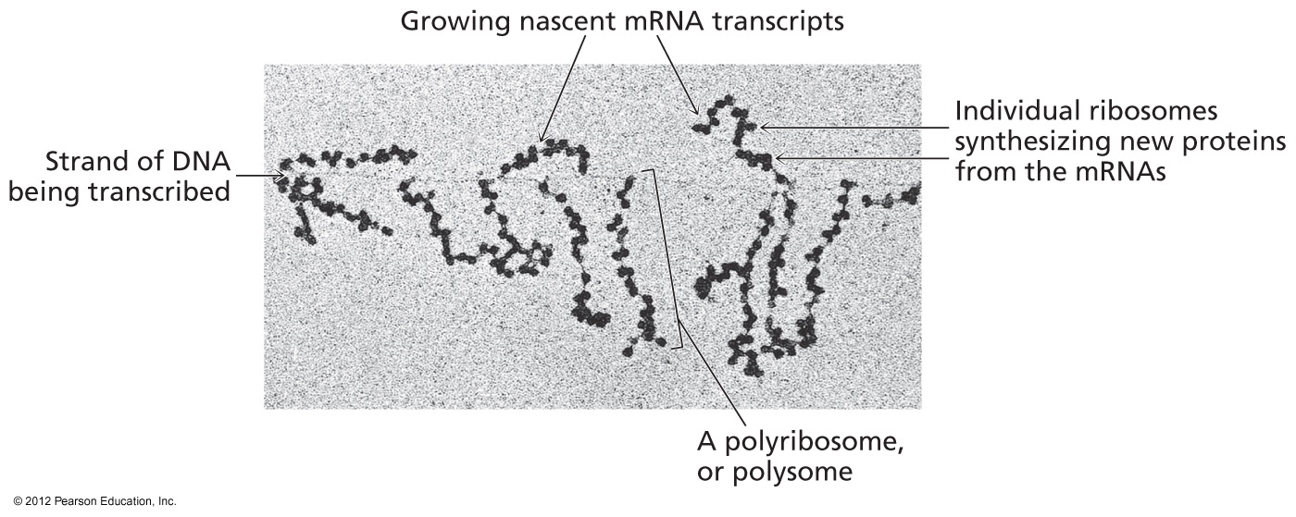
Translation in Prokaryotes
Polyribosome complex with growing mRNA
Not possible with eukaryotes
  Transcription in nucleus; translation in cytosol
  Post-transcriptional modification

Slide 5
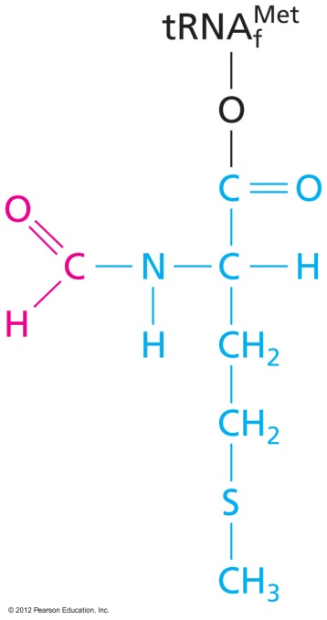
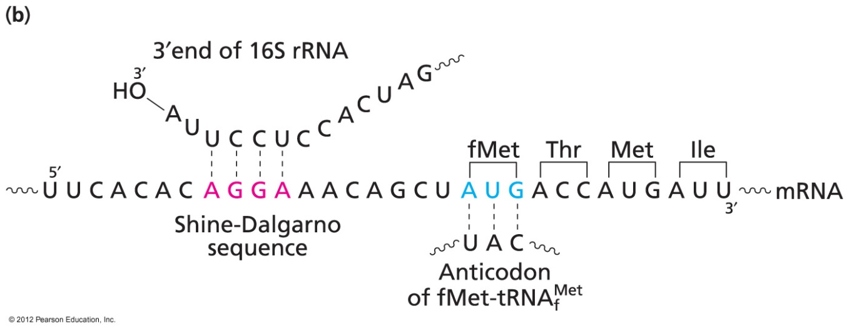
Initiation
Starts with AUG—formyl-met in bacteria
Establish reading frame
Eukaryotes—generally first AUG
Prokaryotes—Shine-Dalgarno sequence

Slide 6
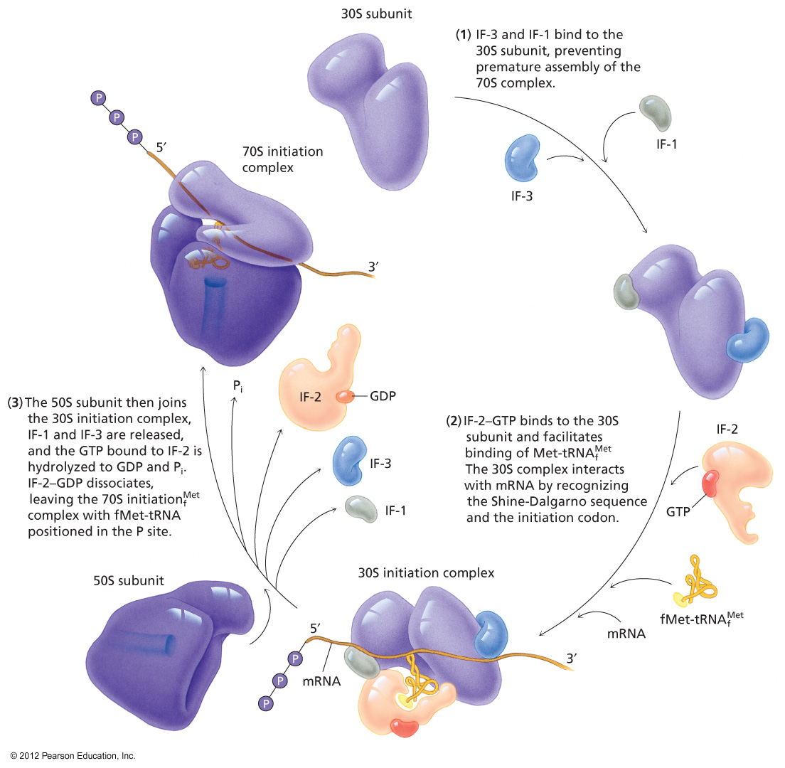
Role of Initiation Factors
Control of assembly
Correct reading frame
Cost of 1 GTP

Slide 7
Elongation
Initiator tRNA in the P-site
Three step mechanism
  Position incoming aminoacyl-tRNA in the A-site
  Catalysis of peptide bond formation
  Translocation of ribosome

Slide 8
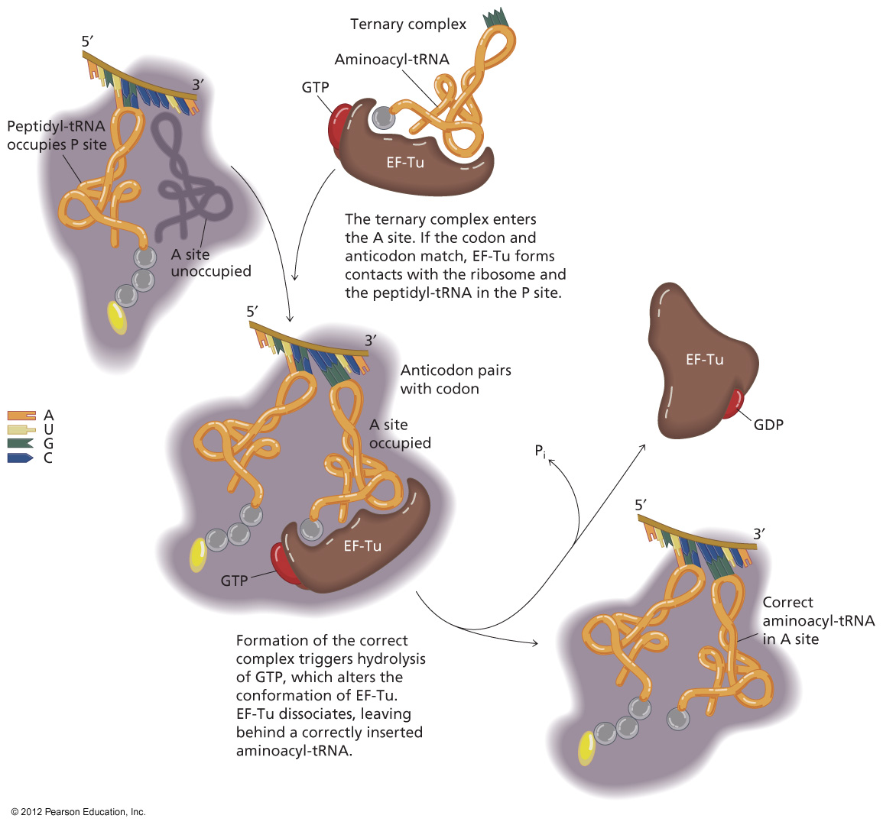
Step 1: Position incoming aa-tRNA

Slide 9
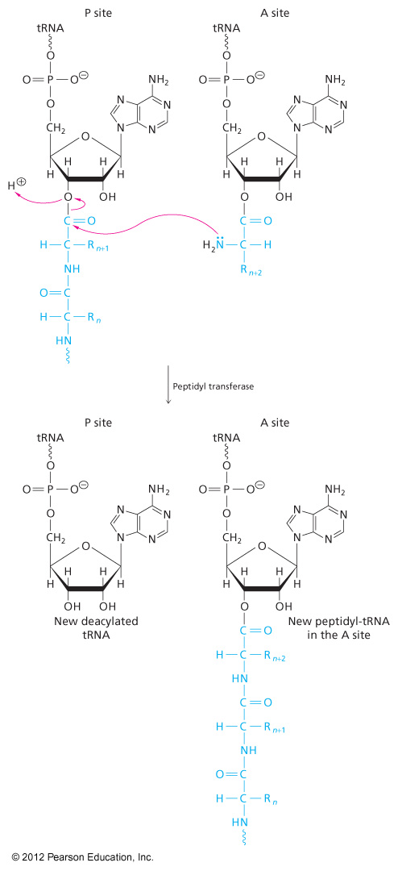
Step 2: Peptidyl Transferase
Thermodynamically favorable breaking of high energy ester
Growing peptide ends up on tRNA in the A-site

Slide 10
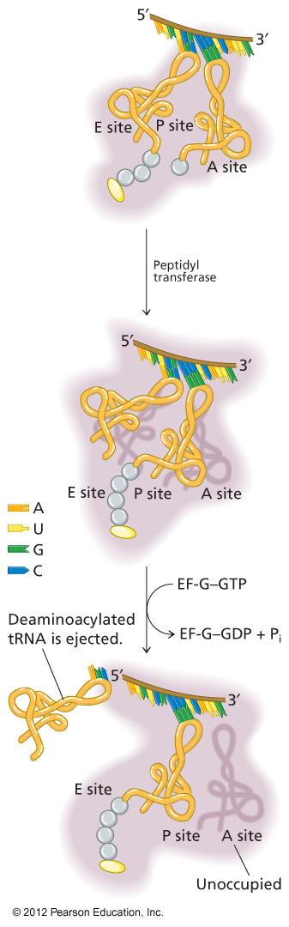
Step 3: Translocation
Which moves? Depends on frame of reference
Empty tRNA in E-site (exit site)
Growing polypeptide in P-site A-site is left open with a new codon
Elongation factor helps at the cost of 1 GTP

Slide 11
Termination
Stop codons (UGA, UAG, UAA) end up in A-site
Not recognized by tRNA; translation stalls
Termination factor binds
  Hydrolysis of polypeptide from the tRNA; release of protein
  GTP bound to termination factor is hydrolyzed

Slide 12
Energetic Cost of Translation
Activation of aminoacyl-tRNA: 2 ATP equiv.
Initiation: 1 GTP
Elongation step 1: 1GTP
Elongation step 3: 1 GTP
Termination: 1 GTP

Slide 13
Example for a 10 AA peptide
Aminoacyl-tRNA synthesis: 20 ATP equiv
Initiation: 1 GTP
Elongation positioning: 9 GTP
Elongation translocation: 9 GTP
Termiantion: 1 GTP
Total: 40 ATP equivalents

Slide 14
Answers
B
B
A
C
B

