Slide 1
Video
http://www.youtube.com/watch?v=o9p2ou1IyC0

Slide 2
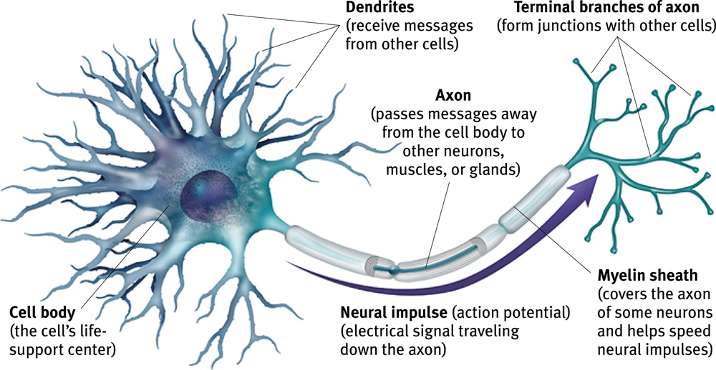
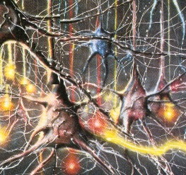
Neurons
Neurons
  Brain cells, or nerve cells
Anatomy
  Cell body (soma)
  Dendrites
  Axon
  Terminal branches (terminal buttons)
  Myelin sheath

Slide 3
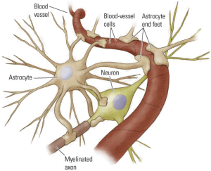
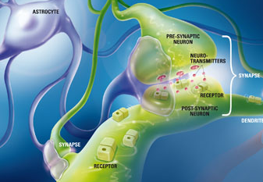
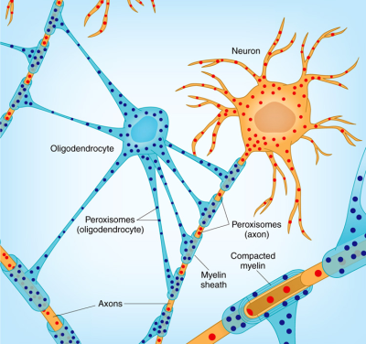
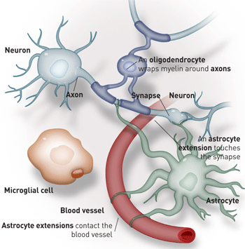
Glial Cells
Glial cells
  Structural support
  Nutrients
  Clean up debris (ions, neurotransmitters)
  Immune functions
  Help in guiding neural connections
  Myelin
  Participate in information transmission

Slide 4
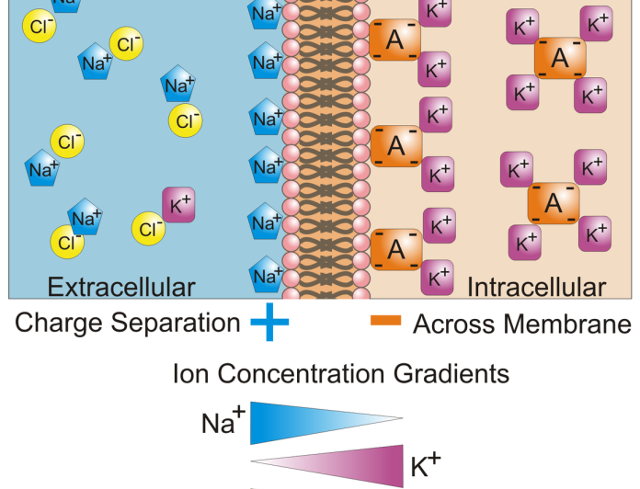
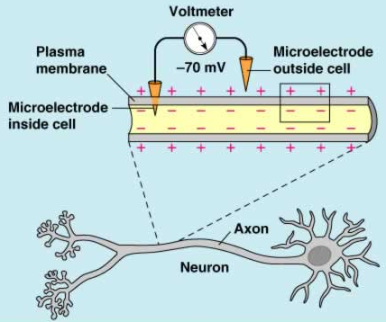
Neuron at Rest
Selectively permeable membrane
  Some things can pass through, while others can not
  Relatively impermeable to sodium (Na⁺) and potassium (K⁺) at rest
    Na⁺ in higher concentration outside the cell
    K⁺ in higher concentration inside the cell
    Chemical or concentration gradient
Overall, inside of the cell is negatively charged, compared to the outside of the cell
  Electrical potential (gradient)
  Resting (membrane) potential

Slide 5
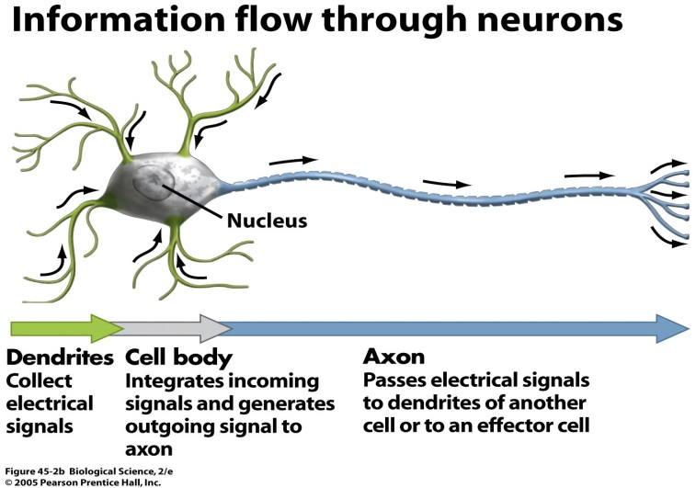
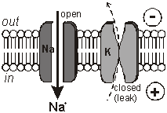
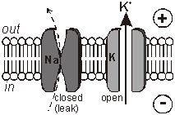
Neuron When Activated:
The Action Potential
Action Potential
  A brief electrical charge that travels down the axon
  A “neural impulse”
  The neuron is “firing”
Electrical signal transmitted along the axon by the diffusion of charged atoms
  The membrane becomes permeable to sodium (Na⁺) and Potassium (K⁺)
  Series of channel openings along the axon that allows the diffusion
    Voltage gated channels

Slide 6
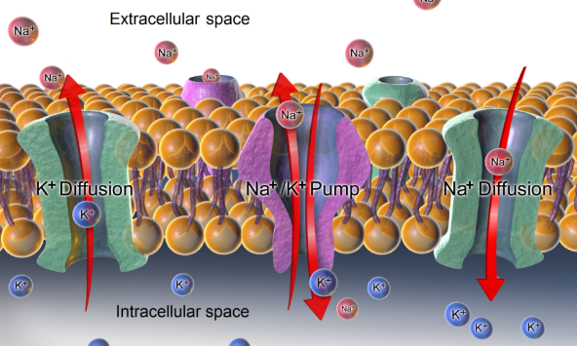
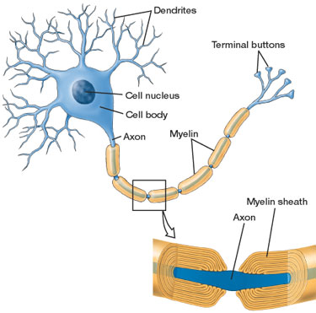
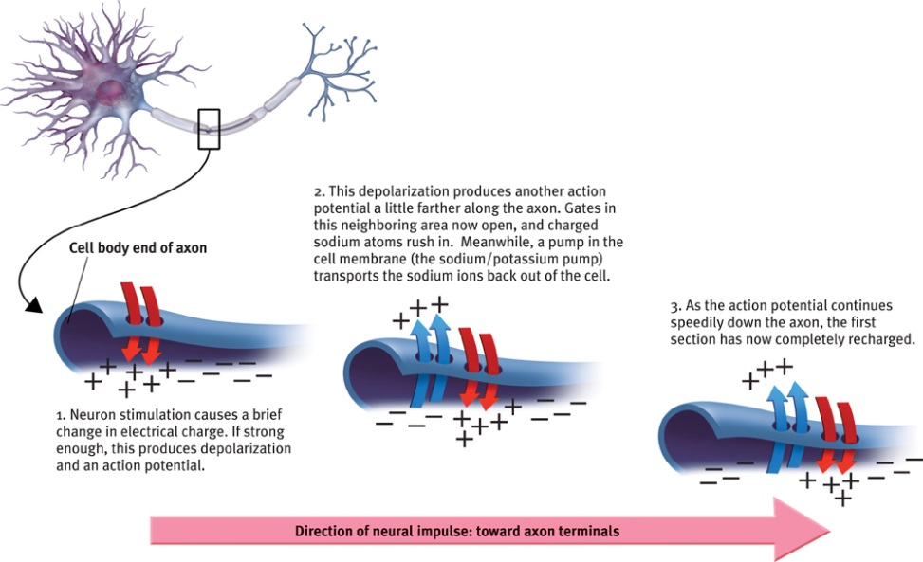
Action Potential (cont’d)
Sodium channels open at the axon hillock
  Sodium rushes in
  Since sodium is positively charged, the inside becomes positive
    Depolarization
Resting membrane potential is then restored
  Sodium channels close
  Potassium channels open and potassium rushes out of the cell, making the cell negative on the inside again
  Sodium pumped back out, while potassium pumped back in
    Sodium-potassium pump
  Repolarization
  Refractory period
    A period in which the neuron can not fire
This occurs at successively adjacent portions of the axon
  Or the Nodes of Ranvier in myelinated axons
All-or-none

Slide 7
Video: Action Potential
http://www.youtube.com/watch?v=U0NpTdge3aw&feature=related
https://en.wikipedia.org/wiki/Action_potential#/media/File:Action_Potential.gif

Slide 8
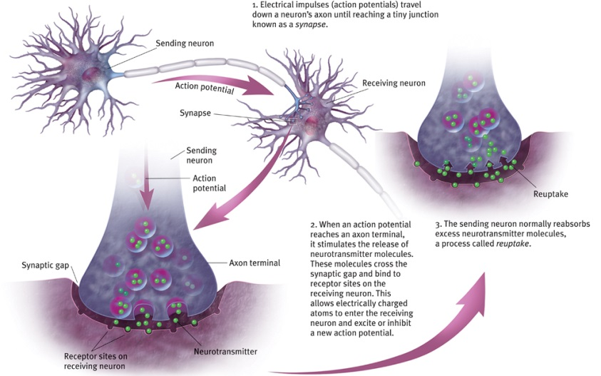
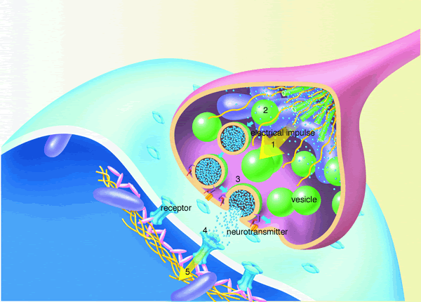
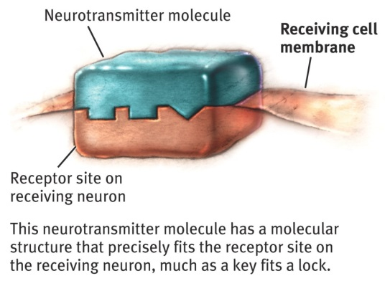
Synapse
Synapse
  The junction between an axon terminal and a dendrite/cell body
  Synaptic gap (cleft)
Axon terminals release neurotransmitter
  Synaptic vesicles
Neurotransmitter binds to a receptor
  Dendrite or cell body of receiving neuron
  Lock and key type relationship
Trigger the opening (or closing) of ion channels
  NOT an action potential
  Postsynaptic potentials (PSPs)
    Excitatory postsynaptic potential (EPSP)
    Inhibitory postsynaptic potential (IPSP)

Slide 9
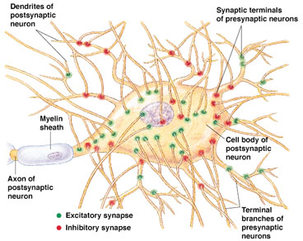
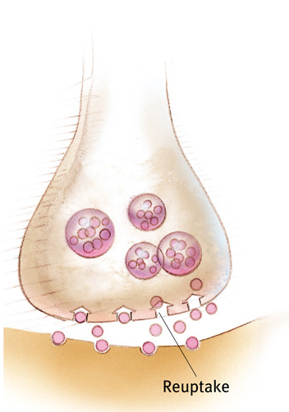
Threshold & Reuptake
Dendrites/cell body receive signals from many neurons
  Most excitatory, some inhibitory
  Summation
  Threshold
Reuptake
  Taking back neurotransmitter
Notes:
-Right hemisphere looks at thing holistically (recognizing a face not the individual features)
-Left hemisphere does more of the individual features, also left narrows focus and makes precise judgements
-One side will inhibit the other if it is better at a job than the other
-Balance of excitation and inhibition
-Summation is a chemical process that sums up all of the signals from the neuron (ie. 500 excitatory (threshold) and 0 inhibitory = firing neuron --- if there are 200 inhibitory, it won’t fire)
-SSRI: selective serotonin reuptake inhibitor (serotonin controls mood) is used to treat depression (they work by partially blocking the reuptake of serotonin, making it as if they have a normal amount of serotonin, keeping some in the synaptic gap for a longer time)

Slide 10
Notes:
-

