Slide 1
Tutorial 10
November 22, 2012.

Slide 2
Announcements
Quiz in tutorial next week (Nov. 29)
Includes:
  Sensory phys lectures 3-5 (vision and hearing)
  Motor neurophys
  Muscle phys
  Cardiovascular phys lecture 1,2

Slide 3
Functions of the CV System
Homeostasis!!
  Transports oxygen and nutrients
  Removes carbon dioxide and waste
  Regulates body temperature and pH
  Transports and distributes hormones throughout the body
  Role as a Transport System
Central pump (heart)
Closed system of tubes (blood vessels)
Fluid (blood)

Slide 4
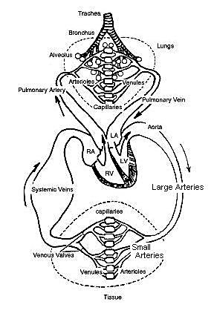
General Organization, Anatomy and
Blood Volumes
2 divisions of the CV system:
1. Pulmonary Circulation
- includes blood vessels- carry blood to and from lungs
-Circulating blood through heart
-exchange of gases between atmosphere and blood (with lungs)
2. Systemic Circulation
-all blood vessels that carry blood to and from rest of body

Slide 5
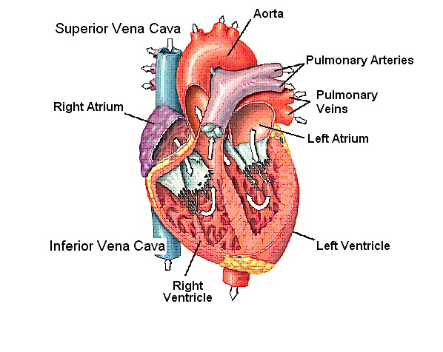
Path of blood through the heart
Pulmonary circulation:
Blood enters through superior vena cava into the right atrium
Passes through right AV (tricuspid) valve into right ventricle
Flows up through the pulmonary semilunar valve
Blood flows out through the pulmonary arteries to the lungs for oxygenation
Pulmonary semilunar valve
Right pulmonary
arteries
Tricuspid valve

Slide 6
Systemic circulation:
Blood enters through pulmonary veins into the left atrium
Blood flows through cusp of left AV (bicuspid) valve to the left ventricle
Blood is pumped out of left ventricle
Blood is pumped out of left ventricle through the aortic valve
  (chordae tendonae and
  papillary muscles
  ensure AV valves don’t
  collapse back into atria)
Flows through aorta out to the body
Aortic valve
Bicuspid valve
(AV valve)
Chordae
tendonae
Papillary
muscles

Slide 7
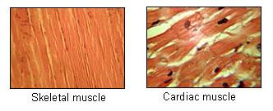
Contractile Cells
Similar to skeletal muscle:
  Striated
  Contain similar contractile proteins (actin and myosin)
  Ca⁺⁺ release from SR triggers contraction

Slide 8
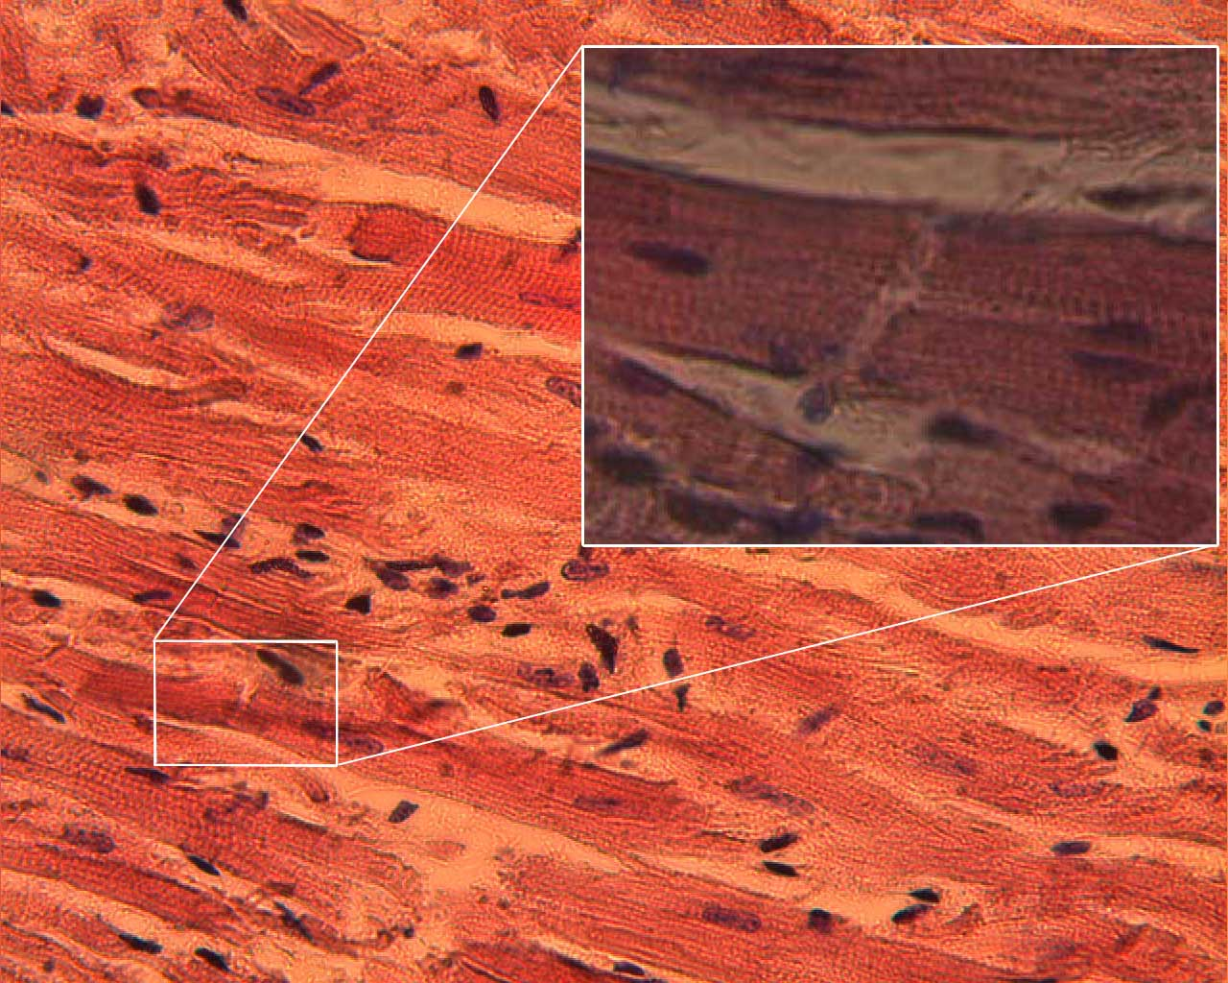
Contractile Cells
Differences
  Short and branched
  1/3 of volume is occupied by mitochondria
  (to produce ATP)
  Extract 80% of the oxygen from the blood
  Joined by intercalated discs that contain gap junctions
    Gap junctions allow movement of ionic currents (APs) between cells

Slide 9
Nodal / Conducting Cells
Contain few contractile proteins
Self excitable: spontaneously generate APs
Rapidly conduct AP through the heart
More like nerve cells
Nodal cells:
  Sinoatrial (SA) node
  Atrioventricular (AV) node
Conducting Cells:
  Bundle of His
  Purkinje Fibers

Slide 10
Sinoatrial (SA) Node
The origin of self-excitability
Heart beats at a rate of roughly 70-75 bpm
Impulses (APs) originate at SA node
Located in the upper posterior wall of the right atrium
Site of fastest spontaneous generation of the action potential
The “Pacemaker” of the Heart

Slide 11
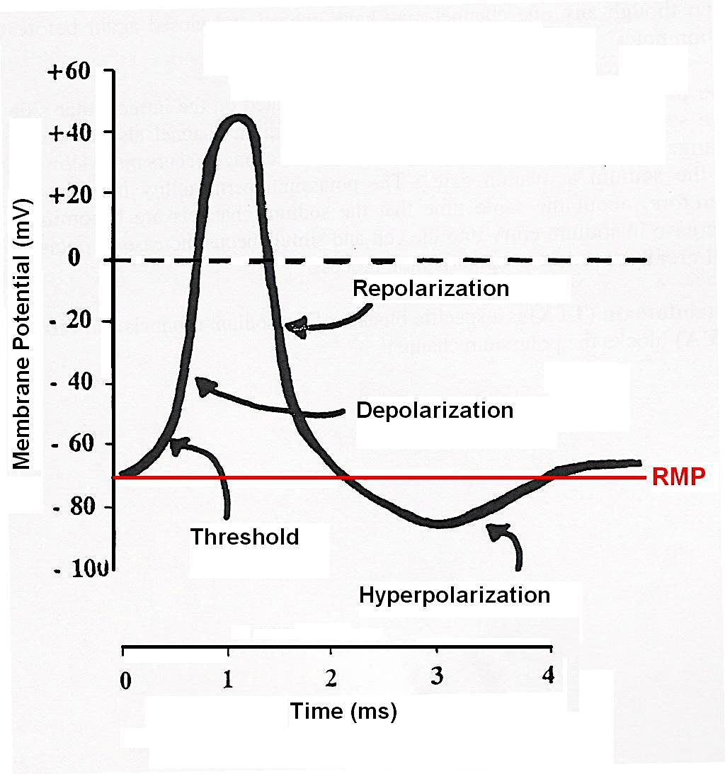
Neuronal AP vs SA node cell AP
Neuronal APs:
  rmp = -70 mV
  Threshold = -55 mV (EPSPs)
  Dep: Na⁺ VG channels,
  Rep: K⁺ VG channels
  Time:2 - 4 ms
SA node APs:
  NO rmp (lowest = -60 mV)
  Threshold = -40 mV
  Dep: Ca⁺⁺ VG channels,
  Rep: K⁺ VG channels,
  Time: 1-2 sec
How do they reach threshold?

Slide 12
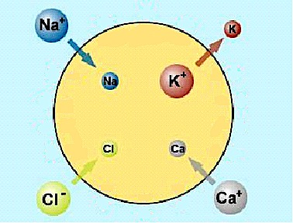
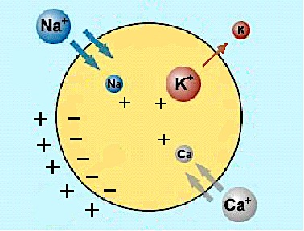
SA Nodal Action Potential
To reach threshold, cell must depolarize (inside becomes more positive)
  Can depolarize on their own- “self-excitable”!
SA node cells have a greater Na⁺ and Ca⁺⁺ permeability
K⁺ permeability of SA node cells decreases during diastole (less K⁺ leaves these cells during relaxation of the heart)
No stable “resting” membrane potential…….
  -constantly depolarizing
  -causes spontaneous AP’s

Slide 13
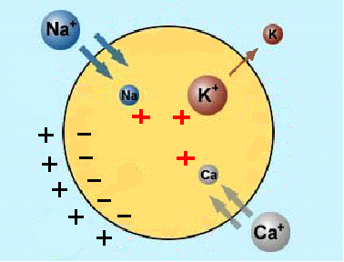
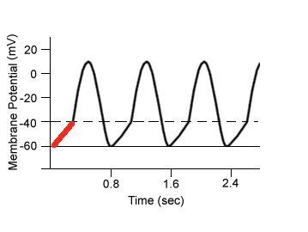
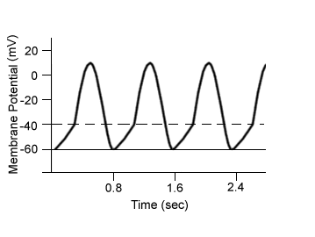
SA Nodal Action Potential
(i) slow depolarization caused by:
  ↑ permeability of cells to Na⁺ and Ca⁺⁺
  ↓ K⁺ permeability
  Pre-Potential (pacemaker potential)

Slide 14
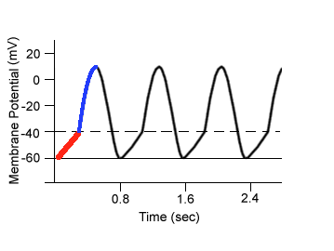
SA Nodal Action Potential
(ii) Depolarizing phase
at threshold (-40mV), Ca⁺⁺ VG channels open
Ca⁺⁺ flows into SA nodal cell
Membrane potential reaches +15 mV

Slide 15
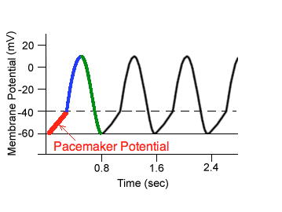
SA Nodal Action Potential
(iii) Repolarization
Ca⁺⁺ VG channels begin to close
K⁺ VG channels begin to open
K+ leaves the cell
Membrane potential returns to –60 mV
K⁺ channels begin to close and cycle repeats

Slide 16
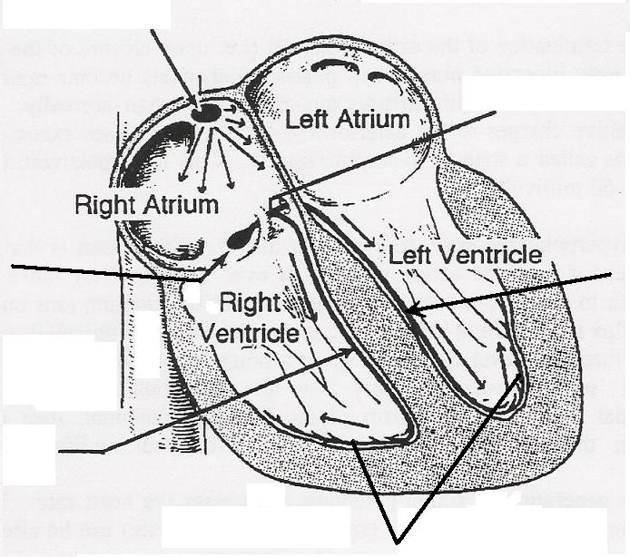
Conducting System of the Heart
(conducts AP from L. atrium- spreads from top- to bottom- atrial muscle contracts from top-down)
Interatrial Band
Sinoatrial (SA) Node
Pacemaker potential
AP spreads down to atrial muscle cells
Atrium contracts from top to bottom
Atrial Muscle (gap junctions)
Bundle of His
Atrioventricular Node
Left Bundle
Branch
Atrioventricular Ring
(Electrically isolates atrial muscle from ventricular muscle- bc we need to drain ventricles from bottom-up)
Right Bundle of His Branch
Ventricular
Muscle (gap
Junctions)
(Sends AP to purkinje fibres)
Purkinje Fibers
(help spread AP into ventricular contractile cells- which will contract from bottom-up pushing blood to the pulmonary or aortic valve)

Slide 17
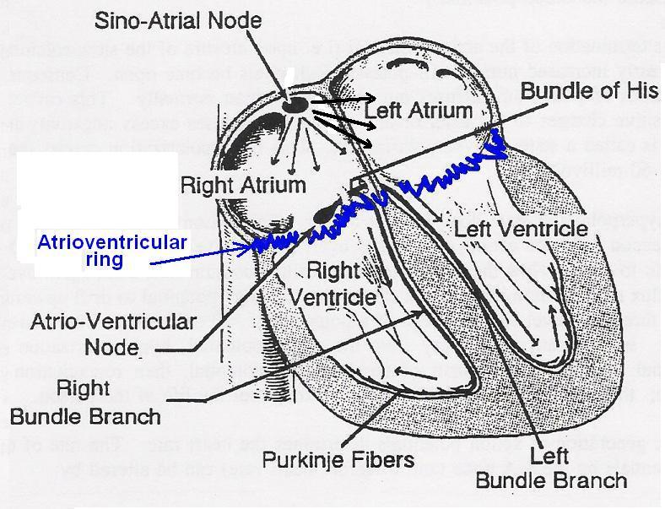
Conducting System of the Heart
Location | Speed of conduction (m/sec)
SA node | 0.05 m/sec
Atrial muscle (gap junct^{ns}) | 1.0 m/sec
AV node | 0.03 - 0.05
Bundle of His | 1.0 m/sec
Purkinje Fibers | 5 m/sec
Ventricular Muscle (gap junct^{ns}) | 1.0 m/sec
Don’t want this to go too fast b/c we have to make sure the atria have finished contracting!
Gap junctions- faster conduction

Slide 18
Electrocardiogram (ECG)
Body fluids are good conductors electricity
Cardiac impulse passes through the heart ➔ passes to surrounding tissue and to the surface of the body
Electrodes can pick up these impulses
ECG is the sum of all the electrical events in the heart – both depolarizing and repolarizing
What can the ECG tell you about the heart?
  The extent and type of disturbances of rhythm or conduction.
  The extent and location of myocardial damage.
  Effects of drugs.
  Heart rate.

Slide 19
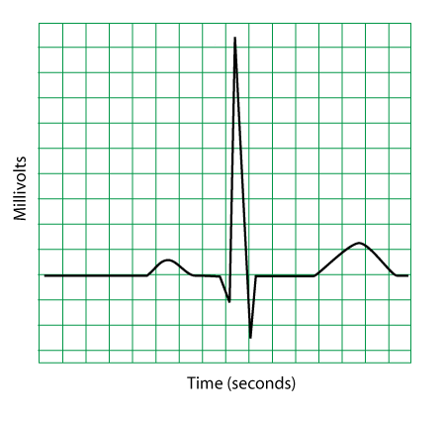
Electrocardiogram (ECG)
R
QRS complex- Depolarization of ventricular muscle (contraction)
-larger than P-wave bc there is more tissue!
T-wave
Repolarization of ventricles
P wave
Depolarization of atrial muscle cells
Q
S- complex
Repolarization of atrial muscle (hidden in QRS complex)

Slide 20
The Cardiac Cycle
It shows all the mechanical and electrical events during a single contraction on the left side of the heart.
AT REST
It includes:
  Pressures changes in aorta, left atrium and left ventricle
  Volume changes in left ventricle
  Valves opening and closing
  ECG

Slide 21
The Cardiac Cycle
Cardiac cycle consists of a period of systole (contraction) and diastole (relaxation)
Each cycle is initiated by the SA-node
On diagram watch for:
  Points where lines of pressure cross = valves are opening or closing
  Pressure gradients (high to low) = blood flow (if valves are open)
  When blood is flowing ➔ Ventricular volumes change

Slide 22
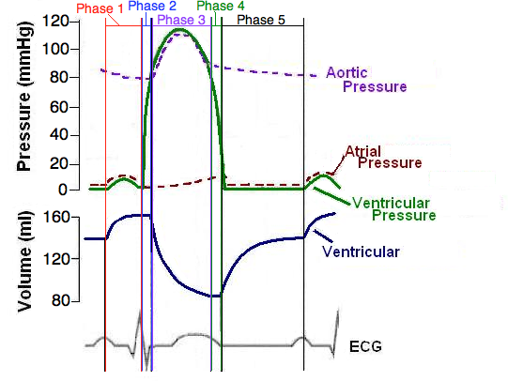
The Cardiac Cycle
  Phase 1- Atrial systole
  Phase 2 - Early ventricular systole
Phase 3 - Ventricular systole
Phase 4 - Early ventricular diastole
Phase 5 - Late ventricular diastole

Slide 23
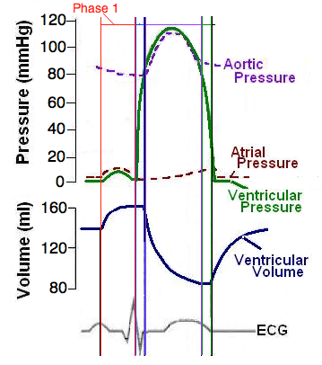
The Cardiac Cycle
1. Atrial systole
  P wave ➔ atria contract
  ↑ Atrial pressure > ventricular pressure
  (Left AV valve is already open)
  Last 30% of Vent filling ➔ end diastolic volume (EDV)
EDV

Slide 24
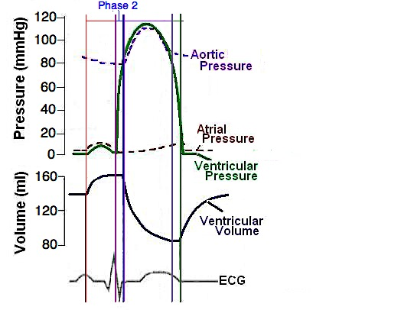
The Cardiac Cycle
2. Early ventricular systole (Isovolumetric ventricular contraction)
  QRS complex ➔
  Ventricles begin contracting➔ pressure builds in ventricles
  ii Ventricular P > Atrial P ➔AV valve closes
  (so blood doesn’t flow backwards)
  iii No change in volume
  -aortic valve is closed
AV valve
closes

Slide 25
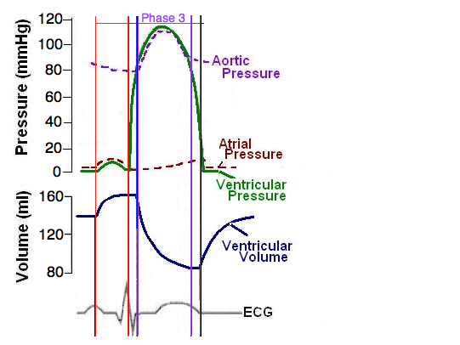
The Cardiac Cycle
3. Ventricular systole (rapid ejection period)
Ventricles continue to contract
Ventricular pressure > aortic P ➔ Aortic valve opens ➔ blood leaves ventricle
Ventricular volume ↓
  (not all blood leaves. End Systolic Volume – ESV - remains)
  T – wave begins
Aortic valve
opens

Slide 26
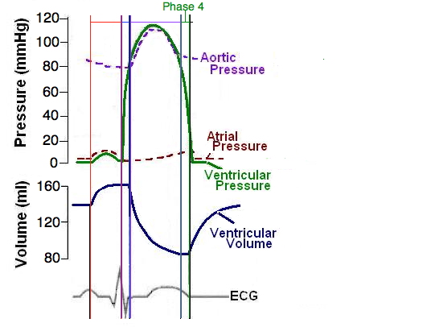
The Cardiac Cycle
4. Early ventricular diastole (Isovolumetric ventricular relaxation)
  Ventricles relax ➔ Ventricular pressure drops
  Vent. P < Aortic pressure ➔ Aortic valve closes
  Vent. pressure > atrial P -AV valve still closed
  -no change in volume
Aortic valve
closes

Slide 27
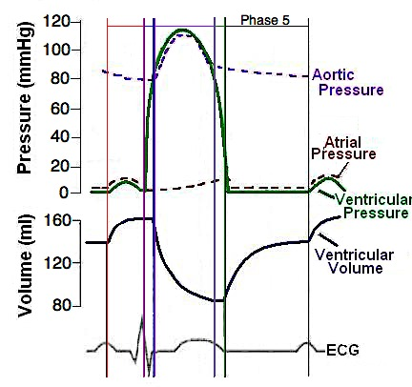
The Cardiac Cycle
5. Late ventricular diastole (ventricular filling)
  Ventricles still relaxing
  Vent. pressure < Atrial pressure ➔ AV valve opens
  Blood enters ventricles (70% of ventricular filling takes place)
  Cycle Repeats
AV valve
opens

Slide 28
Atrial contraction and ventricular filling
70% of ventricular filling occurs when ventricles relax (phase 5 – late ventricular diastole) – not when atria contract.
Last 30%, just before vent. systole, occurs when atria contract (phase 1)

Slide 29
Cardiac Output
Cardiac output (C.O.) = the amount of blood pumped by each ventricle in one minute (l/min)
CO = heart rate (bpm) x stroke volume(ml)
Heart rate is the number of heart beats per minute
Stroke volume (SV) is the amount of blood pumped by each ventricle during one contraction/heart beat

Slide 30
Cardiac output
CO = heart rate x stroke volume
resting heart rate = 70 bpm
resting stroke volume = 70 - 80 ml/beat
At rest, CO = 5 liters/min
During exercise, CO can increase to 20 – 40 l/min
Change CO by changing HR or SV
Look at HR first…

