Slide 1
Tutorial 9
November 15, 2012.

Slide 2
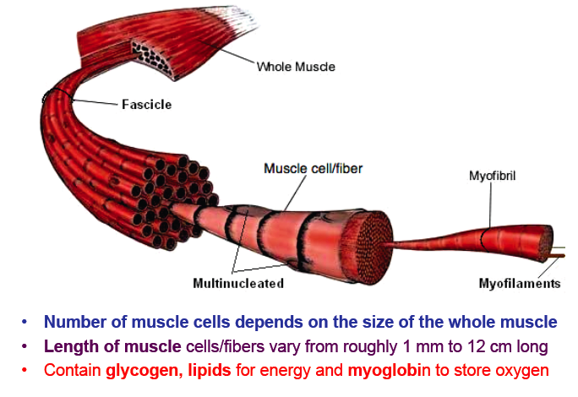
Structure of skeletal muscle

Slide 3
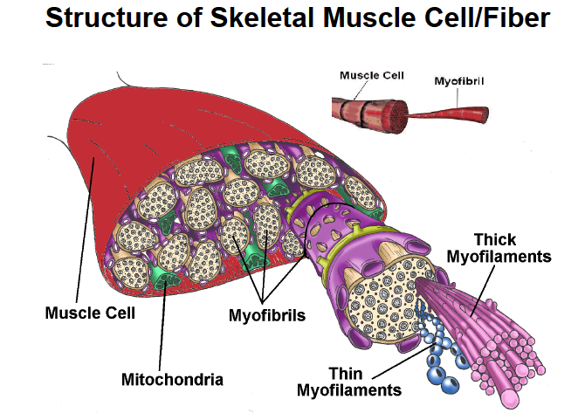

Slide 4
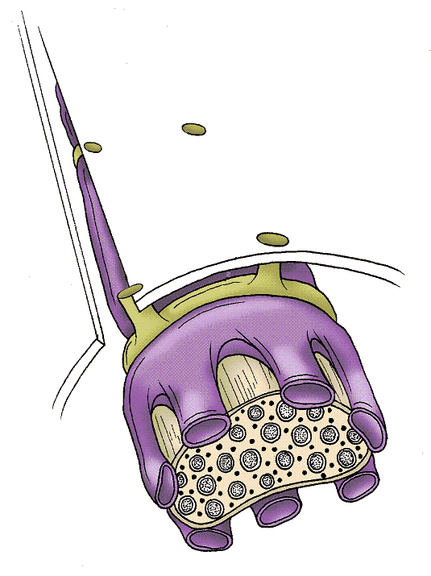
Structure of a muscle cell/fibre
Transverse (T) tubules
Sarcolemma
Terminal Cisternae
(Lateral Sac) of SR
Sarcoplasmic Reticulum
(SR)
Thick Myofilament
Thin Myofilament
Myofibril

Slide 5
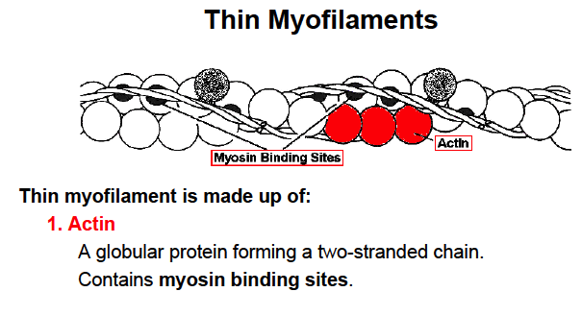
-At rest- myosin binding site is covered by tropomyosin.

Slide 6
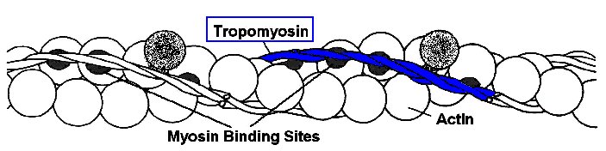
Thin myofilament is made up of:
2. Tropomyosin
  - A rod shaped protein composed of two protein chains wrapped together in a super coil
  - lies in groove formed by actin molecules
  - In the relaxed muscle tropomyosin is situated so that it partially covers the myosin binding sites found on actin.

Slide 7
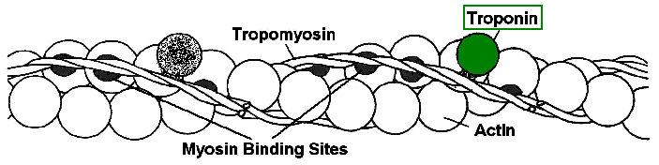
Thin myofilament is made up of:
3. Troponin
In relaxed muscle troponin is attached to tropomyosin and actin so that it holds the tropomyosin over the myosin binding sites
until Ca⁺⁺ arrives!

Slide 8
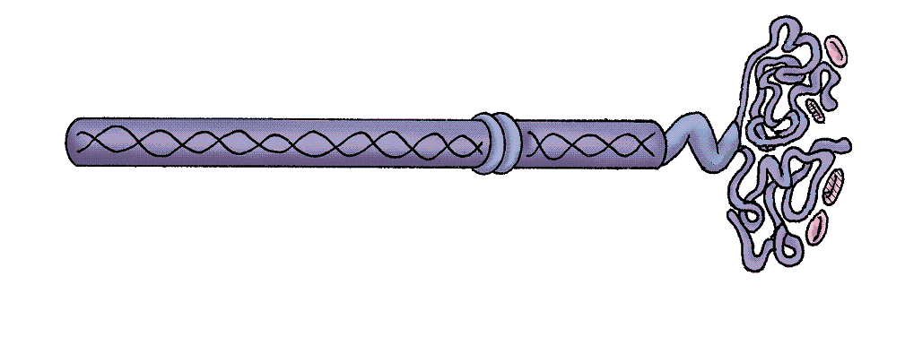
Individual Myosin molecules
Thick myofilaments are made up of many individual myosin molecules – like the one below
Binding site
for actin
Hinge
Binding site
for ATP
Tail
Arm
-myosin made up of poly-peptide chains
-alpha-helical tail, and globular head
-ATP binding site contains ATPase- the enzyme that causes breakdown of ATP to ADP + Pi
One Head Unit

Slide 9
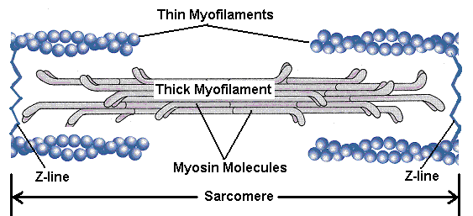
Thin and Thick myofilaments
Myosin molecules in the two halves are oriented in opposite directions, with tail ends toward the centre.
Myosin heads stick out to the sides toward the actin filaments
Sarcomere: between Z-lines; smallest functional unit of the muscle cell

Slide 10
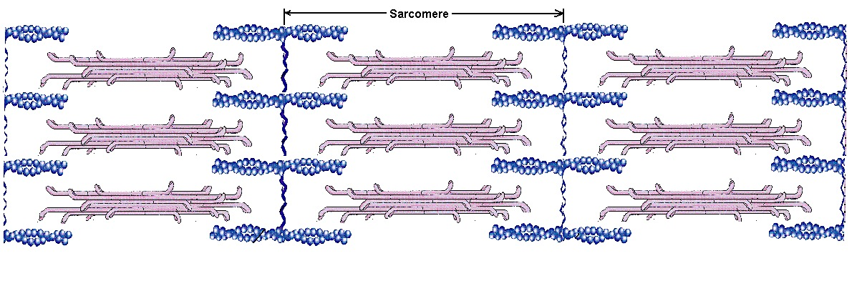
Several sarcomeres together….

Slide 11
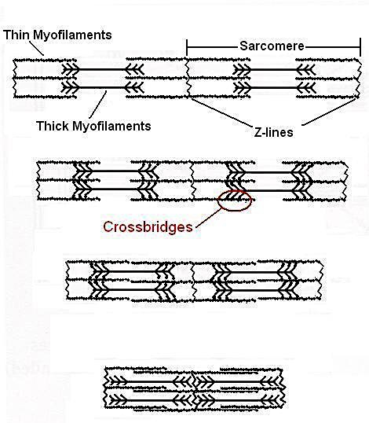
Sliding Filament Theory of muscle contraction
When myosin binds to actin a cross-bridge is formed
Myosin then changes shape and a power-stroke occurs
Actin slides past myosin
The only thing that changes length is the sarcomere- shortens

Slide 12
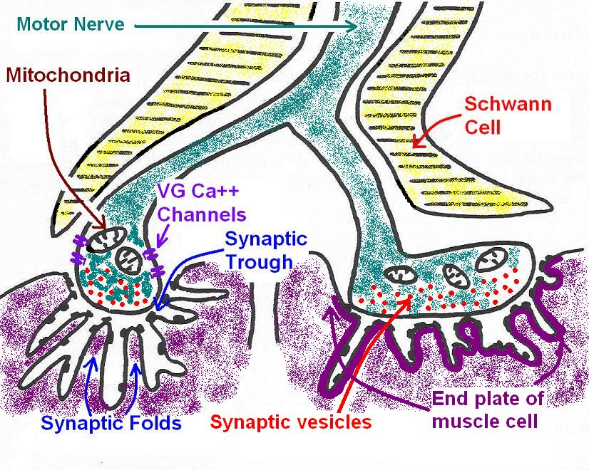
Neuromuscular junction
1 motor nerve can contact more than one muscle cell, but each muscle cell will only be contacted by one motor nerve

Slide 13
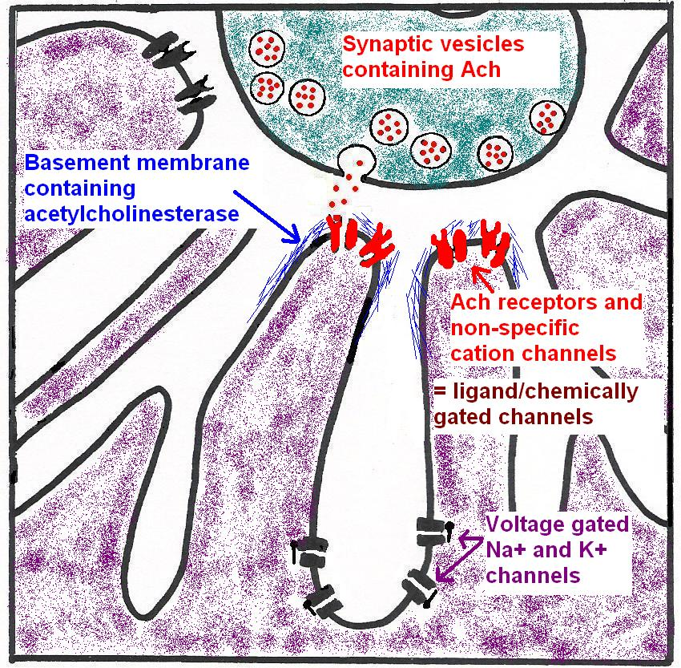
-Purpose of folds is to increase surface area
-Top of fold- chemically gated channel (non-specific cation channel= any + ion can pass through)
-Bottom of fold- Na+ and K+ channels= where AP is generated

Slide 14
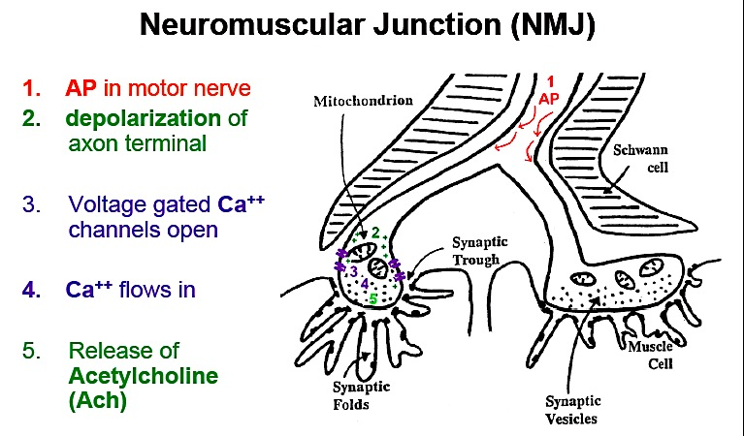
(voltage gated Na+ channels)- makes cell more positive
Ca2+- high conc. outside cell
ALWAYS ACH!

Slide 15
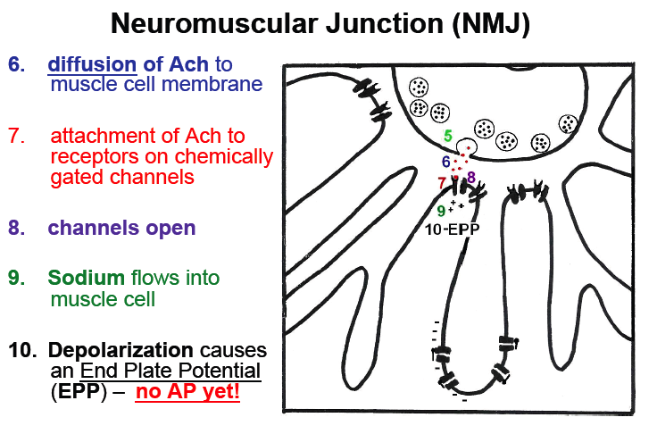
(End plate)
(Non-specific cation channel- but preferentially allows Na+ in)
(Making cell more +ve)

Slide 16
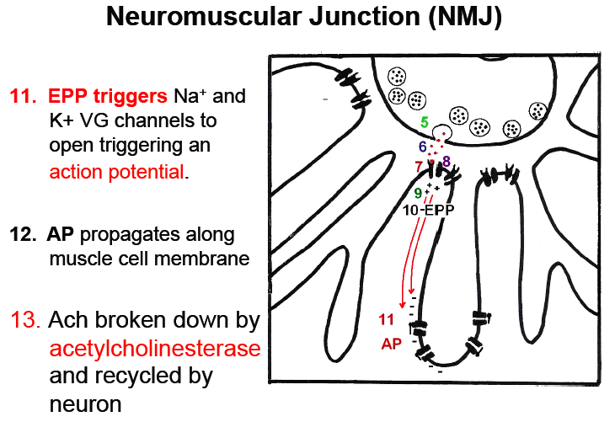
EPP triggers AP!
(To turn off contraction)

Slide 17
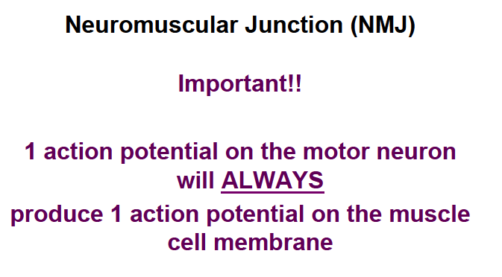
WHY???
Because motor neurons release much more neurotransmitter (ACh) than neurons- therefore better chance for AP

Slide 18
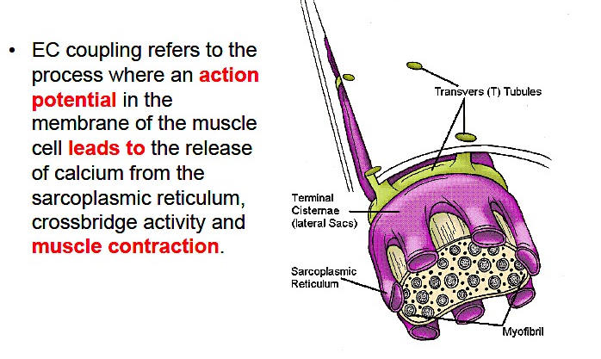
Excitation Contraction Coupling

Slide 19
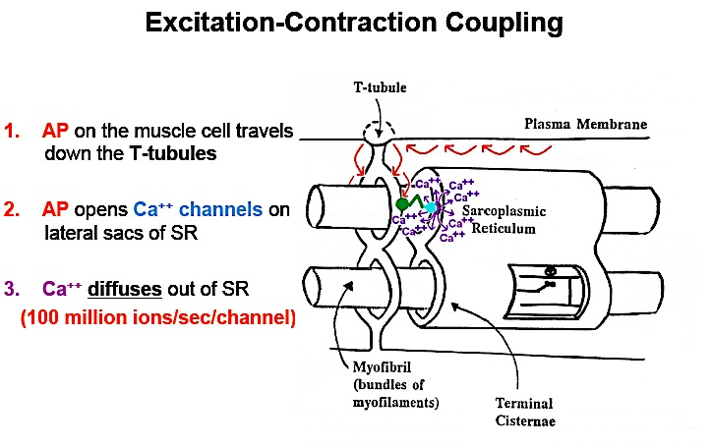
DHP receptor on T-tubules changes conformation.
DHP receptor is linked to ryanodine receptor (Ca2+ release channel on SR)

Slide 20
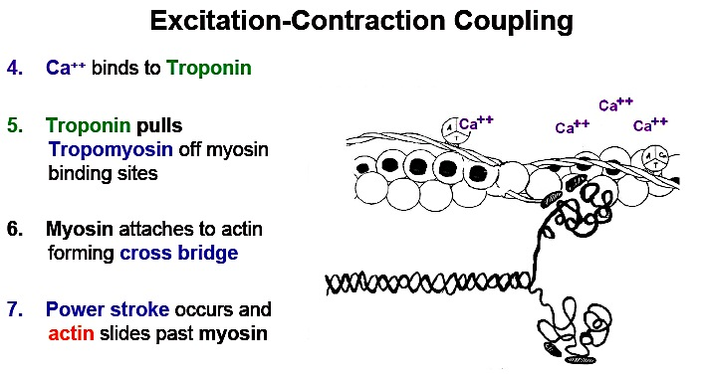
Muscle contracts!

Slide 21
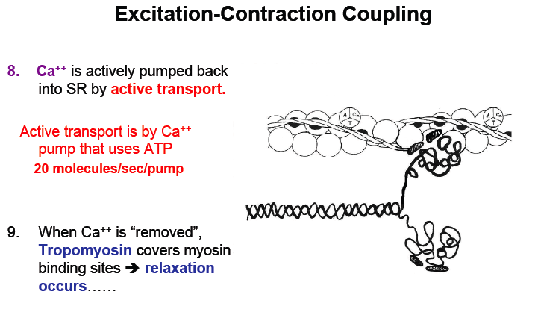

Slide 22
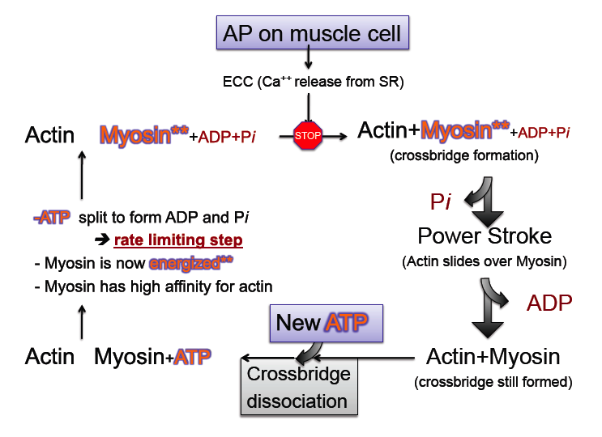
(Ca2+ binds to troponin, which pulls tropomyosin off myosin binding sites)
Myosin can’t bind to actin b/c of tropomyosin
Myosin has enzymatic site that breaks down ATP
START HERE
ATP attaches to myosin for dissociation, so the cycle can repeat-> if no ATP= rigor mortis- muscle permanently fused!

Slide 23
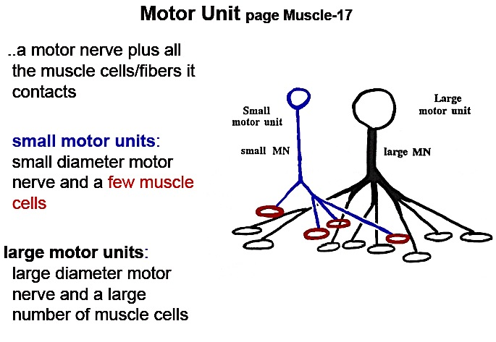
Motor Units
How can we increase the force of muscle contraction?
Recruitment of motor units
Summation of twitch contractions

Slide 24
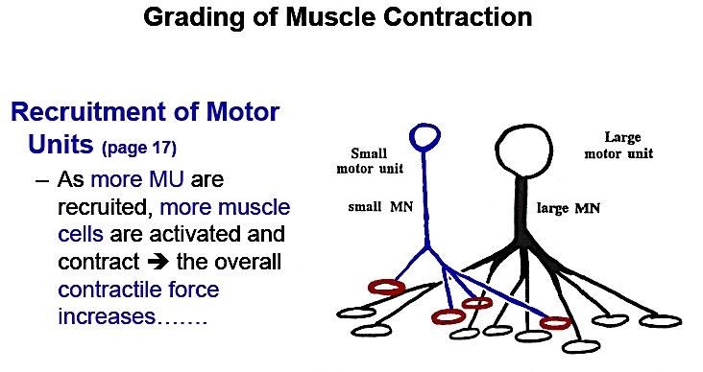
Brain sends signal to activate more motor units
eg. If something is heavy- need a bigger contraction.

Slide 25
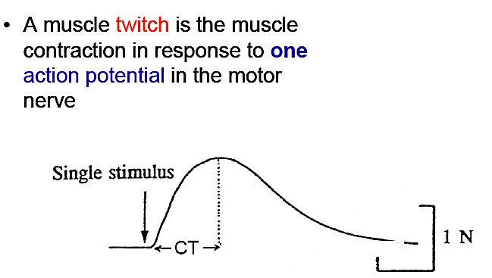
Summation of twitch contractions
Contraction is fast bc of rapid Ca2+ release
Relaxation is slow bc Ca2+ reuptake by SR is slow

Slide 26
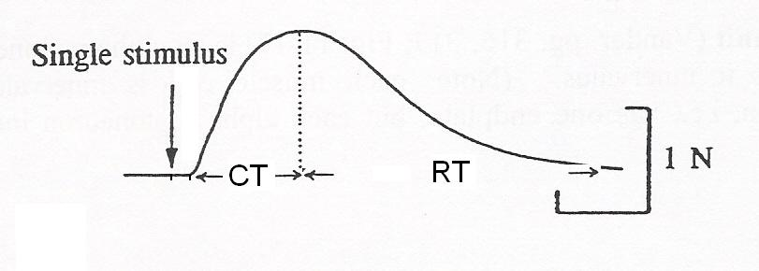
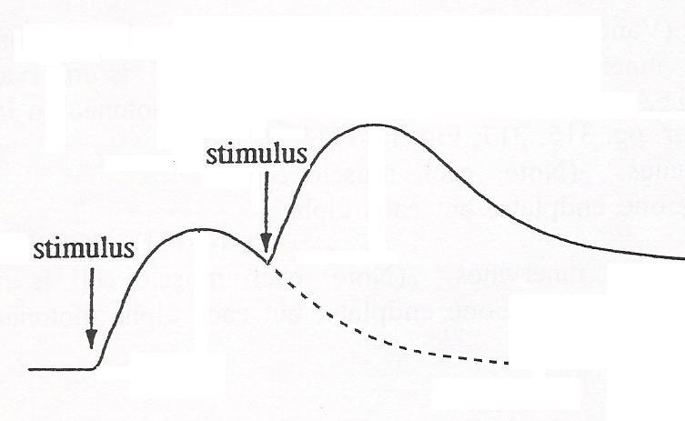
Summation of twitch contractions
As stimulation (AP) frequency is increased, each muscle twitch has less “time” to relax before the next one occurs.
➔ twitches start to “stack up” on one another causing a more forceful contraction.
  Summation of twitch contractions

Slide 27
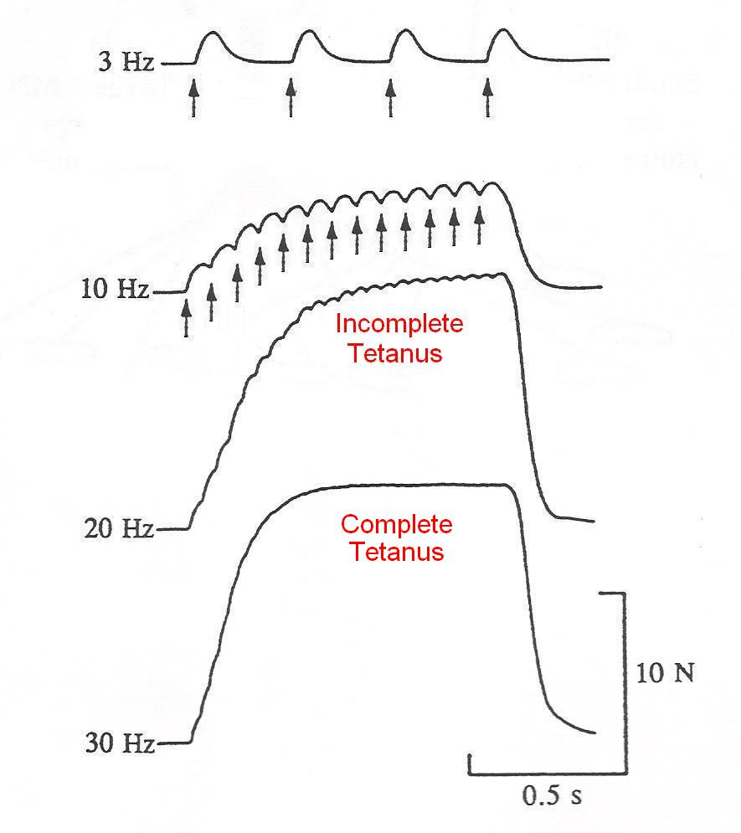
Overall:
Increasing AP
frequency
increases the
force
of contraction

Slide 28
Practice question 1
1. The neurotransmitter that signals the contraction of skeletal muscle fibers is __________.
A. acetylcholine
B. dopamine
C. dopamine and epinephrine
D. Epinephrine
Answer: A- acetylcholine

Slide 29
Practice question 2
Which of the following is correct?
  A sarcomere contains many muscle cells.
  During muscle contraction, the thin and thick myofilaments shorten
  A muscle cell contains many fasicles
  Myofilaments are smaller than myofibrils
  The sarcoplasmic reticulum is in direct contact with the muscle cell membrane.
Answer: D- myofilaments are smaller than myofibrils (remember- it goes alphabetically)

Slide 30
Practice question 3
For each of the incomplete statements below, ONE or MORE of the answers are correct: Choose: A) If only 1, 2, and 3 are correct
B) If only 1 and 3 are correct
C) If only 2 and 4 are correct
D) If only 4 is correct
E) If ALL are correct
Which of the following is found at a neuromuscular junction?
  1. Voltage-gated channels
  2. Gap junctions
  3. chemically gated channels
  4. intercalated discs
Answer: B- 1 and 3 are correct

Slide 31
Practice question 4
For each of the incomplete statements below, ONE or MORE of the answers are correct: Choose: A) If only 1, 2, and 3 are correct
B) If only 1 and 3 are correct
C) If only 2 and 4 are correct
D) If only 4 is correct
E) If ALL are correct
A sarcomere:
  1. extends from one z-line to the next z-line
  2. contains thin and thick myofilaments
  3. is the smallest functional unit of a muscle cell
  4. does not change length when the muscle contracts
Answer: A- 1, 2, 3 are correct- 4 is not correct- the sarcomere shortens during contraction

