Slide 1
Tutorial 8
November 8, 2012.

Slide 2
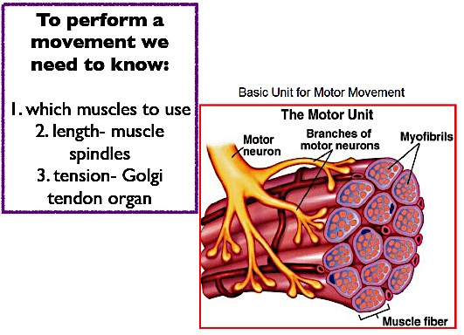
Motor unit: 1 motor neuron and all the muscle fibres it comes in contact with.

Slide 3
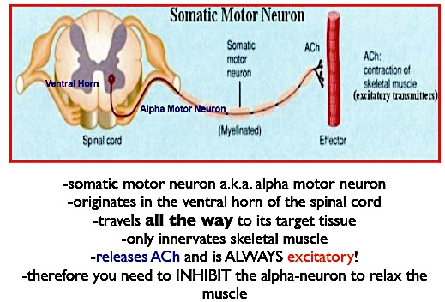

Slide 4
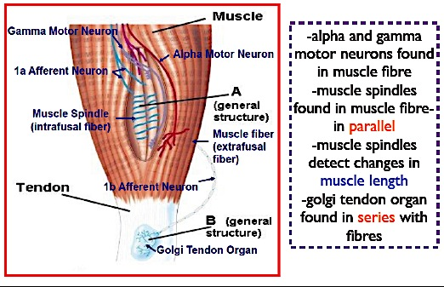

Slide 5
Muscle spindle: sense length of muscle and change in length of muscle. Found in parallel to muscle fibres
Golgi tendon organ: sense tension in muscle. Found in series with muscle tendon.
1a afferent neuron: sensory neuron from muscle spindles (carries info about muscle length)
1b afferent neuron: sensory neuron from golgi tendon organ (carries info about muscle tension)
How does the brain gain information about muscle length and muscle tension?
  Muscle spindles- in muscle
  Golgi tendon organs- in tendons
  Proprioceptors- 1a and 1b afferent neurons: transmit info to medulla via dorsal-medial-lemniscal pathway.

Slide 6
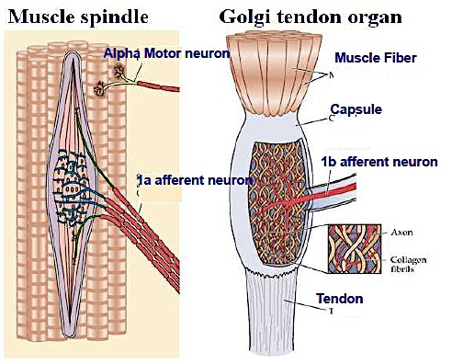
Proprioceptors

Slide 7
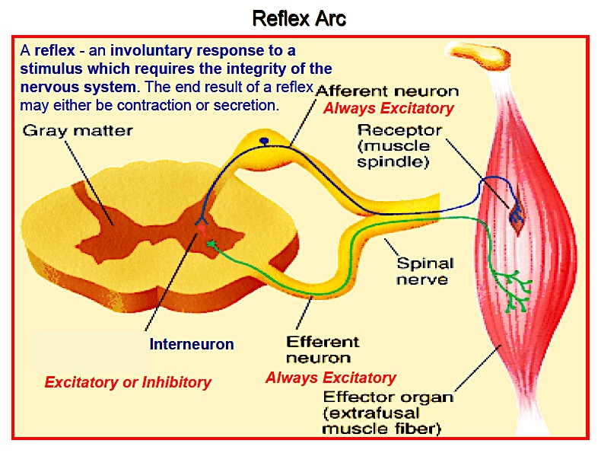

Slide 8
Reflex arc
Involves:
  1. a receptor
  2. an afferent/sensory neuron (excitatory to send impulses to the spinal cord or brainstem)
  3. a synapse
  4. an efferent/ motor neuron which innervates the effector organ to
  5. an effector (eg. muscle or gland)

Slide 9
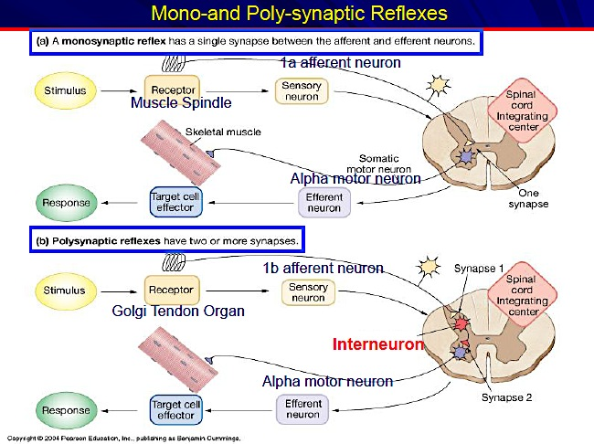

Slide 10
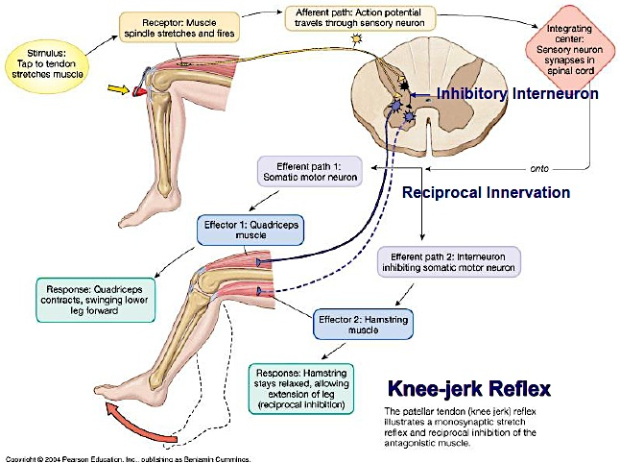

Slide 11
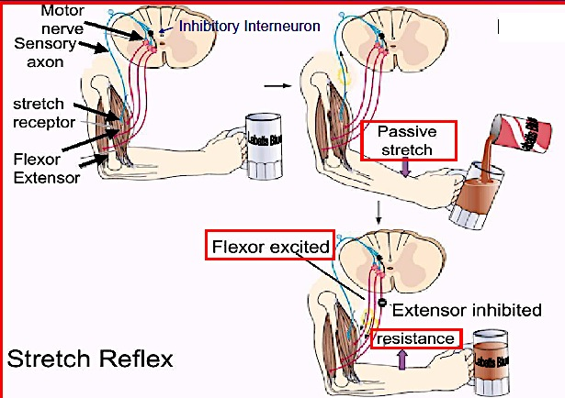
pressure of weight induces stretch reflex- activates muscle spindles
-When it gets too heavy- flexor is excited and extensor is inhibited to provide resistance!

Slide 12
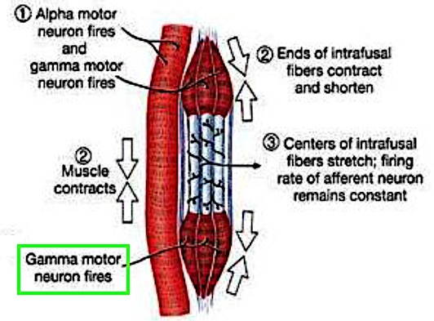
Alpha-gamma co-activation is a process by which alpha motor neurons and gamma motor neurons are activated simultaneously

Slide 13
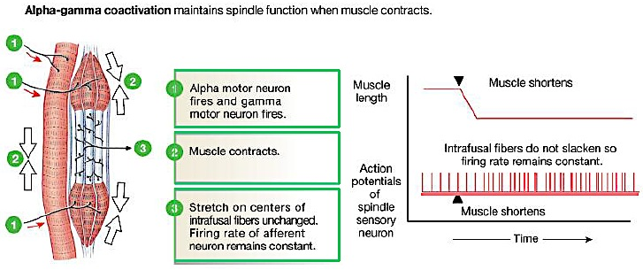
-alpha motor neuron makes muscle fibre (myofibril) contract
-gamma motor neuron makes ends of muscle contract.
-this stretches the centre of the muscle

Slide 14
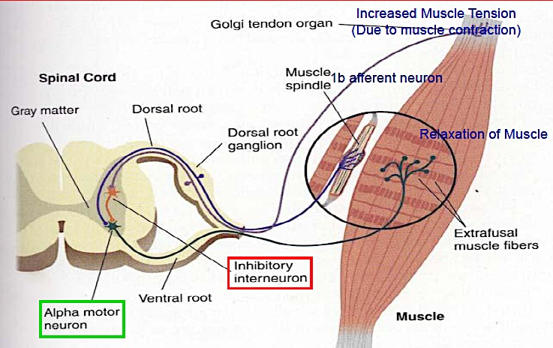
Golgi tendon reflex (Inverse stretch reflex)
-golgi tendon organ senses muscle tension
-sends info to the 1b afferent neuron
-travels to spinal cord to the inhibitory interneuron
-the inhibitory interneuron inhibits the alpha motor neuron
-this causes relaxation in the muscle

Slide 15
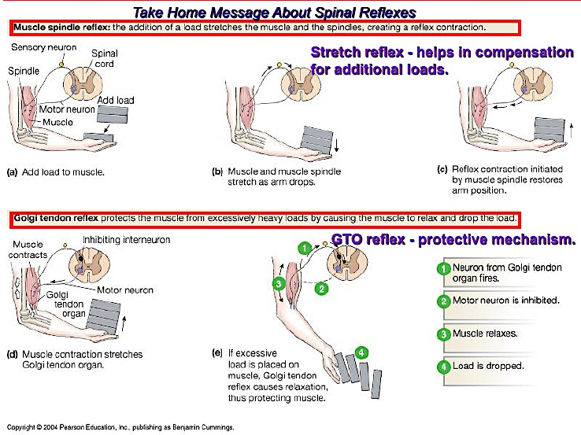

Slide 16
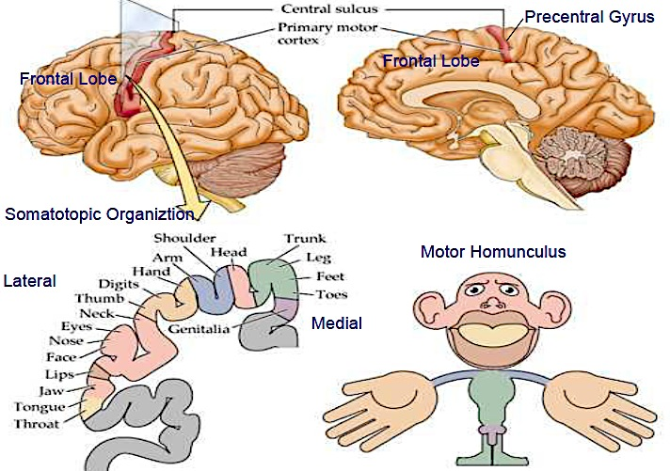
Motor Cortex
-Areas (such as hands) with large cortical representation contain a greater density of motor units, packed into a smaller area

Slide 17
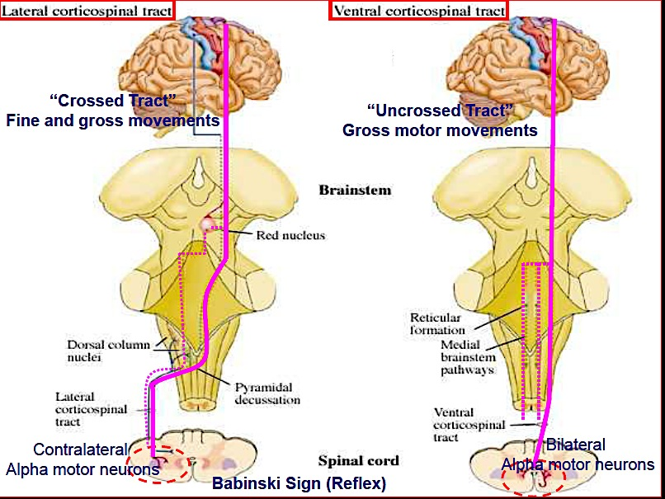
Corticospinal tracts

Slide 18
Corticospinal tract
Cortico-spinal tracts send info to brain
Lateral: alpha motor neurons take info from one side of spinal cord, and send it to the contralateral side of the brain (crosses over in dorsal column of brain stem)
Ventral: alpha motor neurons in spinal cord take info from BOTH sides of body and send it up to the brain
Babinski reflex:
tells you if there is damage to the lateral cortical tract
Run something pointed over bottom of foot: toes will curl in in normal reflex, or will stretch if there is damage to the pathway.
this is because the lateral tract terminates on inhibitory interneurons that shut down the withdrawal reflex (which is the cause for the curl).
Babies do not have this reflex- this is bc the spinal tracts are in tact, but are not mature (takes 1-2 years for full myelination of pathways

Slide 19
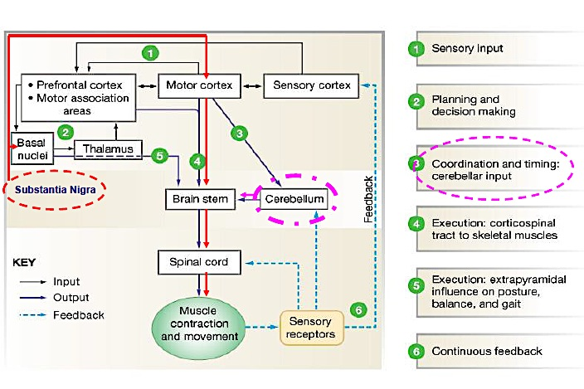
Control of voluntary movement

Slide 20
Cerebellum
Feedback circuits allow the cerebellum to compare the intentions of the cortex with the performance of the body
If movement is not in accord with the intentions of the cortex, the error is calculated by the cerebellum so that corrections can be made
Main functions of the cerebellum:
  Balance (equilibrium)
  Co-ordination of movement
  Timing of movement
  Program of movement
  Maintain muscle tone

Slide 21
Cerebellar disease
Characteristics of a patient with cerebellar disease:
  Hypotonia (decreased muscle tone)
  Dysarthria (slurred speech- b/c of decrease muscle tone)
  Ataxia (no fine movements, lack of balance, etc.)
  Dysmetria (can’t target objects to touch)
  Intention tremor (shaking while making movement)

Slide 22
Practice question
The right ventral corticospinal tract:
  A. carries pain information.
  B. carries fine touch information.
  C. is involved in controlling fine movements on the ipsilateral side.
  D. is involved in controlling gross motor movements
  E. is involved in fine motor movements
Answer: D-the ventral corticospinal tract controls gross motor movements

Slide 23
Practice question 2
A patient is brought into emergency with severe trauma to his head. One of the symptoms the patient shows when trying to move his left hand is an intention tremor. The patient may have damage to the:
  A. right motor cortex
  B. basal ganglia
  C. substantia nigra
  D. cerebellum
  E. cerebrum
Answer: D- an intention tremor is an indicator of cerebellar damage

Slide 24
Practice question 3
For each of the incomplete statements below, ONE or MORE of the answers are correct: Choose: A) If only 1, 2, and 3 are correct
B) If only 1 and 3 are correct
C) If only 2 and 4 are correct
D) If only 4 is correct
E) If ALL are correct
Change in muscle length is:
  1. detected by the golgi tendon organ
  2. mediated by the CNS by 1b afferent fibres
  3. relayed through group II afferent fibres to the brain stem
  4. relayed to the spinal cord by 1a sensory fibres
Answer: D- only 4 is correct.

Slide 25
Practice question 4
For each of the incomplete statements below, ONE or MORE of the answers are correct: Choose: A) If only 1, 2, and 3 are correct
B) If only 1 and 3 are correct
C) If only 2 and 4 are correct
D) If only 4 is correct
E) If ALL are correct
A patient is brought into the hospital after suffering a stroke. The physician concludes the stroke has damaged the cerebellum. What noticeable symptoms would lead her to this diagnosis?
  1. Rigidity
  2. low muscle tone
  3. involuntary, co-ordinated movements
  4. loss of equilibrium
Answer: C- 2 and 4 are correct.

