Slide 1
Tutorial 7
November 1, 2012.

Slide 2
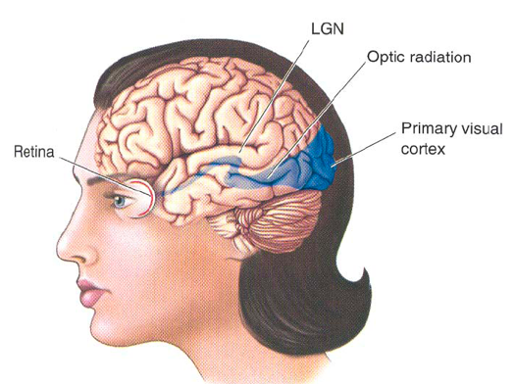
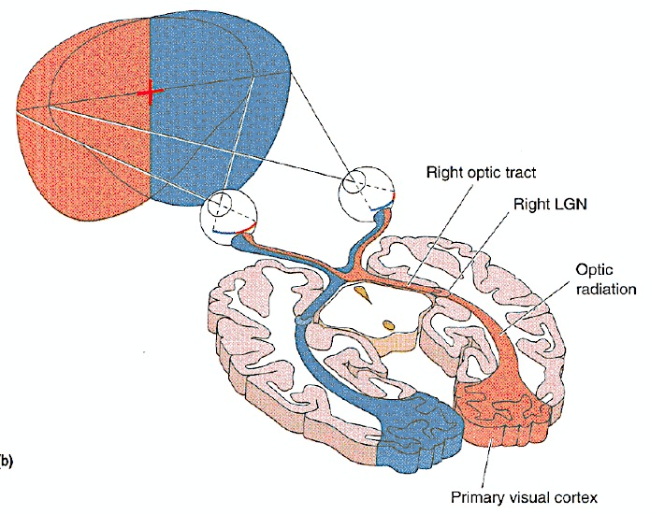
Vision

Slide 3
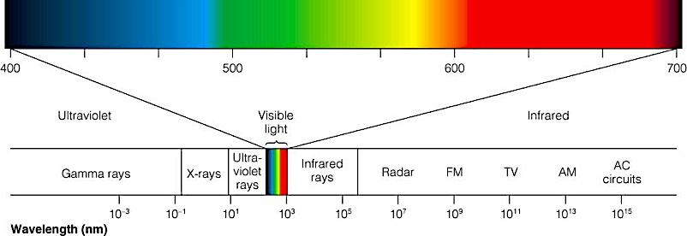
Light: the Stimulus
Electromagnetic spectrum: continuum of energy produced by electric charges that are radiated as waves (electromagnetic energy)
Energy in the spectrum is described by its wavelengths- the distance between the peaks of the electromagnetic waves

Slide 4
Visual acuity
The ability of the visual system to resolve fine spatial detail.
3 factors:
    the stimulus
    the eye
    the central visual pathway
Snellen Acuity: eye chart used to measure visual acuity
at 20 ft. - viewer can detect 1 degree critical features (20/20)
lower acuity- at 20 ft you can see like normal people at 40 ft. (20/40)
high acuity- at 20 ft you can see like normal people at 15 ft (20/15)

Slide 5
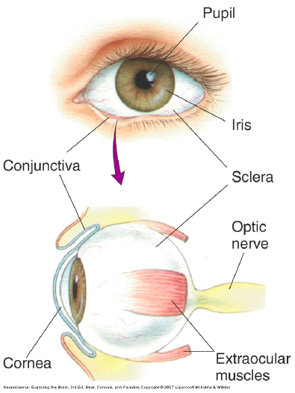
The Eye
Pupil: “hole” in the centre
Iris: regulates size of pupil
Cornea: clear sheet in front of pupil
Sclera: the “white” of your eye

Slide 6
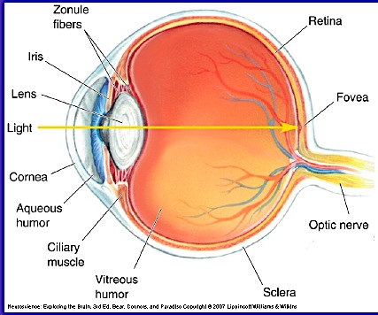
Cross-section of the eye

Slide 7
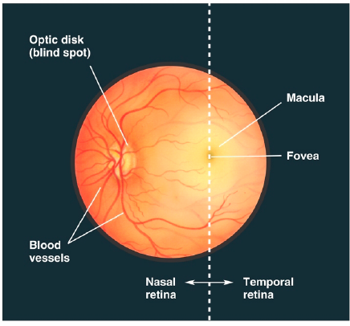

Slide 8
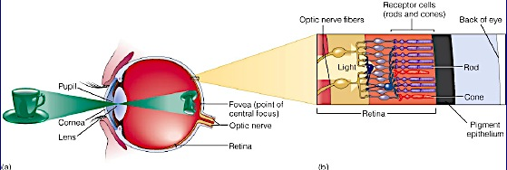
Seen as an inverted image

Slide 9
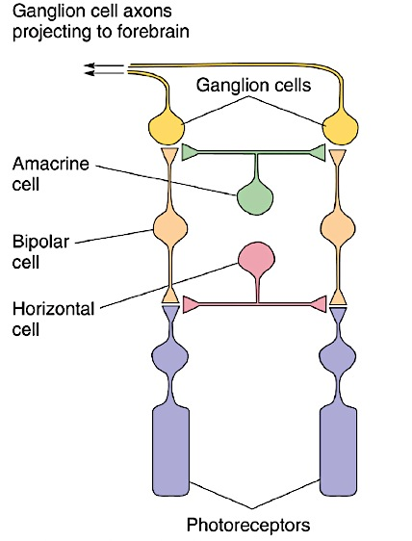
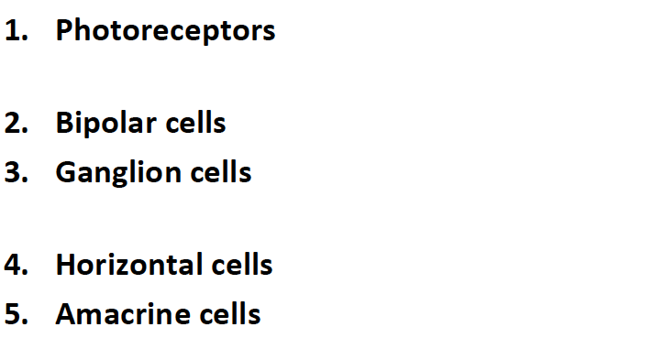
Retinal cells

Slide 10
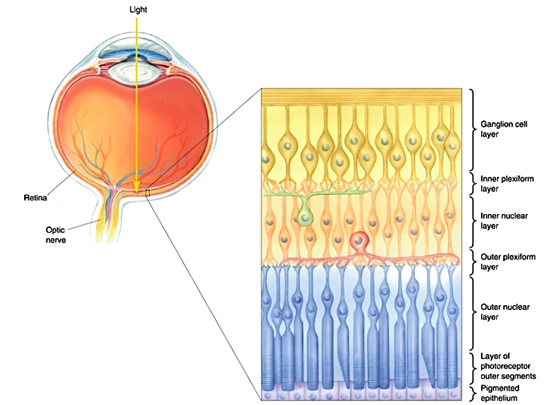
Retinal layers
- Nuclear layers: where the cell bodies are
-Plexiform layer: where the synapses and axons are

Slide 11
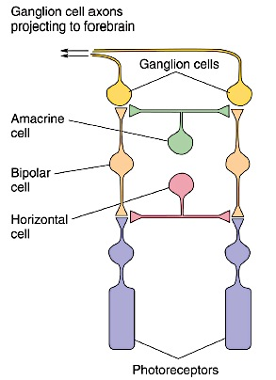
The Retina: Facts
3 important things:
1. the retina is a sheet of several layers of cells that lies against the back wall of the eye
2. the retina is set up backwards
3. a pigment epithelium lines the back of the retina, against the photoreceptors

Slide 12
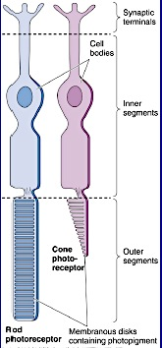
Photoreceptors
Two major parts:
  Outer segment- photosensitive part
  Inner segment- contains cell body
Two types:
1. Rods: light sensitive, used during dim lighting
2. Cones: colour sensitive, used during daylight conditions
  Fovea contains only cones!
There are many more rods than cones in the retina

Slide 13
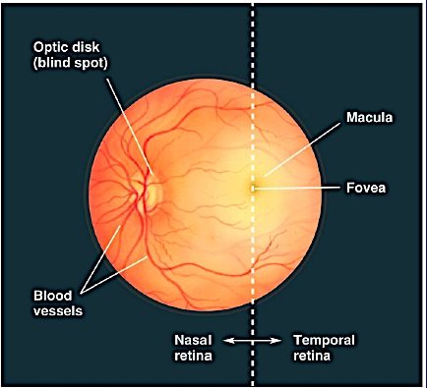
Blind spot
Nasal retina is larger than the temporal retina and contains the blind spot- an area with no photoreceptors.
BLIND SPOT: no receptors! In the blind spot- 1 million ganglion cells leave the eye to form the optic nerve.

Slide 14
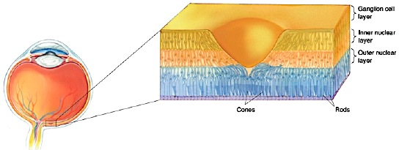
The Fovea
The fovea is a pit- with ganglion cells pushed to the side so that the light can strike the photoreceptors more easily!
Cones are concentrated in the fovea. (the fovea contains no rods!)
Responsible for sharp, detailed vision

Slide 15
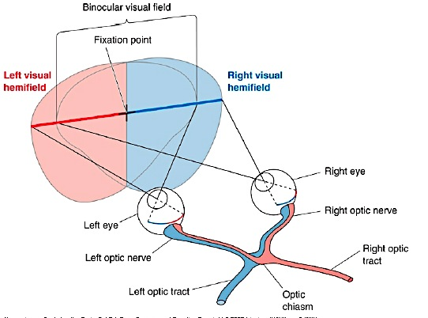
The Visual field

Slide 16
Optic chiasm
In the optic chiasm, ganglion cell axons originating in the nasal retina cross to the contralateral side
Axons from temporal retina DO NOT cross- they stay ipsilateral
Why do nasal retina fibres cross?
left hemisphere sees right side of world, therefore, left side of each retina must go to left hemisphere, and vice versa

Slide 17
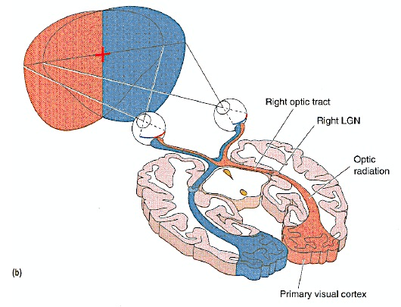

Slide 18
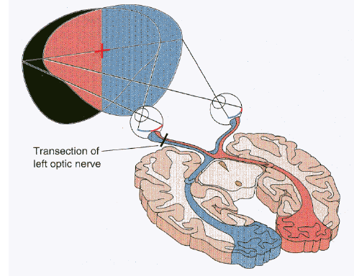
What happens when you cut the optic nerve?
-like closing an eye
-lose function of left eye
Left monocular crescent

Slide 19
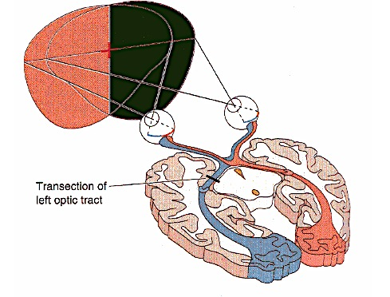
What happens when you cut the optic tract?
-Lose the ability to see the opposite side of the world
-would be the same effect if you cut the left LGN

Slide 20
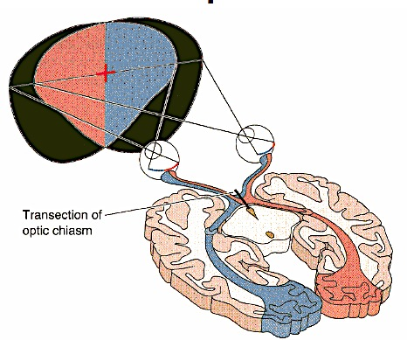
What happens when you transect the optic chiasm?
-all nasal crossing fibres will be lost
-only lose monocular crescent on each side
-will still have binocular overlap
- “tunnel vision”

Slide 21
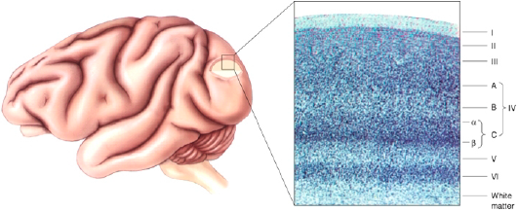
Visual cortex (V1)
Contains 6 layers (I is surface, VI is deepest)
VI is the first place in the brain where cells receive signals from both eyes
Aka striate cortex

Slide 22
Info processing in V1
Neurons are specialized to respond to specific aspects of stimuli such as orientation, movement, and size.
Hubel and Weisel: found that neurons respond best to bar-like stimuli with specific orientation
As we move farther away from the retina (into the cortex), neurons will be found only to respond to more complex stimuli.

Slide 23
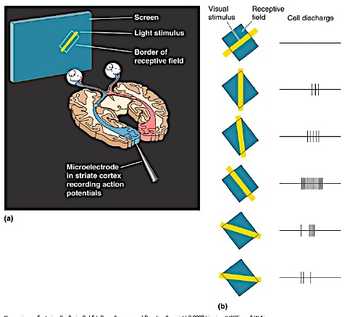
Orientation selectivity
different neurons respond to diff. types of stimuli in diff. orientations.
neurons have receptive fields and are concerned with orientation of a stimulus.

Slide 24
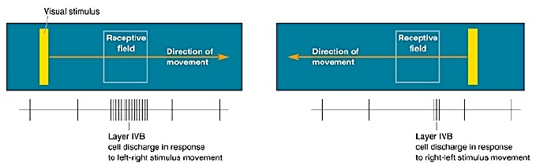
Direction selectivity
each neuron will have a preferred direction of motion

Slide 25
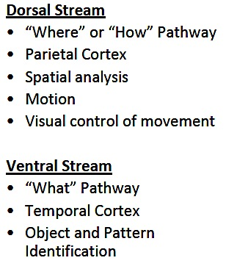
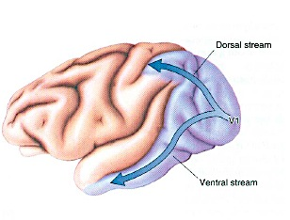
Parallel processing streams in visual cortex

Slide 26
Hearing

Slide 27
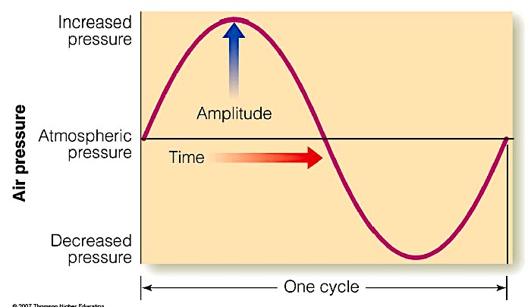
Sound
Sound: variations in air pressure
Variables in sound:
    1. Frequency (pitch)= the number of compressed air patches. Hertz (Hz)- the # of cycles/sec.
    2. Intensity (loudness)= the difference in pressure between compressed air patches (amplitude)

Slide 28
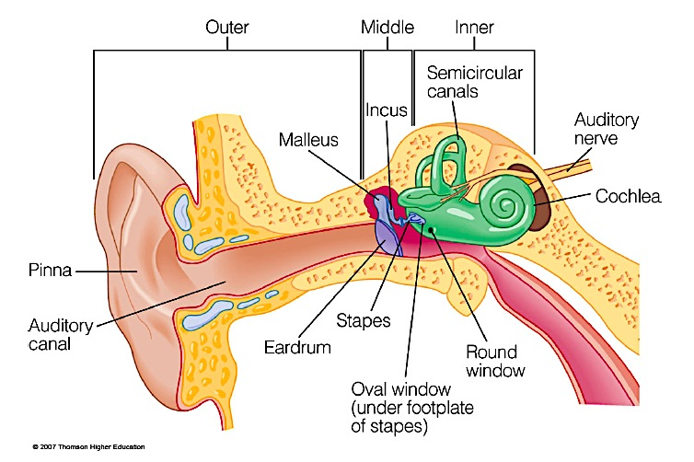
Structure of the auditory system
Outer ear: Auricle (Pinna), Auditory canal (external auditory meatus)
Middle ear: Tympanic membrane (ear drum), Ossicles (three small bones)
Inner ear: Oval window, Cochlea

Slide 29
The Auditory Canal
protects the ear drum
enhances the intensities of sounds by RESONANCE
Resonance: a mechanism that enhances the intensity of certain frequencies b/c of the reflection of sound waves in a closed tube
The Middle Ear
the middle ear is an air-filled cavity
contains 3 ossicles:
  1. Malleus (hammer)
  2. Incus (anvil)
  3. Stapes (stirrup)

Slide 30
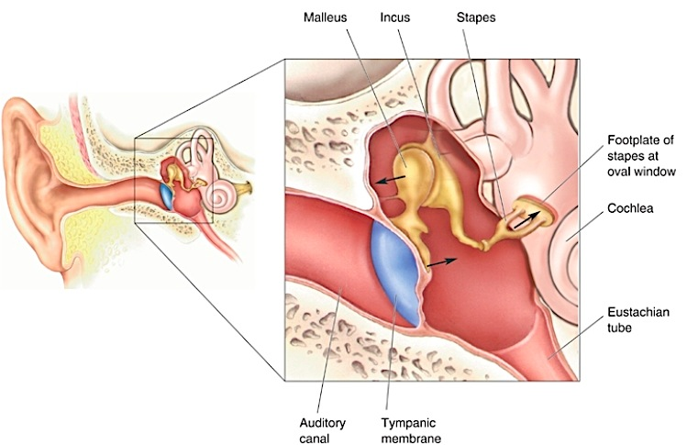
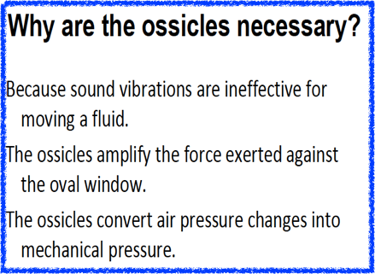
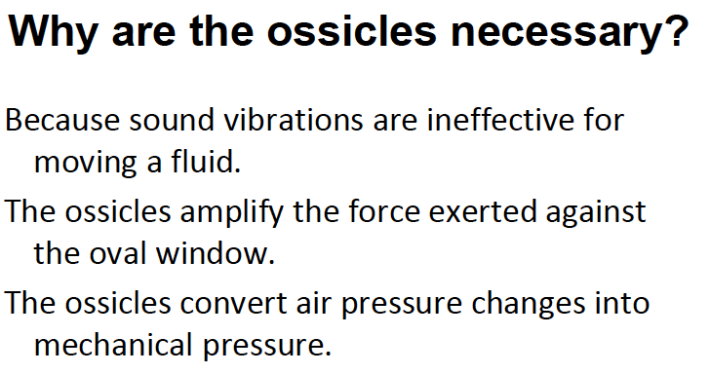
Auditory Tube (Eustachian tube)- an airway between the middle ear and pharynx- important in changing air pressure
    For the ear drum to work you need the same pressure outside and inside the head.

Slide 31
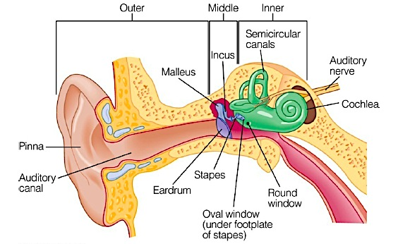
the Inner Ear
the cochlea: a spiral tube
at the beginning of the tube there are 2 windows with membranes:
    1. oval window- what the stapes contacts
    2. round window

Slide 32
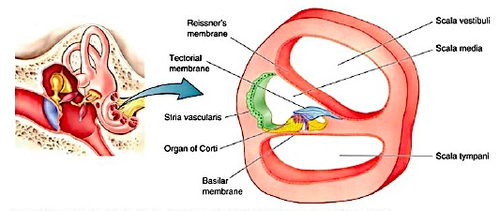
the Cochlea
3 chambers:
  Scala vestibuli- filled with perilymph
  Scala media- filled with endolymph
  Scala tympani- filled with perilymph

Slide 33
The cochlea
-the Basilar membrane is key; contains the Organ of Corti (where hair cells are)
-tectorial membrane hangs over Organ of Corti
-Helicotrema: hole btw scala vestibuli and scala tympani

Slide 34
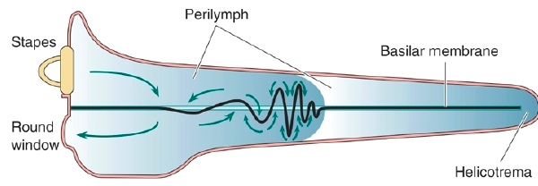
How sound moves through the cochlea
scala vestibuli
scala tympani
Moves from:
  Oval window ➔ Scala vestibuli➔ through the helicotrema➔ Scala tympani➔ Round window
  Round window= relief valve for pressure- lets out pressure when it is applied to oval window

Slide 35
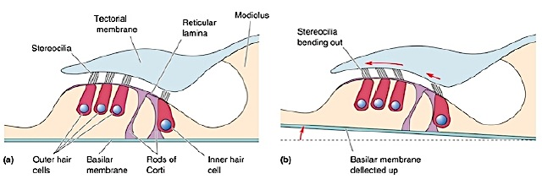
the Organ of Corti
lies on basilar membrane
contains hair cells
tips of hair cells contact the tectorial membrane
movement of hair cells against the tectorial membrane changes the activity of hair cells
hair cells depolarize when the tips (stereocilia) bend

Slide 36
Types of hair cells
1. Inner hair cells: Auditory receptor cells in the inner ear; responsible for auditory transduction and perception of pitch (most important hair cells)
2. Outer hair cells: Auditory receptor cells in the inner ear that amplify the response of the inner hair cells (helper cells)
Motile response: Outer hair cells tilt and get slightly longer, which amplifies the basilar membrane vibration and amplifies the response of the inner hair cells.

Slide 37
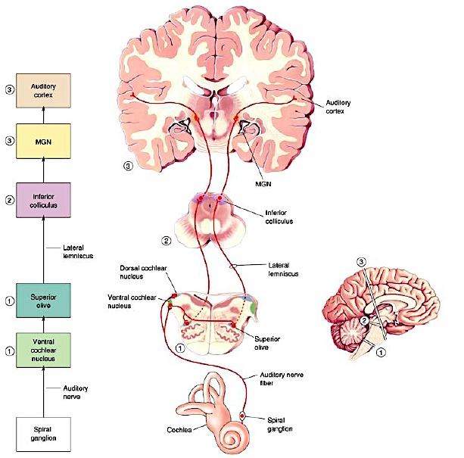
Auditory messages
Hair cells synapse with spiral ganglion cells. The cell bodies of these neurons are located in the spiral ganglion
Axons of these neurons form the auditory portion of the vestibulocochlear nerve (cranial nerve VIII)
Info from the 2 ears is brought together at the earliest level (unlike visual system)

Slide 38
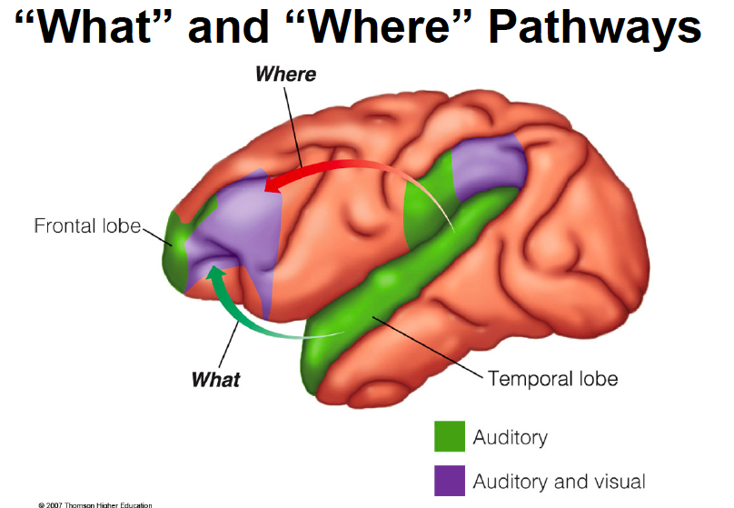
Auditory cortex

Slide 39
Deafness
Unlike the visual system, destruction of the auditory cortex in one hemisphere does not result in the loss of hearing on one side
    this is b/c input from BOTH ears goes to each hemisphere
    it results in the loss of ability to localize sound
Most hearing loss is due to death (with age) or destruction (loud noise) of hair cells
    Hair cells DO NOT regenerate (except in chickens)

