Slide 1
MARKETING FUNDAMENTALS
CHAPTER 01

Slide 2
Learning Objectives
Explain the role of marketing in an organization and the importance of meeting customer needs
Define and analyze elements of the marketing mix
Outline the steps in the marketing process
Differentiate between goods, services, and ideas

Slide 3
Learning Objectives (continued)
Describe the evolution of different business philosophies
Describe new and evolving marketing practices
Summarize careers that exist in marketing

Slide 4
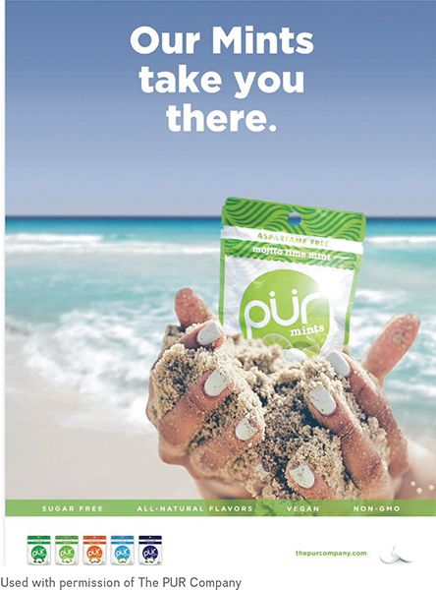
PUR Gum Kicks Aspartame!
Canadian company focused on meeting the needs of its customers
Consumers looking for products without additives
Notes:
In 2010, Jay Klein noticed that friends and family often expressed their concerns about artificial ingredients in food products, and especially the use of chemical sweeteners.
Shortly thereafter came the birth of an upstart, The PUR Company.
The chewing gum industry in Canada declined by 2 percent in 2015, with Wrigley’s and Cadbury Adams holding 96 percent market share in Canada, how can a small company compete?
one sub-segment of the chewing gum industry is continuing to grow at a significant pace—specialty gum.
PUR Gum is made in Switzerland where the company can ensure high quality and high standards with regard to the ingredients used and the manufacturing processes employed.
PUR Gum’s philosophy has been to make simple substitutions to ingredients without sacrificing taste or quality.
Target: PUR Gum focuses on consumers who make active decisions toward living a healthier lifestyle.
Product: PUR Gum is available in eight flavours: Peppermint, Wintergreen, Spearmint, Coolmint, Pomegranate Mint, Bubblegum, Chocolate Mint, and Cinnamon.
uses xylitol, which is an all-natural sweetener.
non-GMO, dairy-free, gluten-free, nut- and soy-free, and vegan.
A new line of PUR Mints has been launched in some of the same minty flavours, as well as with more adventuresome flavours such as Mojito Lime Mint and Tangerine Tango.
Price: PUR Gum is definitely a premium product in the chewing gum category.
PUR Gum blisters of 9 pieces sell for $1.49 and packages of 55 pieces sell for $4.99.
Place: Initially, focus was placed on health food and specialty stores.
Over time, PUR penetrated the stores where its health-conscious consumers shopped.
When PUR felt comfortable that it had market penetration in the independent stores, it pursued listings in larger conventional retailers such as Loblaws and Walgreens.
PUR Gum is currently available in 30,000 stores in over 30 countries.
PUR Gum has even been sold on the Home Shopping Network in the U.S. PUR can also be purchased directly online from thepurcompany.com.
Promotion: very targeted approach to its marketing communications.
Sampling: PUR lives by the motto “convert curiosity into consumption.”
Word of mouth: Loyal customers are PUR’s best asset.
Take a quick look at PUR’s Twitter feed (@ThePURCompany), and the love for PUR by its customers is obvious.
Digital: PUR has a focus on social media and creating media buzz.
Twitter, Facebook, Pinterest, Instagram, and LinkedIn to create an ongoing dialogue with customers.
brand-specific messaging to more general “healthy lifestyle” communication.
PUR’s newsletter, you will receive regular online purchase promotions and the opportunity to be entered into seasonal contests—great incentives for the loyal PUR customer!
Media buzz: featured on Dragons’ Den in October 2014.
4

Slide 5
The Role of Marketing
Brands need to be differentiated and marketers are challenged to stay current to ensure their strategies and messages resonate with customers
“We have a loyal customer base and our promise to them is to keep providing great quality products at an affordable price. We care more about long-term relationships than a quick sale.”
-Jay Klein, CEO, The PUR Company
marketing TIP
Notes:
Long-term business success is tied to carefully designed product, pricing, distribution, and promotional strategies that meet current consumer needs, trends and expectations

Slide 6
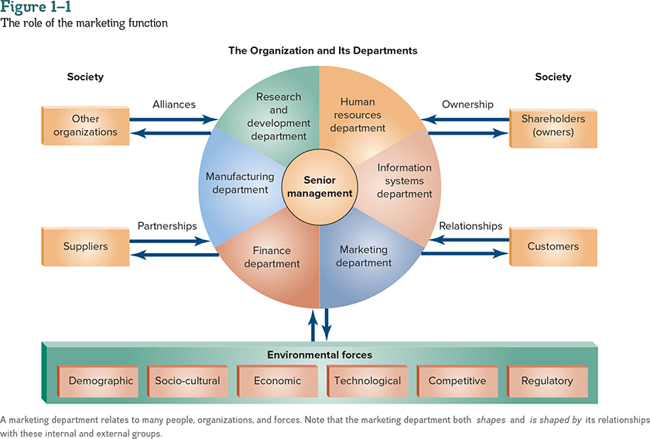
The Role of Marketing (continued)
Notes:
marketers’ ultimate objectives are to drive profits for a company, or if working in the non-profit sector, to generate revenue and support to fund programs and run operations
Marketing plays an integral function in any business

Slide 7
Focusing on Customer
Needs and Wants
“Successful marketing is focused on customer needs and wants and developing programs that engage consumers and inspire customer loyalty”
Need – occurs when a person feels deprived of basic necessities
Want – a need that is shaped by a person’s knowledge, culture, and personality

Slide 8
Focusing on Customer
Needs and Wants (continued)
Customers do not always know what they need or want
Initial point of contact with a brand is often online
Consumers have unlimited opportunities to become informed or distracted
Must be able to quickly find the site through search engines
Notes:
Consumer considerations when developing marketing programs

Slide 9

Creating Customer Value
Customer Value Proposition – unique combination of benefits received by targeted buyers that will satisfy their needs; includes quality, price, convenience, delivery, and both before-sale and after-sale service
  Product design
  Pricing strategies
  Service elements

Slide 10
Appealing to Target Markets
With limited funds, it is better to channel resources to a specific group of consumers who are most interested in purchasing a product, rather than target everyone and squander funds
Target Market – specific group or segment(s) of existing and potential consumers to which marketers direct their marketing efforts

Slide 11
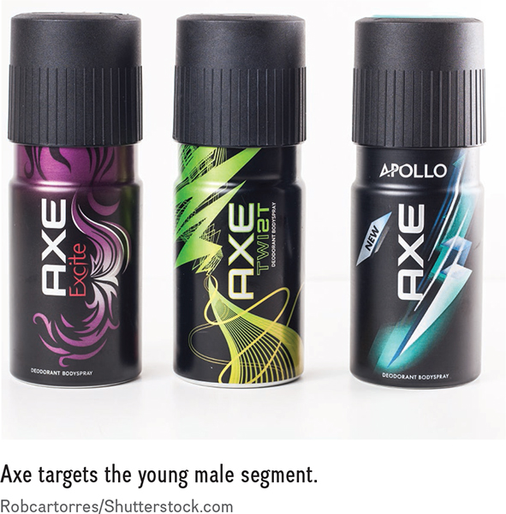
Coordinating the Marketing Mix
“Marketers need to understand what makes their consumers tick.”
Marketing Mix (4P’s) – product, price, place, and promotion
  Carefully manage to ensure that they are well coordinated and appeal to the target market
Notes:
Information often clarified by market research and metrics on consumer behaviour
Over time, marketers gather extensive information on their target markets, being able to identify purchase motivation that goes beyond age and gender into behavioural and psychological motivation, which is an important determinant in many purchases
Digital reality has made the marketing mix more complex
Product: attributes, that make up a good, a service, or an idea, including product design, features, colour, packaging, warranty, and service levels.
Price: what is exchanged for a product, including the expected regular retail or sale price
Place: distribution channels, retail formats, and merchandising used to sell a product
Promotion: communication tools needed to inform consumers about a product, including advertising, public relations, sales promotion, direct response, event marketing, sponsorship, online approaches, and personal selling
Dove targets everyday women of any age. The Dove brand was positioned as a soap for many years; now Dove is a beauty brand. Dove’s products for women are packaged in white or pink bottles.10 The products are sold at a premium price, reflecting its new positioning in the beauty category.

Slide 12
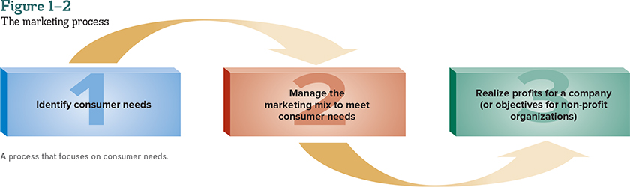
The Marketing Process
“The marketing process requires marketers to understand their customers and apply strategic, analytical, and creative-thinking skills.”
Notes:
Throughout the cycle, marketers constantly evaluate program success, recommending and implementing changes to strengthen efforts

Slide 13

The Marketing Process (continued)
Marketing – process of planning and managing goods, services, or ideas to meet consumer needs and organizational objections
  Includes the marketing mix

Slide 14
The Marketing Process (continued)
Exchange – the trade of things of value between buyers and sellers so that each benefits
  More than just money
$
Notes:
The objectives of both buyers and sellers must be met for exchanges to occur and for profits to be realized

Slide 15

What Can Be Marketed?
Good, Service, or Idea
Many successful marketers today launch products with all three to connect with consumers
Notes:
Good –a product you can touch or own
Service –an intangible product you cannot touch; an activity, benefit, or satisfaction
Idea –a concept that typically looks for support
Marketing the “Mo” p. 12
In 2007, Movember was launched in Canada. Since its inception, the Movember campaign in Canada has raised approximately $700 million.
In fact, the Movember Foundation is one of the largest investors in men’s health in the world.
Why does growing a moustache work? Setting up a very masculine competition aligns well with the platform of men’s health.
Pitting men against each other to see who can grow the best “Mo” takes advantage of their competitive spirit. There is also a touch of humour around growing moustaches, not a current fashion trend.
Movember is a month-long opportunity for participants to outwardly show their support for men’s health, generating conversation, exchange of knowledge, and ultimately donations to the Movember Foundation.
15

Slide 16
What Is a Market?
Market – is used to describe potential consumers who have both the willingness and ability to buy a product
  Sometimes the market, target market, and consumers are different groups of people
  Marketers need to decide on a balance of who should be targeted for their programs
Notes:
16

Slide 17
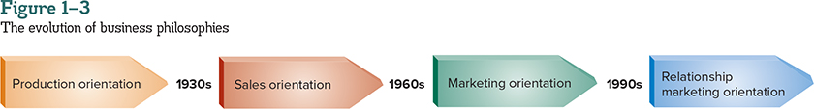
The Evolution of
Business Philosophies
  Three elements of relationship marketing:
  Social Media
  Customer Relationship Management (CRM)
  Corporate Social Responsibility
Notes:
Focusing organizational efforts:
Product Orientation – on the manufacture of goods
Sales Orientation – on selling as many products as possible
Marketing Orientation – to collect and use information about the customers’ needs to create customer value
Relationship Marketing Orientation – on creating long-term links with customers, employees, suppliers, and other partners to increase loyalty and customer retention
Social Media - A form of online media that allows members to create their own network of friends and contacts to share comments, articles, opinions, videos, and images as a form of self-expression
Customer Relationship Management (CRM) - The overall process of building and maintaining profitable customer relationships by delivering superior customer value and satisfaction
Corporate Social Responsibility (CSR) - When organizations voluntarily consider the well-being of society by taking responsibility for how their businesses impact consumers, customers, suppliers, employees, shareholders, communities, the environment, and society in general
17

Slide 18
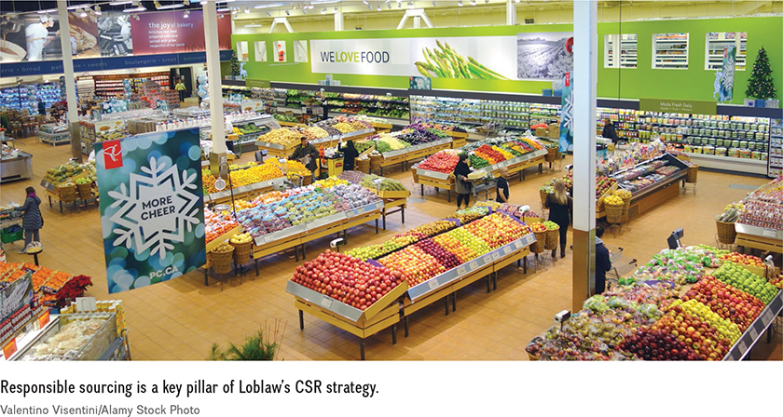
The Evolution of Business Philosophies (continued)
Customer Relationship Management
  Share-of-wallet
  Customer lifetime value
  Corporate social responsibility (CSR)
Notes:
Businesses recognize that improved customer relationships can result in increased customer loyalty, improved customer retention levels, and greater profits for an organization.
Customer Relationship Management (CRM) - The overall process of building and maintaining profitable customer relationships by delivering superior customer value and satisfaction
share-of-wallet – percentage of a customer’s purchases that a company has in a specific product category
Loyalty cards and used and tracked to offer customization per user
Customer lifetime value – the potential sales that will be generated by a customer if that customer remains loyal to that company for a lifetime
Adapt and change as the customer does to follow their “life” needs
Corporate Social Responsibility (CSR) - When organizations voluntarily consider the well-being of society by taking responsibility for how their businesses impact consumers, customers, suppliers, employees, shareholders, communities, the environment, and society in general
Simplest form is sponsorships
Sustainability - The long-term viability of a business related to its financial results, social performance, and environmental impact
Greenwashing - The deceptive use of marketing practices to give the impression that a good, service, or organization is environmentally friendly
Societal Marketing Concept - Marketing programs that focus on the consumer and the well-being of society
18

Slide 19
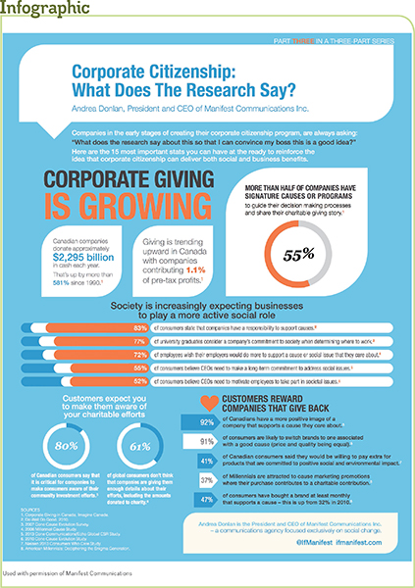
CSR Initiatives
sponsorship and/or spearheading of community programs
sponsorship and/or involvement in fundraising initiatives for charitable organizations
business philosophy that implements socially responsible business practices
Notes:
Corporate Social Responsibility (CSR) - When organizations voluntarily consider the well-being of society by taking responsibility for how their businesses impact consumers, customers, suppliers, employees, shareholders, communities, the environment, and society in general
Sustainability - The long-term viability of a business related to its financial results, social performance, and environmental impact
Greenwashing - The deceptive use of marketing practices to give the impression that a good, service, or organization is environmentally friendly
Societal Marketing Concept - Marketing programs that focus on the consumer and the well-being of society
19

Slide 20
New and Evolving
Marketing Practices
“Marketing today focuses on meeting short-term consumer needs and generating immediate company profits, as well as long-term viability and sustainability of a business”
Widespread use of digital technology in Canada is the most important trend impacting how marketers go to business
Notes:
Consumers and businesses having access to lower-priced computers, multiple mobile devices, high-speed Internet connections, and cloud computing
Digital technology has changed the path-to-purchase and drives how consumers gather information, connect with each other and businesses, and purchase products
2016 over 30million subscribers to mobile devices in Canada
Spending over 36 hours per month online
Loging an average of 25 hours per month watching online videos
20

Slide 21
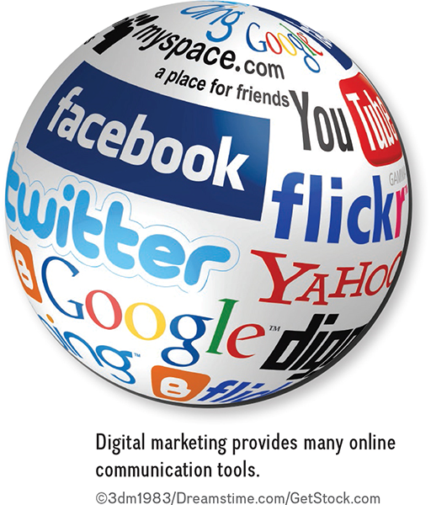
New and Evolving
Marketing Practices (continued)
Digital Marketing
  Content Marketing
  Mobile Marketing
  Proximity Marketing
  Social Media Marketing
Notes:
Digital Marketing – using digital technology to reach consumers through computers, gaming devices, out-of-home electronic screens, or mobile devices
Content Marketing - Creating and sharing expertise, information, or branded content that is designed to inform and engage with tools such as research papers, e-books, infographics, how-to videos, blogs, webinars, e-newsletters, case studies, and events that can readily be found with search engines
Mobile Marketing – a set of practices that enables organizations to communicate and engage with their audiences in an interactive and relevant manner through any mobile device or network
Proximity Marketing – the distribution of marketing content to mobile devices that have opted in at a particular local geo-location to receive information
Social media marketing – a form of online media that allows members to create their own network of friends and contacts to share comments, articles, opinions, videos, and images as a form of self-expression
21

Slide 22
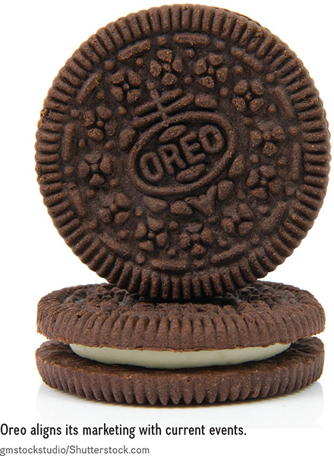
New and Evolving
Marketing Practices (continued)
Real-time Marketing
Experiential Marketing
Partnership Marketing
  Promotional partnerships
  Strategic alliance
Notes:
Real-time Marketing - A planned tactical approach where brands make themselves relevant online during events or newsworthy occurrences by diving into conversations as they occur with aligned short-term messaging that takes advantage of the current buzz
EXAMPLE:
Oreo made its way into the social media history books when the power went out during the 2013 Super Bowl. While the power was out, play was halted and millions of fans watching the game from home were left with nothing to do.
Oreo did not produce a commercial to show at the game, but it did send out one very relevant tweet during this blackout: “Power out, no problem” with a picture of an Oreo in a darkened space.
The caption on the picture was “You can still dunk in the dark.”
This tweet is now considered the birth of real-time marketing.
The message was seen by tens of thousands of fans and re-tweeted over 16,000 times, generating over 20,000 Facebook likes.
Experiential marketing - an approach where marketers create opportunities for consumers to directly interact face-to-face with a brand.
often using a combination of public relations, event marketing, and promotions to break through the clutter of competing marketing messages
Partnership Marketing - to create formal associations between brands that will result in incremental business for both brands that could not have been achieved separately.
AKA “affinity marketing”
purpose is to drive incremental business and a strong return on investment (ROI)
challenge lies in finding appropriate partners, setting realistic goals, tracking results, and aligning partnership goals with business objectives
promotional partnerships - involve short-term offers between brands such as Shoppers Drug Mart and Esso
strategic alliance - Long-term arrangement between companies with similar values and marketing objectives that extend beyond short-term promotional offers into long-term formal business agreements
22

Slide 23

New and Evolving
Marketing Practices (continued)
Metrics and Analytics
Notes:
Metrics And Analytics – to improve programs and deliver better results
Metrics refers to numeric data that is collected and grouped to track performance
Dashboards visualize data using graphs, charts, and numbers so that the data is easy to use and understand.
Analytics refers to the process of taking metrics data and applying smart thinking and technology to gain actionable insights that can help make better business decisions
Marketers are challenged to use metrics and analytics to better understand how to build better customer relationships
23

Slide 24

New and Evolving
Marketing Practices (continued)
Marketing Regulations and Ethical Considerations
  Regulations safeguard people, communities, and the environment
Notes:
Consumer groups exert pressure on government bodies to protect society
New laws protect consumers’ rights to privacy
Canadian Marketing Association – guidelines, codes of ethics, and education programs
Its purpose is to encourage high marketing standards that are honest, truthful, accurate, fair, and professional.
The code of ethics covers topics such as accurate representations, truthfulness in marketing communications, price claims, fulfillment practices, privacy, marketing to children, and marketing to teenagers. It also provides direction on direct marketing practices, sales promotion, public relations, and media usage.
CMA logo is a link to the website
24

Slide 25

Marketing Careers
Starting point is to get an education and create a network of business professionals
Develop a personal marketing strategy
Notes:
importance of having a passion for what you do, thriving in a fast-paced environment, having strong communications skills, and being analytical, creative, and hard-working
Students should do a SWOT analysis and decide on their 4P’s
Students need to be:
Analytical
Work well with others; teams
Strong written and verbal communication skills
Technologically competent
Ability to conduct data analysis
Problem solving

