Slide 1
Personality, Cultural Values, and Ability
Chapter 4

Slide 2
Personality and Organizational Behaviour
The role of personality in organizational behaviour has often been debated in what is known as the “person-situation debate”
This has led to three approaches:
  The dispositional approach
  The situational approach
  The interactionist approach

Slide 3
Personality and the Situation
Personality has the strongest effect in weak situations.
Personality has less of an impact in strong situations.

Slide 4
The Five-Factor Model of Personality
Five basic but general dimensions that describe personality:
  Extraversion (sociable, talkative Vs. withdrawn, shy)
  Emotional stability/neuroticism (stable, confident Vs. depressed, anxious)
  Agreeableness (tolerant, cooperative Vs. cold, rude)
  Conscientiousness (dependable, responsible Vs. careless, impulsive)
  Openness to experience (curious, original Vs. dull, unimaginative)

Slide 5
Emotional Ability (or Emotional Intelligence)
Different than in your book!!!
Emotion perception
  ability to identify one’s own emotions and others’ emotions.
Understand emotion
  Understanding how emotions evolve over time, how they differ from each other, and which are more appropriate in given context.
Emotion regulation
  Skill involving the capacity to consciously induce and maintain a positive affective state.

Slide 6
Cascading Model of EI
Conscientiousness
Emotion Perception
Emotion Understanding
Emotion Regulation
Job Performance
Cognitive Ability
Neuroticism
From Joseph and Newman (2010)

Slide 7
Do the Big 5 Matter?
Task Performance
  Conscientiousness
  Extraversion
  Agreeableness
  Neuroticism (-) (very weakly)
Organizational Citizenship Behaviours:
  Conscientiousness
Counterproductive Work Behaviours:
  Conscientiousness (-)
Training proficiency:
  Openness to Experience
  Extraversion
  Conscientiousness
Notes:
7

Slide 8
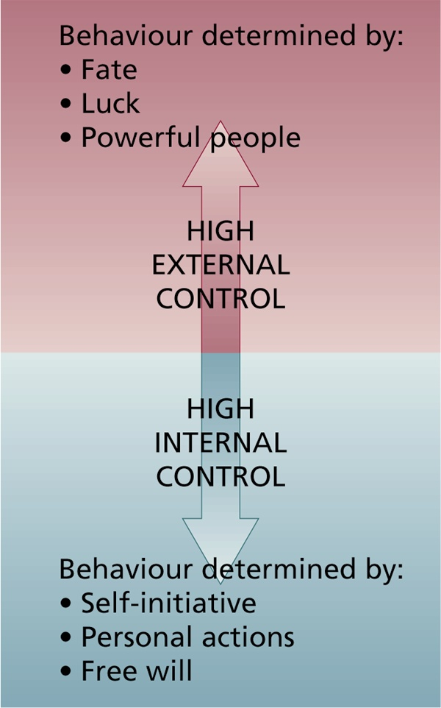
Some additional personality characteristics
Locus of Control
Self-Monitoring
Self-Esteem
Competitiveness
Type A and B
Notes:
Type A prone to burn out due to stressing out.
Type A one task at a time focused on short deadlines, Type B multitaskers in it for the long run

Slide 9
Recent Developments in Personality and Organizational Behaviour
Five new personality variables that have been found to be important for organizational behaviour:
  Positive and negative affectivity
  Proactive personality
  General self-efficacy
  Core self-evaluations
Notes:
General Self-efficacy people believe in an alien environment they can still handle themselves well without caving

Slide 10
What Are Values and Attitudes?
Enduring and long lasting beliefs/preferences/principles about what is worthwhile and desirable.
A fairly stable evaluative tendency to respond consistency to some specific object, situation, person, or category of people.

Slide 11
What’s your Work Centrality?
The major satisfaction in my life comes from my job
The most important things that happen to me involve my work
I live, eat, and breathe my job
I would probably keep working even if I didn’t need the money

Slide 12
Hofstede’s Five Cultural Dimensions
Hofstede questioned over 116,000 IBM employees in 40 countries about their work-related values.
He discovered five basic dimensions along which work-related values differed across cultures:
  Power distance
  Uncertainty avoidance
  Masculinity/femininity
  Individualism/collectivism
  Time Orientation
Notes:
South East Asian societies are collectivist societies as they think about the opinion of everyone else before they think of themselves

Slide 13
Key managerial take-aways
Personality, values, and intelligence are highly stable human characteristics.
  Difficult if not impossible to change!
Each is related to job performance (some more than others).
Each can be easily measured and used as hiring criteria.

Slide 14
Notes:
30 multiple Choice questions
4 short answer questions

