Slide 1
ANP1105C Neuron Sept 14/18 2018
TOPIC #2.2: PHYSIOLOGY OF THE NEURON 63 -80, 392 – 418
2. Cellular Physiology of Nerve and Muscle
2.1. Membrane Transport:
2.1.1. Describe the structure of the plasma membrane
2.1.2. Describe and differentiate among the various types of transport across the plasma membrane
2.1.3. Describe osmosis and explain its role in fluid homeostasis
2.2.1 Identify the different regions of the neuron and associate each region with the functions of reception, propagation and transmission of nerve impulses (pp. 392-395)
2.2.2. Explain the phenomena (diffusion of ions, types of ion channels) that are responsible for the electrical activity of neurons (resting membrane potential, action potential) (pp. 398-403)

Slide 2
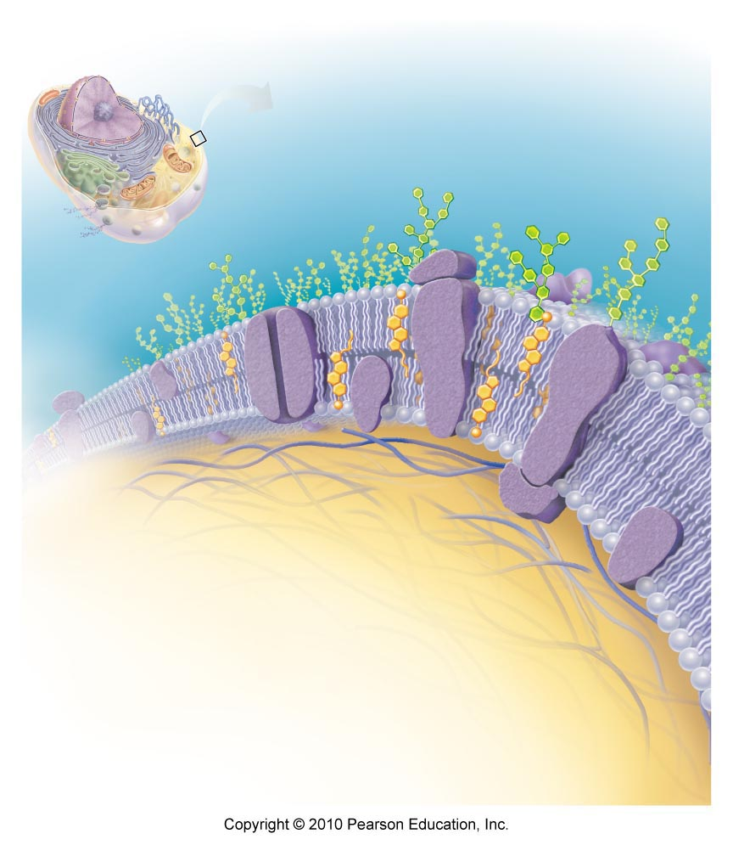
ANP1105B
2.1 Membrane transport (pp. 63-79)
2.1.1 Describe the structure of the plasma membrane
basic structure according to fluid mosaic model:
phospholipid bilayer - what is a phospholipid?? what do we mean when we say the hydrophilic and hydrophobic ends of phospholipids??
Why do we say fluid mosaic model??
integral membrane proteins - span PM (transmembrane); hydrophilic & hydrophobic regions; channels, carriers
Fig. 3.3

Slide 3
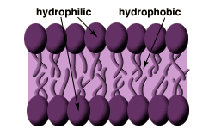
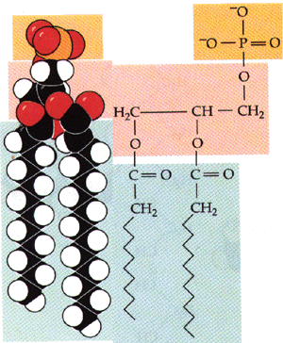
Phospholipid bilayer
http://www.biology.arizona.edu/chh/problem_sets/kidneysmetals/07t.html
A phospholipid

Slide 4
2.1.1.2: Associate functions with each of the following: peripheral and integral membrane proteins, cytoskeleton, glycocalyx, cholesterol
1. Peripheral proteins: attached to integral proteins (usually internal side of PM); can be enzymes, involved in attachment functions, shape changes . .
2. Cytoskeleton: anchors to PM; can also interact with receptors (eg: ??)
3. Glycocalyx: ensemble of carbohydrates attached to lipids & proteins on extracellular face; “sugar coating” on PM
  NB: glycocalyx changes when cell becomes cancerous - can even change repeatedly to avoid recognition by immune system
4. Cholesterol: overall: reduces general membrane fluidity & stabilizes its structure – too much cholesterol causes membranes to lose flexibility
Fig. 3.3

Slide 5
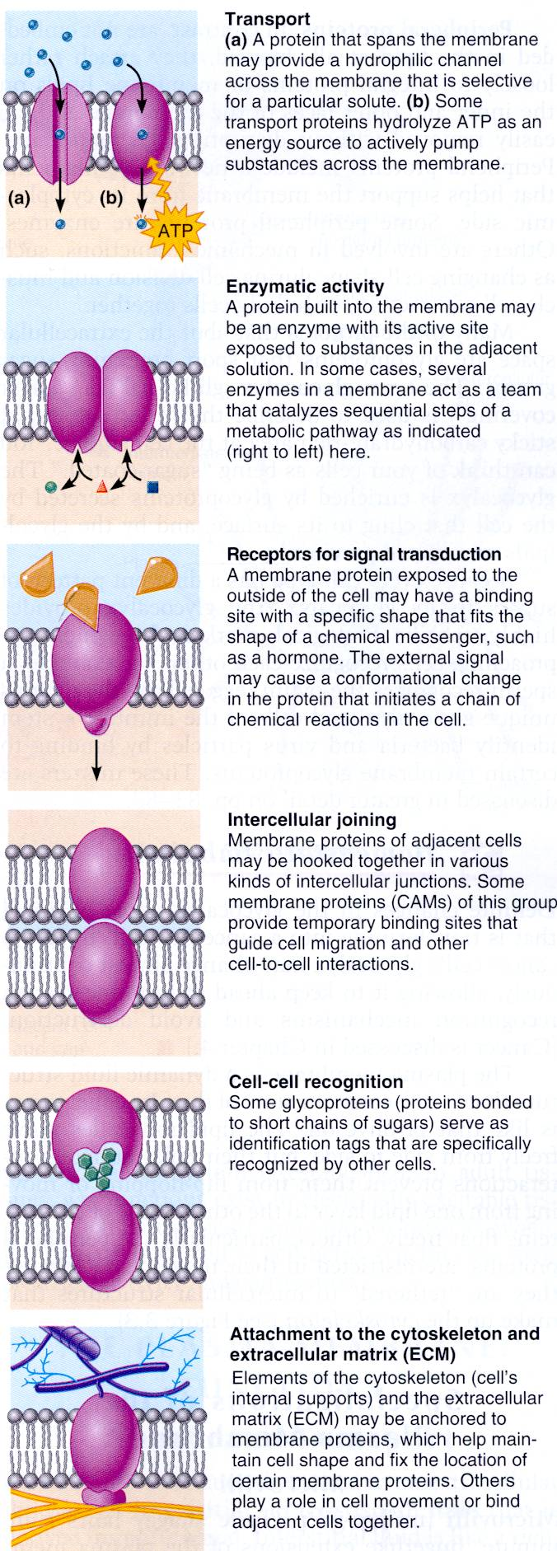
Some Functions of Plasma Membrane Proteins
transport
intercellular joining
enzyme activity
cell-cell recognition
receptors for signal transduction
attachment to ECM
Fig. 3.4

Slide 6
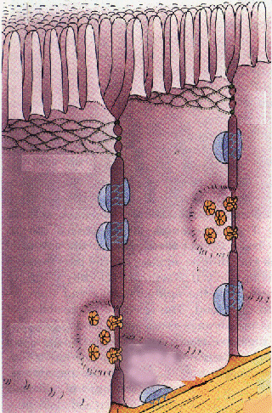
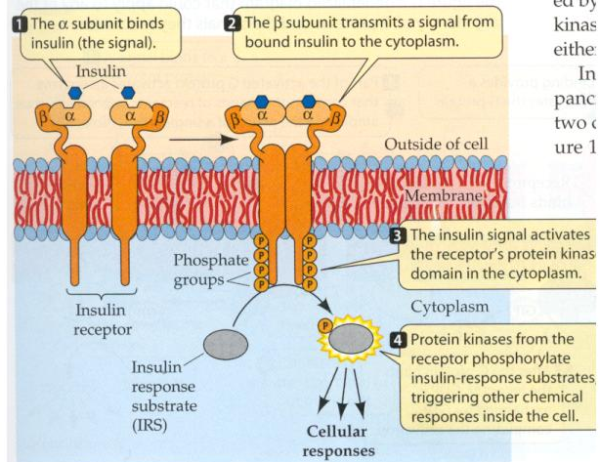
2.1.1.4: List 4 functions of plasma membranes
effective barrier between the intracellular & extracellular fluids
selectively permeable
allows the cell to respond to changes in the extracellular fluid
site of cell-to-cell interaction and recognition
http://www.bio.davidson.edu/Courses/Molbio/MolStudents/spring2003/Williford/assignment2_home.htm
http://www.bgsu.edu/departments/chem/midden/MITBCT/mem/junct.html

Slide 7

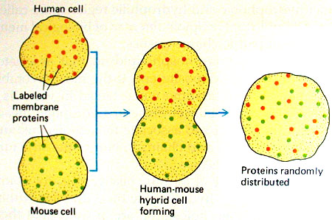

Think carefully about the chemistry of the plasma membrane, then answer this question: Why is minor damage to the plasma membrane usually not a problem?
J. Carnegie, Uof O
http://academic.brooklyn.cuny.edu/biology/bio4fv/page/fluid_p.htm

Slide 8
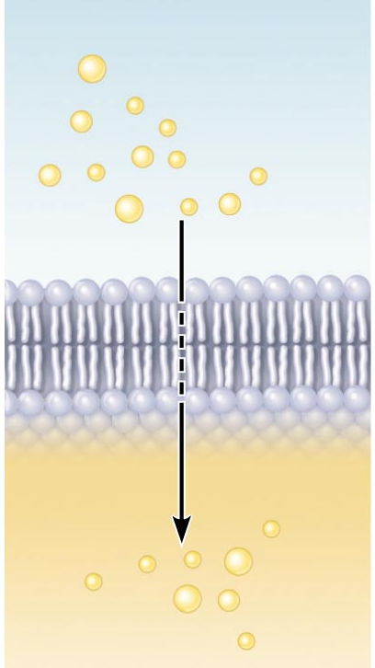
2.1.2.3 describe the mechanism of simple diffusion across the plasma membrane for lipid-soluble versus lipid-insoluble small molecules (give examples of each)
NH₂ - C - NH₂
O
Simple Diffusion:
nonpolar, lipid-soluble: O₂, CO₂, fats, urea, alcohol
O₂ & CO₂ follow gradients into and out of cells, respectively
molecule is moving down its concentration gradient!!
Fig. 3.7a
J. Carnegie, Uof O

Slide 9
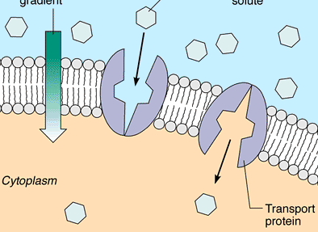
2.1.2.4 describe the process of facilitated diffusion using a physiological example; list 4 characteristics of this transport mechanism
Carrier-Mediated
lipid-insoluble molecules too large to pass through membrane pores/channels
Features of facilitated diffusion:
1) specific
2) not ATP-requiring (glucose to glucose-6-P right after entry)
3) limited by carrier saturation
4) movement down concentration gradient
5) can be inhibited by certain substances
J. Carnegie, UofO
What is the most well-known substance that is transported by carrier-mediated facilitated diffusion?
Fig. 3.7b: Carrier mediated facilitated diffusion

Slide 10
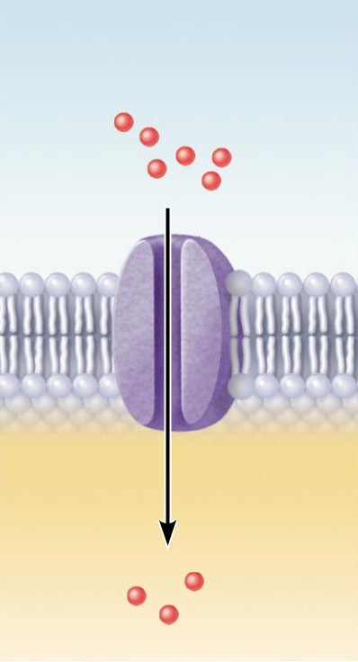
B. Channel-Mediated
selective due to pore size, charges of a.a. that line channels
some are always open (leakage channels)
opening of others is controlled (gated channels)
but movement always down concentration gradient
can be inhibited, can show saturation & are usually specific
Fig. 3.7c: Channel-mediated facilitated diffusion

Slide 11
2.1.2.5 distinguish between primary active and secondary active transport, giving an example of each; indicate the main differences between active and passive transport; differentiate between symport and antiport
ATP used because substance is:
(1) too large for pores
(2) lipid insoluble
(3) moving against concentration gradient
Active transport
Bulk transport
J. Carnegie, Uof O
B1. Active Transport:
like FD, requires a carrier: combines specifically & reversibly with substance
unlike FD, solute pumps move substances (amino acids, Na⁺, K⁺, Ca⁺) AGAINST CONCENTRATION GRADIENTS
many active transport systems are coupled systems:
(a) symport: eg: Na⁺ & amino acids or glucose, Na⁺,K⁺,2Cl⁻ cotransporter
(b) antiport: eg: Na⁺/K⁺ ATPase
• primary AT (Na⁺/K⁺ ATPase) vs secondary AT ( Na⁺ & amino acids )

Slide 12
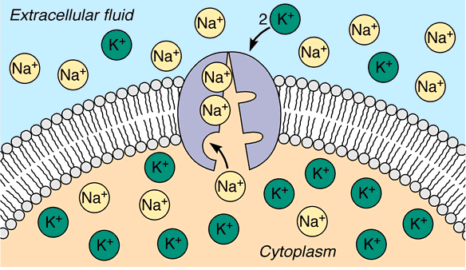
Primary Active Transport:
• [K⁺] 10-20X higher inside cell than out; [Na⁺] higher outside cell than in
• gradients essential to maintain normal cell function/responsiveness/volume
• maintenance of this gradient challenged by:
(1) slow leakage of K⁺ and Na⁺ along conc. gradients
(2) stimulation of muscle & nerve cells
• Na⁺/K⁺ ATPase functions continuously to maintain Na⁺ & K⁺ gradients
3 Na⁺ ions are pumped OUT for every 2 K⁺ ions pumped IN - moving AGAINST their concentration gradients to maintain cell responsiveness
J. Carnegie, Uof O
Na⁺/K⁺ ATPase (example of an antiport)

Slide 13
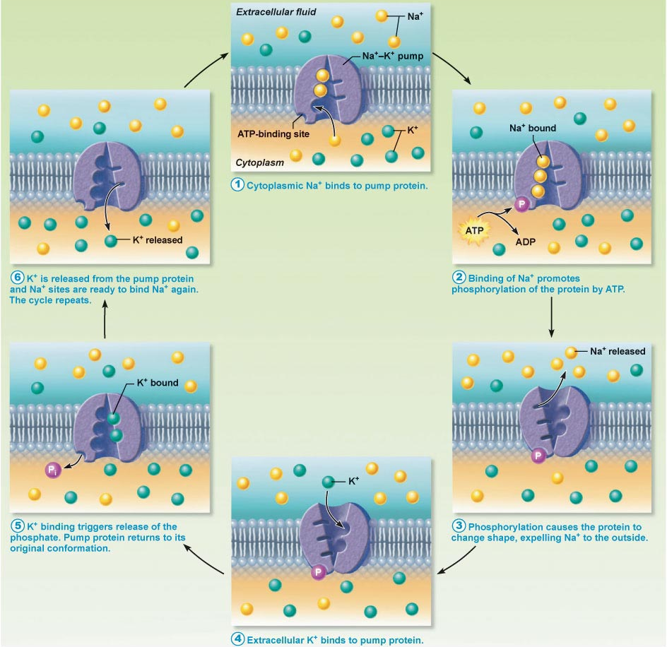
Fig. 3.10: Operation of the Na⁺/K⁺ ATPase, an antiport active transport pump

Slide 14
2.2.1 Identify the different regions of the neuron and associate each region with the functions of reception, propagation and transmission
2.2.1.1 justify 3 special properties of neurons that set them apart from most other cells in the body
2.2.1.2 label and indicate the functions of the receptive, conducting and secretory regions of the neuron
structural units of NS: conduct electrical impulses from one body part to another
Special features:
1. Extreme longevity: adequately nourished ⇒ 100 yr+
2. Amitotic: why? what does this mean if neurons are damaged?
3. High metabolic rate: O₂/glucose requirements?
large, complex cells: all have a cell body + one or more processes
J. Carnegie, UofO

Slide 15
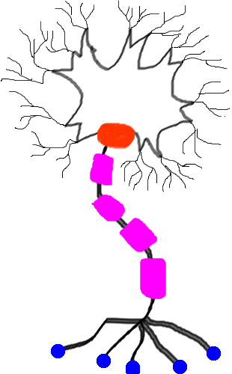
3 functional regions: (plasma membrane very important in all regions!)
1. Receptive region
2. Conducting region
3. Secretory region
http://www.ualberta.ca/~neuro/OnlineIntro/NeuronStructure.htm

Slide 16
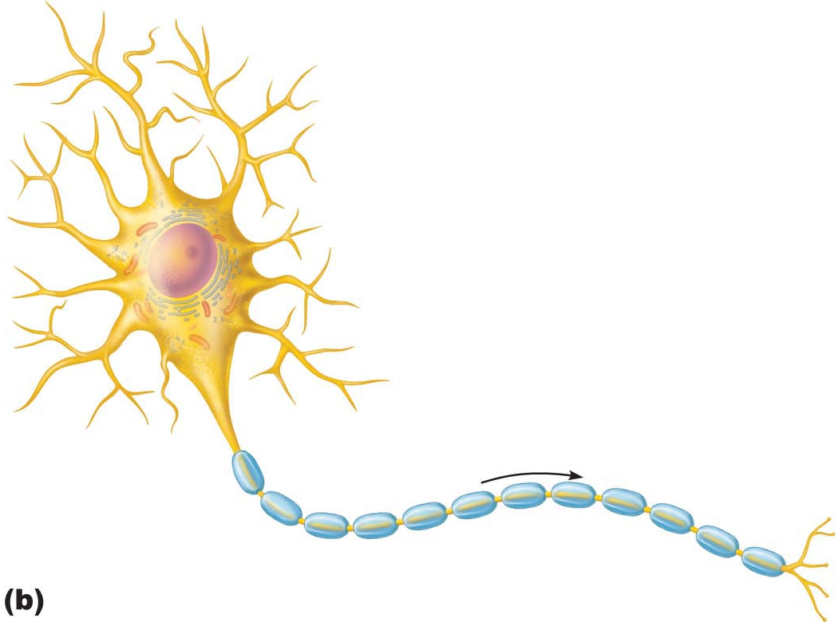
A. Neuron Cell Body
• large, spherical nucleus + granular cytoplasm ➢ biosynthetic centre
• extensive RER + ribosome clusters (Nissl bodies); also elaborate Golgi & lots of mitochondria Why??
• CNS/ PNS as a whole: What is a nucleus? What is a ganglion?
B. Neuron Processes
dendrites
axons
axonal terminals
2 more terms:
tract: bundle of nerve processes in CNS
nerve: bundle of nerve processes in PNS
Fig. 11.4
J. Carnegie, Uof O

Slide 17
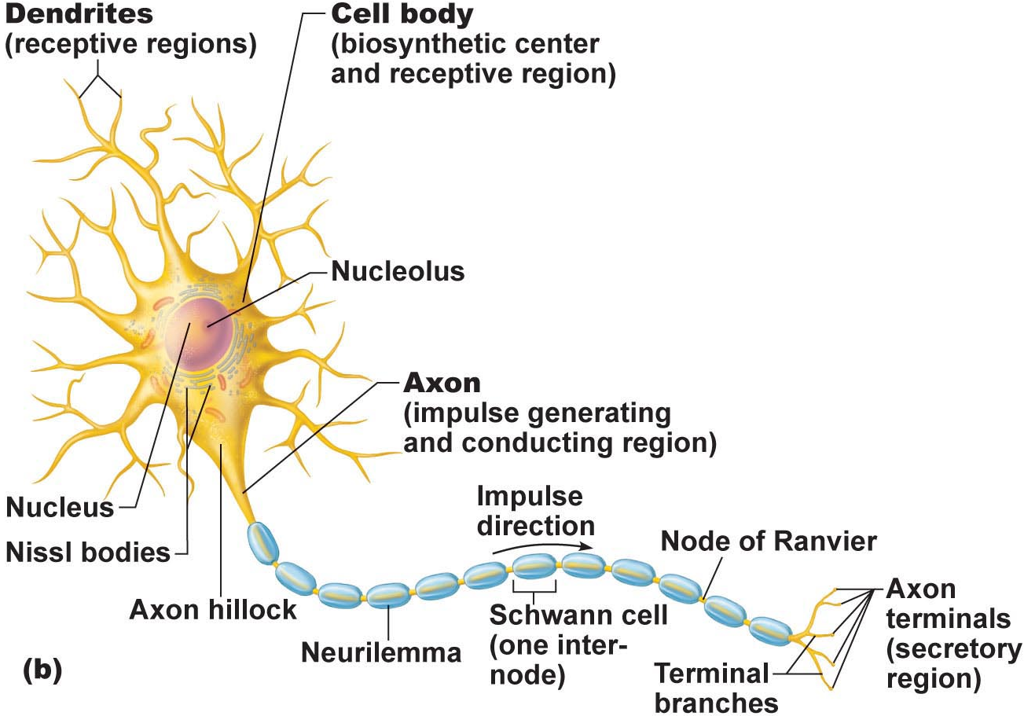
B1. Dendrites: (receptive region)
• short, tapering, branched extensions; usually hundreds/cell body
• enormous SA for reception from other neurons
• conduct impulses toward cell body
• short distance, graded potentials
J. Carnegie, Uof O
B2. Axon
• arises from axon hillock; variable length (can be > 1 metre)
• rate of conduction increases with axon diameter
• usu. 1 axon/neuron; branches at end (~10,000 telodendria) which end in axonal terminals

Slide 18

1. What is the conducting region of a neuron?
2. What is the secretory region of a neuron?
3. Where are the action potentials generated ?
4. In what direction do the action potentials travel?
5. From how many neurons does a single neuron receive information?
6. To how many neurons does a single neuron transmit information?
J. Carnegie, UofO

Slide 19

4.1.5 indicate the effect of axon diameter on neuron conduction velocity
4.1.6 distinguish between anterograde and retrograde transport
B2. Axons (cont.):
Neurotransmitters convey information from one axon to the next
Axon has same organelles as cell body, but no Nissl bodies; axons quickly degenerate if cut
Elaborate cytoskeleton in axon to move material to & fro:
anterograde (eg: mitos, cytoskeleton, membrane parts, NTs)
retrograde (eg: organelles to be degraded/recycled)
Conduction velocities depend on:
(i) axon diameter
(ii) myelin sheath
J. Carnegie, Uof O
Clinical Note:
Viruses such as polio, rabies, herpes simplex & tetanus toxin reach cell body by retrograde transport
Can this be used as a tool to introduce “corrected information” into genome???

Slide 20
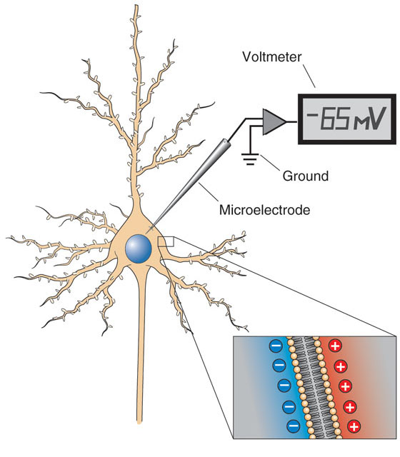
2.2.2.1 describe the resting membrane potential (RMP) of an excitable cell in terms of the differential permeability of the cell membrane to Na⁺ and K⁺; indicate which ion is found primarily inside cells and which is found primarily in the ECF
A. Creation of Resting Membrane Potential (RMP)
What do we mean when we say that neurons are excitable cells??
Some Fundamental Principles of Electricity:
voltage: electrical potential energy due to separation (PM) of oppositely-charged particles (ions) (-70 mV for many neurons)
resting membrane potential: all cells polarized; RMP cell-type-dependent (neg)
J. Carnegie, UofO
http://www.bioon.com/book/biology/whole/image/3/3-11.tif.jpg

Slide 21
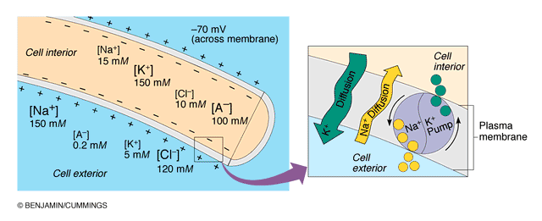
2.2.2.2. describe the Na+/K+ ATPase in terms of its role in maintaining the RMP of a neuron
NEGATIVE because INSIDE of cell negative compared to OUTSIDE
negativity only at level of membrane
RMP due to differential permeability of membrane to Na⁺ and K⁺ ions
Which ion primarily inside cells??
Which ion primarily outside cells??
3. At rest: membrane somewhat permeable to K⁺ but only very slightly permeable to Na⁺; so what happens??? What is the net result???
Fig. 11.8b (7th edition)

Slide 22
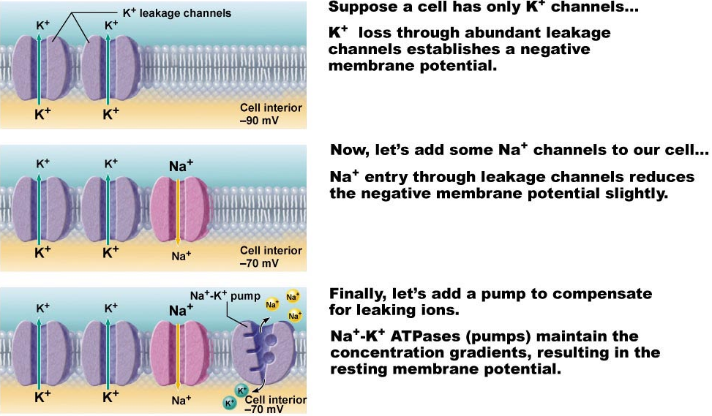
2.2.2.3 define electrochemical gradient; see also pages 79-81
We have:
1. Differential resting membrane permeabilities to Na⁺ & K⁺
2. Also, Na⁺/K⁺ pump moves 3 Na⁺ OUT for every 2 K⁺ IN
Fig. 11.8

Slide 23
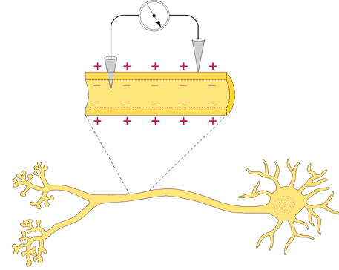
B. Measurement of Resting Membrane Potential (RMP)
RMP for a neuron is -40 to -90 mV (how is this measured???)
Fig. 11.7

Slide 24
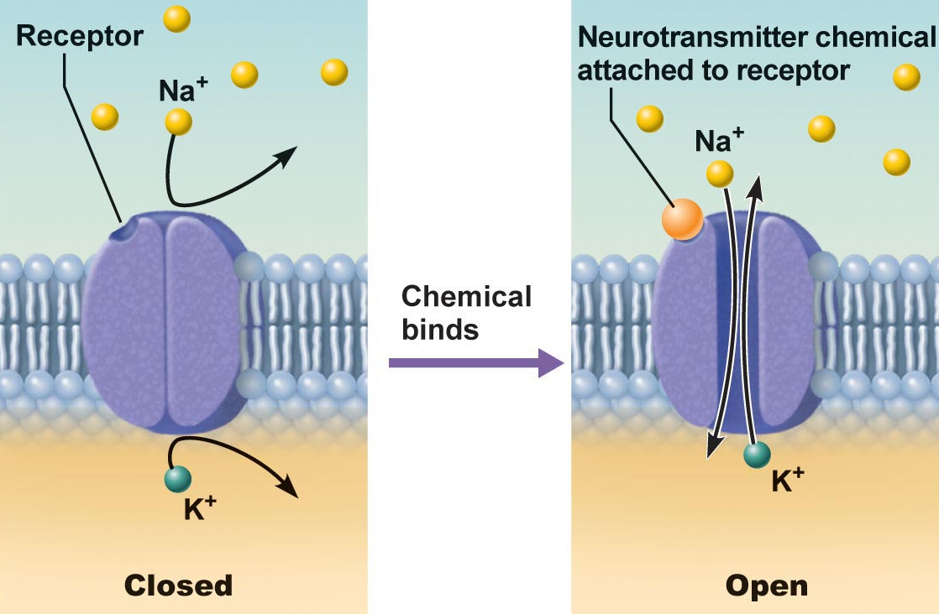
2.2.2.4 distinguish between passive (leakage) and active (gated) channels; list & describe the functioning of the 2 types of gated channels
Channels in plasma membranes:
1. Passive or leakage channels: always open
2. Active or gated channels: signal required to open/close
a) chemically-gated (neurotransmitter/hormone)
b) voltage-gated (change in membrane potential)
channels ion-specific: channels open ➔ ions move in response to electrochemical gradients
Fig. 11.6a
J. Carnegie, Uof O

Slide 25
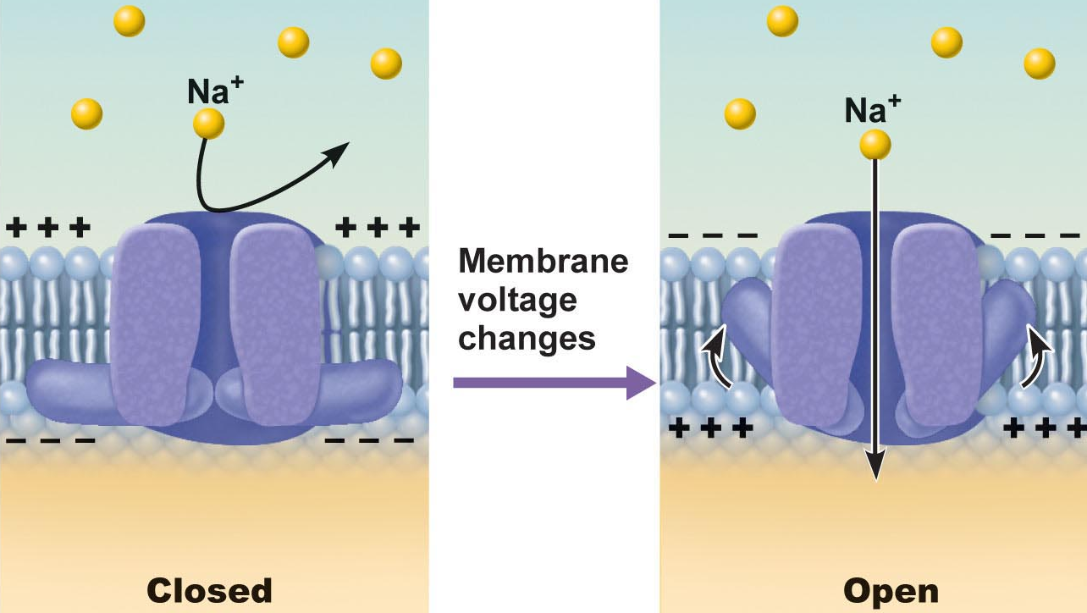
Fig. 11.6b
Fig. 11.6b
● neurons & muscle cells communicate by changing membrane potentials
● 2 types of signals:
graded potentials:……………………………………
action potentials:………………….…………………
J. Carnegie, UofO

Slide 26
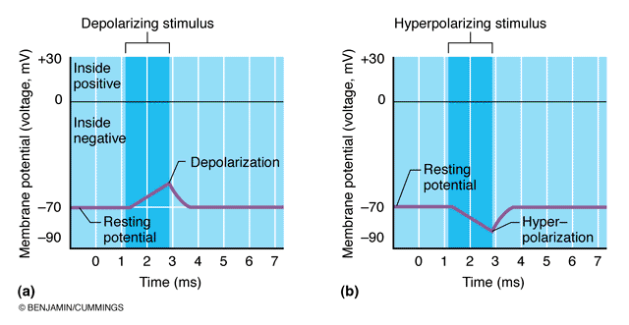
2.2.2.5 distinguish between depolarization and hyperpolarization
Fig. 11.9
remember that depolarization increases the probability of producing nerve impulses; hyperpolarization decreases this probability

Slide 27
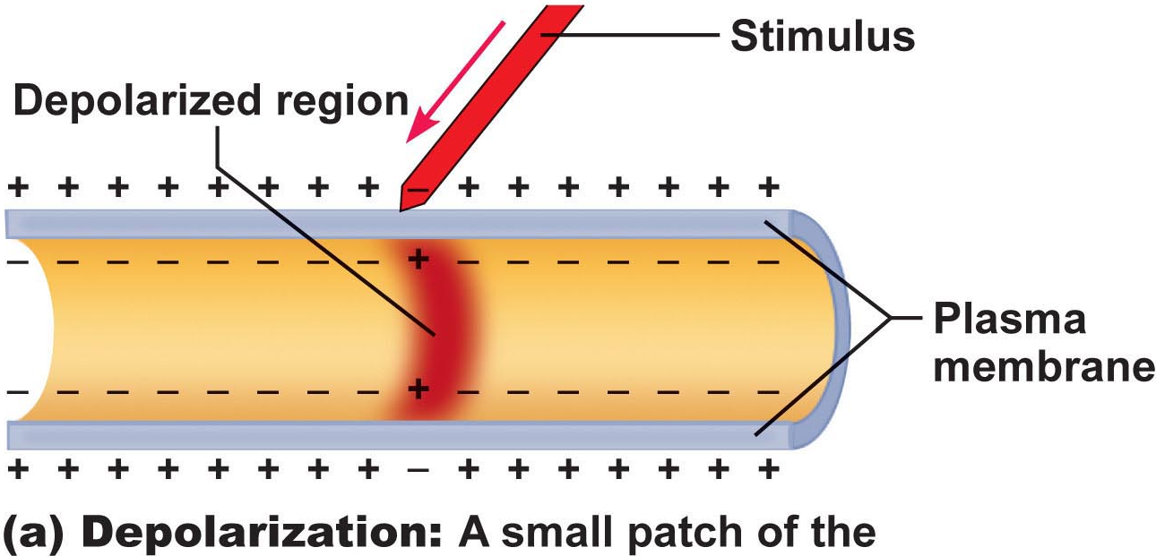
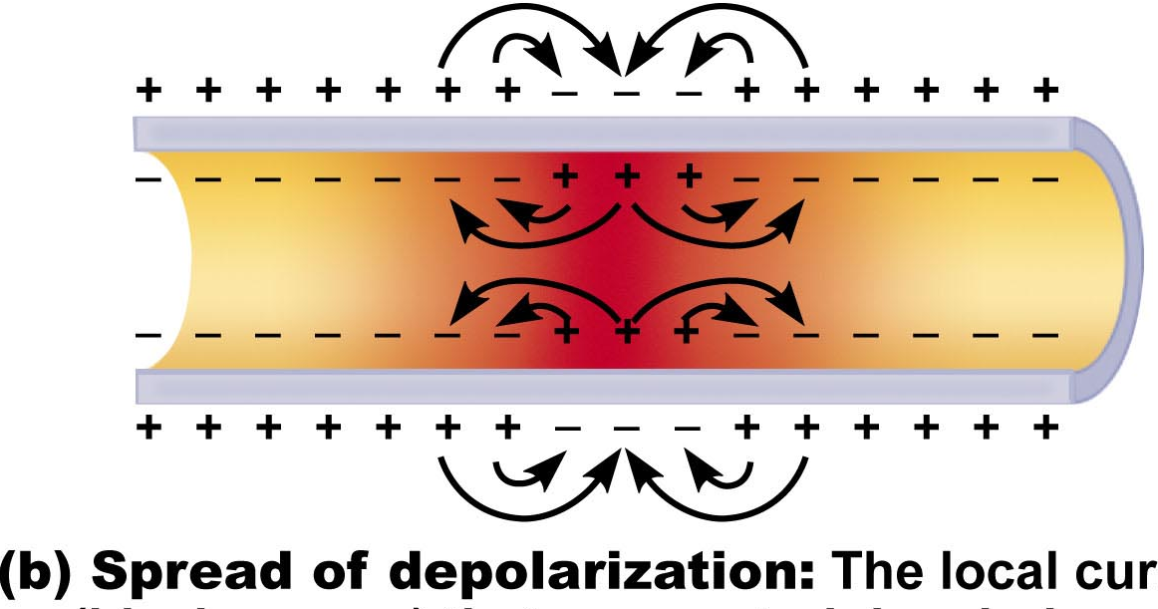
Graded Potentials
short-lived depolarizations or hyperpolarizations
current decreases with distance traveled
graded because magnitude determined by strength of stimulus
Initial stimulus depolarizes or hyperpolarizes local area of membrane
↓
decremental movement of ions on either side of membrane propagates signal for short distance
Fig. 11.10a
Generator potential
Postsynaptic potential
Fig. 11.10b

Slide 28
https://ca.video.search.yahoo.com/search/video?fr=mcafee&p=youtube+ac+tion+potential#id=5&vid=c28451e670997ad2c08ec50a12464303&action=click
Check all descriptions that apply to a resting neuron:
1. Its inside is negative relative to its outside.
2. Its outside is negative relative to its inside.
3. The cytoplasm contains more Na⁺ and less K⁺ than does the ECF.
4. The cytoplasm contains more K⁺ and less Na⁺ than does the ECF.
5. A charge separation exists at the plasma membrane.
6. The electrochemical gradient for the movement of Na⁺ across the membrane is greater than that for K⁺.
7. The electrochemical gradient for the movement of K⁺ across the membrane is greater than that for Na⁺.
8. The membrane is more permeable (leaky) to Na⁺ than to K⁺.
9. The membrane is more permeable (leaky) to K⁺ than to Na⁺.
J. Carnegie, UofO

Slide 29
2.2.3 Describe the factors that influence propagation of the action potential along an axon (pp. 402-408)
2.2.4 Explain the mechanisms of synaptic transmission (synapse, post-synaptic potentials, synaptic integration (pp. 409-418)

Slide 30
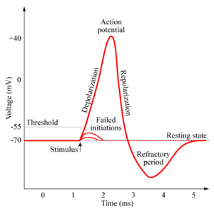
2.2.2.6 describe and graph a typical action potential, illustrating the 3 consecutive, overlapping changes in membrane permeability to specific ions; define: threshold, hyperpolarization undershoot, absolute refractory period, relative refractory period
Definition: a brief reversal of membrane potential; total amplitude = ~100 mV (from -70 to +30 mV)
• cells with excitable membranes (neurons, muscle cells) can generate action potentials; in neurons, only axons can generate action potentials
APs do not decrease in amplitude with distance travelled!!
• voltage-gated channels on axons open & close in response to local currents (graded potentials)
Action potential 403-408
http://www.chm.bris.ac.uk/webprojects2006/Cowlishaw/mech%20synaptic%20transmission.htm
J. Carnegie, UofO

Slide 31
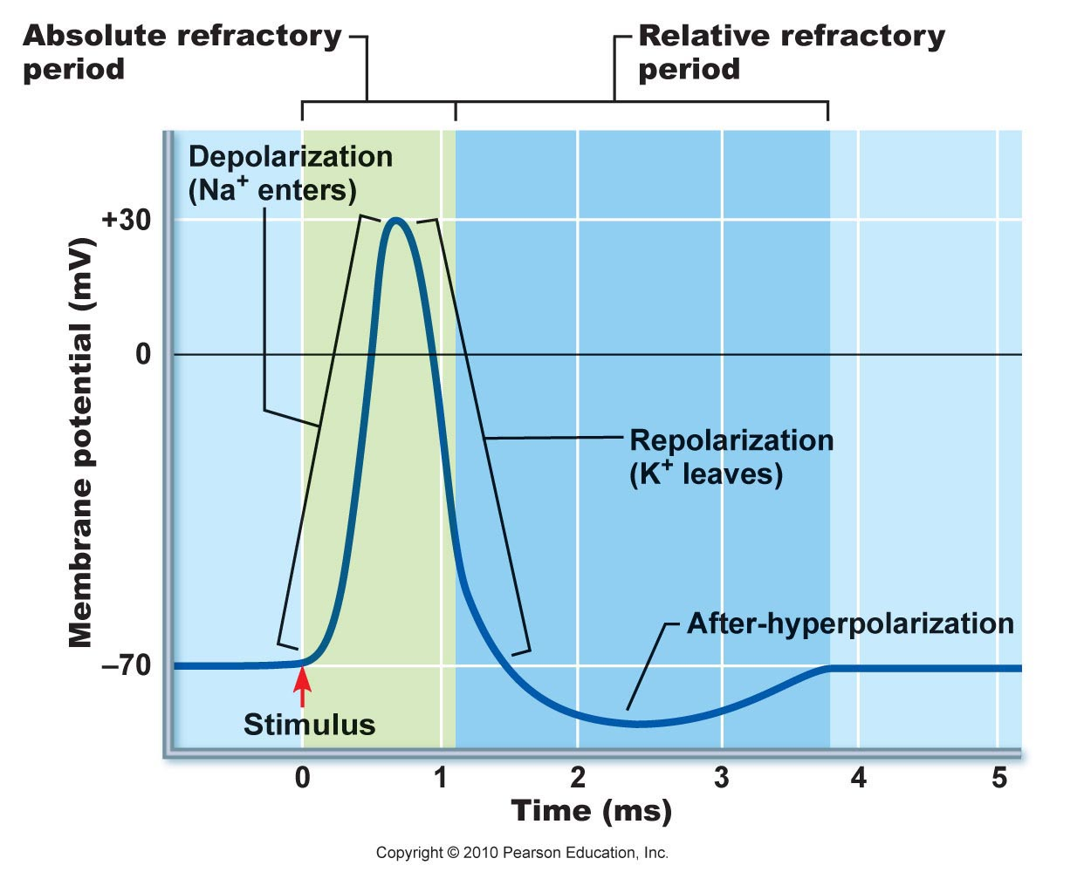
Generation of an Action Potential
transient increase in Na⁺ permeability
restoration of Na⁺ impermeability
transient increase in K⁺ permeability
(i) Increase in Na⁺ permeability
resting state: voltage-gated Na⁺ & K⁺ channels closed; normal leakage
local depolarization: voltage-gated Na⁺ channels open (fast activation gates)
What does threshold (-55 to -50 mV) mean? Why is AP then self-sustaining?
What is the spike of an AP? Concept of positive feedback
Fig. 11.14
Depolarizing Phase:
Both Na⁺ gates must be open for entry; closure of either gate stops Na⁺ entry
J. Carnegie, Uof O

Slide 32
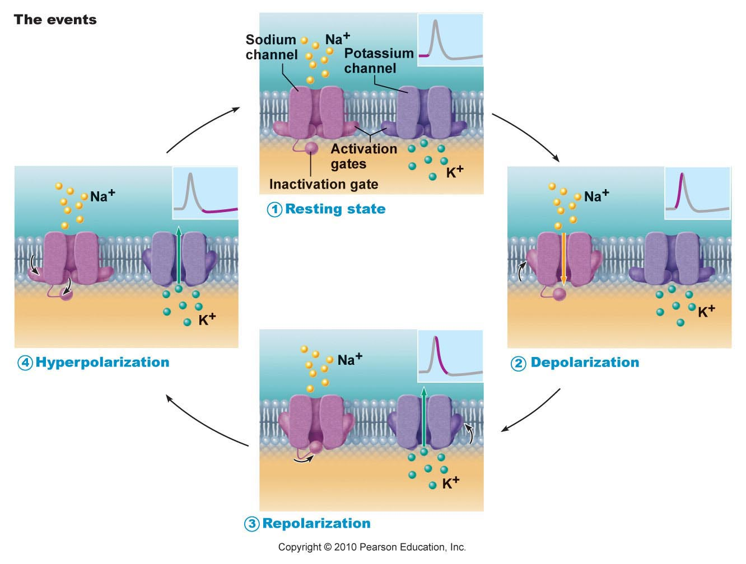
Fig. 11.11

Slide 33
(ii) Decrease in Na⁺ permeability
as membrane potential passes 0 mV, inside positivity resists further Na⁺ entry
Na⁺ gates begin to close; turning point in spike
cell will now begin to repolarize
Repolarizing phase:
(iii) Increase in K⁺ permeability
K⁺ leaves cell along electrochemical gradient & repolarizes cell
also slow gates: so slow that do not close quickly enough →
after-hyperpolarization
Na⁺/K⁺ pumps quickly restore ion gradients across membrane
J. Carnegie, Uof O

Slide 34
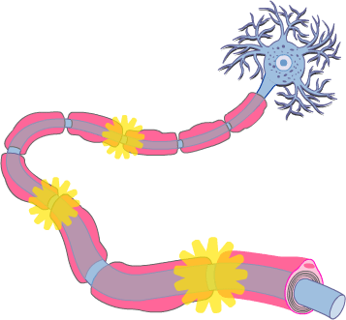
2.2.3.1 justify the unidirectional propagation of an AP and the description of an AP as an “all-or-none” event; indicate how stimulus intensity is coded in action potential production
Propagation of an Action Potential
• AP must traverse length of neuron to signal next neuron
• propagation rather than conduction of an AP - Why??
• unidirectional - Why?? What do we mean when we say that an area of a neuron is refractory to further stimulation? What does this mean about the Na⁺ channels??
J. Carnegie, UofO
http://www.getbodysmart.com/ap/nervoussystem/neurophysiology/actionpotentials/menu/menu.html

Slide 35
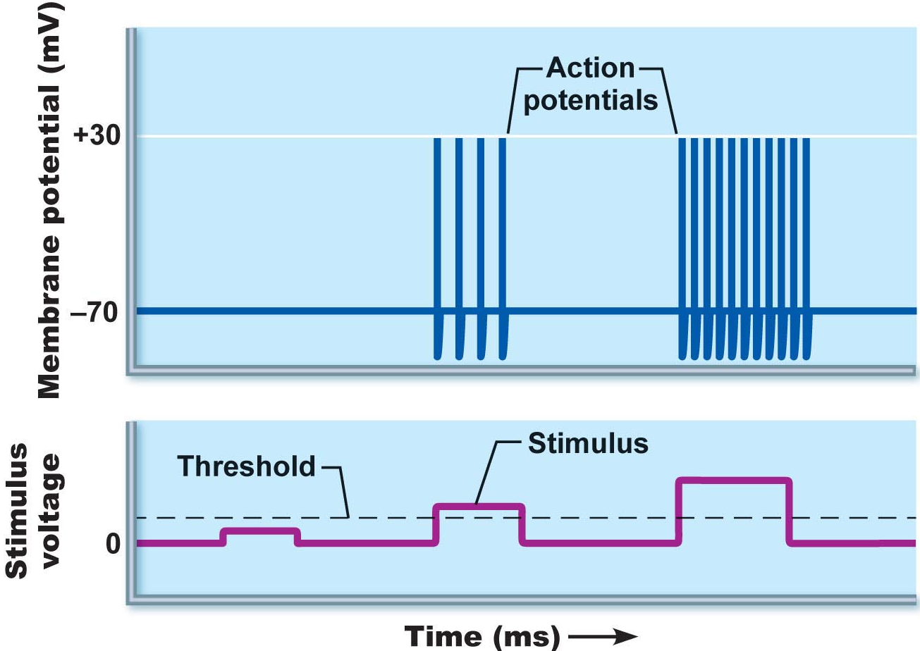
Threshold and All-or-None Phenomenon
outward K⁺ current = inward Na⁺ current (~20 mV of depolarization)
can go either way!!
local depolarizations (graded) must sum to reach threshold or no AP
Why do we say that an AP is an all-or-none event?
NB: APs are all the same size: stimulus intensity is indicated by AP frequency
Fig. 11.13

Slide 36
Absolute & Relative Refractory Periods
Absolute RP: Na⁺ gates open & second depolarization impossible
Relative RP: Na⁺ gates closed but K⁺ gates open; can only be stimulated by a very strong stimulus (greater than threshold); a means of increasing frequency when incoming stimulus is strong
Fig. 11.14

Slide 37
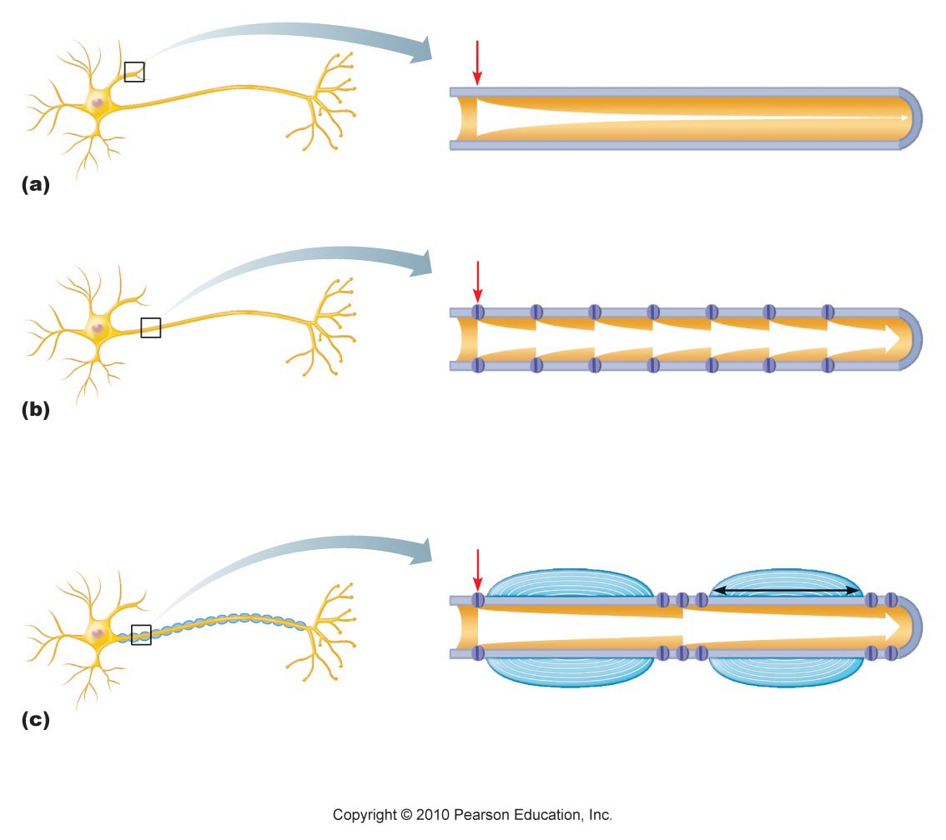
2.2.3.2 describe the production of myelin sheathes around peripheral neurons and indicate their role in AP propagation; define: Schwann cell, node of Ranvier, saltatory conduction, oligodendrocytes, multiple sclerosis as a disease affecting the myelin sheath
Myelin Sheath:
• white, lipid-protein; insulates/protects peripheral nerves
• increases (up to 150 X) rate of impulse propagation
• Schwann cells: membranes <25% protein (minimal channels ➢ Why?)
Node of Ranvier? saltatory conduction? Are dendrites myelinated?
Fig. 11.15. Myelin sheath speeds up impulse propagation

Slide 38
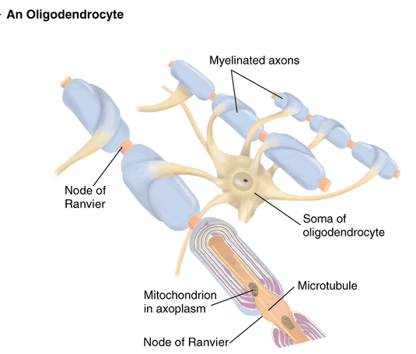
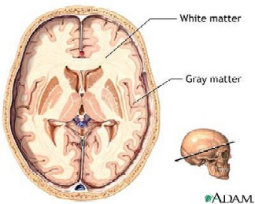
myelinated nerves also in CNS: oligodendrocytes; white vs gray matter
http://homepage.psy.utexas.edu/homepage/class/Psy332/Salinas/Cells/Cells.html
http://reinventioninc.blogspot.com/2005_01_01_reinventioninc_archive.html

Slide 39

A Clinical Note
Multiple Sclerosis:
persistent inflammatory response in which myelin sheaths gradually destroyed (autoimmune? persistent virus?)
cycles of relapse and remission: flare-ups and then some healing and myelin regeneration; axons develop more Na⁺ channels in demyelinated areas
blindness (optic nerve), muscle weakness, clumsiness, urinary incontinence
ultimately myelin destruction is permanent and axons “drop out” or degenerate
Therapy:
(1) reduce inflammatory destruction
(2) manage symptoms
(3) promote repair of damaged myelin
J. Carnegie, UofO

Slide 40
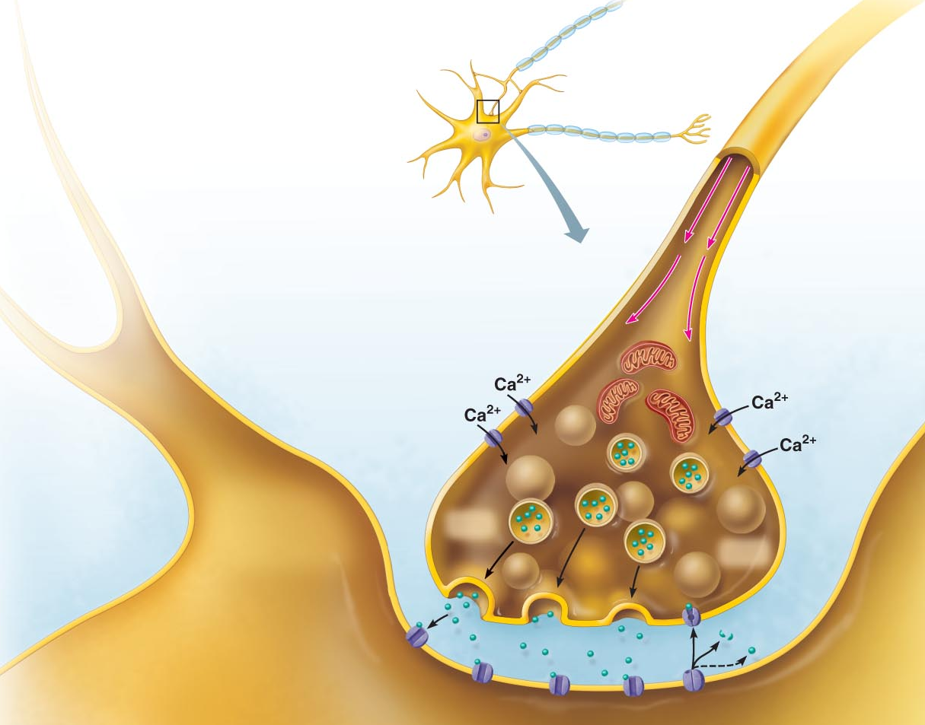
2.2.4 Explain the mechanisms of synaptic transmission (synapse, post-synaptic potentials, synaptic integration)
2.2.4.1 differentiate between electrical and chemical synapses in terms of relative frequencies, distributions, mechanism, speed and properties of inter-neuron communication
Fig. 11.18 (7th edition)
THE SYNAPSE
junction between 2 neurons or neuron + effector
presynaptic vs postsynaptic neuron (most neurons are both)
2 types of synapses: electrical and chemical

Slide 41
A. Electrical Synapses
much less common; like gap junctions
direct current flow - protein channels
rapid transmission (electrically-coupled)
neurons can be synchronized
primarily embryonic, also eye movement; in non-nervous tissue, found in cardiac & smooth muscle where can synchronize contractions
Chemical Synapses
release and binding of neurotransmitters
“Neurotransmitters . . .function to open or close ion channels that influence membrane permeability and, consequently, membrane potential.” (Marieb, /98)
2 parts: (i) axonal terminal:
(ii) receptor region:
What events occur in the synaptic cleft (fluid-filled space of 30-50 nm)?
Why is synaptic transmission unidirectional?

Slide 42
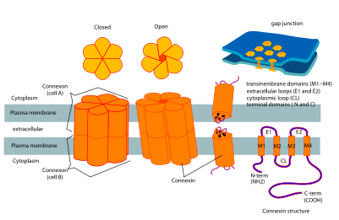
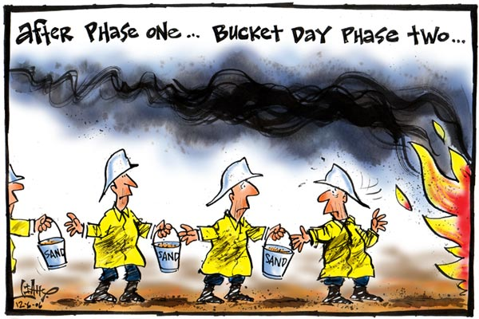
Gap junction coupled chains of astrocytes draw K+ away from sites of high activity
acting like a bucket brigade
Connexins are proteins that form gap junctions between cells that freely pass current and small solutes
- spread of excitatory current through heart tissue (and smooth muscle)
- synchronization of neural network activity (fast spiking parvalbumin interneuron
- coordination of actions, postpartum oxytocin neurons

Slide 43
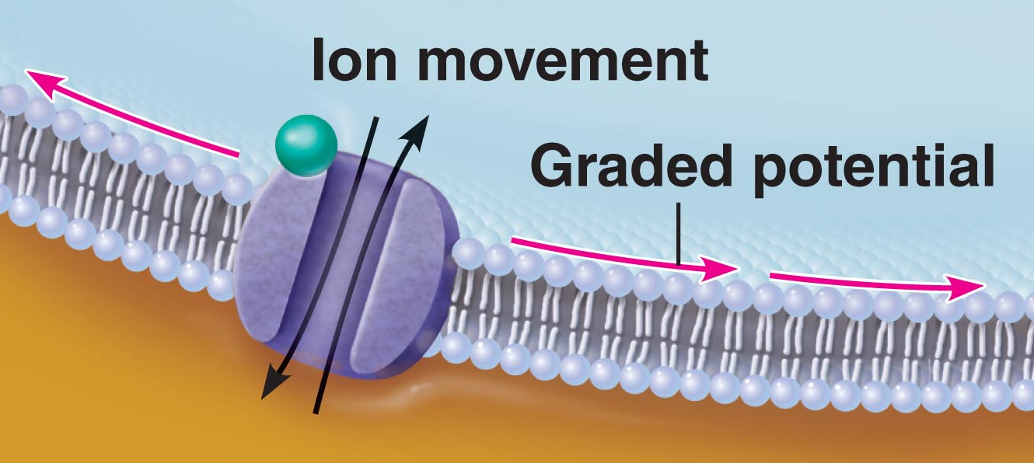
2.2.4.2 illustrate and describe the main features of chemical synaptic transmission; briefly describe 3 ways in which chemical synaptic transmission can be terminated
Mechanism of Synaptic Communication
Initiation:
1. Ca⁺⁺ gates open in presynaptic terminal
2. Neurotransmitter release
3. Neurotransmitter binds to postsynaptic receptors
4. Ion channels open in postsynaptic membranes
NB: ~300 vesicles emptied/impulse - So what happens when we have increased impulse frequency???
J. Carnegie, U of O

Slide 44
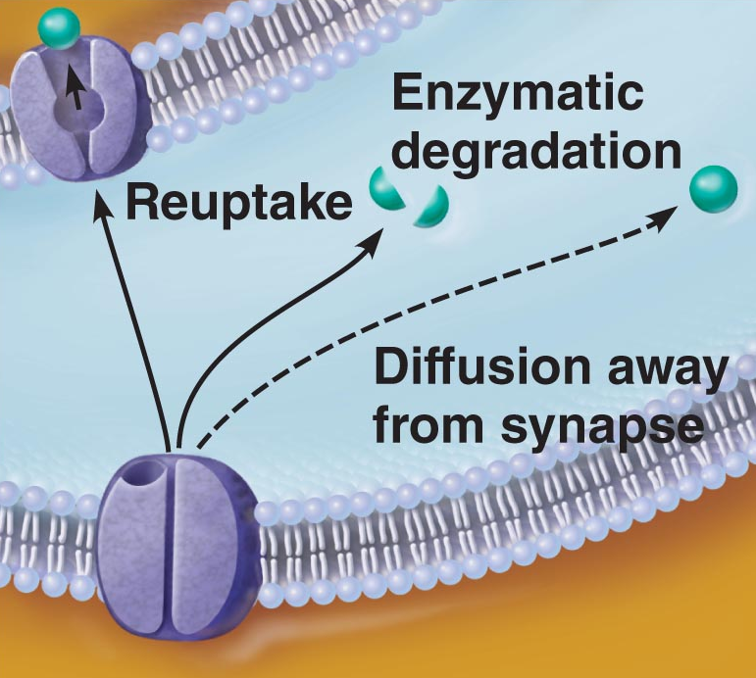
Termination:
3 options:
(i) degradation by enzymes of postsynaptic membrane (acetylcholine)
(ii) reuptake by presynaptic terminal (norepinephrine)
(iii) diffusion away from synaptic site (nitric oxide)
J. Carnegie, U of O

Slide 45
2.2.4.3 define synaptic delay
Synaptic Delay:
• slowest (rate-limiting) step of neurotransmission - Why??
• time for NT release, diffusion & receptor binding: 0.3-5 ms
2.2.4.4 distinguish between EPSPs and IPSPs in terms of channels opened and end results in terms of membrane potential/ease of generating an action potential
Postsynaptic Potentials
channels respond to chemicals rather than changes in membrane potential
channels mediate local changes in membrane potential: graded per amount of NT
2 types of PSPs:
(i) excitatory postsynaptic potentials (EPSPs)
(ii) inhibitory postsynaptic potentials (IPSPs)

Slide 46
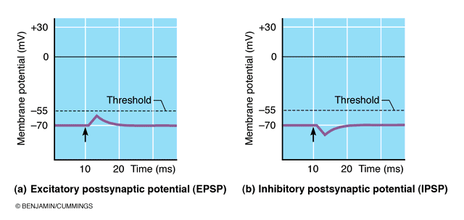
EPSPs:
NT binding ➔ membrane depolarization; opens one channel for both Na⁺ & K⁺
electrochemical gradient for Na⁺ steeper than for K⁺; what is end result??
what is generated is NOT an AP; only axonal membranes can generate APs!!; get local, graded depolarizations called EPSPs; if strong enough to reach axon hillock, then get AP
IPSPs:
NT binding ➢ membrane hyperpolarization by inc. permeability to K⁺ or Cl⁻
What is the end result in terms of membrane potential?
What is end result in terms of ease of generating an AP?
Fig. 11.18

Slide 47
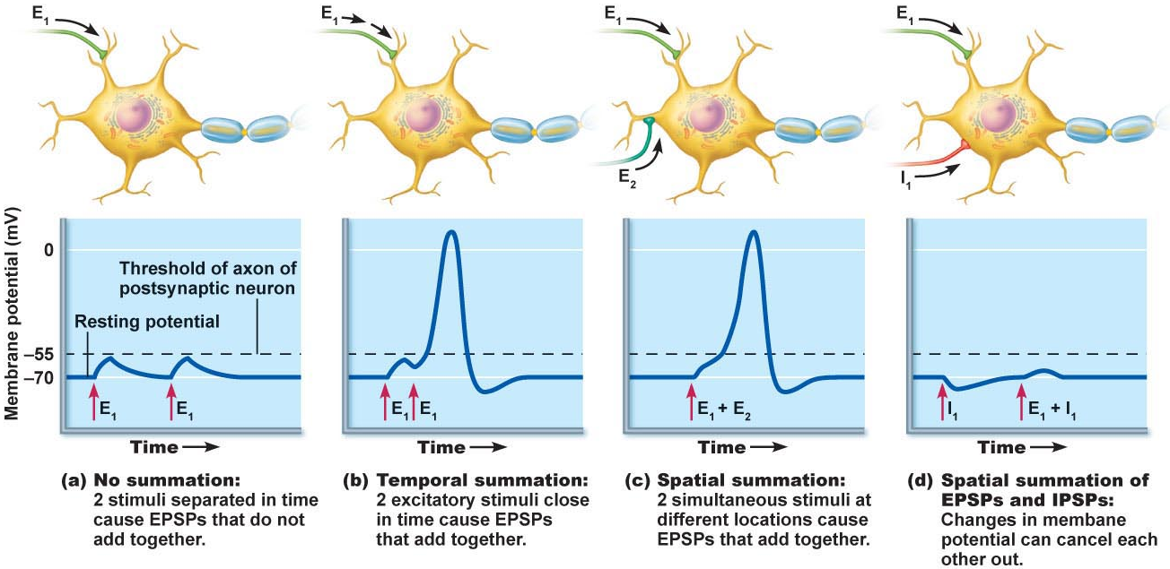
2.2.4.5 define (in terms of EPSPs & IPSPs): temporal summation, spatial summation; justify the role of the axon hillock as the neural integrator
C1. Summation by Postsynaptic Neuron
single EPSP cannot generate an AP
2 types of summation (EPSPs & IPSPs):
(i) temporal: (ii) spatial:
axon hillock = neural integrator (numerous EPSPs & IPSPs)
most effective synapses:closest to axon hillock – why??
Fig. 11.19

Slide 48
https://www.youtube.com/watch?v=bcnf3ZRl5ug
The human brain has a huge number of synapses. Each of the 10¹¹ (one hundred billion) neurons has on average 7,000 synaptic connections to other neurons. It has been estimated that the brain of a three-year-old child has about 10¹⁵ synapses (1 quadrillion)
Connections are constantly evolving, in a toddler
at the rate of 700 per second.

