Slide 1


Exam Review
25 September 2012

Slide 2
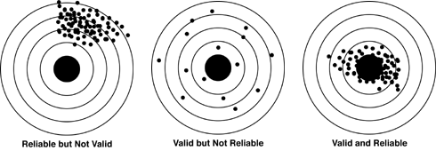
Validity and Reliability
Validity – Are you measuring what you think you’re measuring?
Reliability – Do you get the same time every time you measure?

Slide 3
Validity
Measurement Validity
Internal Validity
External Validity
Face Validity
Concurrent Validity
Construct Validity
Convergent Validity
Qualitative: Credibility and Transferability

Slide 4
Reliability
External
Internal
Qualitative: Dependability and Confirmability

Slide 5
Secondary Analysis
Analyzing previously gathered data
Advantages
  Low cost
  Less time-consuming
  Can provide high-quality data
  Opportunity for longitudinal analysis
  Subgroup analysis often possible
  Opportunity for cross-cultural (international) analysis
  More time for data analysis, since no time is spent gathering data.
  The data can be reanalyzed.
  Fulfills the wider obligations of the social researcher, making full use of data for which the research participants had to make significant sacrifices.

Slide 6
Secondary Analysis
Limitations
  Lack of familiarity with the data
  Complexity of the data
  The ecological fallacy may become part of the analysis.
    The erroneous inference of individual characteristics from group-level characteristics.
  No control over data quality
  Absence of key variables

Slide 7
Equivalence
Lexicon equivalence
Contextual equivalence
Conceptual equivalence
Measurement equivalence

Slide 8
Qualitative Methods
How are they different from Quantitative methods?
  Inductive
  Inductive
  Subjective
  Interpretivist
  Constructionist

Slide 9
Qualitative Methods
Types
  Semi-structured and unstructured interviews
  Focus groups
  Participant Observation and ethnography
  Qualitative content analysis: Semiotics and Hermeneutics.

Slide 10
Questions?
One last set of office hours: Monday, December 10th, from 1-2:30 in SSC 5315.
Available for appointments
Remember email policy: Your email will be answered within 2 business days, Monday – Friday, 8am to 5pm
  Don’t leave questions until 3am the night before the exam!

Slide 11
Next Class: Final Exam
Thursday, December 13th.
9:00 AM – 11:00 AM
SSC 2024
Bring your student ID!
Bring a pencil for the scantron.
Stay in seat for last 15 minutes
Same format as Midterm: Mix of M/C and short answer.
35% of final grade.

