Slide 1
Describe the work of Hall report (1962-1964) and how it impacted what we now call Medicare in Canada.
Presented By:
Nabeel Akhtar
Gagandeep Singh

Slide 2
Medicare in Canada:
Medicare is a term that refers to Canada's publicly funded health care system. Instead of having a single national plan, Canada have 13 provincial and territorial health care insurance plans.
Under this system, all Canadian residents have reasonable access to medically necessary hospital and physician services without paying out-of-pocket.

Slide 3

Video:
https://youtu.be/VSfaoIXTZSE

Slide 4
Emmett Hall:
The descendent of Irish immigrants, Emmett Matthew Hall was born in a small village north of Montreal in 1898.
In 1910 Hall moved to Saskatoon with his family.
He graduated in law from the University of Saskatchewan in 1919 and was appointed chief justice Court of Queen's Bench for Saskatchewan in 1957.
He became chief justice of Saskatchewan in 1961 and was elevated to the Supreme Court of Canada in 1962.

Slide 5
Hall was appointed by Prime Minister John Diefenbaker to chair a Royal Commission on Health Services.
The task was “to study the existing and projected health needs of and health resources of Canada, and to study methods of ensuring the highest standards of health care for all citizens of Canada”
Hall is widely regarded as a founding father of Medicare.

Slide 6
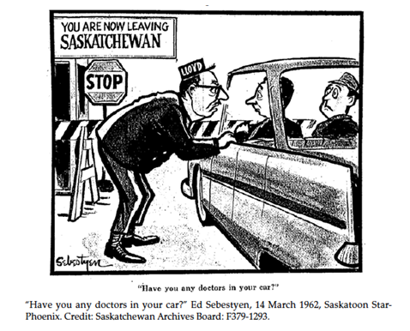
Birth of Medicare :
Medicare was born in Saskatchewan on July 1, 1962. It would be the first government-controlled, universal, comprehensive single-payer medical insurance plan in North America.
It was a difficult birth.
Public medical care insurance also began in the province of Saskatchewan; first announced in 1959.
This plan became operational in 1962 following a three-week physicians strike in opposition to it.

Slide 7
Royal Commission on Health Services:
The Royal Commission on Health Services, also known as the Hall Commission, was established by Order in Council on June 20, 1961 under Part I of the Inquiries Act.
Its purpose was to:
Inquire into and report upon existing and future need for health services for the resident of Canada.
Twelve issues were identified, including:
Financing methods.
Present and future requirements for health services personnel and their training.
Present and projected costs of health care services in Canada.
Methods of improving health care services.

Slide 8
Commission Consist of:
Seven commissioners were appointed, including the chair, Mr. Justice Emmett M. Hall and Ms. Alice Girard (RN), Dr. David M. Baltzan, Professor O.J. Firestone, Dr. C.L. Strachan, Dr. Arthur F. Van Wart, and Mr. M. Wallace McCutcheon. Commission held 67 days of public hearings in all provinces and Yukon.
They visited and studied health care system of different countries, received submission heard individuals and delegates from 406 organizations, and commissioned 26 research studies.

Slide 9
Recommendation of Hall report:
The Commission recommended a national health policy and a comprehensive health care program for three main areas:
Health services
Health personnel, facilities and research
Financing and priorities.

Slide 10

The Hall Commission issued its report in 1964.
To the surprise of many, Hall recommended the nationwide adoption of Saskatchewan's model of public health insurance.
In fact, his recommendations went further than the Saskatchewan plan, proposing additional publicly funded benefits, such as free dental coverage for schoolchildren and welfare recipients and free prescription glasses and drugs for the needy and elderly
The only thing more expensive than good health care, he argued, is no health care.

Slide 11
Implementation:
By the time of his report, the Diefenbaker government had been replaced by the Liberals government of Lester B. Pearson. The Pearson government was deeply divided on the issue of health care, and took some time to reach a decision. Eventually, the federal government implemented the Medicare system which was at the core of Hall's recommendations, on a cost-share basis with the provinces. The new system came into force in July, 1968.

Slide 12
References:
Civilization.ca - History of Canadian Medicare - 1958-1968 - Emmett Hall. (n.d.). Retrieved from https://www.historymuseum.ca/cmc/exhibitions/hist/medicare/medic-5k01e.shtml
Emmett Matthew Hall | The Canadian Encyclopedia. (n.d.). Retrieved from https://www.thecanadianencyclopedia.ca/en/article/emmett-matthew-hall
https://youtu.be/VSfaoIXTZSE
The Birth of Medicare – Canadian Dimension. (n.d.). Retrieved from https://canadiandimension.com/articles/view/the-birth-of-medicare
Canada, H. (2005, June 13). Royal Commission on Health Services, 1961 to 1964. Retrieved from https://www.canada.ca/en/health-canada/services/health-care-system/commissions-inquiries/federal-commissions-health-care/royal-commission-health-services.html
Emmett Matthew Hall. (2018, August 29). Retrieved from https://en.wikipedia.org/wiki/Emmett_Matthew_Hall
Physician at the Frontier: Development of Public Healthcare in Saskatchewan, Canada from 1915 to 1965 | Marzieh Ghiasi. (n.d.). Retrieved from http://ghiasi.org/2013/09/physician-at-the-frontier

Slide 13


