Slide 1
Final Exam
Review
Instructor Todd Armstrong
Fall 2018
QUA 1206

Slide 2
AIMS
Review material covered in the course since the midterm
Target areas that appear to be issues for the class
Provide 1-on-1 in-class support for students with specific questions

Slide 3
THE ART OF PRESENTING DATA
Graphs should (Tufte, 2001):
  Show the data.
  Induce the reader to think about the data being presented (rather than some other aspect of the graph).
  Avoid distorting the data.
  Present many numbers with minimum ink.
  Make large data sets (assuming you have one) coherent.
  Encourage the reader to compare different pieces of data.
  Reveal data – INSIGHT!

Slide 4
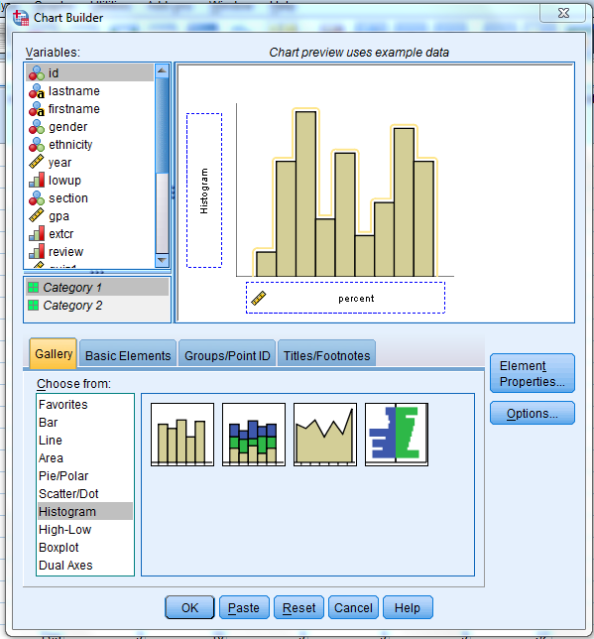

HISTOGRAMS: EXAMPLE
Using the ‘student_financial.sav’ datafile, create a histogram for the ‘age’ variable; comparing TFSA-holders and non-TFSA holders.
Which one of these do we choose?
The ‘population pyramid’ applies to several types of graphs; but is particularly useful when looking at distributions across categorical variables

Slide 5
WHAT IS A CORRELATION?
It is a way of measuring the extent to which two variables are related.
  A measure of association; relationship
It measures the pattern of responses across variables.
  The degree to which scores between two variables move together
  The greater the client affinity with the company, the more likely they are to recommend its products / services to others
Remember: correlation ≠ causality

Slide 6
THE PEARSON CORRELATION COEFFICIENT
The degree to which two variables (interval/ratio) are correlated can be calculated through Pearson R.
Direction: the value of Pearson R can be either positive or negative
  Positive: variables change in the same direction
  Negative: variables change in opposite directions
The strength of a correlation is not weakened by the presence of a negative coefficient
  Only the nature / direction of the relationship

Slide 7
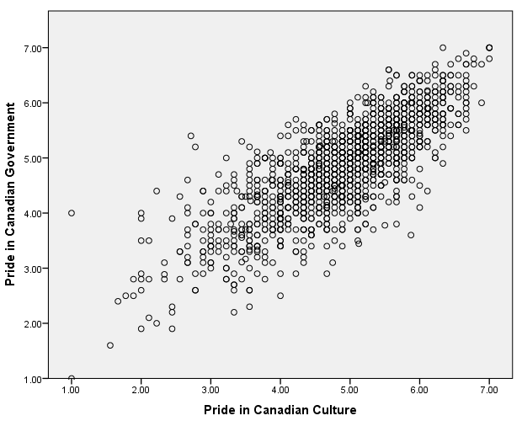
THE SCATTERPLOT
POSITIVE CORRELATION

Slide 8
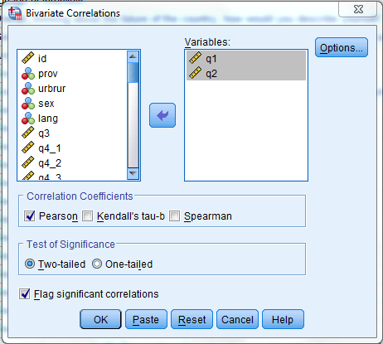
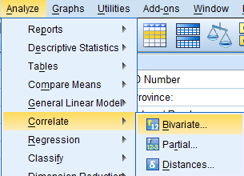
DOING A CORRELATION
Correlation Coefficients
  Pearson, Kendall’s tau, Spearman
Test of Significance
  Two-tailed, One-tailed
Flag significant correlations
Assess the relationship between enjoyment of online banking, and enjoyment of mobile banking.

Slide 9
PARTIAL CORRELATIONS
Reliability of financial advisor and perception of good service; controlling for the influence of age
Research hypothesis:
There is a positive correlation between perceived helpfulness of financial advisor, and perception of good service from branch banking; regardless of age.
Null hypothesis:
There is no relationship between perceived reliability of financial advisor, and perception of good service from branch banking; regardless of age.

Slide 10
PEARSON CHI-SQUARE TEST
Use to see whether there’s a relationship between two categorical variables
  Compares the frequencies you observe in certain categories to the frequencies you might expect to get in those categories by chance.
The equation:
  i represents the rows in the contingency table and j represents the columns.
  The observed data are the frequencies in the contingency table
  n is the total number of observations.
The ‘Model’ is based on ‘expected frequencies’.
  Calculated for each of the cells in the contingency table based on the totals for both the rows and the columns.

Slide 11
A CONTINGENCY TABLE
 |  | Purchase
 |  | Yes | No | Total
Education | No High School | 54 | 48 | 102
 | High School | 78 | 119 | 197
 | Total | 132 | 167 | 299
The observed count is what we see above.
The expected count can be derived from the totals of both variables
No HS, Yes = RT x CT = 102 x 132 = 45.03
n
299
No HS, No = RT x CT = 102 x 167 = 56.97
n
299
HS, Yes = RT x CT = 197 x 132 = 86.97
n
299
HS, Yes = RT x CT = 197 x 167 = 110.03
n
299

Slide 12
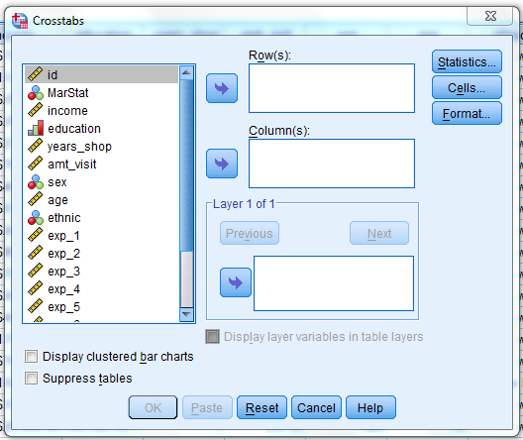
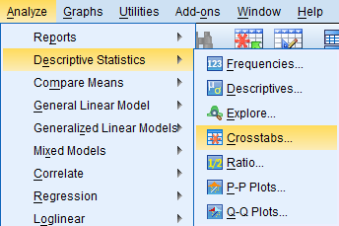
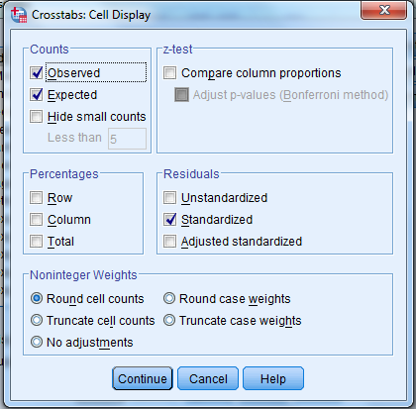
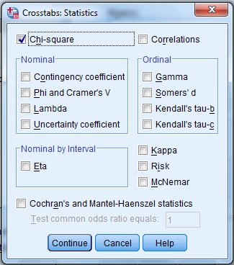
CHI-SQUARE IN SPSS
Both ‘Chi-Square’ and ‘Cells’ options should be selected
Determine the relationship between age group and primary financial institution.

Slide 13
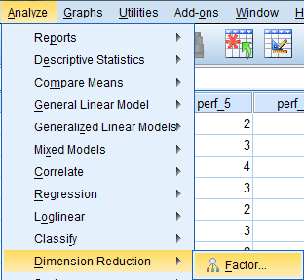
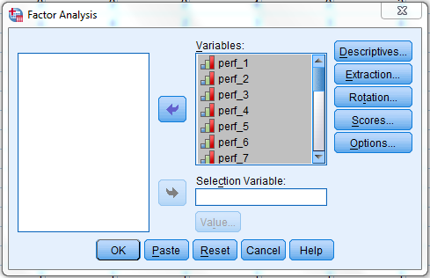
FACTOR ANALYSIS IN SPSS
Using the ‘print_services_sat.sav’ data file, factor variables 6 through 18. Select the standard options reviewed throughout the semester.
For factor analysis, all variables that are thought to be correlated within a set of data should be included for analysis
Generally speaking, the more variables included, the better in terms of data reduction

Slide 14
FINAL EXAM FORMAT
Divided into 3 main sections
3 hours to complete
Section 1 – Multiple Choice
  35 questions for 1 mark each = 35 marks
Section 2 – Short Answer
  2 questions for 5 marks each = 10 marks
Section 3 – SPSS Questions
  4 questions for 5 marks each = 20 marks
65 marks in total
Represents 35% of your final course grade
Bring your calculators! You will need them..
The first 2 sections of the exam will be close-booked, while the 3rd section on SPSS will be open-book
  The first 2 sections must be finished prior to starting the 3rd
Remember to bring a pencil / eraser for the multiple choice section of the exam!!

Slide 15
AIMS
Review material covered in the course since the midterm
Target areas that appear to be issues for the class
Provide 1-on-1 in-class support for students with specific questions
This course has a TARGETED PASS. Students must have BOTH 50% on the final exam AND 50% overall to pass this course.

