Slide 1
Virtualization
Virtualization
1

Slide 2
Do I need an operating system on my computer?

Slide 3
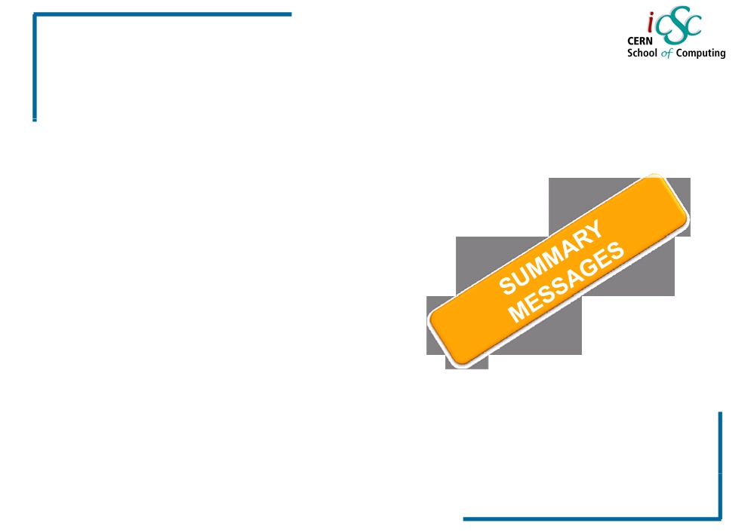
Virtualization
Outline
▪ Some definitions
▪ Reason and benefits of Virtualization
▪ Virtualization techniques
▪ Hypervisor
▪ Server Virtualization
▪ Approaches for Virtualization
3

Slide 4
Terminologies
Platform?
It is a computer system (Operating system) on which application programs can run. It is a base for hardware and software.
Example: MS 2000 and Mac OS X
Process?
In computing, a process is an instance of a computer program that is being executed.
It contains the program code and its current activity.
Depending on the operating system(OS), a process may be made up of multiple threads of executions that execute instructions concurrently.

Slide 5
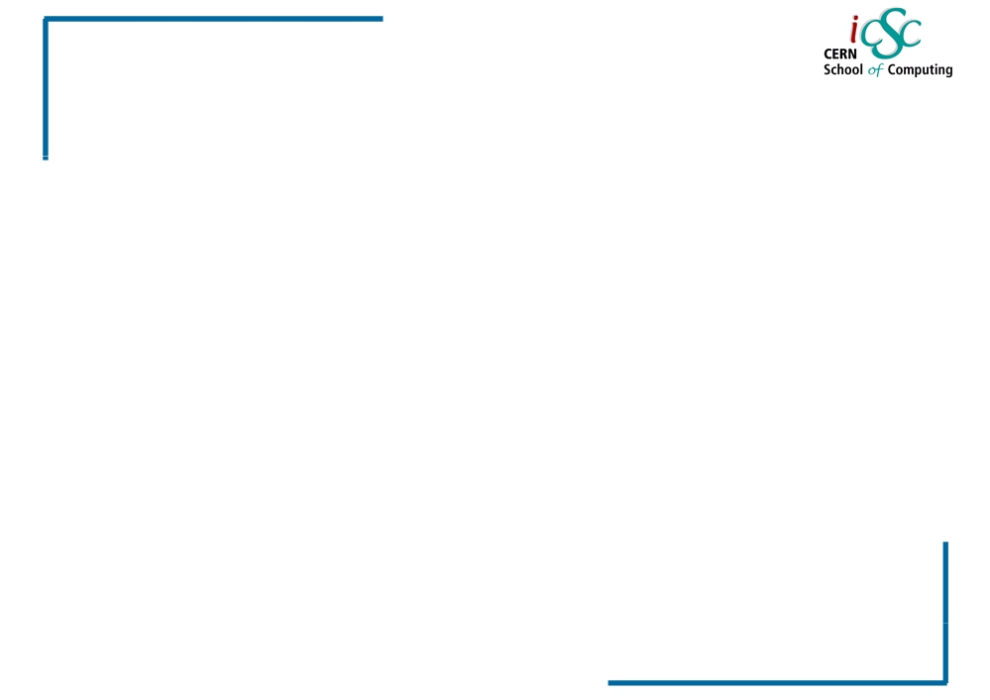
Virtualization
Definitions @ Computer Science
Virtual:
Created, simulated, or carried on by
means of a computer or a computer network
Virtualization:
Virtualization is the creation of a virtual version of something, such as an operating system, a server, a storage device or network resources.
Virtual Machine:
A virtual machine (VM) is a software implementation of a machine (a computer) that executes programs like a physical machine.
8

Slide 6
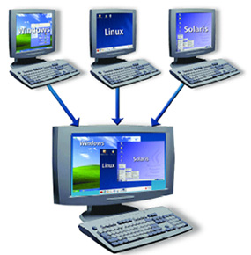
Virtualization

Slide 7
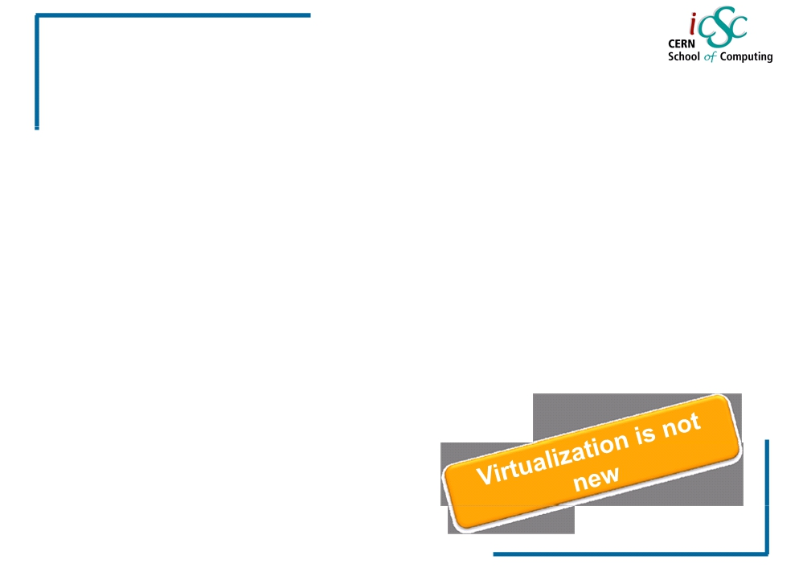
Virtualization
The beginning
•1960s
IBM creates this concept to fully utilize Mainframe hardware by logically partitioning them into virtual machines.
•1980s - 1990s,
Desktop computing and x86 servers become
available and so the virtualization technology was discarded
eventually
•1990s,
VMWare invented virtualization for the x86 architecture.
• Main objective:
Portability of applications
Isolation
Integration /deployment
(solving dependencies)
9

Slide 8
Virtualization
Reasons and benefits
Of
Virtualization
10

Slide 9
Reasons & Benefits of virtualization
▪ Low Infrastructure Utilization, more powerful hardware
▪ Decreasing Physical Infrastructure Costs
▪ Relocation from one physical machine to another as
needed, helping with Failover and Disaster Protection
▪ Insufficient Physical Space in Data Centers
▪ High Maintenance end-user desktops
▪ Server consolidation: P2V transformation

Slide 10
Reasons to use Virtualization
Set up complex testing environments including networking
Faster access to other operating systems
  A VM can be up and running while you use to host operating system
  Access to other operating systems almost instantly instead of shutting down your computer and restarting another operating system

Slide 11
Virtualization Benefits
Run Multiple Operating system on a single computer including Windows, Linux and more.
Let your Mac run Windows creating a virtual PC environment for all your Windows applications.
Reduce capital Costs by increasing Energy efficiency and requiring less hardware while increasing your server to admin ratio
Ensure your enterprise applications perform with the highest availability and performance
Improve enterprise desktop management & control with faster deployment of desktops and fewer support calls due to application conflicts

Slide 12
Virtualization
More concepts
13

Slide 13
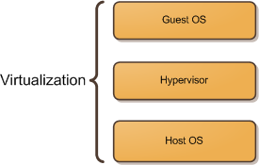
Virtualization concept
Host OS: Windows 7
The host operating system provides a host to one or more virtual machines (or partitions) and shares physical resources with them.
Guest OS: Windows XP or Linux OS
The guest OS is the operating system installed inside a virtual machine (or a partition).
Hypervisor:
Also called a Virtual Machine Manager (VMM), is a program that allows multiple operating systems to share a single hardware host
Windows XP
Linux
Windows 7

Slide 14
What can be virtualized?
Network
Storage
Servers
Hardware

Slide 15
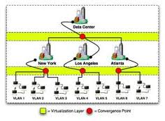
Network Virtualization
splits up the available bandwidth into channels, each of which is independent from the others, and each of which can be assigned to a particular server or device in real time.

Slide 16
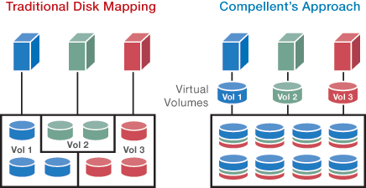
Storage Virtualization
Is the pooling of physical storage from multiple network storage devices into what appears to be a single storage device. It is commonly used in storage area networks (SANs).

Slide 17
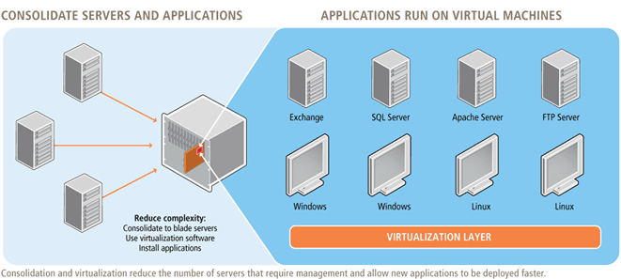
Server virtualization
Is the idea of taking a physical server and partition it, or divide it up, so that it appears as several “virtual servers”, each of which can run their own copy of an OS. The main purpose of this approach is ISOLATION.

Slide 18
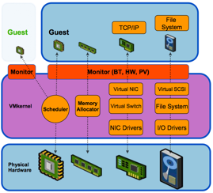
Hardware Virtualization

Slide 19
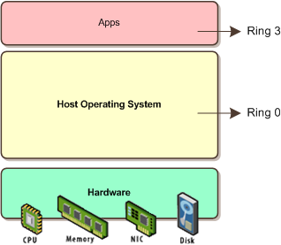
Traditional virtualization
Here the OS sits on the hardware and on ring 0.

Slide 20
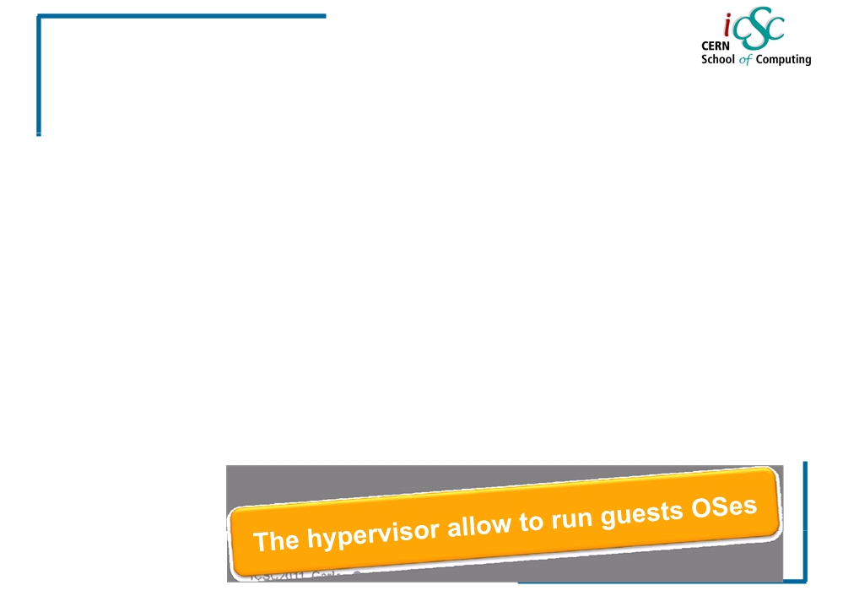
Hypervisor
Virtualization
• Also called Virtual Machine Monitor (VMM) or Virtualization
Manager
Concept:
Software program or part of the code in firmware that manages either multiple OS or multiple instances of the same OS on a single computer system
• What is controlled by the hypervisor:
• CPU
• Memory
• Other resources required by the operating system
• It validates all the guest-issued CPU instructions and manages
any executed code that requires additional privileges.
15

Slide 21
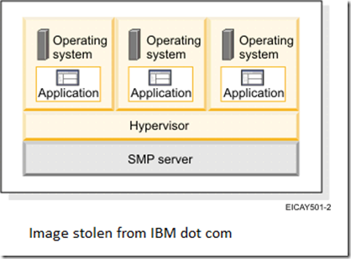
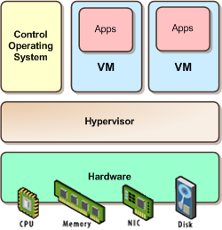
Types of Hypervisor: Type 1 and type2
Type 1 : Bare Metal
hypervisors are those that run directly on the host system hardware and offer a higher level of virtualization efficiency and security. ESX, Xen, and Hyper-V Faster performance.

Slide 22
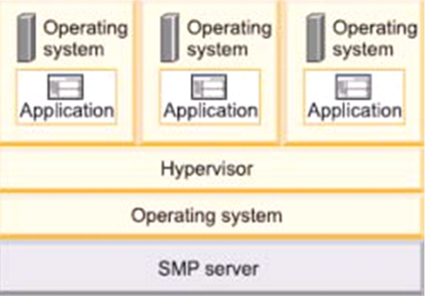
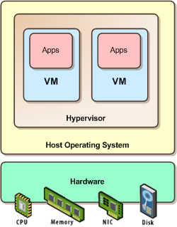
Types of Hypervisor
Type 2: Hosted
Hypervisors are those that run on a host operating system. It provides virtualization services, such as I/O device support and memory management. Ex: Microsoft´s Virtual PC, and VMWare´s Workstation. Slower performance.

Slide 23
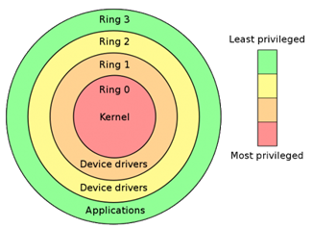
Needed concept: Protection Rings
Concept: Mechanism to set the layers of privilege used to protect the data and the functionality.
Ring 0 or Kernel: Can execute any CPU
instruction and reference any memory
address.
Ring 3: The access to hardware and
memory reference needs to be arbitrated.
Hypervisor: handles the resource
and memory allocation for the
virtual machines
X86 Priority modes

Slide 24
Virtualization
Virtualization Techniques
19

Slide 25
Virtualization
Virtualization Techniques
▪ Emulation
▪ Full Virtualization
▪ OS-level virtualization
▪ Para virtualization
Host OS: The actual computer with an OS(physical computer)
Guest OS: An OS sitting in an actual computer (logical computer)
20

Slide 26
Virtualization
Emulation
▪ Concept: VM Emulates/simulates complete hardware.
▪ Unmodified guest OS for a different PC can be run
It is possible to emulate an architecture in a completely different one
It makes a fake hardware environment for the VM, like Nintendo 64
▪ What runs where?
▪ Ring 0: runs the host
▪ Ring 3: runs the guest OS (as applications)
▪ Cons: Very slow because of not native execution
▪ Examples: Bochs, Virtual PC for Mac, QEMU
21

Slide 27
Emulator benefit
Emulators maintain the original look, feel, and behavior of the digital object
Despite the original cost of developing an emulator, it may cost efficient solution over time.
Reduces labor hours. Like data migration
Emulators allow video games exclusive to one system to be played on another. For example, a PlayStation 2 exclusive video game could (in theory) be played on a PC or Xbox 360 using an emulator.

Slide 28
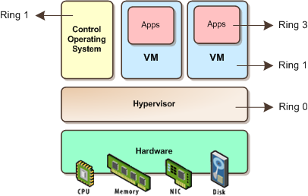
Full Virtualization:
Virtualization
▪ Concept: The host OS emulates a hardware
layer for each guest OS
▪ What runs where?
▪ Ring 0: run the guest OS privileged operations
Hypervisor provides CPU emulation to handle it
▪ Pros: Stability, guest OS doesn’t need modifications
▪ Cons: System Resources, time performance
Examples:
IBM’s VM family, VMWare Workstation, …
Full virtualization is used to simulate a complete hardware environment, or virtual machine, in which an unmodified guest operating system (using the same instruction set as the host machine) executes in complete isolation.
22

Slide 29
Difference between Emulator and Virtualization
Emulator
Virtualization
Emulates hardware only
Very slow
Copies hardware and software
Very fast

Slide 30
Virtualization
OS-level Virtualization
The physical server and single instance of the operating system is virtualized into multiple isolated partitions, where each partition replicates a real server. The OS kernel will run a single operating system and provide that operating system functionality to each of the partitions.
▪ Concept: Same OS for host and guests and only isolation in the user land
If you run `ps aux` in the host, you will see all guest processes
Ps aux = process status in Unix (similar function as a task manager in Windows)
What runs where?
Ring 0: run the OS (same for all)
Pros: Low overhead, highest performance
Cons: Isolation, stability
Examples: FreeBSD Jails, Solaris Containers, Virtuzzo/OpenVZ
23

Slide 31
Virtualization
Para-virtualization (I)
▪ Concept: The hypervisor, interfaces the hardware
to all OS’s (host and guest)
• Guests are modified to run on the hypervisor
▪ What runs where?
▪ Ring 0: run an hypervisor
▪ Ring 1: run the guest OS
▪ Ring 3: run the applications
In theory Para-virtualization (where the guest kernel knows that it’s running on a hypervisor, not “real” hardware) is faster than pure hardware virtualization.
24

Slide 32
Virtualization
Paravirtualization (II)
• Pros:
- Stability is very good
- Performance is very good (nothing can beat
OS-level virtualization in this matter)
- Overhead is very low
• Cons:
- Not easy to implement (it’s getting better these
days)
- Both host and guest kernels have to be patched
- Maintainability
• Example: XEN, VMWare, ESX server
25

Slide 33
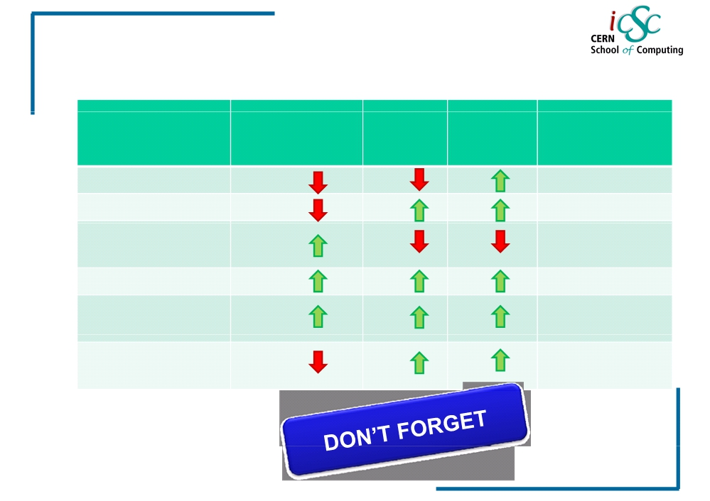
Virtualization
Comparison table
Performance
Stability
Isolation
Modifications?
/ HW support?
Emulation
Full Virtualization
No/No
No/No
-
OS-level
No/No
virtualization
Paravirtualization
+
Yes/No
Hardware-assited
+
No/Yes
Virtualization
Application level
No/No
virtualization
29

Slide 34
Virtualization
Server Virtualization
30

Slide 35
Virtualization
Server Virtualization
▪ Concept:
▪ Is the idea of taking a physical server and
partition it, or divide it up, so that it
appears as several “virtual servers”, each
of which can run their own copy of an OS.
31

Slide 36
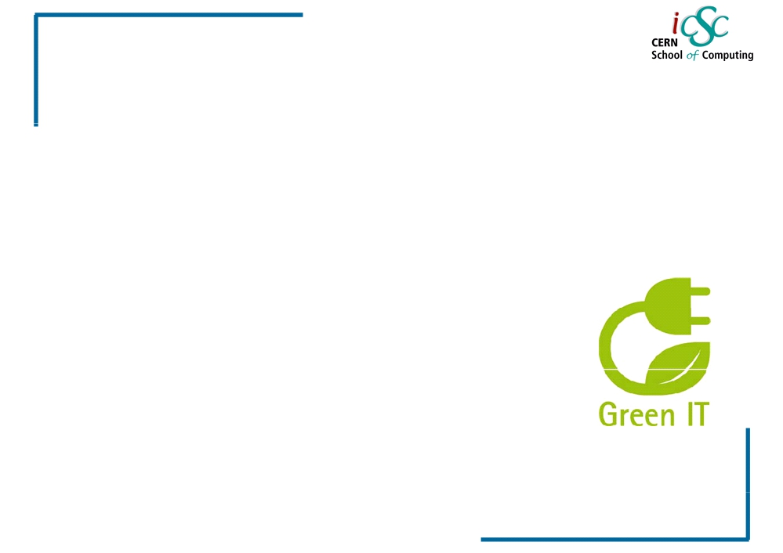
Virtualization
Why is it so popular?
▪ Multiple operating system instances at once on a
single physical server.
▪ Reduce the number of physical servers and in
consequence physical space in data centers
▪ Offers higher availability
▪ Cut down on energy consumption
▪ Eases the maintenance and patching
32

Slide 37
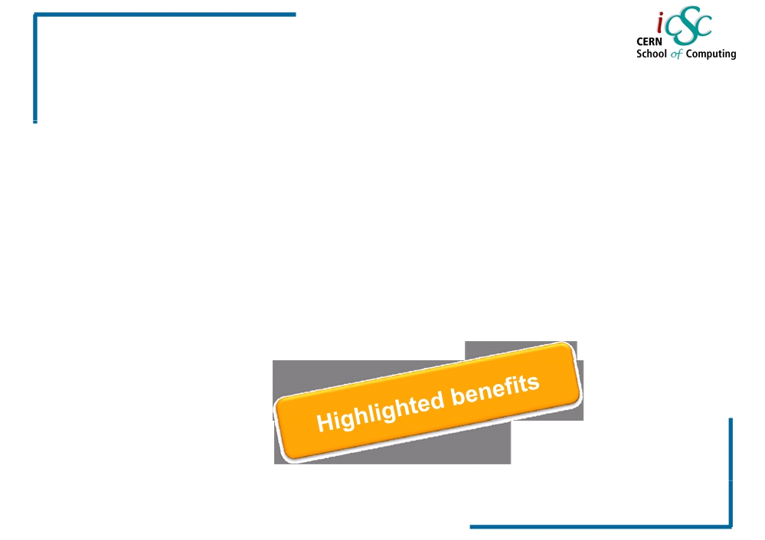
Virtualization
Server Virtualization Landscape
▪ As of October 2009, only 16 % of server
workloads were running on VMs
▪ Gartner predicted that the numbers would rise
to approximately 50 % of workloads (x86
architecture) by the end of 2012 - or about 58
million deployed machines
33
Source: Gartner
Inc

Slide 38
Virtualization
Practical Approaches
35

Slide 39
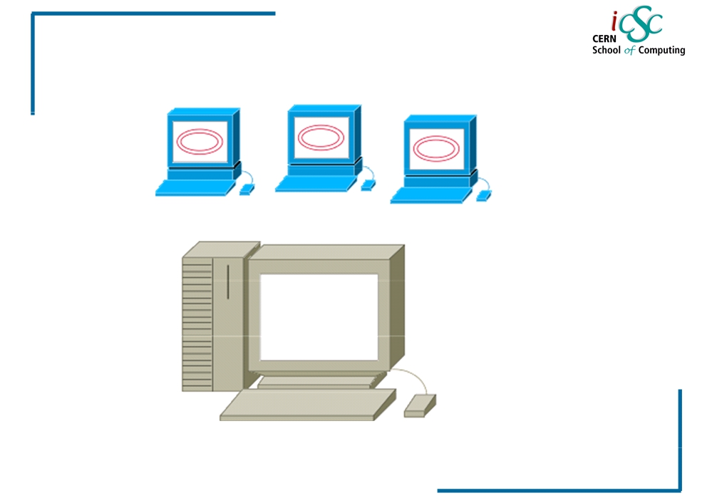
Virtualization
Simple Virtualization 😐
Virtual
Machines
Physical
Hypervisor
36

Slide 40
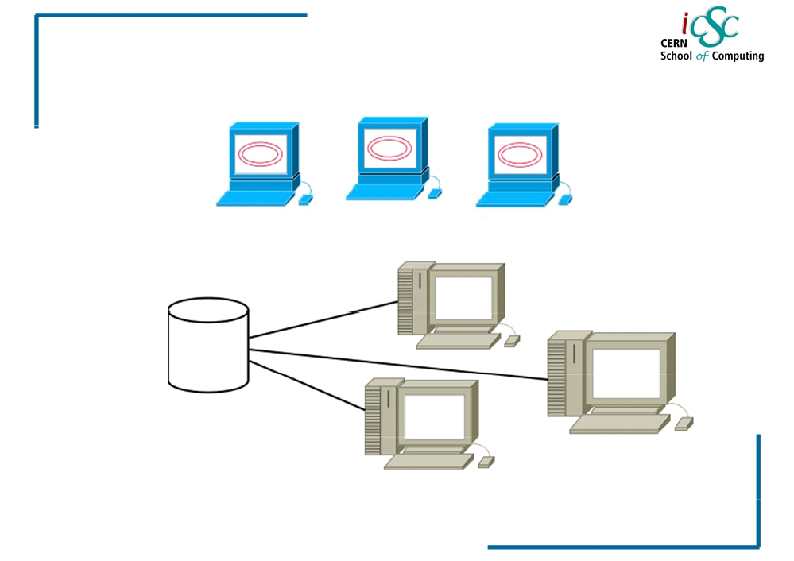
Virtualization
More virtual approach ☺
Multiple
Hypervisors
Vm image
in a network
storage
37

Slide 41
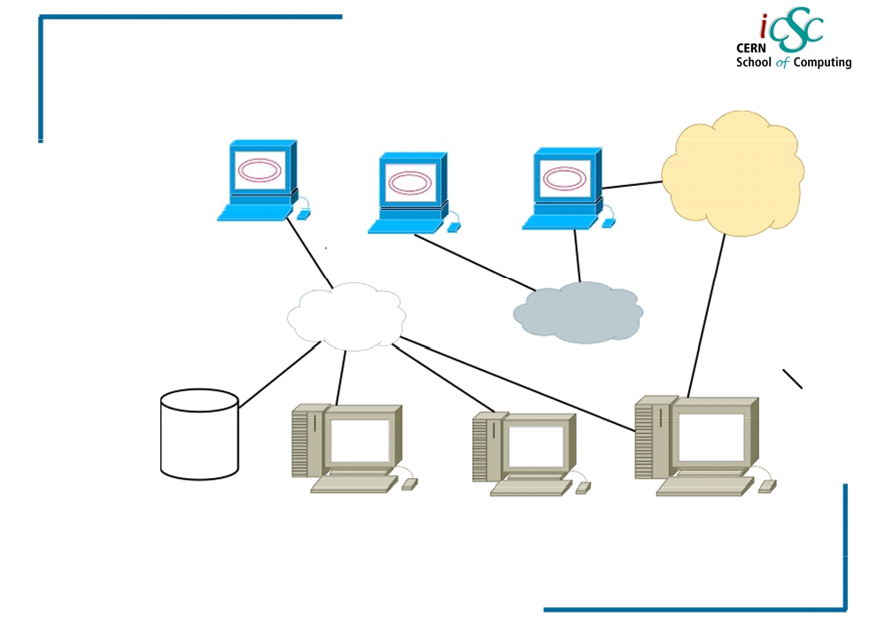
Virtualization
Virtual networking
BETA
ALPHA
GAMMA
1 ETH
ALPHA
1 ETH
1 ETH
ALPHA 1
ALPHA
ETH BETA
38

Slide 42
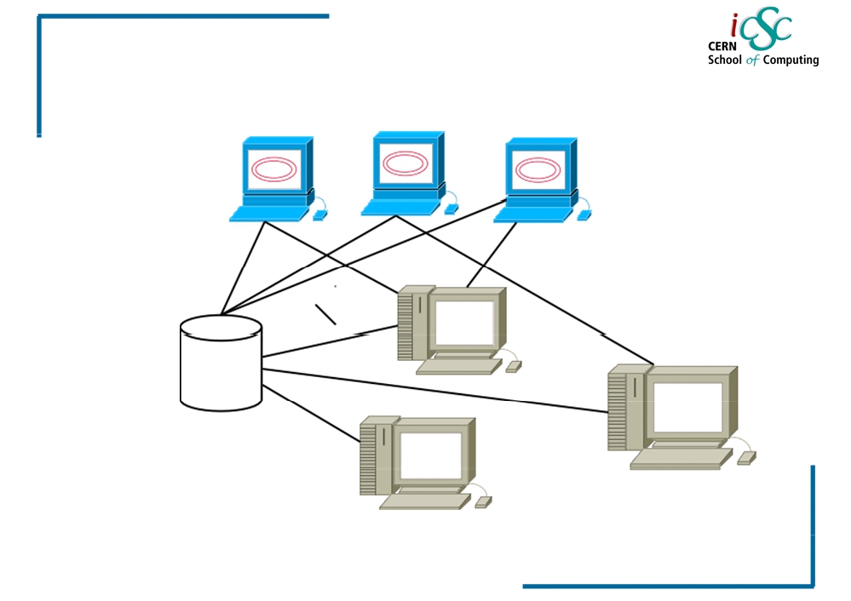
Virtualization
Management scenario ☹
WHERE
ARE
MY VM
MACHINE
RUNNING?
39

Slide 43
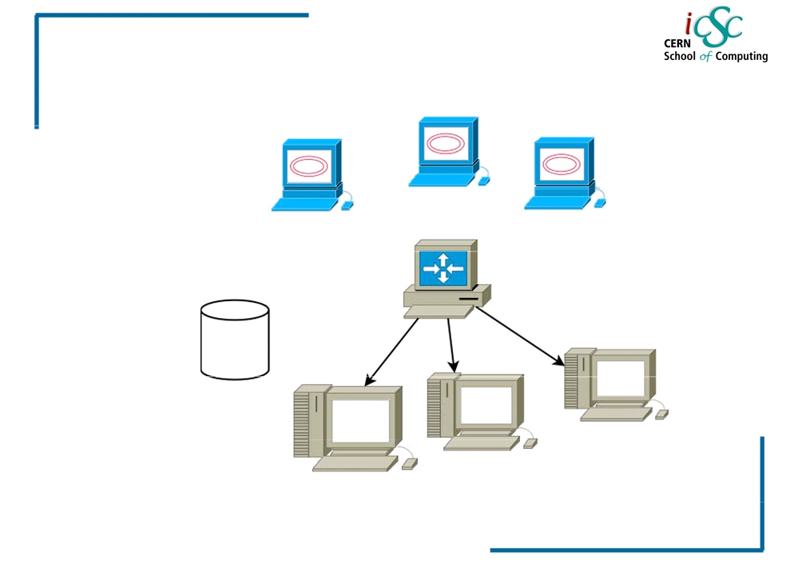
Virtualization
VM Manager ☺
VM
MANAGER
40

Slide 44
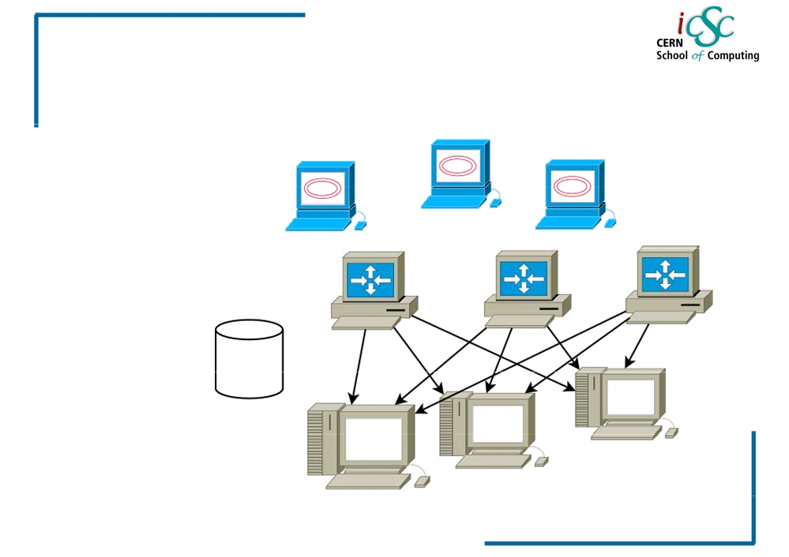
Virtualization
More virtual approach ☺☺
MULTIPLE
VM
MANAGERS
41

Slide 45
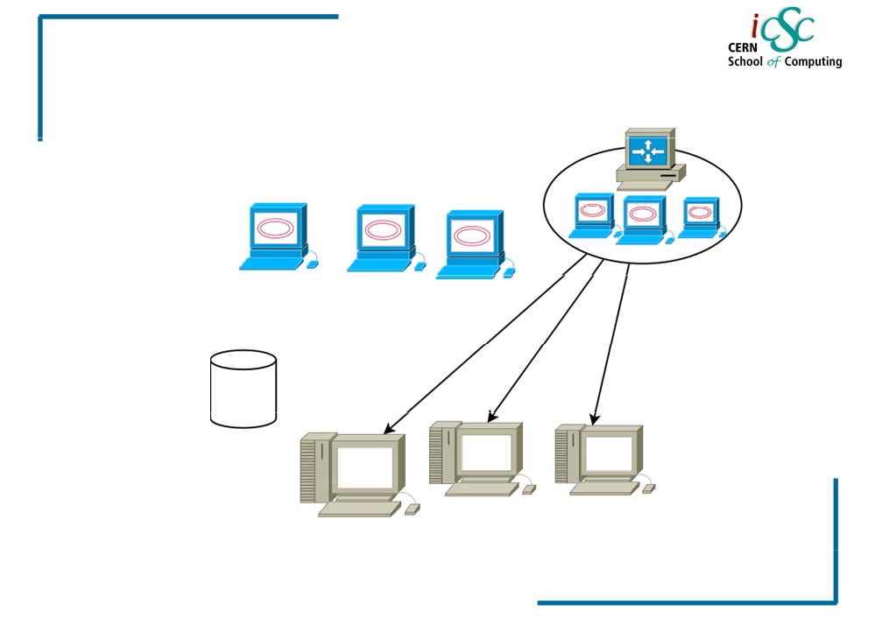
Virtualization
Full virtual approach
MANAGER
CLUSTER/POOL
VM
MANAGER
ON MULTIPLE
VIRTUAL
MACHINES!!
42

Slide 46
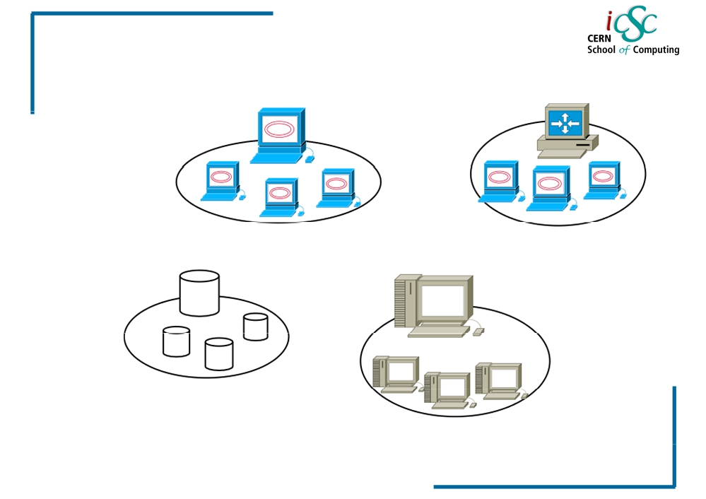
Virtualization
Resource clusters/pools
VM POOL
CLUSTER
VM
MANAGER
CLUSTER
STORAGE
CLUSTER
PHYSICAL
CLUSTER
43

Slide 47
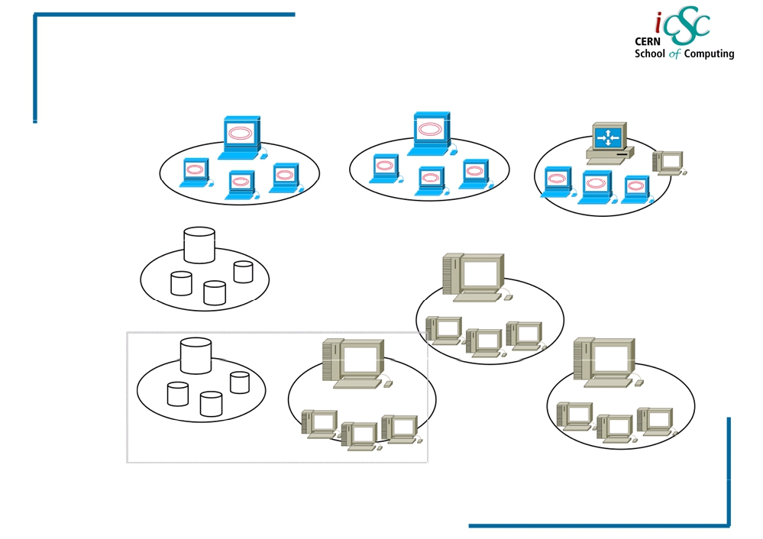
Virtualization
More virtual again!
DISTRIBUTED
APPROACH
RACK - UNIT
44

Slide 48
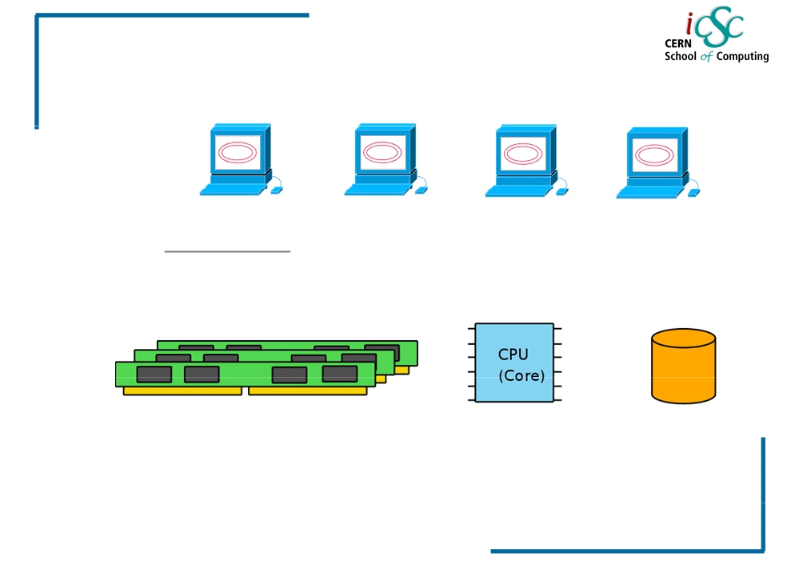
Virtualization
Virtualization ingredients
RUNNING EXISTING VIRTUAL MACHINES
MEMORY
CPU CORE
STORAGE
45

Slide 49
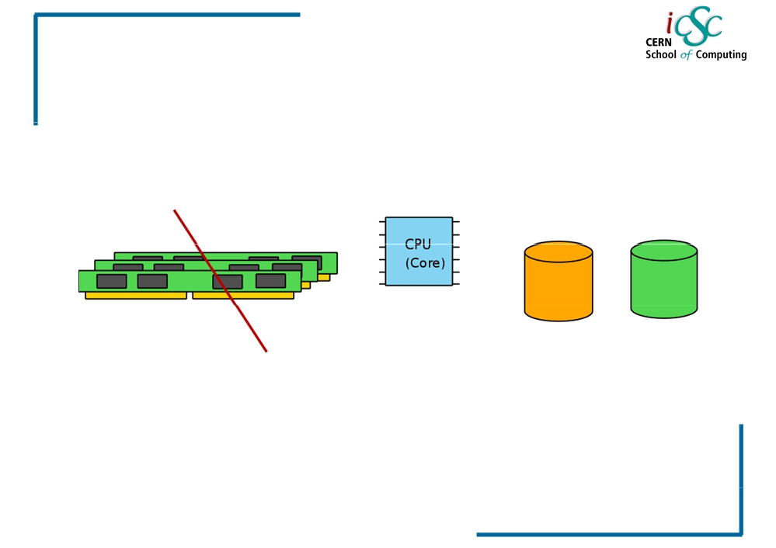
Virtualization
Running VM with no memory!
We can swap all the VM memory in a
physical disk, or we use the storage as a
slow virtual memory
46

Slide 50
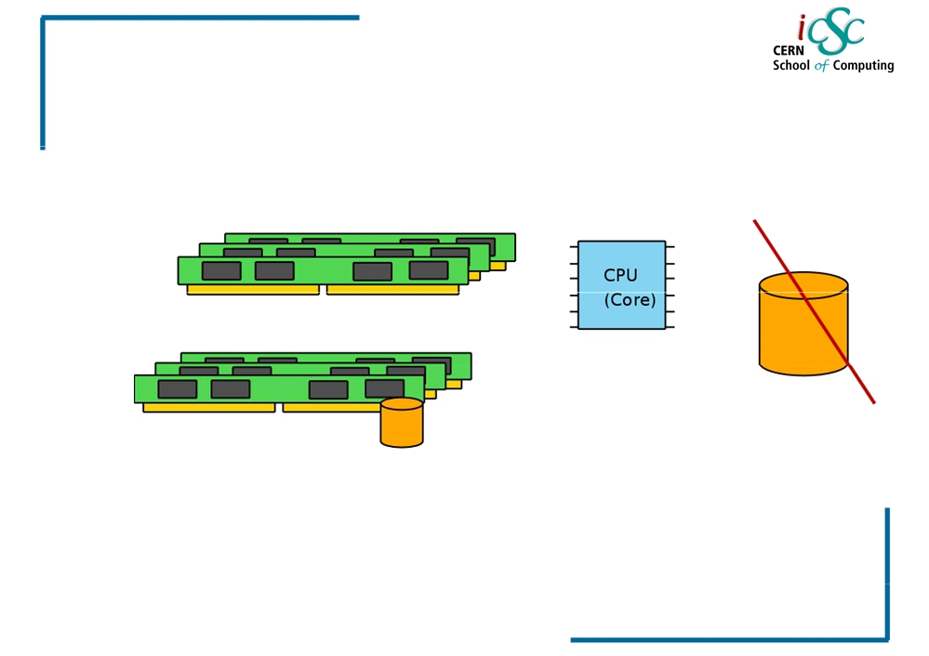
Virtualization
Running VM with storage!
We could use the memory as a physical
storage (tmpfs) for the Vm image. Extremely
fast virtual machine!
47

