Slide 1
Email Issues
Email is a nearly ubiquitous social technology
Difficult to convey subtle emotions using email
  Medium is too informal, impersonal, casually written
  Conversational cues are missing
  Emoticons may help but use sparingly
Asynchronous medium (Not Synchronous) makes dialog difficult
  For interactive purposes (like negotiation) synchronous medium (Agreed timing bits)like telephone may be best
  Maybe IM/chat is better?

Slide 2
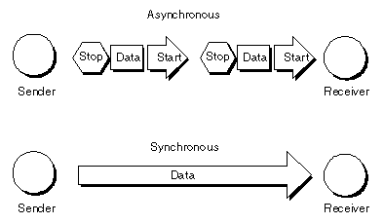
Asynchronous, Synchronous
Negotiation
Negotiation

Slide 3
Email Issues
Text can be interpreted in ways we don't intend
  Typing for EMPHASIS can convey the wrong meaning
  People don't proofread what they write in email, often create ambiguity
  Sarcasm only works as humor when face-to-face
Flame is slang for inflammatory email
  Flame-a-thon is ongoing exchange of angry emails
  Common now in chats, boards, social networking in general
Don’t wade in… delay replies until you cool down… chill, have a coffee, breathe deep, think

Slide 4
Out on Good Behavior
Rules for “acceptable behavior,” basic courtesy and respect create smooth social interactions
Normal social pressures often don’t work well in online settings
Netiquette?
“Netiquette” is etiquette for the Internet, guidelines for civilized behavior in email and broader online social contexts

Slide 5
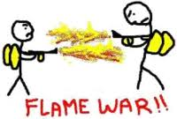

Slide 6
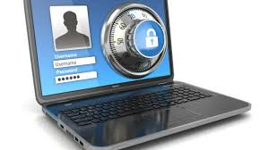
Password
Is it a good idea to have password?

Slide 7
Creating Good Passwords
The Role of Passwords
  To limit computer or system access to only those who know a sequence of keyboard characters
Breaking into a Computer without a Password
  Trying all possible passwords algorithmically would eventually find correct password, but software usually limits the number of tries
Forgetting a Password
  Passwords are scrambled or encrypted and stored, so system administrator usually can't tell you your password if you forget it

Slide 8
Guidelines for Selecting a Password
It's not a good idea to choose something easily guessed, but should be easy for you to remember
Should have at least 8 characters, with a mix of uppercase and lowercase letters, numbers, punctuation characters
Use a sequence not found in dictionaries
No personal associations (like your name)

Slide 9
Picking a Password
Select a personally interesting topic or theme
  Favorite movie, travel destination, sport/hobby
  Always select passwords related to topic
Make password from a phrase, not a single word
Encode the password phrase
  Make it short by abbreviating, replace letters and syllables with alternate characters or spellings, punctuation patterns

Slide 10
Examples of the Heuristic
Theme is Alma Mater… Oxford University
  OxfordU (shorten)
  Ox4dU (replace for with 4)
  Ohx4dyoU (replace O with Oh, U with yoU)
Theme is favorite movie… Gone with the Wind
  GWTW (shorten)
  G2uT2U (replace W with 2u and 2U)
  G2uTdosU (replace 2 with spanish “dos”)

Slide 11
Top 10 List of really bad passwords for 2016
123456 6. 1234567890
123456789 7. 1234567
qwerty 8. password
12345678 9. 123123
111111 10. 987654321
Source: http://www.zdnet.com/article/only-yourselves-to-blame-the-worst-passwords-of-2016-are-as-lazy-as-ever/

Slide 12
Changing Passwords
Show example
Should be changed periodically
Managing Passwords
  Using a single password for everything is risky; using a different password for everything is hard to remember
  Passwords can be “recycled”
    Make slight systematic change to good passwords
    Rotate passwords

Slide 13
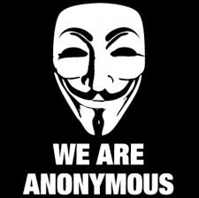
Hackers

Slide 14
Spam
Junk Mail
Unsolicited commercial email is a serious annoyance
Not unusual to get 100’s of messages a day
Laws against spam have not ended the problem
Spam filter helps:
  Software that automatically separates legitimate messages from spam
  Independent vendor software is available
  Most email providers offer spam filters
  Example: Spy Ware and Spybot search and Destroy

Slide 15
How Spam Filters Work
Spam filters cannot “understand” the content of a message, they just guess based on message characteristics
Spam score is computed by checking
  Forged message headers
  Suspicious text content (keywords like “lottery” or “mortgage”)
  No text, just as image (an attempt to foil text checks)
  Foreign language text
  Fonts styles – all caps, large font size, bright colors

Slide 16
How Spam Filters Work
If the score passes some threshold, the message is quarantined, meaning put aside in a spam folder
User can scan the spam folder for legitimate messages that have been wrongly flagged
User can set the threshold if too many spams are passed, or too many good emails flagged

Slide 17

Spam Netiquette
License agreement
Many of the commercial spam emails we receive seem unsolicited, but may not be so
We often have given our permission to the sender
  we may not remember doing this
  it was in some small print or checkbox on some Web form or site we used
Reputable companies provide “opt out” addresses or links in the ads so we can get off the mailing lists

Slide 18
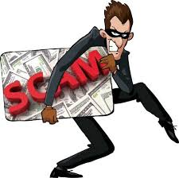
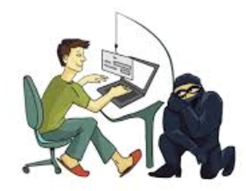
Scams
Special category of spam specifically created to defraud or commit identity theft
“Nigerian Widow” Scam
  Appeal to sympathy, appeal to greed, they request up-front money for non-existent services
Phishing
  Attempts to capture personal data (passwords, SIN, bank accounts) through deception

Slide 19
Nigerian Widow scam

Slide 20
Nigerian Widow Scam
Also called a 419 scam for a fraud-related section of the Nigerian Criminal Code
  Someone you don’t know claims great wealth they cannot access
  They ask your help in transferring the money (usually out of their country, to get it to safety)
  For your help, you will get some percentage of the wealth
  It is a big secret… tell no one (for safety and security)
  Once you help, the transfer goes wrong
  They need upfront cash to bribe officials, pay fees, etc.
  More and more cash is requested until you catch on
Many variations, but all require urgency, secrecy, and your money

Slide 21
Scams and the World in General
Variants… “You have won the Spanish Lottery” (and funny, you don’t remember even entering it)
“Our account is locked to us, we are sending you a check for $5000, please send back $4500 and keep $500 for your troubles” (their check is bad)
If it sounds too good to be true, it is … this is how the world works
Surprising these things trap people, but if they didn’t work, you wouldn’t get 10 a week in your spam box.

Slide 22
Phishing
Main aim is some form of identity theft
Spam emails are made to look like they come from trusted sources like banks, eBay, PayPal, government, etc.
  Look very authentic, use company logos and graphics, mimic corporate web pages
Message text will claim some problem has arisen and that you must log on to resolve the issue

Slide 23
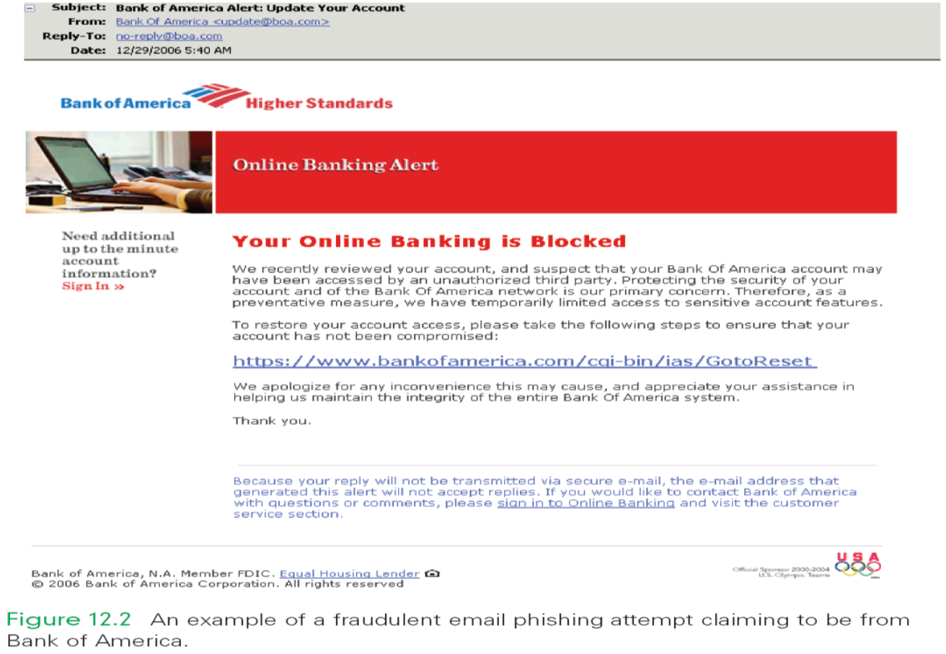
Phishing example

Slide 24
Phishing and Spoofing
They provide a “logon” link to click
  Link does not take you to the trusted login you are expecting
  Rather, it takes you to a bogus server where the information you type in will be harvested for fraud
Deception is often done with spoofed links
  Page text might show
  http://login.ebay.com/userVerify
  True destination might be something like
  http://ic5.elmerfudd.net/gatherChumpInfo
  E-mail spoofing is the forgery of an e-mail header so that the message appears to have originated from someone or somewhere other than the actual source

Slide 25
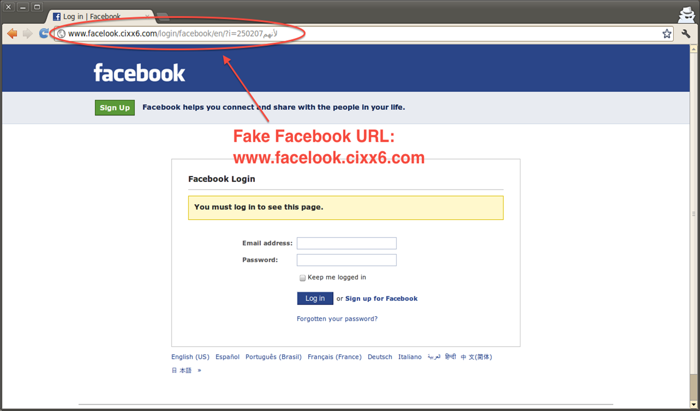
Spoofing example

Slide 26
Fighting Phishing
Most phishing pages become easy to spot once you know what to look for
Many companies (because of phishing) will never deal with real issues, or ask for sensitive or personal information, via email
Do not click links in suspected phishing pages
  Mouse-over links in text, and let the browser show you the real destination
  If you do visit the company’s website, type the URL yourself into a new browser window

Slide 27
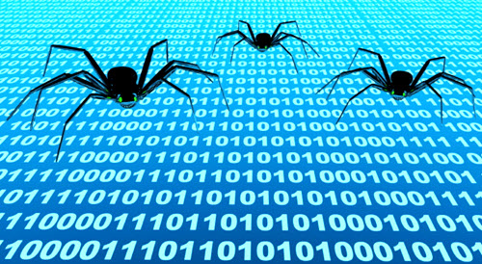
Virus, Worm, Trojan
Virus:
A program that "infects" another program by embedding a copy of itself. When the infected program runs, the virus copies itself and infects other programs (and perhaps does its damage)
Example:
Browser Hijacker. ...
Resident Virus. ...
Direct Action Virus. ...
Polymorphic Virus. ...
File Infector Virus. ...

Slide 28
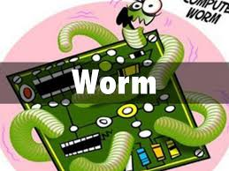
Viruses, Worms, Trojan
Worm:
An independent program (not part of another) that copies itself across network connections
Example:
The Anna Kournikova worm. ...
I LOVEYOU. ...
The Melissa virus. ...
The Blaster Worm. ...
Netsky and Sasser. ...
Storm worm

Slide 29
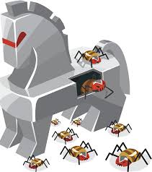
Virus, Worm, Trojan
Trojan
A type of virus; it “hides” inside another useful program, and performs secret operations
  May record keystrokes to collect passwords or other sensitive data, or load malicious software
  May take advantage of some security hole and create a means for remote users to control the computer (backdoor access)

Slide 30
Vectors of Attack
Malware is a term for software like viruses, worms, Trojans
CERT(Computer Emergency Respond Team) is an organization that monitors the security of the Internet (established 1988). Morris Worm
Five common ways attacks can happen
  Email attachments
  Spoofed links
  Social engineering
  P2P file sharing
  Bluetooth and MMS (Multimedia Messaging Service) file transfers

Slide 31
Email Attack
Mechanism: an infected file is sent as email attachment
Behavior to avoid: clicking on the attachment
Result: the malware (usually a worm) runs, sends copies of the email+attachment to names in your address books
Protection: don’t automatically open email attachments without examining the file extension; know why it was sent, what it is for

Slide 32
Email Attack
Examine the file extension of the attachment
  .doc, .exe, .msi, .pif, .bat, .com, .cmd (and many others) are executable and potentially unsafe
  media like .gif, .jpg, .mpg, .mp3 are safer
Make sure you have the OS set to show file extensions ( Folder option-demonstrate)
  if hidden, newCar.jpg.exe will look like newCar.jpg
Be cautious
  Is there any good reason for the sender to use email to send me executables?

Slide 33
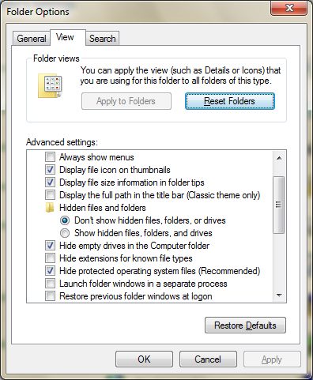
Folder option
Show extension
Show

Slide 34
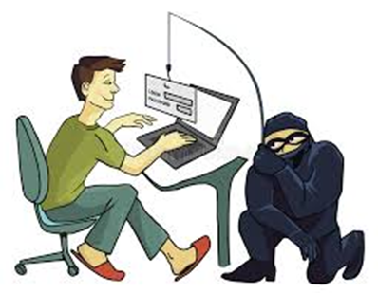
Spoofed Links Attack
Mechanism: a hyperlink is an email
has been changed to point to a
deceptive site
Behavior to avoid:
clicking on the link to jump to the
bad site
Result: several alternatives could occur at the target site – it could be a phishing site, or it could be a setup to install malware
Protection: avoid clicking on links from email or Web pages that you are uncertain of; copy/paste correct URLs into the location window

Slide 35
Social Engineering Attack
Mechanism: A user is presented with an opportunity to visit an unknown link, often from spam or comments at a social networking site
Behavior to avoid: clicking on the link and then accepting software “updates”
Result: the computer is seriously compromised
Protection: don’t install software offered to you from untrusted sources; get all software from the creators

Slide 36
Social Engineering (Just Say ‘No’)
This is a new term for a more recent attack vector; increase comes with rise of social networking sites (FaceBook, MySpace, etc.)
Bots (programs acting like humans) visit sites, post notes in chat or boards, with URL to some tantalizing site
If you click, you will be asked to “update” software you have and recognize (like Flash)
The “update” will actually install malware

Slide 37
P2P File Sharing Attack
Mechanism: files (esp. music) are transferred containing spyware or malware
Behavior to avoid: installing file sharing software, or files, from untrusted sites
Result: computer is seriously compromised; possible loss of personal information including passwords; possible copyright violations
Protection: avoid P2P sharing from unreliable sites; protect your computer with a firewall and up-to-date anti-virus software

Slide 38
P2P File Sharing Attack
P2P means peer-to-peer
User must install software, then each user can act as a server for others (and share, or serve up, the user’s files)
2 ways to get malware via P2P
  Sharing software itself might be malware, you are infected when you install it
  Files shared might be infected

Slide 39
Anti-Virus Software
Get some, use it always
Programs check for known viruses, worms, Trojans, malware, spyware
New viruses are created all the time, so update often (weekly if not daily)
Interesting twist: social engineering attack where you are (falsely) told you have a virus and need to download some software to zap it… be wary

Slide 40

Protecting Intellectual Property
Intellectual property is any human creation like photograph, music, textbooks, cartoons, etc.
Licensing of software
  You don't buy software; you lease it
  License gives you the right to use personally, but not sell or give away
Try before you buy
  Shareware allows you to download and try software for free, then pay the person who built it if you like it (honor system)

Slide 41
Open Source Software
Software for which the source program is publicly available
  Mozilla Firefox, Linux OS
Who pays for the technology and how do companies make money?
  Selling specialized corporate versions, providing customer support, selling other related software
Open source software is worked on and improved by many others (bugs can’t hide from 100,000 eyes)

Slide 42

Copyright on the Web
A person automatically owns copyright of what he/she creates in the U.S. and most nations
Copyright protects owner's right to
  Make a copy of the work
  Use a work as the basis for a new work
  Distribute or publish the work, including electronically
  Publicly perform the work
  Publicly display the work

Slide 43
Copyright on the Web (cont'd)
Free Personal Use
  You are free to read, view or listen to protected work
When is permission needed?
  Information placed in public domain (by the creator/owner) is free for anyone to use
  Otherwise you must get permission from owner

Slide 44
Copyright on the Web (cont'd)
The Concept of Fair Use
  Allows use of copyrighted material for educational or scholarly purposes, to allow limited quotation for review or criticism, to permit parody
Violating the Copyright Law
  You break the law whether you give away copyrighted material or sell it
  (for example) File sharing pirated music is a violation, even though it’s given away
  Commercial use usually results in higher fines

Slide 45
Copyright on the Web (cont'd)
So When Is It Fair Use? Depends on the answers to these 4 questions
  What is the planned use?
  What is the nature of the work in which the material is used?
  How much of the work will be used?
  What effect would this use have on the market for the work, if the use were widespread?

Slide 46
Have a Plan of Action
New threats will continue to appear
  Technology marches on, so will twisting the technology to abuses
Address these threats by
  Installing protective systems
  Tuning the installed protections
  Behaving to avoid difficulties

Slide 47
Installing Protective Systems
Firewall is a barrier between the Internet and your system, prevents intrusions
  Modern OS has this
Virus protection, anti-spyware, rootkit detection
  Rootkit is malware that “hides” itself by removing its name from process lists, etc., exists to give remote access and control . It is a back door hacker.

Slide 48
Tuning Installed Protections
Keep programs up-to-date
  OS, browsers, emailers… updates are put out to deal with new security problems
Spam filters… tune them to filter properly
WiFi protection
  Use WEP2 (Wired Equivalent Privacy) encryption and passwords
Disable file sharing

Slide 49
Behaving to Avoid Problems
Careful with email attachments
Use strong passwords
Know and trust the source of software
Always think before installing downloaded software
Always think always

Slide 50
Security Checklist
Install, use, and update anti-virus/anti-spyware software
Keep your OS and Web browsers up-to-date
Do not download files from untrusted sources; be suspicious of sites that want to send information
Use strong passwords
Do not open email attachments from unknown sources
Only do file sharing with trusted sites
Do not run OS services you don’t need (turn off web servers and UPNP if you don’t require them)
Use an Internet firewall (in your OS) to block intruders
Back up your computer storage regularly (for attack recovery)

Slide 51
Summary
Email has weaknesses as a medium for human communication
Simple courtesy guidelines make use of email more effective and less of an irritating
“Expecting the unexpected” is a useful survival skill; think about the unexpected event and correctly determine whether and how to respond
Copyright infringement poses legal risk, so don’t share software or pirate copyrighted materials from the Web

Slide 52
Summary
Selecting passwords connected to some common topic can make them easier to remember; choose simple passwords when security needs are low, and more obscure ones when there is greater risk
Viruses and worms cause considerable damage; reduce the change of infection by installing and running anti-virus software; be aware of hoaxes and phishing scams
Implement a plan of action to keep your digital world private and secure

